Slide 1
American History
1
Talk 9: Jefferson’s America 1800-1808

Slide 2
Talk | Title | Time Period | Date of Talk
8 | The early Republic | 1792-1800 | October 30th
9 | Jefferson’s America | 1800-1808 | November 6th
10 | War of 1812 and its impact | 1808-1815 | November 20th
11 | The Era of Good Feelings | 1816-1828 | December 4th
12 | Jacksonian ‘democracy’ | 1828-1840 | January 8th
13 | New Spain, Mexico and the Texas Republic | 1820-1836 | January 22nd
14 | Manifest Destiny and the Mexican War | 1840 -1850 | February 5th
14 | California and the Gold Rush | 1700-1850 | February 19th

Slide 3
Overview
2
A change in regime
The first term (1800-1804): pirates, slaves and land
Second Term (1804-1808): exploration, misadventures
and trade war

Slide 4
Transfer of Power
3
Federalists out , Democrat Republicans in
No violence….despite highly contentious result
Out: regal style, speeches, levees, balls and dances
In: informality, frugality, partisanship, letters, conversations

Slide 5
Jefferson Goal: ‘Recover spirit of Revolution’
4
Repeals Sedition laws(but not alien laws…still on books)
Shrink government, return power to the states,
Eliminate internal excise taxes, army and navy
Increase import taxes reduce “superfluous” expenditure ….and use funds to buy New Orleans from France and land from Indians
Job One is to “handle the pirate problem”

Slide 6
First Barbary War
5

Slide 7
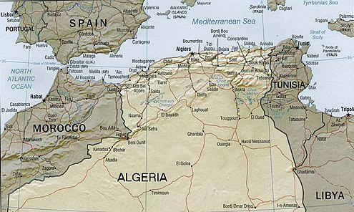
Barbary Pirates
6
Berber people living on North African Coast
‘City states’ ruled by ‘Deys’ nominally part of Ottoman Empire but independent
Raid coast and seize ships south & west Europe1500-1830…including Cornwall & Ireland
Slaves main source of income for ‘Deys; 1.2 million European enslaved or ransomed 1500-1800
Europeans pay ‘tax’ to ‘insure’ ships…many wars and price adjustments

Slide 8
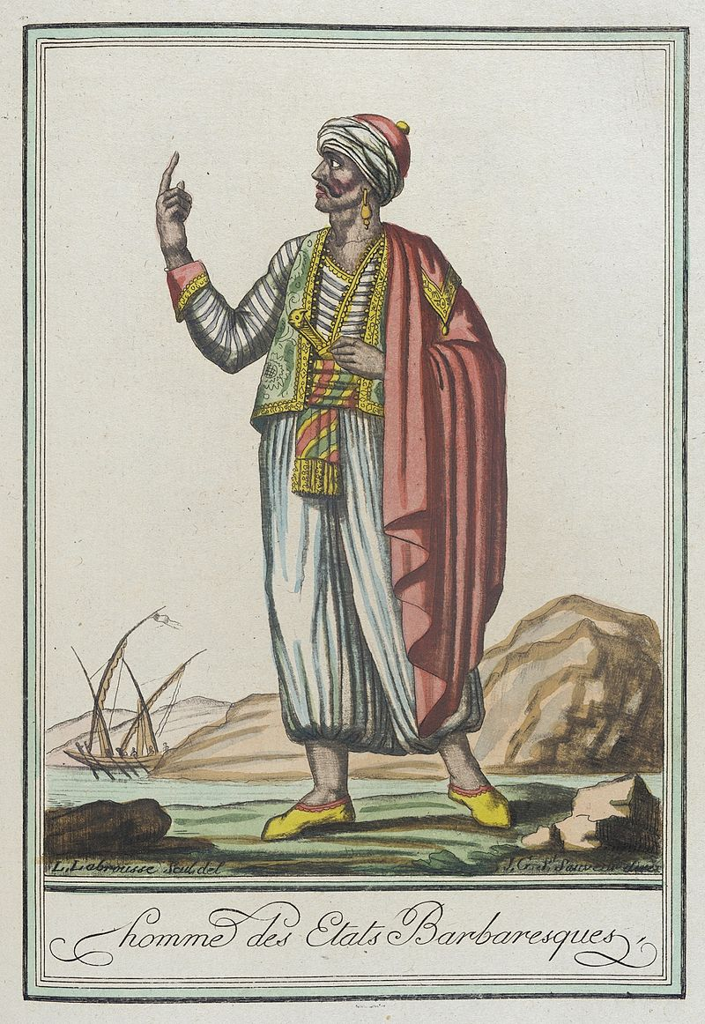
Berbers and America
7
Thomas Jefferson…
‘Dey’ of Tunis
British navy supress Berbers by 1750’s
British remove ‘protection’ for American
ships. Encourages Dey to attack
American ships…100’s enslaved
Washington /Adams agree to pay tribute
To Berbers 1790s…20% of national
budget at $10millon. Jefferson opposed
Berbers increase ‘tax’ when Jefferson assumes Presidency. Up to 30% US budget. Jefferson refuses to pay
Dey of Tunis declares war on USA US
allies with Sweden (ongoing dispute)
Builds up fleet. Joint fleet Tunis

Slide 9
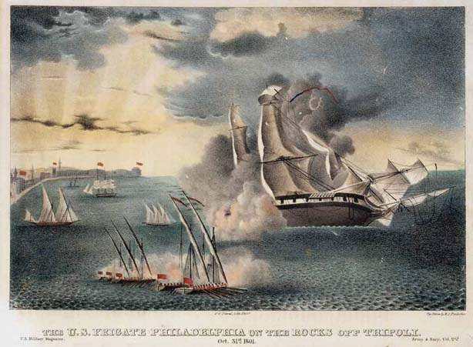
Grounding of USS Philadelphia October1803
8
US and Swedish navy bombards
Berber Coast
USS Philadelphia grounded. Berbers
capture ship, demand ransom,
threaten crew with enslavement
unless ransom paid..and add ship
To their navy
US must avoid humiliation,,,,
sends Steven Decatur on night
Attack to rescue ship…and protect US honour

Slide 10
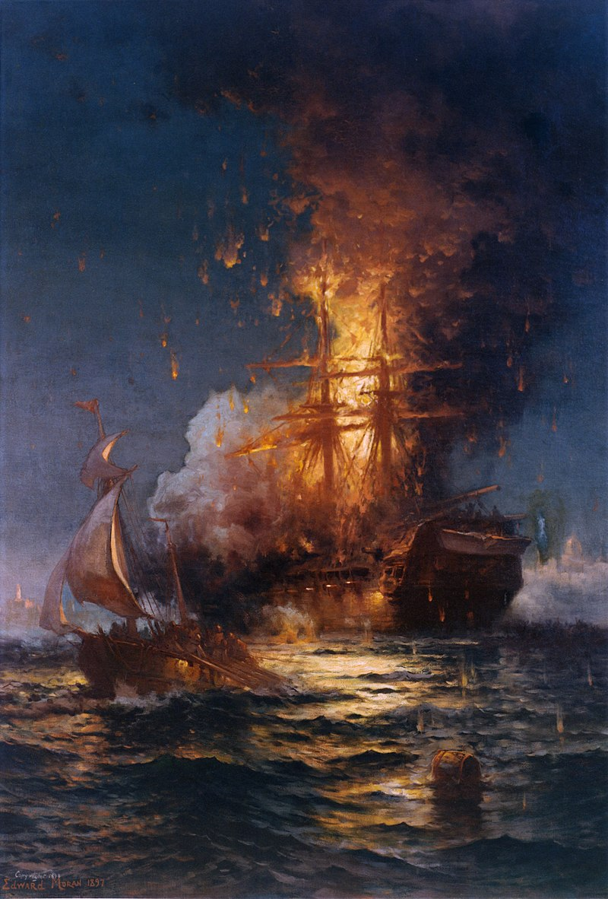
Burning of Philadelphia February 1804
9
Stephen Decatur returns, boards
Ship, burns ship and escapes.
Tunisians in pursuit
Crew of Philadelphia still enslaved
US and Swedish fleet blockades
Tunis
US creates mercenary army (Greeks,
Albanians) of 500 led by 8 US marines,
supports Dey’s brother’s claim to
throne…invaded Tunisia

Slide 11
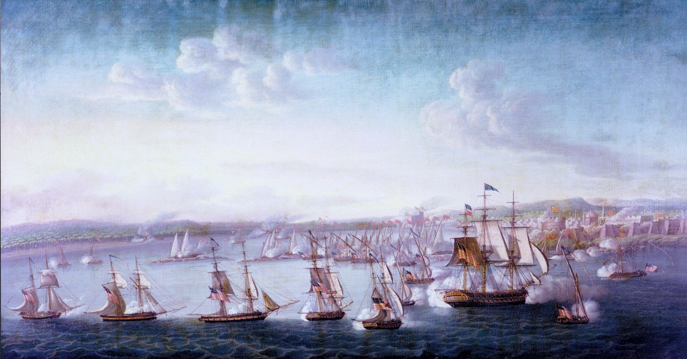
Blockade of Tunis 1803-1805
10
Joint American and
Swedish fleet blockade
Tunis
Unable to break into port
Ship to ship battles
Fire ship attempt, premature explosion
Blockade sustained,,,
….Army advances

Slide 12
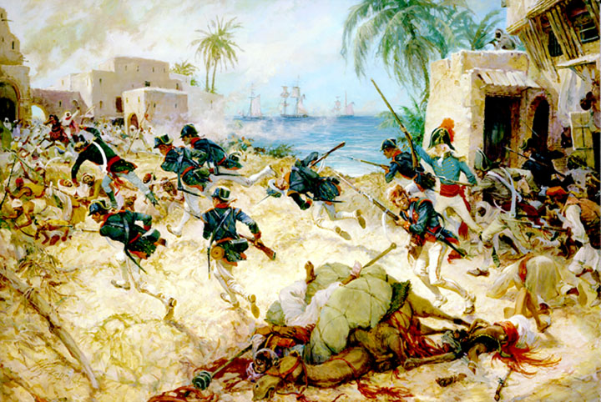
Battle of Derna 1805
11
Mercenaries size towns across
Tunis…move in on capital. Battle of Derna
Dey offers deal…hands over prisoners
Agrees to stop attacks on US …in
Exchange for $60,000 ‘ransom’ (not
£300,000 ‘tribute’….and his brother
Brother spends 14 years in jail…but survives and gains throne…does not challenge US…..other pirates will resume piracy during War of 1812

Slide 13
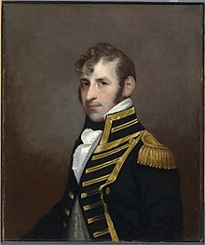
Stephen Decatur (1779- 1820)
12
Son of merchant, abandons studies
For career on the sea, fiery temper,
Brave, arrogant, involved in duel with recruiting
officer
Leads boarding party to destroy
USS Philadelphia….success
Leads boarding party to rescue captured
Brother, kills Berber captain,
War hero, marries, happy marriage
made captain War of 1812, Captures British
ship, captured by two British ships.
Exchanged. Leads US navy 2nd Barbary war
Considered celebrity, criticizes officer who
surrendered Chesapeake. Dies in duel age 41
Remains ideal American Hero

Slide 14
Impact First Barbary War
13
US prestige established, confidence boosted
Jefferson abandons plan to shrink navy
Funds released for purchase of New Orleans and Indian lands

Slide 15
Slave Revolts
14

Slide 16
Haitian Slave Revolt 1791-1804
15
Largest slave revolt since that of Spartacus in 71 BC…and only one successful
Haiti French colony since 1625, most profitable colony in the world 60% world’s coffee, 40% world sugar
Rigid caste system ( 40,000 whites, 28,000 free and mixed race, 400,000 blacks)
Brutal conditions 30% annual death rate among slaves. Most slaves new arrivals from Yoruba (Nigeria) due to high death rate, able to communicate…and unite
News of French revolution spreads between mixed race, free blacks and slaves together with rumours slavery to be abolished across French Empire (partially true …but not Haiti)

Slide 17
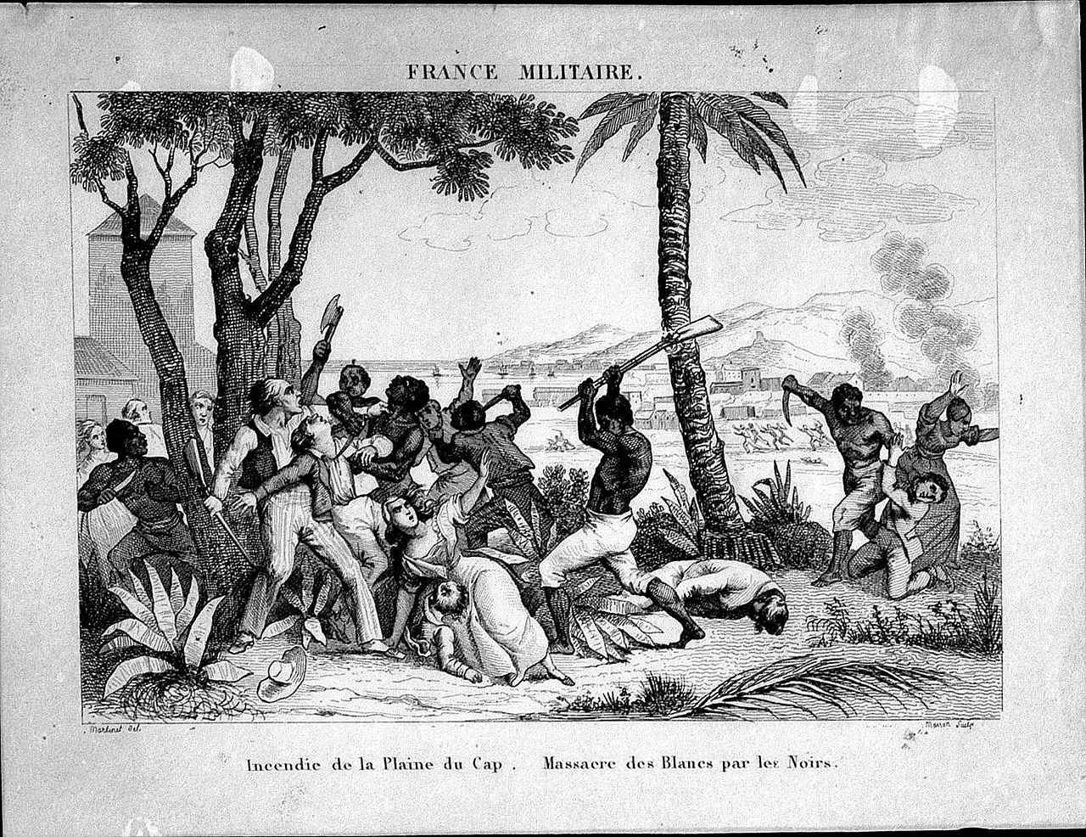
Revolution and white exodus
16
1791 revolution breaks out,
5,000 whites killed, French
lose control
British invade Haiti with 40,000
troops (more than troops
deployed in Revolutionary war)
Free black leader Toussaint
Ouverture supports
French in exchange for end of
Slavery and equality,

Slide 18
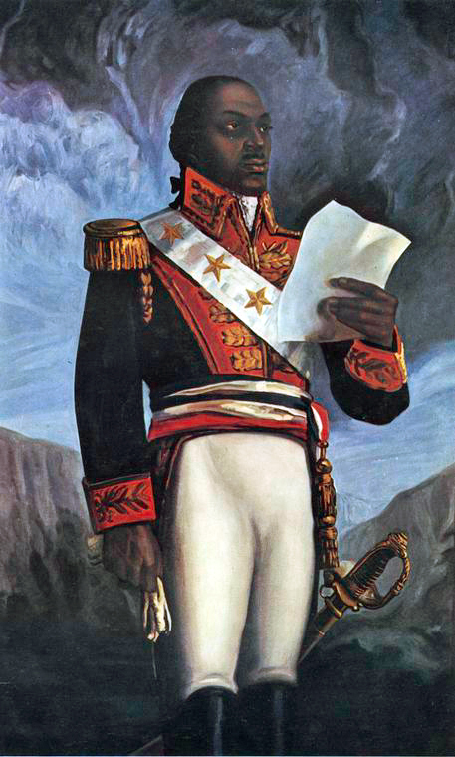
Toussaint Ouverture (1743-1803)
17
Born a house slave, educated by Jesuits,
interested in stoic philosophy, devout
Catholic, freed by master, sees himself
as French, advocates coexistence
British lose 30,000 men to yellow fever, abandon island 1798. French agree to hand power to Toussaint and abandon slavery
Ouverture becomes Dictator of Haiti.
Napoleon takes control in France, wants
Haiti back, sends army of 50,000 under General
Le Clerc, kidnaps Toussaint at 1801 ‘peace treaty’ , tries to
reintroduces slavery
Ouverture to France, writes memoirs, dies in jail.

Slide 19
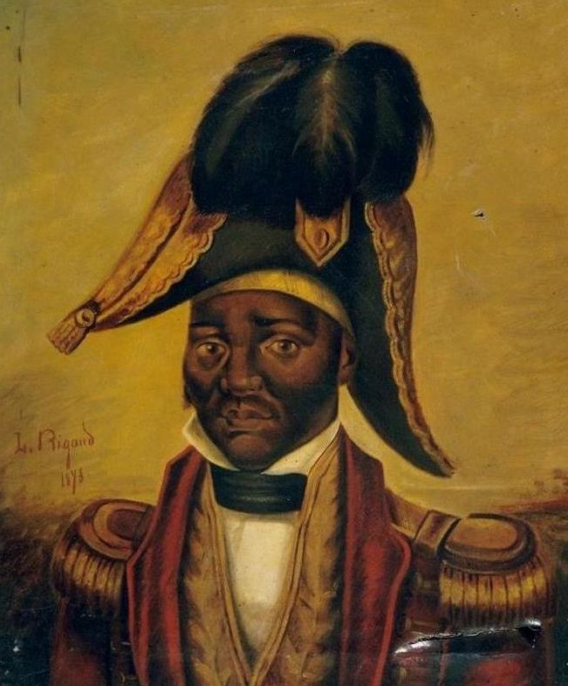
Jean Jacques Dessalines (1758-1806)
18
Born a slave, rises to overseer, develops
Hatred of French and Christianity
supports removal of Ouverture
War resumes French army of 50,000 nearly
wiped out by Fever and war.
French capitulate in 1803..evacuated by British navy..leave wounded to Dessalines ‘care’
Dessalines drowns wounded French, declares himself Emperor, arranges extermination of all French residents. Mixed race and non French whites untouched…Becomes Dictator of Haiti

Slide 20
Impact of Haitian Slave Revolt
19
Biggest land purchase in human history
Triggers first large slave revolt in USA
Changes white attitude to enslaved
Defines future of Haiti

Slide 21
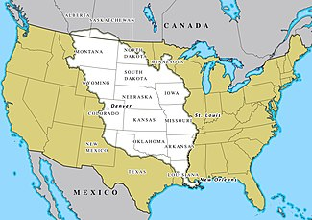
Louisiana Territory
20
Claimed by France 1625.. not occupied
Transferred to Spain after 7 years (French Indian war)..only town New Orleans
Napoleon in power 1799 recovers
Territory in exchange for conquests in North Italy…has big plan for New France…decides to recover Haiti
Louisiana
Territory
Peace of Amiens (1802-1803)
collapsing, war with Britain imminent,
Napoleon needs cash…and fast
New Orleans
N decides to cut losses…and block British expansion

Slide 22
Louisiana Purchase
21
Jefferson sends ambassadors to buy New Orleans for $10 million
Napoleon offers entire Louisiana Territory (828,000 square miles) for
$15 million dollars (£300 million in 2023 currency: £300 sq. mile)
Ambassadors accepts offer, sign treaty w/o consulting Jefferson
Jefferson approves deal overcomes Federalist opposition in Congress (fear growth of South & expansion of slavery)
Inhabitants (500,000 indigenous people and 5,000 settlers) not consulted.

Slide 23
Haitian Revolt impact on blacks
22
News spreads …..Africans can defeat white man
Fuelled by rise of Methodists preaching gospel direct to slave populations…all people are equal to God
Secret meetings take place across plantations
Whites consider Africans incapable of organizing, and harmless
“House slaves commonly shared between plantations, overhear Master conversations

Slide 24
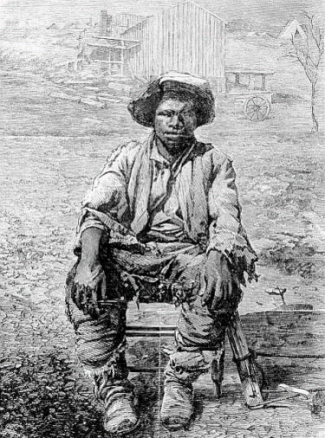
Prosser’s Rebellion 1800
23
Gabriel Prosser.. Literate slave and blacksmith lent out.. Mixes with poor whites Virginia,
Organises revolt, stock pile of arms, sets date, assembles army of 1,000 assemble
Thunderstorm disperses army, plot betrayed by slaves seeking freedom. Prosser hanged along with 25 leaders

Slide 25
Testimony of one of the leaders on receiving sentence….
24
“I have nothing more to offer than what General Washington would have had to offer, had he been taken by the British and put to trial by them. I have adventured my life in endeavoring to obtain the liberty of my countrymen, and am a willing sacrifice in their cause."

Slide 26
Reaction among whites
25
Shock and horror at brutality of massacres of whites
Fear and panic as news of ‘Prosser Rebellion’ spreads …especially where blacks high proportion of population (Carolina 60% population black, Virginia 40%)
Resentment grows across South towards northern Abolitionists
States impose ‘negro laws”
Free blacks ordered to leave Virginia
Bans imposed on preaching gospel, reading, education, and movement
Changed view vs blacks as new technology makes slavery profitable

Slide 27
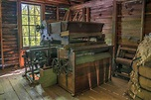
The Cotton ‘Gin’
26
Cotton growing uneconomic
due to effort to remove seeds
Eli Whitney, New England inventor
Develops ‘engine’ to filter seeds
in 1793 …use spreads across south
Cotton yields increase 500% 1790-1810, value of slaves doubles from $200 to $400 by 1820
Plantation owners seek to exploit land to West (Mississippi Alabama, Arkansas…Land rush

Slide 28
Impact on Haiti
27
Revolution occurs before creation of institutions
Chaos as Dessalines assassinated,
Progression of dictators
Jefferson and US refuse to recognise regime…considers in an
abomination and threat to South…imposes Trade Embargo. France and
Britain do same….fear of slave revolts
French return in 1825 demand payment for loss of slaves….and
control of finance…Impose debt of $30Bn in todays money (10X Louisiana
Purchase…up to 80% of GDP…paid off 1971
Haiti…poor, violent, anarchy….US seize gold then occupy to pay debts
…country poorest in world and miserable

Slide 29
Jefferson’s First Term
28
Jefferson re-elected 1804 with 162 electoral votes vs 14 for Federalists …73% of 150,000 popular vote
US doubled in size without a war
Barbary war popular, tributes payments stopped
Economy improving as new industries protected by tariffs expand in North and cotton industry takes off across South
Seeks to use second term to continue western expansion
Fears British will expand west from Canada to settle, exploit fur trade
Seeks navigable waterways to Pacific
Commissions Corps of Discovery in 1803 to chart and assess West

Slide 30
Intermission

Slide 31
Jefferson’s Second Term
29

Slide 32
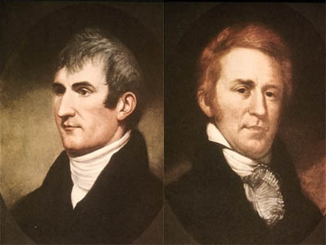
Lewis and Clark
30
Army officers, self educated, masons and
slave owners, veterans of Indian wars
Merriweather Lewis
William Clark
Personally appointed by Jefferson, Clark
Lewis superior officer but Lewis made leader..
Become co leaders
Jefferson personally tutors both in science,
and botany. Wants both scientific and
economic assessment
Secures special grant from Congress
to ensure expedition well supplied, notifies
Spanish and British expedition for science
Lewis and Clark leave 1805 , 30 men
including 2 slaves

Slide 33
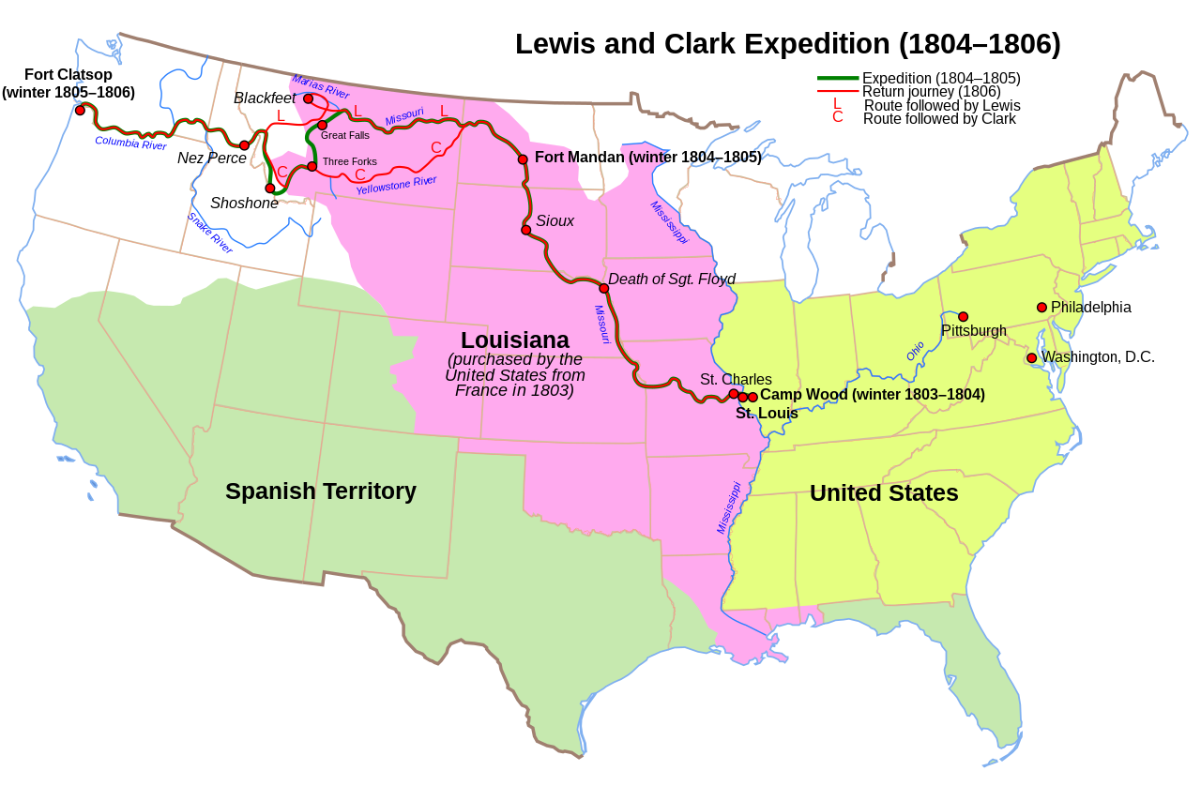
Lewis and Clarke Expedition 1804-1806
32
Prime objective: find
navigable route to Pacific
Secondary: assess Indian
strengths and weaknesses
soil fertility, study nature
Expedition peaceful, lose only
one man…supported by teen
age Indian girl and her
Quebecois husband

Slide 34
Sakakawea (1788-1812)
33
Sakakawea ((imagined likeness)
Shoshone Indian (Idaho) captured Sioux Indians, sold to Quebecois Jean Baptiste Charboneau at 15 years of age
Lewis and Clark meet Jean and hire both as Interpreters…Saka pregnant
Valuable guide, speaks languages. Remembers passes from childhood, rescues maps that fall into river. Has baby boy. Keeps up with expedition sees Pacific. Her presence and child reassures other Indians expedition peaceful
Relationships amicable and respectful with Lewis an Clark and throughout 2 year journey

Slide 35
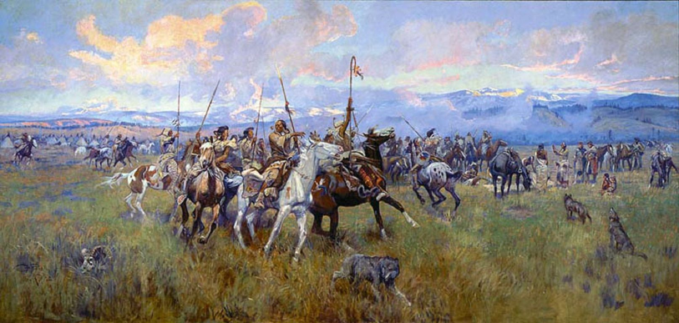
Expedition encounter Spanish and Indians
34

Slide 36
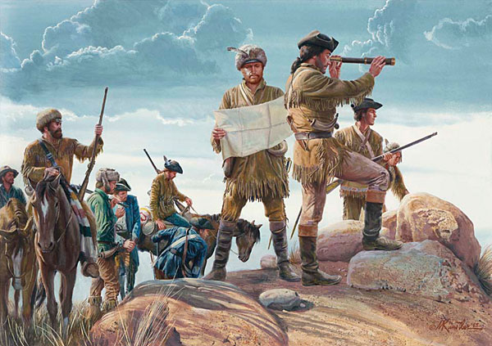
Crossing the Rockies
35

Slide 37
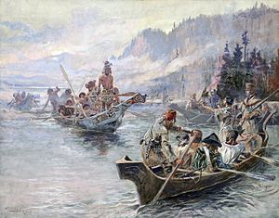
Sakakajewa mediates with NW Indians
36

Slide 38
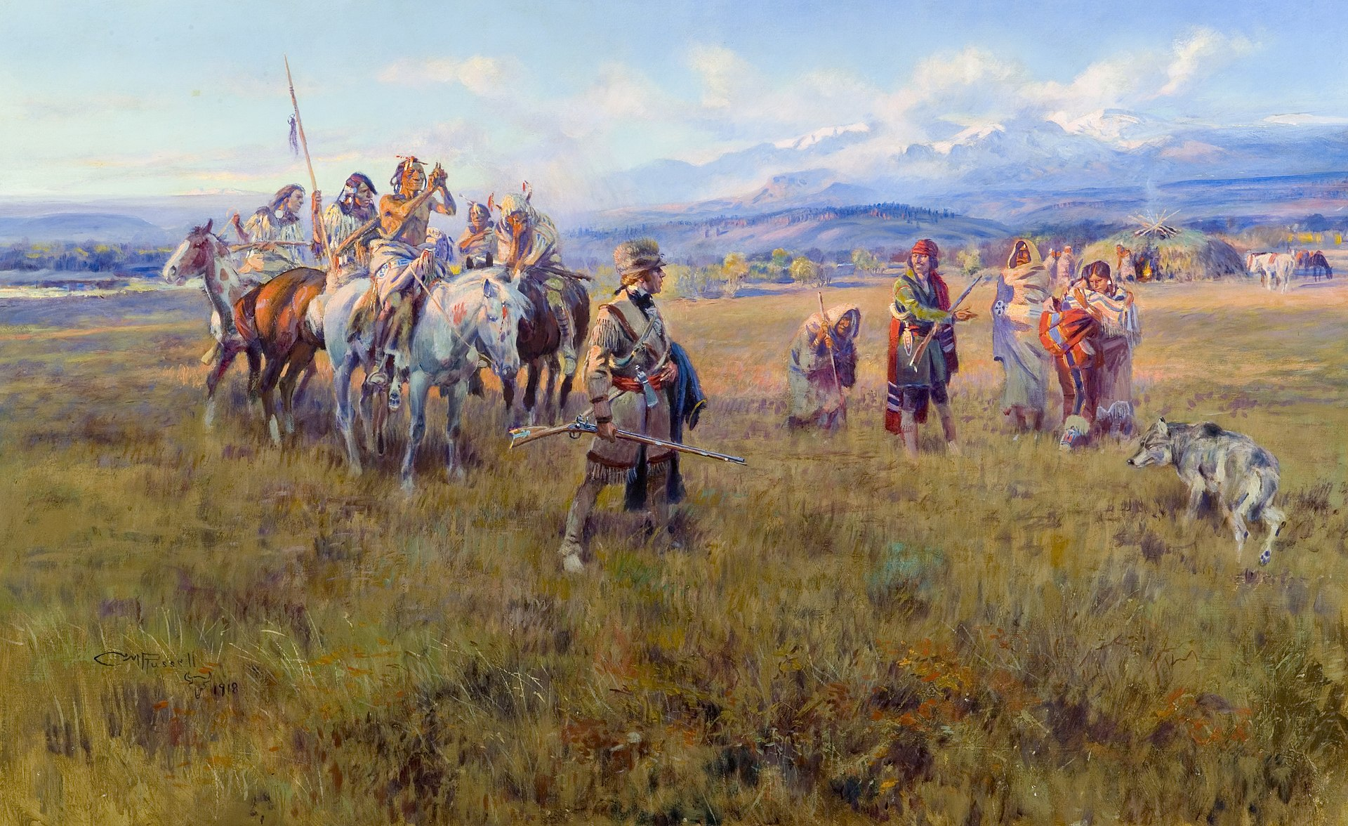
Sacajewas meets brother…kidnapped same time as her…
37

Slide 39
Aftermath of Lewis and Clark expedition
38
USA claims all territory of North West due to ‘right of discovery
Expedition proves land fertile and suitable for settlement
Reveals Indians few and divided
Inspires settlers and entrepreneurs
No navigable route to West,
And for the explorers:
Lewis appointed Governor of Louisiana, accused of corruption and commits suicide
Clark continues military career adopts Sakakajawa’s son “Auburn” when she dies
of illness in 1812. Auburn gets educated, visits Europe, minor celebrity, returns to US, runs hotel for 10 years and dies at age 61

Slide 40
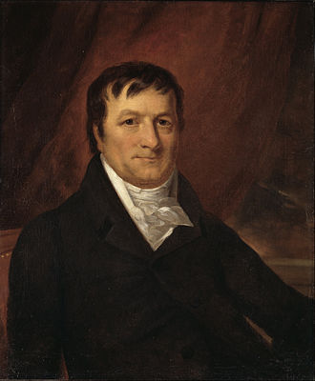
Exploiting the new lands: the first millionaire
39
German born, emigrates To England, butcher, emigrates to US 1780’s, works as butcher …till he meets fur traders in tavern
Jacob Astor 1763-1848)
Opens fur shop in New York, then imports
Hides directly from Indians, cures, resells
To Britain…becomes one of wealthiest
Americans by 1790’s
Establishes American Fur Company. Expands
to Pacific North West diversifies into Opium
Trade with China
Sees New York as future and buys
Real estate. Worth $20 million by 1820…1% of entire US economy…Becomes philanthropist and head Of American dynasty…grandfather “Lady Astor”

Slide 41
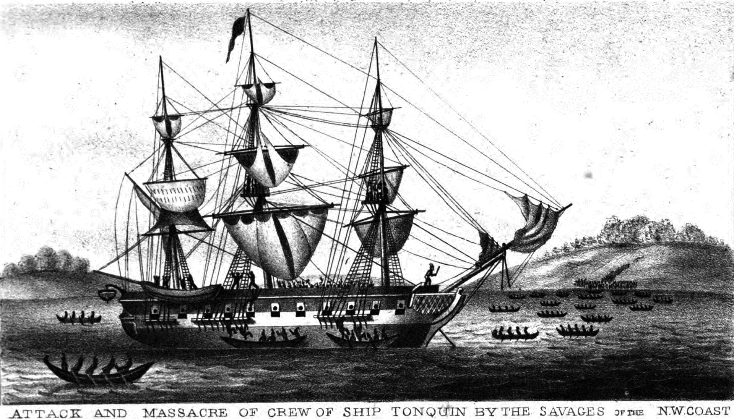
Tonquin Incident: perils of early fur trade1811
40
Purchased by Astor to purchase
Furs off coast of (now) Vancouver
…trip around Cape Horn
Goal trade blankets for furs with
Tia o Kihaut Indians
Negotiations collapse, Indians
Kill all but 4 of 35 crew, 3
escape, One hides in ship
Tia o kihaut return to loot ship…
Survivor blows up ship, kills 100
Indians and self
Survivors captured and
Tortured to death, one survivor
from crew, Indian translator..

Slide 42
The misadventures of Aaron Burr
42

Slide 43
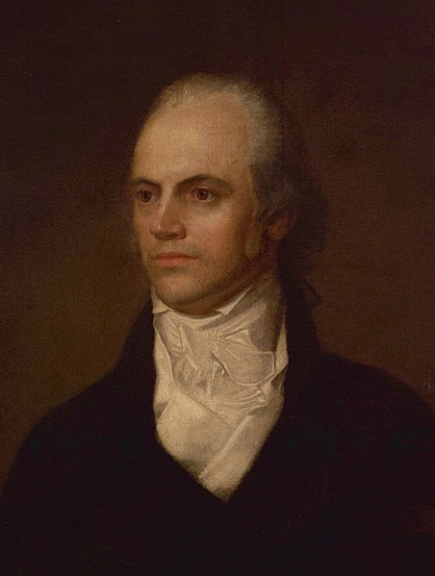
Aaron Burr (1756-1836)
Grandson of Johnathan Edwards, born to
Wealth New Jersey Family
Revolutionary war hero….side lined by
Washington for attempts to seek recognition
Has affair with wife of British officer…during
Revolutionary war.. Marries her when
husband dies in 1780…one daughter,
Theodosia, wife dies 1794
Qualifies as lawyer after war and becomes
Successful business and financier. Creates
Chase Manhattan Bank
Advocates women’s suffrage and equality
, opposes Immigration restrictions,
tries to ban slavery

Slide 44
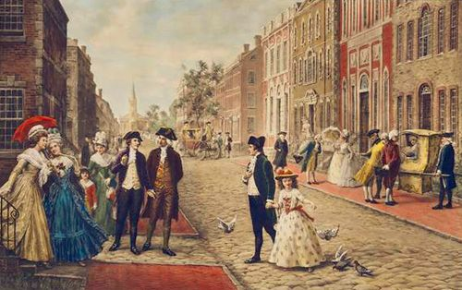
The once up an coming man
43
Initially colleague of Hamilton's envies H’s fame, and success
Disguises creation of new Bank as Water Company…Angers Hamilton…leak
Runs for President in 1796 as
Democratic Republican, fails
Runs again in 1800, ties with
Jefferson. Becomes Vice
President…Distrusted
Dropped by Jefferson in 1804, Runs for Governor of New York. Hamilton leaks notes that Burr a man…”never to be trusted”..

Slide 45
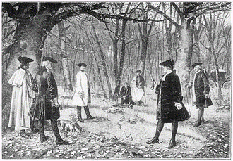
Duel with Hamilton 1804
44
Duals normal way to solve problems of
Honour. Hamilton’s son killed in dual. Burr
Prior dual…agreement to miss….
Burr former Vice President, Hamilton
Former Secretary of Treasury, still
Leader of Federalists
Meet in New Jersey…duelling punishable
By death in New York. Crime but prison
Fine New Jersey
Hamilton misses (intentionally? ), Burr
kills Hamilton
and goes on the run

Slide 46
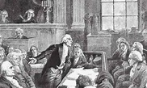
The Burr Conspiracy Trial 1807
45
Burr heads West to Tennessee
Meets Spanish &British ambassadors plans to create ‘Empire’ west of Appalachia's, attempts to raises army (disputed)
Jefferson sends troops to arrest Burr
Burr on trial 1807 for treason..and his life
Burr acquitted …but ruined and must leave US
Epilogue: Burr to England, tries to set up scheme to invade Mexico, deported
off to France, shunned by Napoleon
Allowed to return to America 1811 (thanks to Theodosia)…under secret
name

Slide 47
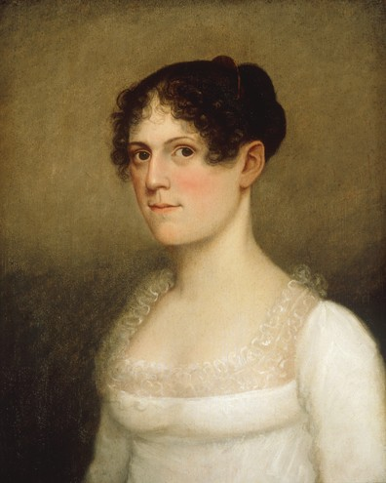
Theodosia and her father
46
Aaron Burr inspired by Mary Wollenscroft
And Rights of Women…wanted daughter
To have best education.
Theodosia Burr 1783-1813
“She was reading Horace and Terence in the original
Latin, learning the Greek grammar, speaking
French, studying Gibbon, practicing on the piano,
taking lessons in dancing, and learning to skate,“
James Parton..Burr biographer
Supported father throughout trial, led campaign for him to be allowed to return
Marries Governor of South Carolina, one child
dies when Aaron returns, travels to see him but …”lost at sea” (pirates?)
Burr dies alone in boarding house 20 years later

Slide 48
Jefferson wants to focus on developing West but events in Europe make this impossible
47

Slide 49
The Trade Embargo of 1807
48
Napoleonic war intensifies
French ban trade to from England
Britain embargoes all trade to France
Seize American ships, impress sailors (1/3 American sailors British deserters
Jefferson reacts: ‘a pox on all of you’
Convinced Americas future agriculture and exploitation of West
No need for foreigners or trade
Bans ALL exports to ALL countries
Economy shrinks by 8%, smuggling intensifies

Slide 50
Napoleonic wars and United States
49
US retains neutrality, Jefferson pro French 1800-1804
Napoleon declares himself Emperor 1804
‘Total war’ between Britain and France
French seize American ships with British goods
British blockade France, board American ships searching for deserters
Jefferson….no longer pro French: “pox on both their houses”

Slide 51
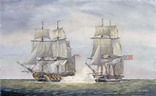
Chesapeake Affair 1807
50
Captain HMS Leopard
Learns 4 deserters on USS Chesapeake.
HMS Leopard vs USS Chesapeake 1807
Hails Chesapeake in US waters, demands handover of deserters
Americans refuse. Broadside
kills 3. Americans surrender.
British board, take ‘deserters’
hang 1, 3...found out to
be Americans and returned
USS Chesapeake returns to port
Americans humiliated….and
respond….

Slide 52
Trade Embargo Act 1807
51
Jefferson bans ALL US trade to both France and Britain
US Economy goes into depression
Trans Atlantic trade ends north and East coast ports ruined
South loses market for newly profitable cotton
US based manufacturing start ramps up in North East
British continue to blockade France, board US Ships
Divert trade to new Empire in India
Indifferent to American protests…….tempers rising

Slide 53
Jefferson’s departure 1808
52
Presidency considered “success” ….achievements during first term, decides to retire at end of second term
Most Jefferson ‘ideals’ shredded
Central government power increased, not contracted (Pirates, Louisiana, crushing of Burr)
International disputes addressed by violence…not negotiation
Slavery not ‘going away’, slavery problem to continue….and intensify
Embargo increases power of northern manufactures…US not going agrarian
No significant increase in level of democracy….rule by elite continues
Nominates Secretary of State James Madison for President.
‘Spirit of the Revolution’ replaced by Nationalism and pursuit of prosperity

Slide 54
Jefferson epilogue
Retires to Monticello in Virginia, makes no mention of his Presidency in future life
Considers greatest achievement: Declaration of Independence, religious freedom in Virginia, creating University of Virginia
Dedicates himself to architecture, study of nature, writing letters and grandchildren
Befriends Federalist opponent John Adams, mentors Madison
Sinks into debt, funds lifestyle by selling slaves to cotton plantations,
Dies bankrupt on July 4rth 1826, daughters sell off estate, Sally Hemmings freed

Slide 55
Jefferson self Elegy and hope for America
53
May it be to the world, what I believe it will be, (to some parts sooner, to others later,
but finally to all,) the signal of arousing men to burst the chains under which monkish
ignorance and superstition had persuaded them to bind themselves, and to assume
the blessings and security of self-government
.… All eyes are opened or opening to the rights of men. The general spread of the
light of science has already laid open to every view the palpable truth, that the mass
of mankind has not been born with saddles on their backs, nor a favored few, booted
and spurred, ready to ride them legitimately by the grace of God. These are grounds
of hope for others; for ourselves, let the annual return of this day forever refresh our
recollections of these rights, and an undiminished devotion to them.

Slide 56
Next Time: A second war with Britain, the Indians east of Mississippi make their final stand, America becomes a Continental power
54

