Slide 1
American History
Talk 7: Creating the United States (1783-1792)

Slide 2
This talk
1
Treaty of Paris, winners and losers
The disunited states
The Constitutional convention
The first Washington Administration

Slide 3
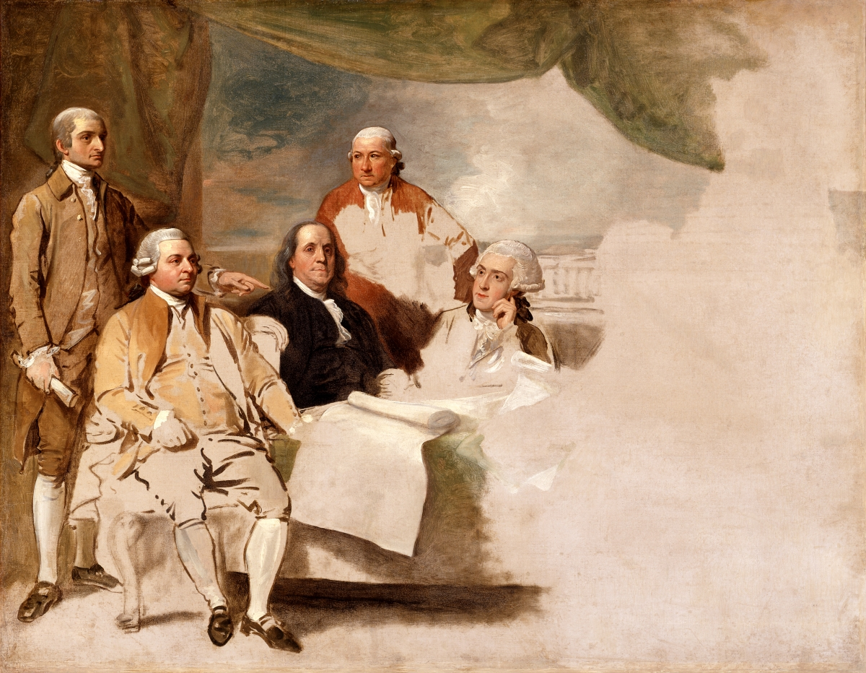
Treaty Paris 1783…British refuse to pose
2

Slide 4
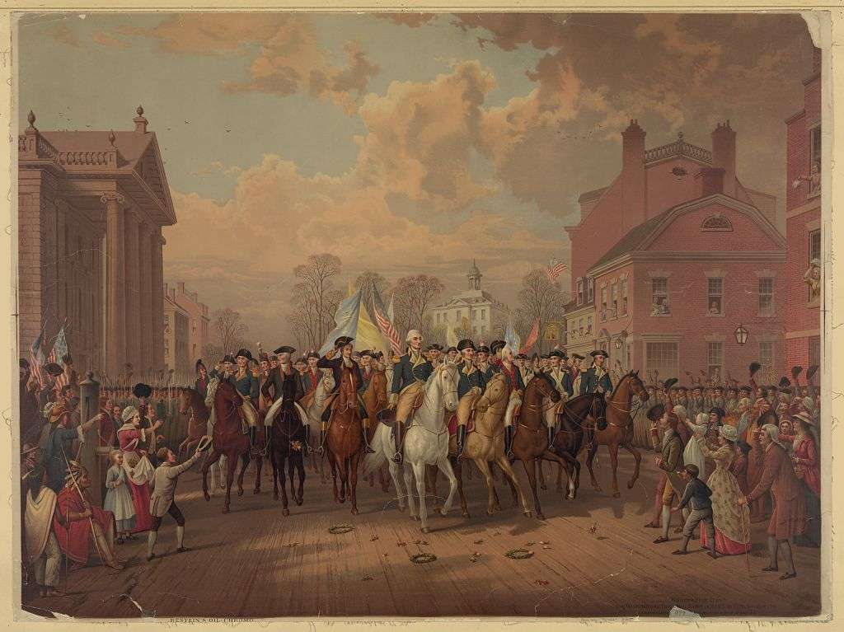
Exit the British
4
British Army consolidates in
New York and waits for Peace
Treaty…no more battles
Washington demands return of slaves to masters, British refuse and evacuate city November 1783
Washington makes grand entrance
at head of army
British soldier leaves Union Jack on top of greased flag pole to prevent its removal

Slide 5
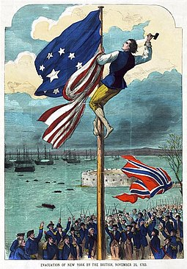
It doesn’t work………
5
After several attempts….wooden cleats
were cut and nailed to the pole and,
with the help of a ladder, an army
veteran, John Van Arsdale, climbs up
the pole and replaces Union Jack with
Stars and Stripes…. before the British
fleet are out of sight……
British are finally gone…

Slide 6
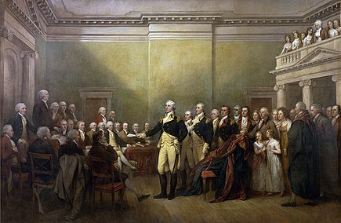
Power shifts from military to politicians
6
King George asks Loyalist refugee
Benjamin West if Washington will
become a dictator. Oh," said West,
"they say he will return to his farm."
"If he does that," said the king,
"he will be the greatest man in
the world."
Washington resigns commission and
retires to farm
‘Continental Congress becomes
National government…and renames itself “Congress of the Confederation”

Slide 7
Winners and Losers
7
Winners
Colonies gain independence
New elite of local merchants, lawyers, and land owners replace royal appointees (Governors, Senates, Judges and civil servants)
No change in voting rights for State Assemblies
Settlers and land speculators gain rights to Indian lands east of Mississippi
Spain: Florida returned
Losers (apart from 20,000 killed in battle plus 150,000 deaths from small pox)
France: bankrupted by cost of war
Indigenous peoples
Status: no longer ‘subjects’ of Empire, occupants of land reserved for ‘citizens’
Power: can no longer play British off vs French
Loyalists …property, jobs and identity

Slide 8
The Loyalists
8
100,000 “Loyalists” leave (5% total population of new United States)
New England Loyalists to Canada
Southern Loyalists to West Indies and Bermuda,
Elite and well connected to England…many struggle to adapt to weather, costs and taxes
Adventurous to India and colonies (Cornwallis appointed Governor General of Bengal after Yorktown….offers his support to aid resettlement)
Most Loyalists adapt and remain within new United States
Properties confiscated, jobs lost….but no mass murders
25% of leavers return during 1790’s, as deal made with Britain:
British pay owners for slaves not returned
United States pays debts to Britain/compensates some Loyalists

Slide 9
Loretta Holmes(1) : loyalist spy
9
New York born socialite, spinster living with aunt.
Becomes courier for British army messages during 1776 campaign
Patriot mob attacks house, forced to stand naked by window for public shaming, made to stand on hot coals ..but is not shot.
Works in boarding house and attends GW, accused of poisoning him…acquitted. GW gives her safe passage to British army
Returns secretly to New York, claims to be “reformed” but continues spying for British Army

Slide 10
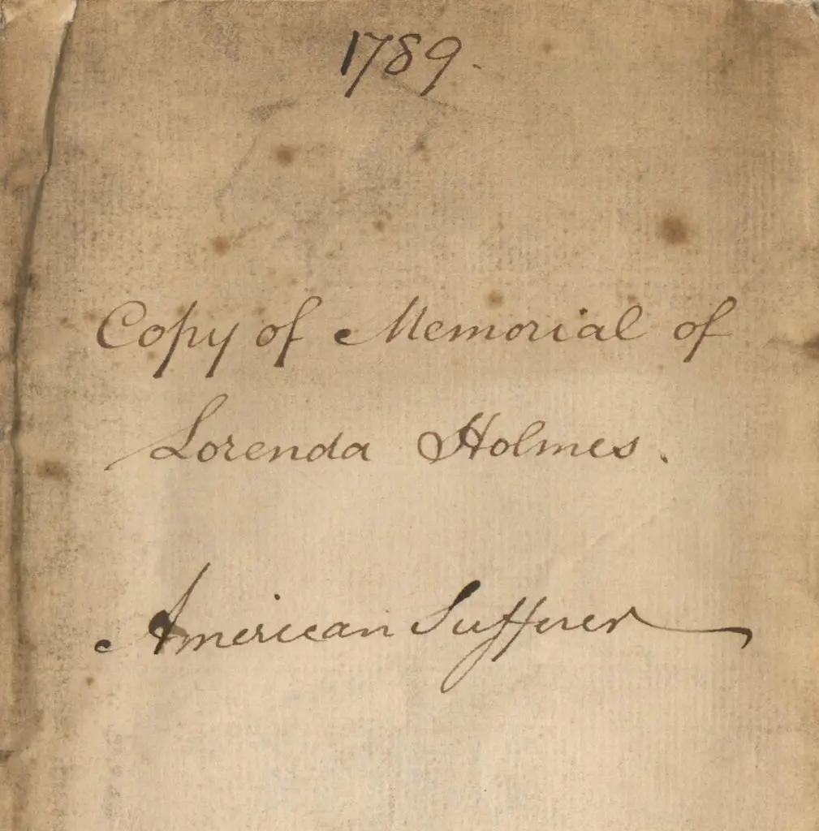
Loretta Holmes (2)
10
Moves to England when British
army occupy city
Presented to Queen, supported
by charity, makes Compensation Claim
Damage claim rejected for lack of
evidence, supported by charity and

Slide 11
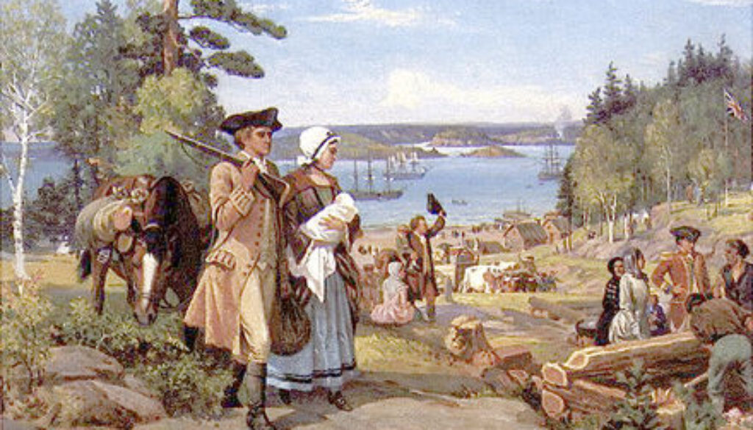
Loyalists arriving in New Brunswick 1783
11
British Government covers
Transportation, food, clothing
and temporary living costs
Given land Grants &
subsidised loans
British American Loyalists become majority of Canadian population
British Government launches
first national Relief programme

Slide 12
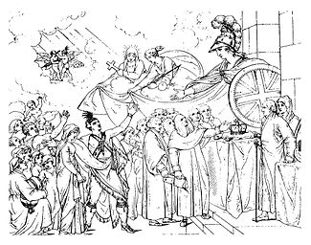
Loyalist Claims Commission
12
National Welfare organisation
Operating from 1785 -1830
To compensate loyalists for losses
Civil servants travel from London
To America to assess claims
Over 3,000 claims paid.
Slow, bureaucratic, no payment without proof of loss
First ever national relief system

Slide 13
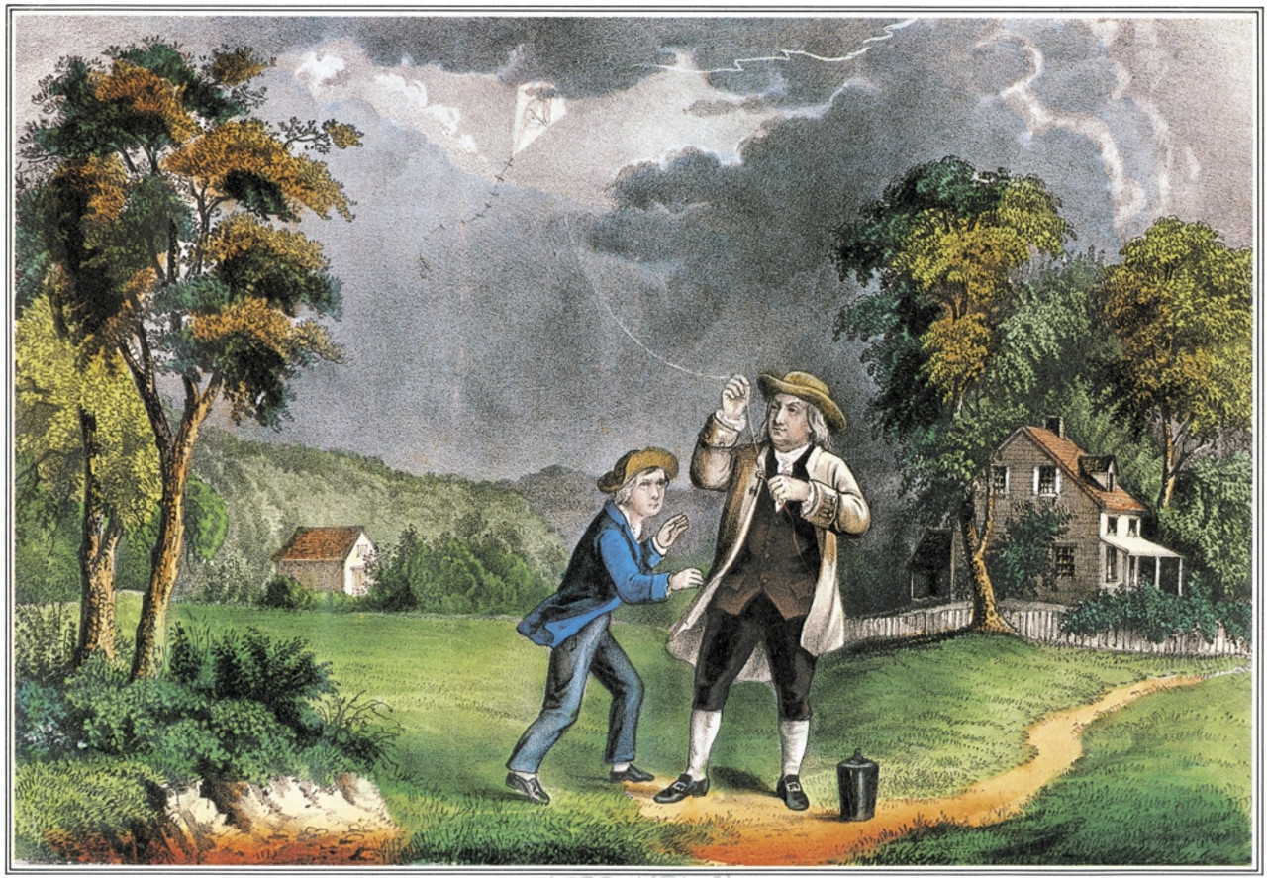
Benjamin Franklin and son William testing lightening rod…1750’s
13

Slide 14
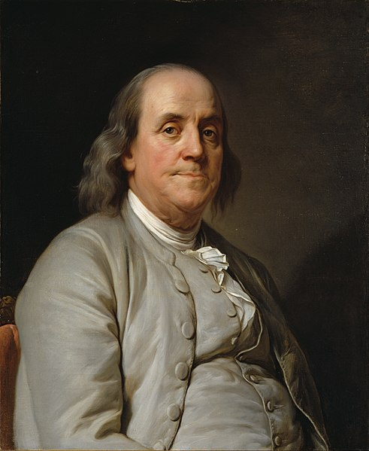
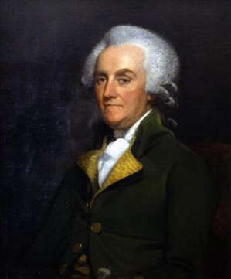
A tale of two Franklins…
15
William Franklin
Benjamin Franklin
Inventor, writer, architect of
Declaration of Independence
& Constitution, US ambassador
To France, Deist, Mason, ex Quaker
Ben’s illegitimate son, writer, devout Anglican Governor of
New Jersey, imprisoned, Released, leads Loyalists but his
own son joins Patriots. Moves to England after
Yorktown. Attempts to reconcile with father but shunned.
Reconciles with son and gives him his American estate

Slide 15
Black Loyalists
16

Slide 16
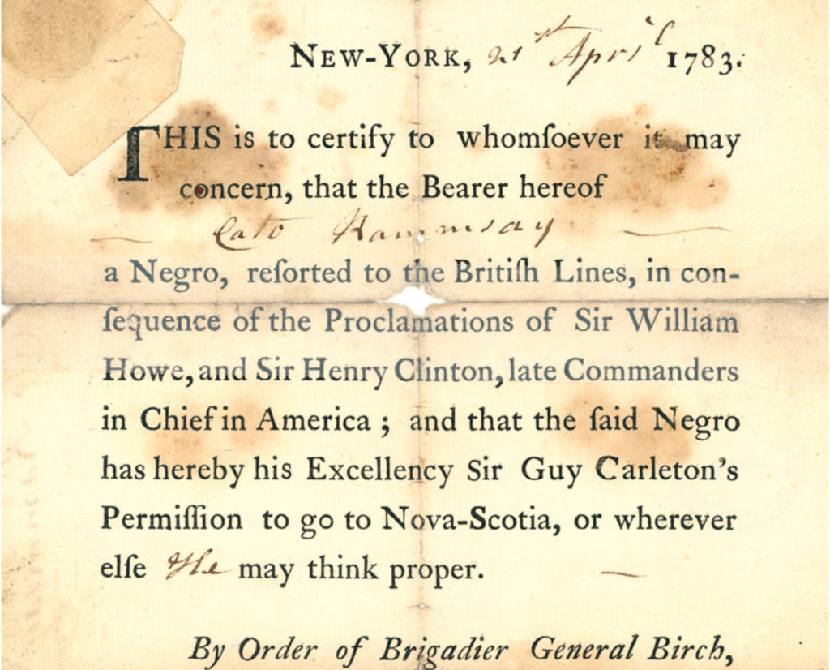
Black Loyalists
17
100,000 flee Masters, 20,000
Join British Army. Most recaptured
Many flee to Florida.. join Indians
creating “Maroon” culture
British army in NY refuse to
Hand over slaves, evacuate
3,000 black soldiers and families to Halifax
Names recorded in
‘Book of Negroes’ and given
‘passes”
Given land and living costs
…best sites to white Loyalists

Slide 17
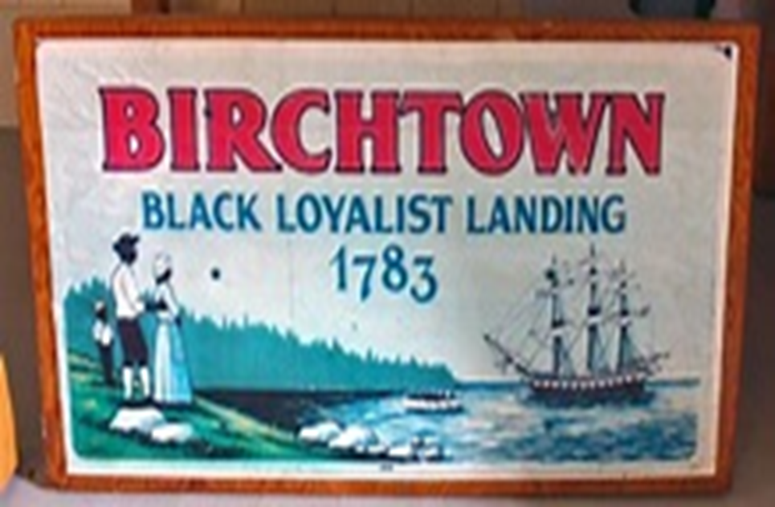
Black Loyalists in Nova Scotia
18
Given clothing and 80 days rations
Best sites reserved for White Loyalists, used as cheap labour by locals. Blacks elect leaders to protest.
Governor sends them to London to petition for help
Meets abolitionists Thomas Clarkson
and Wilberforce brothers in London
“Great Fleet” sent to Nova Scotia,
1,500 Colonists form colony of
Sierra Leone in 1789
Rest stay in Canada
…community remains to this day

Slide 18
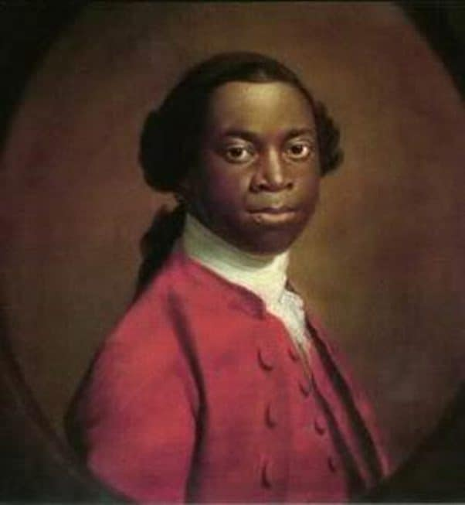
Thomas Peters (1738-1792)
19
Son of Yoruba chief enslaved by Spanish in 1760
And transported to Louisiana
Sold to Scottish planter and located to Carolinas
Escapes master to join British Army, becomes
Pioneer, wounded twice at siege of Charleston
Evacuated to Canada, elected leader of Loyalists travels to England to petition Parliament
Goes to London and organises “Great Fleet”
Considered founder of “Freetown” Sierra Leone, loses election to Thomas Clarkson lead abolitionist, dies of malaria (and broken heart) two years later 1792

Slide 19
The Disunited States 1783-88
20

Slide 20
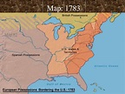
Territorial Gains for Congress of Confederation
21
Britain keeps Canada
and West Indies, loses all
Territory east of Mississippi
Returns Florida to Spain
United States increases
from 360,000 to
800,000 sq. miles
Gains from
Treaty of Paris
1783
13 Colonies
1776
Indigenous peoples
neither consulted or
Informed...Proclamation
of 1763 boundaries
abolished …land open to
Settlement…if it can be
taken
Florida returned
to Spain

Slide 21
Congress of the Confederation
22
New ‘national’ government established by Continental Congress
One house, no executive, no judiciary or civil service
Changes location each year, no permanent members
Amendments require 2/3 vote from each State
Members appointed by State Assemblies and come and go as they wish
Could not raise taxes regulate trade, manage currency
Could sign treaties, declare war, draft plans on how new lands would be made into states (Wilmot Proviso 1787)…but no ability to enforce….anything

Slide 22
The situation 1783-1789
23
Economic depression
Trans Atlantic trade disrupted, economy shrinks by 30%
No recognised currency, barter and gold economy
No credit, $40 million owed to France and Holland $25m internally
Barbary pirates (Algiers, Tunisia) seize American ships, enslave crews
Insecure borders (no navy, national army reduced to 8 men!)
British refuse to leave Western territories, encourage Indian resistance
Spanish Florida becomes haven for escaped slaves and pirates
Internal Disorder
Thousands of unpaid soldiers
Trade wars between states
State assemblies triple taxes but cannot collect
Survival of New Republic in doubt…. Tax Rebellion of 1787

Slide 23
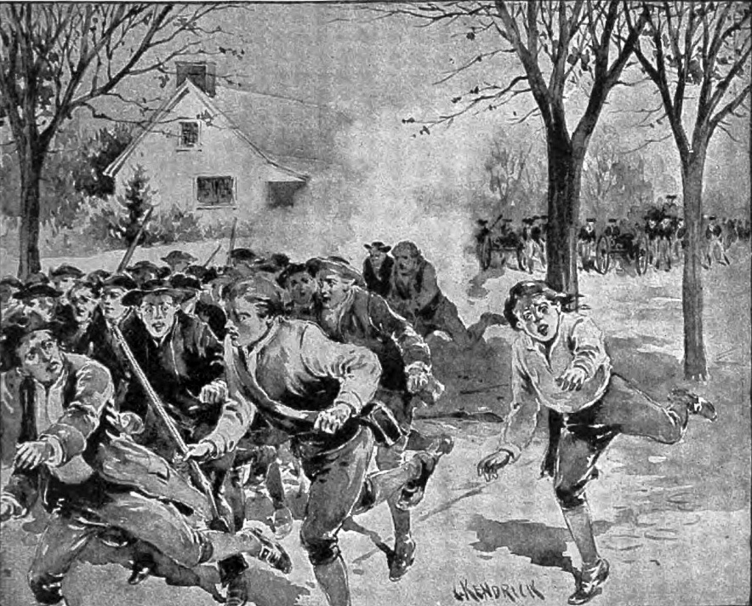
‘Shays Rebellion February 1787
24
4,000 former soldiers
March on Boston to
Seize armoury
Samuel Adams (Patriot)
Raises militia (no national
Army available) and
Orders “hang them all”
Rebels routed by
8 killed, 2 hanged
Congress asks states to
meet and Amend Articles of
Confederation. Meet in
Philadelphia to discuss

Slide 24
Constitutional Convention
25

Slide 25
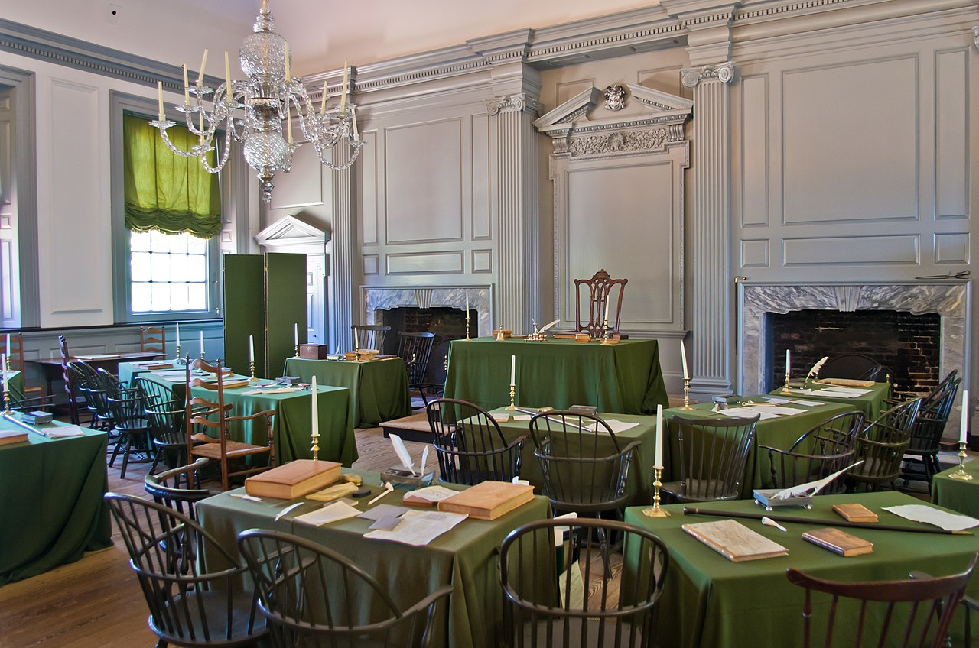
Constitutional Convention (May-September 1787)
26
59 delegates eventually show up Appointed by 13 state Assemblies , attendance varies day to day
All male white Lawyers, bankers, planters, merchants Land speculators, Average age 44, 9 in their 30’s,17 delegates slave owners
Present: George Washington (48)
Presiding Officer, Benjamin Franklin
(81) just returned From France
Not Present …53 of the 59 signers of Declaration of Independence. …Jefferson ambassador in France.
….Adams, Hancock. Busy hanging rebels

Slide 26
Two factions ….apparently irreconcilable
27
Federalists (Madison and Hamilton)
Republic is in crisis
United States needs powerful central government and financial institutions
Need army and navy
The future to be delivered by merchants, bankers, and lawyers
Anti Federalists (Jefferson, Patrick Henry—not present
Republic facing difficulties
Temporary association of independent states all that is required
No army or navy needed
Yeoman farmers and plantation owners to run government
No one considered giving vote to non property owners, blacks, Indians or women
Any change must be agreed by 2/3 of states…Anti Federalists dominate states

Slide 27
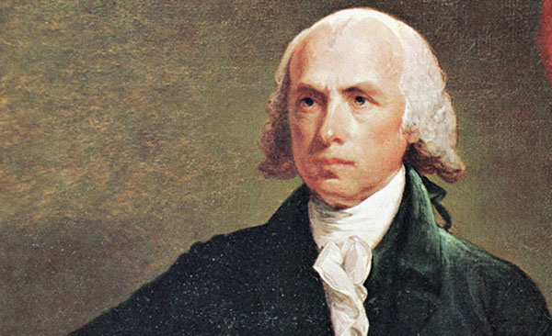
James Madison (1751-1836)
28
Born Virginia, son of wealthy planter, Princeton educated, Classical scholar, Qualified as lawyer but never practiced,
37 year old member of Virginia Assembly no military service during Revolution
Creature of ‘enlightenment’ : “Religious bondage shackles and debilitates the mind and unfits it for every noble enterprize”
Workaholic perfectionist, arrives at
Convention with “Virginia Plan”

Slide 28
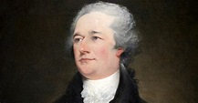
Alexander Hamilton (1) (1757-1804)
29
Born Nevis, West Indies, illegitimate
son of Scottish Merchant and French
Huguenot
Orphaned at 13, uncle adopts , self taught, works as clerk in import export office
Writes letter about hurricane, read by father, who secures donations to send Alexander to go to New York at age 15

Slide 29
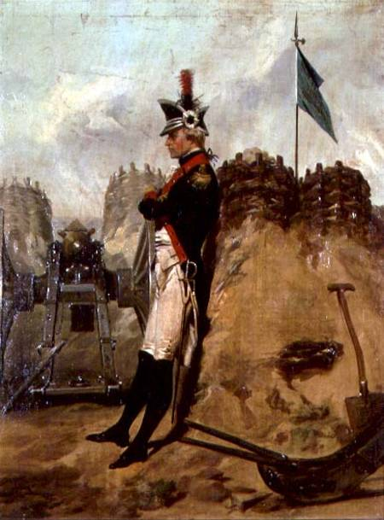
Alexander Hamilton (2)
30
Irish landlord gets him job in merchant office,
Attends Kings College New York, joins student soldiers to fight British occupation of New York…noticed by GW and put on staff then to front line
Studies law and finance, excels at finance, founds Bank of New York, elected to New York Assembly and sent to Convention at age 30
Deist Liberal beliefs: “Real liberty is neither found in despotism or the extremes of democracy, but in moderate governments”
.

Slide 30
Breaking the Impasse
31
“Compromised democracy”
People vote for ‘electors’, electors choose President
Senators appointed by State Assemblies
2 senators for each state regardless of population
States free to decide who has right to vote
Commitment to Bill of Rights
Slavery a non issue:
Slavery not seen as economic in long term, slaves to be either repatriated
to Africa or dispersed across new territories
Mandate ending of importation of slaves from Africa in 20 years (1807)
Future of slavery to be a ‘state decision’
Tyranny to be avoided by “Separation of Powers”

Slide 31
The Separation of Powers
32
Article 1
Creates and proposes laws to Executive
Approval needed by both Houses
“necessary and proper laws”
2/3 both houses to override veto
Power to impeach 2/3 vote
Article 2
4 Year term, chosen by state electors,
Approves or vetoes laws from legislators
Commander in Chief
Can issue Pardons
Other powers not defined
Executive
President & Vice President
Article 3
Creates Supreme Court
Life time appointment
Proposed by President, ratified by Senate
Scope: “highest court”
Remit vague beyond:
inter state issues
Treason trials
final appeals
Legislature (Congress)
Senate (Upper House)
2 per state/6 year term)
House of Representatives (Lower House)
Proportional by state/
(2 year term)
Judiciary

Slide 32
Election System 1789: Compromised democracy
33
Electors
# in proportion
to state
2 votes each . Rules decided by States
Northern State
Voted by property owning whites
South: appointed by State Assemblies
President
(highest number)
President
Executive
(4 yr term)
Vice President (second
highest_)
Senators (Upper House)
6 yr term
Appointed by
State Legislatures
2 per state regardless
of population
Congress
Legislature
Rules set by state
North white property owning males (60%)
South: wealthy only (10%)
Number based on
Population (blacks
3/5 of person, Indians not counted
Representatives
2 yr terms

Slide 33
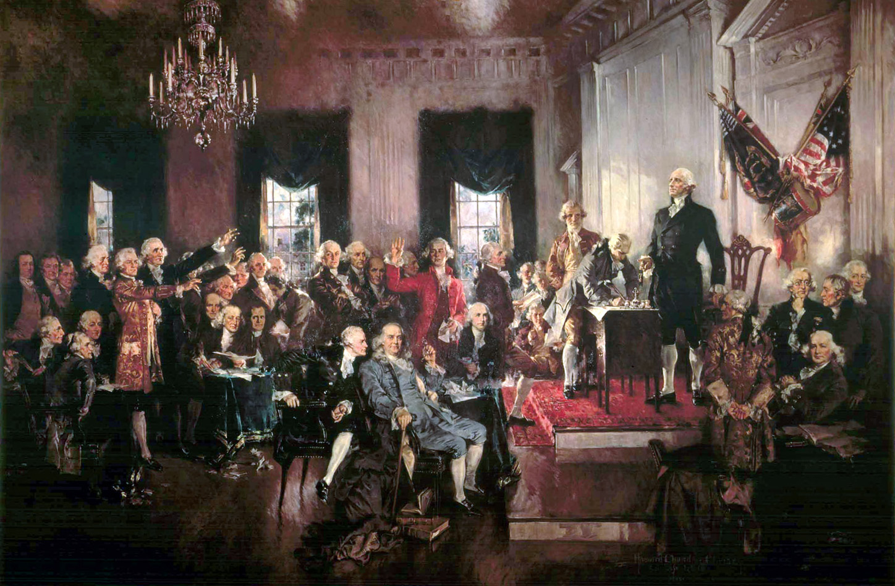
Congress approves Constitution approved
34
Signed by 39 of 41 delegates present..
Most Anti Federalists
not present. Saw no
need
Copies sent to 13 states for approval September 1787
Congress waits for response most go home…
Famous painting but…according to Adams constitution left guarded on desk and delegates dropped by to sign when in town

Slide 34
Intermission
35

Slide 35
The Fight for Approval
36
“Slow response, only 5 states approved by March 1788, much opposition/ fear of tyranny loss of state power
Madison and Hamilton go on attack…publish “Federalist Papers” arguing for Constitution…..brilliant, readable, persuasive
9th state (New Hampshire) approves June 1788
New government to open for business March 1789

Slide 36
Washington’s First Administration 1789-1792
37
Setting the right style
Keeping the Anti Federalists loyal
Creating financial and military institutions
Fixing the borders

Slide 37
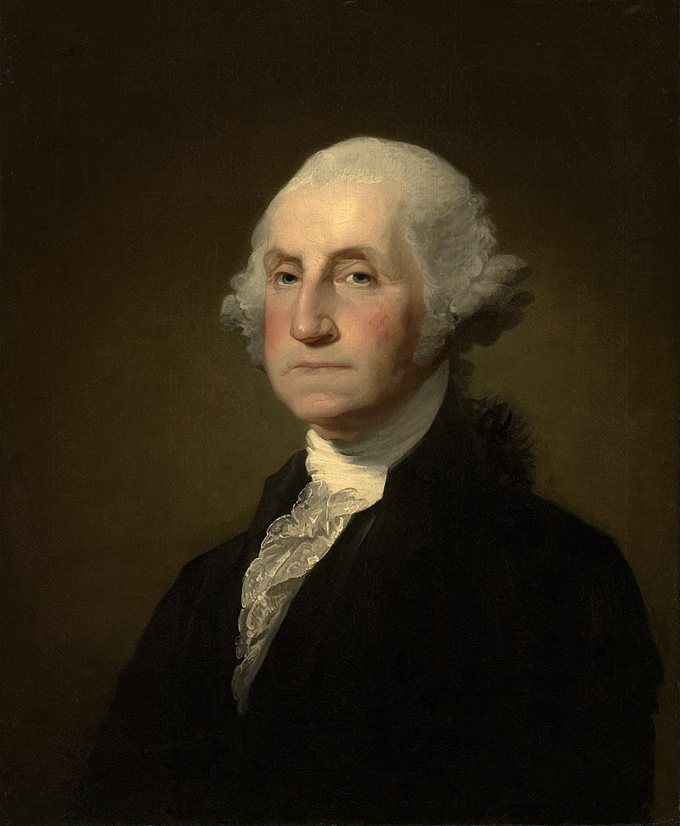
George Washington (1732-1799)
38
Retired to Mount Vernon
After leading Patriot Army to
Victory, married, childless, poor
speaker but trusted.
Elected unanimously by Congress
Has to borrow money to pay for 7
day journey to
“About ten o'clock I bade adieu to
Mount Vernon, to private life, and to
domestic felicity; and with a mind
oppressed with more anxious and
painful sensations than I have words
to express, set out for New York …with
the best dispositions to render service
to my country in obedience to its
call, but with less hope of answering
its expectations”

Slide 38
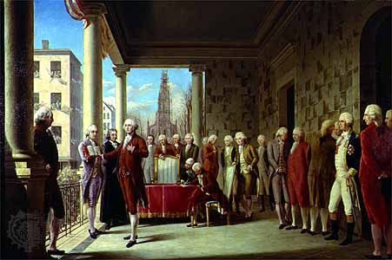
A Government to be formed
39
Debate on Etiquette, ‘His majesty” “his Excellency” till ’President’. agreed
Takes oath April 30th 1789
No institutions, army or
navy, bureaucracy or credit
Anti Federalist and foreign
Powers, especially British
expect experiment to
fall apart ….and fast
Washington meets challenge

Slide 39
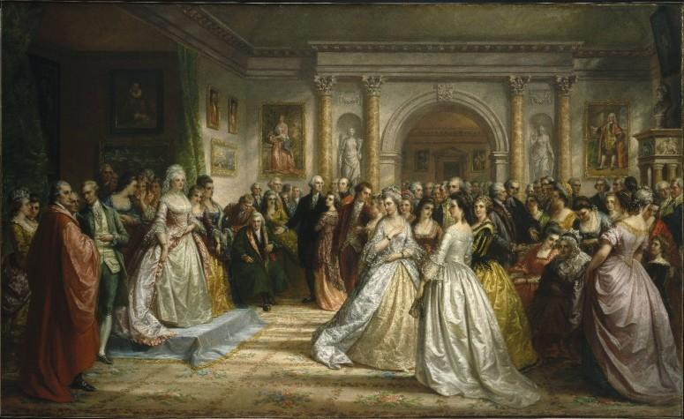
Establish right “style”
40
How balance dignity of office with need for to get things done
Weekly ‘levees’ for men on Tuesdays
Congressmen and wives Thursdays
“Be courteous to all, but intimate with few; and let those be well-tried before you give them your confidence.“
“Let your ceremonies in courtesy be proper to the dignity of his place with whom you converse, for it is absurd to act the same with a clown and a prince.
(from GW “Rules of Civility and behaviour”

Slide 40
Procession around the Country 1791
41
Makes four month tour
along coast to see, be seen
Develops awareness of
differences and vulnerabilities,
Uses this insight to guide
Policy of neutrality during
French revolutionary wars

Slide 41
Secures Anti Federalist loyalty
42
Anti Federalists) accept Constitution on condition “rights” embedded into Constitution…do not run for office…stay in their states
80% of First Congress Federalists and don’t see Bill of Rights a priority
Washington and Madison push through Bill for first 10 Amendments to
Constitution …approved Sept 1789
Approved by 9 out of 13 states and added to Constitution December 1791

Slide 42
Bill of Rights (First 10 amendments)
43
Congress to make no law establishing religion or prohibiting freedom of speech, religion, right of assembly, right to petition
A well regulated Militia, being necessary to the security of a free State, the right of the people to keep and bear Arms, shall not be infringed
No soldiers quartered in homes
No searches of homes without warrant for probably cause
Protection vs self incrimination, no double jeopardy,
Speedy trial, right to counsel, informed of causes of trial
Right of jury trial
Prohibits excessive fines and ‘cruel or unusual punishments
People retain rights not set out in the Constitution (never used)
US Government has only those powers set out in Constitution
Most content from English Bill of Rights 1688, Toleration Act 1689 ,plus Magna Carta 1215…Anti Federalists do not trust reliance on ’Common Law”

Slide 43
Perilous financial status of USA 1789
44
United States 1789 13 currencies, most trade barter or gold….
Government owes $80 million, annual revenues $4m ... largest single obligation $600,000 annual ‘Tribute’ to Barbary Pirates as British Navy no longer available (11 ships seized 1790, 100 Americans sold into slavery when payment late….)
States bankrupt, unable to raise taxes without rebellion
Speculators have bought pensions and bonds at discount… Anti Federalist
do not want to reward the “idle rich”
No army or navy, veterans unpaid…and dangerous.
Alexander Hamilton to the rescue.

Slide 44
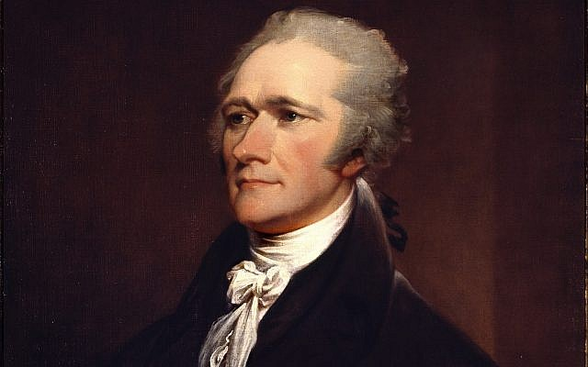
Alexander Hamilton Secretary of
45
Appointed by Washington 1790-1796 based
on banking and war record. Trusted, cannot
become President since born in West Indies
Establishes Bank of United States in New York
Consolidates Debt (Debt as Asset)
Government assumes debts of all states
Pays off speculators
Guarantees all foreign debt (even to British)
Increases revenue:
Creates tax collection service
Raises import taxes
Imposes high excise taxes
Economy booms……..Hamilton becomes most respected and despised man in America….seen as friend of the rich and British

Slide 45
Fixing the borders…resolving unfinished business with the Indians in NW
46

Slide 46
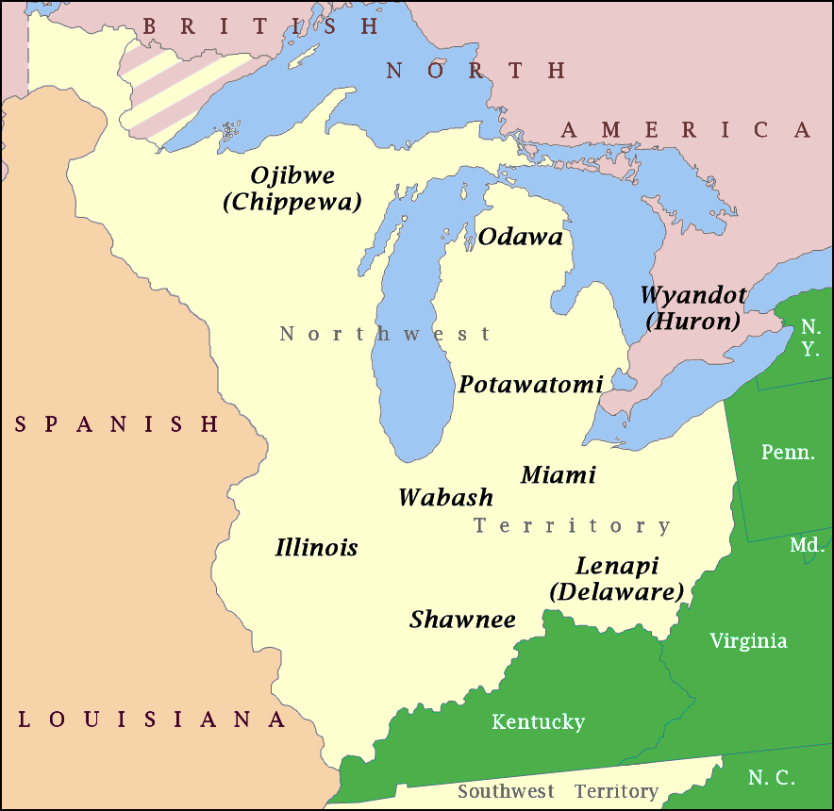
North West Territory 1783
47
Claimed by France 1600’s
Won by British from France during ‘’French and Indian War 1756
Reserved for Indians by Proclamation of
1763)
United States gains territory in Treaty of Paris 1783 … sets aside ‘public domain’ by Ordinance of 1787..sell land to settlers
Indian tribes not consulted, reduced from 1 million in 1500 to 100,000 in 1790 by small pox ..but still powerful
American expedition to Ohio during
Revolutionary War annihilated

Slide 47
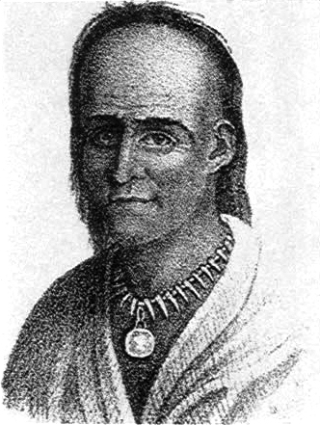
Little Turtle, chief of the Miami people (1747-1812)
48
6 ft. 3 , teetotaller, fought for British in
Revolutionary war wiped out French army of 100 men,
Helps form ‘North West Tribes Confederation
to resist US settlement of territory, military leader
Washington sends army of 1,500 to seize land
Army destroyed at battle of Kehianga, 500 men lost
Washington sends Generals St Clair with half of entire US army (2,000 men funded by Hamilton’s Bank) to try again

Slide 48
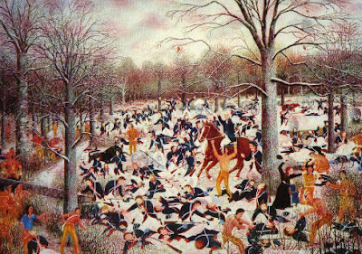
Battle of Wabash (St Clair's Defeat)1791
49
St Clair sets up camp, does
not entrench
Miami and Shawnee attack
1,200 US Troops killed vs 30
Indians.
Greatest ever Indian
Victory (4X ‘Little Big
Horn) …30% of entire
US army dead
Washington resilient,
Does not give up

Slide 49
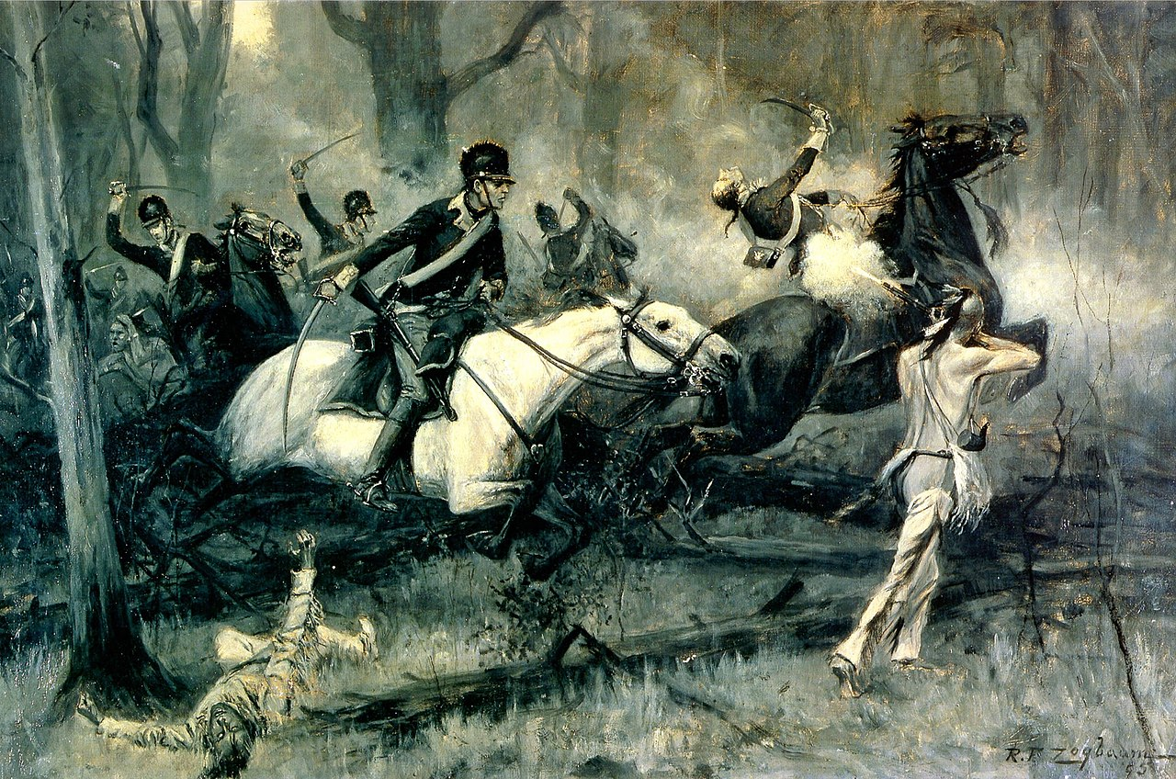
Aftermath of Wabash
50
Washington raises taxes
Creates new army of 5,000
General ‘mad dog”
Wayne sent to try again
Battle of Fallen Timbers
1794, Indian army of
1,000 retreat. Both sides
lose 100 men
Little Turtle seeks help
From British army
British say no
Little Turtle seeks terms

Slide 50
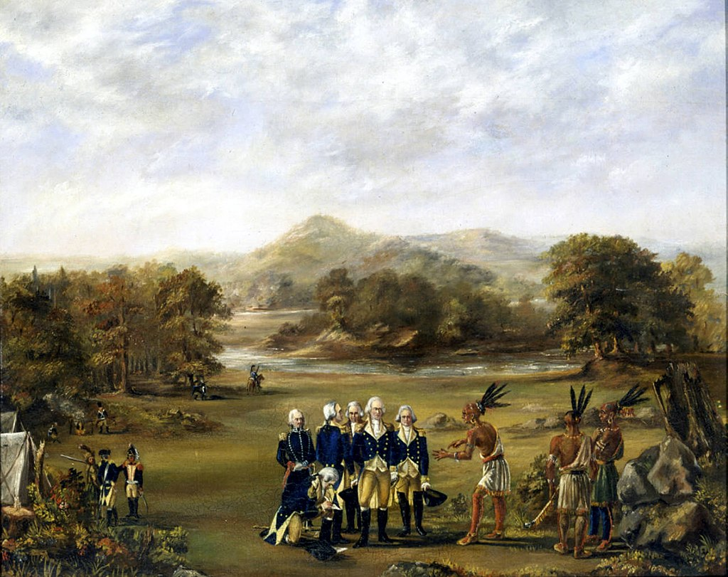
Treaty of Greenville 1795
51
Indian Confederation surrenders land for cash and agree to ‘take up white man’s ways…..first of many concessions..
Little Turtle becomes ambassador to Washington. Seeks help to stop sale of liquor
Dies of rheumatism and gout 1812.. US gives him full
military honours

Slide 51
Situation 1792
52
Washington re-elected by state legislatures unanimously
Government up and running
Government and states solvent
Barbary Pirates Tribute paid (slaves recovered)
Borders secure
#
USA is a going concern

Slide 52
Next Talk: The growing Pains of the early Republic

