Slide 1
End game

Slide 2
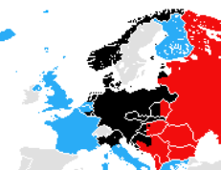
European War December 1944
Russian offensive
Has recaptured
Ukraine , East Europe
Approach East Germany
1
Allies advancing to
N Italy, Mussolini
“rescued”..but will be
Killed April
2
1
Allies at German border
Free French army created
Have won Battle
of Atlantic & “Masters
of the Air”
3
3
2

Slide 3
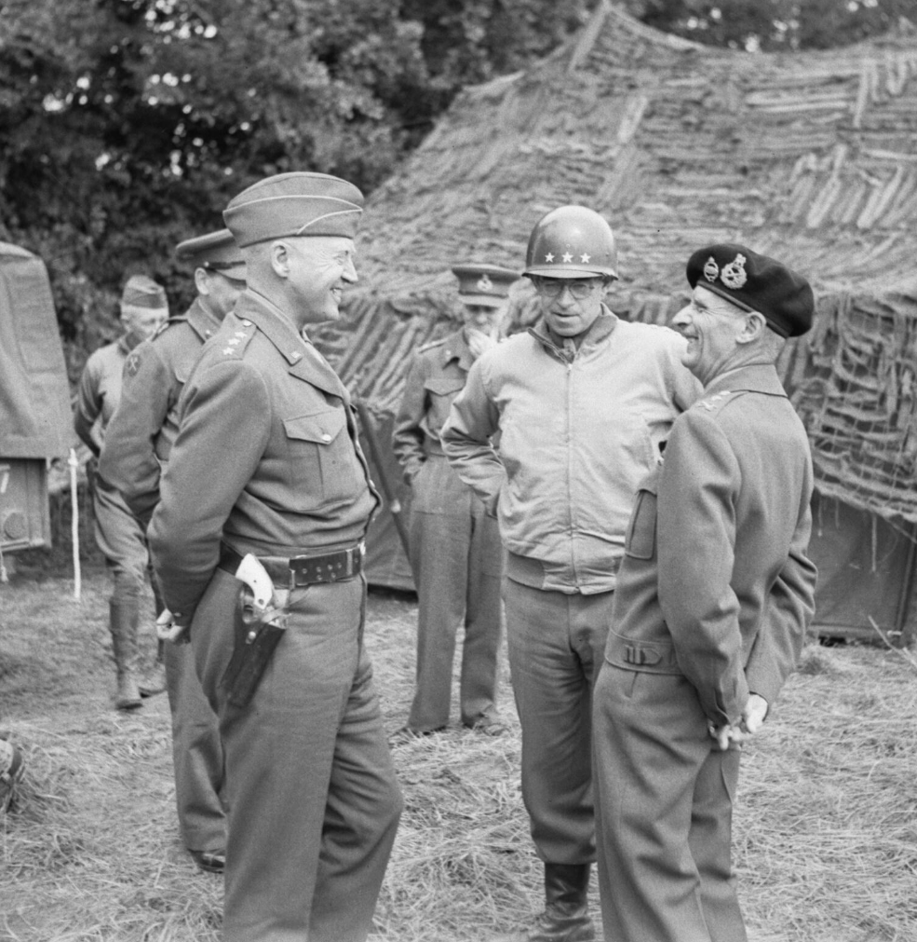
Eisenhower, Patton, Montgomery …fragile and volatile but successful partnership
There would be one more surprise

Slide 4
Battle of the “Bulge”
German objectives
Split American and British armies
Occupy Antwerp
Pivot and block Russians
Allies over confident…focused on invasion plans
Weather prevents allies from seeing troop build up
Germans commit 410,000 men 500 tanks to attack
….target US in Ardennes….temporary numerical advantage

Slide 5
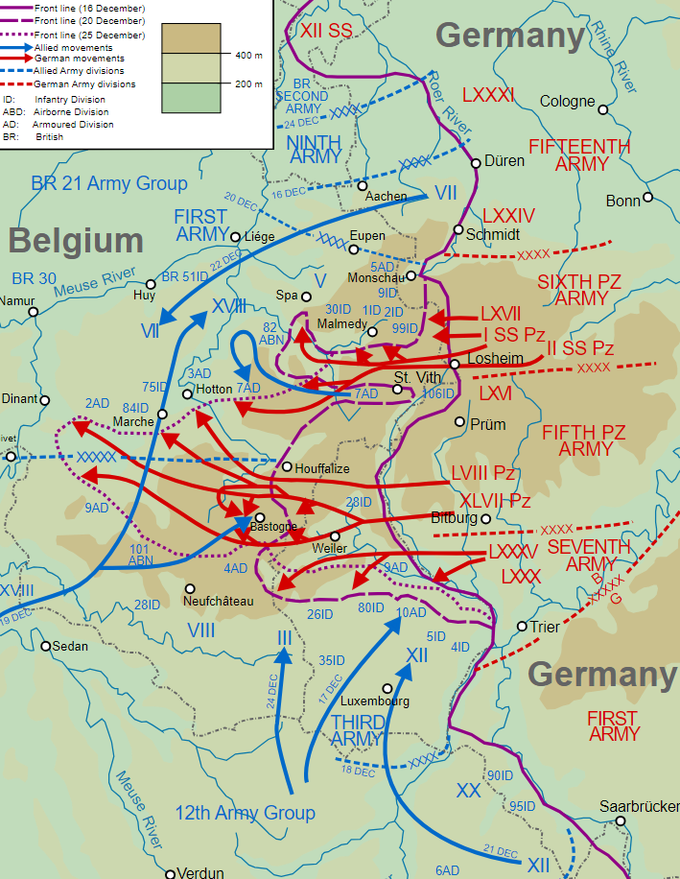
Battle of the Bulge December 16 – January 25, 1945
Attack initially successful
….US 12 Army crushed
…..surrounded at Bastogne
…panic among local commanders
Eisenhower puts Montgomery in
Control….temporarily
Patton had anticipated attack
And advances north intercept
Americans recover, numbers increase
From 400,00 to to 800,000 by January
Attack doomed from start…required miracle and foolishness by allies to succeed
Convinces Allies Germany still strong…and
All precautions to be taken

Slide 6
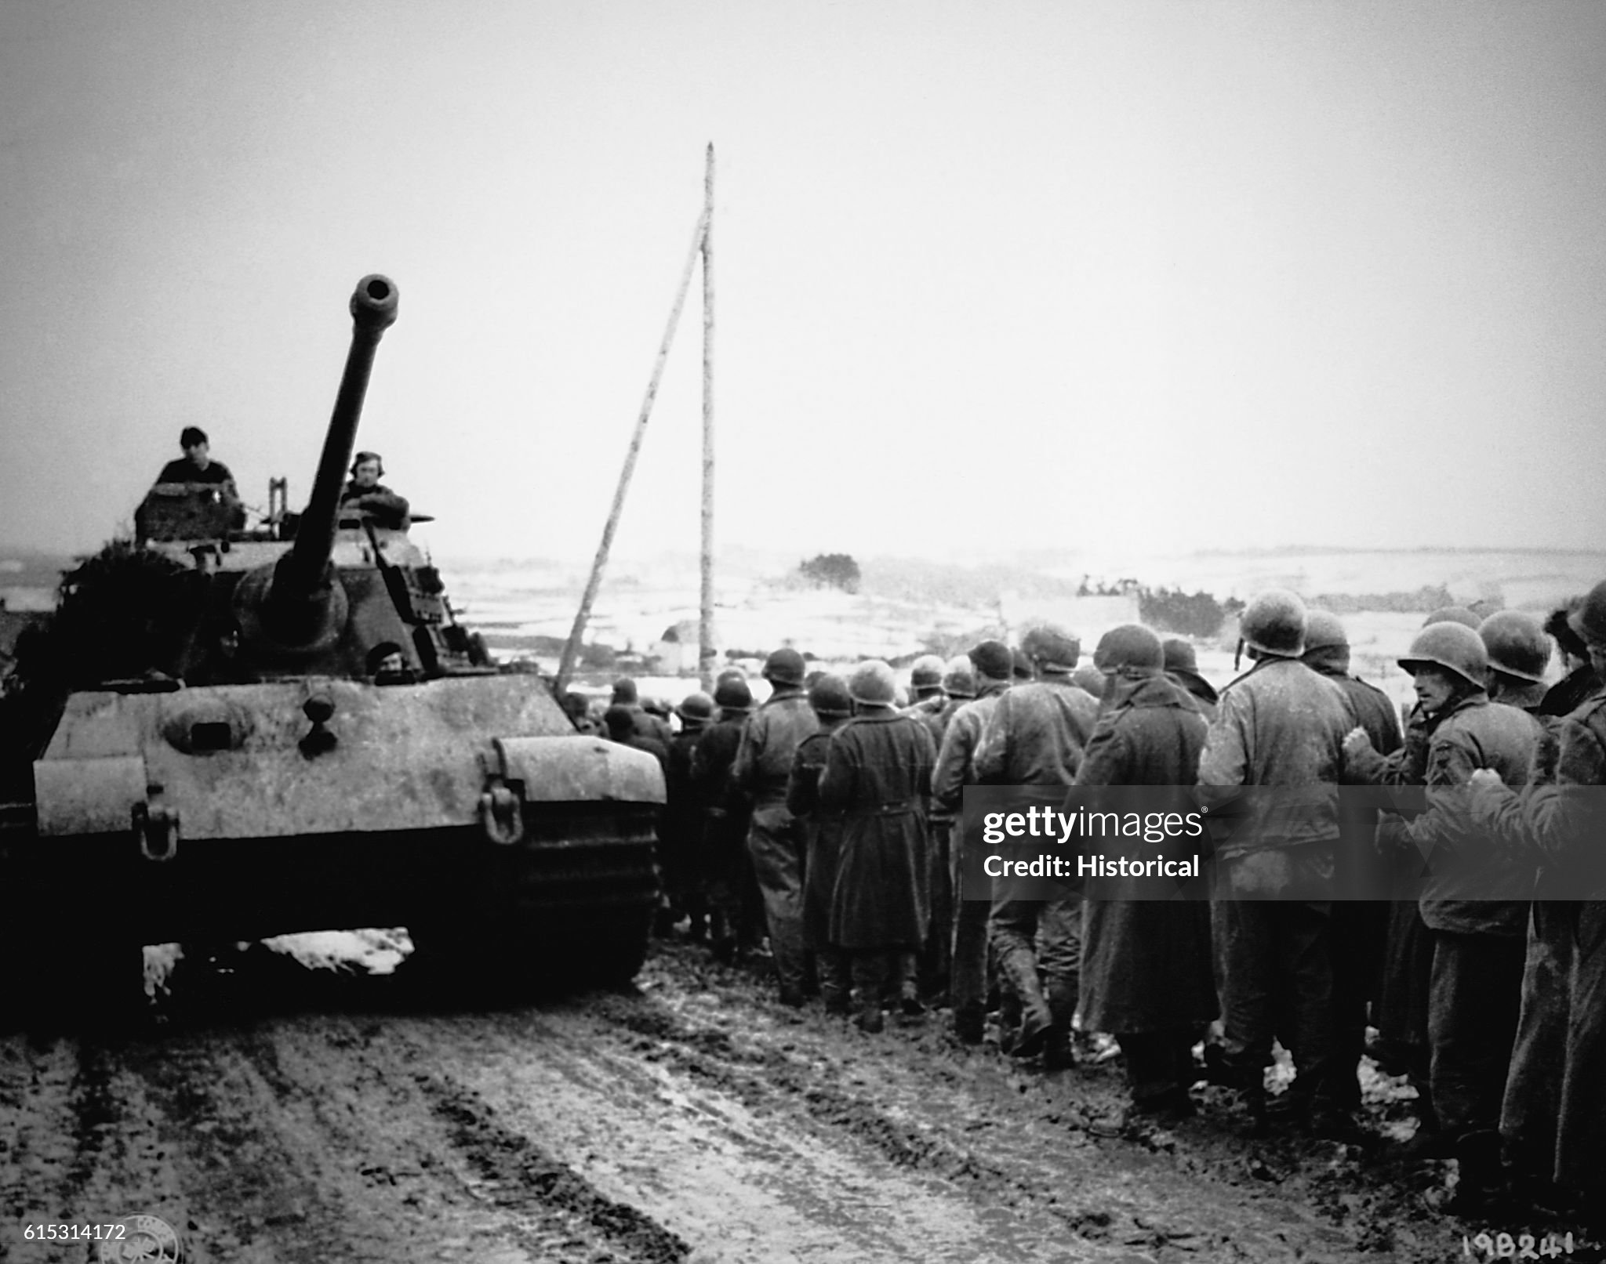
Initial German success

Slide 7
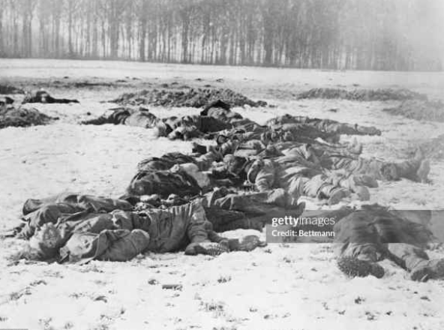

Slide 8
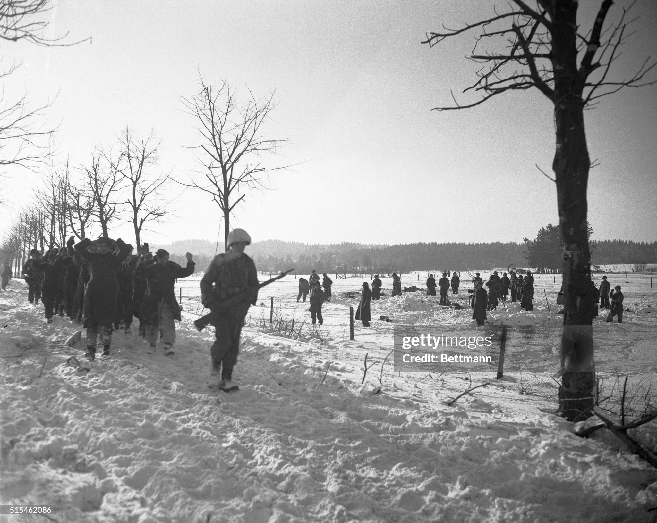
German prisoners January 1945

Slide 9
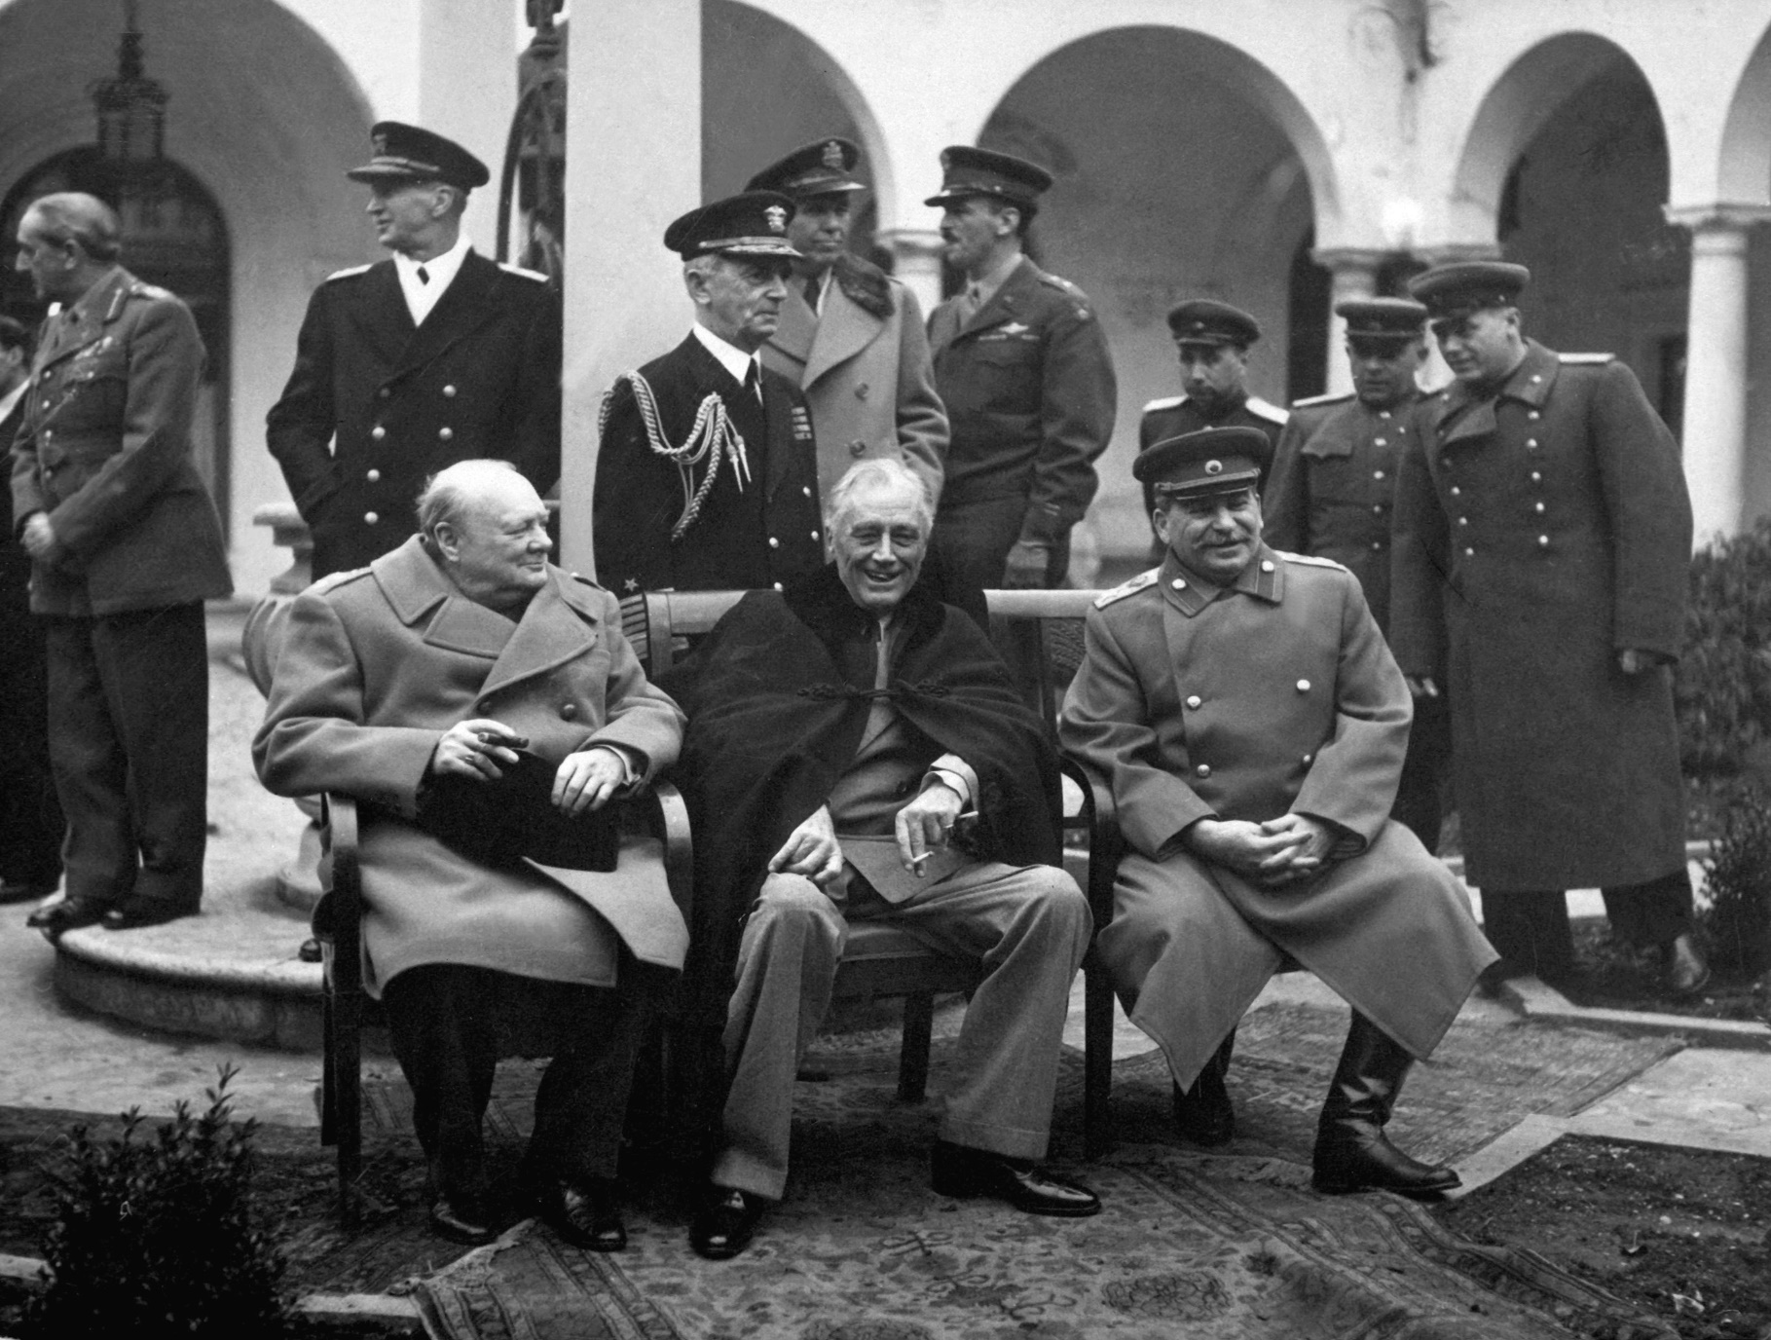
Yalta Conference February 1945
FDR relected for 4th term
…failing health
…wants settlement agreement
Europe divided up between
Soviet and West (and subject to
“free and fair elections”
Unconditional surrender demanded
USSR to join war vs Japan within
3 months German surrender

Slide 10
Dresden bombing February 1945
Dresden: untouched by war so far..considered cultural city
Decision to bomb based on false intelligence
Allies believe Russian offensive stalling
Germans creating “Southern Redoubt”
Industrial capacity of city over estimated
Mass raid destroys city February 14th/ 15th
25,000 killed
No strategic importance, Germans retreating
One of the many WW2 tragedies…claims of “war crime” unjust,
fuelled by false claims of 500,000 deaths by “revisionist historians”

Slide 11
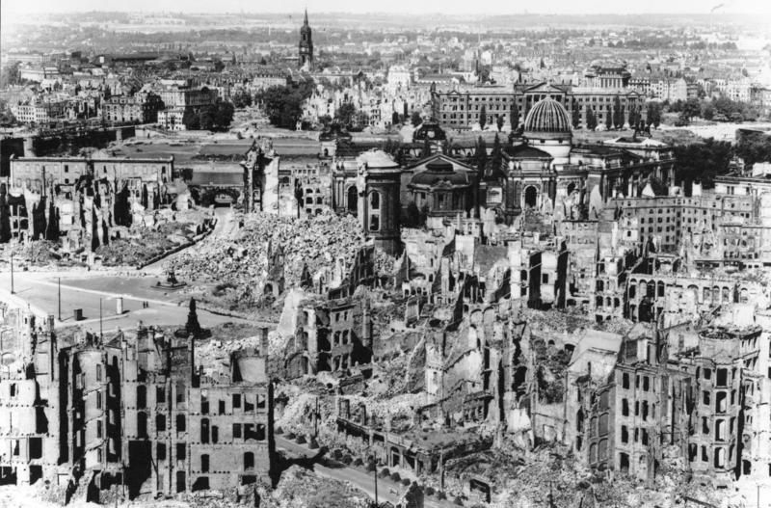
Dresden….after bombing, 90% city destroyed…25,000 dead

Slide 12
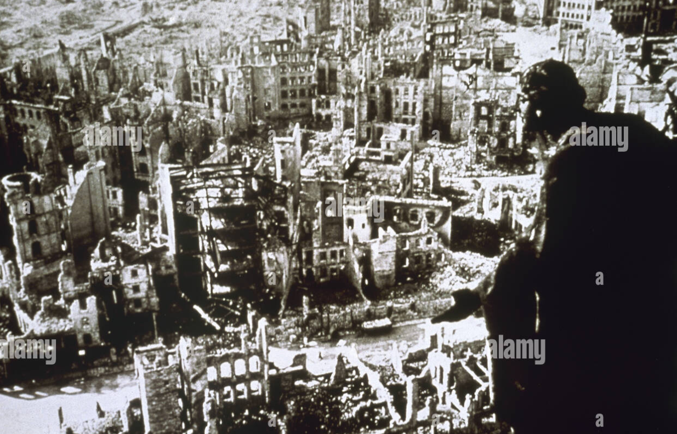
Dresden 1945

Slide 13
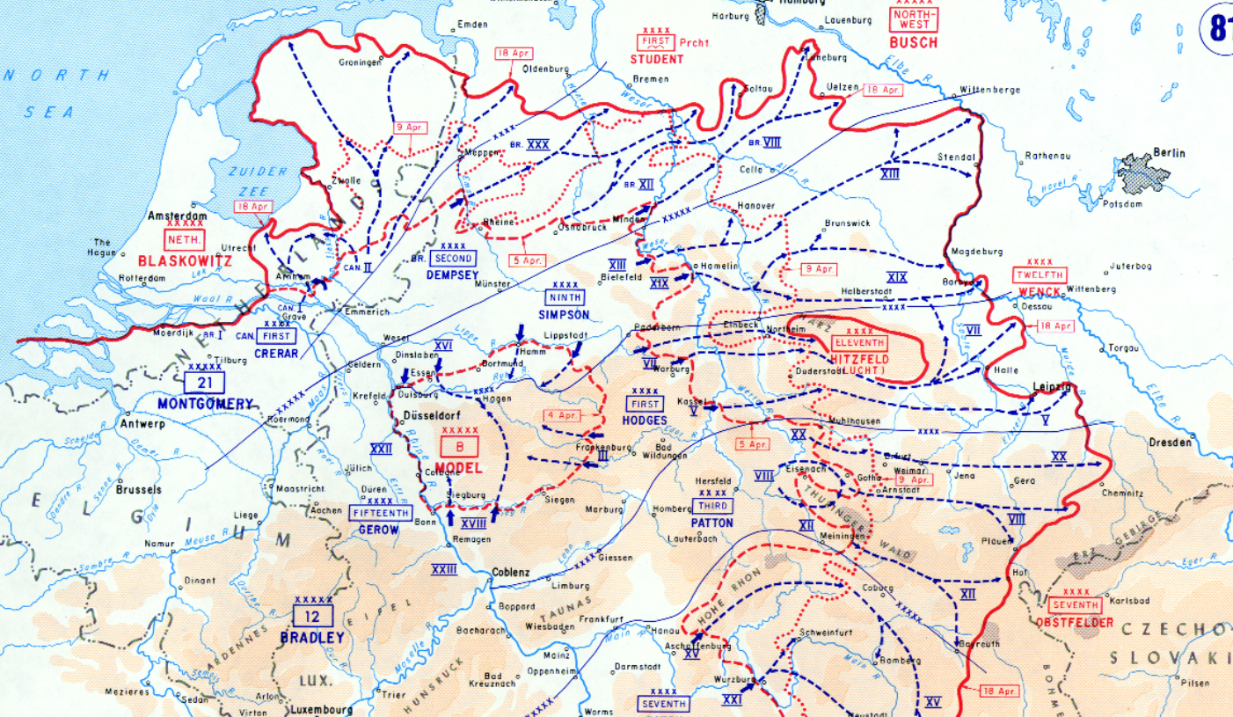
Rhine crossings: February – May 1945
Allied army of 4.5 millon
Staged attacks, air cover
Thoroughly planned & coordinated
German army reduced to
1.6m…few aircraft
Fanatical resistance
Advance continues on all Fronts
…65.000 US, 20,000 British casualties
Discovery of concentration camps

Slide 14
The End
Hitler hopes rise on death of FDR on April 12th
Russians arrive April 15th….lose 300,000 men taking city by May 8th
Hitlers commits suicide April 30th
Successor Admiral Doenitz surrenders to Montgomery May 7th 1945
Followed by surrender of all German forces

Slide 15
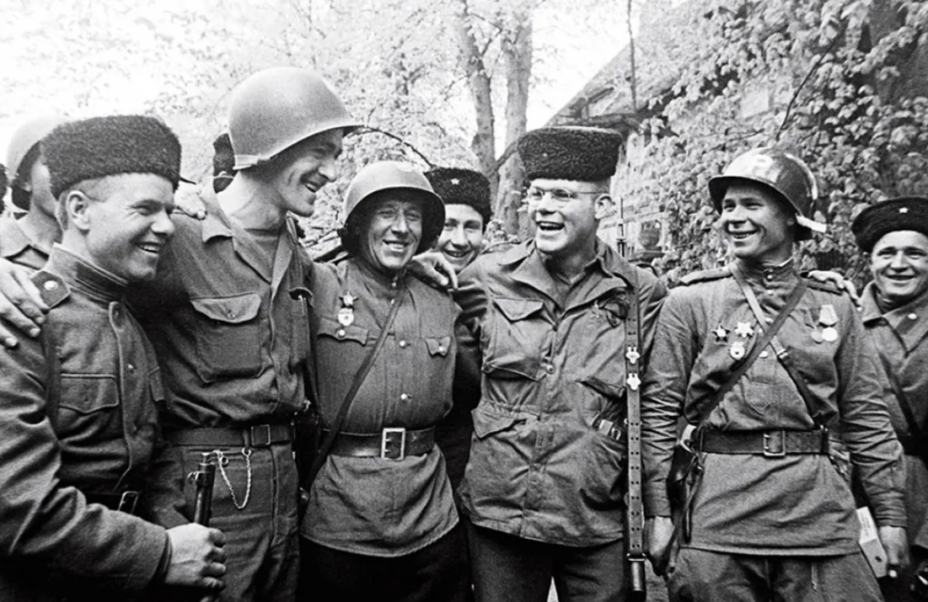
US and Russian Troops meet up at the Elbe River
May 1945

Slide 16
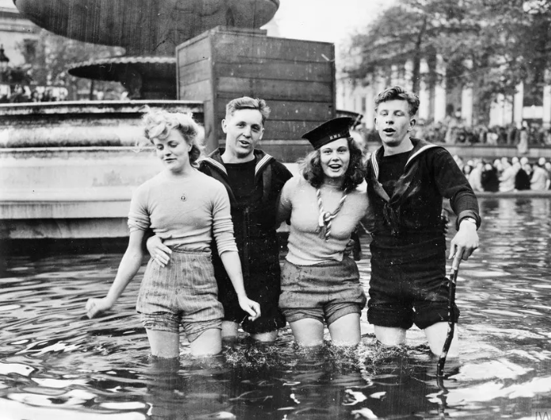

Slide 17
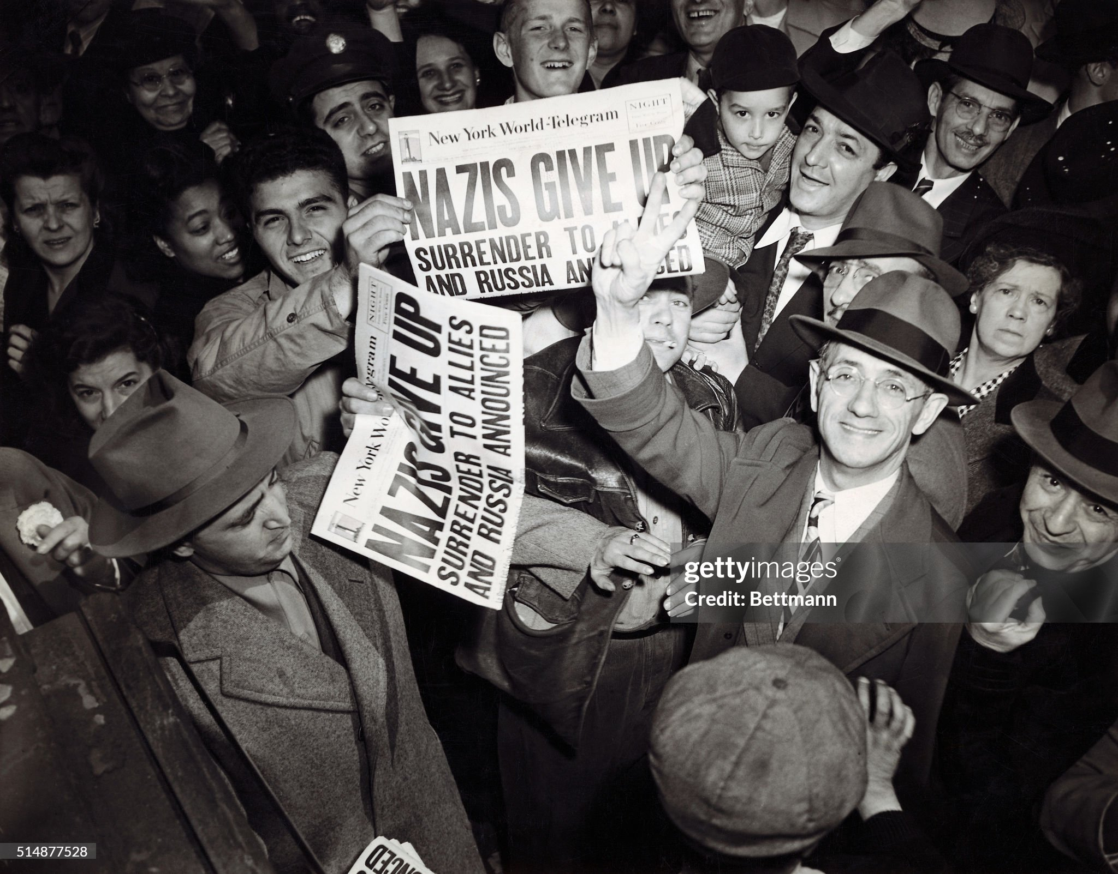

Slide 18
Next Talk: The war in the Pacific

