Slide 1
Pearl Harbour Aftermath

Slide 2
Military Impact
Japanese secure naval supremacy in Pacific
6 US battleships sunk (4 will be resurfaced), 188 planes lost ---2,800 lives
Open door for Japanese expansion to SE Asia
Invades Hong Kong, Malaya, & Dutch East Indies
Attack US occupied islands Wake Guam,
Land troops on Philippines
British rush battleships Prince of Wales and Repulse to block Japanese
Attack on Malaya

Slide 3
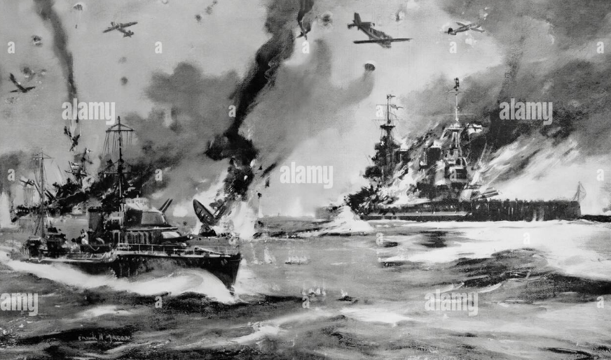
Prince of Wales and Repulse sunk Dec 8
Both sunk by Japanese dive bombers…..British retreat to Indian Ocean
Japan …total dominance in Pacific

Slide 4
Impact on German decision making
Hitler unaware Japanese plan to attack
Believes war with US inevitable
Battle of the Atlantic …US escorts..prevent Germany defeating Britain
US a “non military race and decadent”
US will take too long to mobilize
Convinced victory over USSR imminent (army outside Moscow0
New long range U Boat + 300 plus operational…supremacy imminent
Declares war with Italy on USA December 11th 1941

Slide 5
Strategic Impact
Winston Churchill on news of Pearl Harbour: “So, we had won after all! …We had won the war. England would live; Britain would live; ….How long the war would last or in what fashion it would end no man could tell, nor did I at this moment care. . . . but now we should not be wiped out. Our history would not come to an end. We might not even have to die as individuals. Hitler's fate was sealed. Mussolini's fate was sealed. As for the Japanese, they would be ground to powder.”
Churchill wants alliance with US to prevent defeat of USSR
……….. US focused on Japanese & revenge
…………Invites himself to White House …stays 3 weeks

Slide 6
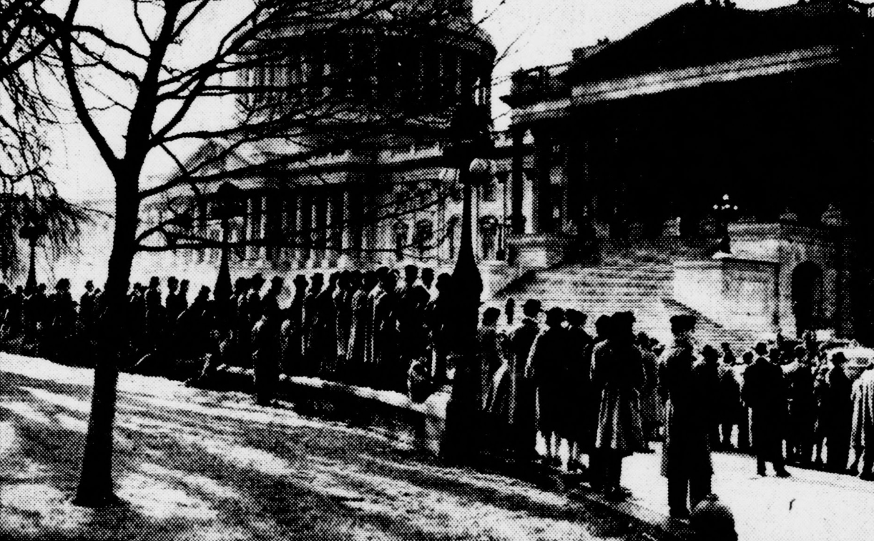
The Christmas Visit…3 weeks in White House
Agree strategy:
(1)Prioritise defeat of Germany
….support USSR
….win battle of Atlantic
….. Open 2nd front. Eventually
(2) ”hold Japan”
….prevent future expansion
….build resources to counter attack
Crowds outside Capital waiting to hear
Churchill address to Congress
Extend offer of alliance to USSR
Peak Britain

Slide 7
Domestic Impact
USA united, isolationists demolished
FDR “Fireside Chat”….”Day that will live in infamy”
97% US public support war with Japan
90% support war vs Germany and Italy…Germany co conspirator
US economy shift to mass mobilisation
All mechanisms and institutions in play (New Deal + Rearmament)
Budget restraints removed
Mobilisation of people resources accelerated
Mass volunteer to join Navy to get revenge
Army…harder sell

Slide 8
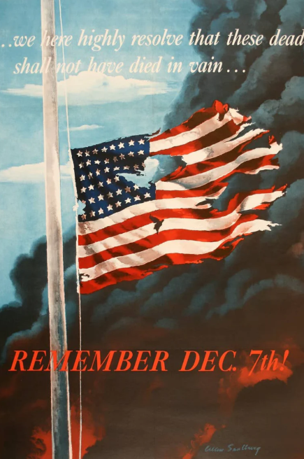

Slide 9
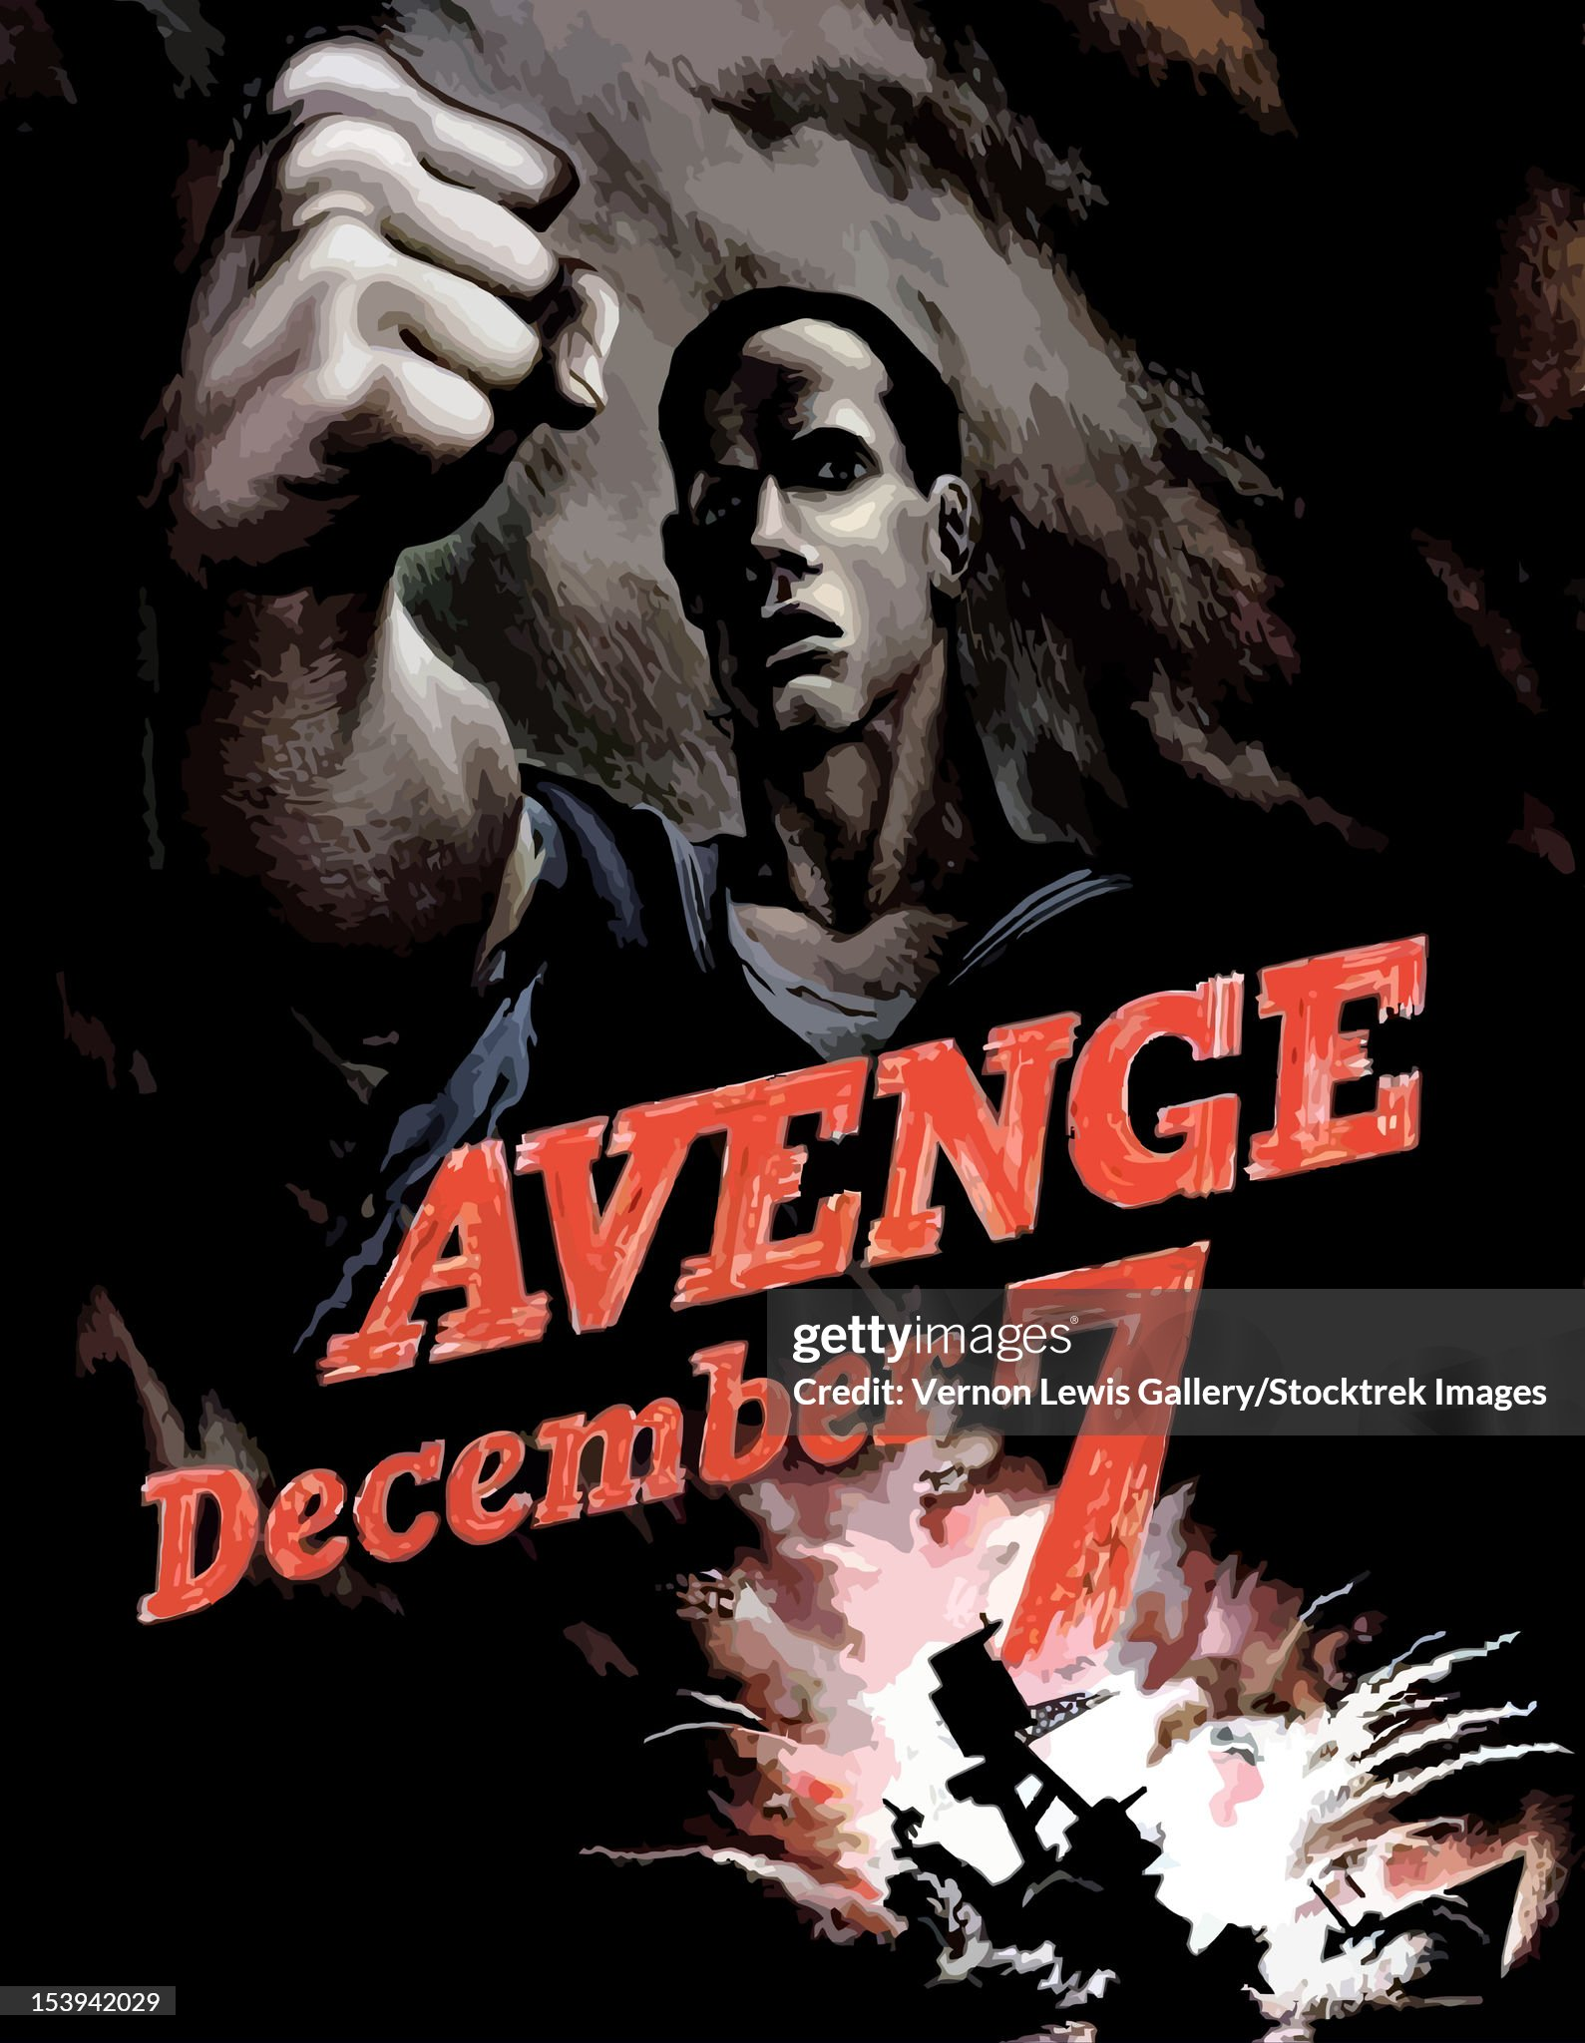

Slide 10
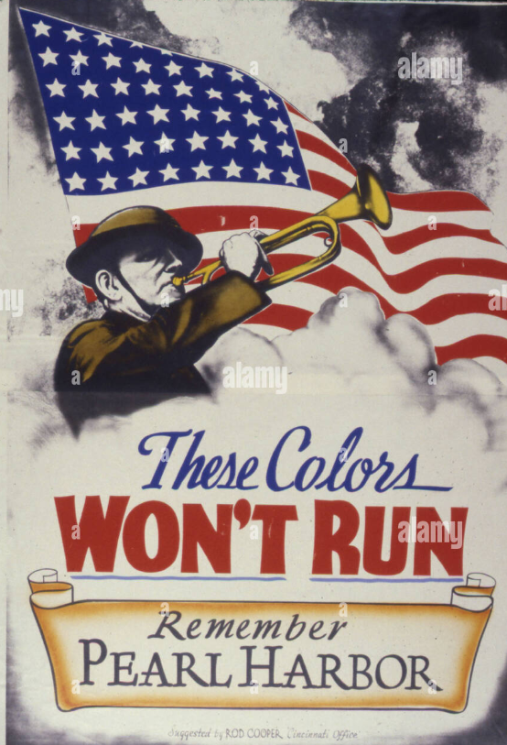

Slide 11
US Home Front 1941-1945: .. Money, people, behaviour,

Slide 12
War financed by economic growth increases in debt and taxation
Economy doubles
In size as US rearms
and delivers aid
Rearmament
Starts
US Joins
WW2
Debt increase from 30%
To 111% of GDP
….from $33BN TO $210bn
,,, 800%!
Bn$
Interest rates pegged at
1.7% ..supported by high
Rates of taxation

Slide 13
War taxation
Income tax prior to 1940
Paid by 5% Americans
60% rate top marginal rate for highest earners
Income tax during war
40% paying income tax war end due to lower thresholds
Top marginal rate increased to 94%
“Victory Tax” added 1944
Tax Yield increases from $,2Bn 1949 to $35Bn 1945

Slide 14
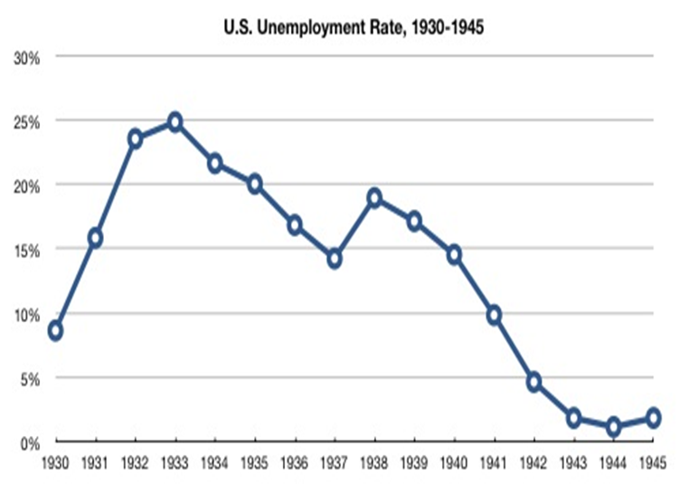
Unemployment disappears…..for 30 years
Second
New Deal
Rearmament
starts
First
New Deal

Slide 15
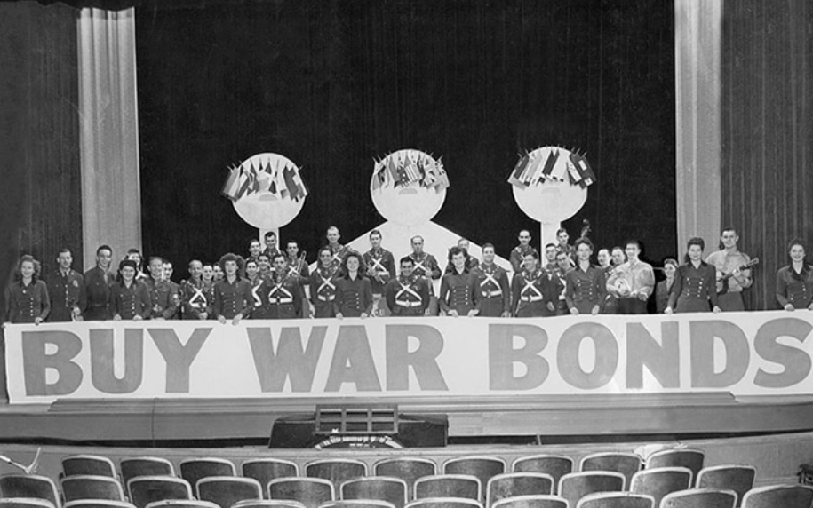
Bond Drives boosts debt…

Slide 16
Cartoons….don’t consume…invest

Slide 17
US economic capacity takes off

Slide 18
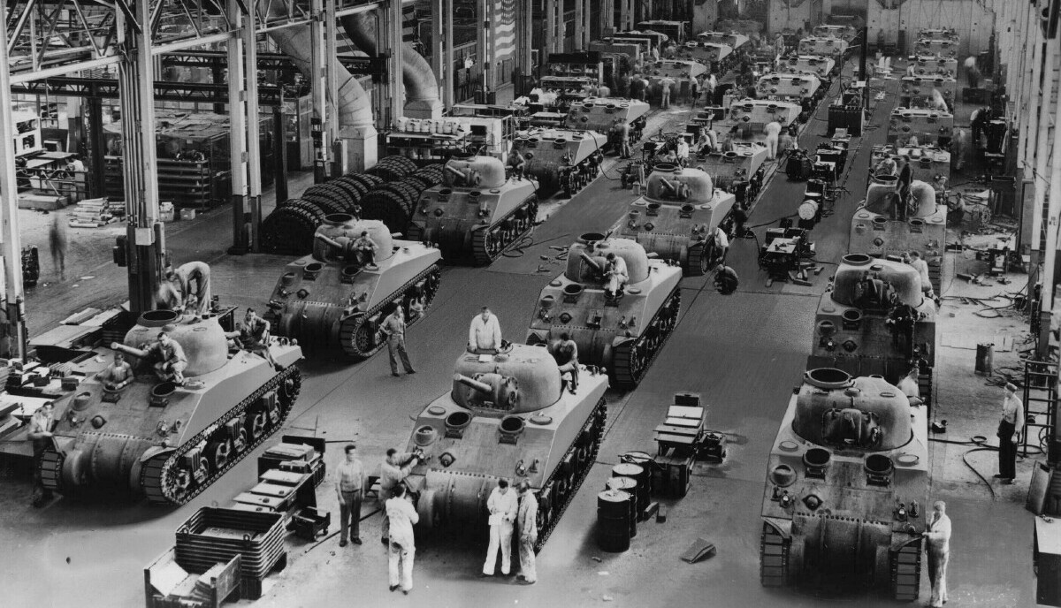
Sherman tanks: 50,000 made 1940-45

Slide 19
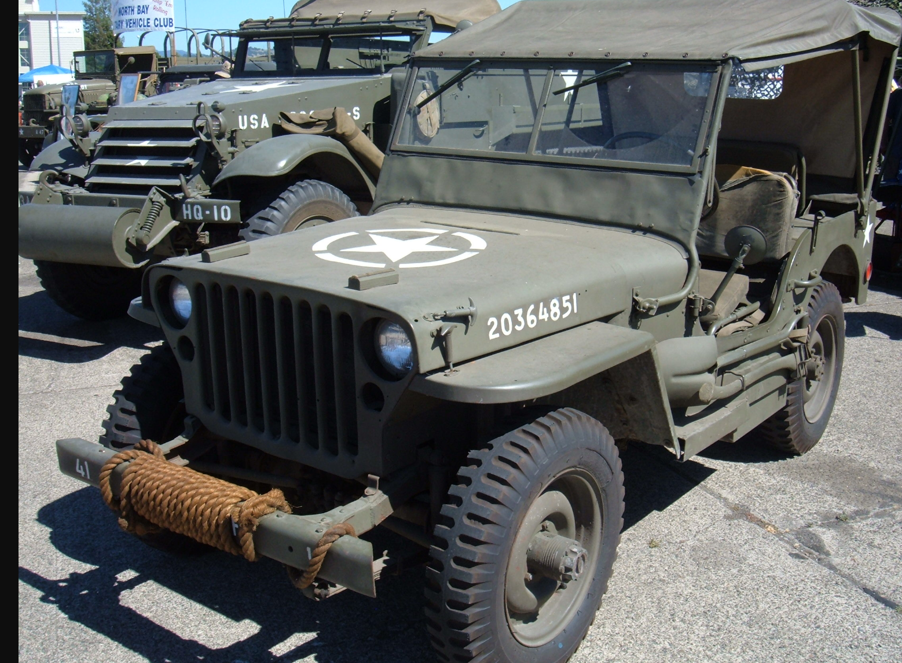
Willys MB Ford Jeep: 640,000 made …75,000 given to USSR (total German production 50,000)

Slide 20
Douglas Aircraft

Slide 21
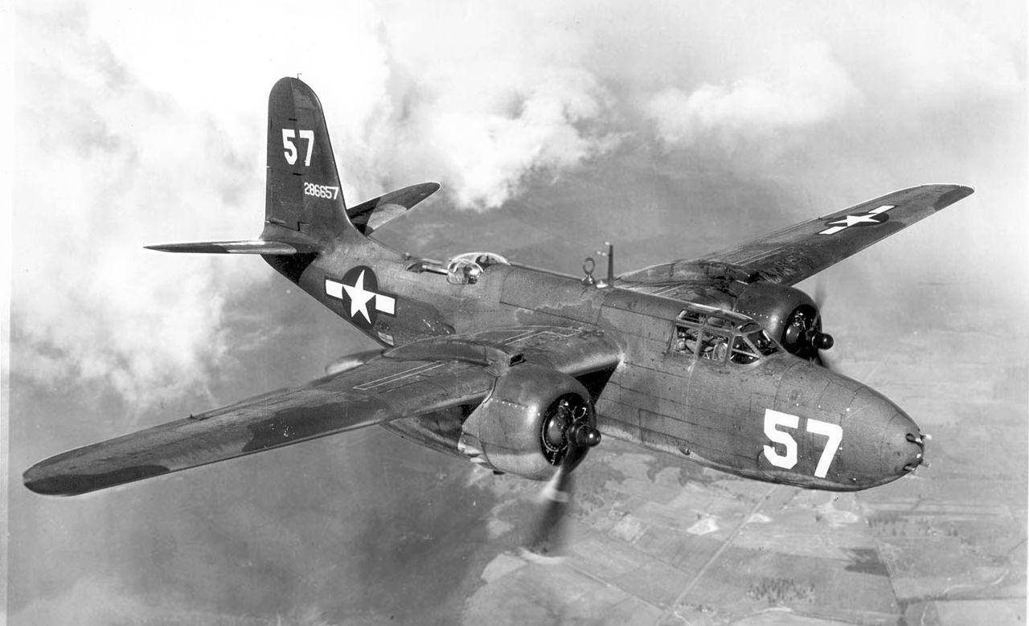
Douglas Aircraft

Slide 22
US ..the logistics giant: 50% more than all Axis combined … quality, quantity improves throughout war
Aircraft Production 1941-1945
 | USA | USSR | UK | Total
Bombers | 97 | 65 | 24 | 186
Fighters | 99 | 27 | 55 | 181
Transports | 30 | 7 | 6 | 43
Total | 226 | 99 | 85 | 410
Allies
` | Germany | Italy | Japan | Total
Bombers | 18 | 6 | 38 | 62
Fighters | 74 | 3 | 15 | 92
Transports | 5 | 1 | 5 | 11
Total | 97 | 10 | 58 | 165
Axis

Slide 23
Government funded Propaganda

Slide 24
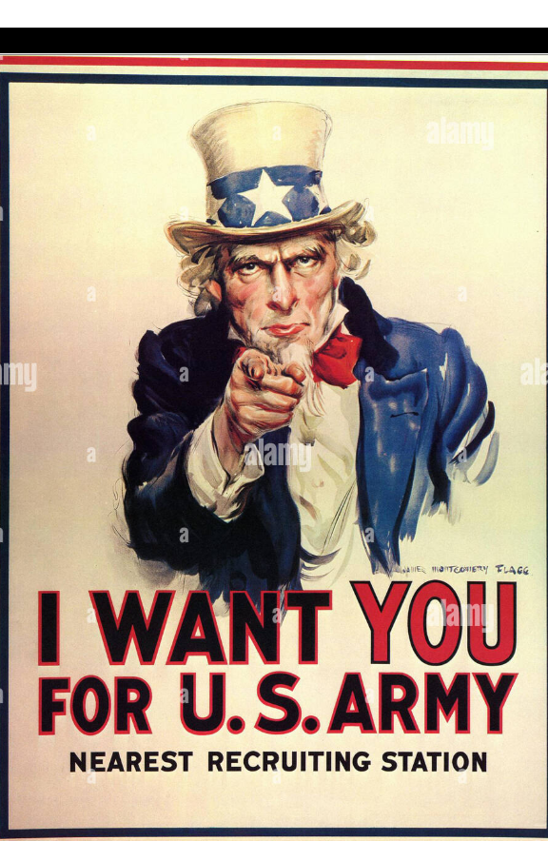
Appeal to Recruits

Slide 25
Appeal extends to women to join army

Slide 26
Persuading women to join workforce …rise from 20% to 30% employed by 1945

Slide 27
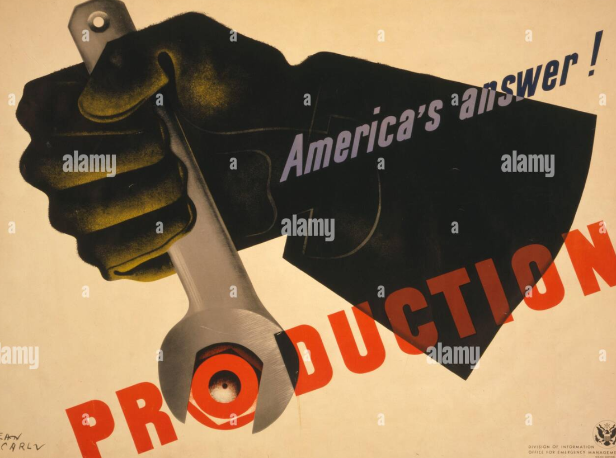
Central planning turbo-charged ….Alliance Government. “cartels” and unions

Slide 28
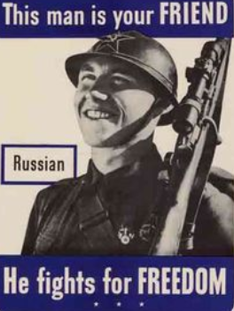
Russia transformed from threat to ally

Slide 29
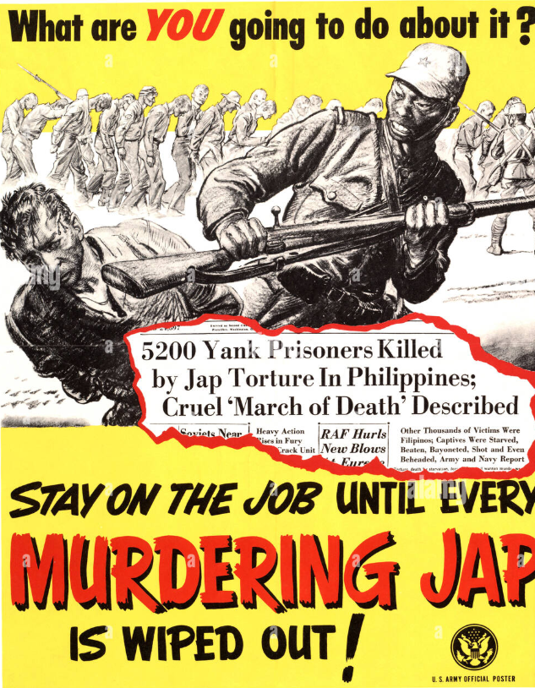
Rise war fever….racism vs Japanese

Slide 30
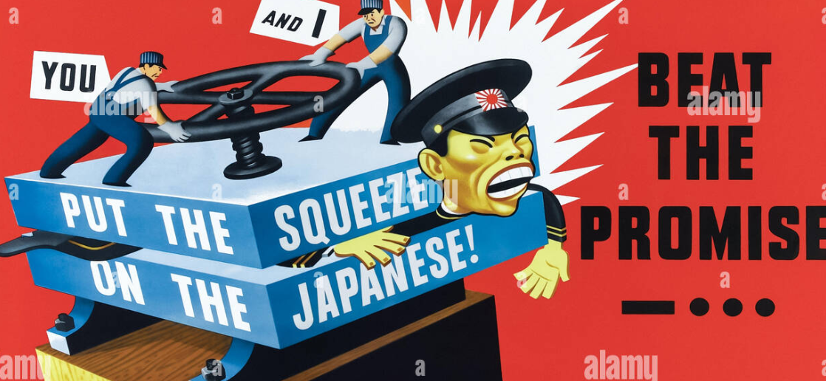
Appeal to labour unions …using racist cartoons……highly effective

Slide 31
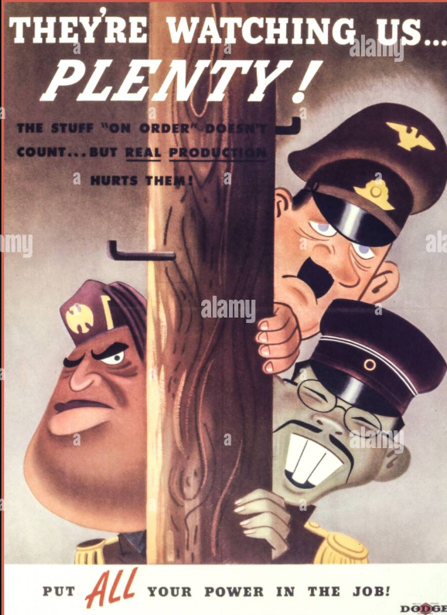
Axis….easy to demonise?

