Slide 1
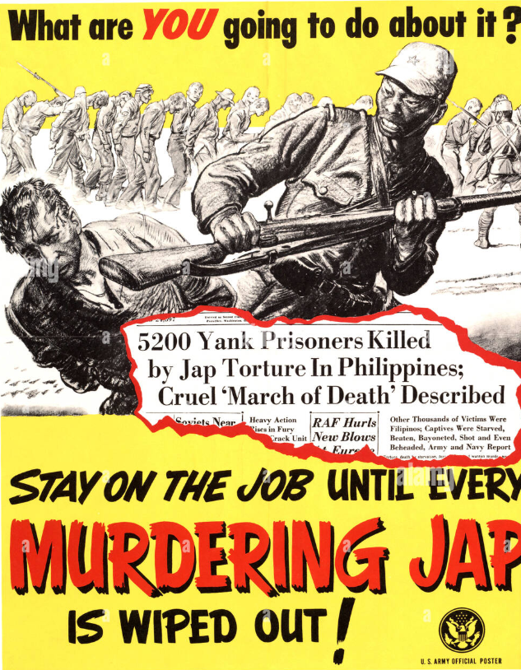
Rise war fever….racism vs Japanese

Slide 2
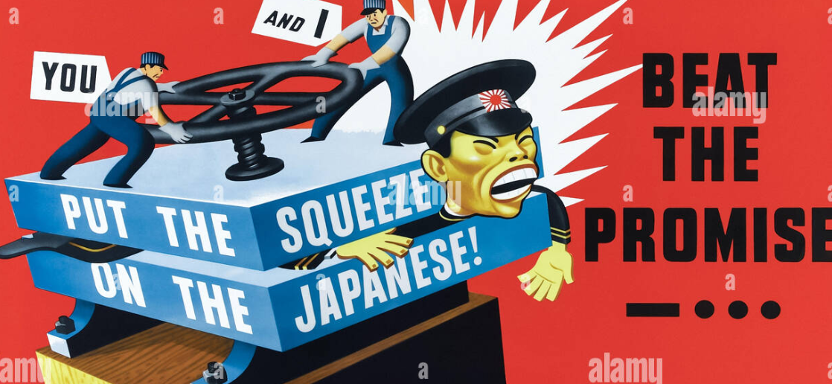
Appeal to labour unions …using racist cartoons……highly effective

Slide 3
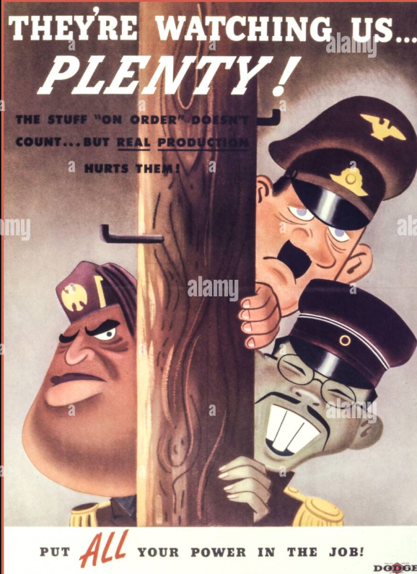
Axis….easy to demonise?

Slide 4
Changing behaviour

Slide 5
The US problem: match massive new demands with limited resources
Constraints
Negative publicity vs WW1 restrictions
“Freedom” central to US politics.. Need positive messages
FDR “Office of Price Administration” (New Deal) sets policy Rationing
Food …needed for army, British and European allies
Rubber…Japanese seize in Malaya….US not yet oil superpower
Vehicles: stop civilian production 1942
Propaganda. High level of Trust ensures high level of compliance

Slide 6
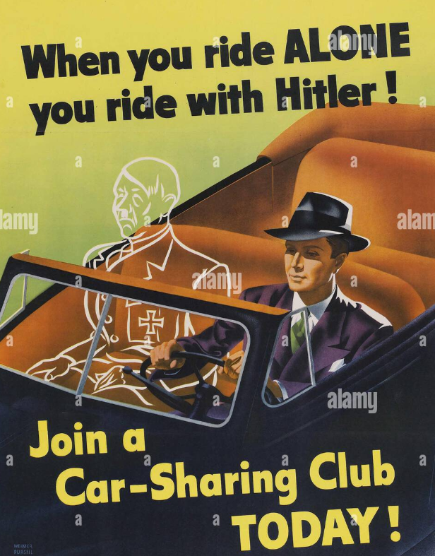

Slide 7
Rationing….the problem rubber, not oil

Slide 8
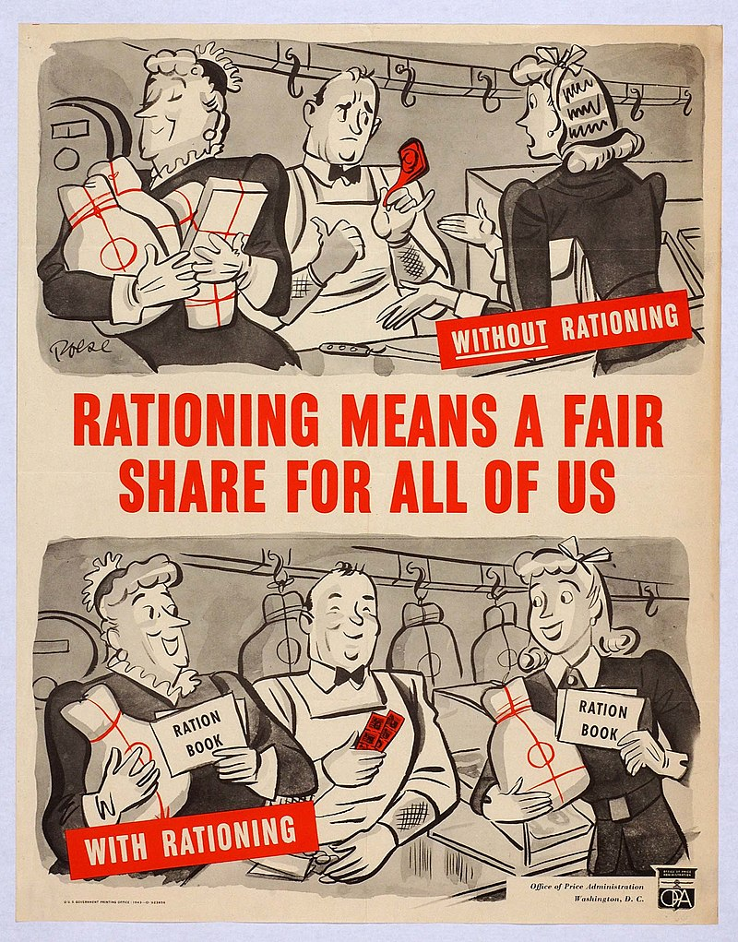
Positive propaganda….New Deal legacy

Slide 9
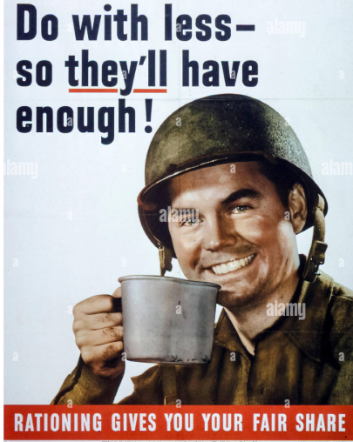
Positive advertising

Slide 10
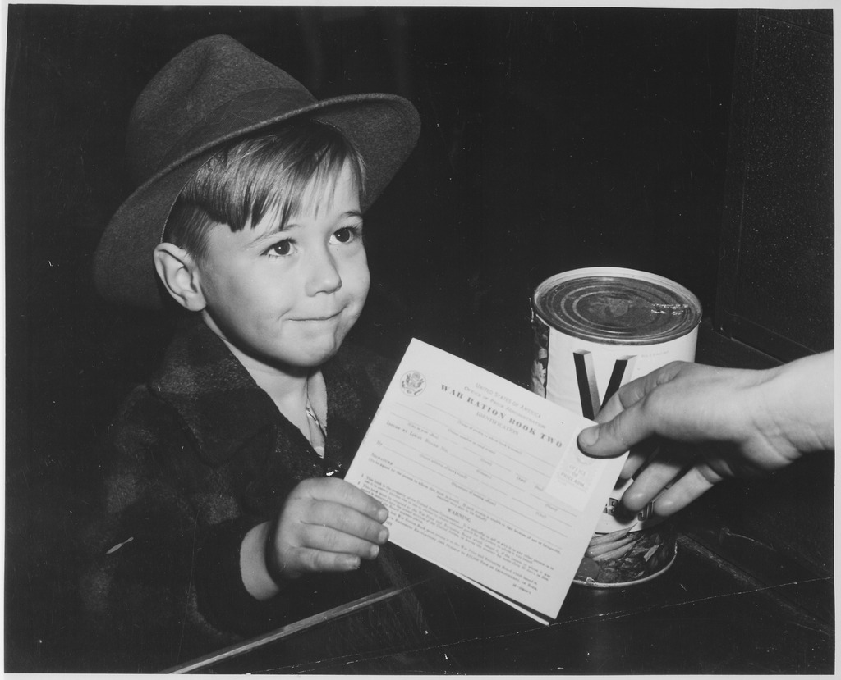
Coupon book ---right to purchase

Slide 11
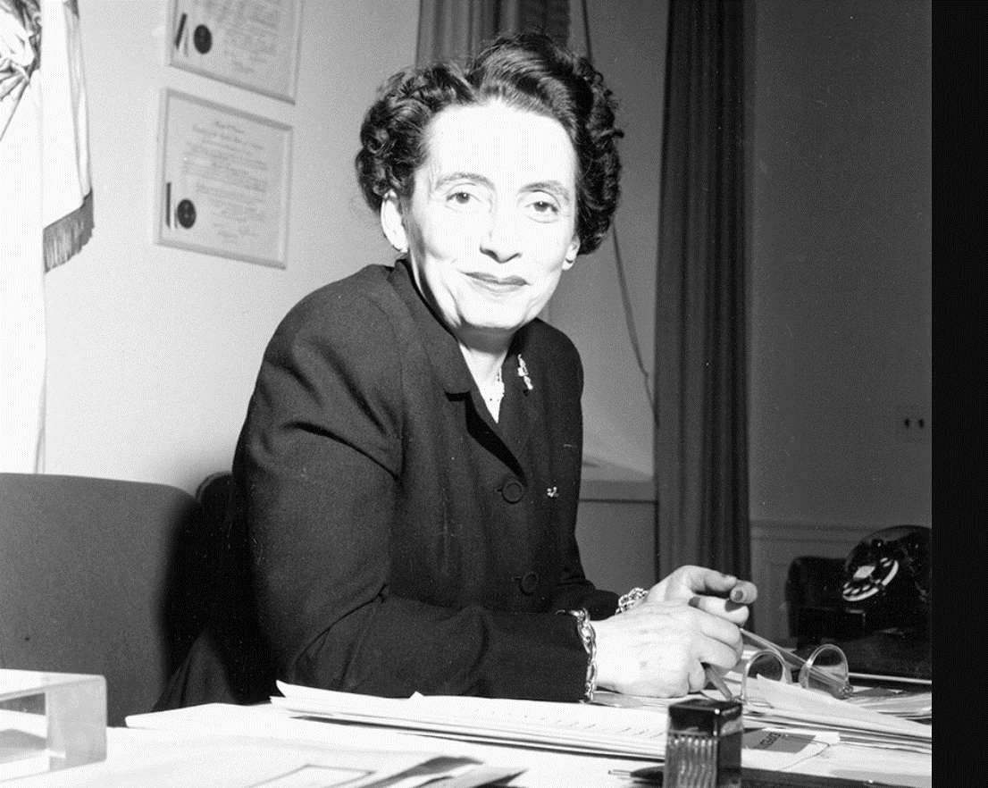
Anna Rosenberg
FDR wants to avoid
“Bonus” Army issue
From WW1 …send Anna
Rosenberg to interview
soldiers
Hungarian immigrant
Student organiser at
High school….works for
FDR election….New Deal
agencies
Tours army camps.
….men want Education
…access to professional
world

Slide 12
You join the armed forces…we will take care of you…GI Bill 1944
Education
grants
up to 4 years
One year basic
income
Discount
mortgages
Yes
…Whites Only

Slide 13
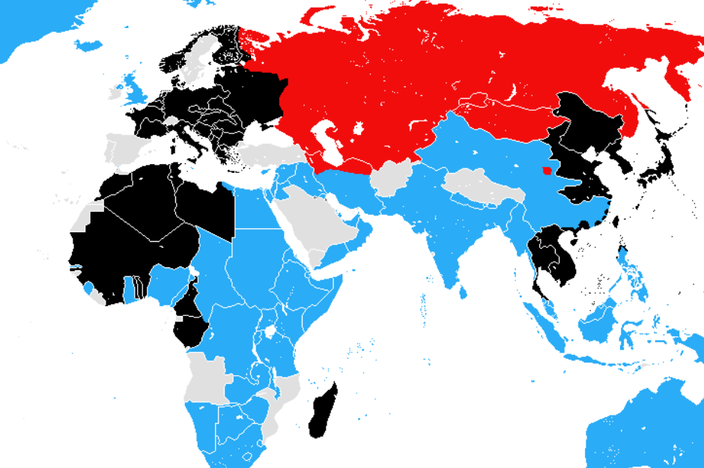
World at War…. 1941
British destroy
Italian Army in Ethiopia, 140,000 prisoners
1
2
April. May Germany
/Italy Invade SE Europe
4
2
5
..British destroy Italian invasion of Egypt 150,000 prisoners
..German reinforce
…Stalemate
6
3
3
1
4
3m Germans Invade USSR
5
Japan Vs China
(KMT & CCP ‘united
…stalemate’
Japan attacks
Hawaii, HK, Malaya Philippines,
6

Slide 14
USA end 1941
United by economic class and race
Mobilising fast and massively
1940 – 485,000
1941- 1,800,000
1942- 3,915,000
1943- 9,195,000
1944 – 11.700,000
1945 –12, 200,0000
Totally committed and confident of victory

Slide 15
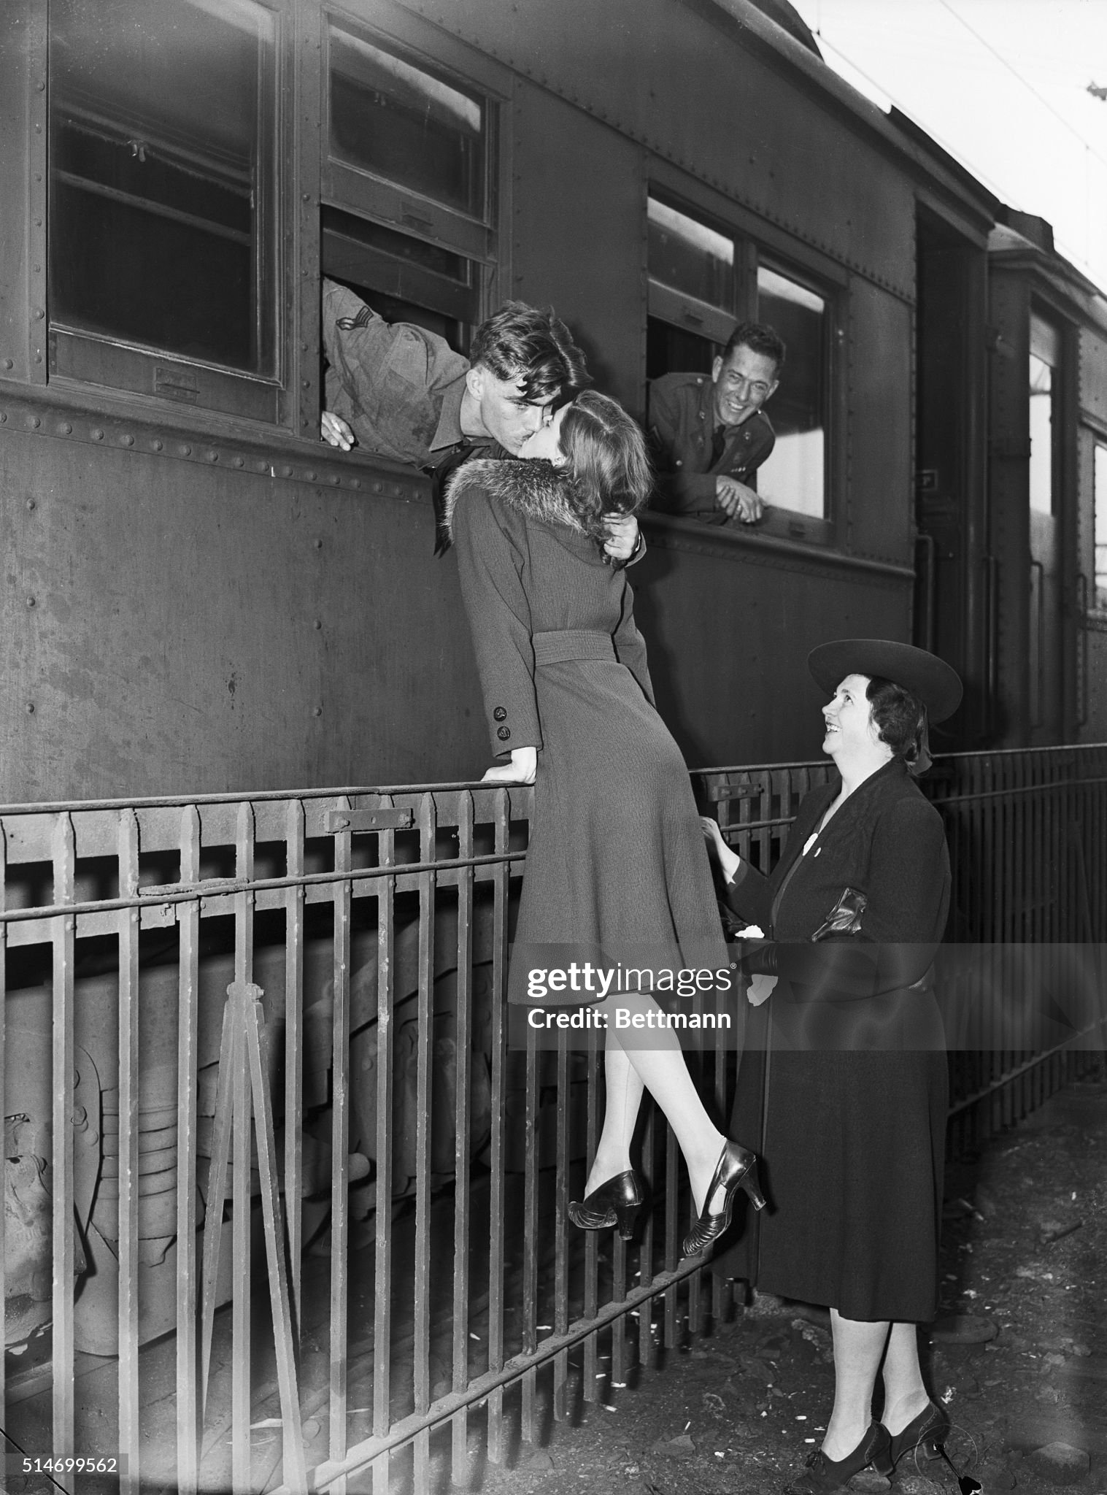
Time for Goodbyes

Slide 16
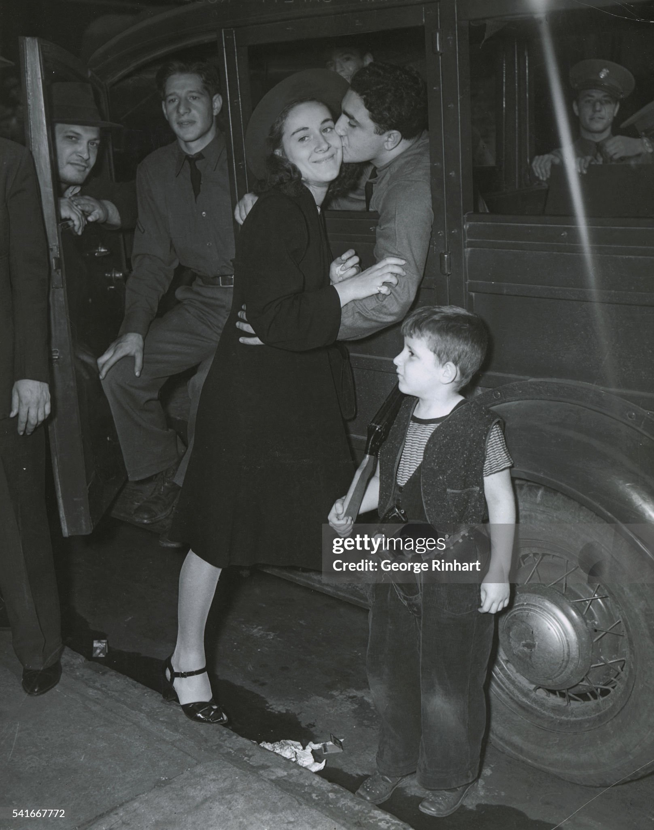

Slide 17
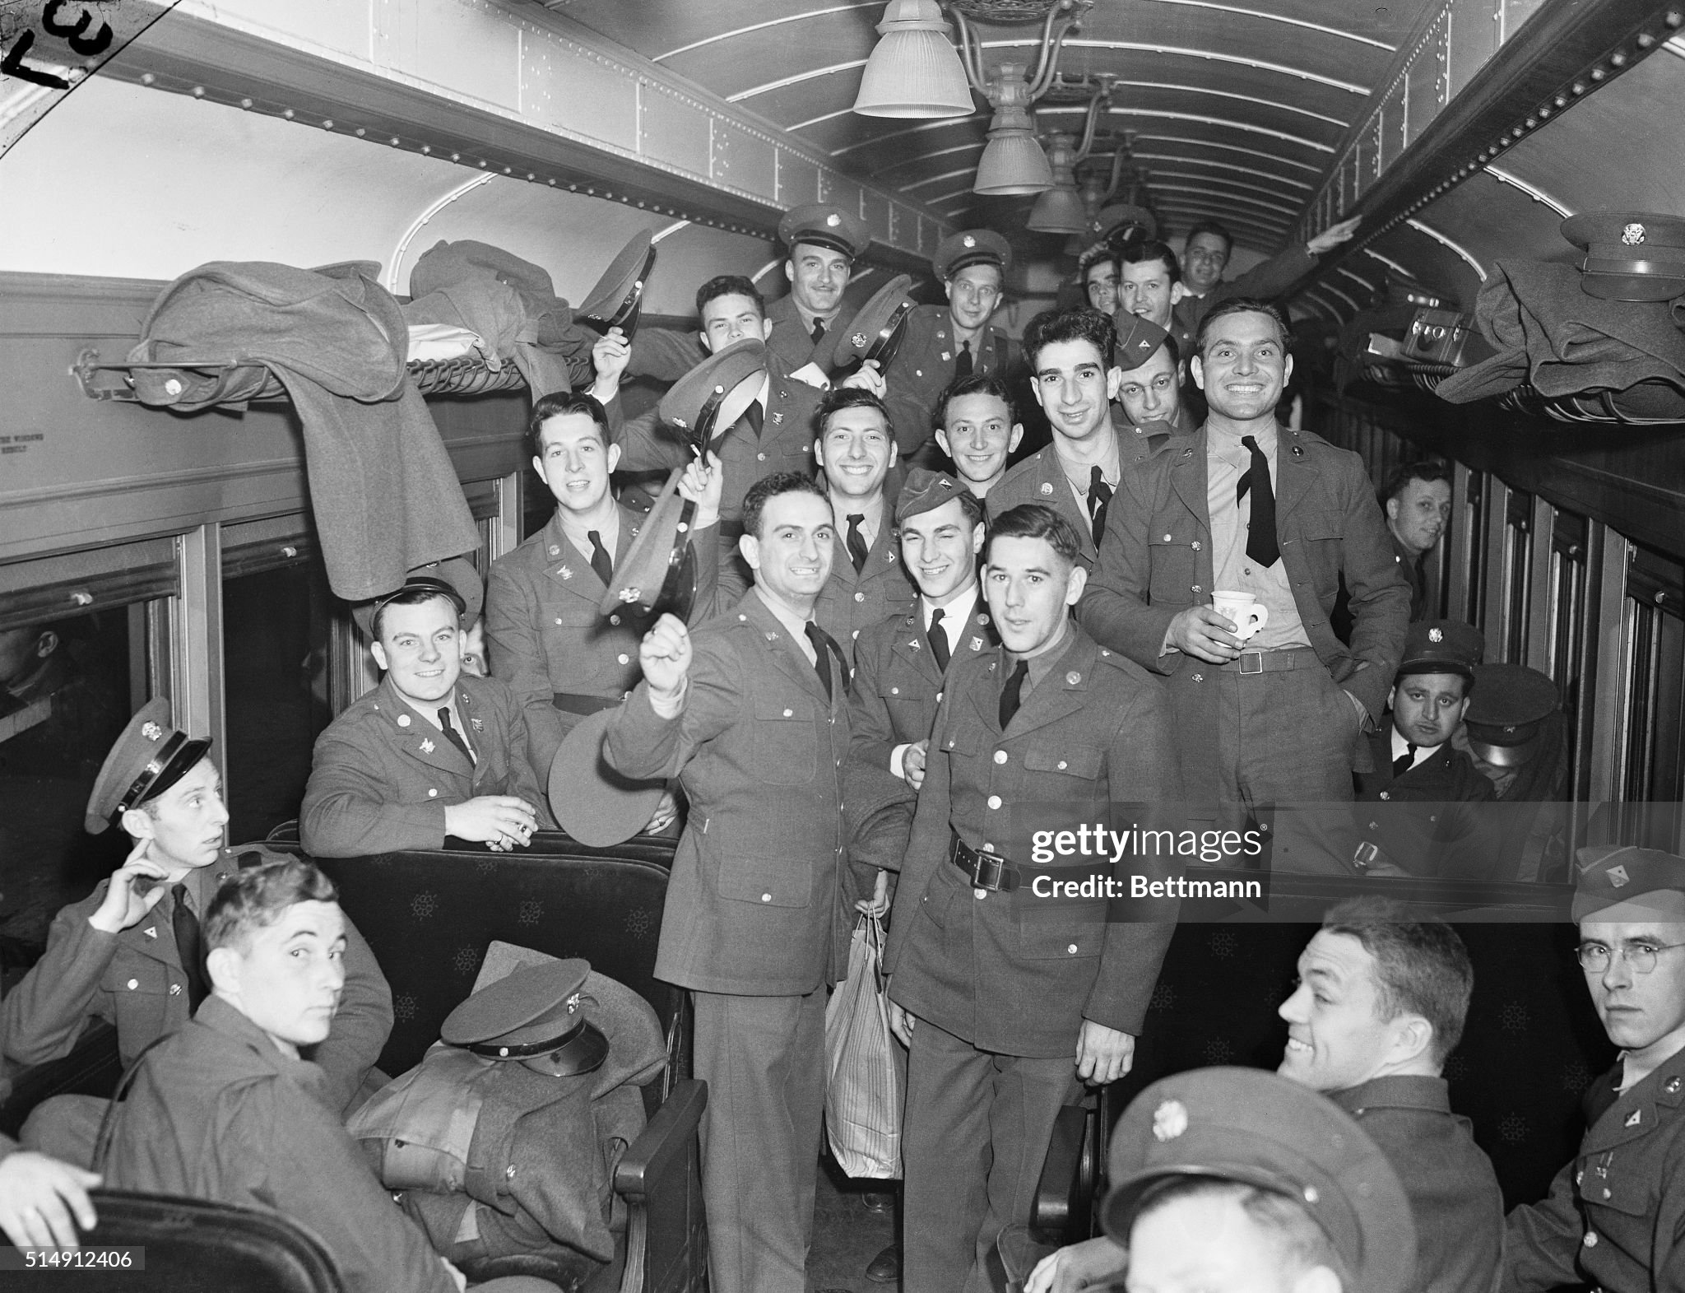
On the way to war

Slide 18
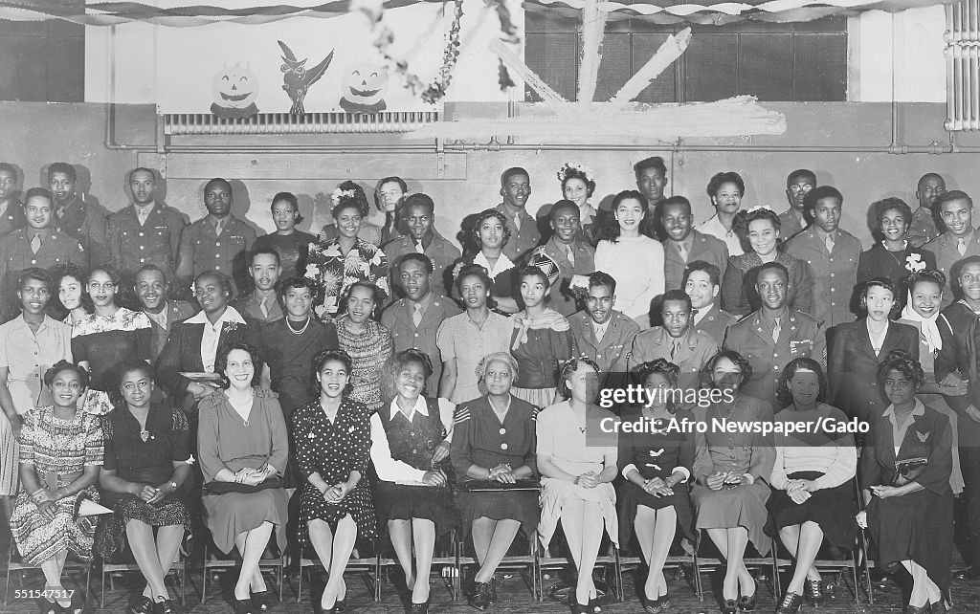
The day before leaving

Slide 19
WE'LL MEET AGAIN 201
(Vera Lynn)
We'll meet again Don't know where Don't know when But I know we'll meet again some sunny day
Keep smiling through Just like you always do Till the blue skies drive the dark clouds far away So will you please say "Hello" To the folks that I know Tell them I won't be long They'll be happy to know That as you saw me go I was singing this song We'll meet again Don't know where Don't know when But I know we'll meet again some sunny day

Slide 20
Next Talk: The War in Europe

