Slide 1
American History
1
Talk 29: USA and the 1930’s world

Slide 2
USA and the 1930’s world
USA and its neighbours
Rise of the Totalitarians
USSR
Fascist Italy
…..Intermission
Nazi Germany
Imperial Japan
US and world situation 1939

Slide 3
USA and its neighbours

Slide 4
World 1938
 | GDP ($1990) | Population
USA | $800Bn | 130m
USSR | $359Bn | 167m
Germany | $351Bn | 69m
China | $320Bn | 411m
British Empire | $284Bn | 454m
United Kingdom | $280Bn | 48m
France | $185Bn | 42m
Japan | $169Bn | 72m
Italy | $100Bn | 42m
USA already world’s largest economy
….despite Depression
USSR ..rapid growth under Stalin
…5 year plan
…forced labour/ gulags…Terror
Germany ….rapid growth
…War economy
…Debt financed…war economy
Japan nearly as large as France
Britain a declining power
…industrial power shift to US Germany
…Financial power has shifted to USA

Slide 5
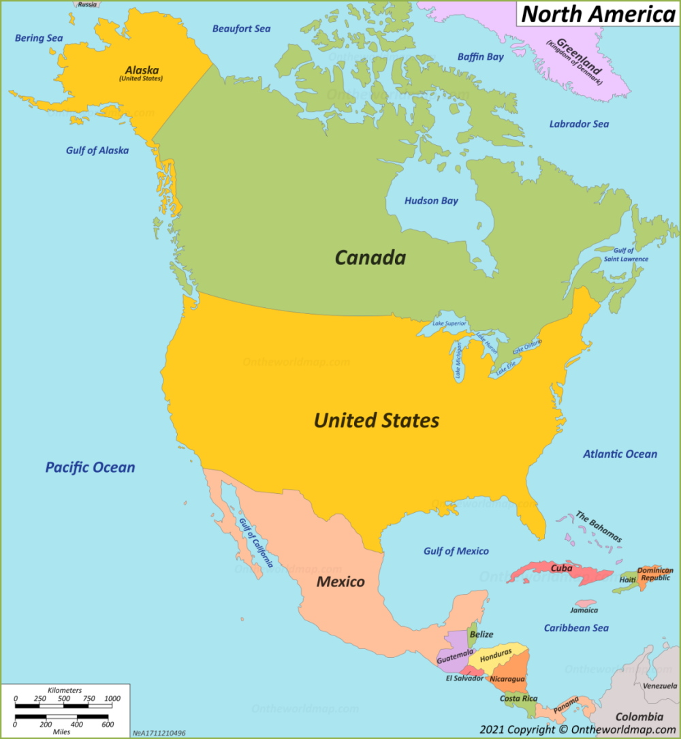
USA and its neighbours
Economies 1940
 | Pop ml | GDP p/p()
USA | 132m | $11,000
Canada | 11m | $9,000
Mexico | 20m | $750
Canada independent from
Britain Statute of Westminster 1931
Mexico …violent 1920, stable 1930’s
Caribbean/ South America
….No significant colonial presence
…Cuba “client state”
…South American, independent
States, poor, unstable, regional

Slide 6
Canada 1920-1940
Canada in the 19th Century
Accommodation achieved between French and English speakers
Constitutional Federal Government established 1867
British control foreign policy/Canada Parliament domestic policy
Economy integrates with USA: 90% population within 50 miles of border
The Independent Nation
British ally throughout WW1
Haven for bootleggers 1920’s
1931 – Statute of Westminster. Full independence
Depression impact as US…25% unemployment, GDP down 50%
Democratic, affluent, integrated with US economy

Slide 7
Mexico 1920’s
Mexico post Revolution 1920-1926
Military leaders Stabilise government power and centralise control
..Revolutionary military leaders take control
Enforce Constitution of 1917
President Calles 1924
Secularise Mexican Society
Land reform. State seizure of land…from land owners….and church
Supress church…create secular state
Priests to be licensed and banned from teaching, gov teachers
Government seize Catholic land, big estates cooperatives
Los Cristeros War (Supporters of Christ) 1924-1929.
….revolt across central Mexico/,,city vs country, centre vs periphery state vs church

Slide 8
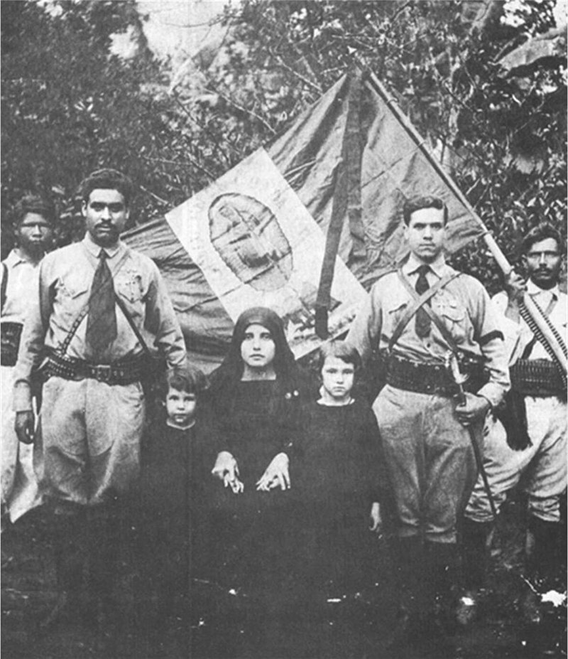
Catholic Revolt:alliance church/peasants/landowners

Slide 9
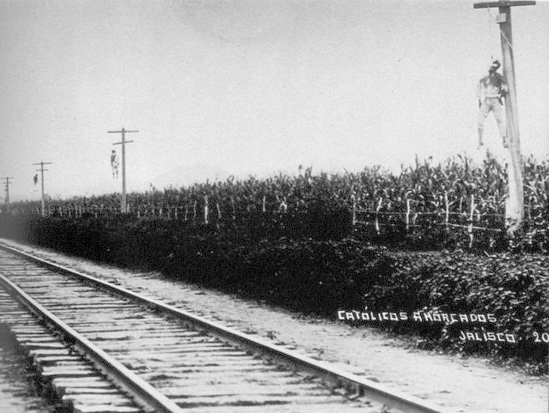
Teachers murdered, priests shot, peasant hanged

Slide 10
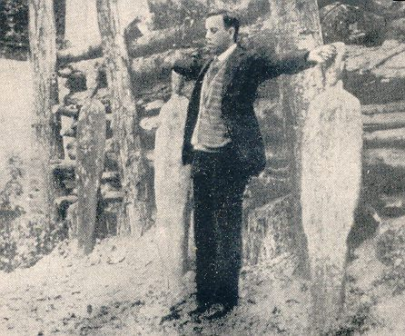
Execution of Catholic Priests…martyrs

Slide 11
Achieving stability
Fedarales crush Cristeros armies 1928,…guerrilla war
Change in regime
Calles cannot be re-elected
Handpicked Successor assassinated by Catholic and new
Replacement seeks to end conflict & accommodate Church
Agreement between Church and State 1929
US concerned interruption of oil US & mediate
Knights of Columbus ..support Catholic
Most Anti Catholic rules stay……but not enforced
100,000 deaths….250,000 plus Mexicans flee to USA
…ongoing conflict 1930/s….500 Federal teachers murdered

Slide 12
Mexico and US 1930’s
Emigration to US halted by Border controls…..Repatriation
Mexican government cooperates
Promises of land and reintegration not met
Foreigners in US and in Mexico
Mexican President Cardenas power 1934
Focus on nationalising industry, dealing with Depression
Stabilise government…One Party Rule with “rigged elections”
Accommodates Catholics/ good relations with US
Nationalised oil industry 1935…seize US assets
.. …………US “Good Neighbour Policy” averts conflict, deal made…..

Slide 13
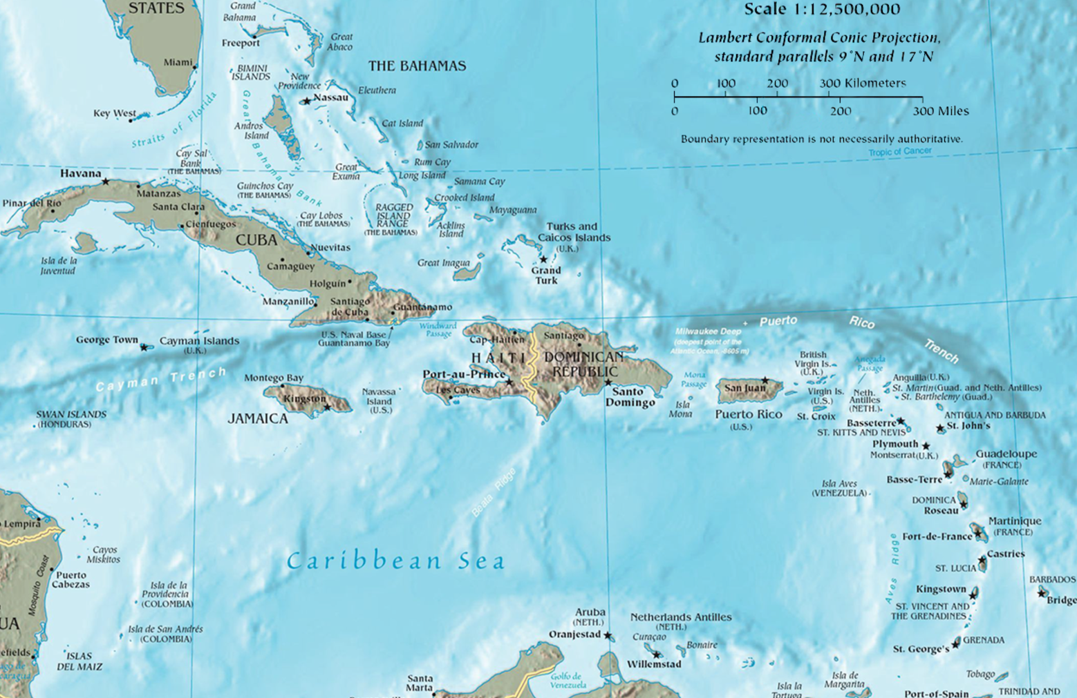
Caribbean 1920’s
Roosevelt (Teddy) Corollary: Right to intervene as and when
British
US
British
British
French
Dutch

Slide 14
Cuba and Dominica
Cuba
US withdraws 1902 but retains control via Platt Amendment
Military interventions (1912 & 1921) to ensure “right government” in power
US dominates economy
60% Cuban sugar, take 95% Cuba trade replace
Supports coup by General Batista 1933…in control till 1959 (crime + tourist)
Dominica
US controls customs and taxes 1902+
Invades 1915-1924..establishes civil gov
…installs General Trujillo as President…dictator till 1962

Slide 15
The problem of Haiti
Pre World War One
80% budget paid direct to France for freedom/ …unstable governments
Unstable government, corrupt, brutal, unable to fund services
Land, business owned and operated by US and European elite
German elite threaten control/ growing unrest
Invasion and Occupation 1915-1934
US marines land…seize Haitian treasury, move gold to New York
Managed by National Bank of New York
Forced labour programs -150,000 Haitians die from disease. Overwork
Cacos revolt

Slide 16
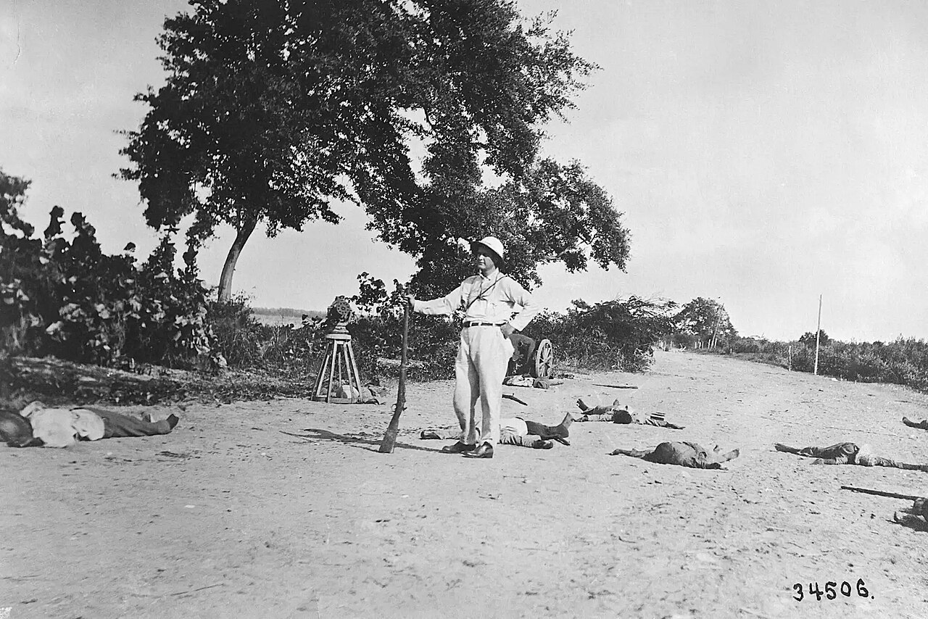
… White Supremacist/ resistance crushed/ military rule

Slide 17
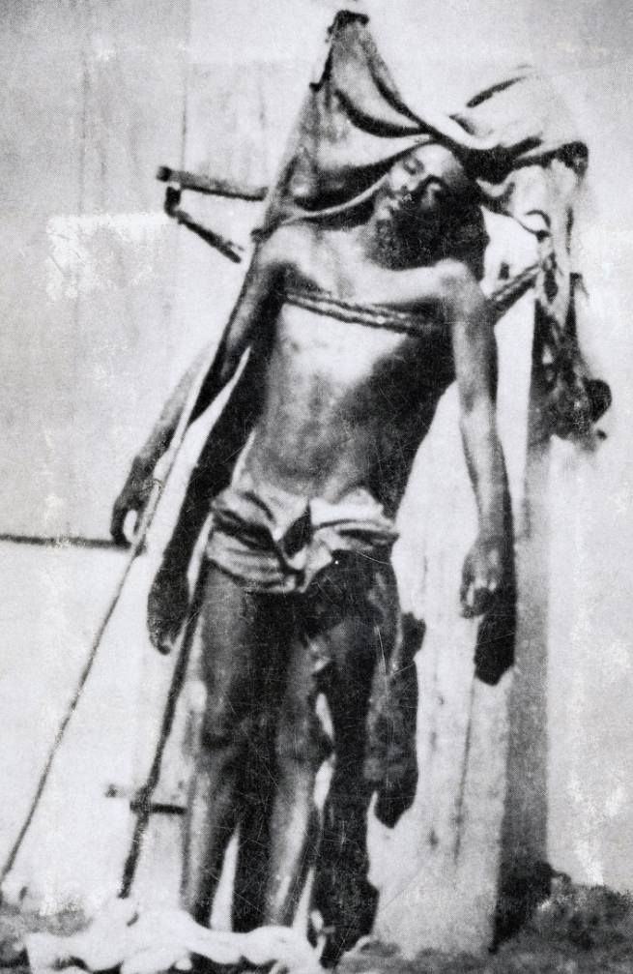
Cacos War
Haitian Nationalist Charlemagne
Peralte leads resistance
…captured 1917/..escapes
Charlemagne Peralte 1919
US increases military presence
….concentration camps
...forced labour
…infrastructure/ schools
…captures and executes Peralte
US distributes picture….symbolic
Crucifixion…..increases revolt
Peaceful demonstration of 1,00
at Lay Cays 1929
Massacred by US marines

Slide 18
A change in policy
Hoover Administration 1928-1932
Commissions investigation of massacre at Lay Cays
Removes National Bank…stops Forced Labour
FDR Administration
Recognises anti US Caribbean a threat `to US
Ends occupation of Haiti…..no institutions left in place
Good will visits to Latin and South America ….No US interventions till Cold War 1945

Slide 19
Good Neighbour Policy
Policies
No US military interventions till Cold War
Good Will visits to South and Central America
Encourages media to change image of Latin Society
Impact
Reduces hostility….secures cooperation during WW2
Trivialises Latin American differences …Central/ South/
Stabilises relations….till Cold War

Slide 20
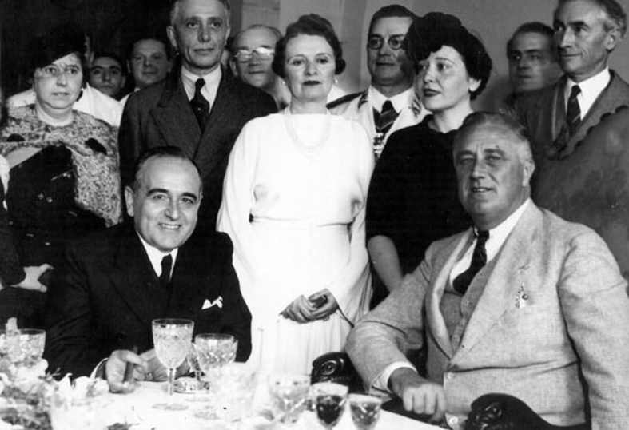
Good Neighbour….meeting as “equals” ….with Brazilian President 1935 ….first and first of many

Slide 21
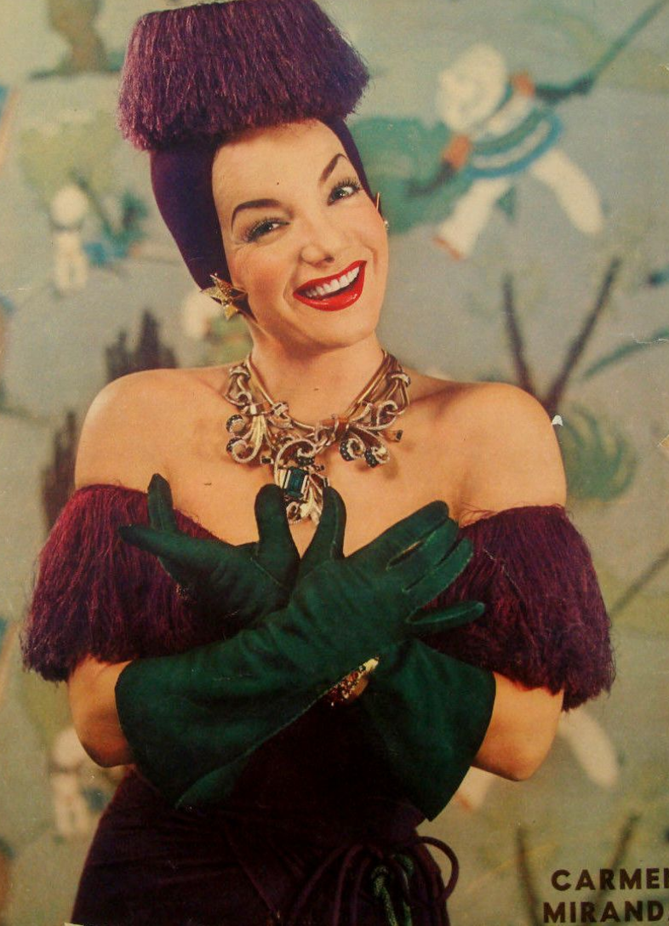
Carmen Miranda
FDR encourages
Favourable portrayal of
“Latins”..reduce stereotype
As dangerous, violent
New stereotype
Movies depict Latin
As “fun”, friendly”, smart
Brazilian singer Carmen
Miranda…to NY 1940
…highest paid star
1940-1945
“Down Argentine Way”
“Streets of Paris”
“That night in Rio”

Slide 22
Rise of Totalitarian regimes in Europe

Slide 23
US and Europe 1920’s
US disengages
Abandons interference with Russia
Refuses to join League of Nations
Reduces trade,
Tariffs increased from 15% to 30% on key goods
Trade shrinks by 60% from 15% to 10% of economy
Focus: Disarmament and Finance
Chairs Disarmament Conferences/ Famine Relief
Loans to Germany to fund reparations/ moderate reparations
Debt collection from Allies

Slide 24
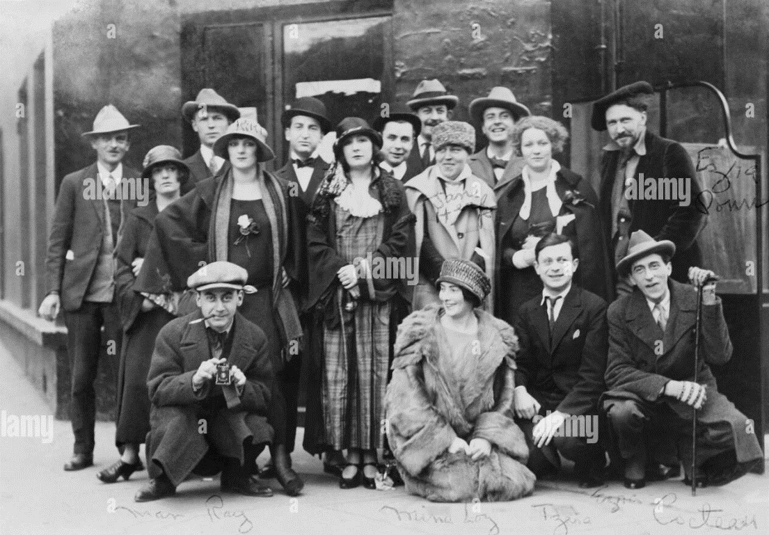
Golden Age of American Tourist
American ex pat artist Paris 1925
Europe as place to go
For wealthy artists
…15,000 prior to 1914
400,000 year 1920’s
Escape from prohibition
Constraints, conformism
…lost generation, disillusioned
….Fitzgerald, Hemingway
Black musicians welcomed
…exotic to French
…shocking to Americans

Slide 25
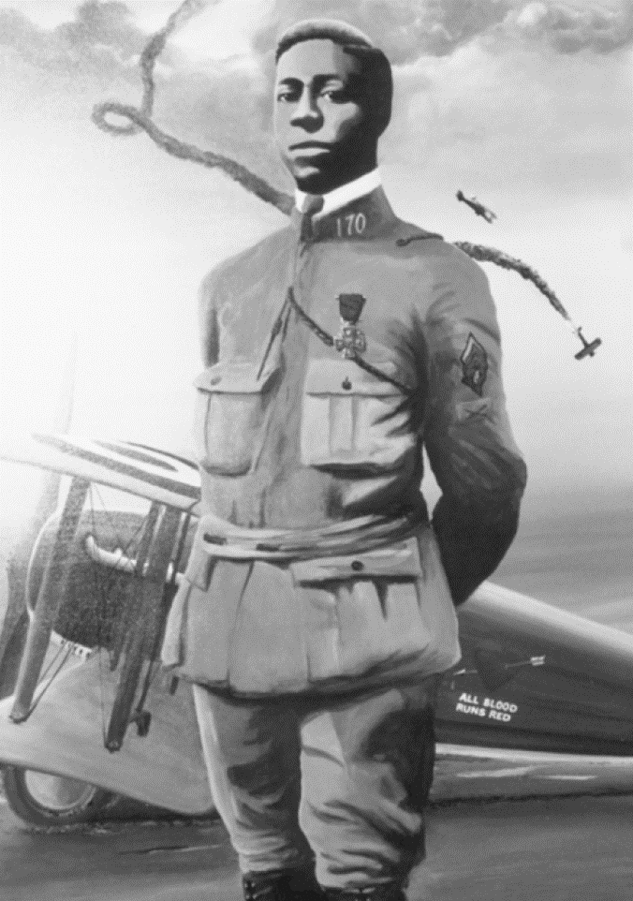
Black Americans in Europe welcomed and thrive
Josephine Baker Paris 1930
Eugene Bollard, American fighter pilot…jazz drummer
Night club entrepreneur

Slide 26
For Americans in 1920’s Europe ….a place to lend money to and escape ….no threat to US prosperity or security ….US isolated, internally focused…”roaring 20’s”
Rise of Totalitarianism in the USSR, Italy and Germany ……make that impossible

Slide 27
USSR

Slide 28
Soviet Union 1920’s
War Communism 1918-1921…defeat of “Whites”
Secure revolution and spread “Proletarian Revolution “ across world
Abolition of private property/Forced labour/ seizure of food
Destruction and murder of upper class Red Terror: killings by quota
The cost of “Victory”
Famine 3-10 million deaths from starvation
Economic collapse. Food reduced 50%, industry 80%
Depopulation of cities (St Petersburg from 2.7m to 750,000)
Loss of “Empire”…Poland, Baltics, Lithuania, loss /recovery Ukraine

Slide 29
New Economic Policy 1921-1928
Lenin …change in policy required to save Revolution
“State Capitalism” introduced
Agriculture and small businesses re-privatized
Stable currency established
State ownership of large manufacturers, railroads
Financed by “shadow banks,” seizure of assets, progressive taxation
Government during NEP
Collective leadership after Lenin’s death 1924 (Stalin & Trotsky)
Goal of achieving world revolution abandoned after defeat by Poland
Limited press/artistic freedom
Destruction of Orthodox Church/seizure property. Exile/execution of priests

Slide 30
“Stalin” (1878-1953)
Joseph Dzhugashvili..1920
Born to poor Georgian family
….seminary school
… socialist, bandit
….committed Bolshevik & writer
Path to “Supreme Leader”
….General Secretary of USSR 1920
…increases control of Police
...discredits rivals at Lenin’s death
…controls promotions
…achieves leadership 1928
…removes all opposition
Committed communist & nationalist
…supresses minorities
…”make Russia great again”
… “100 years behind the west”

Slide 31
Stalin and 5 year plans
Greatness to be achieved by industrialisation
Total state ownership of all industry
Enforced collectivization of agriculture
Deliberately unachievable plans….500% increase in industrial output ….Constant replacement of the “failed”/ hire…then blame foreigners
Management techniques
Plans deliberately unachievable. Failures due to foreigners/ traitors
Forced labour, Gulags, use of Terror
Compulsory savings

Slide 32
Impact: Soviet Union: 2nd largest economy 1940
 | 1914 | 1940
Steel (Million Tons) | 4 | 18
Coal (Million Tons) | 29 | 166
Oil | 10 | 31
% industrial workers | 10% | 45%
Minimal increase in agriculture automation offset by collectivization
 | 1914 | 1940
Wheat (million tons) | 36 | 39
Agricultural workforce | 80% | 40%
Population
140m
160m

Slide 33
Cost of 5 Year Plan
Collectivisation 1928-1933 Holodomor Ukraine ---3 -7 million deaths
Forced Labour Gulags 1928-1950
18 million sent to camps for forced labour
2 million deaths
Great Terror 1938/1940..800,000 shot, ( including Bolshevik leadership)
Costs hidden by effective Propaganda
……Western Socialists view USSR and 5 year plan great success
……..Stalin as visionary man of the future

Slide 34
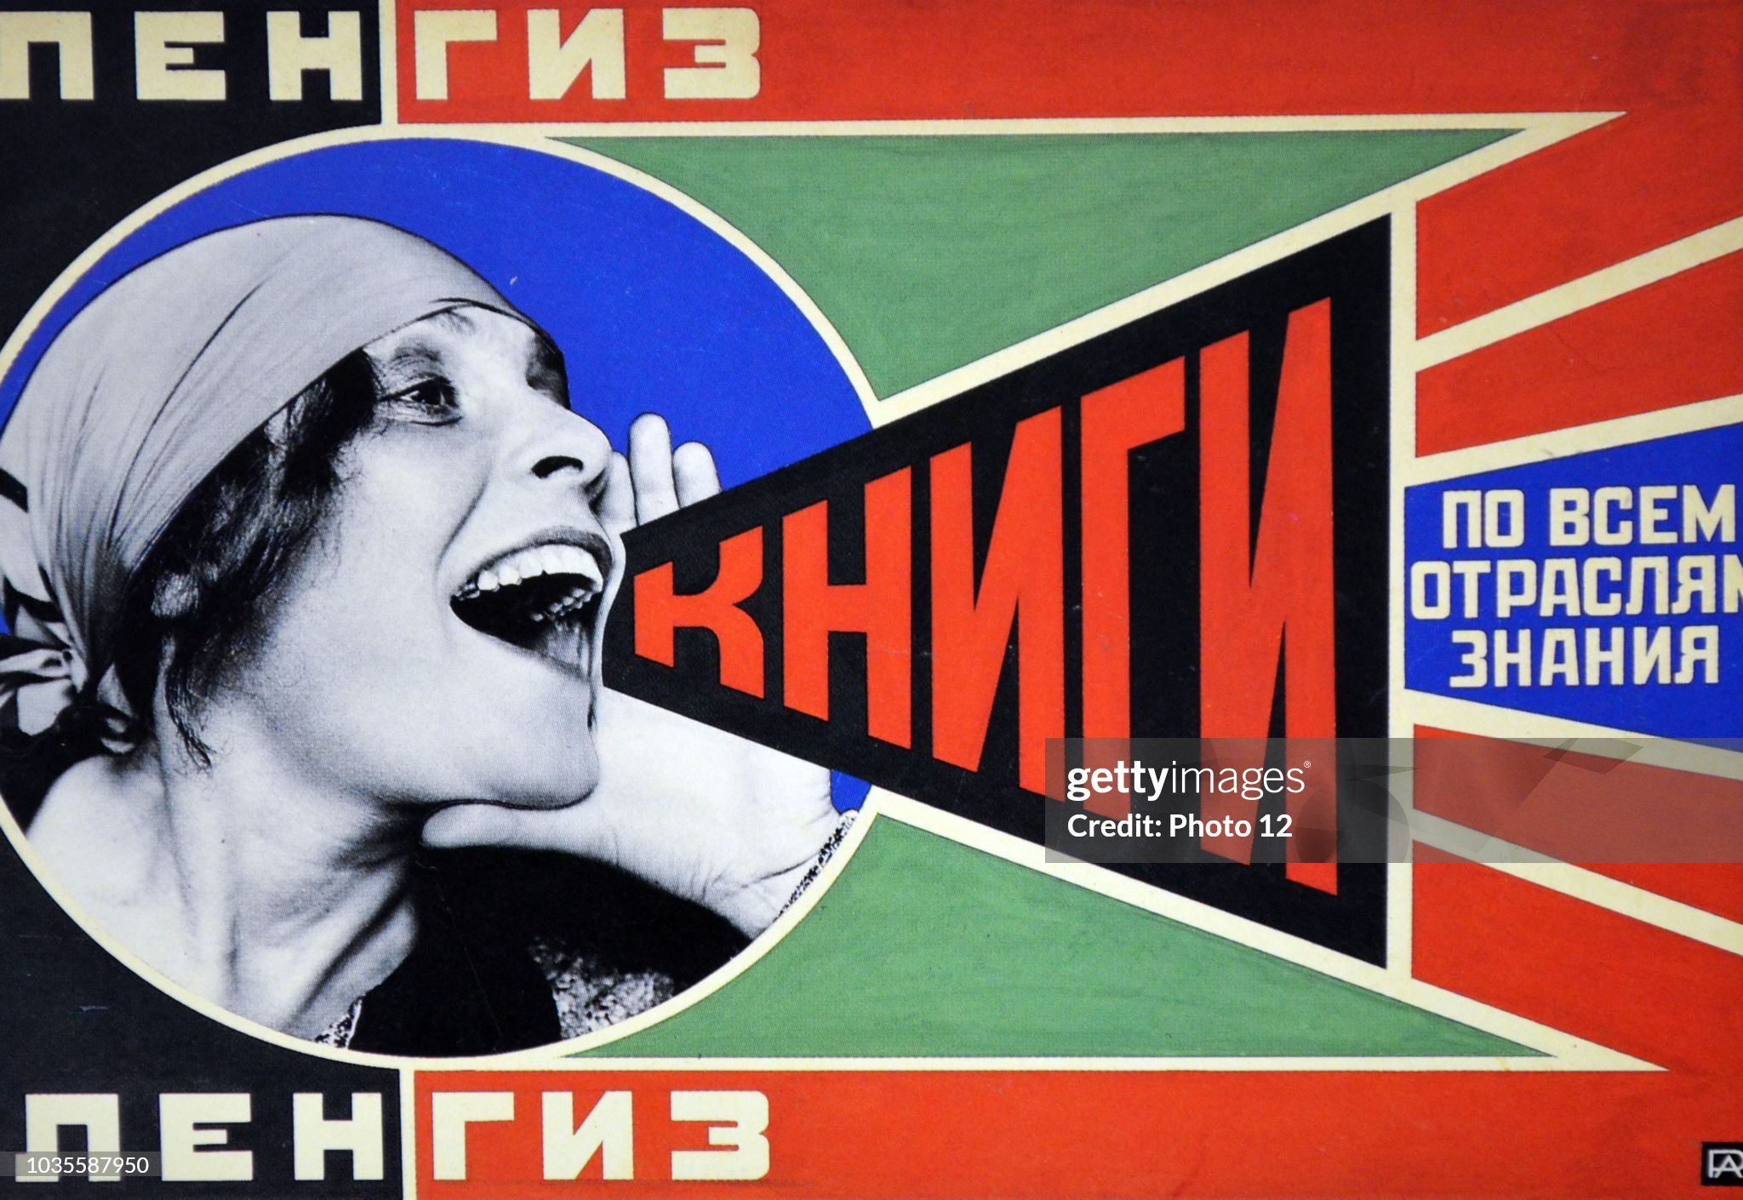
The call to revolution

Slide 35
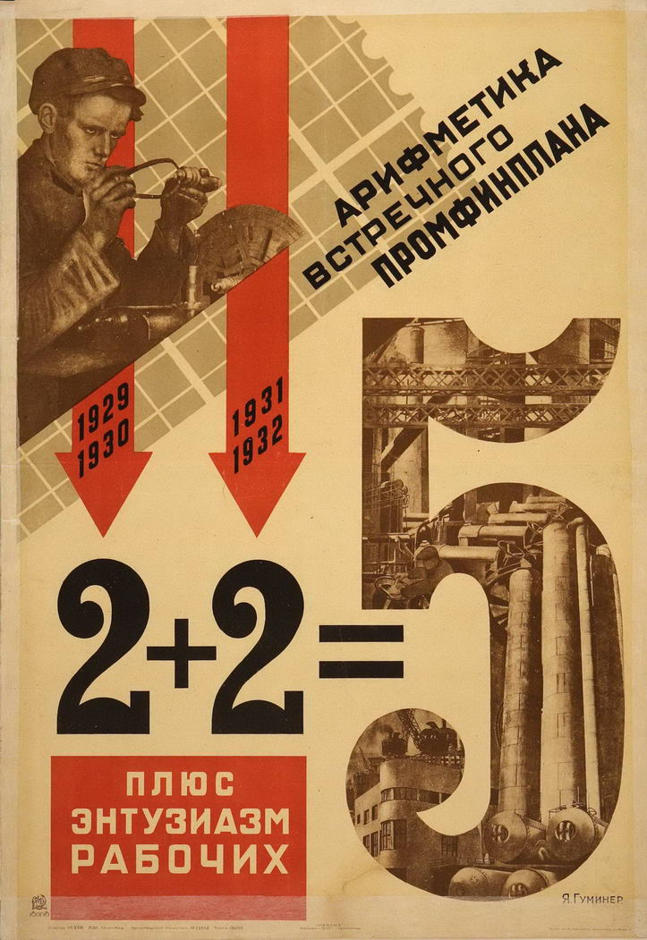
5 Year Plan 2+2 = 5

Slide 36
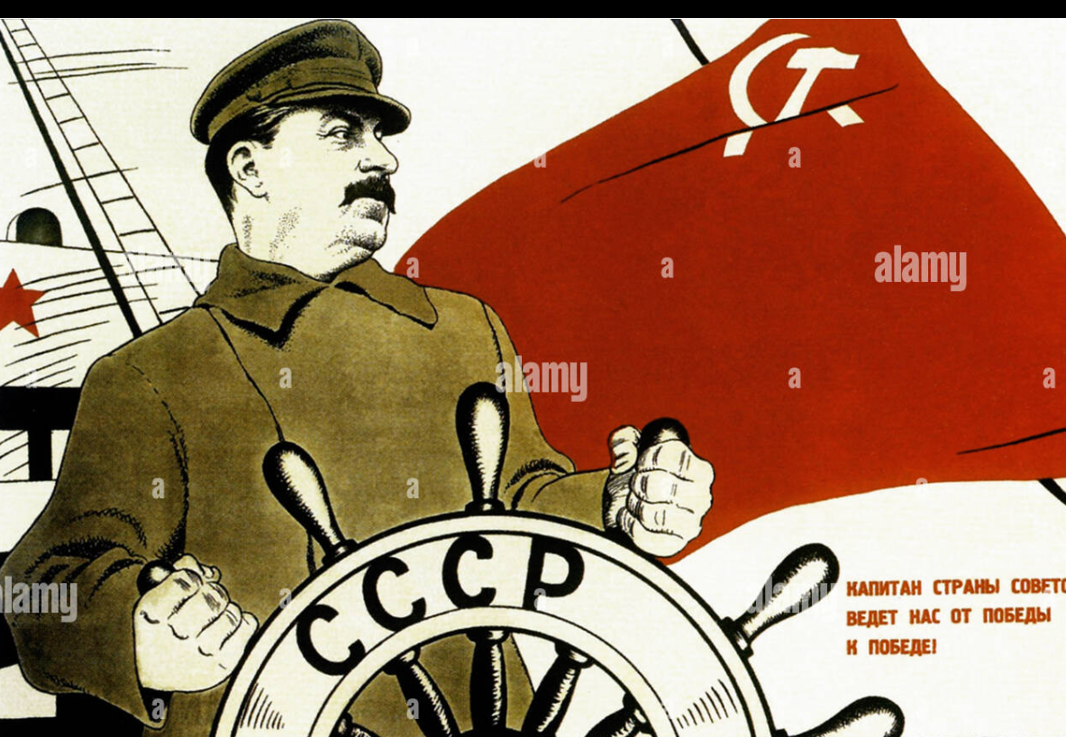
The Great Helmsman

Slide 37
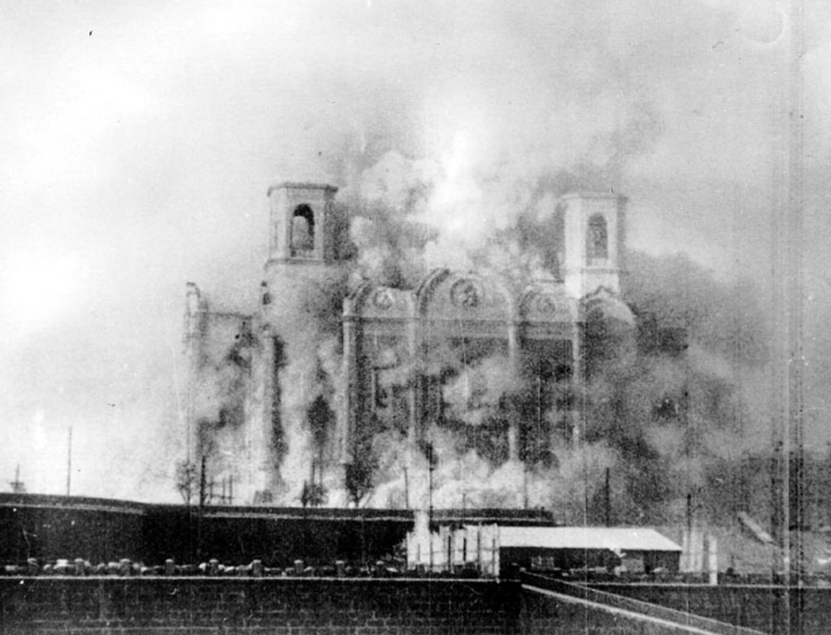
Destruction of old world…Cathedral

Slide 38
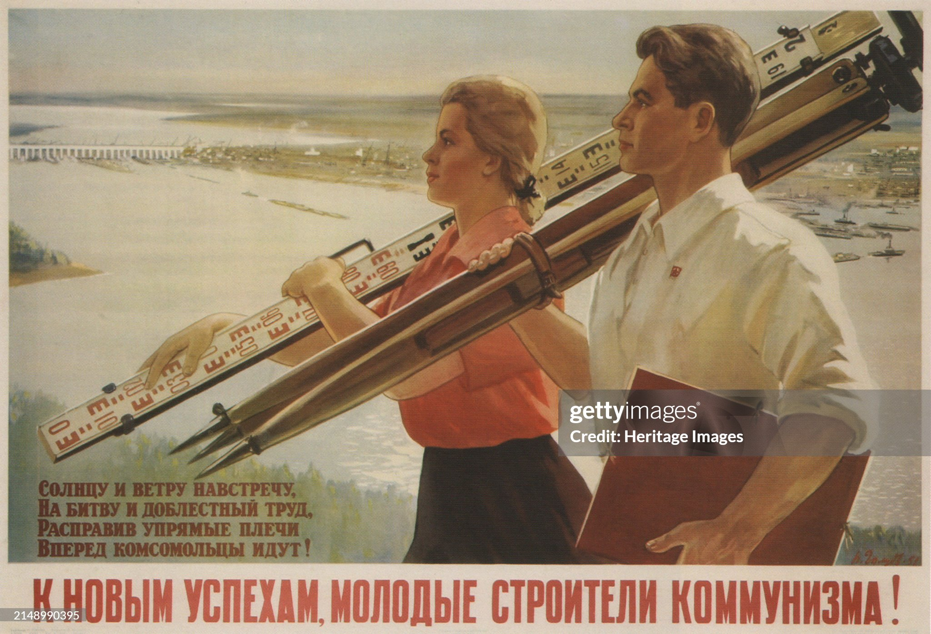
Virtuous Designers making new world

Slide 39
Hard work to be rewarded

Slide 40
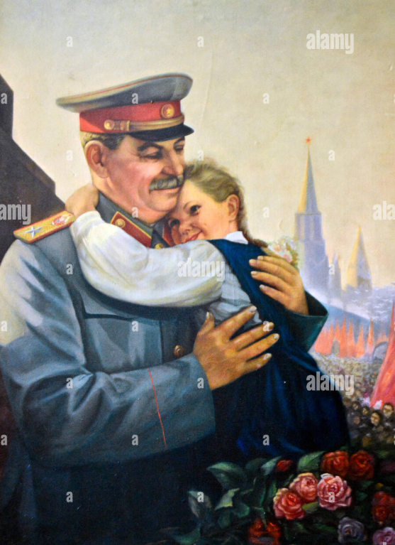
“Father of the People”

Slide 41
USSR View 1939
(Stalin) convinced either West or Nazi Germany will invade
Seeks to recover “lost” empire …Poland, Baltics, Finland and
domination of Eastern Europe
5 Year plan has become “war economy”, ignore civilian wants
War inevitable….unclear with whom, wants to avoid war with
Both West and Nazi Germany

