Slide 1
American History
1
Talk 29: USA and the 1930’s world
Part two

Slide 2
Rise of Fascism: Italy

Slide 3
Italy 1870-1918
United 1870
Disunited….regions act autonomously/ North South divide
Poor, under developed…mass migration to USA and Argentina
Constitutional monarchy….fragile Liberal democracy”
Govt seeks unity by invasion: Libya, East Africa (Somalia)
Invasion of Ethiopia fails. Army destroyed…national humiliation
Italy and World War One
Allied with Germany 1914..does not join war
Joins war on side of British/ French in exchange for promised territory
Loses 600,000 men 500,000 civilians….defeats Austrians 1918
“Promised” territories not delivered….14 Points: “Mutilated Victory”
1920’s…high unemployment, communist revolts vs Catholic conservatives

Slide 4
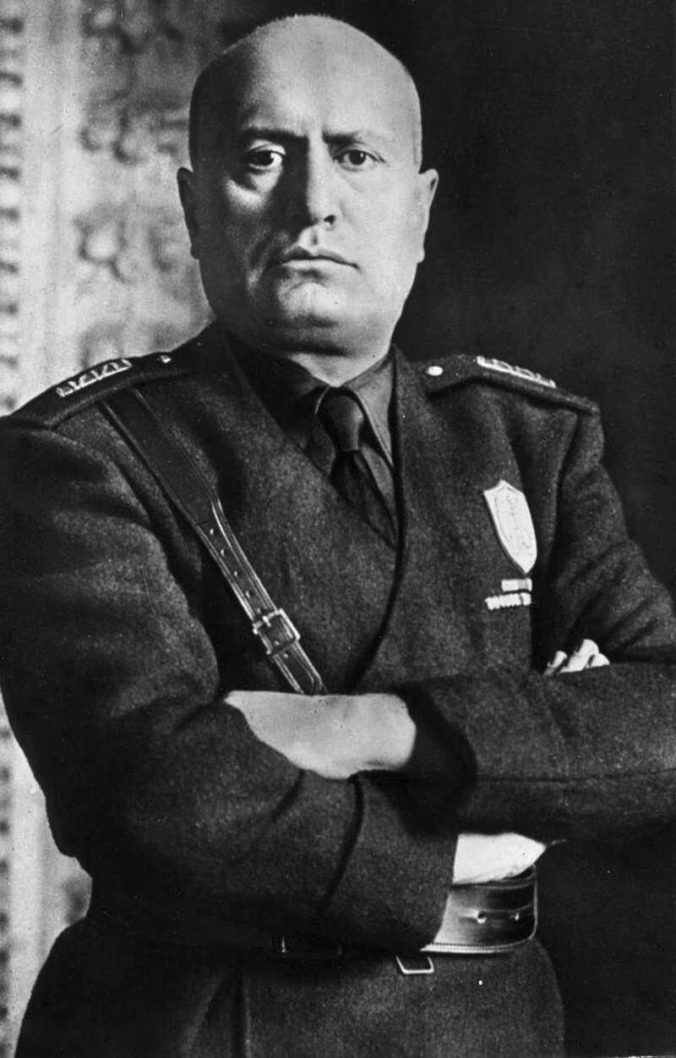
Benito Mussolini (1883-1945)
Mussolini 1932
Humble family
..mother devout Catholic/..father blacksmith. Socialist
…religious school. Expelled for stabbing student
…boarding school. Qualifies as school master
Committed Socialist
..reader of Marx/ Nietzsche. Superman
…Opposes invasion of Libya
…journalist. Editor of Avanti/anti church
…joins Socialists
..expelled for supporting WW1
Creation of Italian Fascists
..joins army 1915..wounded 1917
…forms party—1919
Anti egalitarian, anti church,
“Make Italy Great Again”…new Rome

Slide 5
Rise of Italian Fascists
Growth of Fascists
Unemployment, rise of communism…fears of revolution church/landowners/middle class
Fascists popular…accommodate with Church
Form “National Fascist Party”---25% of vote
Rise to power
“March on Rome” 1923
King appoints Mussolini Prime Minister
Acerbo Law …one party, arranged murder of opposition

Slide 6
Italian Fascism 1922-1939
Opposition murdered/ imprisoned, control of media
Public works, land reclamation, youth groups
……… trains run on time/ 60% military
Alliance with church/Papal state, Catholic national religion
Compulsory savings, bonds based on future wealth funded by recreating Ancient Rome: “Mare Nostrum”

Slide 7
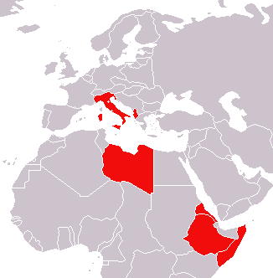
Italian Empire & Test of League
Italian Empire 1939
Italian colonies in Libya 1911
….Cyrenaic and Tripoli
…Mussolini invades 1931
…50,000 population killed
..use of mustard gas
Invades Ethiopia 1938….revenge
…Mussolini invades 1931
…750,000 population killed
..use of mustard gas, mass killings
Sanctions imposed by League
….abandoned British French
…Mussolini ‘hero'. Wants more

Slide 8
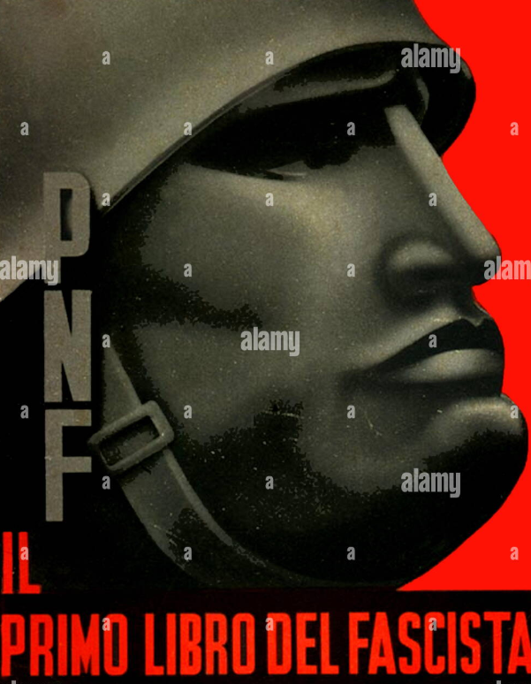
Mussolini the all powerful leader

Slide 9
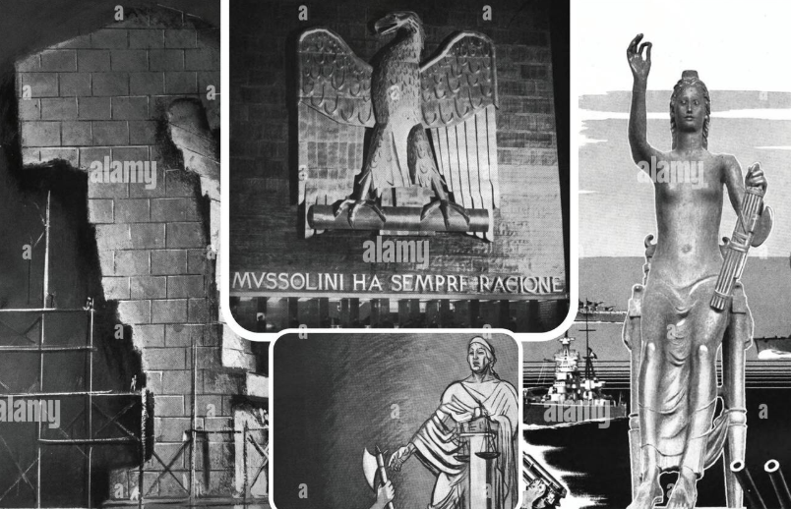
“The New Rome”: Fascist architecture

Slide 10
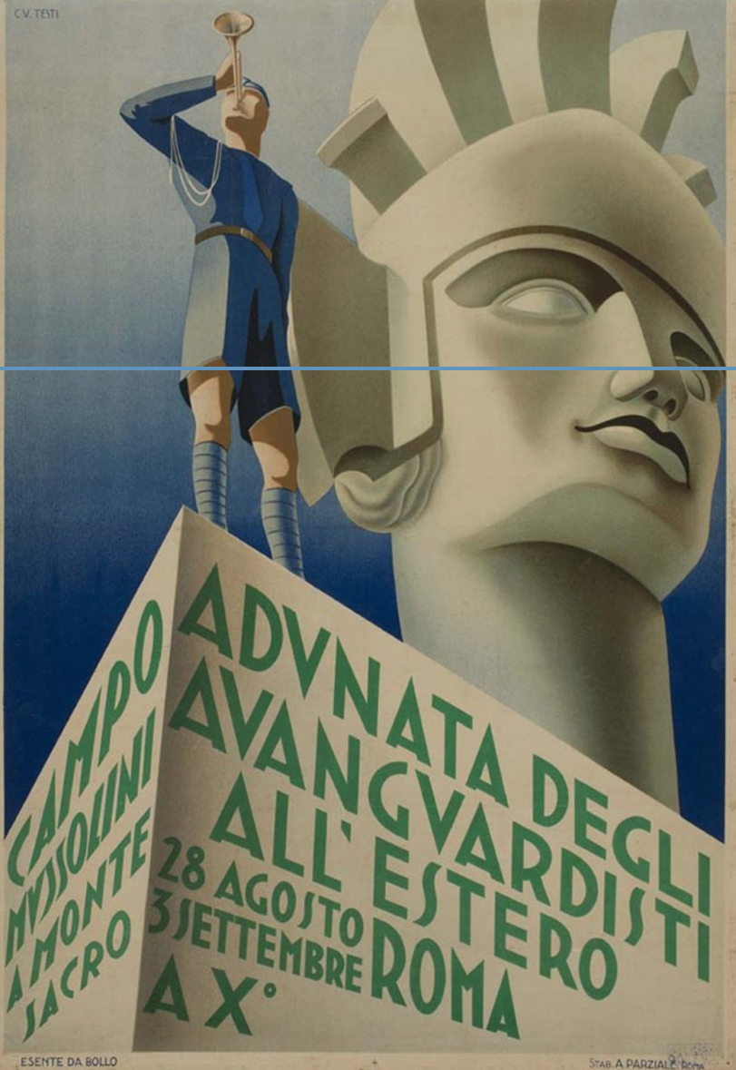
The glorious future beckons

Slide 11
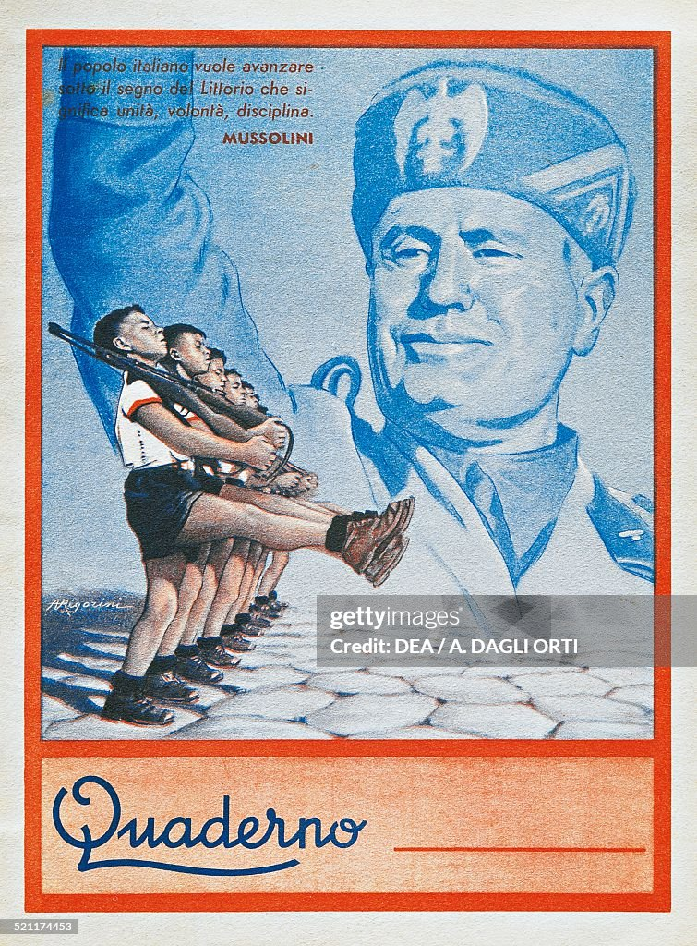
Children’s exercise book…

Slide 12
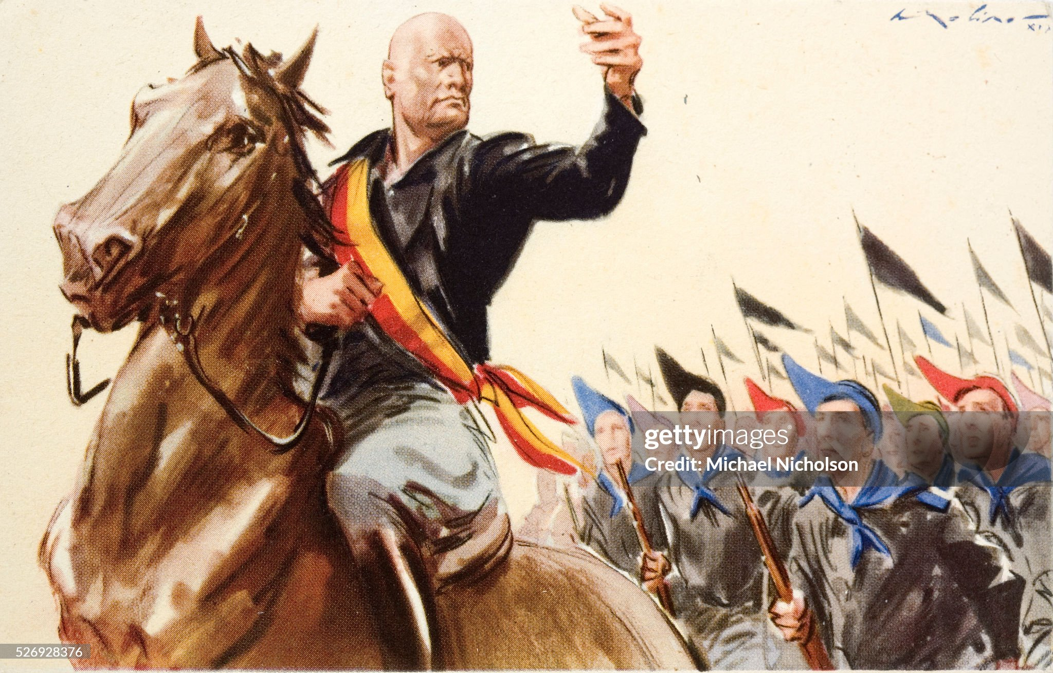
Forward to victory

Slide 13
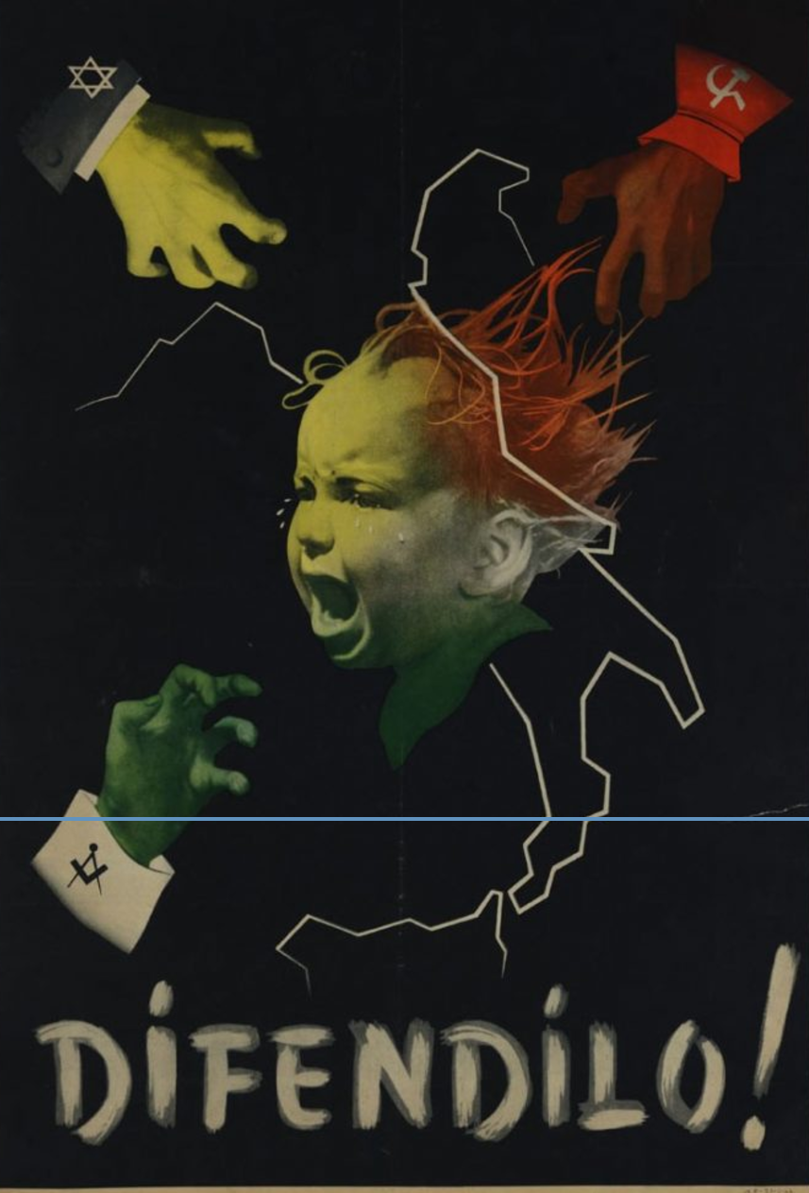
Fascist propaganda: “protect me from Communists, Jews and Masons

Slide 14
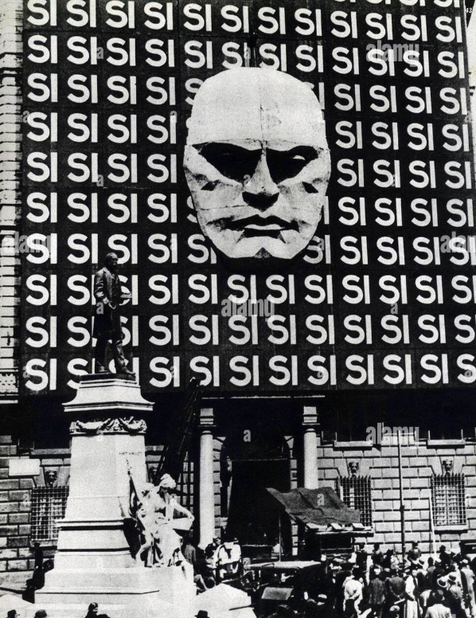
Mussolini….One Party, master race, primacy of force

Slide 15
Legacy of Italian Fascism
Proven modern alternative to Communism
80% of economy under direct control of state
Cartel capitalism/compulsory savings, capital controls
Apparent success…social order, territorial gains …admired in USA
League of Nations/ World Government e impotent
Ambition constrained by weaknesses
Rampant corruption, underinvestment in quality, effectiveness
Still agrarian economy…50% workforce agriculture vs 25% Germany 5%
Inspiration and guide to far more powerful German fascists

Slide 16
There will be trouble ahead Irving Berlin 1936
There may be trouble ahead But while there's moonlight And music and love and romance Let's face the music and dance
Soon, we'll be without the moon Humming a different tune and then There may be tear drops to shed So while there's moonlight And music and love and romance Let's face the music and dance

Slide 17
Before the fiddlers have fled Before they ask us to pay the bill And while we still have the chance Let's face the music and dance
Soon, we'll be without the moon Humming a different tune and then There may be tear drops to shed So while there's moonlight And music and love and romance Let's face the music and dance Let's face the music and dance

Slide 18
Germany 1870 -1914
39 independent German Kingdoms united 1871 by Bismarck
Rapid industrialisation and urbanisation 1870-1914
Germany industrial super power by 1914
Colonial Empire established in Africa, outpost in China
Highest literacy, education, healthcare, technology
Disguised dictatorship
Kaiser retains supreme power, ruled via Chancellor
Prussian Military dominate upper house
Bundestratt debate/approve but subordinate to Chancellor

Slide 19
Germany After World War One
Defeated in West, victorious in East
Military delegate “Armistice “ in the West
“Armistice” becomes surrender….”stab in the back” claim by military
Political chaos 1918/1921
Kaiser deposed, Constitutional Republic formed at “Weimer”
Civil war 1918-1919: Communist led revolt, crushed
Weimer Republic : first democratic government
Revolts crushed by para military force FreiKorps
Approves Versailles Treaty May 1919…after Allies threaten invasion

Slide 20
Weimer Republic 1918-1933
Years of Crisis 1919-1923
Violent reaction to Versailles Treaty/Political assassinations
National Workers Party established…3% vote 1923
Industrial chaos…inability to pay reparations
French & Belgian army occupies Ruhr Valley 1923
Hyper inflation 1923-1924
War financed by bonds…not taxation
Reichsmark collapses…middle class impoverished
Attempted coup 1923 by
Recovery 1924-1929
US “Dawes Plan”: US loans fund reduced/rescheduled reparations
German “Golden Age” / Joins League of Nations

Slide 21
Weimer Collapse, Rise of Hitler
US Stock market Crash & Depression 1929
US ends loans, demands recall
Imposes trade bans
German economy collapses
Unemployment rises to 30%/ no finance to offset
Social unrest, rise of Communists and Nazi Party
Dictatorship
Nazis 37% vote 1932 vs Socialist 20% Communists….15%
Hitler made Chancellor/ abolishes/murders opposition

Slide 22
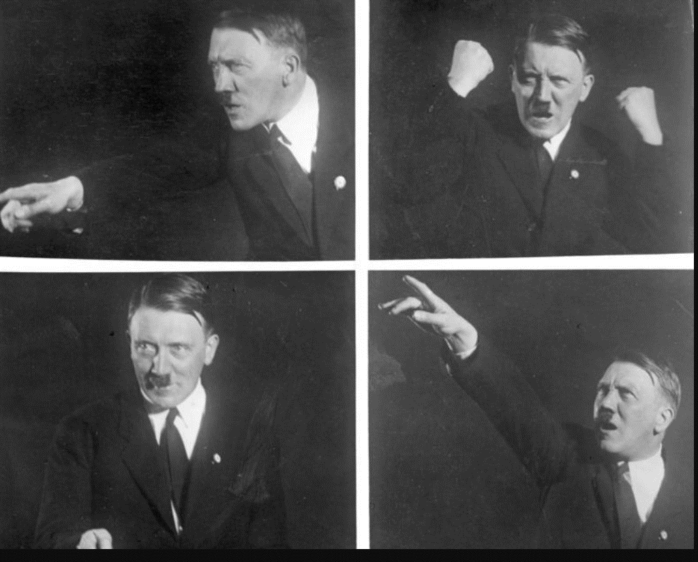
Adolph Hitler (1889-1945)
Hitler 1933
Born Austria, father customs officer. fails exams, drops out
Moves to Munich 1908
…fails Art exams
…German nationalist
WW1 “hero”
Joins Workers Party 1920
…becomes chairman 1921
….failed Putsch 1923
…writes “Mein Kampf”
…re-joins party

Slide 23
Nazi Germany 1933-1939
Nazi Economy
Cartels, central planning, price and wage controls, rationing
Self dependency, high tariffs
“Public Works and Rearmament “:autobahns and military
Unsustainable deficit spending, arms 60% national budge, 10%
Techniques
Opposition suppressed/murdered +Labour unions supressed,
Use of forced labour
Anti Semitic laws, murder of “unemployable”, communists, socialists, and disabled…secure wealth, maximise employment

Slide 24
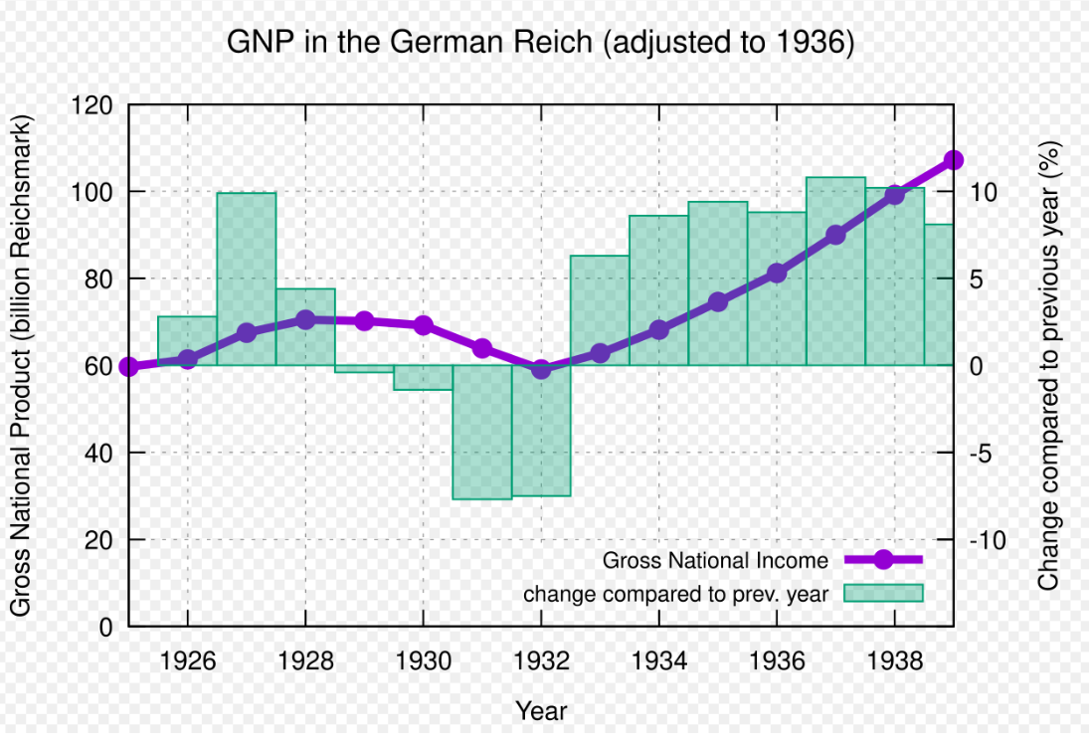
Nazi Economics
Economic growth
5%-10% per year
Regains #2 economy
Unemployment reduced 30%
To 1% by 1938
Funded by
Deficit spending
Compulsory saving
Collateral….conquest
Of lands to East
“Lebensraum”

Slide 25
Nazi Germany: Route to war
Offer of “world peace” 1933…if simultaneous disarmament
Germany leaves League 1933 when “offer” rejected
Occupies Rhineland 1935….no response from League
Union with Austria 1938
Partition Czechoslovakia 1938/ Munich “Agreement”
Alliance with USSR Molotov Ribbentrop Pact August 1939

Slide 26
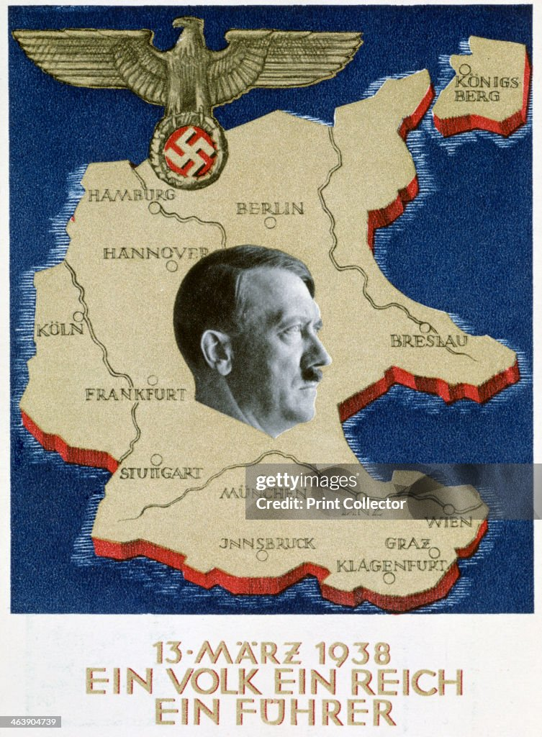
The Great Leader

Slide 27
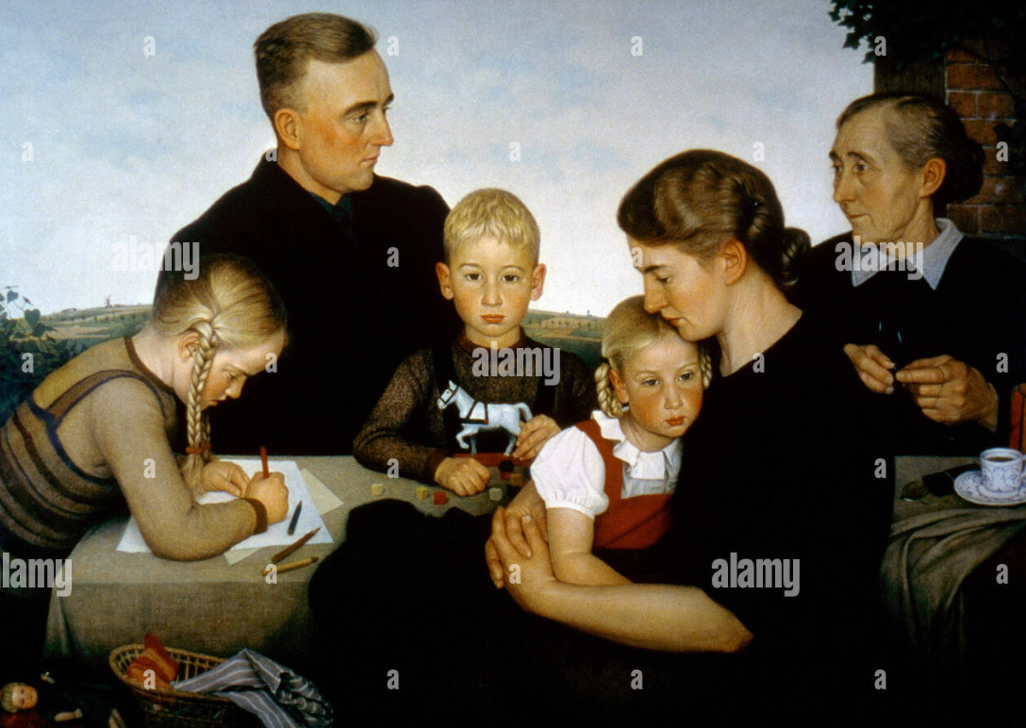
The ideal family

Slide 28
Fund raising for hostels

Slide 29
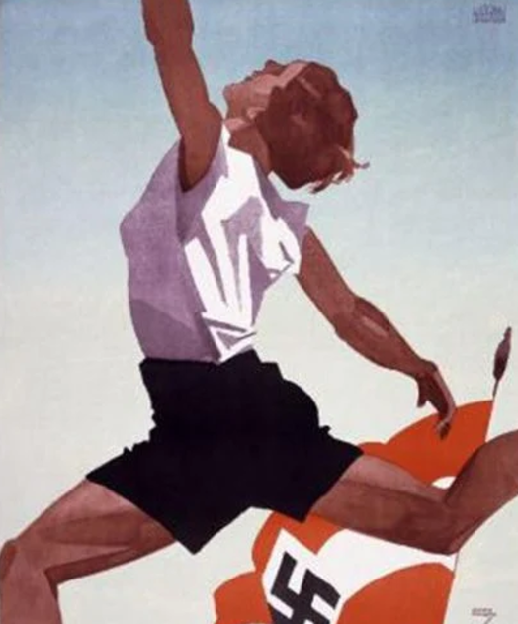
The New Germany: Young, invincible Athletic fit

Slide 30
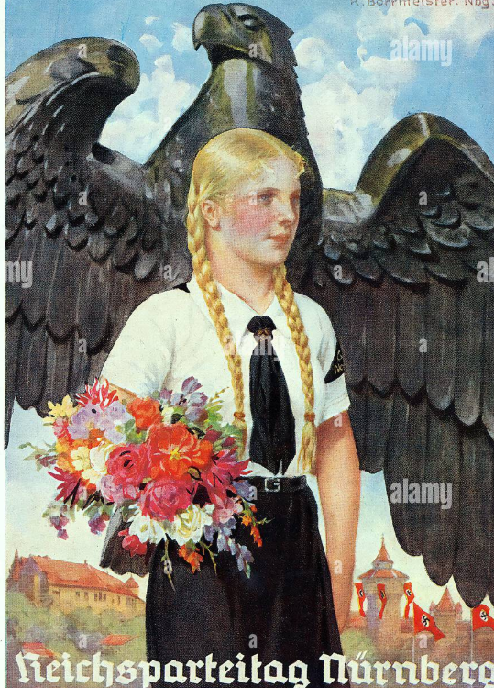
Children protected by strength

Slide 31
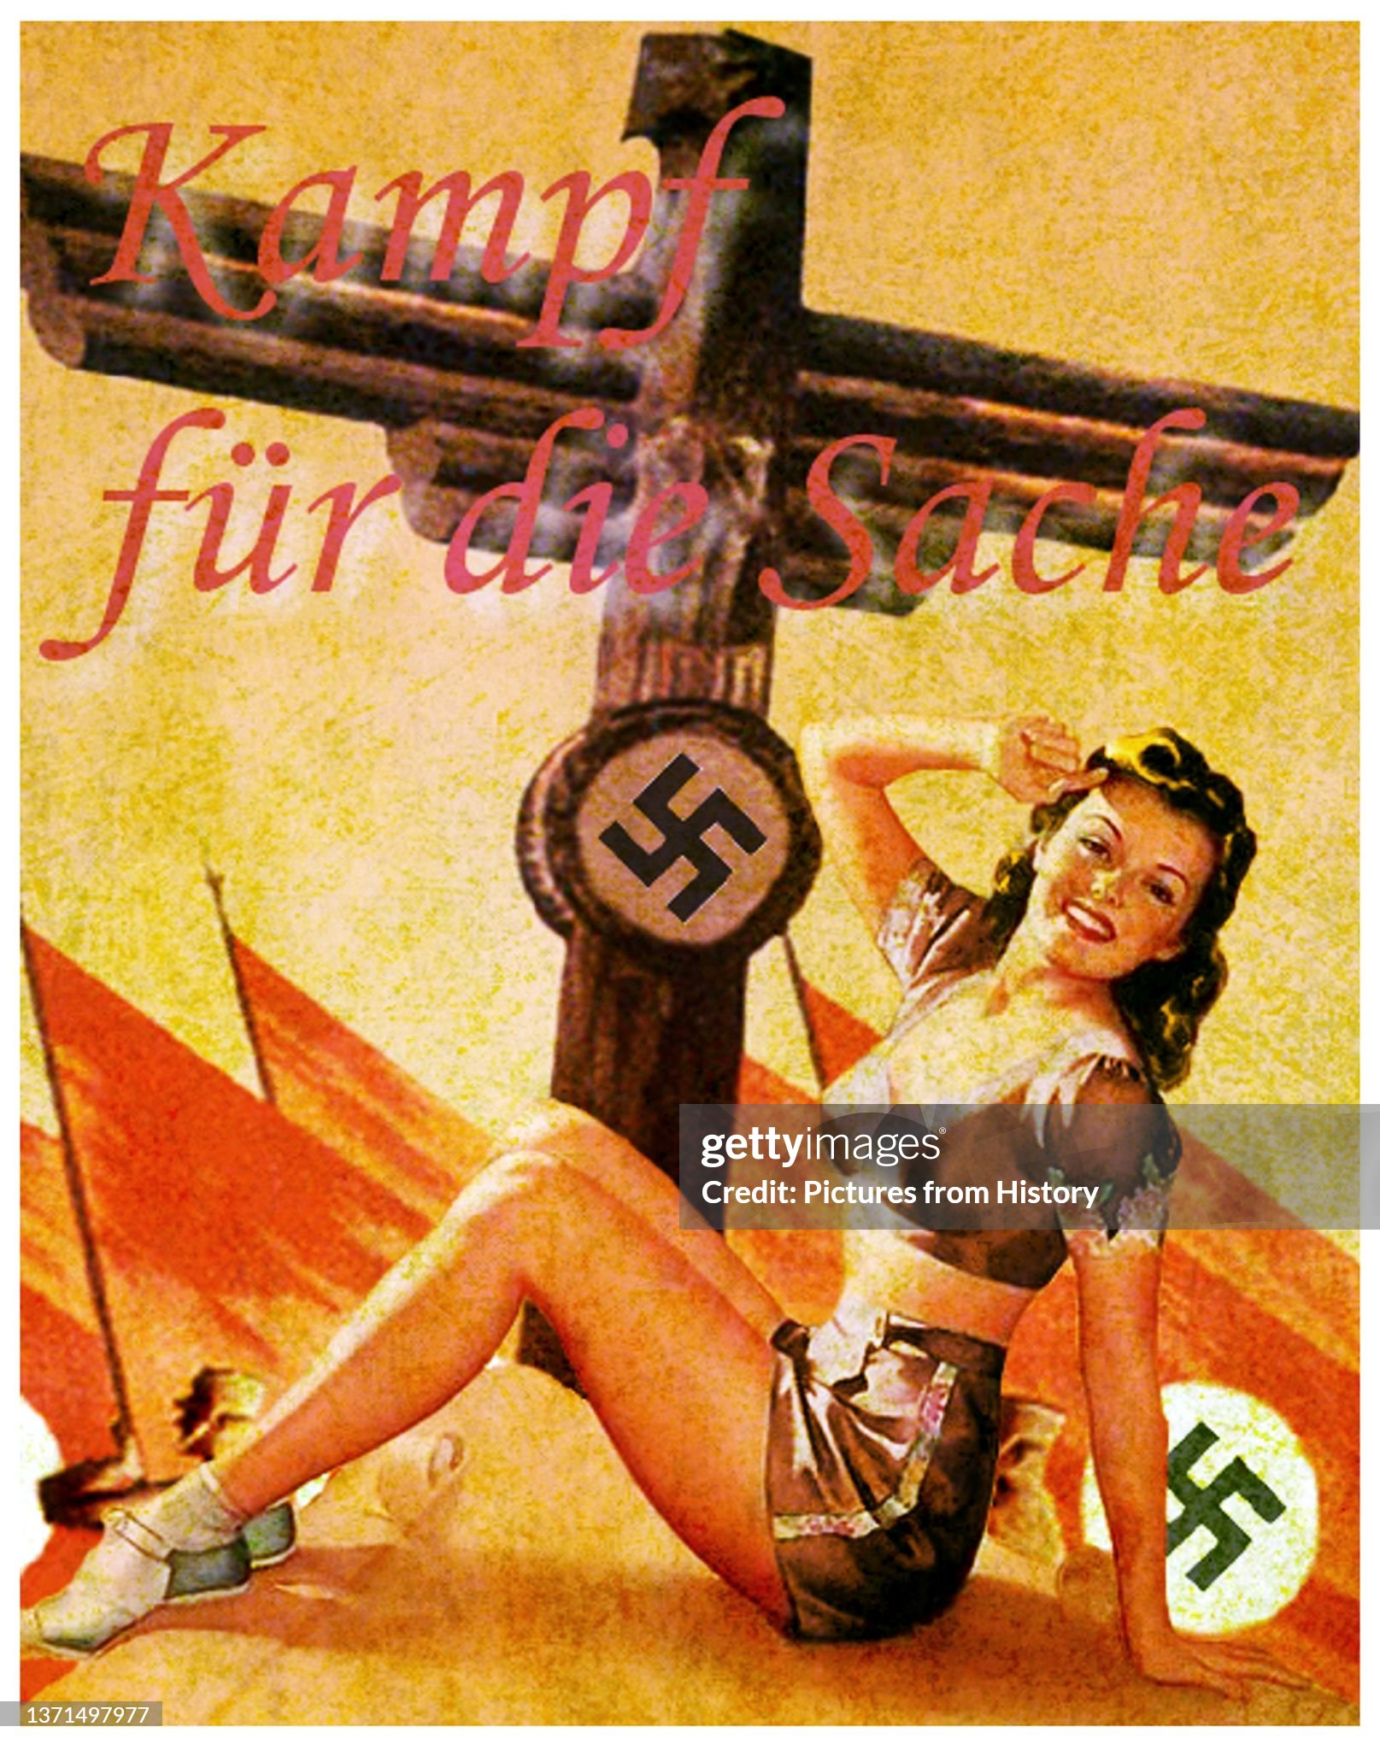
The glamour of Fascism “Fight for the cause” glamour

Slide 32
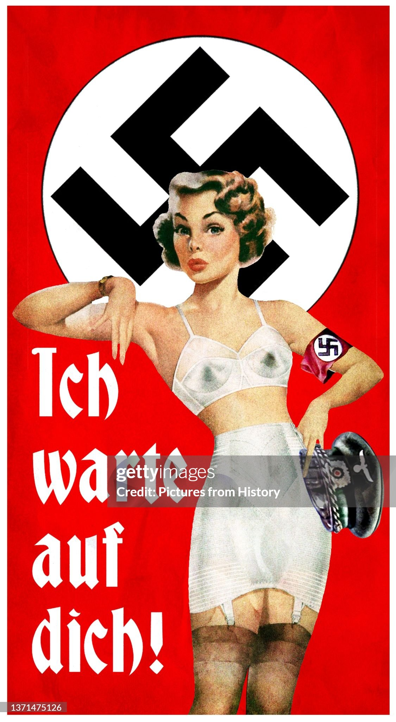
Fascism can be sexy “I am waiting for you….”

Slide 33
Fascist made great movies “Triumph of the Will (1935) Lena Riefenstahl …

Slide 34
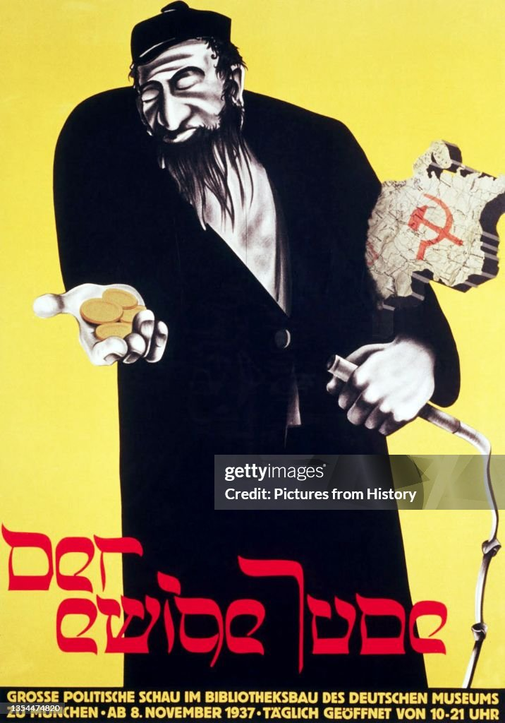
The enemy: “The eternal Jew”

