Slide 1
American History
1
Talk 29: USA and the 1930’s world Part three

Slide 2
Imperial Japan

Slide 3
Japan 1868-1890
Feudal isolated island 1550- 1868
Ruled by “Shoguns”…Samurai culture, Emperor symbol only
Humiliated by American navy Perry 1854 and British 1861
Civil war, “restoration” of emperor Mejia 1868
Emperor a God…citizens reflections of God, foreigners subhuman
European colonies unacceptable and unnatural threat
Modernisation1868 -1890
Industrialisation rapid, supported by civil service, rule of law
Destruction of old temples, castles
Constitution of 1889
Emperor maintains control military and superior and independent of Diet
House of Peers (aristocrats), House of Representatives (1%) debate/ enforce

Slide 4
Emergence of Imperial Japan 1890-1920
`From island to Empire 1890-1905
First Sino Japanese War 1894/1895 –seize Korea and Taiwan
Boxer Rebellion. 1900.Japanese dominant force retaining European concessions, secure access to China
Transition to major Asian Power 1905-1920
Defeats Russia 1905, expand into Manchuria, demand Siberia
“Great Betrayal” US negotiated Treaty of Portsmouth to end war
…keep outposts in China, but withdraw from Siberia and Manchuria
1914-1918 ..alliance with allies, secure German colonies in China
1920 …Japanese dominant army of Allied intervention to Siberia

Slide 5
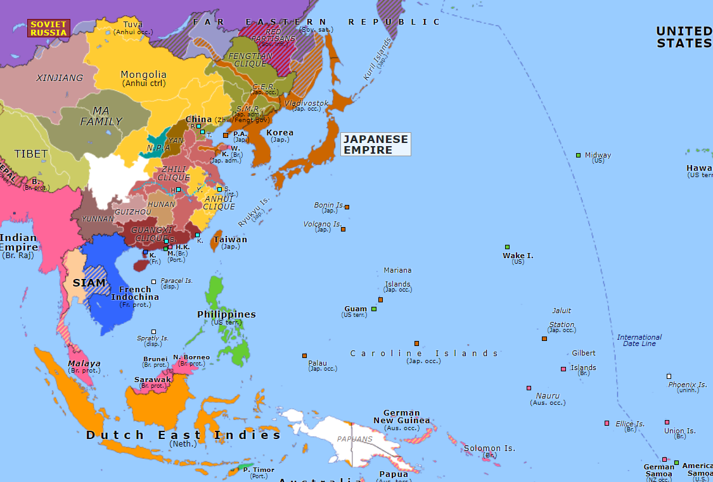
East Asia 1920….war seemed inevitable
War Lord China
France
British
Netherlands
USA
Japan

Slide 6
Washington Peace Conferences 1921
US intervention…President Harding
Non interference China
Non interference USSR
Washington Peace Treaties 1921
Freeze territorial expansion in China
Reduce navy sizes to agreed ratio
Japanese join League of Nations
War averted
Focus on internal modernization and democracy

Slide 7
Democratic Japan 1921-1931
Rapid industrialization continues
Growing middle class demand political reform
Universal Male suffrage 1925
Parliament redesigned to mimic British government
Upper house…nobility
Lower House multi party system Socialists/Conservatives

Slide 8
Japanese industrialisation
 | 1870 | 1920 | 1930
GDP (1990 $) billion | $11.0 | $90.0 | £135.0
GDP per capita | $730 | $2,000 | £2,350
Merchant ships | 26 | 1,500 | 5,900
Coal production (million tons) | 0.6 | 21.0 | 30.0
Population | 30 million | 60 million | 65 million
Agricultural workforce | 80% | 60% | 50%
The key difference to West: Military report direct to Emperor
…..military formed by ex samurai, warrior culture
…. lost power since Restoration: democracy Western imposition

Slide 9
Transition to Military State
Impact of 1929 economic crash
Elite discredited/ mass sudden impoverishment
Army view: prosperity only secured by conquest, invade Manchuria
Parliament order army to withdraw, ignored
League of Nations banishes Japan, isolated Japan blames West
Military take over 1931-1936
Army collude with Emperor Hirohito in 1931 to invade Manchuria without
approval of parliament….expelled from League…blame West
“Government by assassination” 1932-1936, murder of PM and moderates
One party state established 1936: its mission “Make Japan Great”

Slide 10
Japanese Fascism
No one leader/writer….deep cultural view by “warrior class”
Emperors God, Japanese made in his image, others non human
The ultimate goal of individual to serve/ die for emperor
Economy / Political
Cartels (Honda, Mitsubishi, Toshiba) which follow warrior goals of dominance
Unions replace by state run organisations
Parliament replace by “Imperial Assistance Association”
Destiny of Japan dominate Asia
Evict Europeans and colonise
Native people to become slaves to Japanese elite….and be grateful’

Slide 11
The state of China
Collapse of Empire 1912…..disintegration into multiple war lords
Central government re-established 1923
National government (KMT) led by Chiang Kai Shek
KMT unites socialists, communists, democrats vs “war lords”
Control Central South China, abandons Manchuria, Tibet, Far west
Civil War 1927-1938
KMT massacre Communists 1927
Mao Tse Sung leads communist army (CCP)
KMT dominate, Communists banished to interior by 1935
Japanese military fears United China will emerge….and invade

Slide 12
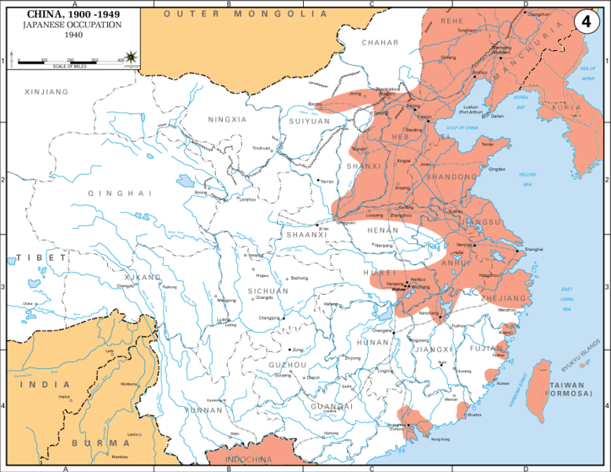
Japanese Invasion of China
Japan invades 1938
…army 1 million plus
…Nationalist 2 million
…Communist 1 million
Situation 1939
KMT &CCP unite vs Japan
….CCP avoids most
Japanese policy
….mass murder (Nanking)
…use of gas, tanks,
…conquer cities and coast
Stalemate 1939

Slide 13
US “Asian Policy” 1939
Support united “National “China…but want the “right China”
Commits to Philippine independence …retain bases
Recognise Japan threat to Pacific dominance
Too weak to attack US, Japan dependent on US for oil
Expand Pearl Harbour
Commission expansion of Pacific fleet

Slide 14
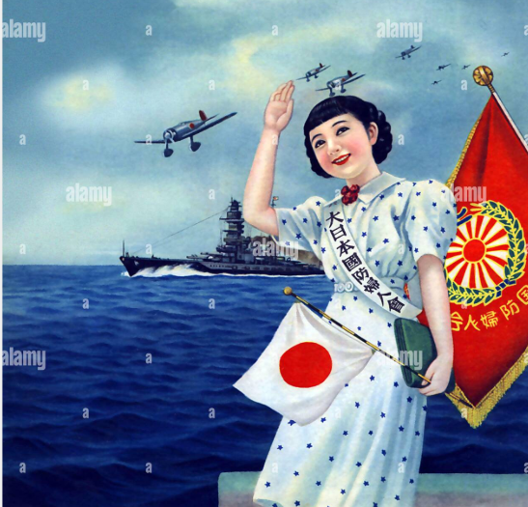
Women supporting the men off to war

Slide 15
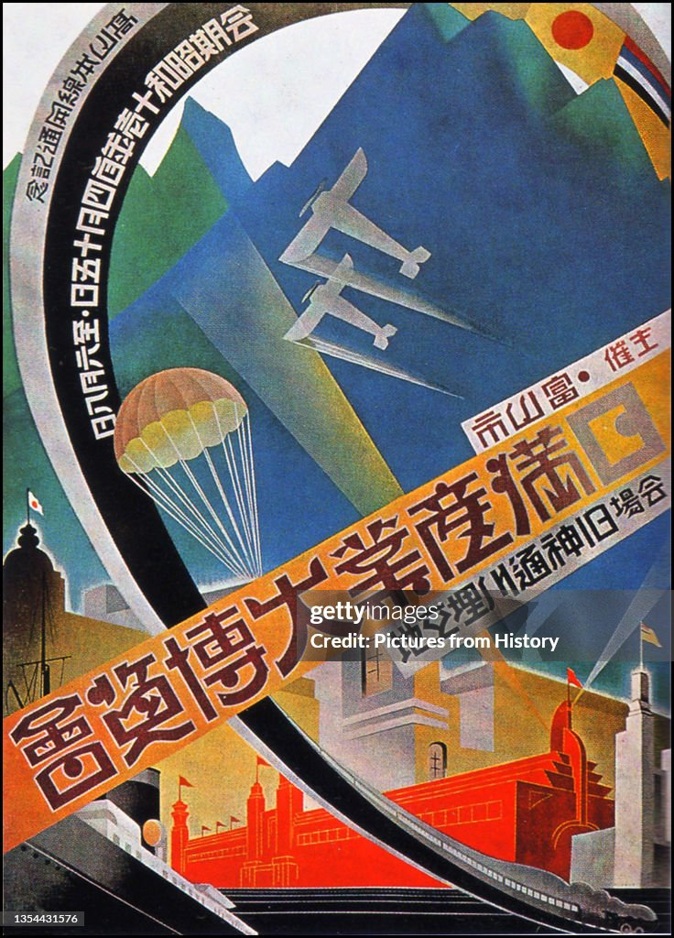
The new Japan : Industrial exhibition: Manchuria 1936

Slide 16
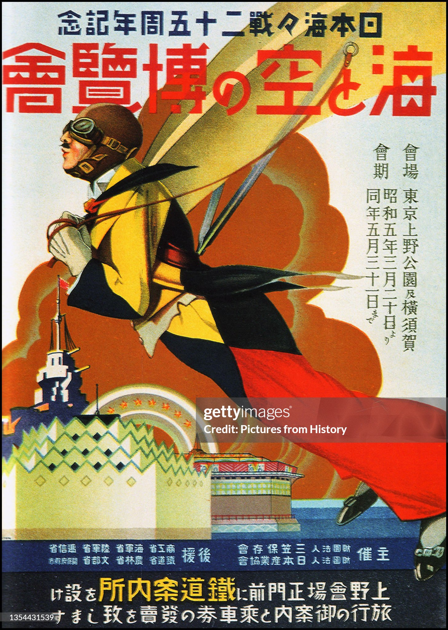
Japanese military power will dominate

Slide 17
Military Government propaganda to Chinese “Absolutely trust the Japanese, down with the KMT”

Slide 18
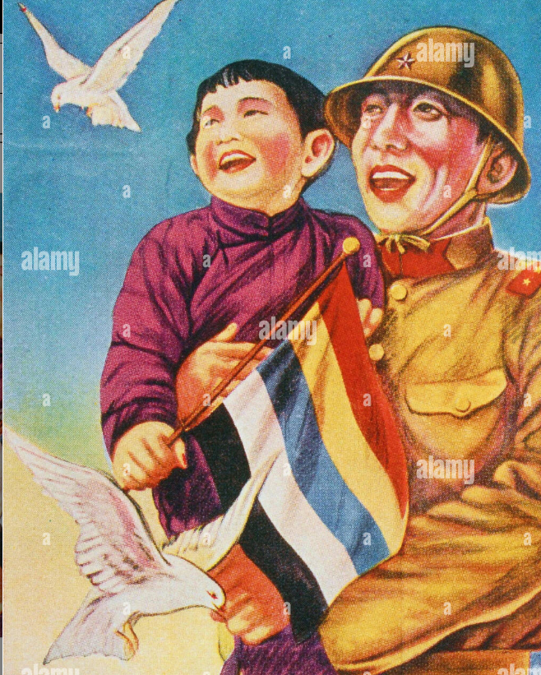
Japanese soldier with Chinese child. …(Nanking 300,000 Chinese killed)

Slide 19
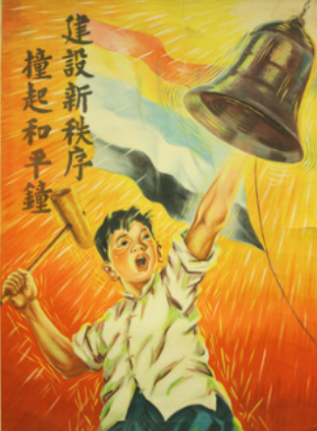
“Bring new order, ring the peace bell” ...(war justified by future peace)

Slide 20
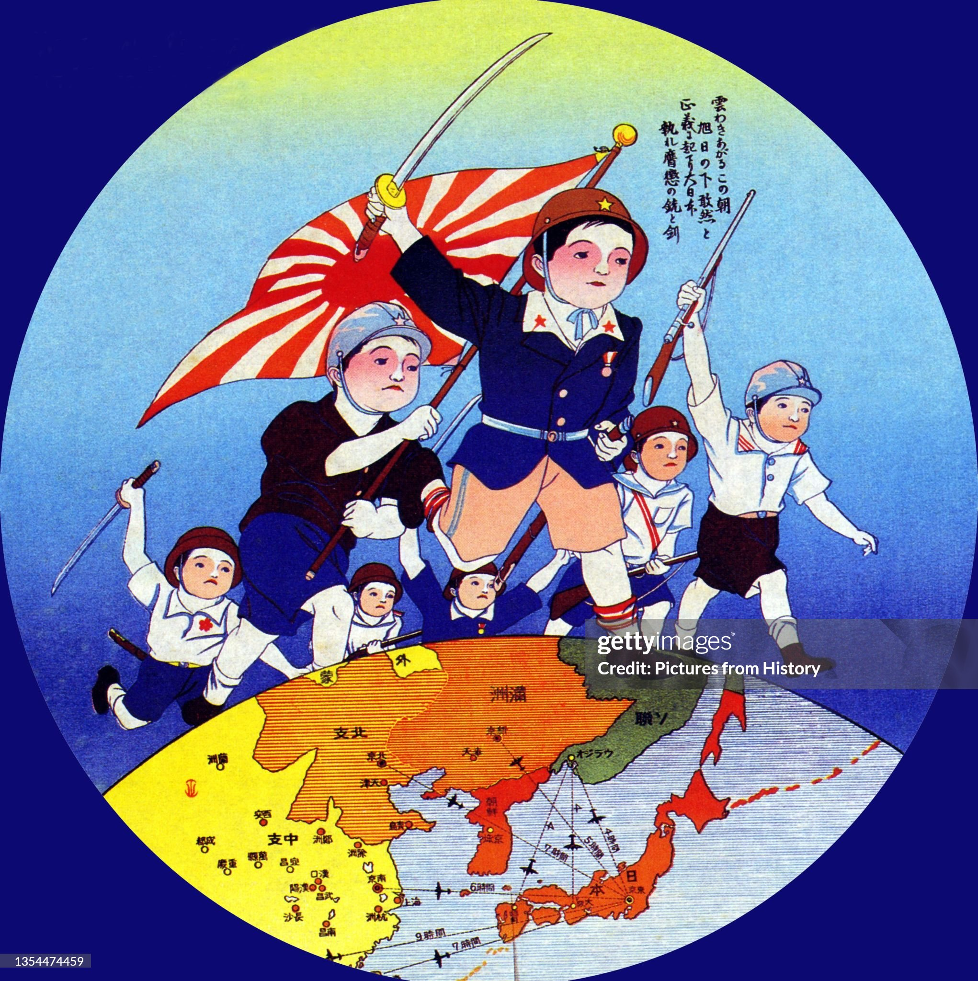
Forward children of Japan

Slide 21
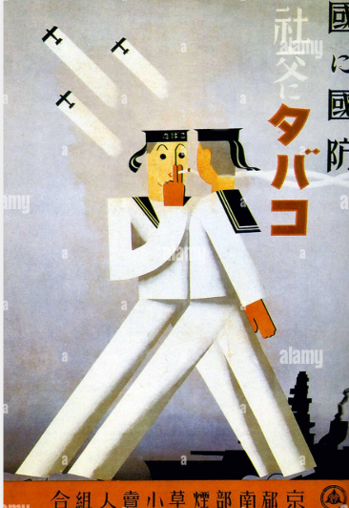
“Defence for country, tobacco for society”(?)

Slide 22
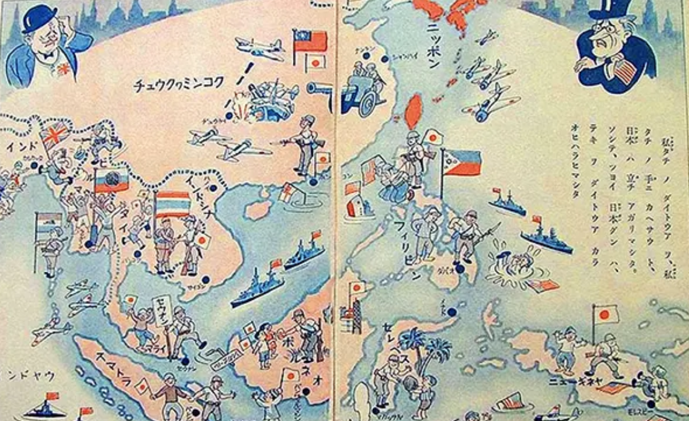
The new Japanese order: “Co Prosperity Sphere “Japan the guardian of Asians….West removed

Slide 23
USA and 1930’s world

Slide 24
USA and world 1939
US “stuck” in depression
18% unemployment 1939 and not falling
New Deal seen to be failing
Strict immigration controls in place….despite increasing Jewish refugees
US public:
65% public believe war inevitable/ 75% demand neutrality
60% oppose totalitarians but will not accept US involvement
Fascist cause limited support among Italian and German immigrant
Enough to influence 1940 election
FDR pro British but cannot demonstrate support

Slide 25
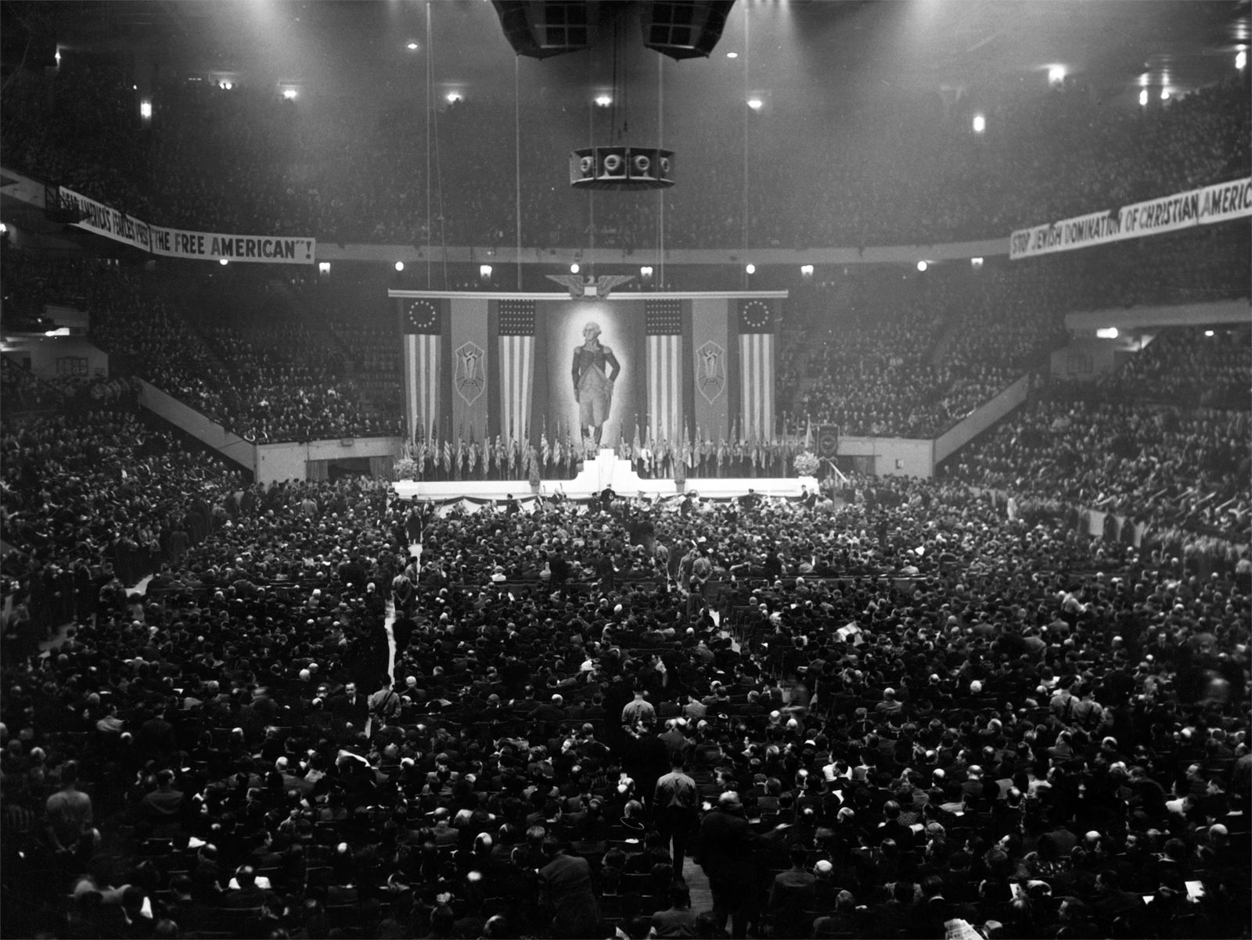
US Nazi Party…September 1939 ….20,000 attend….public revulsion ….Roosevelt depicted as “Jew lover”

Slide 26
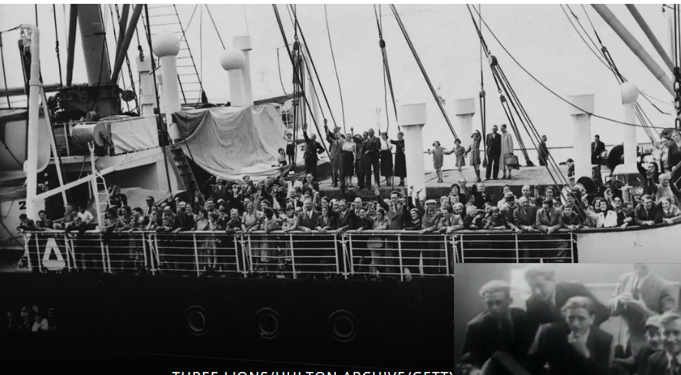
St Louis incident
US 1924 Immigration act
Limits Jewish refugees
27,000 allowed
11,000 processed
Backlog 240,000
SS St Louis New York
SS St Louis leaves Germany
For Cuba..970 on board
Cuba refuses entry
Captain sails to US
Refused entry, quota met
Plea to FDR/Rejected
Return to Europe
UK accepts 300
..300 out of 600 will be gassed

Slide 27
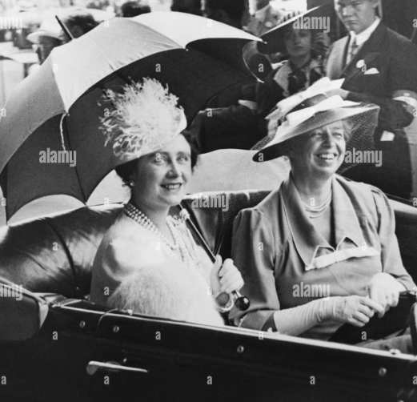
Most successful royal tour…ever
Queen Elizabeth and Eleanor Roosevelt
FDR wants to “nudge” US public to
Support UK
Suggest King George V! include detour
To US during tour of Canada
First visit to USA by reigning monarch
…..huge crowds
….George and the hot dogs
…. Support from press and public

Slide 28
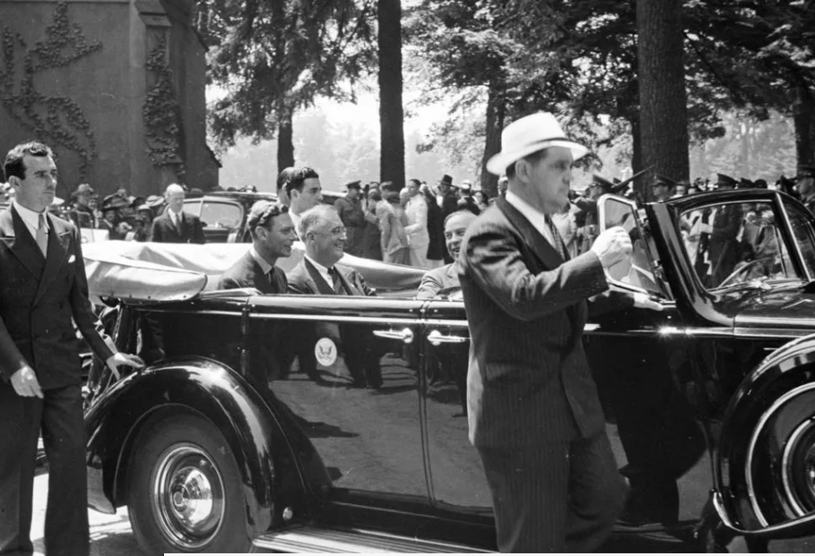
George V1 and FDR June 1939

Slide 29
The Visit: triumph of informality
Royal family invited to country fair
FDR ….offers George & Elizabeth hot dog
queen supposedly asked Roosevelt how one
“Very simple. Push it into your mouth and keep pushing it until it is all gone,” have told her.
She elected to use a knife and fork instead
FDR invites family to Hyde Park.. For three days
Informal talks, FDR and US position / inevitability of war
Basis established for future

Slide 30
The path to war in Europe
August 1939…..Ribbentrop Molotov pact…non aggression pact
September 1st…Germany and USSR invade Poland …..simultaneously
British ultimatum ignored…war September 3rh
US declares neutrality

Slide 31
US public expects future war but hope to remain isolated
……that hope will not be met!
To be continued January 20th :
Module 5, Talk 31 “Isolation interrupted”

Slide 32
Irving Berlin 1942
I'm dreaming of a white Christmas Just like the ones I used to know Where the treetops glisten And children listen To hear sleigh bells in the snow I'm dreaming of a white Christmas With every Christmas card I write May your days be merry and bright And may all your Christmases be white

Slide 33
I'm dreaming of a white Christmas Just like the ones I used to know Where the treetops glisten And children listen To hear sleigh bells in the snow I'm dreaming of a white Christmas With every Christmas card I write May your days be merry and bright And may all your Christmases be white

