Slide 1
Welcome to Module 4

Slide 2
American History Overview
1. From Colony to Nation
(1600-1789)
4. The Vacillating Giant
(1898-1941)
2. From Nation to Continental Power
(1789-1849)
5. Master of the Free World
(1941-2008)
3. From Continental to World Power
(1850-1898)
6. America in a multi polar world
(2001-2025)

Slide 3
Talk 23: USA and the 20th Century

Slide 4
Module 4: The vacillating Giant
Talk | Title | Time Period | Date of Talk
23 | USA and the 20th Century | 1898-1900 | September 2nd
24 | The Progressive era | 1900-1916 | September 16th
25 | USA and world War One | 1914-1920 | October 21st
26 | The retreat to “normalcy’ | 1919-1921 | November 4th
26 | The Roaring Twenties | 1921-1929 | November 18th
27 | Great Depression and New Deal | 1929-1941 | December 2nd
29 | Foreign Policy: Isolationism interrupted | 1921-1941 | December 16th

Slide 5
USA and the 20th Century
The State of America 1900
Emergence of the Progressives
The American Philippine War 1898-1902
Boxer Rebellion
The new century

Slide 6
The state of America 1900

Slide 7
USA 1898
President McKinley Republican elected 1896: Business and Empire
Economy growing again after “Panic of 1893”
Frontier closed, Indians irrelevant, race issues institutionalised, borders secure
America triumphant…one of the Great Powers
Spain defeated, empire secured ( Philippines, Puerto Rico, Hawaii)
Cuba “liberated”

Slide 8
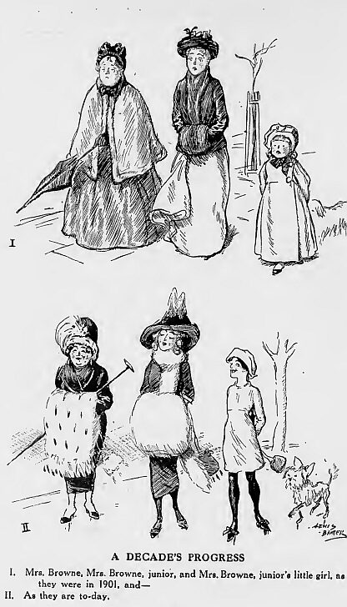
Fashion changes 1900-1910
1890
Clumsy. uncomfortable
Dark, conservative
1910
Sporty, comfortable
…light, open

Slide 9
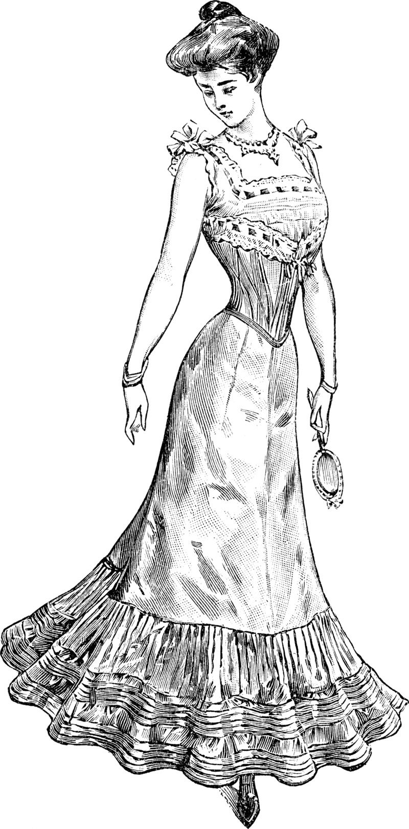
A lady of fashion 1900

Slide 10
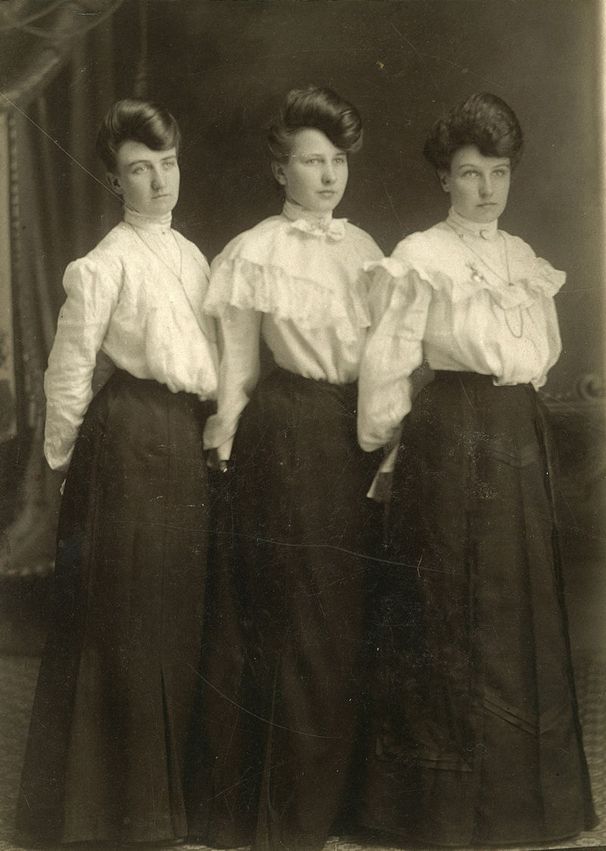
School teachers

Slide 11
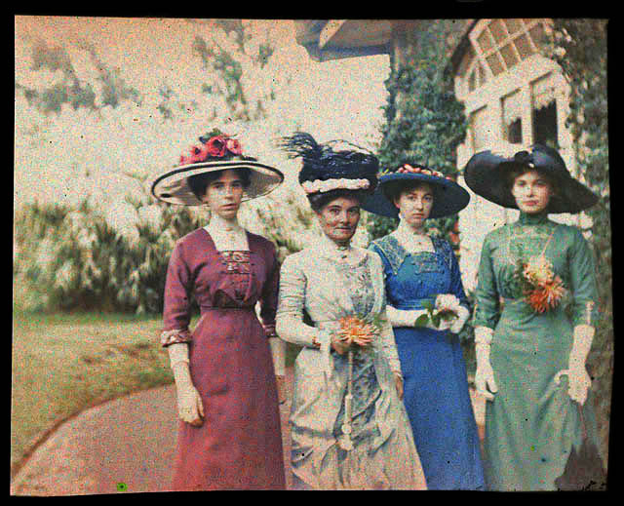
A day out

Slide 12
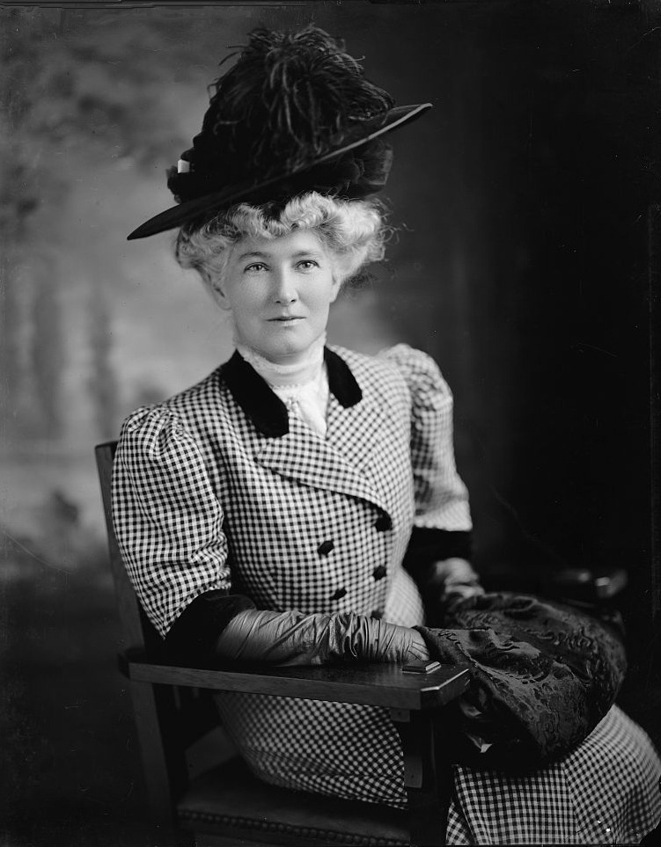
A lady of elegance

Slide 13
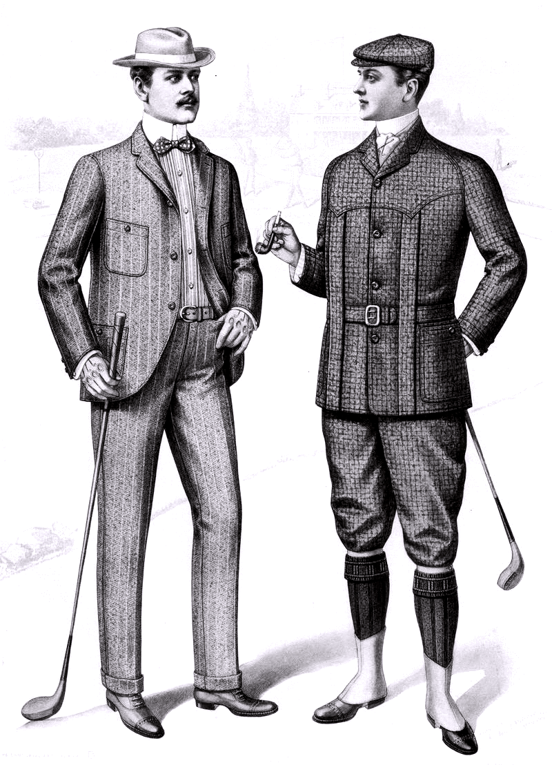
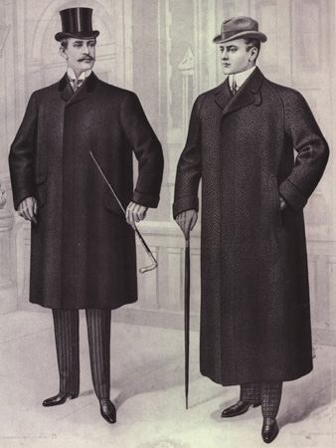
Gentlemen about town and golf course

Slide 14
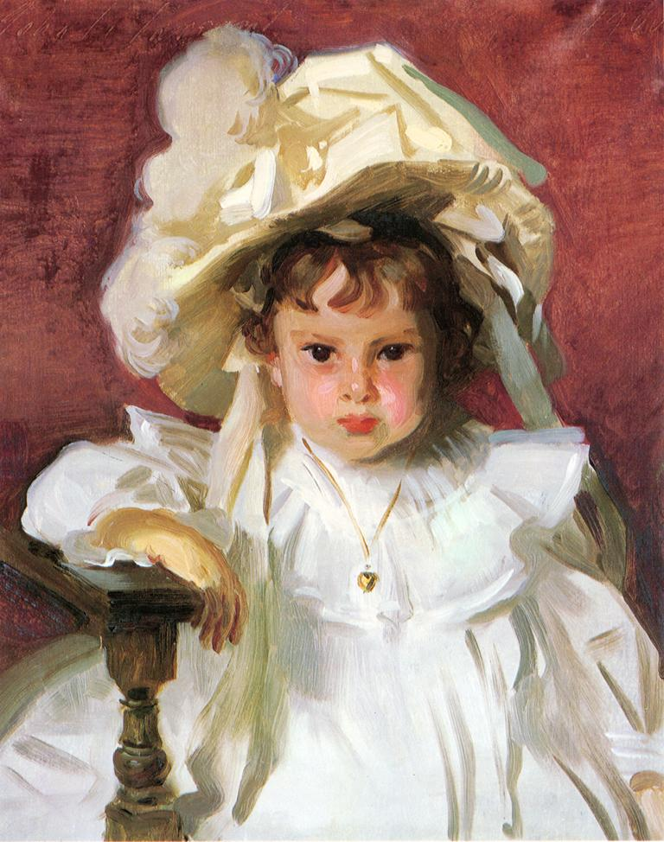
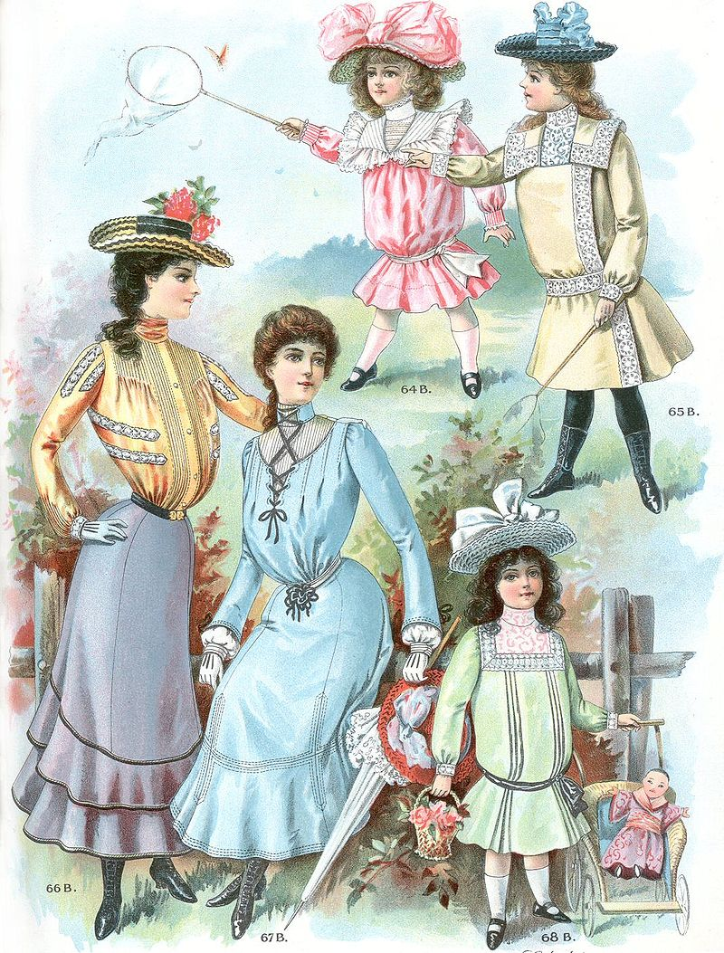
1900 Girls (1)

Slide 15
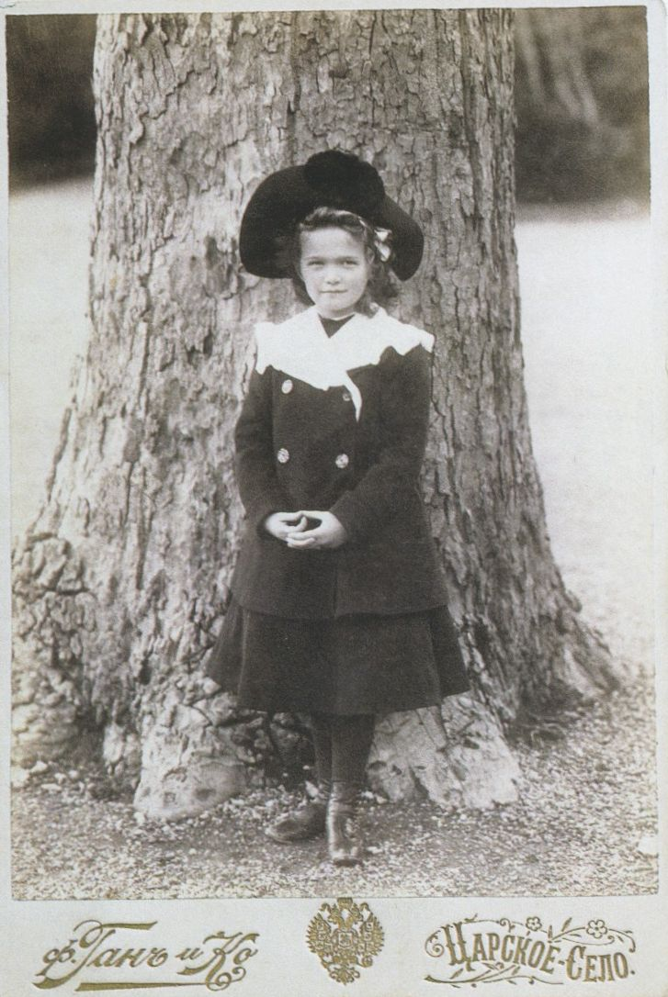
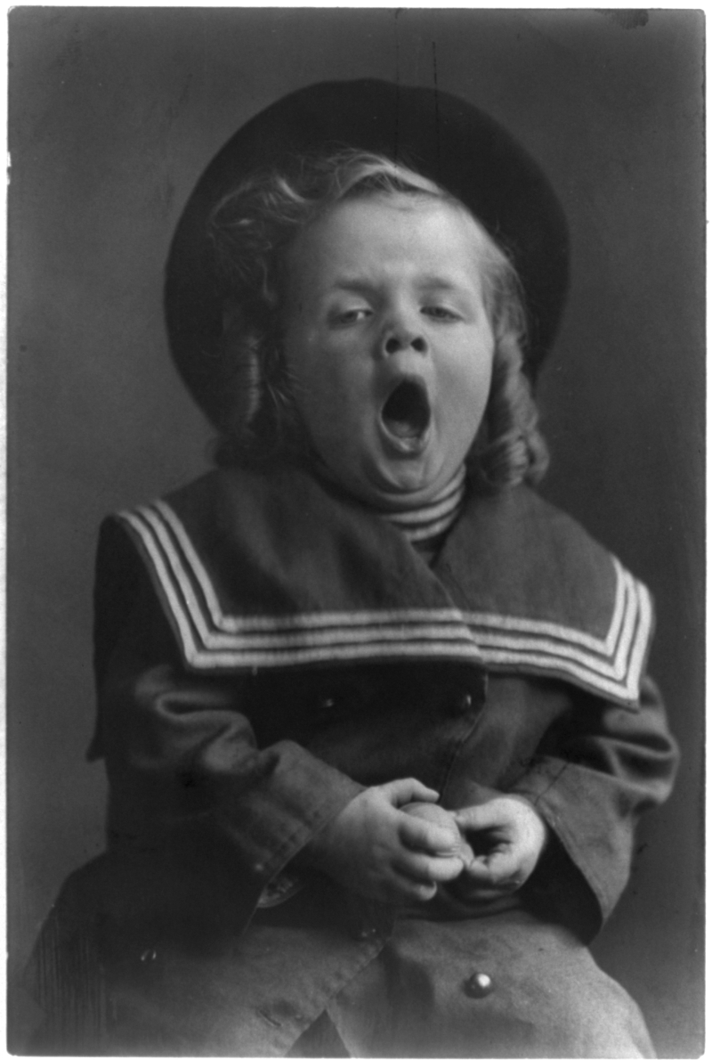
Girls 1900’s (2)
Posing as required
Fed up with posing

Slide 16
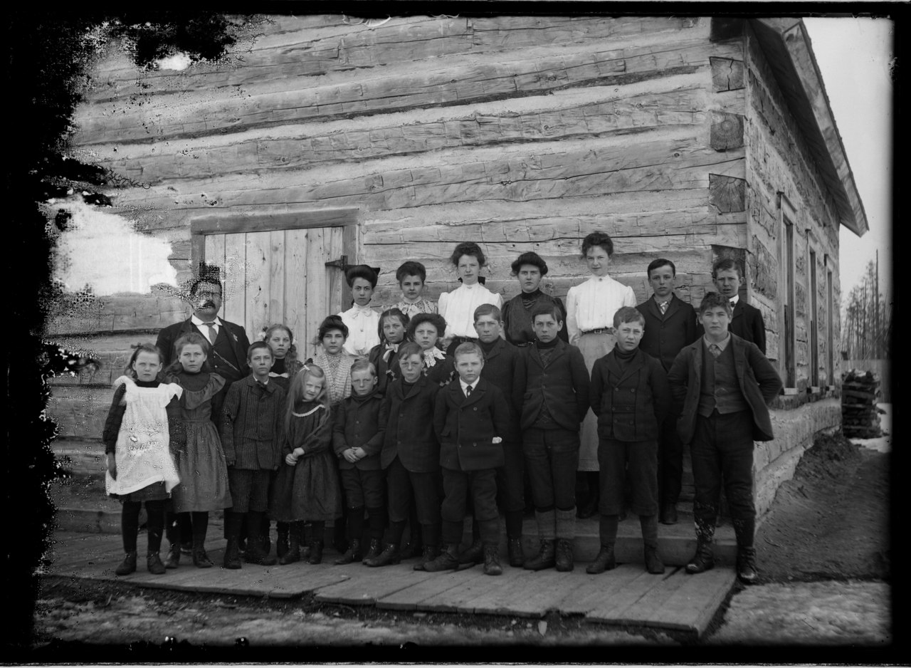
School Children small town 1904

Slide 17
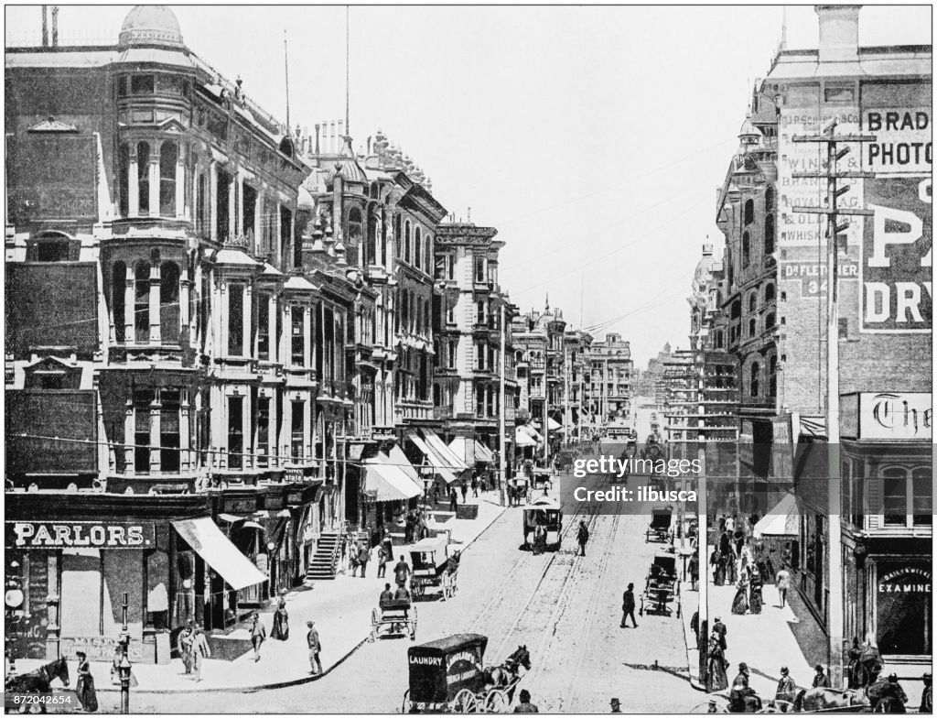
San Francisco 1905

Slide 18
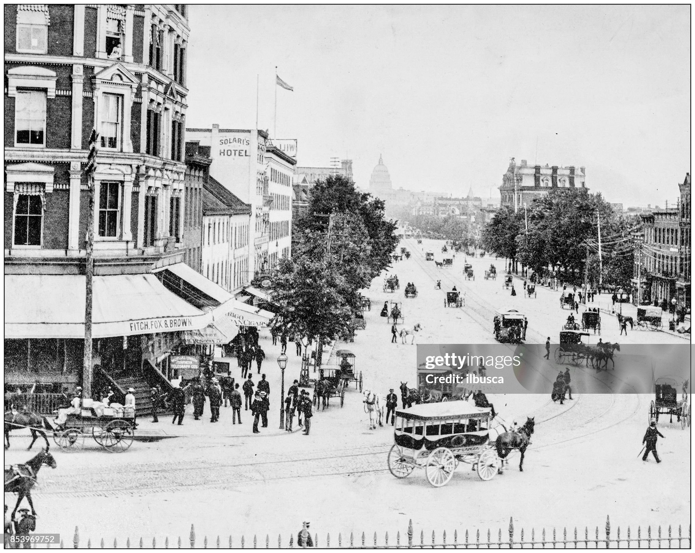
Washington DC 1905 –Pennsylvania Avenue…Capital in foreground

Slide 19
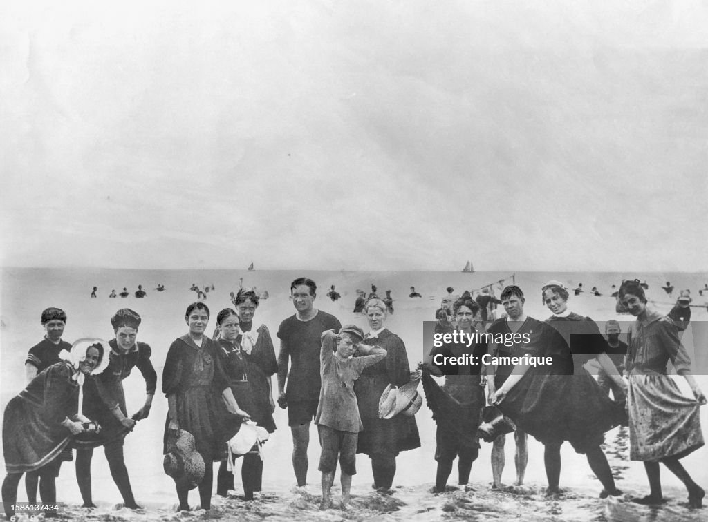
Long Beach California 1903

Slide 20
US becoming an Economic Superpower
World Economy Size $Bn (1990 …Maddison)
 | 1870 | 1913
USA | 98 | 517
United Kingdom | 110 | 224
Germany | 72 | 230
France | 72 | 144
Grows 500%, …twice size of UK
Germany overtakes UK ..grows 300%
GDP per capita $US (1990 …Maddison)
 | 1870 | 1913
USA | 4,800 | 10,100
United Kingdom | 5,200 | 8,200
Germany | 2,900 | 5,800
France | 2,990 | 5,555
Americans 20% wealthier than Britain
British 20% wealthier than Germans

Slide 21
Rapid population increase
Population in millions
 | 1870 | 1890 | 1900 | 1910 | 1920
USA | 38 | 62 | 75 | 92 | 105
UK | 31 | 37 | 41 | 45 | 44
Germany | 40 | 49 | 55 | 63 | 61
France | 38 | 39 | 40 | 40 | 38
A nation of big cities industrialising rapidly
3 largest cities
1870
New York 1,200,000
Philadelphia 600,000
St Louis 300,000
1900
New York 3,400,000
Chicago 1,700,000
Philadelphia 600,000
1920
New`York 5,600,000
Chicago 2,700,000
Philadelphia 1,800,000
London: 3,300,000
7,000,000
7,400,000

Slide 22
An increasingly urban and unequal society
Declining agricultural workforce:
1870 --- 56% of total
1900 ---38%
1920 –20%
1% of population own 45% of national wealth (vs 38% today, 20% 1960)
Highest standard of living in the world…yet much poverty
50% of population living in poverty/ subsistence
40% comfortable
10% wealthy

Slide 23
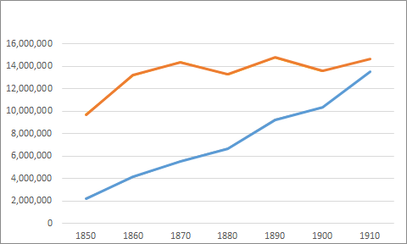
Rising levels of immigration
15 million immigrants 1900-1915
Foreign born % rise from 10%-15%
……British ancestry 50% 1870, 30% 1910
……Irish 5% 1870, 10% 1910
……German 5% 1870, 1910 25%
15%
Level of immigration
New Immigration/ cultures from South & East Europe
……….Italy
……….Poland
……….Russian and Polish Jews
% Population
foreign born
Push: South/ East Europe ….pogroms
Pull: Opportunities…higher standard of living
improved communications, safety family
10%

Slide 24
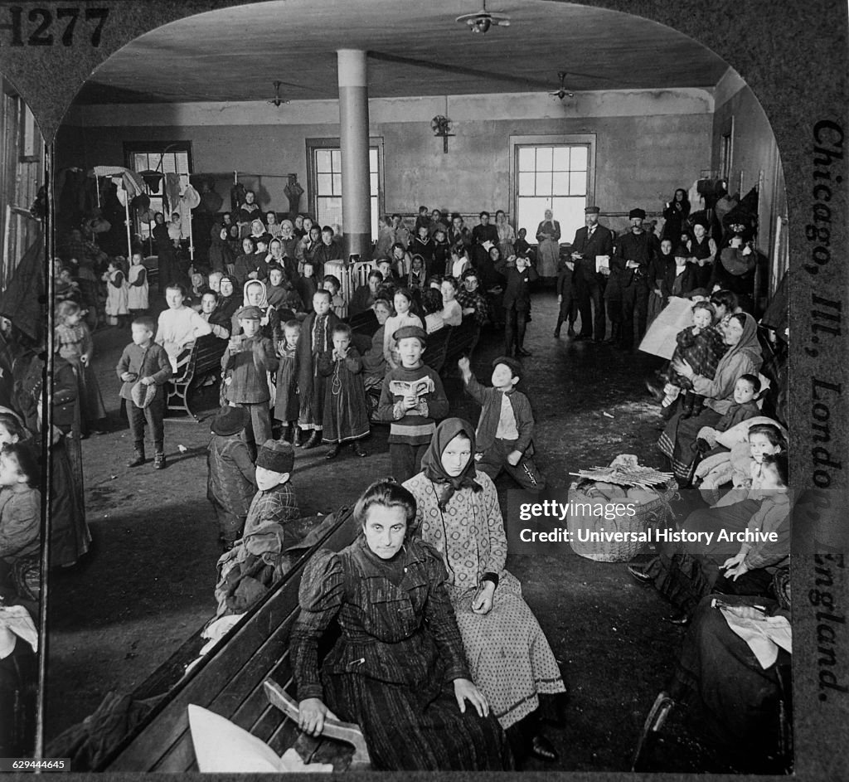
Ellis Island arrivals

Slide 25
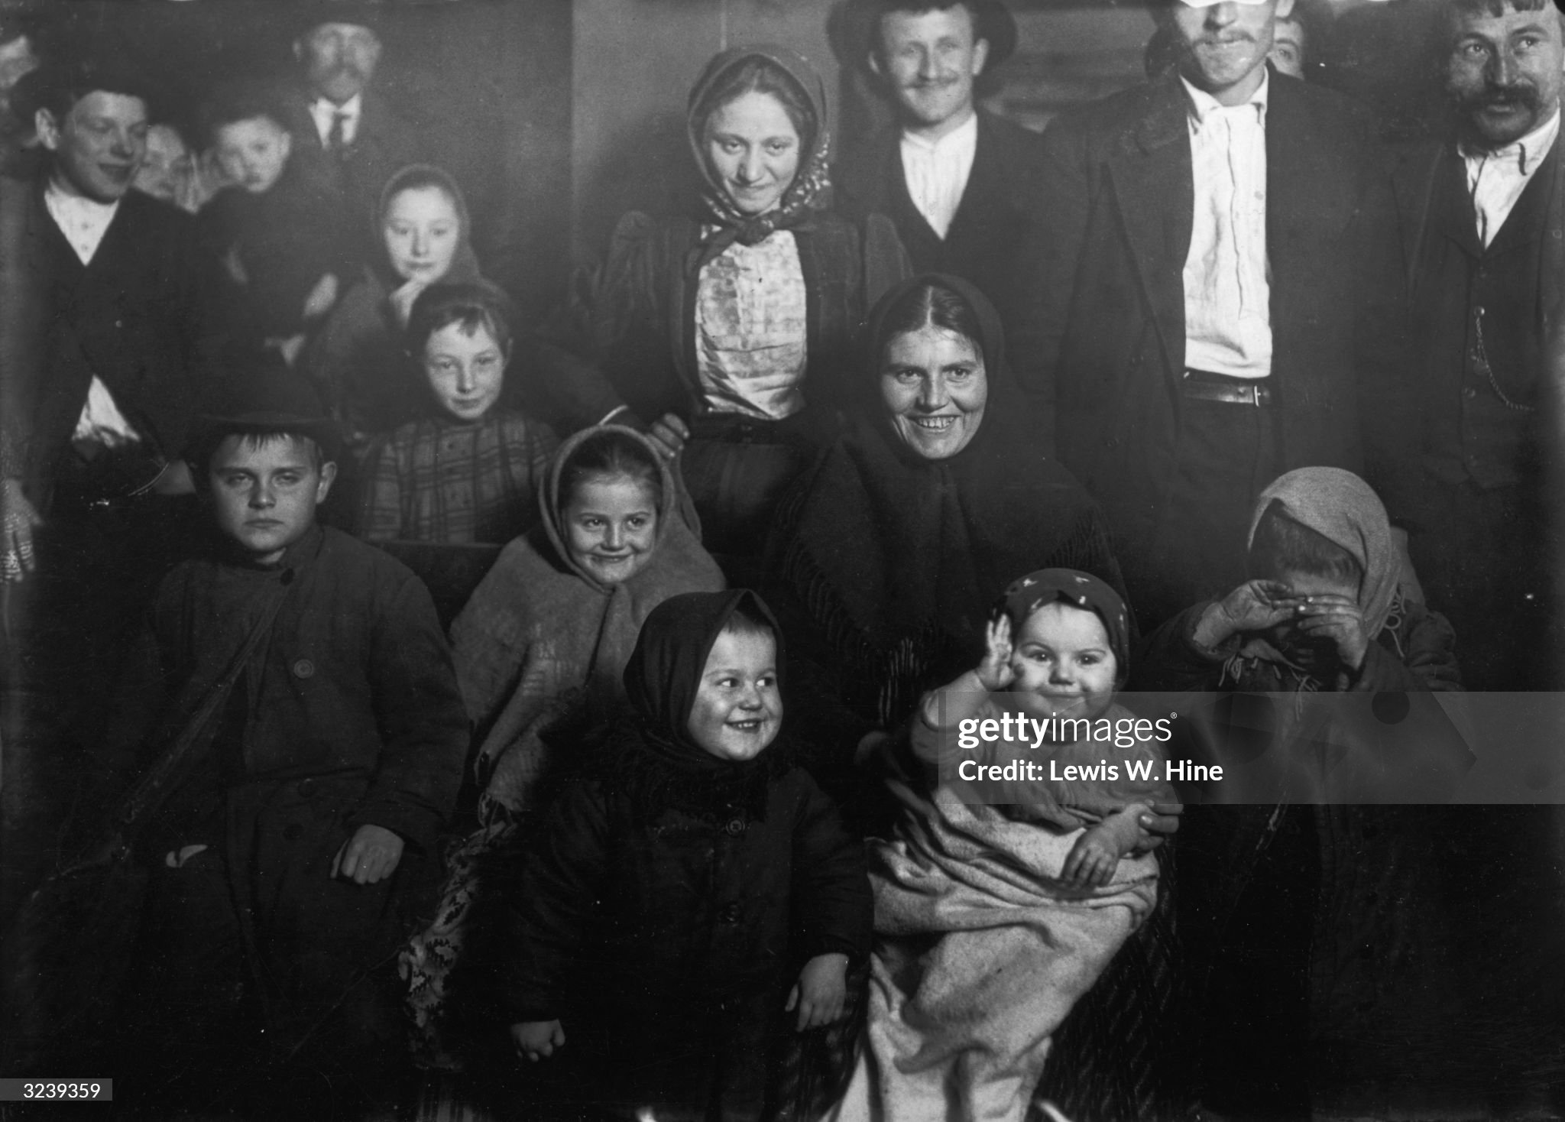
Polish immigrants 1901

Slide 26
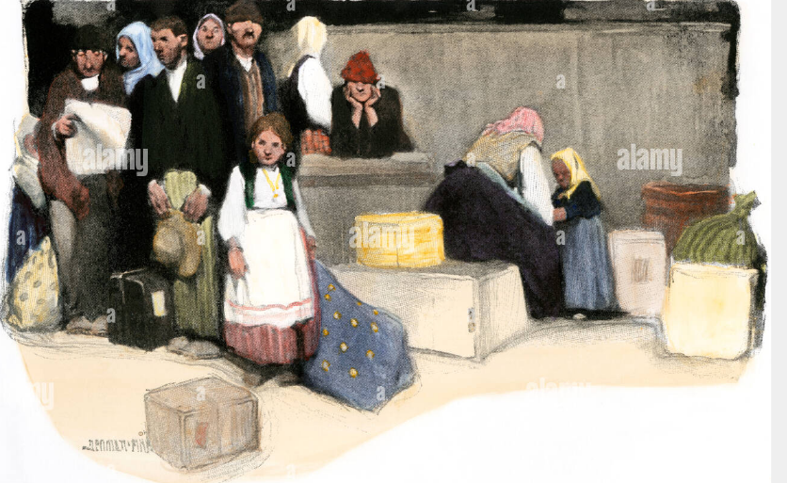
Most from south and eastern Europe

Slide 27
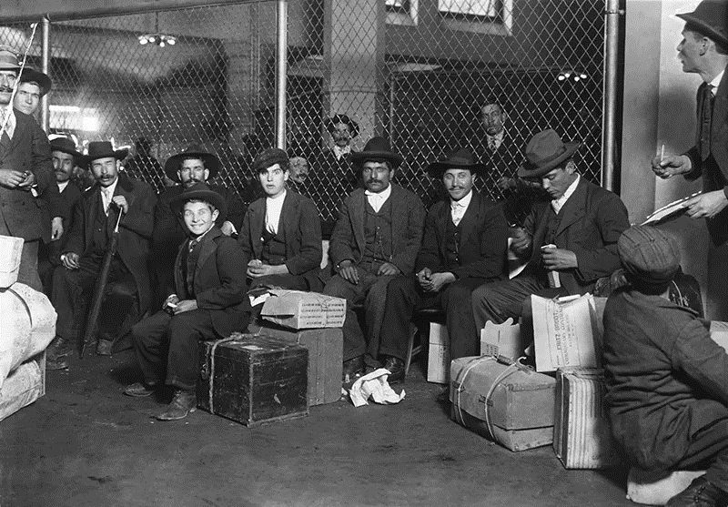
Italian arrivals

Slide 28
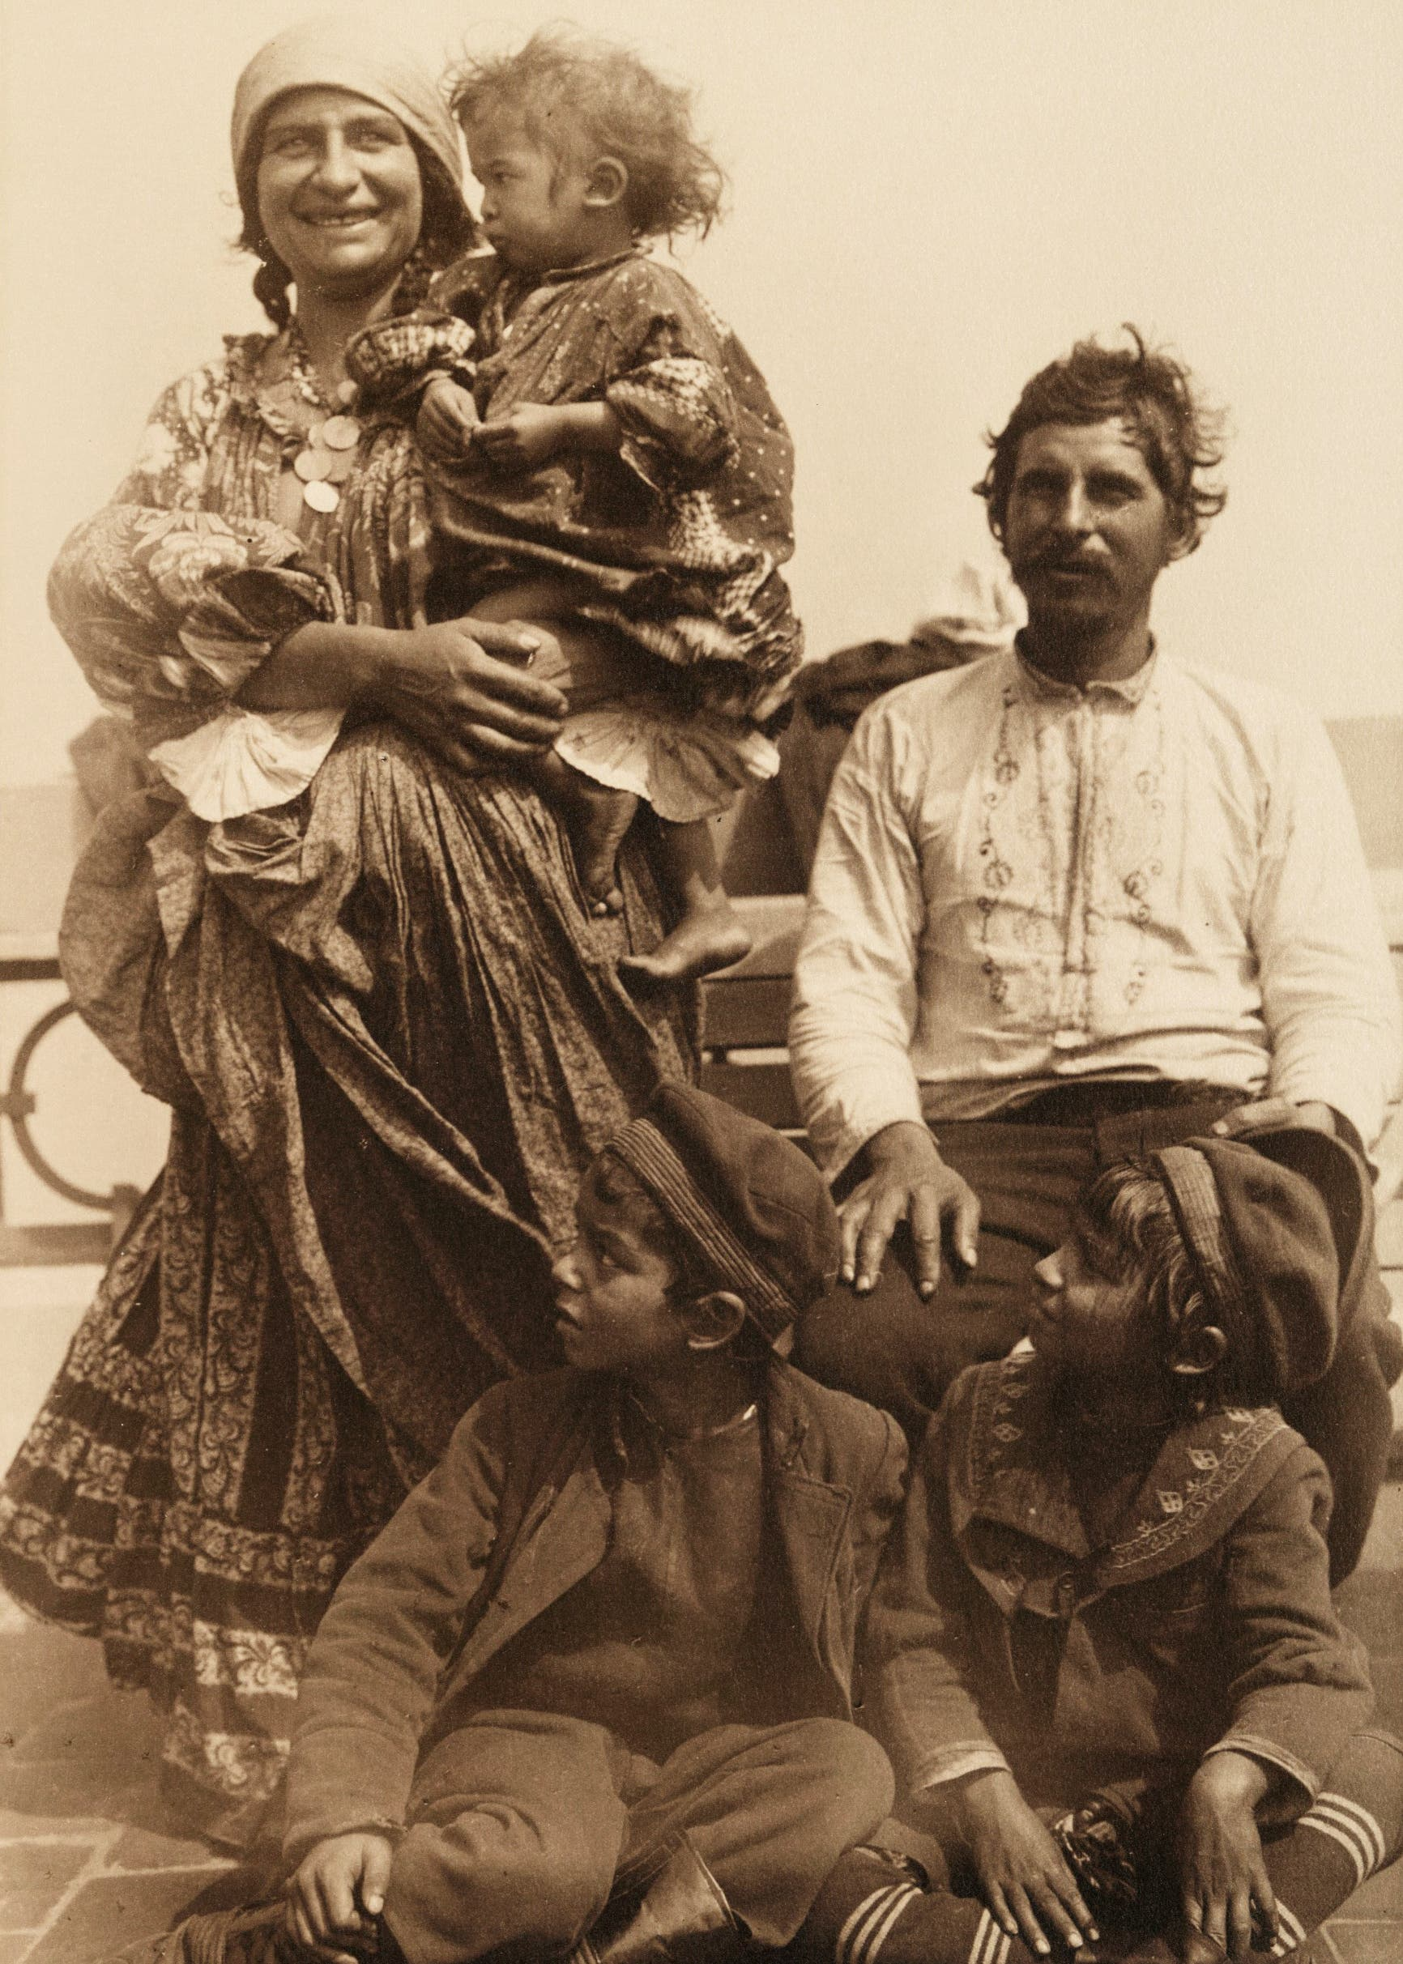
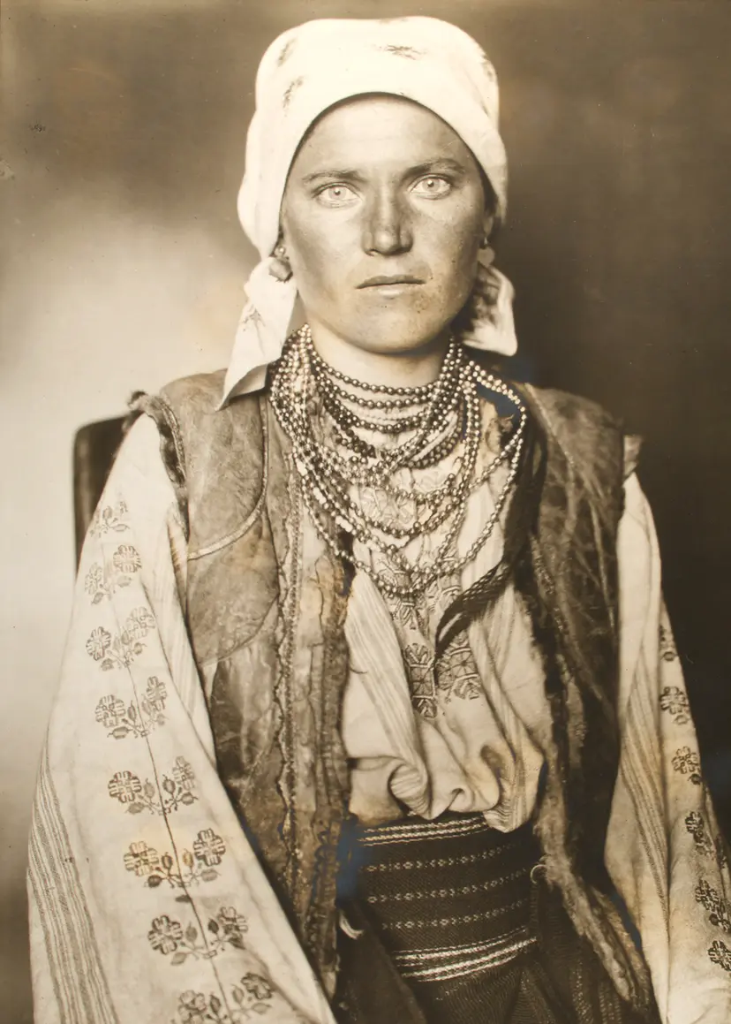
East Europeans
Roma people
Polish

Slide 29
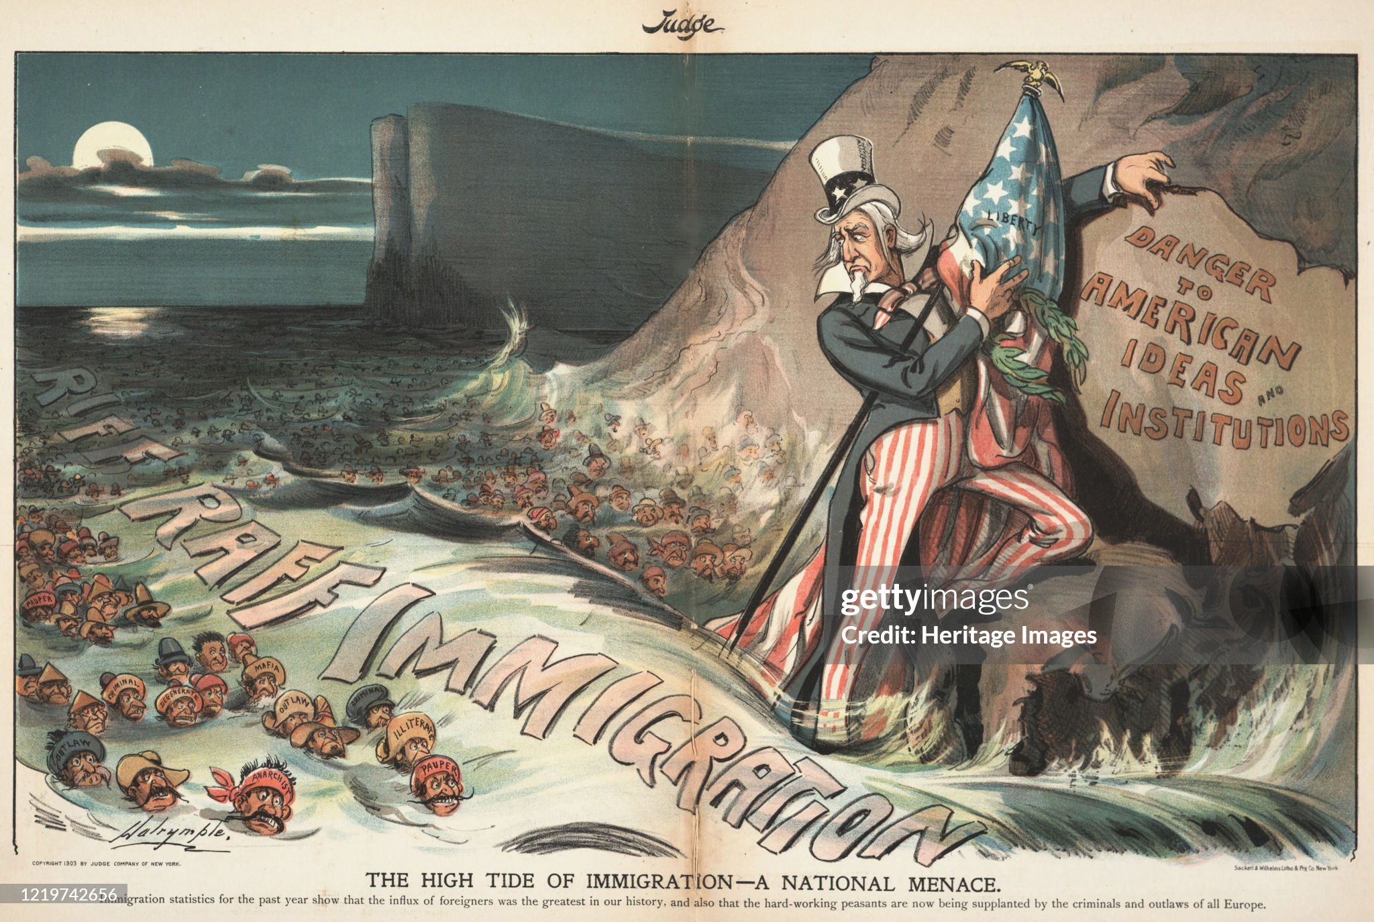
1903 Domestic reaction

Slide 30
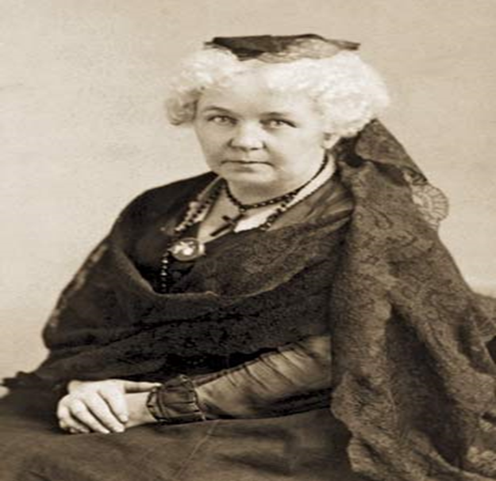
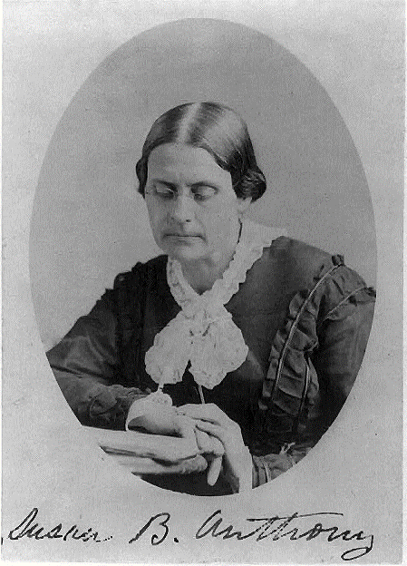
The great partnership
Elizabeth Cady Stanton 1815-1902
Susan Anthony (1820-1906)

