Slide 1
American History
1
Talk 22: A World Power Emerges

Slide 2
Spanish Empire 1898

Slide 3
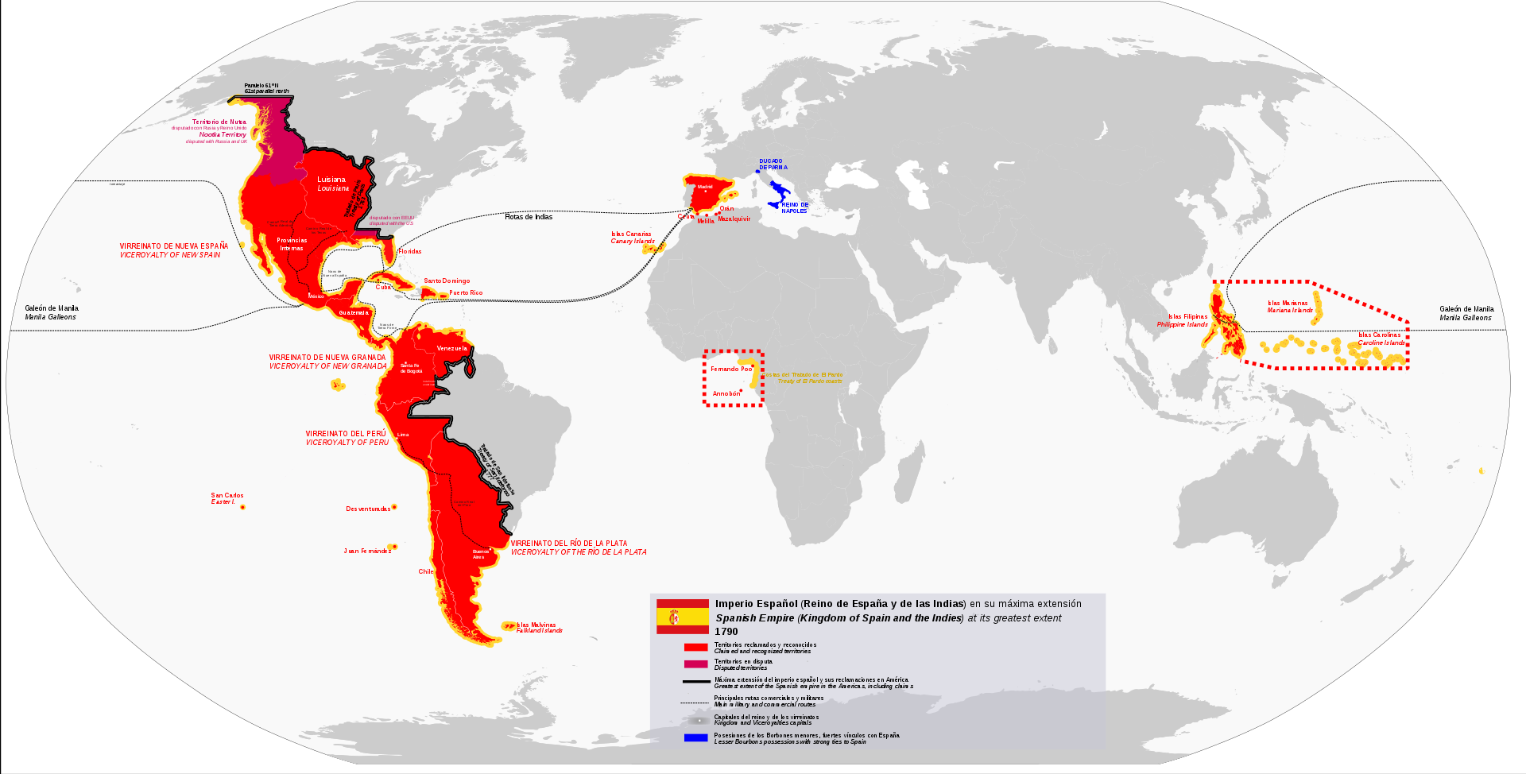
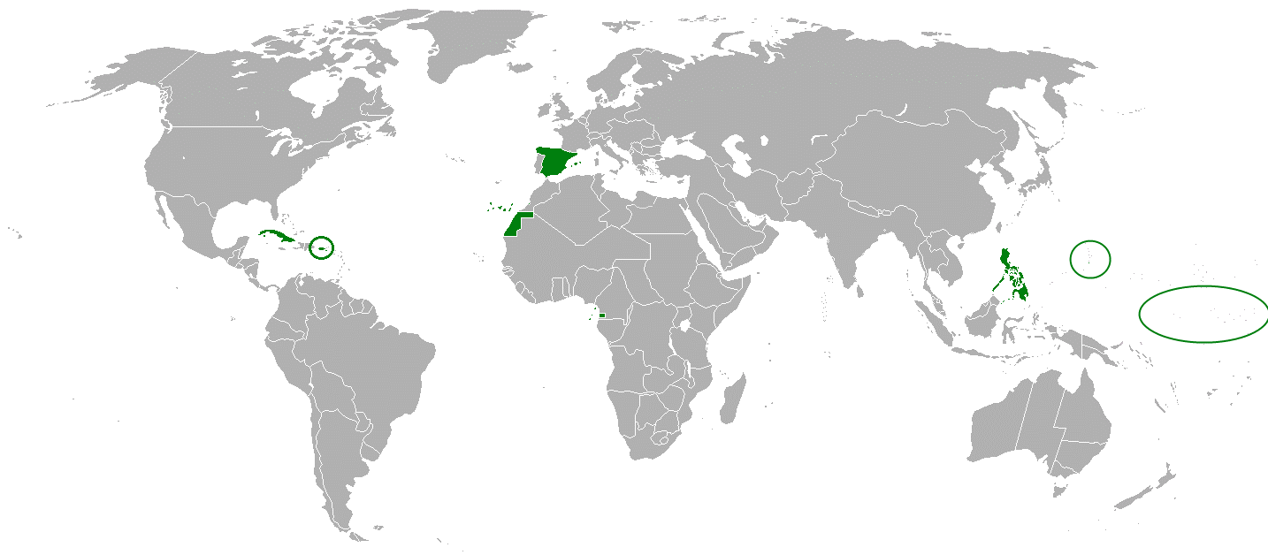
…….The mighty fallen
Empire 1800
Empire 1898
Philippines
Cuba
Puerto
Rico
Guam
…established 1519
….abandon central US to France 1803
…Mexico, S America lost 1810-1830
.. Spain unstable
…wars of Reform: Liberals vs Conservatives
…all colonies under threat,
…vulnerable, ripe for “picking”

Slide 4
Cuba 1800 - 1895
Marginal Spanish colony. 1800---population 150,000
Rise to importance:
Collapse of sugar industry Haitian Revolt
Loyalist migration/ sugar industry mass importation of slaves for sugar industry
1850-1870 US attempts to annex. Offers to purchase/ filibuster invasions
First war of independence
10 years war 1878-1888
Slavery abolished 1888/ Spain seeks to modernise…encourage investment by US
US Sugar/ Tobacco companies dominate economy
.
Rising population despite wars :1.5 million, 1 million white, 250,000 black, 250,000 mestizo

Slide 5
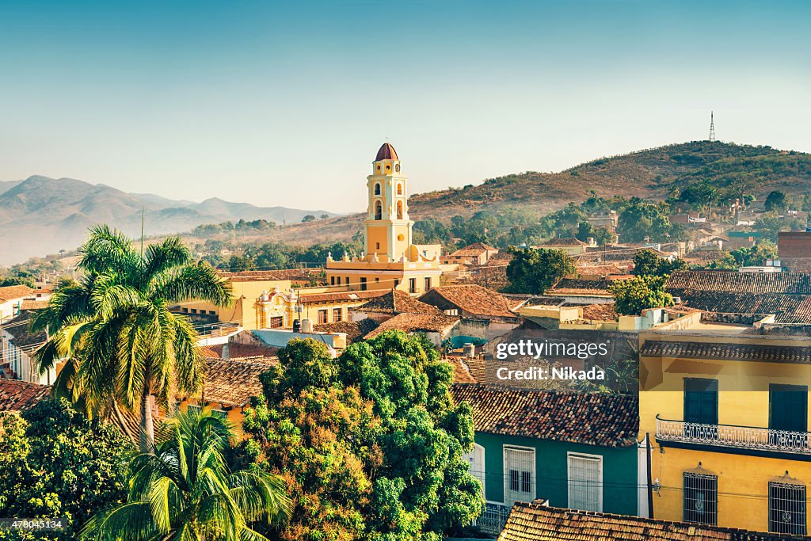
Interior, many small towns/ Spanish architecture

Slide 6
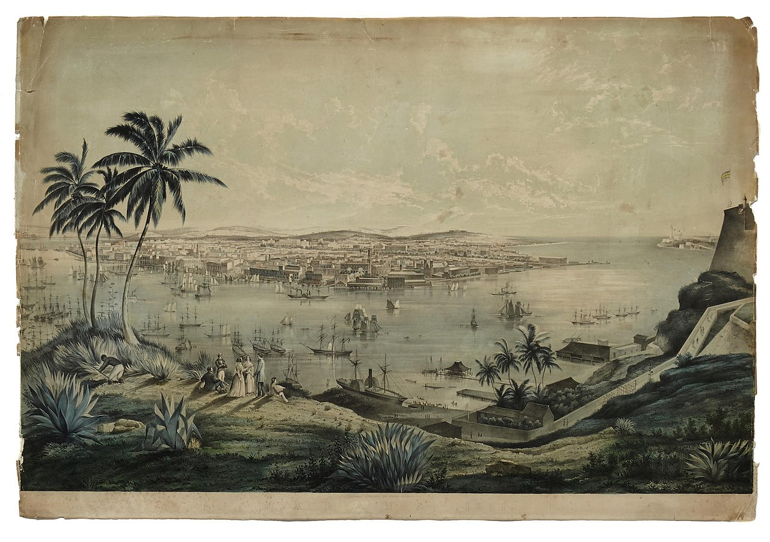
Cuba: Havana 1860: founded 1519 ….capital/ thriving, large middle class

Slide 7
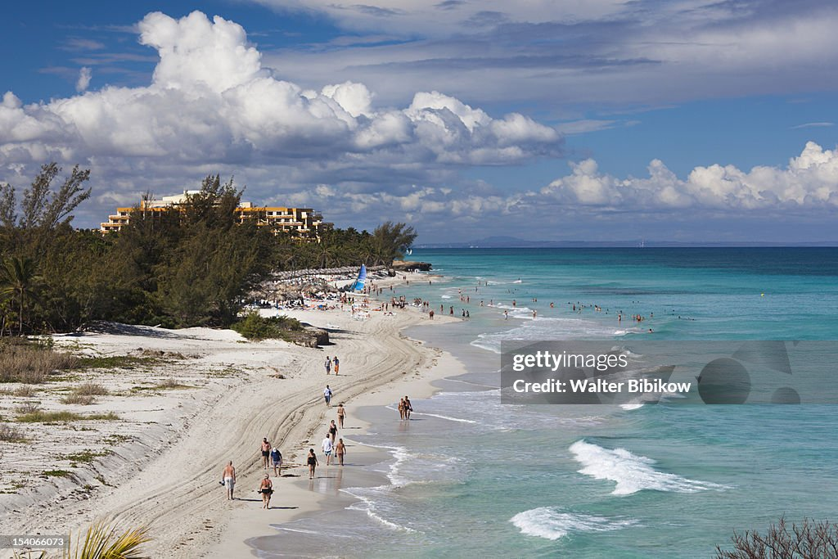
Sandy beaches, warm seas

Slide 8
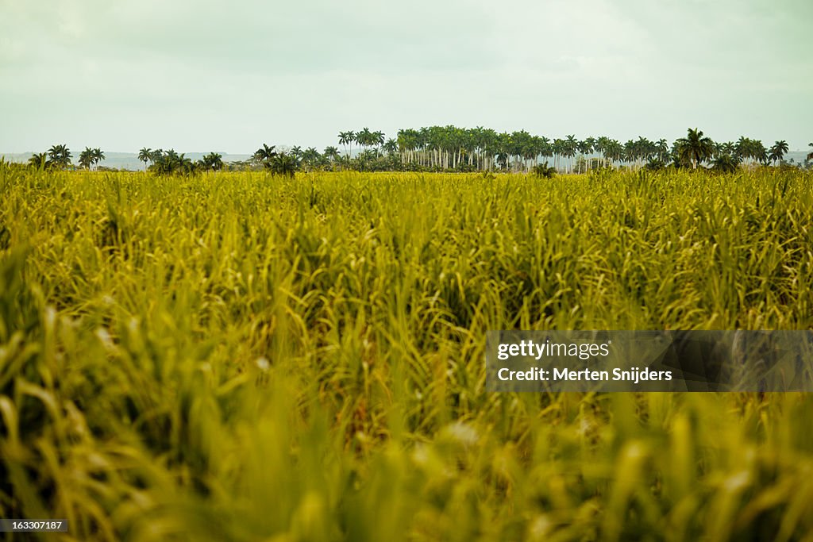
Perfect conditions for sugar cane

Slide 9
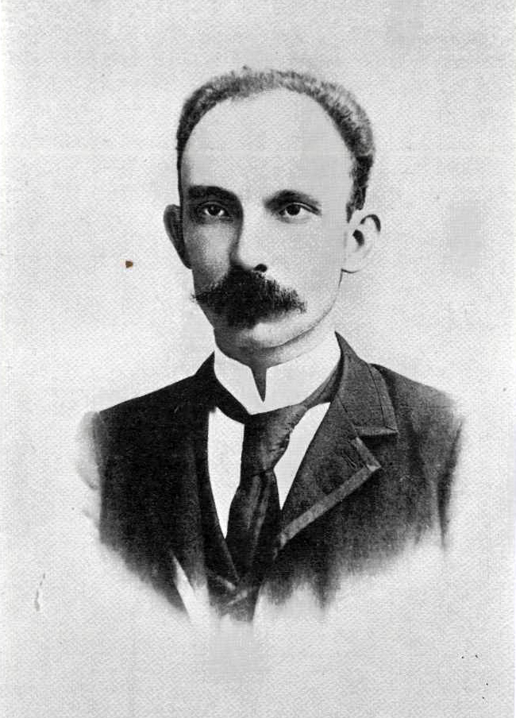
Jose Marti (1853-1895): Cuban nationalist
Born to Spanish parents
Liberal democratic nationalist. Poet
Writer, anti slavery, democrat
Joins war of independence
Exiled to Spain…
Studies law in Spain
…prolific writer argues for Cuban independence….
…forbidden to return to Cuba
….visits Guatemala, Venezuela, US & Mexico
….fears US colonisation
Joint leader with Jose Gomez1895
….simultaneous landings
… distrusts Cuban elite/dictatorship
… believes Gomez seeking dictatorship
…Marti killed in battle

Slide 10
2nd war for Cuban Independence
Marti/ Gomez expedition lands in Cuba…widespread support
Spanish General Weyler imposes concentration camps policy
30% rural population die from disease/starvation.
Spanish control cities/ rebels countryside
Spanish army of 200,000…yellow fever outbreak
Cuban Junta: exiles in US, lobby for support vs Spain, worry about annexation
New Liberal government in Spain attempts accommodation:
Offers autonomy to Cuba within Empire, civilian rule 1897
Rebels ignore...war continues
Loyalist riot December 1897…S businesses under threat
US sends USS Maine new battleship to protect US citizens January 1898

Slide 11
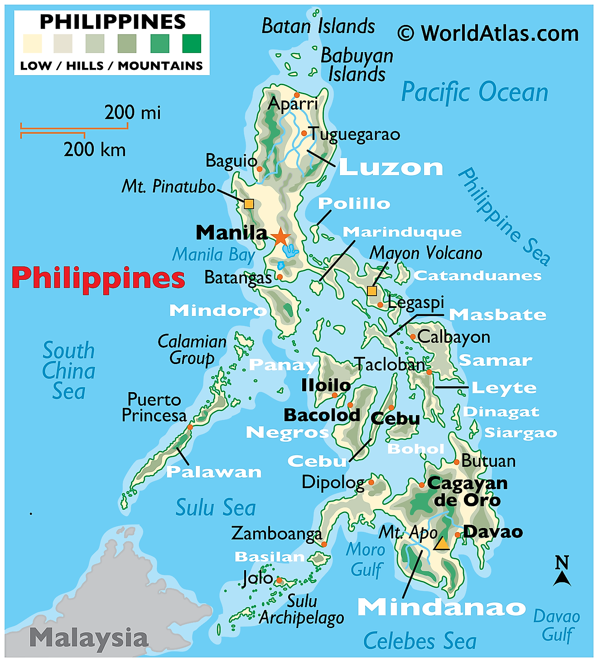
Philippines

Slide 12
Philippines 1500 - 1895
Thousands of islands and small kingdoms
Polytheist north/ Muslim sultanates in the South
Mosaic of cultures: Chinese, Indigenous, Indonesian
Philippines as Spanish colony
Colonised 1560 …control centred around cities/ divide and rule
Spanish and mestizo less than 3% of population
90% population indigenous people …already immune to disease due to centuries of trade
Economic drain on Spain. Subsidised by Crown…control nominal
……multiple local revolts/garrison of 10,000 –population of 7 million.
Organised nation-wide Independence movement emerges 1880’s
…Elite led…university educated & middle class
….Muslim south rejects any central authority

Slide 13
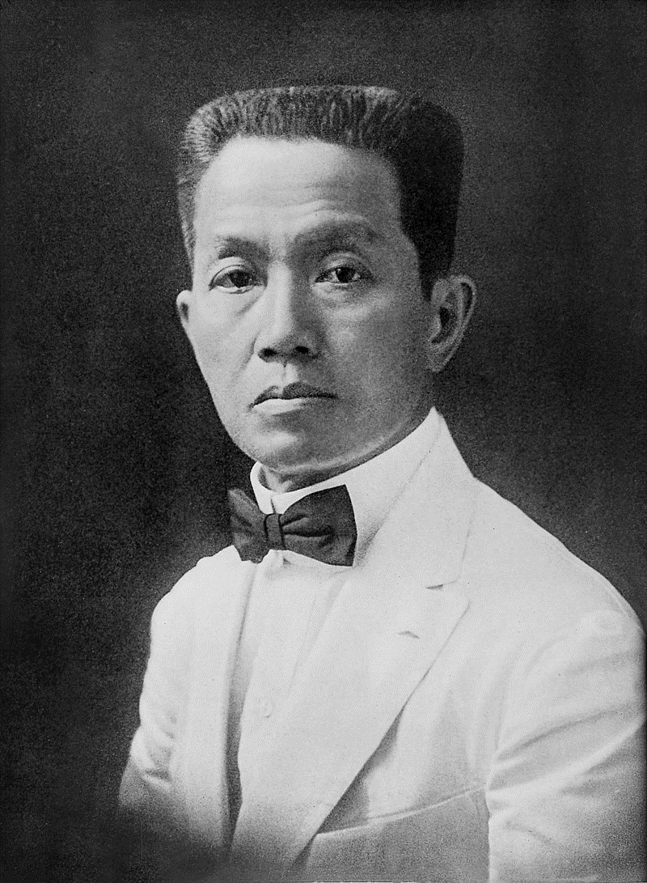
Emilio Aguinaldo (1869-1964)
Born to Chinese/ Indigenous
Wealthy family….Catholic and
Freemason. Father municipal
Governor..
Inherits control of administrative region.. Joins revolt vs Spanish 1895
Leads revolution. Guerrilla war
Vs Spanish (small 20,000) army
Accepts defeat 1897 …in exchange
for £25m (todays money) “indemnity”
paid by Spanish….exiled to Hong Kong
Creates “Government in exile”
…contacts Americans for help

Slide 14
Other Spanish Colonies
Puerto Rico
…population 1,000,000, 60% white, 30% mixed, 10% black
…No major independence leader
….reformists split 30% independence /30% remain in Spain/ 30% join US
…movement forms 1895 but no major wars as in Cuba
Guam:
population of 15,000, 95% Polynesian
…garrison of 50 soldiers
…coaling station, fishing
Other Pacific Islands
…remote, sparsely populated

Slide 15
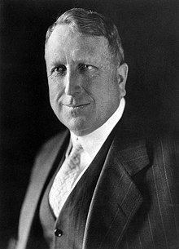
Randolph Hearst (1863-1951)
Newspaper tycoon…San Francisco
Examiner, NY Post….circulation battle
Pioneered “yellow journalism”
…scandal
…emotion
…sensationalism
Multiple stories on Spanish war in Cuba
….made up interviews and stories
..some true…most not
Commissions artist Fredric Remington to
Portray Spanish atrocities
….”can’t find enough evidence for pictures”
….Hearst “Find. You provide the pictures,
I’ll provide the war”
“War fever” spreads across US/ esp NY
….Republican agenda
…..genuine moral outrage at camps

Slide 16
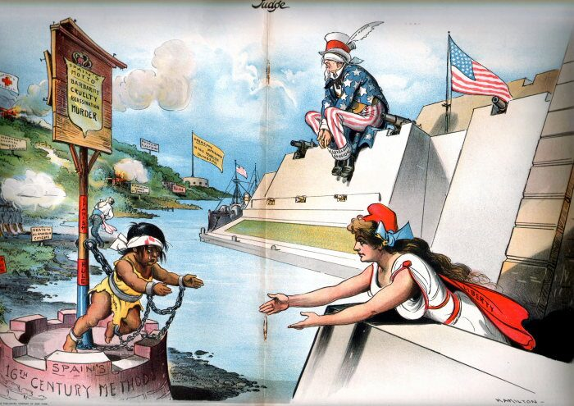
Hearst Newspaper….US ignoring suffering

Slide 17
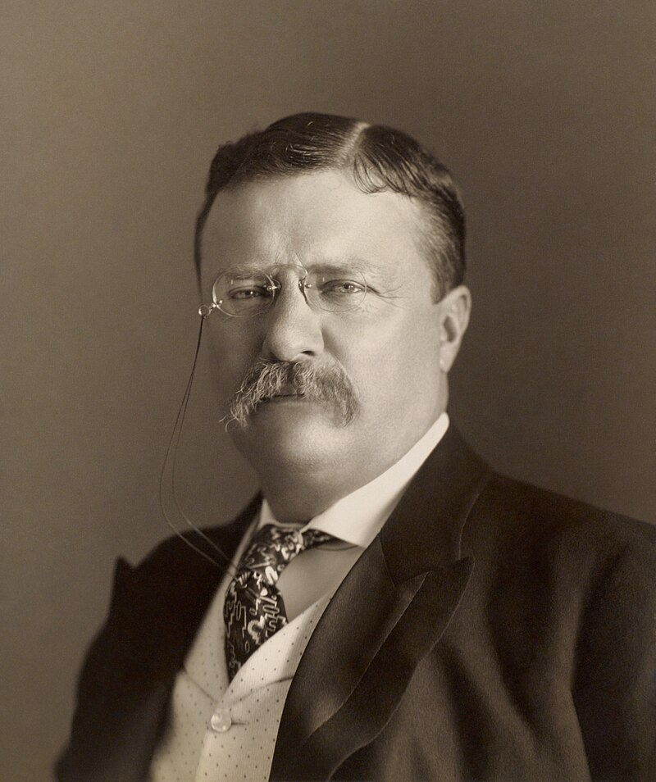
Theodore (‘Teddy’)Roosevelt (1858-1919)
Sickly son born into wealthy
NY family…home schooled
…studies Naval History
..book “War of 1812”
Drops out of law school to
Enter politics “I intend to become
One of the governing class
Enters NY politics as Republican
..freed from corruption by wealth
…reforms local government
…too popular for machine politics
Wife dies…mourning
..buys ranch in Dakotas for 2 years …pearl pistols/ tough/ popular
Returns to politics 1886..remarries
… NY Police commissioner,
… Professional police force
… Enters Republican politics
…. America destiny, naval power

Slide 18
Roosevelt and War
Supports McKinley…views Bryan as a fanatic….appointed Assistant Undersecretary for
Navy…Naval Secretary ill. ‘Teddy’ runs navy…
1897 quote…
“ I would regard war with Spain from two viewpoints: first, the advisability on the grounds both of humanity and self-interest of interfering on behalf of the Cubans, and of taking one more step toward the complete freeing of America from European dominion; second, the benefit done our people by giving them something to think of which is not material gain, and especially the benefit done our military forces by trying both the Navy and Army in actual practice.”
Orders US Pacific Fleet to prepare for war with Spain

Slide 19
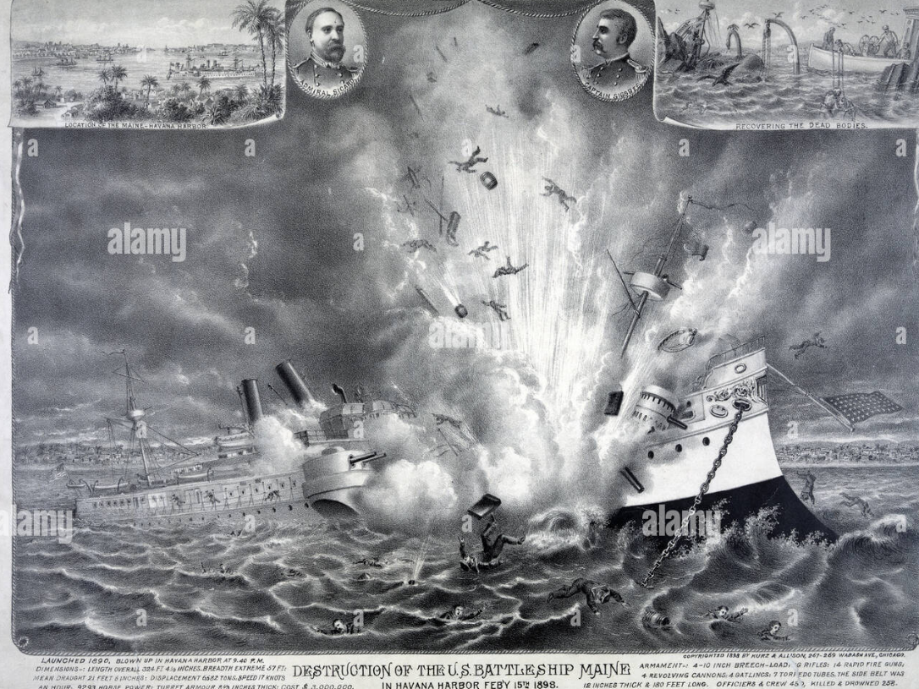
February 1898 USS Maine blows up in Havana …266 of 400 crew killed

Slide 20
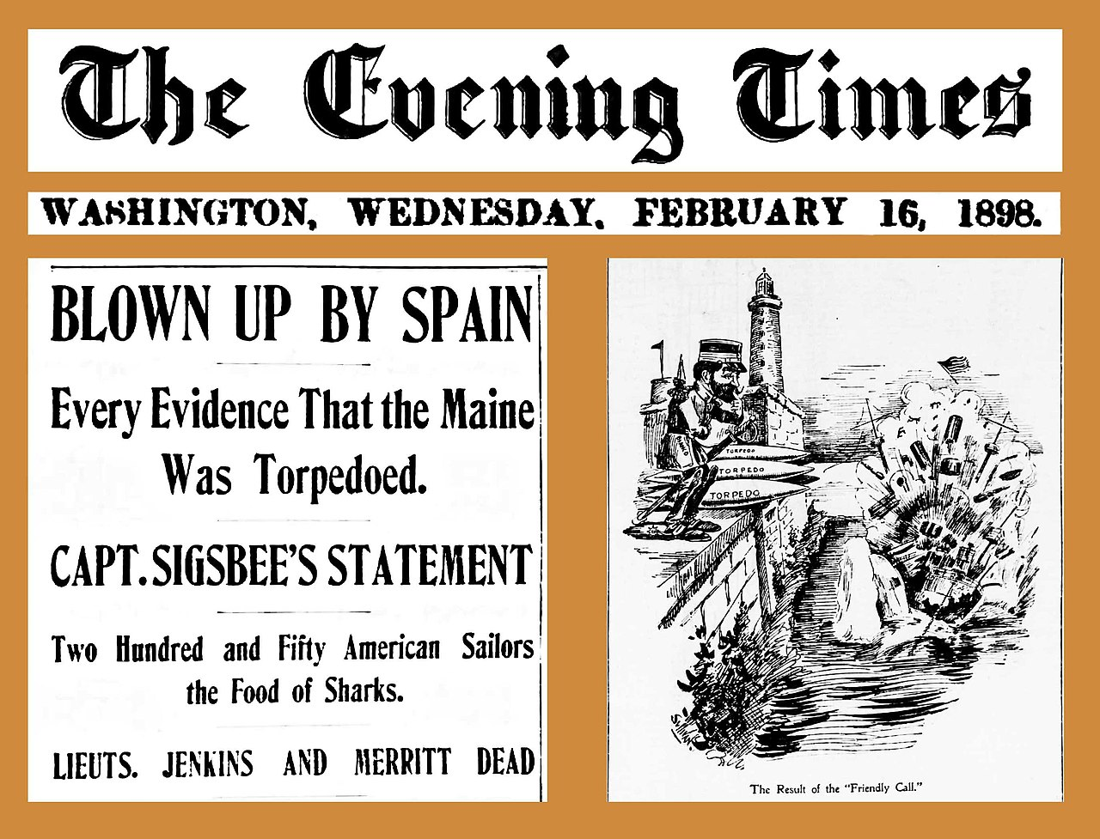
Spain blamed…immediately (1972 ….internal explosion..1999…mine)

Slide 21
Road to war
McKinley seeks inquiry and avoid war
Congress demands Spain give Cuba independence/ McKinley approves
US will invade Cuba unless Spain complies. No mention Philippines
Pass “Teller “amendment: US will not make Cuba colony
Spain rejects demands.
"the Spanish nation is disposed to sacrifice to the last peseta of its treasure and to the lastt drop of blood of the last Spaniard before consenting that anyone snatch from it even one piece of its territory“
Declares war against USA
McKinley response: “ We go to war only to make peace. We never went to war with any other design. We carry the national conscience wherever we go.”

Slide 22
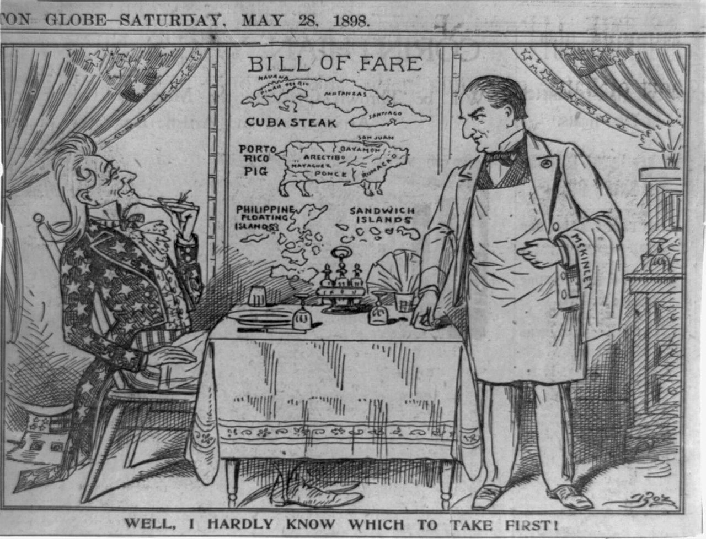
US and Empire 1898

Slide 23
…….A lop sided war
Spain
Weak navy…collection of old cruisers and gunboats
Professional army dispersed across globe (200,000 Cuba, 20,000 Phillipines
Central government weak….PM assassinated, civil wars/ Conservatives vs Liberals
Fight war for “honour”…accept defeat inevitable
USA
Strong navy…fleet of modern battleships and cruisers built in 1890’s
United public support
Army of 25,000…calls for 200,000 volunteers…300,000 enlist
Supported by 200,000 Cuban nationalists, 100,000 Filipinos
…..US Army ‘created’ over three months….
…..Teddy orders navy to destroy Spanish fleet in Philippines

Slide 24
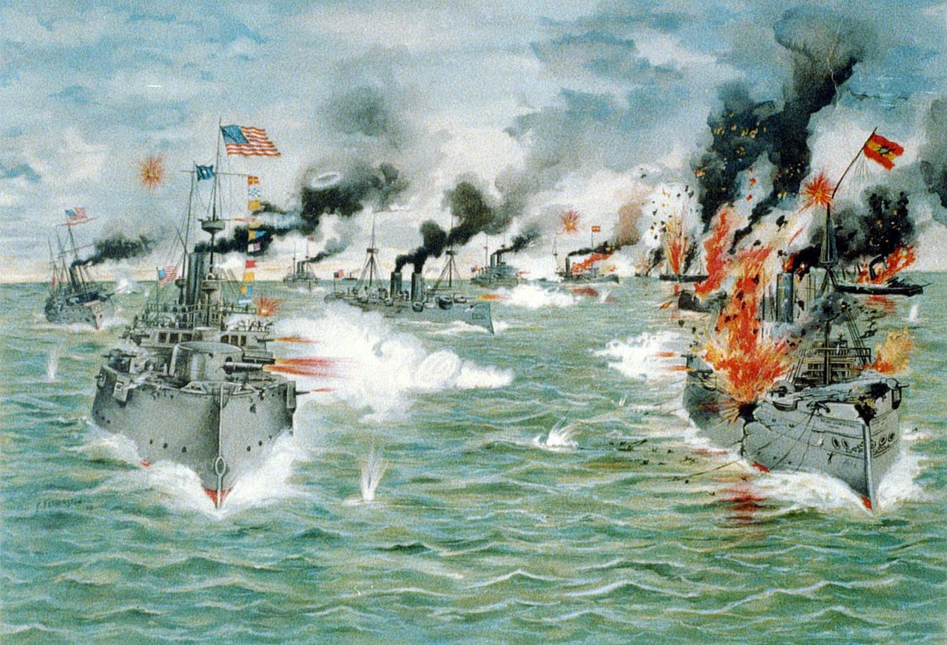
War in Pacific (1) : US Navy enters Spanish Manila…Spanish fleet destroyed

Slide 25
War in Pacific (2)
US fleet blockades port of Manila/
Transports Aguinaldo from exile to lead Filipinos, promises independence
Aguinaldo leads Filipino Revolt
Controls countryside and most of main islands by 1897
Declares Independence June 1898---not recognised by Spain or USA
US lands army of 25,000 July 1898 to seize capital
Spanish agree to “symbolic defence” of Manila with US Ambassador
Communication break down and “battle”…Spanish surrender
Spain agrees to surrender Philippines to US for $20 million
US declares Philippines a colony…ignore Aguinaldo….waits to see US decisions
US invades Guam
US bombard coast
Spanish garrison thinks this salute…unaware of war. Ask for ammunition to respond

Slide 26
War in Caribbean (1)
Spanish army of 150,000
Spread across island & weakened by disease
Retreat towards capital and ports
Ongoing war between Spanish army and Cuban
Most of countryside controlled by rebels led by Gomez (Marti killed)
Joined by 50,000 Cuban revolutionaries
US lands July 1898
Army builds up to 275,000…volunteers from across US
17,000 troops land…include black regiments….to support future occupation

Slide 27
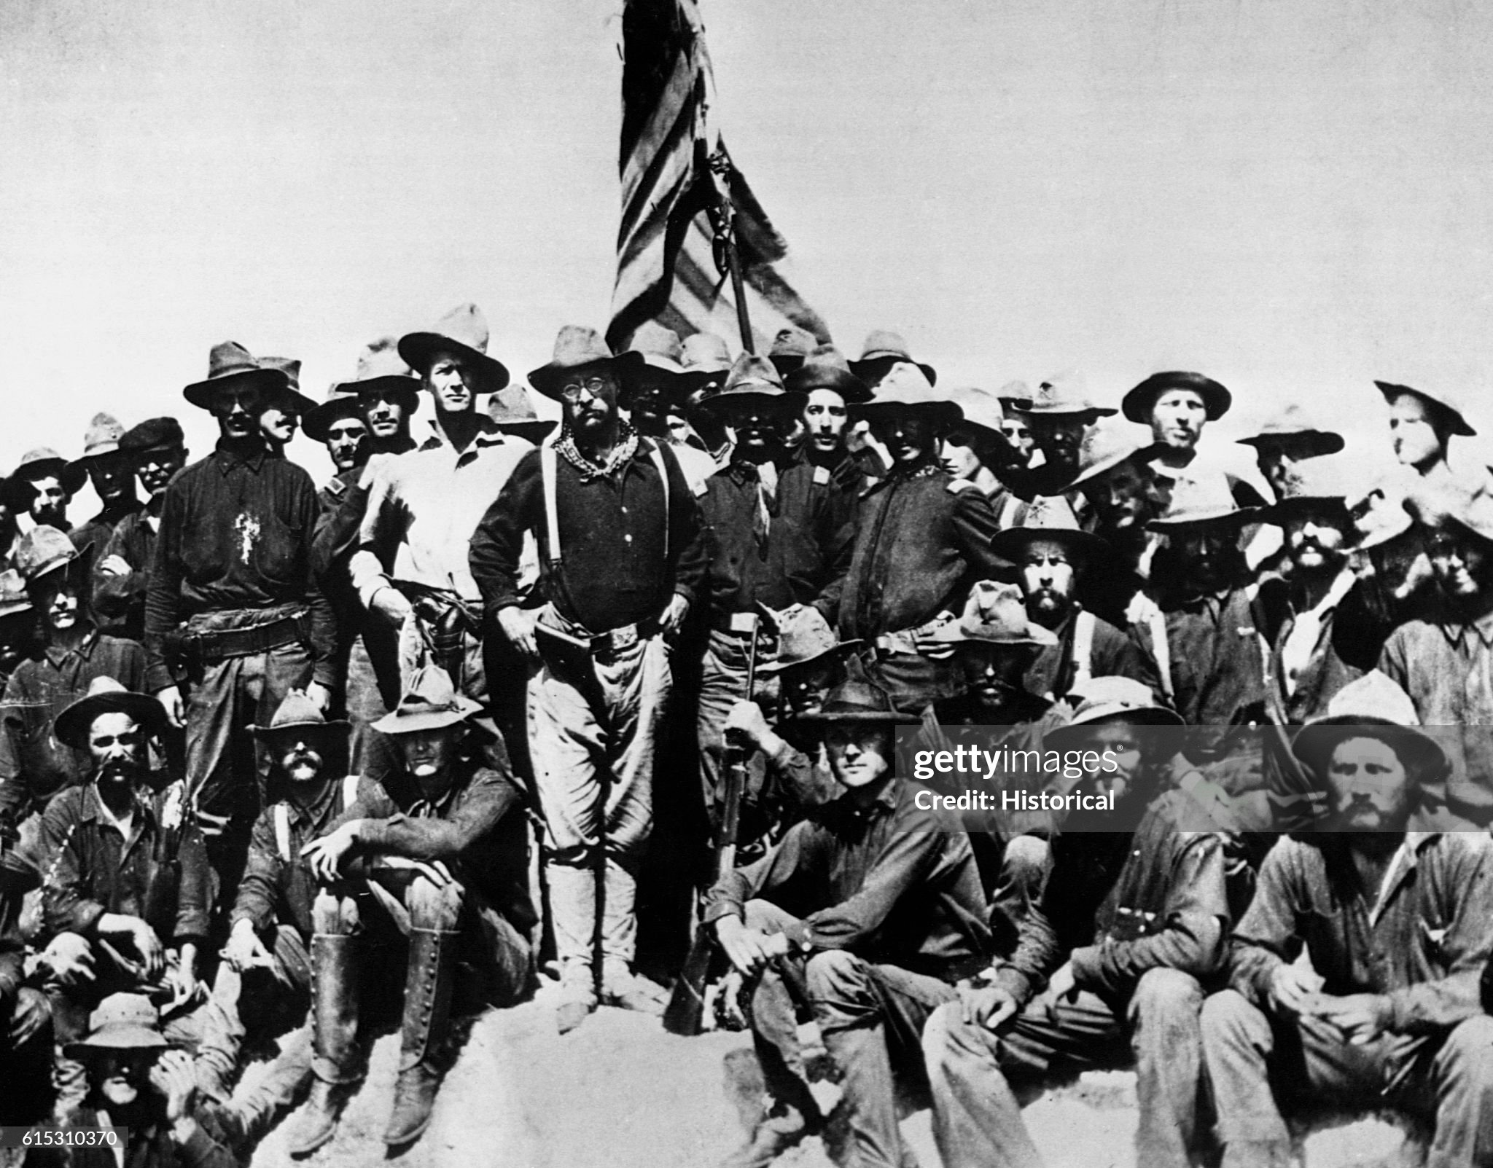
Teddy Roosevelt goes to war
Teddy’s father avoided
Civil war…paid substitute
Wants glory/ proof of
Manliness/ political future Abandons Navy Job and recruits private army…ex Cowboys/goes to Cuba…”Rough Riders”
Spanish army facing
Gomez army + US..
Withdraws Havan
Leaves rear guard.
US decide to attack

Slide 28
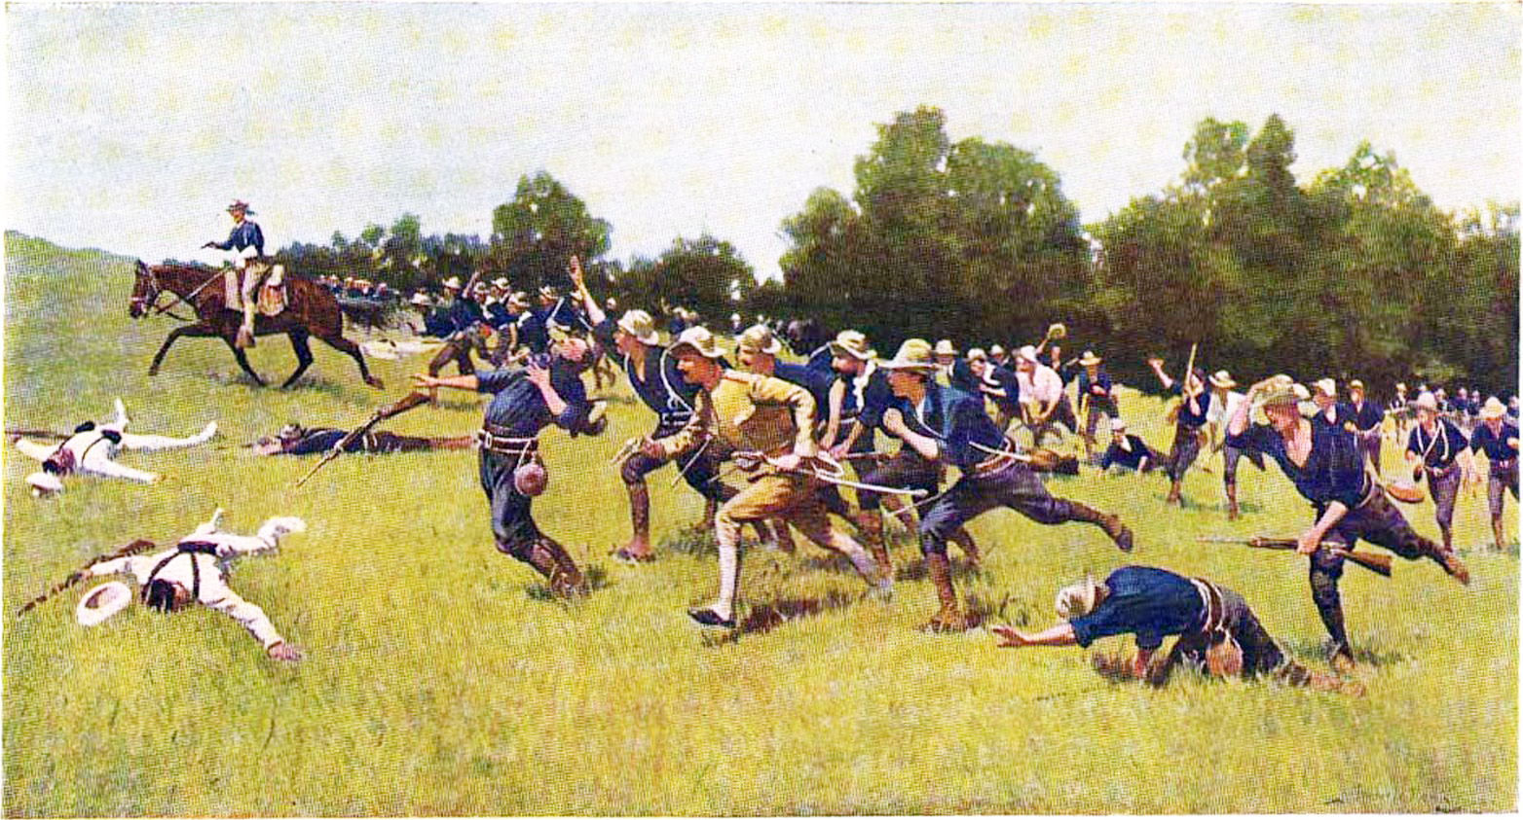
Storming of Kettle Hill …Teddy Roosevelt & “Rough Riders” …capture positions…Teddy leads charge..200 killed, 1,000 wounded

Slide 29
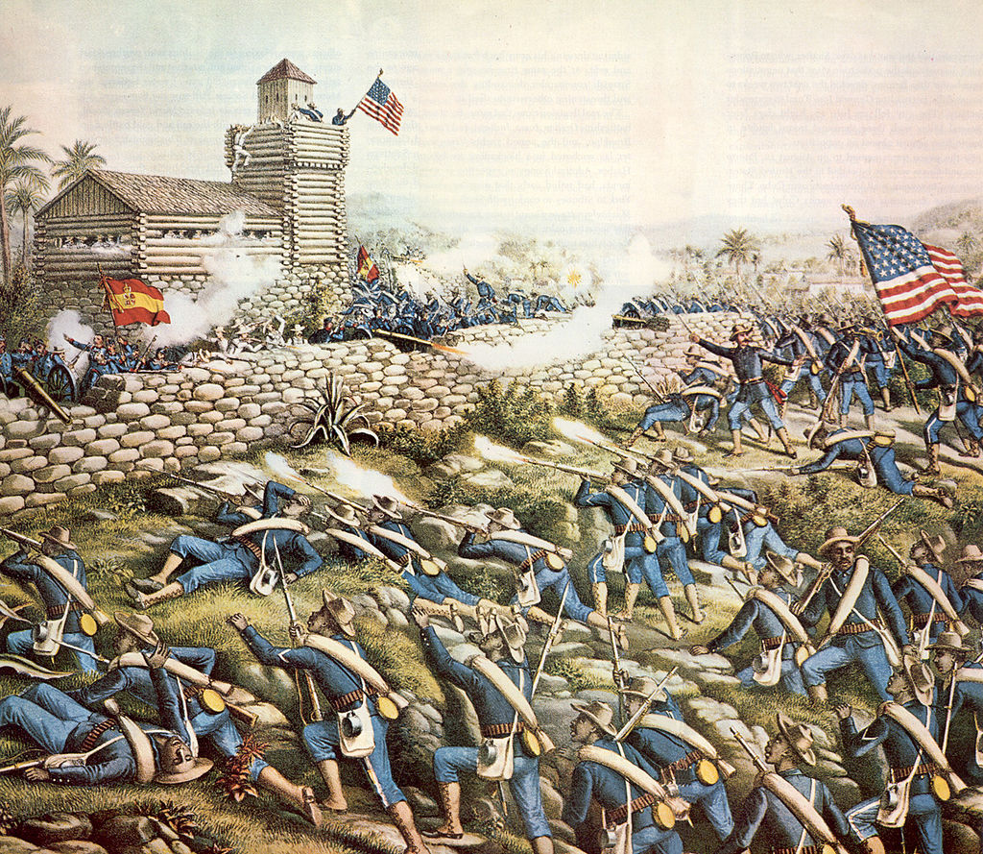
Black regiments storm San Juan Hill …..omitted from records…

Slide 30
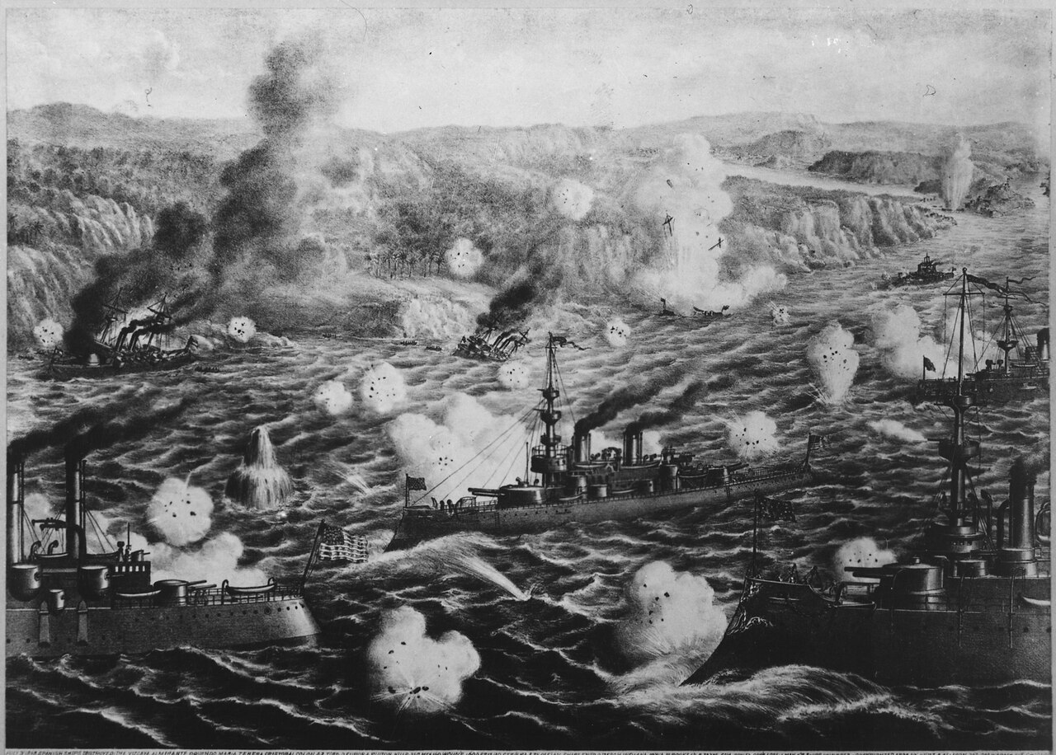
Spanish fleet tries to escape …fleet of 5 cruisers, 2 destroyers annihilated by US fleet of 5 Battleships and cruisers at battle of Santiago

Slide 31
Ending the war
Spanish army in Cuba surrenders August 1898
US invade Puerto Rico….token resistance
Treaty of Paris signed
Philippines, Puerto Rico, Guam become US colonies
Cuba made “US Protectorate” by “Platt Amendment”
Withdraws army 1899
Cuba banned from foreign policy/ finance control
US controls economy: 90% exports, 60% Sugar and Tobacco companies US owned
Sugar exempt from US import taxes (and owned by US companies)
Philippines a problem:
Aguinaldo declares war on US 1899…..to be continued

Slide 32
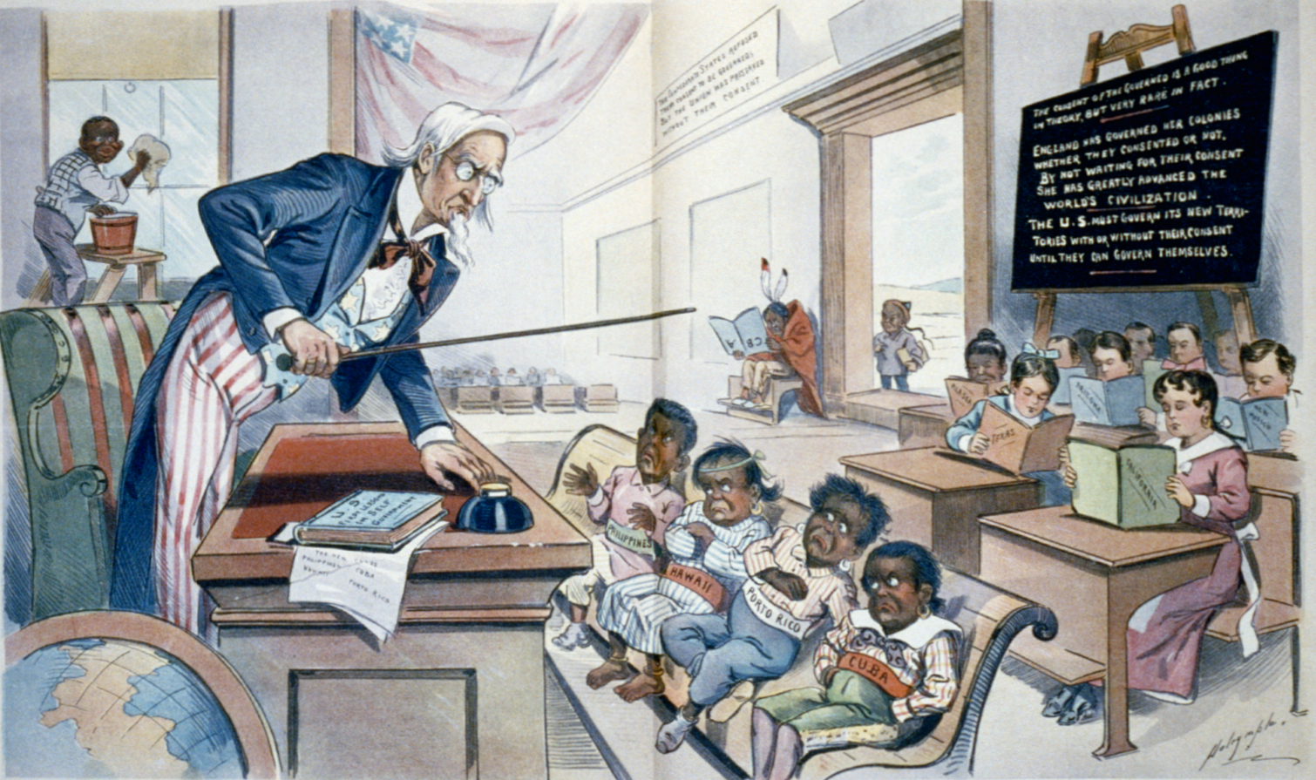
US and its new colonies …..McKinley: “Our policy, benevelont assimilation”
Blacks
Indians

Slide 33
Aftermath
Surge in national self confidence
European power defeated
Manifest destiny revealed as true
Empire secured….master of the Pacific and Carribean
US has ‘arrived” ---one of the great world powers

Slide 34
Starting in September??? Module 4: A great power turned inward 1900-1941

