Slide 1
America and the Pacific

Slide 2
US and the Pacific
California Gold Rush 1849 triggers interest
West coast becomes integral part of Continental USA
Trade increases US and China gold, skins out, silks, cloths,
US Navy expands navy 1840’s-1850’s
West coast vulnerable to Russians and British
Naval base established
Need for coaling stations…..seizure by British & French
US wants new markets opened by British Opium wars
Trade with China secured Opium War treaty
Japan bars entry to US ships, refuse trade talks
US annoyed

Slide 3
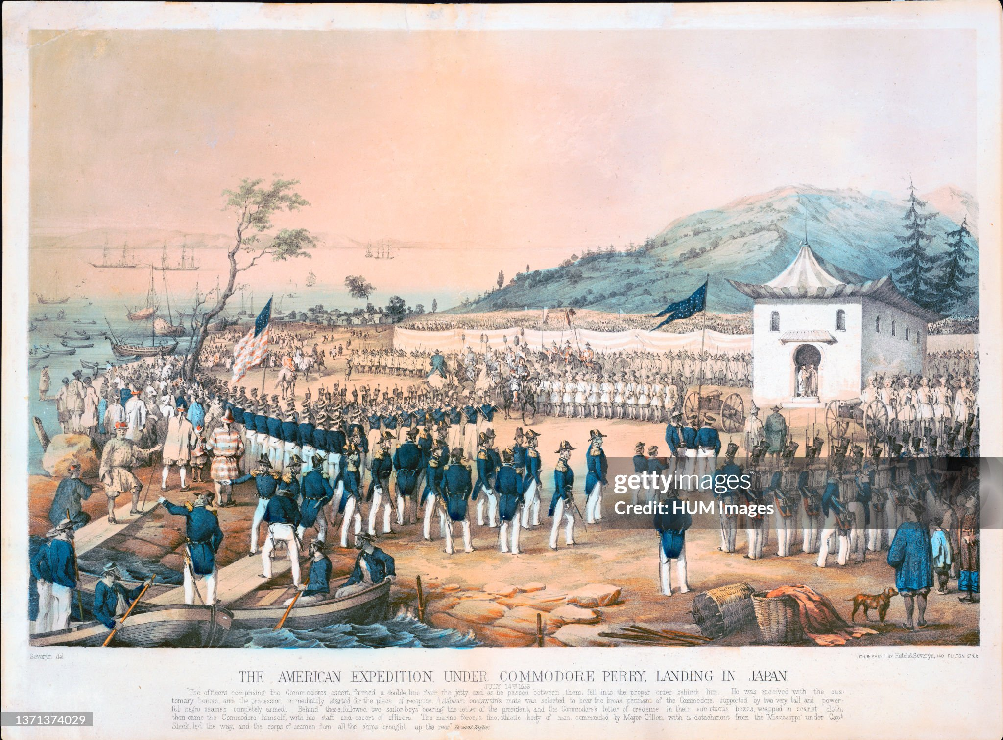
US opens trade with Japan…by intimidation
Japanese Tokugawa
Dynasty policy of social Exclusion….feudal society/…no trade…visitors executed
US sends Commodore Perry
Fleet of ironclad steam ships
Japanese humiliated
…local governor ‘agrees” to open ports
…triggers internal revolt in Japan
to modernise (Mejia Restoration)
…not to be intimidated again
US Pacific trade increases
….US wants coaling stations
….Increased business

Slide 4
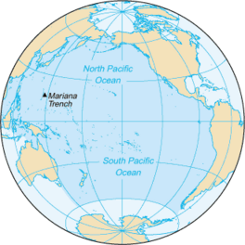
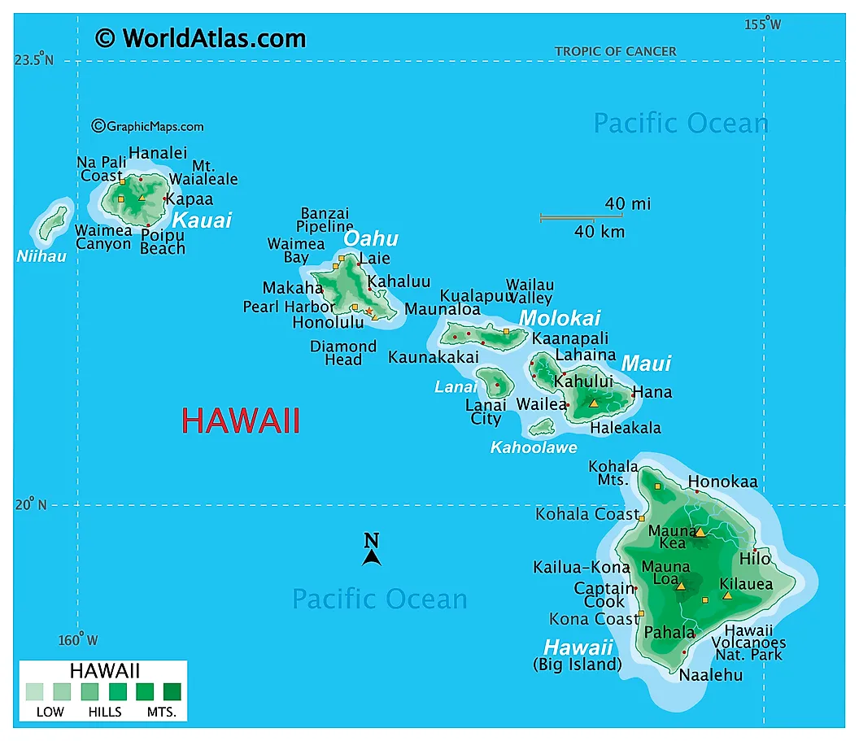
Hawaii and the USA
First inhabitants 600 AD
Hierarchical, complex, taboo based Polynesian culture
300,000 people Multiple kingdoms
… none dominant,
Isolated from America/ Asia

Slide 5
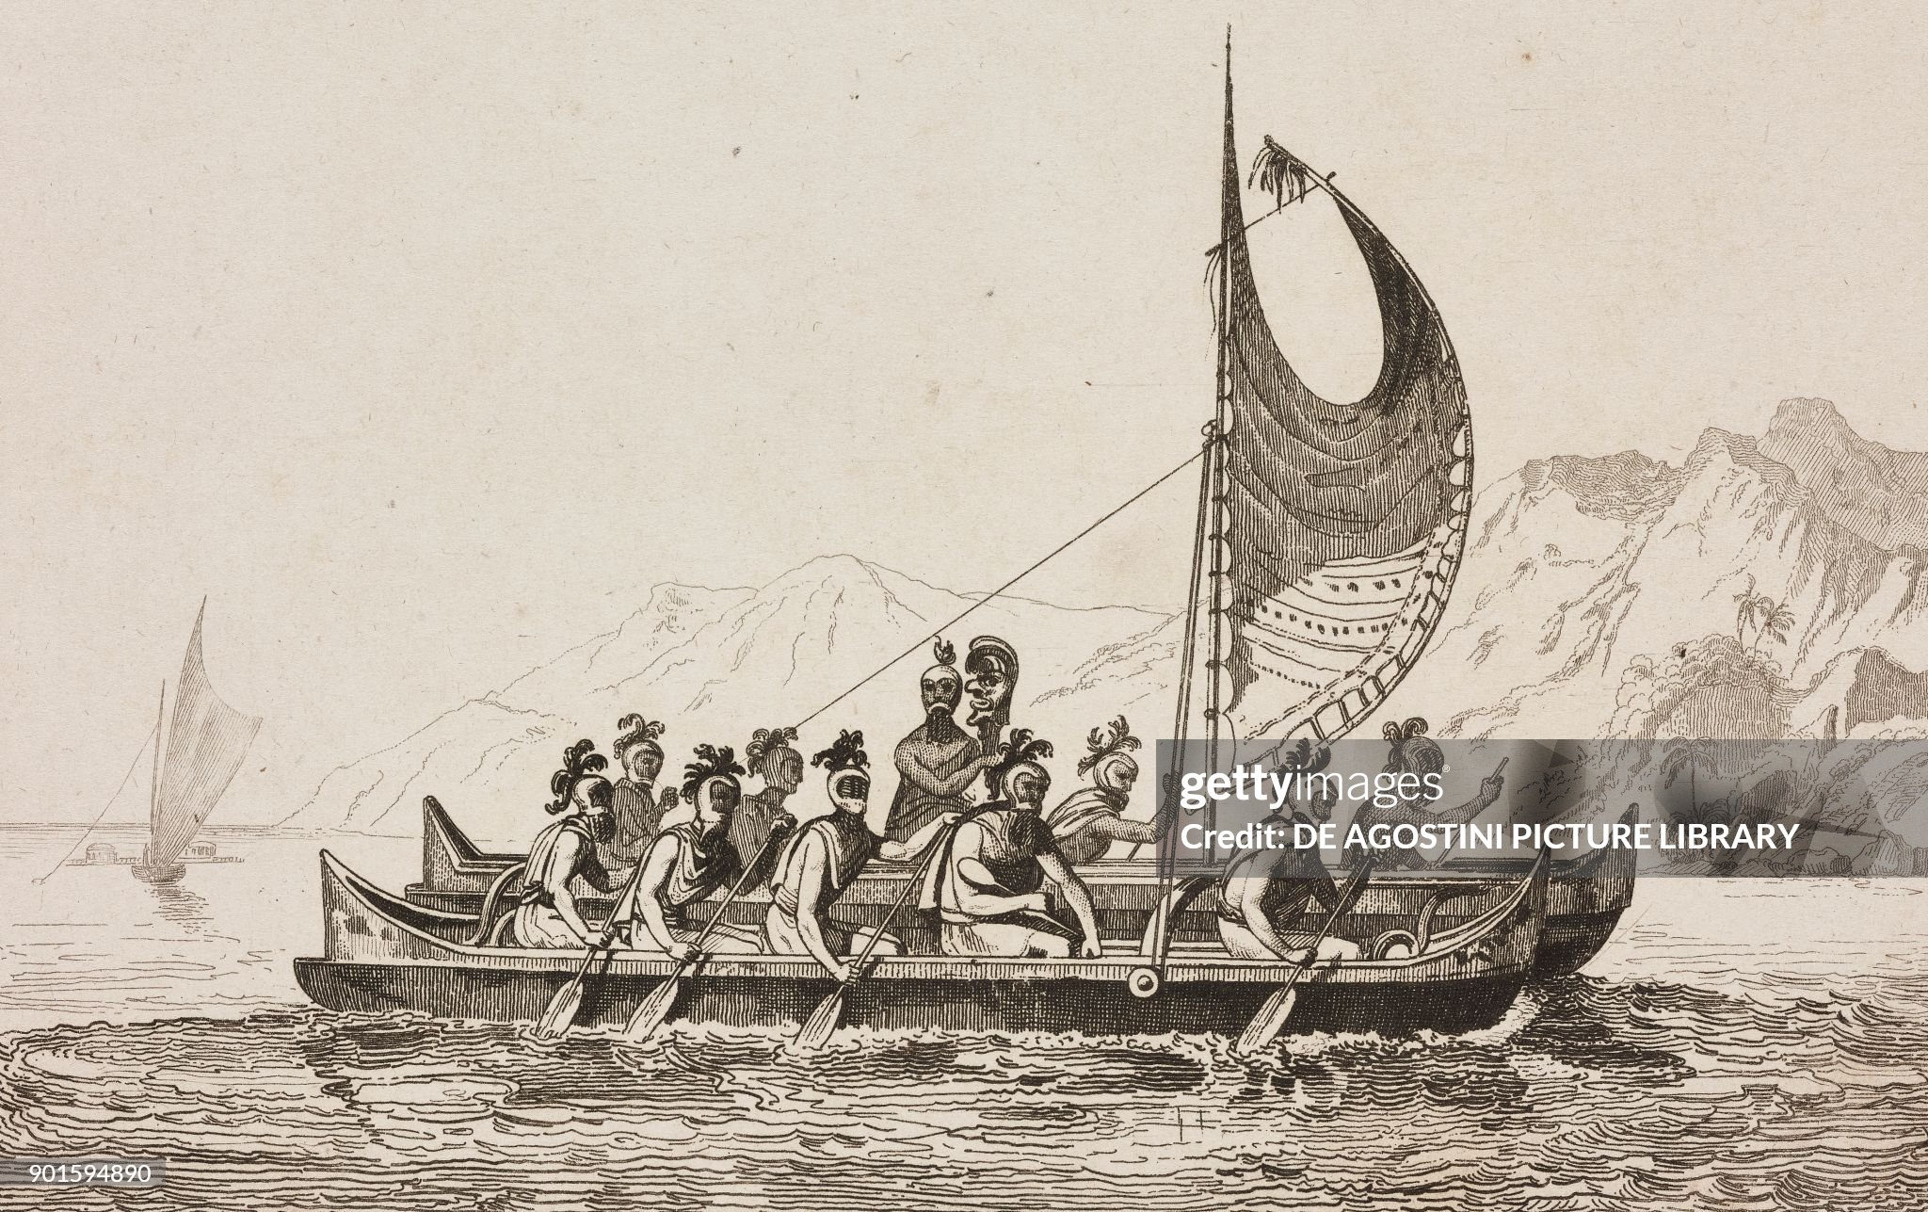
First arrivals 400-600 AD from Tahiti …subsequent Polynesian conquests

Slide 6
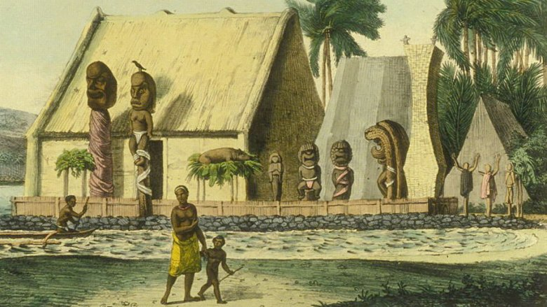
Pre contact society: complex, hierarchical, patriarchal society…constant small scale war…heroic warriors.no mass slaughter

Slide 7
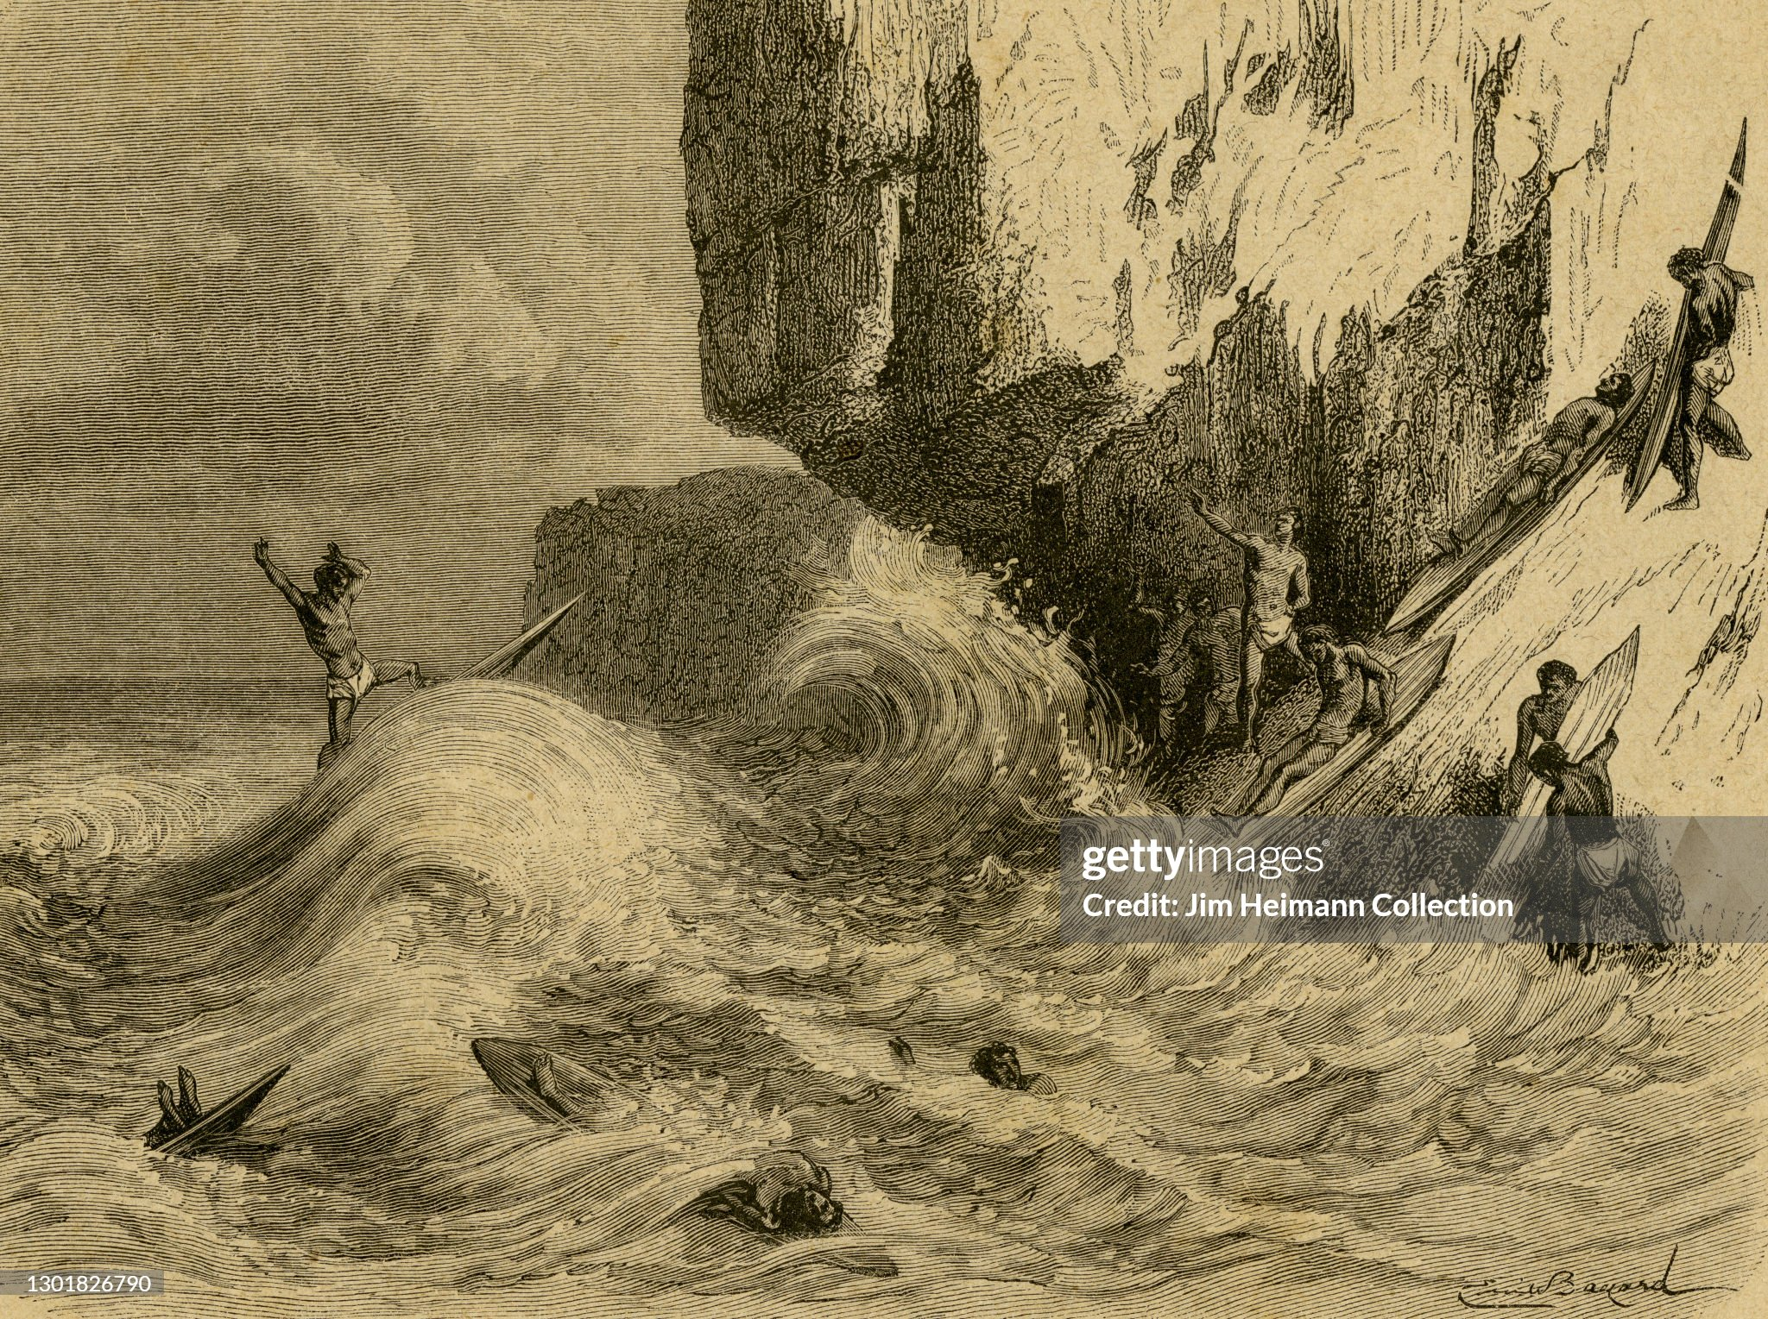
…good at surfing, war, agriculture, ritual sacrifice

Slide 8
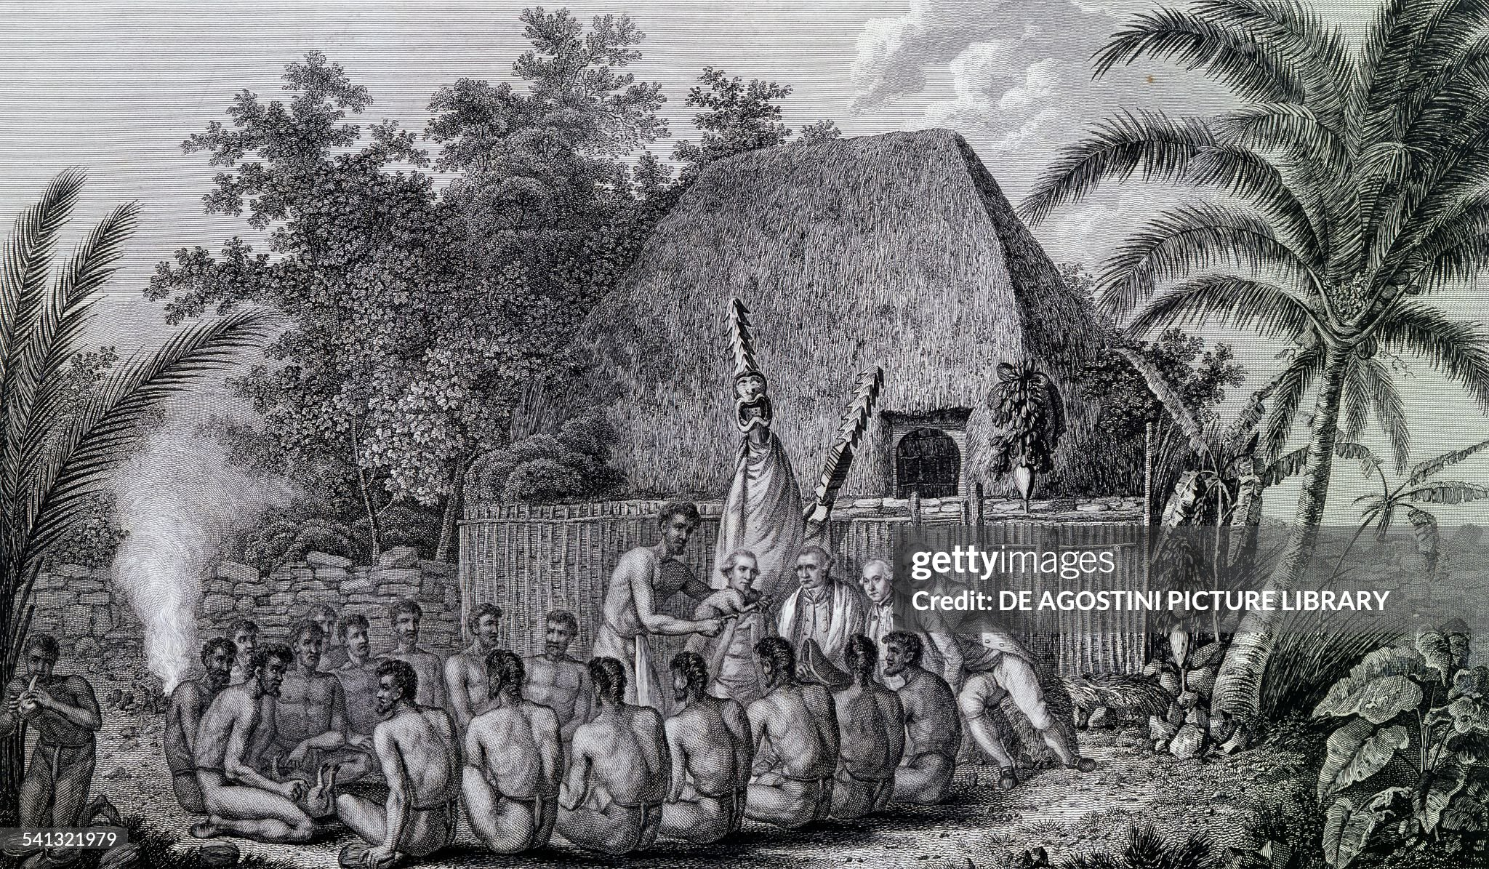
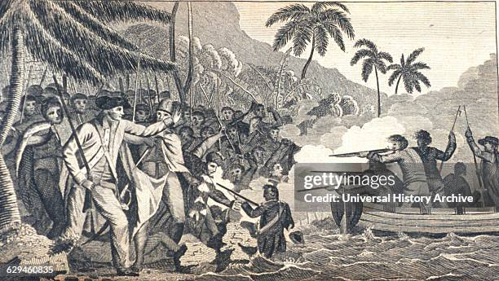
First contact- 1776 Captain Cook
Native steal/borrow boat/
….Cook goes ashore to seize
…hits Hawaiian with flat of sword
….sailors shoot many, Cook killed, eaten
Cook…looking for NW passage ….at first all goes well

Slide 9
First contact to Unification
King Kahemenha !
Minor Hawaiian king
Sees Cooks killing and effectiveness of Western Guns
Attacks offshore US ship at night
Kills all crew but 2 who become his advisors on gunnery
Vision of conquest
Manufactures gunpowder
Stockpiles weapons from British and American merchants
Launches ‘modern’ war for total domination

Slide 10
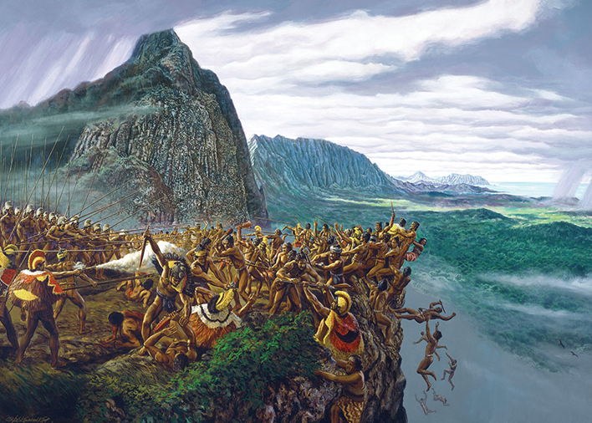
Wars of Unification 1780-1810
Other islands also
Secure weapons all out
Large scale war
Kahuemana wins major
Battle, kills 5,000 to control
Big Island
Islands unified 1810
Population reduced to
150,000 by war and disease
From Europeans
Kahamena II recognises
Need to modernise
Adopts Christianity
Introduces law code/
writing./ constitution

Slide 11
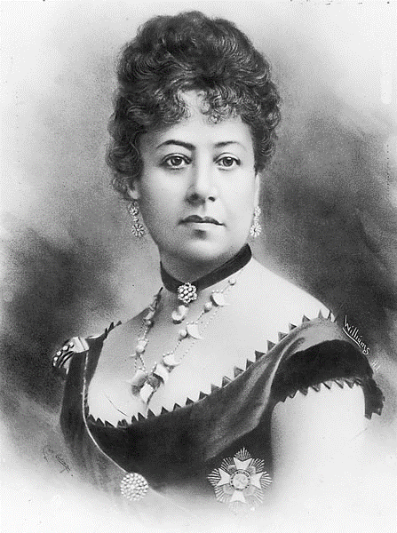
Hawain modernisation: rise of American influence
Kahemana III (1850) seeks to continue
Modernisation. Opens land to foreign
..US planters arrive
Queen Emma
Kahemana IV marries Emma Rooke
(adopted by British couple)
….rule 1850-70
…need US investors but limit power
…US wants Pearl Harbour base
…K dies, Emma to UK seek ally
Emma returns to Hawaii 1870
Seeks election as Queen
..pro US King Kalaheo wins (bribes)
..Emma supporters riot.
…Crushed by King supported by US marines. Emma retires

Slide 12
Hawaiian population declines by 90% ….European diseases/ wars/emigration ….US planters own 90% sugar…large populatin of contractors
 | Native Hawaiians | Mixed | Japanese/ Chinese | Other Contractors (Portuguese) | Americans
1790 | 300,000 | 0 | 0 | 0 | 0
1820 | 130,000 | 0 | 0 | 0 | 0
1850 | 85,000 | 1,500 | 300 | 0 | 500
1870 | 50,000 | 2,500 | 2,000 | 1,000 | 900
1890 | 35,000 | 6,000 | 28,000 | 20,000 | 2,300
The problem for the Americans: dependent on King to retain investment

Slide 13
Hawaiian Republic
US planters seize power : 1889 Bayonet Constitution
Planters lead coup…impose constitution, US marines land to support
King made constitutional monarch
Voting limited to wealthy US planters…natives disenfranchised
American inserted into government
Counter revolution of Queen Lili’uokalania 1893
Pro US King dies, Queen seizes throne, removes US advisors demands votes for Hawaiians
US Planters contact / US navy offshore and seize power & claim Republic
Queen forced to abdicate and placed under house arrest
US president Cleveland appalled --refuses to recognises Republic ..seizure unlawful
1896 US election: Republcian President McKinley Imperialist..

Slide 14
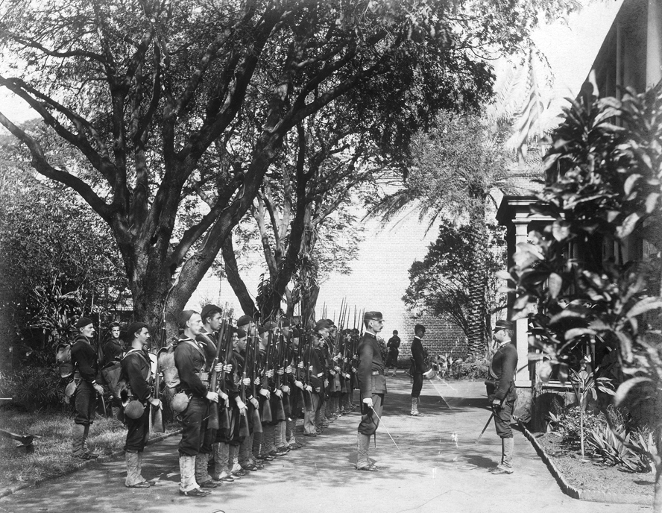
US marines…crush Queen’s revolt 1893

Slide 15
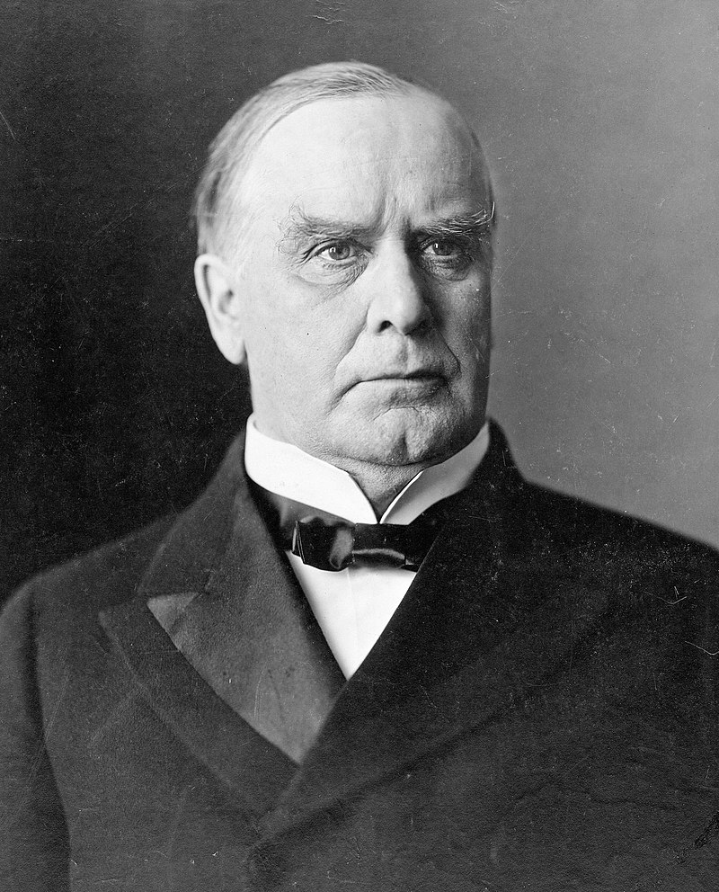
US politics 1896: William McKinley
Modest background, last
Civil war vet to run for President
.
Lawyer, professional politician
Representative, Gov of Ohio
Represents business interests
…High protective tariffs
…anti union legislation
…Gold Standard
…Subordinate to Trusts
…Business of America business
Expansion of America oversees
Fulfilment of God’s plan
“We need Hawaii just as much and
a good deal more than we did
California. It is manifest destiny.”

Slide 16
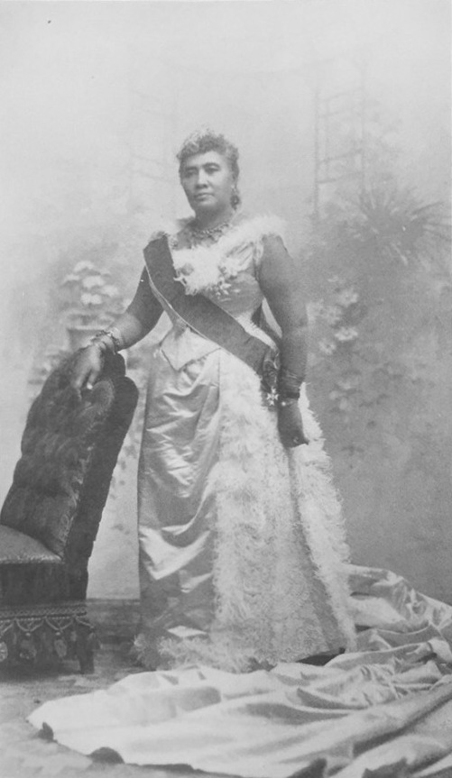
Annexation of Hawaiian Republic
Queen Liliʻuokalani (1838-1917)
McKinley decides to annex
Hawaii in 1898 as US territory
…not a state till 1960
Hawaii becomes preserve of US
Sugar and Pineapple Corporations
…. “Big 5”
Queen Liliuokalani “pardoned”
…accepts US control
…spends life petitioning for
pension
….dies a ward of US government
.

Slide 17
Hawaii the legacy
Native Hawaiians remain minority/ culture obliterated
Native Hawaiians 10%/ Mixed 25% /Asian 38%/White 24%
Most unequal US State: Highest real estate/ rental/ food costs in US
Highest urban density
98 % of land ownership restricted to non residents and 90% on 3rd largest island
Billionaires (Larry Ellison, Oprah /Winfree) own islands of Lanaiii and Kauai
Military ownership Pearl Harbour and surroundings
Interior grasslands owned by US Sugar and Pineapple
Tourist Industry largest employer. Low wages, coastline destruction

Slide 18
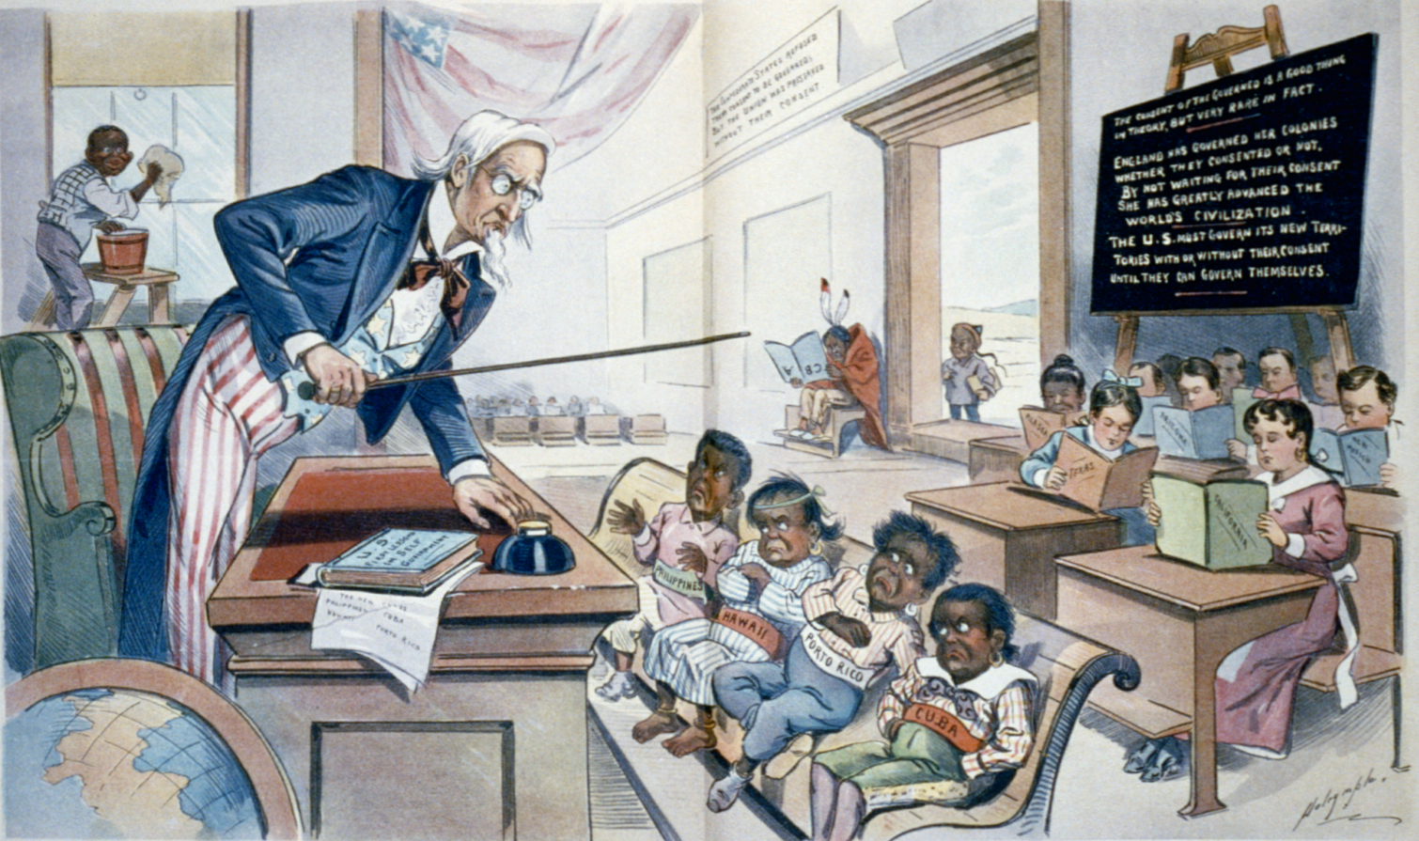
US and its new colonies …..McKinley: “Our policy, benevelont assimilation”
Blacks
Indians

