Slide 1
American History
1
Talk 22: A World Power Emerges

Slide 2
Module 3: From Continental to World Power
Talk | Title | Time Period | Date of Talk
16 | Competing destinies | 1848-1854 | March 4th
17 | The Union falls apart | 1854-1861 | March 18th
18 | Civil War | 1861-1865 | Wednesday April 3rd
19 | Reconstruction & the New South | 1863-1900 | April 15th
20 | Conquest of the West | 1865-1890 | April 29th
18 | Civil War (Repeated) | 1861-1865 | Wednesday May 8th
21 | Triumph of capital | 1865-1900 | May 20th
22 | Emergence of a World Power | 1890-1898 | June 3rd

Slide 3
Overview
Consolidating power: Liberia, Mormons, Indian Territory
USA and its neighbours
Hawaii and its annexation
Spanish American War of 1898 and its aftermath

Slide 4
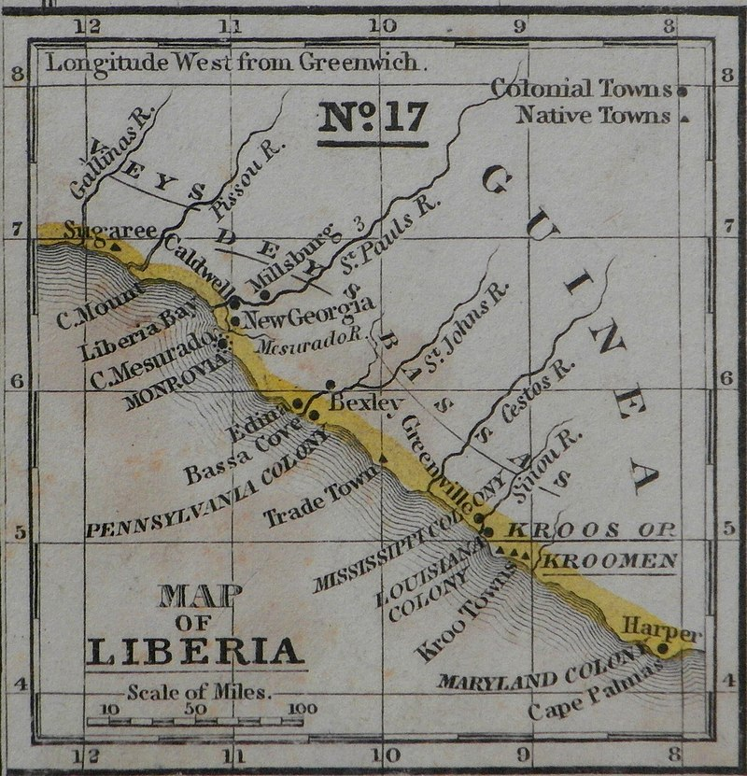
Liberia
Founded by American Colonisation
Society 1820…home for slaves
Land “purchased” from indigenous
Kingdoms (British –Sierra Leone,
French Guiana)
…”repatriation“ preferred policy
Monroe---Lincoln
….effectively American ‘ Colony”
Only 13,000 freed slave migrate to Liberia
1820-1861
….idea rejected by most
…..50% die from malaria

Slide 5
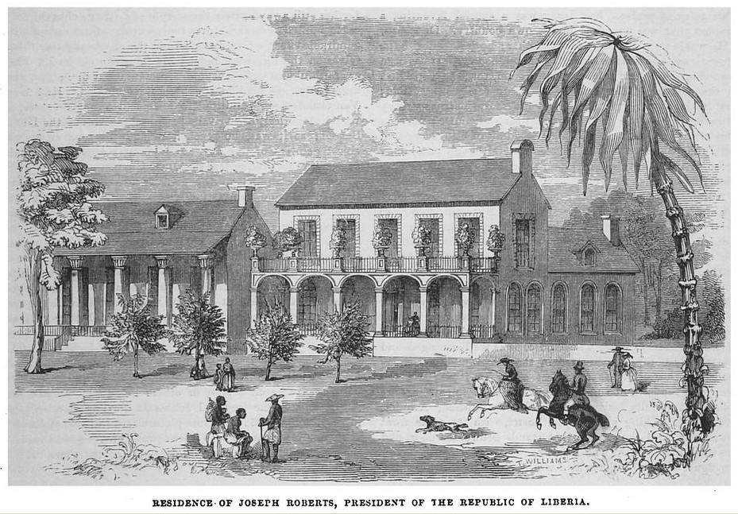
Liberian Independence
Surviving emigrants form local elite
Mimic Southern plantation
Lifestyle…as new masters
…recreate “White House”
…enslave locals
Declares Independence
1848…recognised by UK
…and US 1862
5,000 African Americans
Emigrate to Liberia
1861-1904
Enduring hostility with Kingdoms

Slide 6
Mormons & USA
Mormon objectives 1820-1848
Establish a community where Mormonism could be practiced
With US territory…but not subject to laws on polygamy and democracy
Brigham Young…effectively Dictator of territory
Conflict US and Mormons 1849-1861
US rejects, establish Territory of Utah: do not want “theocratic state” within US borders
Agree Brigham Young “Governor”.
Hostilities US & Mormons increase
Meadowland Massacre 1858 (150 settlers bound for California
Post War conditions for inclusion in USA
Outlaw polygamy
Justice for “Meadowland Massacre”

Slide 7
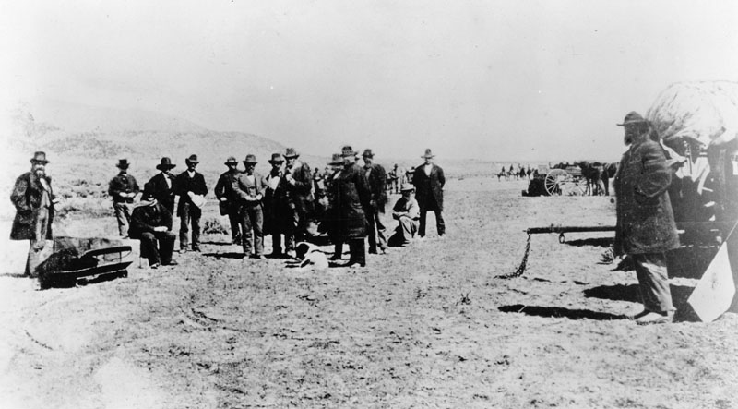
Meadowland Settlement
Brigham Young and “Quorum”
Provide names of massacre
Organisers 1876
John Lee
Sitting on coffin
….waiting
Most flee….offer testimony
John Lee.. Made scapegoat
…confesses, convicted
…claims Brigham Young planned massacre
….US ignores and arranges
his execution

Slide 8
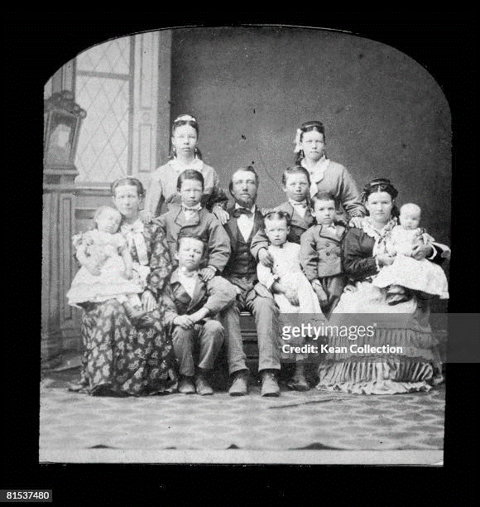
Resolution on polygamy
Statehood blocked till polygamy outlawed
Four wives, seven children 1890
US threatens confiscation church
Property….removal tax exemptions
Mormon President has “divine revelation”
…discontinue polygamy
…existing ‘marriages’ continue
Fundamentalist “fundamentalist” Mormon groups emerge
….marriages not legally recognised
…persist to this day
Statehood granted 1896
…Utah “normal” state
…Population 275,000

Slide 9
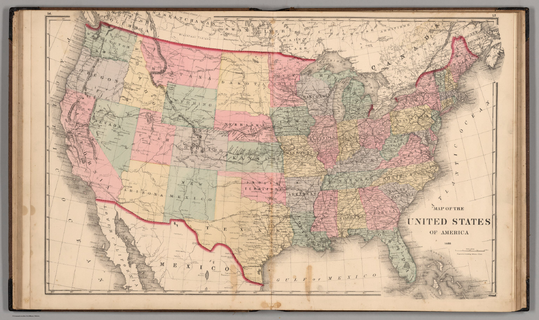
Absorption of ‘Indian Territory’ 1870
Indian Removal Acts forcibly migrate Indians to Indian Territory 1830-1860
“Subdivided into
Tribal regions
..East…5 “Civilised Tribes”
..West…Plains Indians
..Semi autonomous
…closed to whites
65,000 residents 10 tribes
1870…fragmented
….land ‘owned’ by tribes
Not individuals
…underdeveloped and
much of land fertile

Slide 10
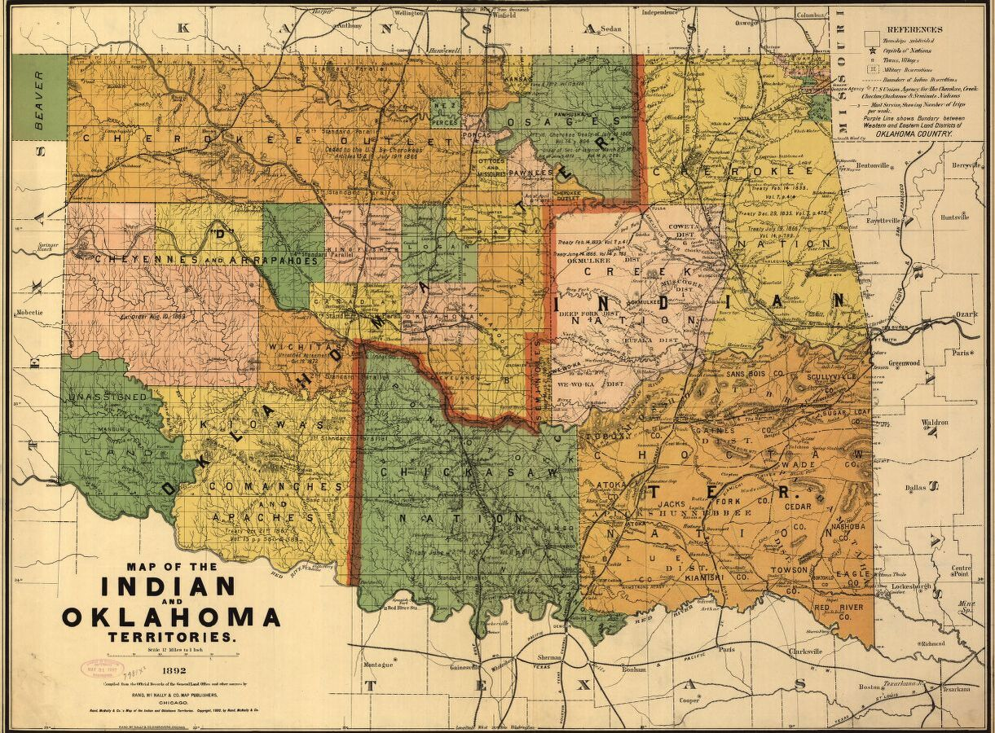
Absorption of ‘Indian Territory’
Mass western migration
…land fever....political pressure to ‘open’ land to white settlers
1871—Appropriation Act Ends ‘independence". Confiscates some land from Indians who supported South
1887 Dawes Act ends “Tribal ownership”
“rid the nation of tribalism through the
virtues of private property, allotting land
parcels to Indian heads of family”.
Land not allocated to individual considered. Open to Settlement
…70% of Indian Lands sold to US
Land Rushes..1889- 1906
…first come/ first serve

Slide 11
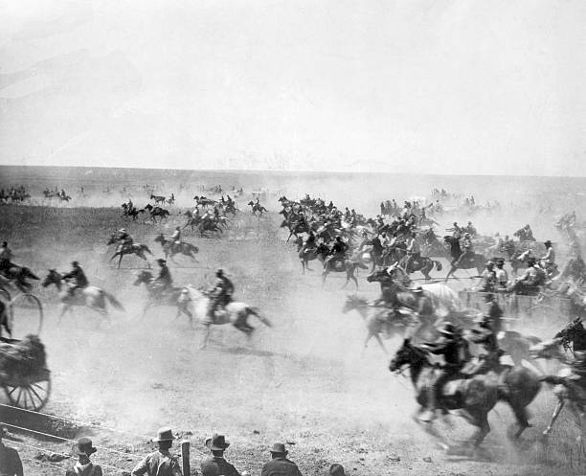
Land seekers line up….and rush to grab title
1st “Run”
15,000 line up…pistol shot…rush to claim 12,000 ‘lots’…one day
Subsequent “runs”
As 2 million acres of land opened up for settlement
“Indian Territory” gone 1906 State of Oklahoma
…300,000 whites
….20,000 blacks
….75,000 Indians
Frontier is closed

Slide 12
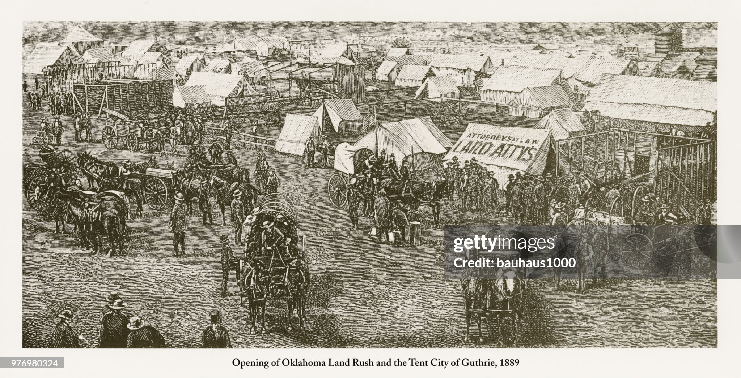
Instant cities.....Guthrie 10,000 inhabitants …..overnight…high population of lawyers

Slide 13
Canada 1812-1900

Slide 14
Canada 1812 - 1840
US invasions during War of 1812 defeated
US focused on West/ Slavery….abandon invasion
Catholics neutral….British accommodation
Two hostile colonies, Appointed Governor, advisory “councils”
Lower Canada – 335,000 French – Catholic
Upper Canada- 90,000..most Loyalists from US
Direct Rule from England via Governor General
Seen as corrupt/ remote/ repressive…elected provinces “advisory” only
Rebellions 1837 seek “Responsible Government” & Republicanism. Crushed
Durham Report 1840 & “Responsible Government”
Lord Durham….Unites Upper and lower Canada in one Parliament”
Requires compromise French and British
Governor General dependent on Parliament by 1850

Slide 15
Canada 1840- 1867
British devolve power…wish to avoid “American experience”
Establish“Rule of the Prime Ministers” Quebec/ Ontario. Amicable & effective
Governor General….constitutional monarch
Border agreements with USA
Canada Refuge for runaway slaves
Mass immigration transforms population
British/ Canada see need for stronger government
Expansion West/ conflict Indians/French “Metis”
Threat from Irish “Fenians” in USA
 | French | British
1815 | 335,000 | 90,000
1840 | 600.000 | 400,000
1870 | 1,100,000 | 2,100.000
1900 | 1,600.000 | 4.000,000

Slide 16
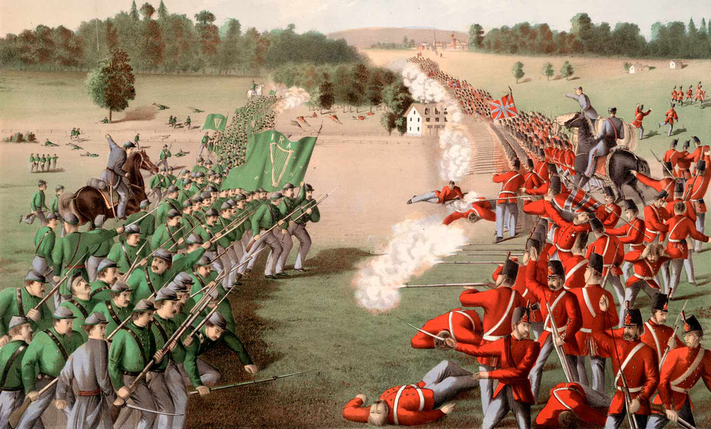
Irish invasions of Canada 1866-1871
1.6 million Irish immigrate
To USA 1850’s
Battle of Ridgeway 1866
180,000 armed Irish
Veterans from Civil War
Fenian Brotherhood formed in USA …seeks seizure of Canadian/ Irish independence
US Gov sell Fenians arms
Allows preparations
10,000 Irish form to plan invasion. British threaten war/ ..
….US change policy/ block
1,300 Irish invade, win “battle”
then retreat….50 killed
…further raids 1858/71
…Canadian militia effective

Slide 17
Canada and USA 1867-1900
British Canada independent nation (within British Empire) 1867
Rapid industrial and agricultural growth
Potential areas of dispute with USA resolved by negotiation
Slavery issue ends with civil war
Fenian raids end 1871
French/ mixed race “Metis” rebellions 1870/s -1880 crushed
Western Provinces incorporated within Canada
Alaska Canada border settled
Indian tribes reservation respected/ US Indians given refuge/ aid …but no support
Open border policy agreed …northern border secure/ US has no interest in invasion

Slide 18
Mexico

Slide 19
Mexico 1848-1862
Mexico 1848: humiliation/ war/ chaos
Half of territory lost
Capital occupied
Government in Chaos
Mexico 1848- 1860: humiliation/ civil war/ more chaos
30 Presidents
Civil war between (anti Catholic) Liberals and Conservatives
Raids by Spain, France and Britain to collect debts 1860
Rise to power of dictator Benito Juarez…suspends debt payments

Slide 20
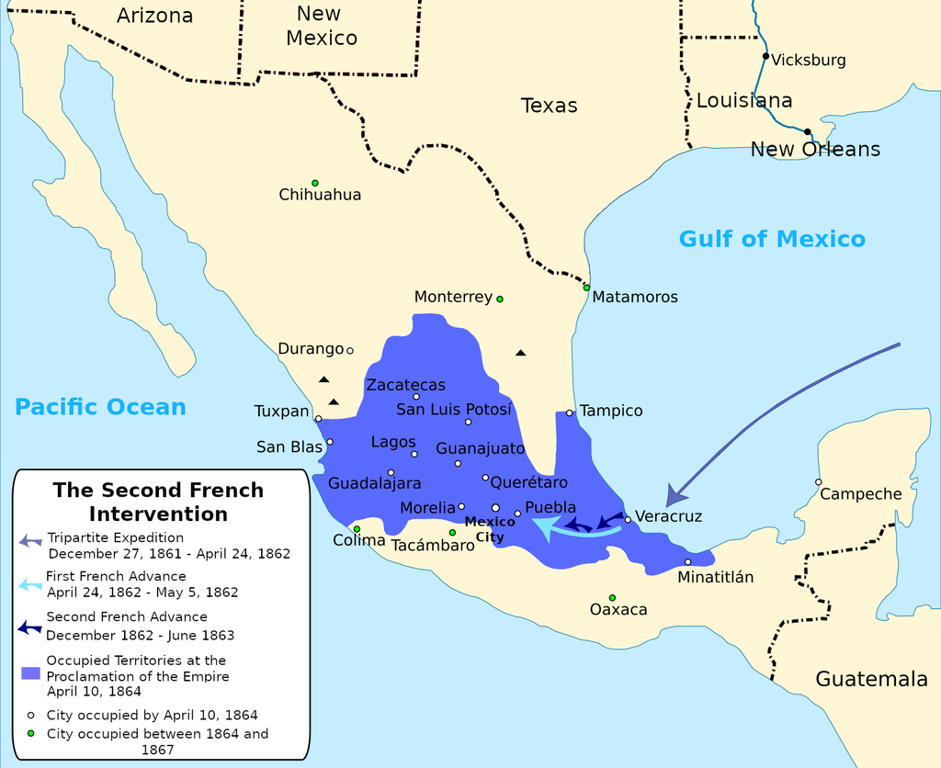
French Invasion 1862
French seek alliance with
Britain to recover debts
..install puppet Emperor
…British refuse w/o US agreement
…French Emperor Napoleon III
US distracted by Civil War
France invades/installs Austrian Prince as “Emperor". Juarez leads revolt
Five years warfare
…’Emperor imposes liberal constitution
…rejected by Liberals and Conservatives
US supports Benito Juarez
….pre occupied by civil war

Slide 21
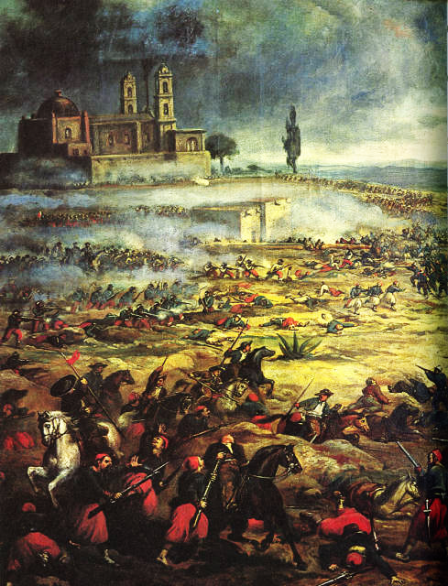
Cinqo de Mayo
French occupy Mexico City
Battle of Puebla 1863
Mexican army wins battle of
Puebla. General Porfio Diaz
….celebration today
French invasion falters
….forced to retreat to cities
US Civil War ends
… supports Juarez
…sends volunteers to Juarez
…threatens intervention
…French leave
Puppet emperor Maximillian ….refuses to leave out of principle ……and shot

Slide 22
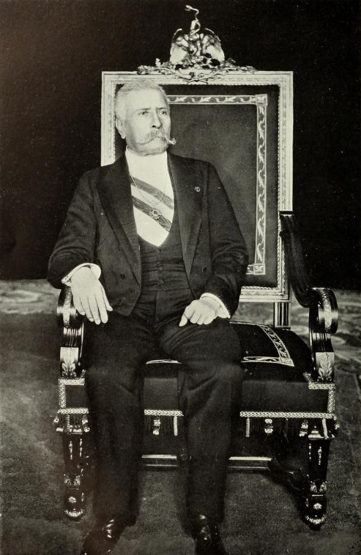
The Porforita 1876 - 1910
Successful general vs French
Goes to US, secures financial
Support….offers deal to prefer
US interest…then seizes power when
Juarez dies in bed
“Benevolent Dictator”
…retains power 35 years
…Conservative/ pro USA
…Secures foreign investment
…Accommodates Catholics
…supresses opposition
…avoids executions
…cooperates with US vs Apache
Mexico at peace….

Slide 23
US 1880’s
Internal issues resolved/ frontier closed
Borders secure
Canada prosperous, border agreed
Mexico at peace, US business interests secure
European powers colonising Africa, US “left behind”
USA Destiny to be a great power: turns to Pacific and Caribbean

