Slide 1
American History
1
Talk 11: Era of Good Feelings (1816-1824)

Slide 2
Overview
2
Prelude: pirates, maroons and a volcano
The One Party State
Threats to unity resolved
Second Great Awakening
Good feelings shelved

Slide 3
Prelude

Slide 4
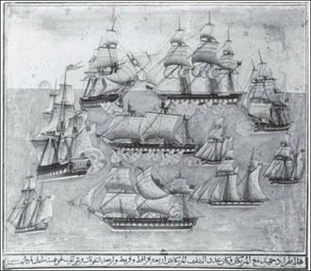
2nd Barbary War June 1815
Battle of Cape Gata June 17, 1815
Berbers resume attacks on US Shipping
During War of 1812 capture 10 Americans
Congress despatches Stephen Decatur
and fleet recover captives
US chase and capture Algerian flagship
…other ships, threaten to bombard Algiers
Dey gives in returns captives. refunds
Ransom.. Agrees to stop piracy..US leave
Captives drown on return journey
Dey resumes piracy when ships leave, threatens US ambassador…he flees on British ships…British bombard Algiers 1816…..peace…piracy resumed till French invasion 1830

Slide 5
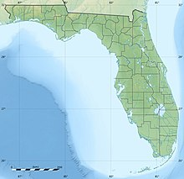
Maroons and Fort Negro
West Florida
East Florida
Florida Spanish Colony 1500-1763
British till 1783…returned to Spain
Spanish Fort
West Florida occupied by runaway
slaves, Choctaw Indians, Pirates,
former Black British Colonial
Marines…..no Spanish
Fort Negro
“Capital” Fort Negro (formerly British
Evacuated end war of 1812
“Free community”….venue for
escaped slaves from Georgia, raids
Into Georgia
Andrew Jackson….fort an
“abomination” to be destroyed
Spanish garrisons only in East Florida

Slide 6
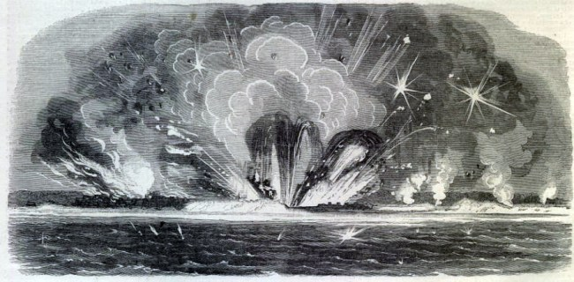
Occupation West Florida
Jackson dispatches army of
300 plus gunboats and Creek
Indians to destroy fort
Destruction of Fort Negro June 1815
Pretext need before attack
…Spanish territory..raiding
Party ambushed and killed..1
Boiled allive
Fleet approaches fort..baits attack, slave masters, Fort fires
On Americans
US response….gunpowder magazine…storm fort
US army attacks survivors enslaved…or shot…
Jackson announces US has occupied West Florida…Spain unable to reply

Slide 7
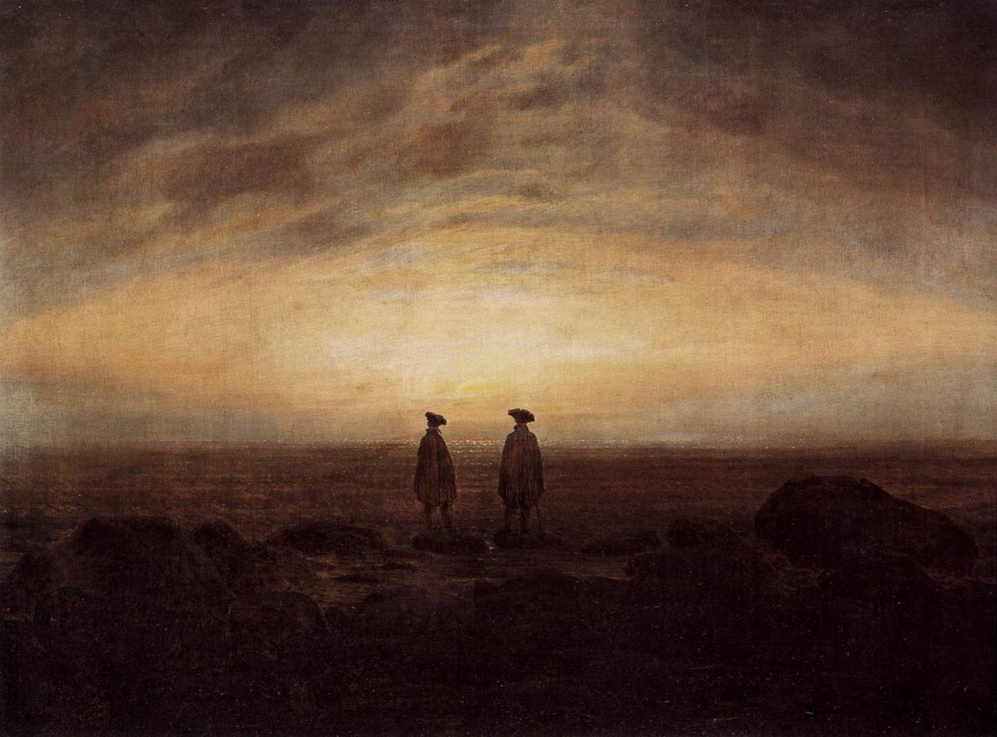
Mount Tambura volcano 1815
2 Men by the Sea, Kaspar Friedrich 1817
Largest eruption ever recorded explosion..10x Krakatoa ..heard 1,200 miles away
Ash cloud circulated
To Europe by early 1816
Year without summer across Europe and North America…sky
Yellow for 2 years
Catastrophic loss of
Crops….Virginia price of oats
Rose form 12cents to 92c
Per Bushel (

Slide 8
Year without summer
Massachusetts farmer
severe frosts occurred every month; June 7th and 8th snow fell, and it was so cold that crops were cut down, even freezing the roots ... In the early Autumn when corn was in the milk it was so thoroughly frozen that it never ripened and was scarcely worth harvesting. Breadstuffs were scarce and prices high and the poorer class of people were often in straits for want of food. It must be remembered that the granaries of the great west had not then been opened to us by railroad communication, and people were obliged to rely upon their own resources or upon others in their immediate locality.^{[3}
Lord Byron
I had a dream, which was not all a dream. The bright sun was extinguish'd, and the stars Did wander darkling in the eternal space, Rayless, and pathless, and the icy earth Swung blind and blackening in the moonless
air;Morn came and went—and came,
and brought no day

Slide 9
Impact on United States
High food prices stimulated demand for land
Emigration west accelerated…fertile government owned land
Frenzy of Mass unregulated lending to fund land purchases
Re established Bank of US led by political appointees
Drop reserve requirements for banks, down payments for purchases
of Louisiana (renamed Missouri) Territory

Slide 10
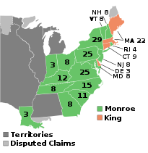
Election of 1816
Madison retires after 2nd term.
Hand picked candidate James
Monroe…wins 183 votes to 34
Federalists discredited by anti
War position….obliterated as political force…except New England
New states Louisiana, Ohio,
And Indiana
New
states
Most electors still appointed…only
100K popular votes (population of
10 million)..property tax eligibility

Slide 11
The One Party State

Slide 12
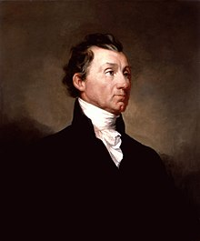
James Monroe (1751-1831)
James Monroe
Son of small plantation owner, inherits slaves , brought up by uncle, left college to fight for independence
Distinguished Revolutionary war record mentored by Jefferson …studies law
State Senator, diplomat, pro French returns to US…sneaky…leaks letter of Hamilton blackmail payments.
Appointed ambassador, Louisiana
Purchases, Governor of Virginia.
Supports manumission and resettlement to Africa of slaves…but not his own. Opposes big government but
Supports National Bank, large army

Slide 13
The grand tour of New England 1817
Policy of “domestic tranquillity”
Includes Federalists in Cabinet
Visits New England in 1817
to encourage Unity…war hero,
Above faction.
Appoints Democrat Republicans
And Federalists to Cabinet
John C Calhoun Secretary of War…
John Quincy Adams (North)
Former Federalist Sec of State
Maroons & Seminoles raid
Georgia, free slaves from
East Florida…Monroe asks
Calhoun to solve problem

Slide 14
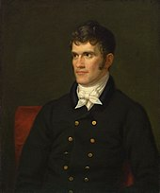
John Calhoun (1782-1850): Voice of the South
New generation Politician “statesman”
Born into minor South Carolina
Plantation. Slave owner”. Unitarian
Religion, Lawyer, elected To Congress
, marries well, 10 children
"Intensely serious and severe, he could
never write a love poem, though he
often tried, because every line began
with 'whereas' ...
Starts career as “nationalist”
Anti British, War Hawk, supports Big Government, large army/navy
Defender of slavery and South

Slide 15
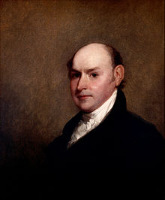
John Quincy Adams (1767-1848) : Economic Nationalist
Born Massachusetts son of President John Adams. Harvard Scholar, no slaves, devout, becomes Unitarian
John Quincy Adams aged 40 (1818)
Ambassador to Russia & Britain. married Englishwoman (only foreign first lady till Melania)
Federalist but approved Embargo and War of 1812. Opposes slavery, becomes Abolitionist
Made Secretary of State
Set US Foreign policy as Neutral…focus expansion west and peace with Europe

Slide 16
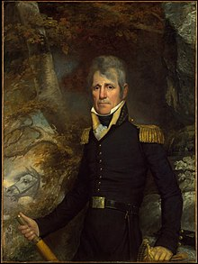
Andrew Jackson (1767-1845): man in the saddle
Jackson in 1819
War hero. Victor of Creeks
And British at New Orleans
Disciplinarian, duellist, brutal
hangs 19 militia deserters
Paternalistic slave owner…
Harsh runaways: advertises
About escaped slave: "ten dollars extra,
for every hundred lashes any
person will give him" up to three
hundred lashes….
Commander US Army
Southern United States

Slide 17
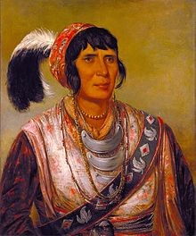
Seminole Indians
Osceola Seminole Leader
Name means “refugee”
Formed 1700’s fusing Creeks, Cherokees
Refugees from white settlers,
Escaped black slaves, and
Surviving indigenous peoples
…ethnogenisis.
Allied with British during Revolutionary
War and war of 1812
Raid Georgia for food, slaves,
and guns. Adopt Slaves …some
Become Chiefs…Tribe of 2,000
in Northern East Florida

Slide 18
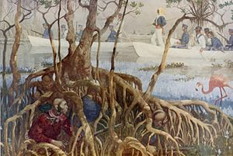
First Seminole War 1817-1818
Jackson leads army
Into Florida to destroy
Seminole Indians
Ambushes, skirmishes
Indians retreat to Spanish
Fort. Jackson bombards for
….without agreement by
Calhoun or Monroe
Spanish surrender
Jackson claims he is “helping
Spanish fight Seminoles,
seizes British Agents Amister
and Coombe

Slide 19
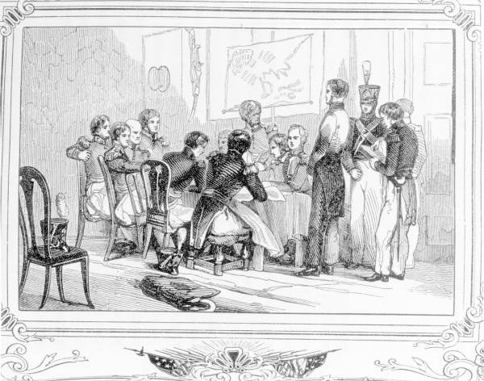
‘Purchase of Florida’
Jackson puts agents on trial
has Coome shot, overrides jury
And hangs Ambister…diplomatic
Incident…Spain and Britain
Trial of Ambister and Coome
War with Spain and Britain ?
Calhoun incensed demands
Jackson’s Court martial…
Monroe asks John Quincy to meet
Spanish and placate British..
British complain want trade not war
Adams offers to settle boundary
With New Spain, pay up to $5 million
For US legal claims vs Spain…Spain
No choice…weak empire falling
apart

Slide 20
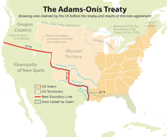
New Boundaries
US acquires Florida, agree to pay Spanish debt to American slavers …and not to invade New Spain !
Boundary with New Spain “fixed” …for 20 years
Jackson forces Seminoles to
Move to Everglades
Jackson removed from command
Seen by Federalists and Norh as
future despot, ‘man on horseback’
Louisiana Territory renamed
“Missouri Territory “ and opened
for settlement

Slide 21
Henry Clay (1777-1852): The Great Compromiser
7th son and only survivor of Baptist Minister, shop worker, father dies, mother remarries to rich planter moves to Kentucky
“Amanuensis” for judge sponsored to law school…successful lawyer
Successful gambler and generous.. Forgave and forgiven. Duelist but
Agrees to miss
Married. 11 children (...all die young, go bankrupt,become insane or get killed in war)
Anti slavery but buys and sells slaves plantation and slaves
Speaker of the House…advocates ‘American System’

Slide 22
Henry Clay’s “ American System”
High Tariffs to protect manufacturing industry
Set at 5% by Hamilton in 1790’s
raised from 12 ½% to 40%
US Central Bank and state bank regulations
Encourages sale of US government land and westward expansion
Government funded“ Internal Improvements” (roads and canals)
Economic Nationalism: Federalist (Northern) ideas adopted by
Democrat Republicans…. Jefferson Agrarian dream abandoned

Slide 23
Threats to Unity
Economic collapse
Rise of sectionalism

Slide 24
Panic of 1819
The Boom (1816-1819)
Food prices soar during Napoleonic wars
Land prices soar due to demand and “frontier spirit” and easy credit
Bank of US charter expired 1814 replaced by unregulated state banks
Bank of US renewed 1816: ‘political appointees’ fuel lending
Surge in state funded Improvements such as Erie Canal
The Bust (1819-1820)
Food prices fall 50% as Europe recovers from wars and weather
Cotton prices collapse as British switch from US to India
British dump surplus goods on US market due to European post war depression …US factories collapse…US gold and reserves drained
Investors unable to pay loans
Bank of US new regime…calls in loans, imposes 60% reserve, imposes specie requirements

Slide 25
Impact of Panic
US GDP decreases 30% in one year
20% unemployment in North
Half new banks go bankrupt in one year
20% population ruined, rise in debtor prisons
Land prices collapse (Pennsylvania from $350 to $50 per acre)
Economy recovers 1820/21 as prices rise, credit and reserve eased
……Shock to American self belief….not supposed to happen here!
Sense of betrayal by elites…demands to remove franchise restrictions

Slide 26
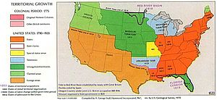
The Missouri problem
Expansion West…Missouri
Population >60,000 and
Ready for statehood…as
“slave” or “Southern state”
South controls Senate due
To 3/5 vote for slaves..despite
only 40% white population
Rising abolitionist in north seek to restrict slavery in Missouri: Tallmadge Amendment
South outraged…North
Imposing control…threats
of secession .violent debates.

Slide 27
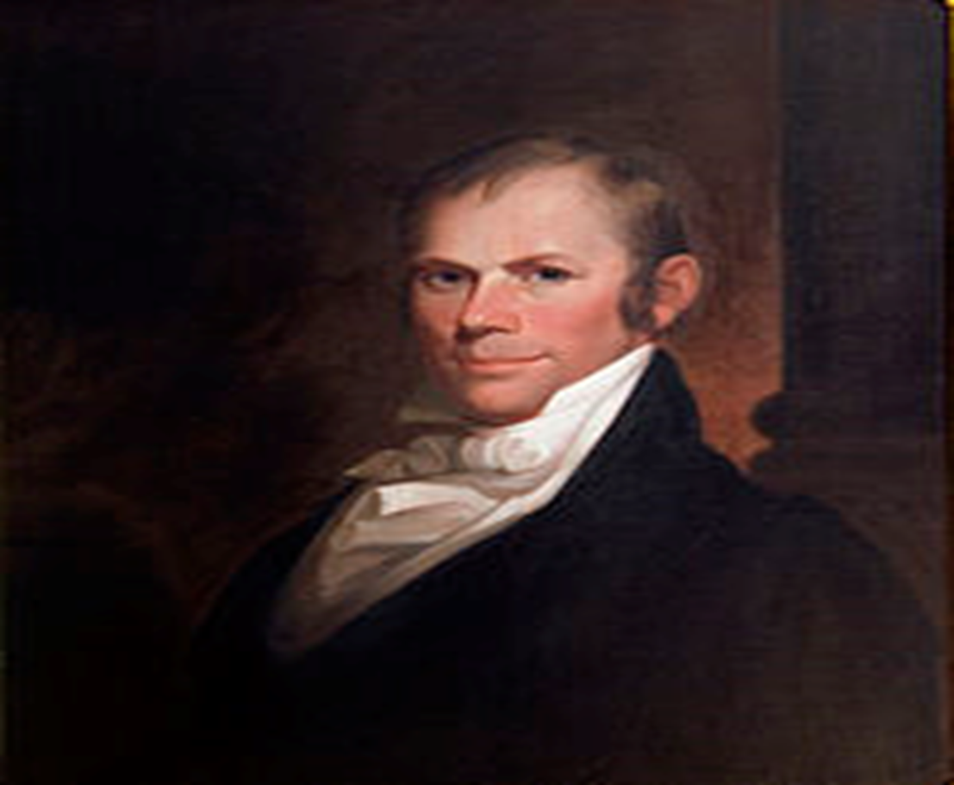
The Compromise of 1820
Tallmadge Amendment narrowly
Passes House….blocked in Senate
Admission of Missouri blocked
North fears South control of
Senate
Clay proposes Compromise
Admit Missouri…split Maine
From Massachusetts,
Agreement that new states
Admitted must balance…one
‘free’ one ‘slave’
First of several….requires Clay to maintain…Calhoun ‘transformed’

Slide 28
Emerging Divisions
North
Want high tariffs to protect domestic manufacturing
Central bank , regulated credit, gold conversion, prevent panics
Restrictions to slavery to protect wage labour
Abolitionist presence rises….Second Great Awakening
South
Free trade to support cotton exports and cheap imports
Deregulated banks, easy credit, paper or bi metallic money
Protection of slavery property
West
Cheap land
Government funded Improvements
Plus rise of populism and distrust vs elite and demands to increase franchise

Slide 29
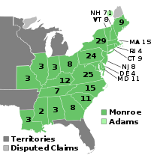
1820 Election
Resentment vs elite grows
due to Panic …Irrelevant
since only elite vote and no
organized opposition
Monroe re- elected….
‘unanimously’..1 elector
asked to change vote
Federalists obliterated
Only 80,000 votes (population of 12 million! Most electors chosen by
major property owners
New
States

Slide 30
Monroe’s Second Term (1820-1824)
Economy recovers….”good feelings return”
Foreign Affairs dominate
Spanish Empire disintegrating….new South American Republics
British propose joint declaration no European power to invade
JQ Adams rejects US to guarantee independene…”Monroe Doctrine”
Democratic Republicans split as Jackson decides to run in 1824
National Republicans… High tariff, central Bank, centralised finance (ex Federalist), Indian rights
Democratic Republicans… Low tariff, anti bank, for Indian removals
Jackson decides to run in 1824 election vs Bank Conspiracy
…..era of “good feelings” about to end

Slide 31
Intermission

Slide 32
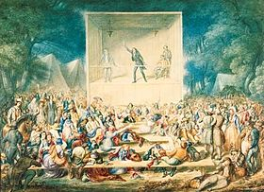
Second Great Awakening
Mass meetings
Rural, small
towns
Emotional.. Fits, seizures
Itinerant ‘rock star; preachers
‘Anxious Bench’

Slide 33
First vs Second Great Awakening
First Awakening 1720-1740
Anglican or Methodist led
New England
Pre Destination… trust in God’s mercy, individual has no agency
Communal focus
This earth “as it is”
Second Awakening 1800-1850
Multiple denominations
Western focus (West = Appalachians, Great Lakes
Deeds and behaviour decide ‘after life’…humans have agency
Individual not community
Apocalypse and 1,000 rule by Jesus imminent… need “heaven on earth first

Slide 34
Context
Events
Culture
Events
Independence
1776
Jefferson
1800
Good Feelings
1820
Mexican
War
1850
Civil
War
1860
Jamestown
1620
First Great
Awakening
Second Great
Awakening
Unique American events create unique culture

Slide 35
Second Great Awakening Causes and Effects
New
Religious
Movements
Market
Revolution
Second
Great
Awakening
Reform
Movements
Social
Changes

Slide 36
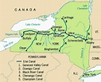
Market Forces
First American “Superhighway”
Completed 1825 at cost of £17 million:NY State as “Improvement”
Erie Canal
Most labour Catholic Irish migrants …physical attacks
90% reduction in freight costs
Grain from Great Lakes to NY..Manufactured goods in return
‘National Road completed 1811-1837connects Interior to coast
Shocking transition from personal barter
economy: Impersonal, unpredictable
relationships…

Slide 37
Social Change
Movement west....away from traditional power centres NY, Philadelphia
Increase in wealth and opportunity for all….beyond self sufficiency
Cult of the “rugged individual”
Middle class of trades, shop owners, small manufacturer emerge
…..especially along Erie Canal
Conditions ripe for ‘new religion” focused on individual and agency

Slide 38
Religious Movements: common themes
“Heaven on earth”….the objective
Jesus’s return imminent ---1,000 yeas of His rule
‘Apocalypse” to be welcomed (not ‘Day of Judgement’)
Heaven on earth must be created first
Emotion not Logic
Conversion to be personal, sudden, overwhelming
‘Conversion accompanied by seen to be real: ‘Rapture’‘
Mass Appeal
Everyone can be saved…..poor, women, blacks
Mass meetings…each an event involving entire communities
‘Star preachers’ touring ‘Burned Over Districts”

Slide 39
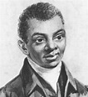
‘Black Harry’ Hosier (1750-1803)
Benjamin Rush: “making allowances for
his illiteracy, he was the greatest orator
in America…The white people looked on with
attention" even at the first performance;[
^{8]} subsequently, they would often be moved to tears
Slave born in Carolinas, sold north, acquired
By Ray Asbury leading Methodist…memorises
Bible, first use to preach to blacks…but expands
..preaching vs slavery, for common man, that
Slave ‘should be good’
Seeks ordination but rejected due to being
Black…falls out with church
Becomes drunk, living of rags from garbage
for resale. Recovers but dies in poverty

Slide 40
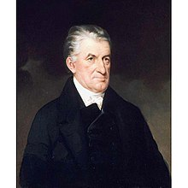
Lyman Beecher (1775-1863)
Traditional New England Presbyterian preaching vs Catholics and for Temperance & repatriation of slaves
Evangelism, female preachers and Temperance..Much respected but poor
Gets big job and huge salary to move to Ohio and run Seminary…supports camp meetings, revival sessions
Organises debate on slavery…gets out of
Hand (Lane Debates) student vote repatriation a hoax. Riots, has to flees to NY
13 Children ….most become evangelists. Daughter Harriet writes “Uncle Tom’s Cabin ….abolitionist tract

Slide 41
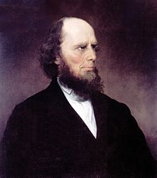
Charles Finney (1792-1875)
Born new England, brought up Presbyterian Self taught, ‘born again’ abandons law school to preach
Intinerant evangelist, Mass meetings supports women preachers Abolitionist.
Temperance Bans slave owners from communion
Advocates ‘perfect perfectionism’ unity belief
And behaviour due to surrender to God..impossible without
Abolition of slavery
Effect on Rochester: "The whole community was stirred. Religion was the topic of conversation in the house, in the shop, in the office and on the street. The only theater in the city was converted into a livery stable; the only circus
into a soap and candle factory. Grog shops were closed; the Sabbath was honored; the sanctuaries were thronged with happy worshippers; a new impulse was given to
every philanthropic enterprise; the fountains of
benevolence were opened, and men lived to
good."^{[1}

Slide 42
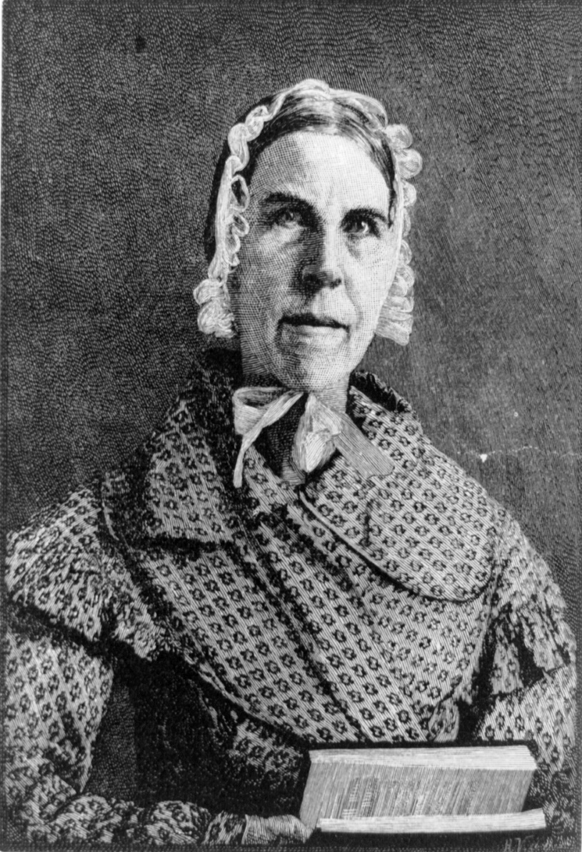
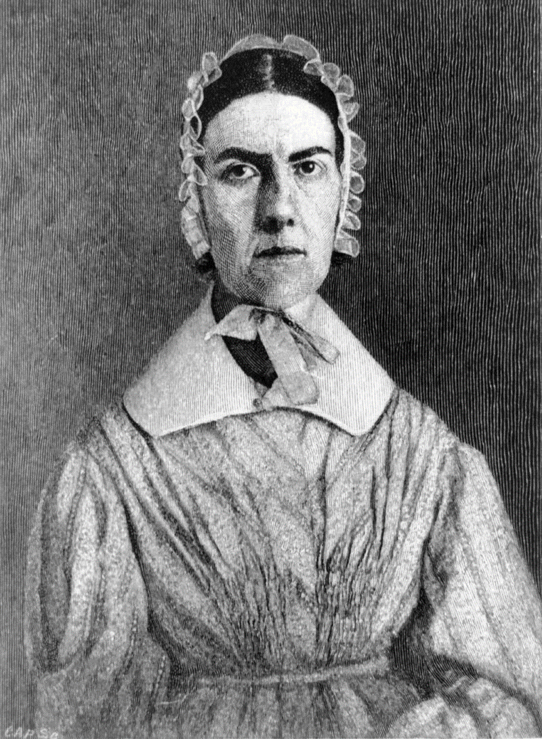
Grimke Sisters
Sarah (1792-1873
Angelika ( 1805-1879)
Born S Carolina to slave owning family
Self educated..father would not allow education
…reject slavery
Accompany father to Philadelphia meets
Abolitionsts…father retains support..Angelika
Marries abolitionist…Sarah joins family
Become writers for Abolitionism and women’s
Rights. Then public speakers…to women, then
mixed groups..
Speech at new “Philadelphia Hall”
Intimidated…flee building…mob attack
Grimke’s cease public speacking
Set up boarding school adopt mixed race
children of deceased brother..live to
See Slavery ended

Slide 43
Sarah Grimke on female equaliy
Sarah “Letters on Equality..1838):
"men and women were CREATED EQUAL.... Whatever is right for a man to do, is right for woman....I seek no favors for my sex. I surrender not our claim to equality. All I ask of our brethren is, that they will take their feet from off our necks and permit us to stand upright on that ground which God destined us to occupy”

Slide 44
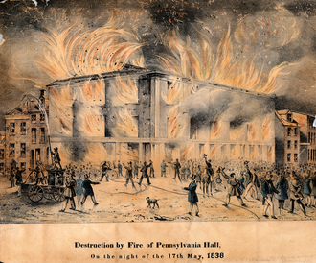
Burning of Philadelphia Hall

Slide 45
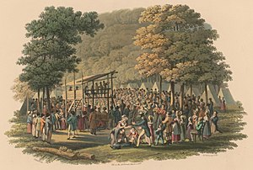
Great Awakening Events
Most along Erie Canal….“Burned Over District”
(so many preachers..
hellfire
All classes mix…political
Impact…Democracy
Spurs creation of religious movements

Slide 46
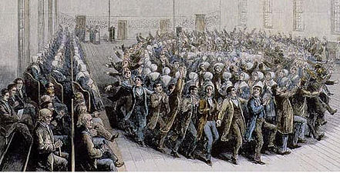
Shakers
Originated in England,,,
“Shaking Quaker”…end of
World…ecstatic feelings
Believe women leadership
Leader Anne Lee preaches
Celibacy The way to purity
Anne moves group to US
In 1774 to escape persecution
Establishes communities
Communal living all property
Shared. Men women equal
Celibacy, dancing..spirit gifts
Era of Manifestations
Expansion 1820-60..then
Decline…3 left (2014)

Slide 47
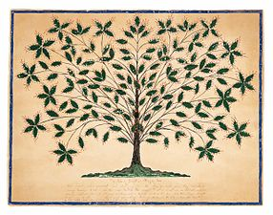
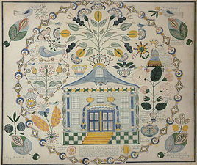
Shaker “spirit gifts”…gift drawings---messages from ‘the mother’
Hanah Cohoon 1845
Polly Anne Reed 1851

Slide 48
Millerites
Founded Charles Miller. Prosperous
farmer..obsessed with Book of Daniel
Publishes prediction end of world due
1830… 600,000 copies …”Sign of Times” newspaper
End of World calculated 2,300 ‘days’
(year day method) after building of
new Temple 457 BC
Mass movement.. Up to 500,000 members across “Burned Over District”. Only true believers saved
“EOW October 22nd 1844…crowds
Gather…expecting world to be consumed
By fire. And deserving saved..abandon
Possesions…families
Great Disappointment….violence, ridicule & rapid reinterpretations …..Miller recalculates till his death 1849…7th Day Adventists

Slide 49
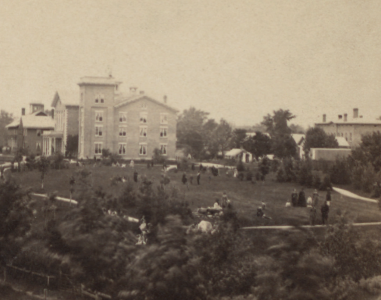
Oneida Community
Perfectionist Religious community
of up 300 in New York founded in
1848…Charles Noyes
Jesus already returned but cannot
Be found till perfection achieved
“Complex marriage”….multiple Partners, communal children, all equal (except for
Breeding) , rotate jobs…silverware
Public criticism and confession circles
Policy of Eugenics….selective breeding
for elite members to achieve purity
Disbanded 1885

Slide 50
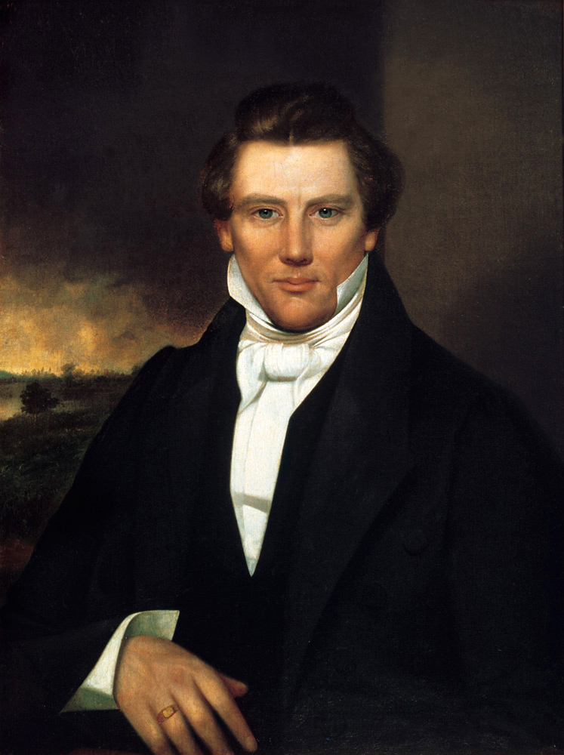
Origin of the Mormons
Joseph Smith (1805-1844)
Born Vermont to Methodist family moved to
New York “Burned out District” Family
immersed in revivalism, visions, does ‘odd
Jobs” ‘folk magic and treasure seekers”
Claims visited by God and Jesus in 1821: his sins forgiven, Gospels incomplete
Visited by Angel Moroni in 1823 :Magic box
golden tablets. transparent “Seer Stones”
Translate….create “Book of Mormon”
Creates new church with followers …. considered heretics…flees to Ohio with followers

Slide 51
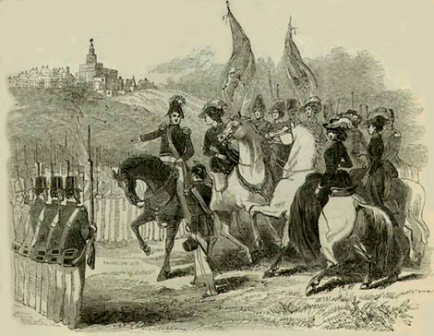
Mormons in Ohio/Missouri
Smith & Nauvoo Legion
Smith to Kirtland Ohio: community of thousands
Establishes ‘theocracy’ …crushes local ‘ecstatic” believers…communal society, disciplined, ritual, creates bank, influences State Government
Mormons seen as “heretics”. Smith tarred and feathered by mob… moves to Missouri…’Far West’…create theocracy
‘Mormon War’...killings both sides, Smitharrested for Treason…escapes to Illinois…the new Zion
Governor sympathetic. Smith builds Nauvoo.
Wants new territory , creates ‘army & introduces polygamy…backlash. Smith suppresses dissent, revolt, arrested…and lynched
To be continued…Talk 14 “Manifest Destiny”

Slide 52
Mormons: Key Beliefs
End of world due but ‘Zion’ must be built first
God a physical being, multiple wives, lives on throne near star Kolob
Book of Mormon includes “lost truths”> Gospels
Three tiers of heaven…..intercession possible by post death baptism
‘Celestial marriage’ and family
Jews populated North America 600BC…war with ‘Laminites” Jesus appears after resurrection:United States 2nd coming “chosen place”
Polygamy abandoned in 1890…End of world delayed to gain state-hood

Slide 53
End of “Good Feelings”

Slide 54
1824 Election ‘Campaign’
No Federalist campaign
‘Popular Vote’ triples to 300,000…..Elector ‘appointment’ process ending (states removing
property and tax payment qualifications to vote
Democratic Republicans one party four competing candidates….based on Regions
John Quincy Adams. North East, Bank of USA , high tariffs
Andrew Jackson: West and South: Anti Bank, anti foreigners, Indians
Henry Clay: West: “American System” …high tariffs
William Crawford: South: Plantation owner Anti Bank low tariffs, anti Bank

Slide 55
1824 Election & “Corrupt Bargain”
Popular vote triples to 350,000
As more states allow direct voting
Deadlocked election, no
Candidate majority
Contingent Election by Congress
Clay hands all his supporters
Over to John Quincy Adams/…
… appointed Secretary of State
Jackson claims “Corrupt Bargain”

Slide 56
Beginning of “Bad Feelings”
Jackson claims “Conspiracy” , employs “Campaign Manager” Martin Van Buren to run four year campaign
Push more states to switch to popular vote
Rebrand Jackson as “Common Man” vs Bank, Elites, Indians, Abolitionists
Motivation Revenge vs Corrupt bargain
Democratic Party splits in two
National Republicans led by John Quincy Adams
Democratic Party led by Andrew Jackson

Slide 57
Next time: Democratic America emerges …for good (poor whites, plantation owners, and ill (for elite ‘enlightened’, Indians, and slaves)

