Slide 1
Module 5: Leader of the Free World
Talk | Title | Time Period | Date of Talk
30 | Isolationism interrupted | 1939-1941 | January 20th
31 | The European War | 1941-1945 | February 3rd
32 | The Pacific War | 1941-1945 | February 17th
33 | America and the Post War World | 1945-1948 | March 3rd
34 | The Age of Consensus | 1948-1960 | March 17th
35 | The Cold War | 1948-1960 | March 31st
36 | Camelot | 1961-1963 | April 7th

Slide 2
Talk 31 The European War
War strategy 1941-43 and Battle of Atlantic
Attacking the “soft underbelly” 1941-1944
US “occupation” of Britain
…..Intermission
Strategic Bombing campaign
Invasion of France
Endgame

Slide 3
War strategy and Battle of the Atlantic

Slide 4
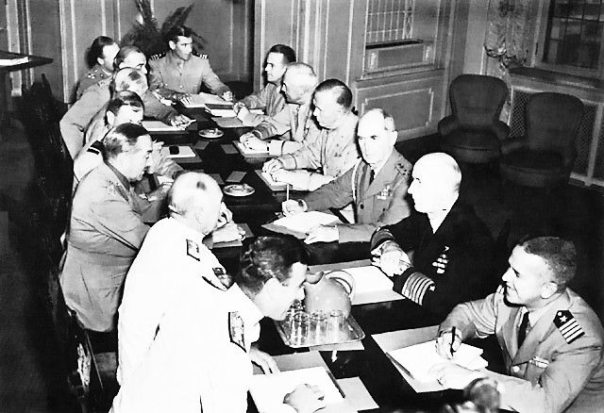
Joint Chiefs of Staff
Joint British American
Committee Washington
Based.. European War
Separate committees
US/UK Europe
US…Pacific
UK…Middle East
Excludes USSR
Via governments only
US becomes increasing
Dominant over time

Slide 5
Conflicts of Interest
Churchill and Britain
Minimise casualties….memories of WW1
Protect Empire/ minimise power of USSR
Reduce risk by attacking ”Soft Underbelly” first
FDR and USA
End war fast/ accept higher casualties
Create post imperial world based on rules
Wants direct attack on Germany in 1943

Slide 6
Decisions
European war given priority
Nazi Germany global threat
USSR at risk of destruction/ must be avoided
Japan a regional threat to be “held”
Peripheral or “Soft underbelly” strategy approved….for now
Nazi Germany too powerful/ allies too weak to attack directly
War in Atlantic must be won before large scale invasion
Troop ships too vulnerable to modern submarines & aircraft
….win Battle of Atlantic first

Slide 7
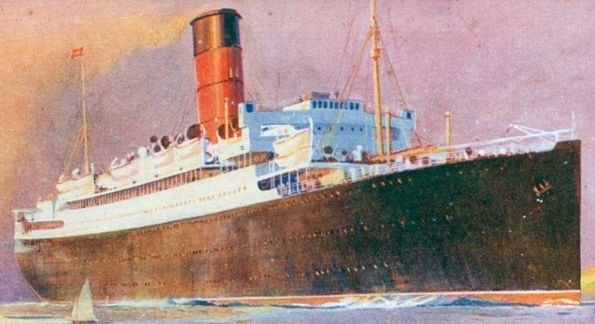
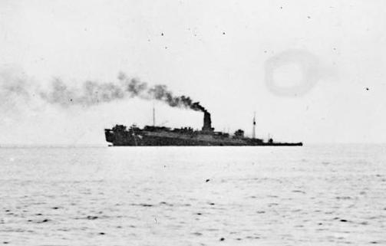
Troops ships U Boat menace
RMS Lancatria requisitioned
as troop Ship 1940 West France
Used to evacuate support staff
And civilians from France
…packed 7,000 -10,000 support
Troops and passengers
Hit by 3 bombs
….4,000- 7,000 drown
….largest British naval disaster
….news supressed during war

Slide 8
Battle of Atlantic first phase 1939-1941 : U boats ascendant
German intelligence> British
German decipher British code…know convoy plans
British unware till end 1942
Superior German technology
medium range submarines plus resupply subs extend range
British ASDIC ..low range, steep learning curve
U boat operations range across Atlantic
U boats operate from West Coast of France,
Long distance aircraft support …reconnaissance

Slide 9
Battle of Atlantic 1939- 1941
Stalemate 1939- June 1940
60 submarines deployed
Failed technology ...German torpedoes, British ASIC sonar detetionGerman advantages> British
“First Happy Time” June 1940 ---February 1941
Sumbarines increased to 150..technology overcome
Germans decipher British codes.. British don’t know
Wolf pack strategy overwhelm escorts
Return to Stalemate March 1941-December 1941
Improved ASDIC detection, new weapons systems
Use of long range aircraft to find submarines
Increased escorts/ US WW1 Destroyers + Corvettes

Slide 10
Battle of Atlantic: US Entry to war
German prepared
Intercept allied code systems
Develop long range submarines…milk cow supply ships
Despatch squadron to US cost
US unprepared
No black out mandated. ….cities lit up….”illuminated ships”…
No convoys…escorts to British
“Second “Happy Time” January – June 1942

Slide 11
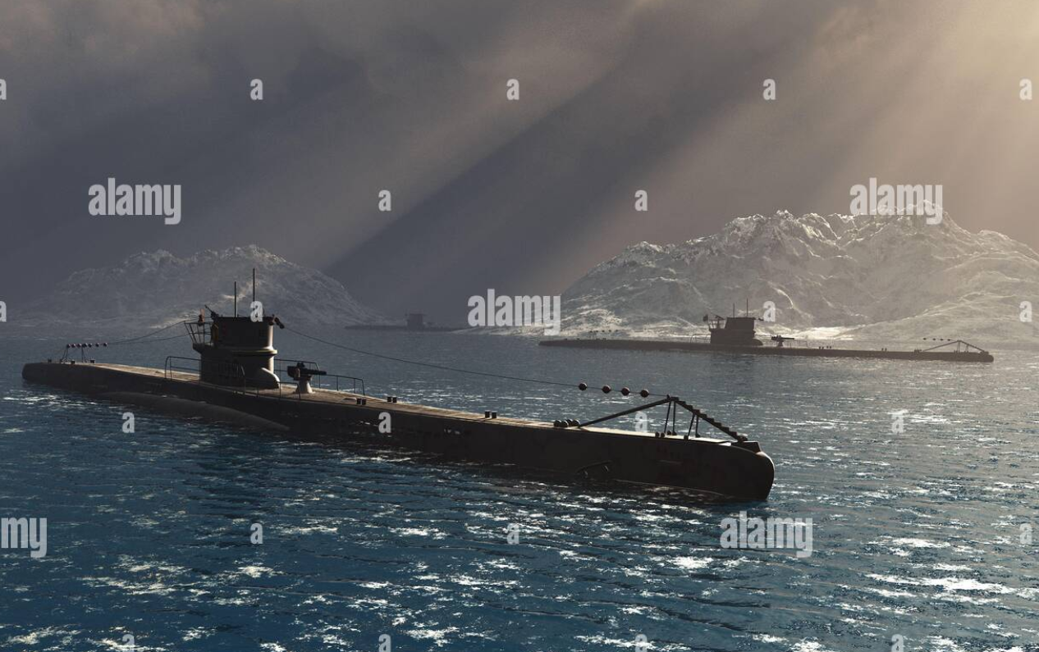
Use of “wolf packs” to enter & destroy convoys….30%-50% during 1941/42

Slide 12
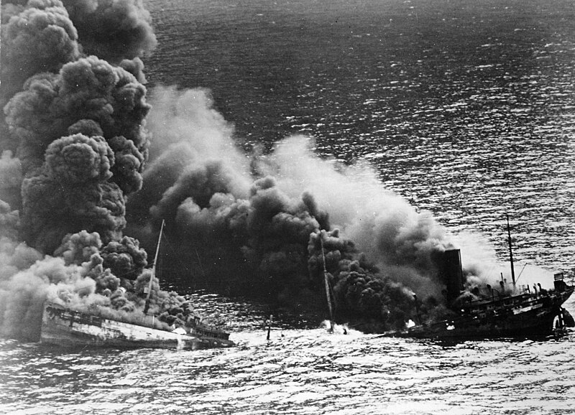
Slaughter of US merchant ships

Slide 13
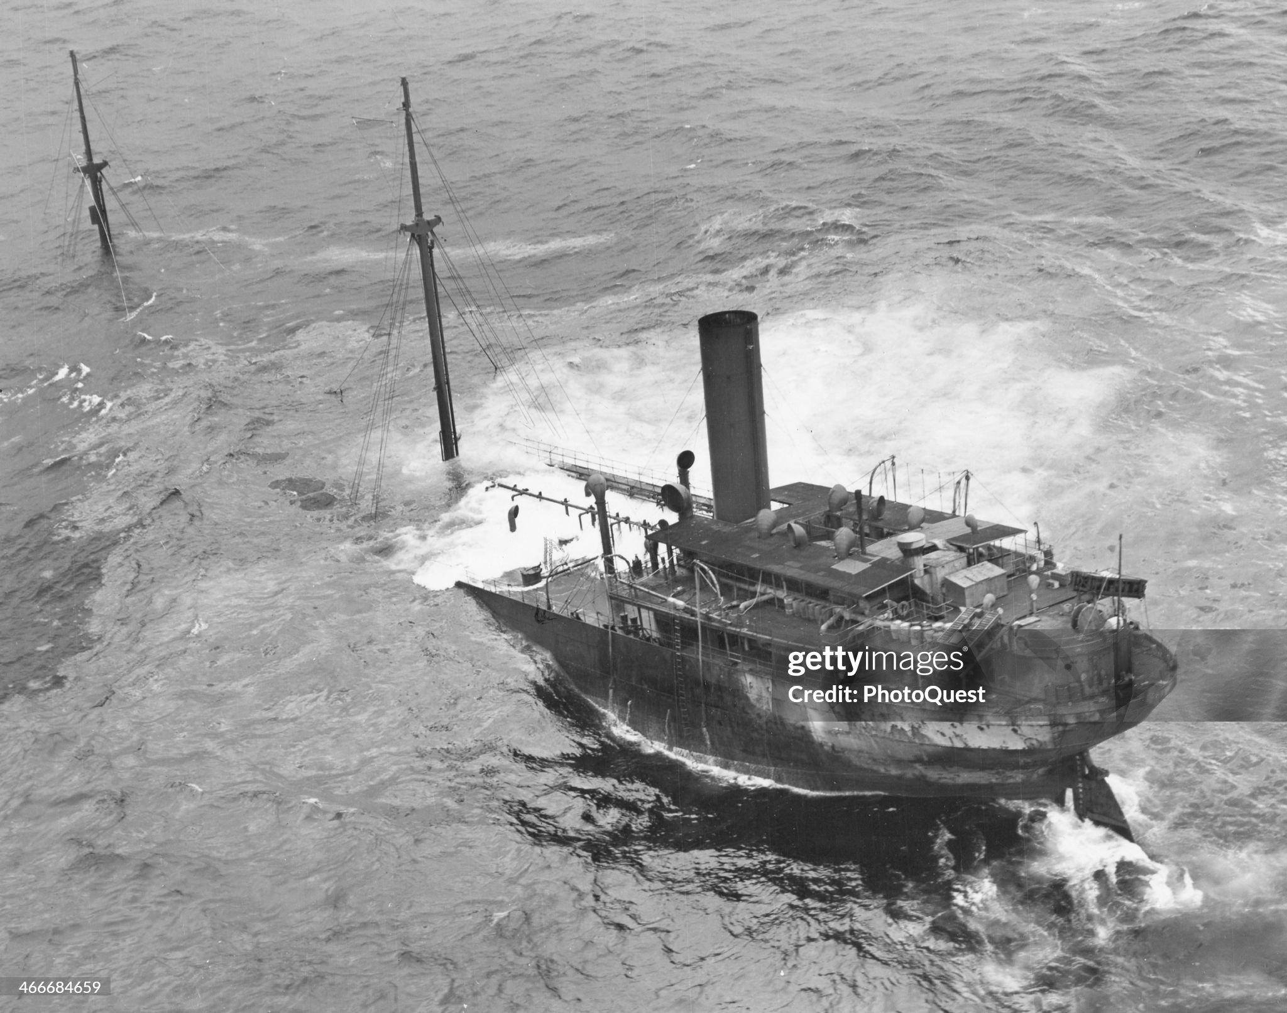
Jan- June 1942: 640 ships sunk, 3 million tons .. loss of 22 u boats, 300 operational simultaneously

Slide 14
The balance shifts July 1942- 1943
Allies secure technology & Intelligence advantage
British complete decoding of Enigma….intercept U boat signals
Offset German intercepts
Improved detection and depth charge systems
Air support for convoys throughout entire voyage
Catapult aircraft
Long distance bombers
Mass production Escort carriers (100 US,
Increase in escorts, submarine hunters…corvettes
Mass production of “Liberty Ships”….2,700 completed by 1945

Slide 15
Battle of Atlantic 1943-1945
Germans abandon Wolf Packs end 1943
Loss rate unsustainable…air craft
Unable to prevent rising number of merchant ships
Germans lose access to French West coast 1944
U boats remain lethal…but no longer existential threat
80% U Boats deployed sunk by war’s end

Slide 16
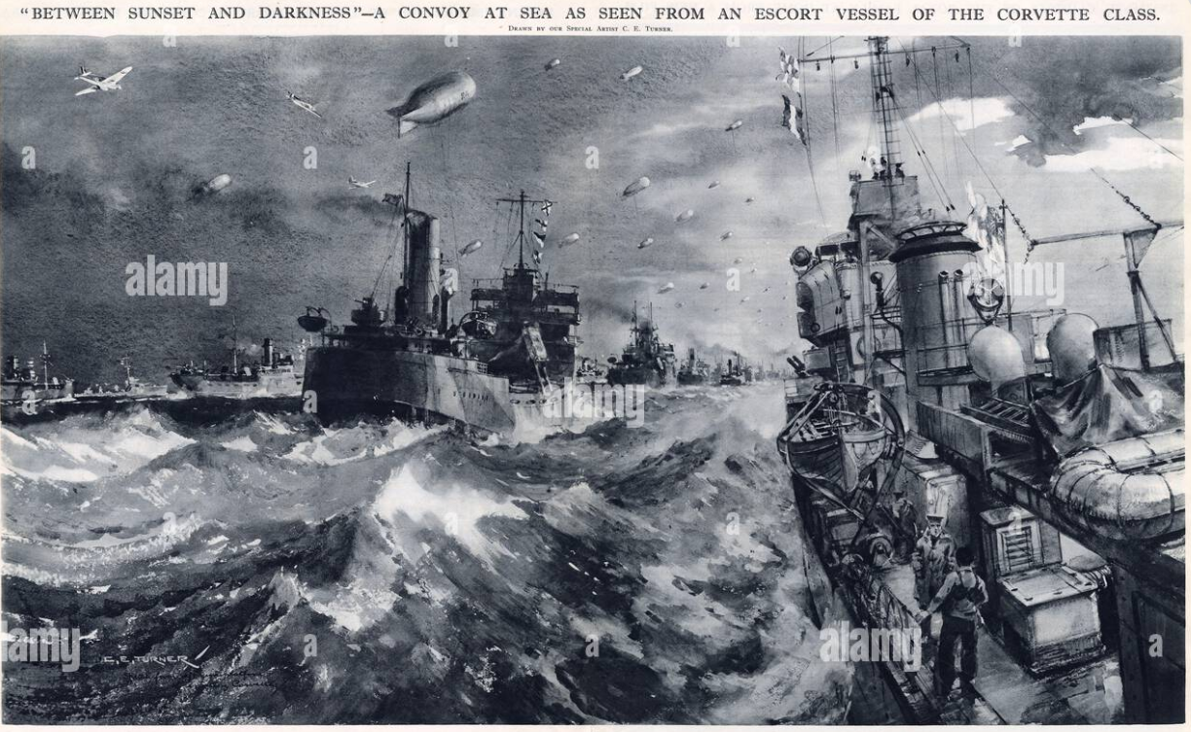
Mass production Corvettes/ Liberty Ships 1942-45

Slide 17
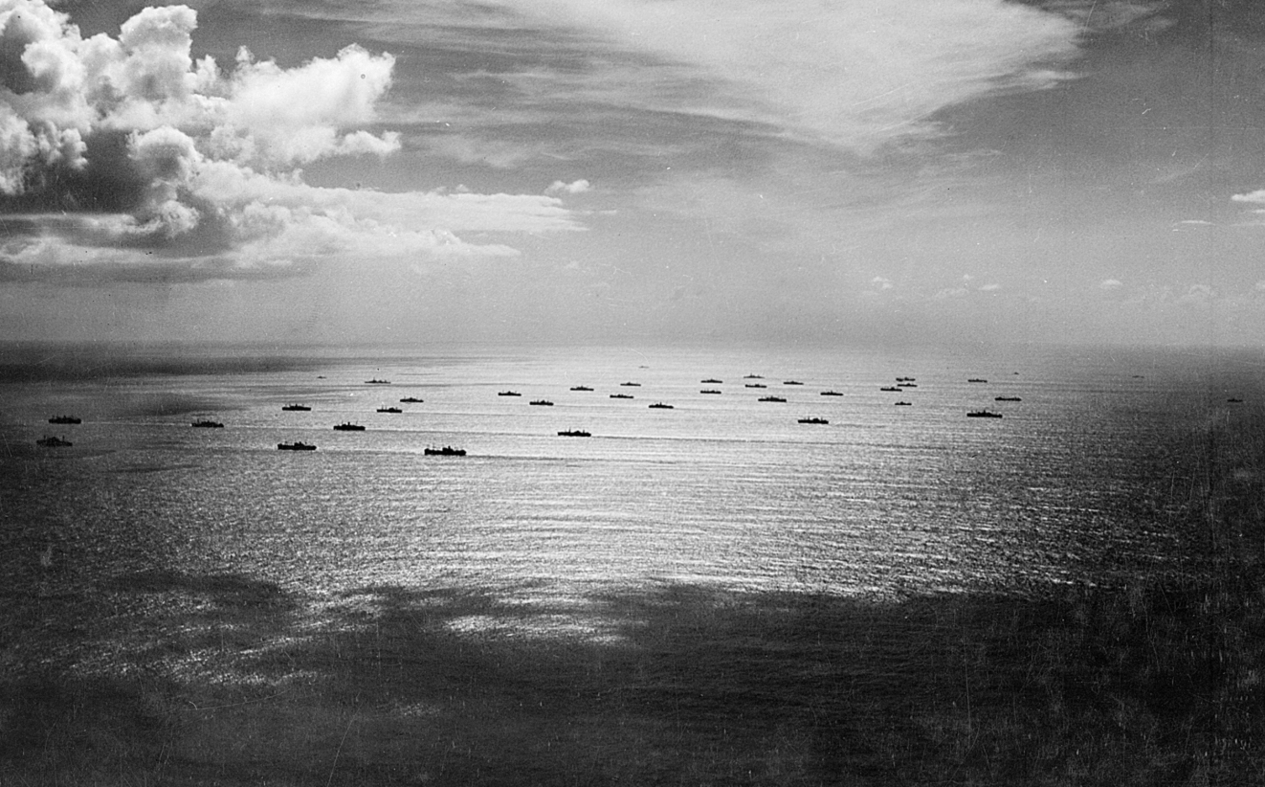
Wolf Packs vs Convoys

Slide 18
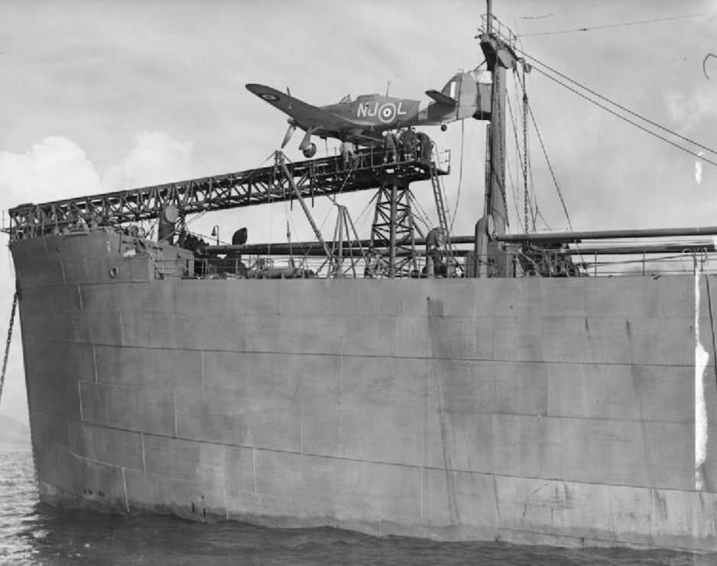
Catapult aircraft

Slide 19
Escort Carriers “mass produced”175 US, 50 UK by 1945…each 5-10 aircraft round clock air support

Slide 20
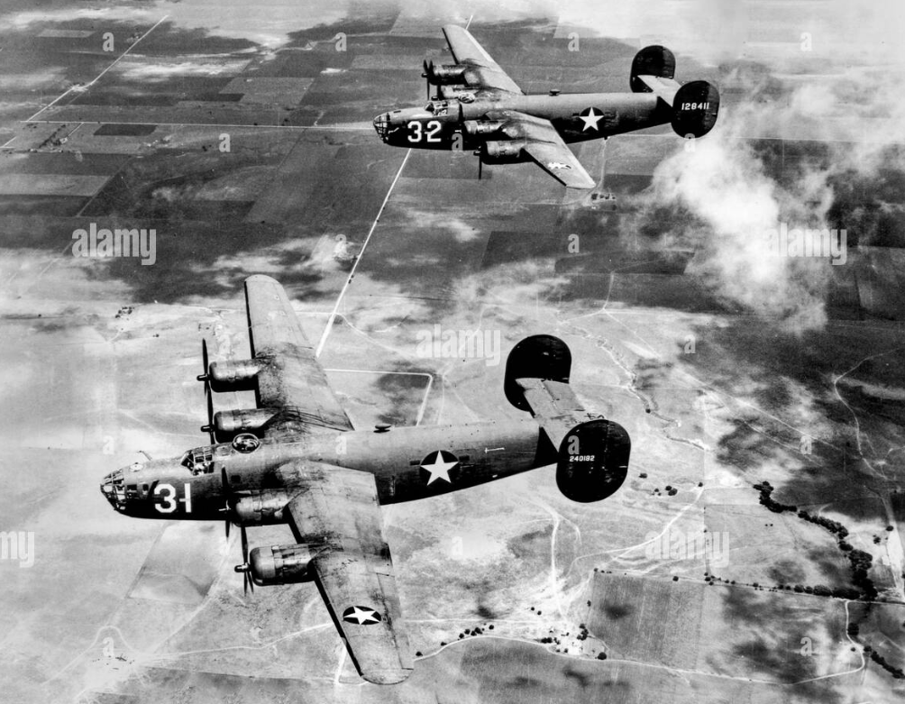
Long distance shore based bombers …Iceland…”Liberators”

Slide 21
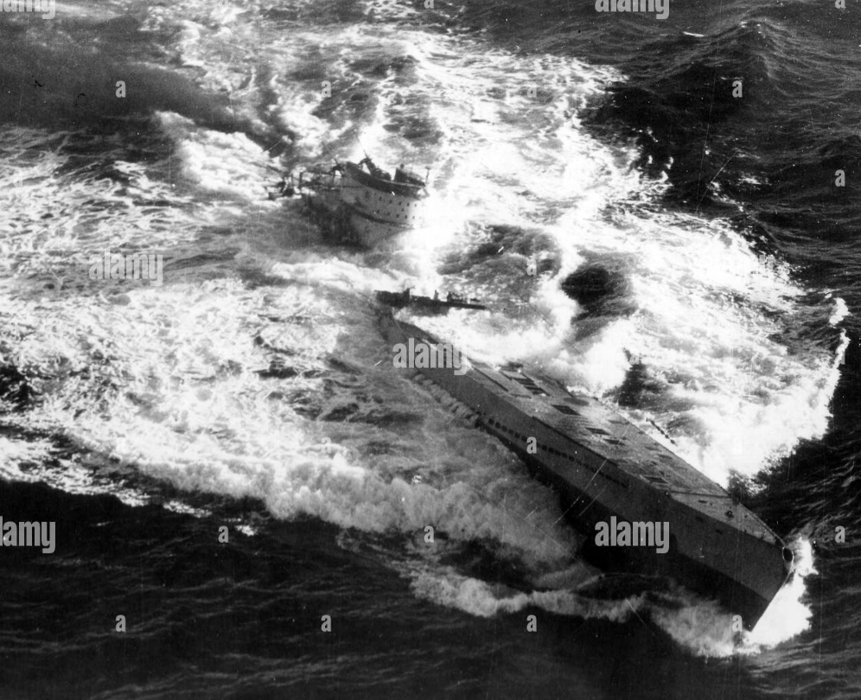
Introduction long range bombers …submarines nowhere to hide …Wolf packs abandoned end 1943..

Slide 22
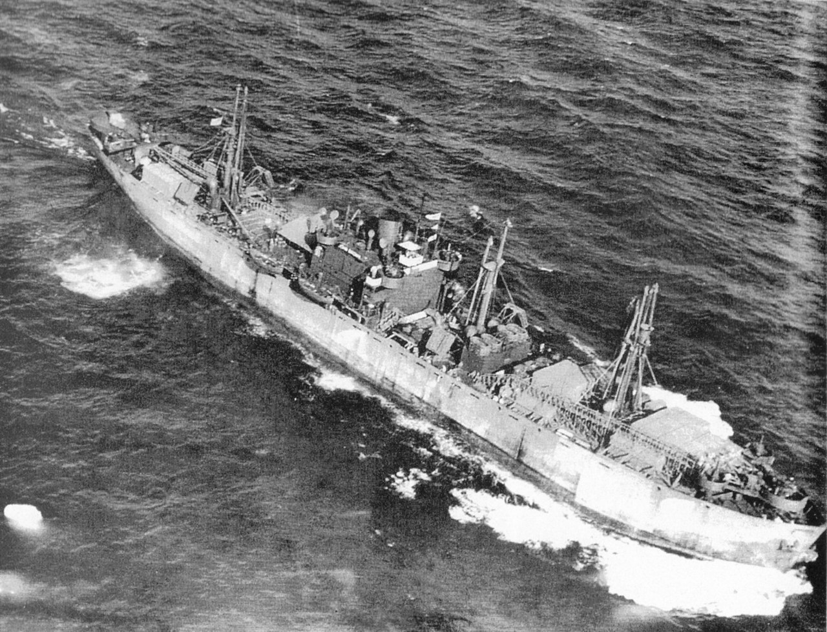
U boats overwhelmed also by volume: Liberty Ship ….3 built every 2 days by 1943, 2,700 by 1945

Slide 23
Battle of Atlantic ‘won’ by 1943 u boats cannot threaten mass troop shipments
 | U Boats deployed | U Boats Sunk | Merchant ships Sunk
1939 | 57 | 9 | 114
1940 | 120 | 24 | 471
1941 | 200 | 35 | 432
1942 | 300 | 87 | 1,664
1943 | 400 | 237 | 588
1944 | 400 | 249 | 132
1945 | 375 | 155 | 50

Slide 24
Attacking the “soft” underbelly

Slide 25
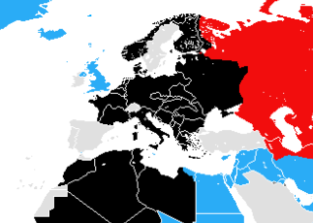
European War June1942
3.5 million Germans
Attacking 5 million Russians
…target Stalingrad & oil
1
1
British driven out of Greece
Defeat Italans, face Rommel
150,000 German and Italian
Attacking 175,000 British
Occupied
France
2
VICHY
France
200,000 Vichy French soldiers
Algiers, Morroco, Tunis
….allegiance uncertain
..waiting for orders?
3
3
2

Slide 26
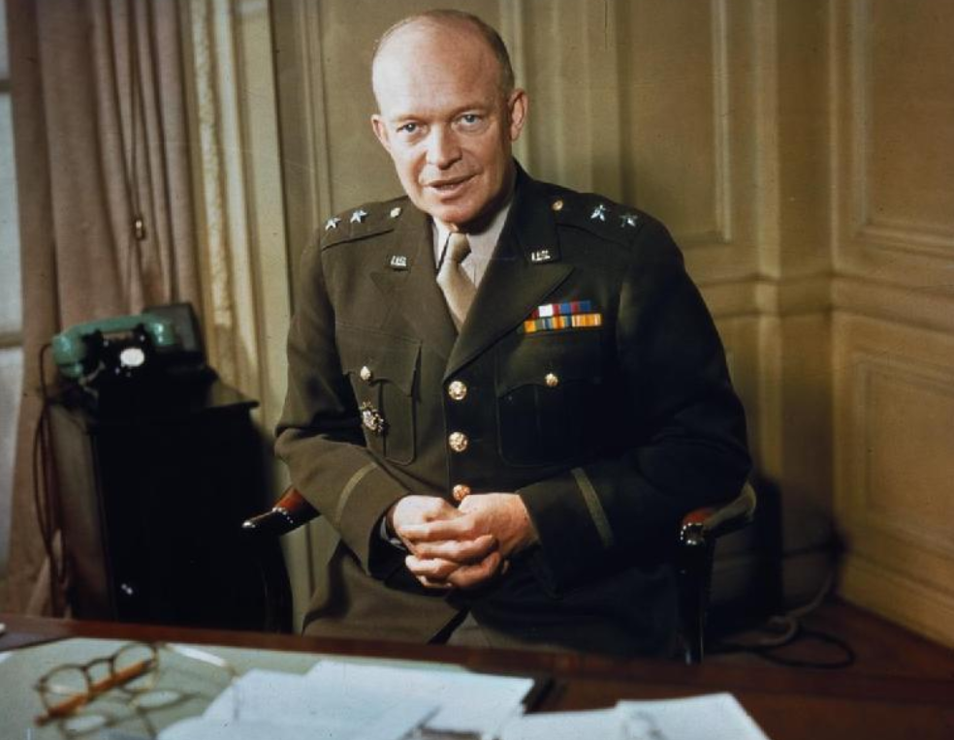
Dwight Eisenhower (1890-1969)
3rd of 7 sons, born Texas
Father mechanical engineer
“Ike”….1942
Deeply religious family..mother
Jehovah Wtness. Ike..no
denomination
Scholarship to West point…
Mediocre student..good at
English….studies military history
Training instructor Tank Corps
In USA..during WW1
Stays in army….trains Philippine
Army 1936-1939….master at Bridge
...to Washington…Assistant Chief of
Staff George Marshall

Slide 27
Eisenhower….path to leadership
Commanding officer about Eisenhower:
"you can always judge a man's character by the way he plays cards. Eisenhower is a calm and collected player and never whines at his losses. He is brilliant in victory but never commits the bridge player's worst crime of gloating when he wins."
Marshall sends “Ike” to to UK to assess credibility of acting US commander of US troops.
…Makes balanced, constructive,negative assessment …trusted by British
…Returns to US, FDR needs Diplomat to win over Vichy French
…Eisenhower promoted to Commander in Chief European Theatre of Operations
Meanwhile…..back in Africa…October 1942 British army under Montgomery of
200,000 defeat Rommel’s German/ Italian army of 100,000 at El Alamain
…..retreat across Libya to Tunis…TIME TO ACT

Slide 28
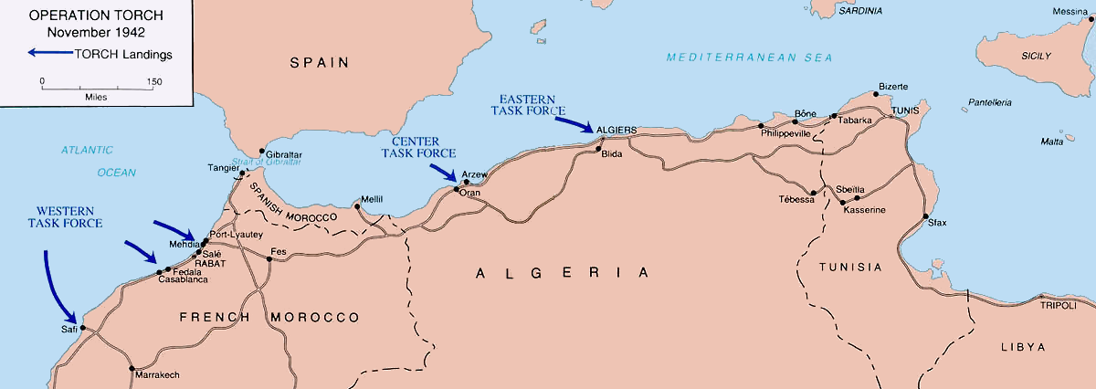
Operation Torch November 1942
100, 000 US _ 30,000 British
Land ….opposed by Vichy
French 3 days fighting
…5,000 causalities
Vichy emissary.. ceasefire …change sides…German armies occupy Vichy France Torch armies move east to Tunis…Italian army blocks advance
Italian
Army
Rommel
“Race to Tunis”
…..Rommel wins
…reinforced by 100,000
Germans from Italy
Vichy French forces
Montgomery

Slide 29
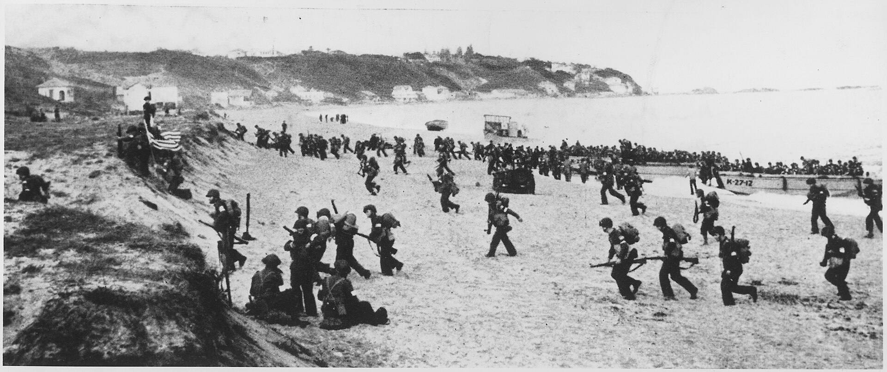
US troops landing in Morocco

Slide 30
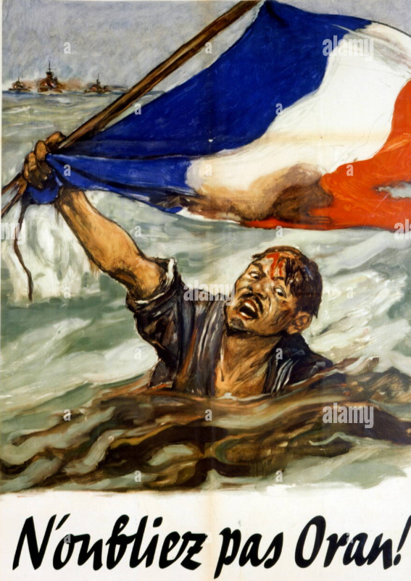
Vichy anti British propaganda (attack on French fleet May 1940)….need for US diplomacy

Slide 31
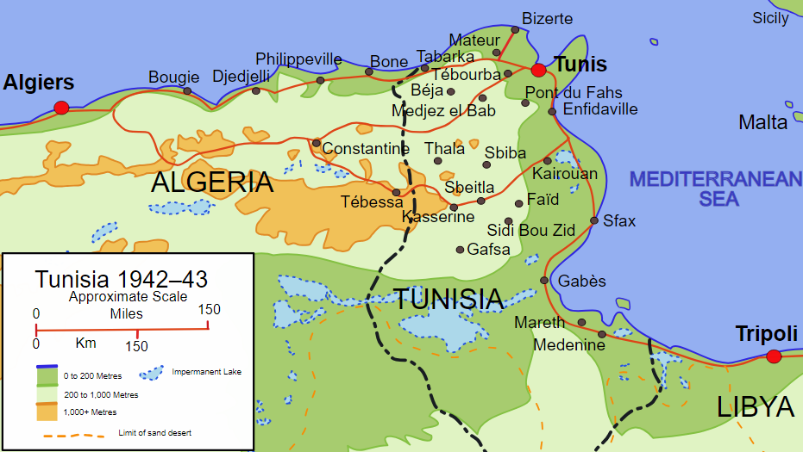
Tunisian Campaign December 1942- May 1943
4 month Campaign
500,000 US/ UK/ FR
Vs 300,000 Axis
Rommel ..defeats US At Kasserine Pass,10,000 US loss
Eisenhower replaces
Generals..enter Patton
Montgomery breaks “Mareth Line”..April
Rommel seeks exit,
Removed Hitler. “Die to last man”
General offensive May
…Axis surrender 300,000
,,,75,000 allied casualties

Slide 32
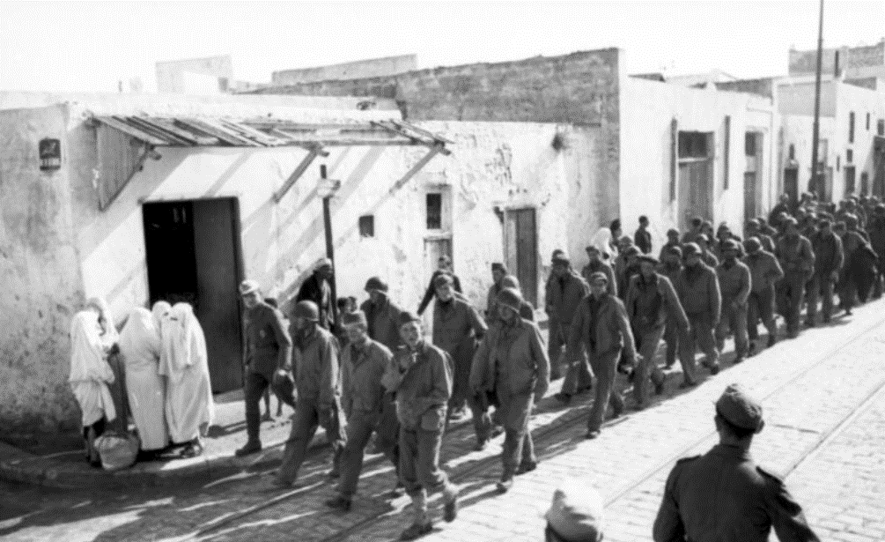
Rommel attacks approaching US army …creates havoc….5,000 casualities US prisoners from Kasserine Pass battle

Slide 33
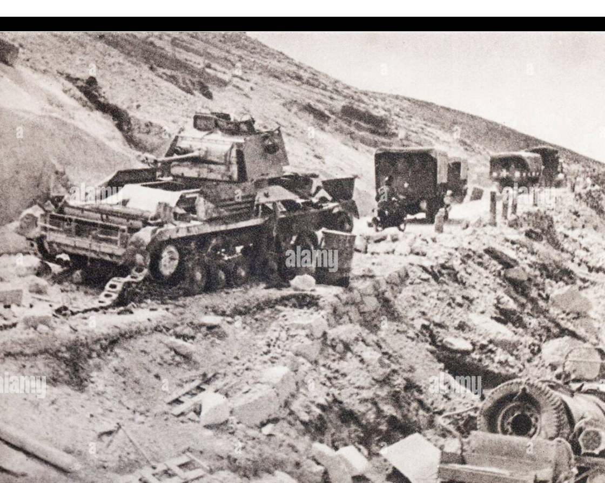
IKE reorganises….US advance to Tunis

Slide 34
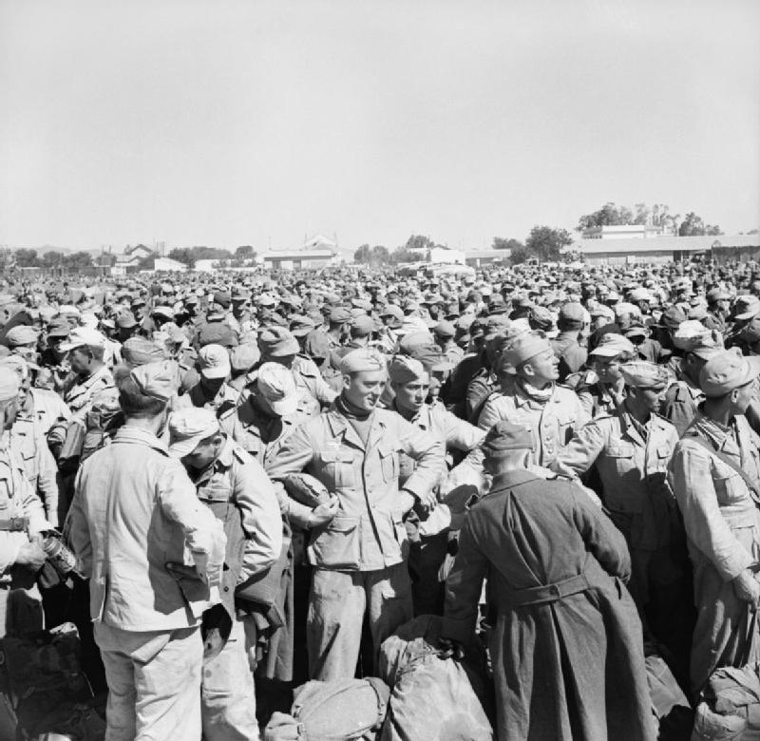
Some of 300,000 Axis Prisoners May 1943

Slide 35
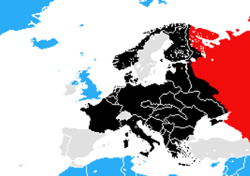
European War June 1943
German army of 1.5m
Annihilated at Stalingrad
By Jan 1943..2m Soviet
losses
Germans retreat..
Last major offensive
At Kursk..2m Germans
Vs 3m Soviets.
Attack fails 500K German
750K Soviet losses
US/ UK ready to invade
“Soft underbelly”
U boats overcome
US builds up forces
In UK

Slide 36
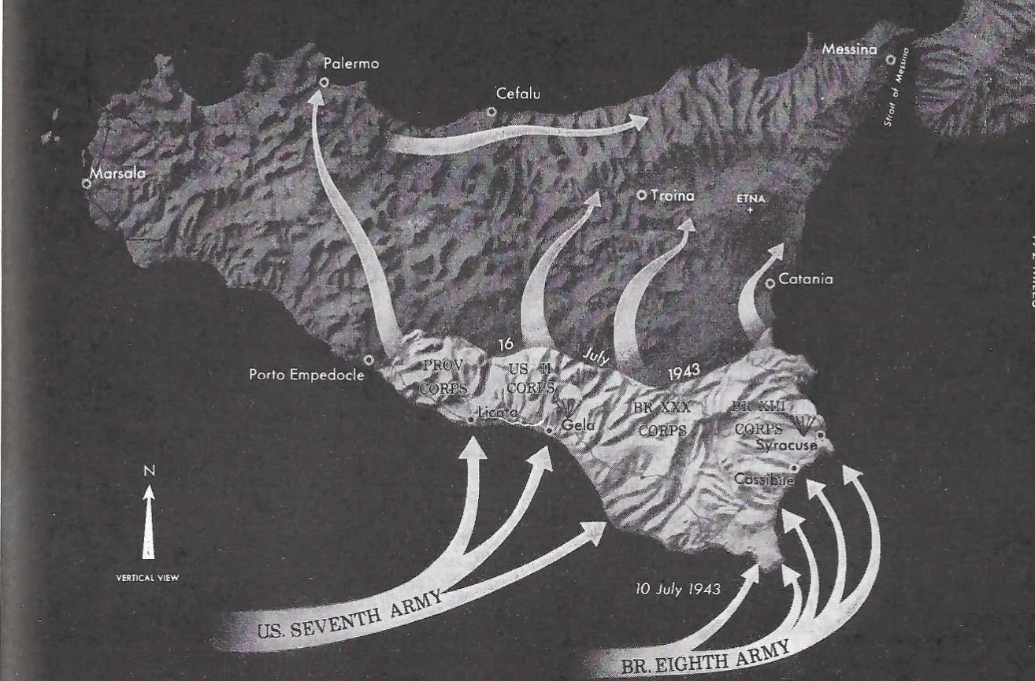
Invasion of Sicily June 1943
Germans tricked into expecting
Invasion of Sardinia
..160,000 Allies land…builds up to
500,000 within 2 weeks vs 100,000
Germans + 200,000 Italians
Resistance breaks
..US General Patton
“race to Messina”
…antipathy vs slow/risk Monty
Germans evacuate army to mainland
100,000 Italians captured
30,000 Allied causalities

Slide 37
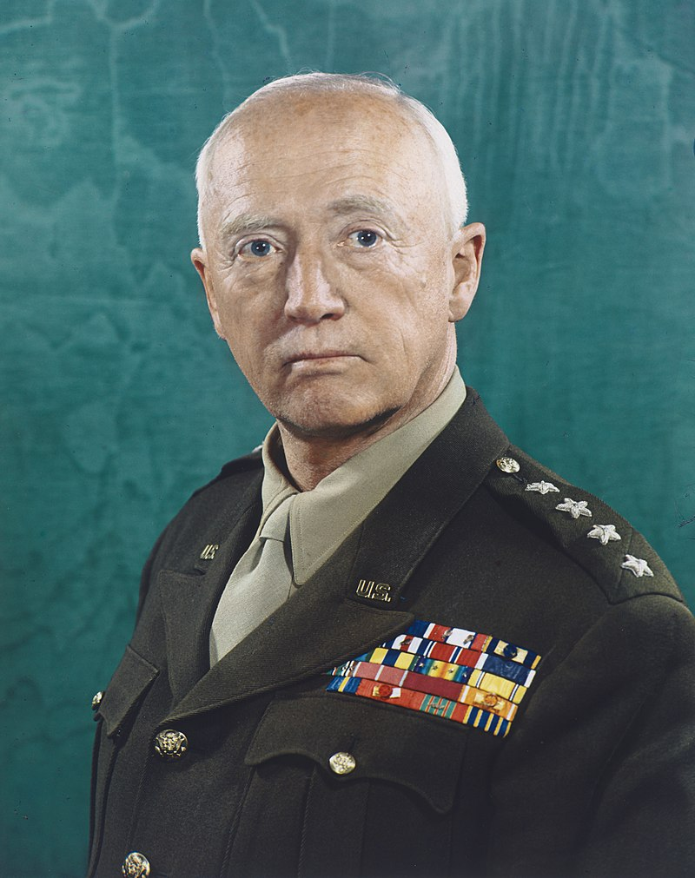
George Patton (1885-19450
Patton 1945
“Warrior family” Army is
Life…West Point ..led raid vs
Pancho Villa (el Bandito)
Led tank brigade WW1..hero
Takes over US operations
Afer Kasserine Pass
Leads flanking attack Sicily
…hatred vs Monty..mutual
Slaps shell- shocked soldier
…press report
..sent to UK for Normandy

Slide 38
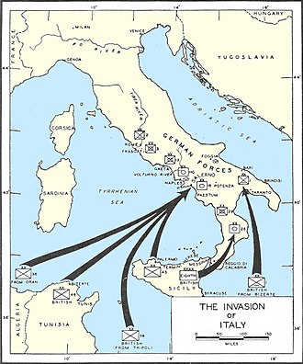
Italian Campaign 1943-1944
190,000 allies land September 1943
Fascist Government collapses
…Italian civil war vs Communists
…Allies move north
German general Kessrling assumes
Command..exploits mountains
Builds line of defense
Attritional campaign 1944-45
1.2 million allied soldiers vs 600,000 Germans
300, 000 allied casualties, 200,000 German
Mussolini imprisoned, recaptured, heads up
North Italy “German vassal
“Soft underbelly---”tough nut”

Slide 39
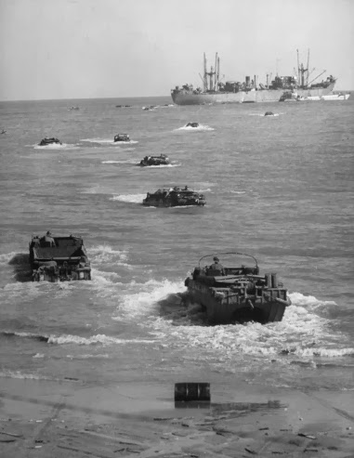
Amphibious landings…moments before dive bomber attack

Slide 40
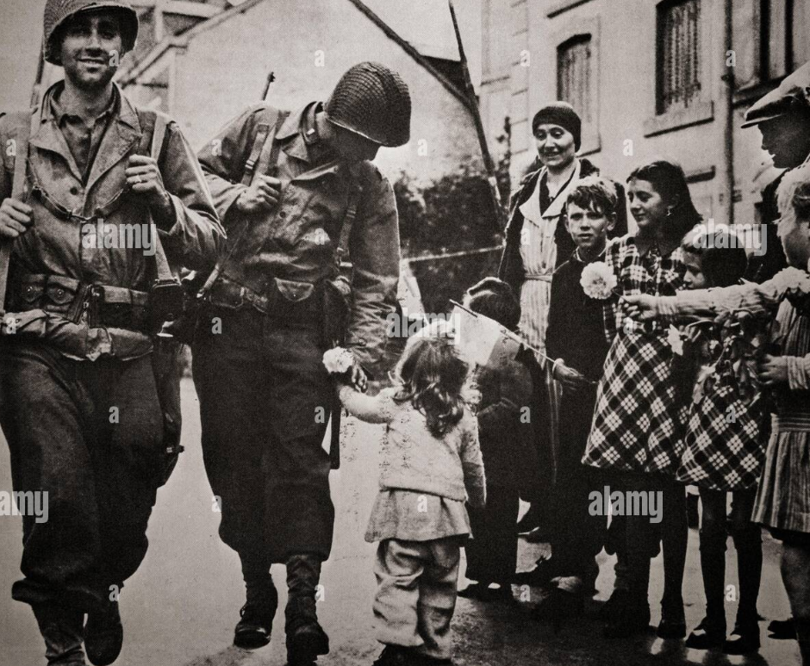

Slide 41
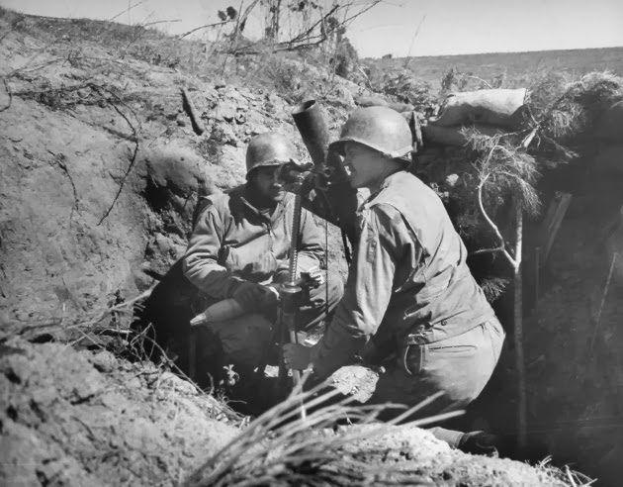
18 months attractional trench warfare

Slide 42
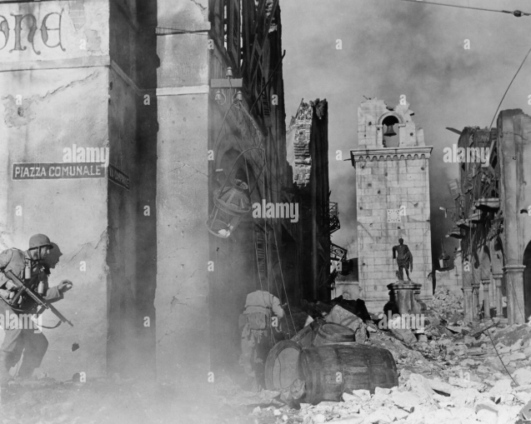
Stalemate till early 1945

Slide 43
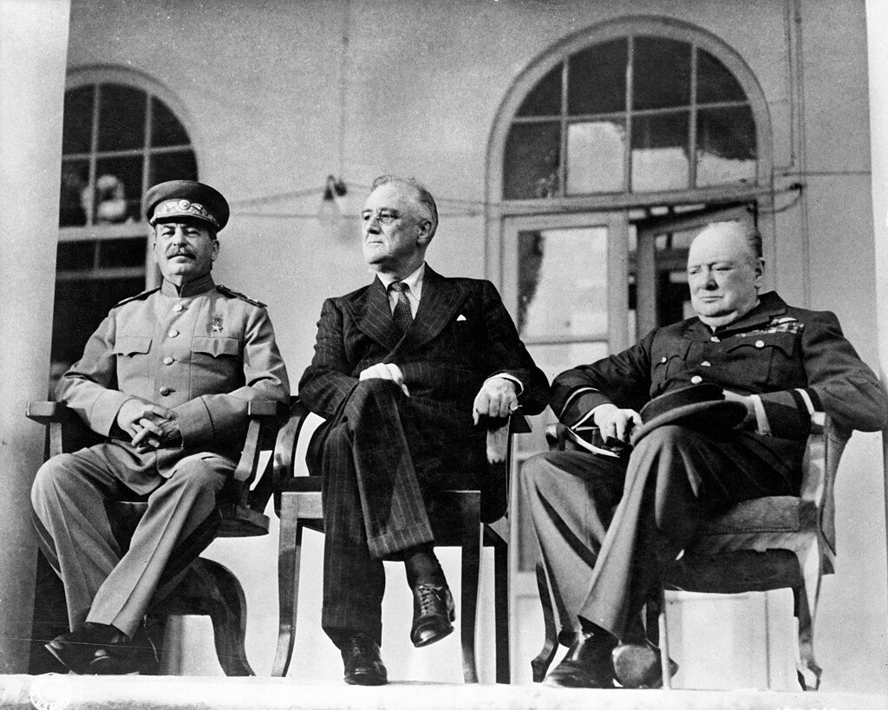
Tehran Conference December 1943
First joint meeting FDR
Churchill , Stalin
…British influence waning
…victory inevitable
Stalin…Italian, African
Campaigns…minor
events
FDR commits to 2nd
Front in France
First discussion division of
Europe between allies
….East Europe to USSR
…Italy/ Greece to West

