Slide 1
War on Poverty and Backlash

Slide 2
Social Security Expansion Act 1965
Medicare
Low cost insurance for the retired
Complex rules on care types duration
Paid by payroll taxes and deductions from Social Security
Medicaid
Low cost insurance for those 130% poverty level
Complex eligibility, care provisions
Government welfare costs rise from 1% to 8% of US Budget
Expansion of Administration/ Insurance/ Compliance “industry”

Slide 3
Immigration and Nationality Act
Immigration prior to 1965 based on “national origins". Established 1920
Retain ethnic mix based on 1900 census
Immigration from Asia, Africa, South America banned
US population 90% “white” 1900….90% white 1965
Replace “national origins with “new categories”….eliminate racial bias
Family background
Job skills
Refugees
Limits set by hemisphere
“Mentally defective”….LBGQT labelled as such….and banned from entry
Not expected to change population mix……

Slide 4
Other
Education Act….Funding for “Head Start”….primary school education
Clean Air Act…remove pollution from vehicles
Highway Beautification (Lady Bird Johnson) vs billboards state highways
Gun control….mentally ill, convicted felons banned from owning guns
Most ambitious programme “War on Poverty”

Slide 5
Economic Opportunity Act: ….a “hand up, not hand down”
Objectives: End poverty by eliminating its causes:
Education and lack of skills
Head Start….free education for underprivileged Primary School
Youth apprenticeships/ Job Corps for unemployed 18-15 year olds
Resolving disempowerment
Create “Community Action Programmes”…bottom up change
Integrate “experts” with “underprivileged”….mix of volunteers and employees paid directly by national government
Programme to be managed by “Office of Economic Opportunity”

Slide 6
Warnings……social change
Increasing internal migration
blacks from South to North and West
Mexican migration to booming agricultural industries of west
Rising levels of automation: mining, industry, loss of “unskilled” jobs
“White flight” to suburbs, zoning restrictions vs blacks
Reduced tax base, local government increasingly unrepresentative
Reduced employment opportunities
Consumerism feeding expectations…participation in “good life”
Rising tensions…...triggers for violence…unexpected places

Slide 7
Los Angeles 1965
A growing and changing city 1.5million 1940m, 2.6 million 1960
1940 90% white, 8% Latino, 2 % black
1965 65% whit, 18% Latino, 15% black, 2% Asian
Segregated suburbs
95% housing restricted to “whites only”…over crowded/ absentee landlords
95% police and local government white…rampant corruption
Reforms blocked
Housing reforms passed by Democratic Governor
Over-ruled by state “referendum”…Proposition 14
August 1965…black drunk driver white police in Watts area
…violent confrontation…..rumour….crowds……violence

Slide 8
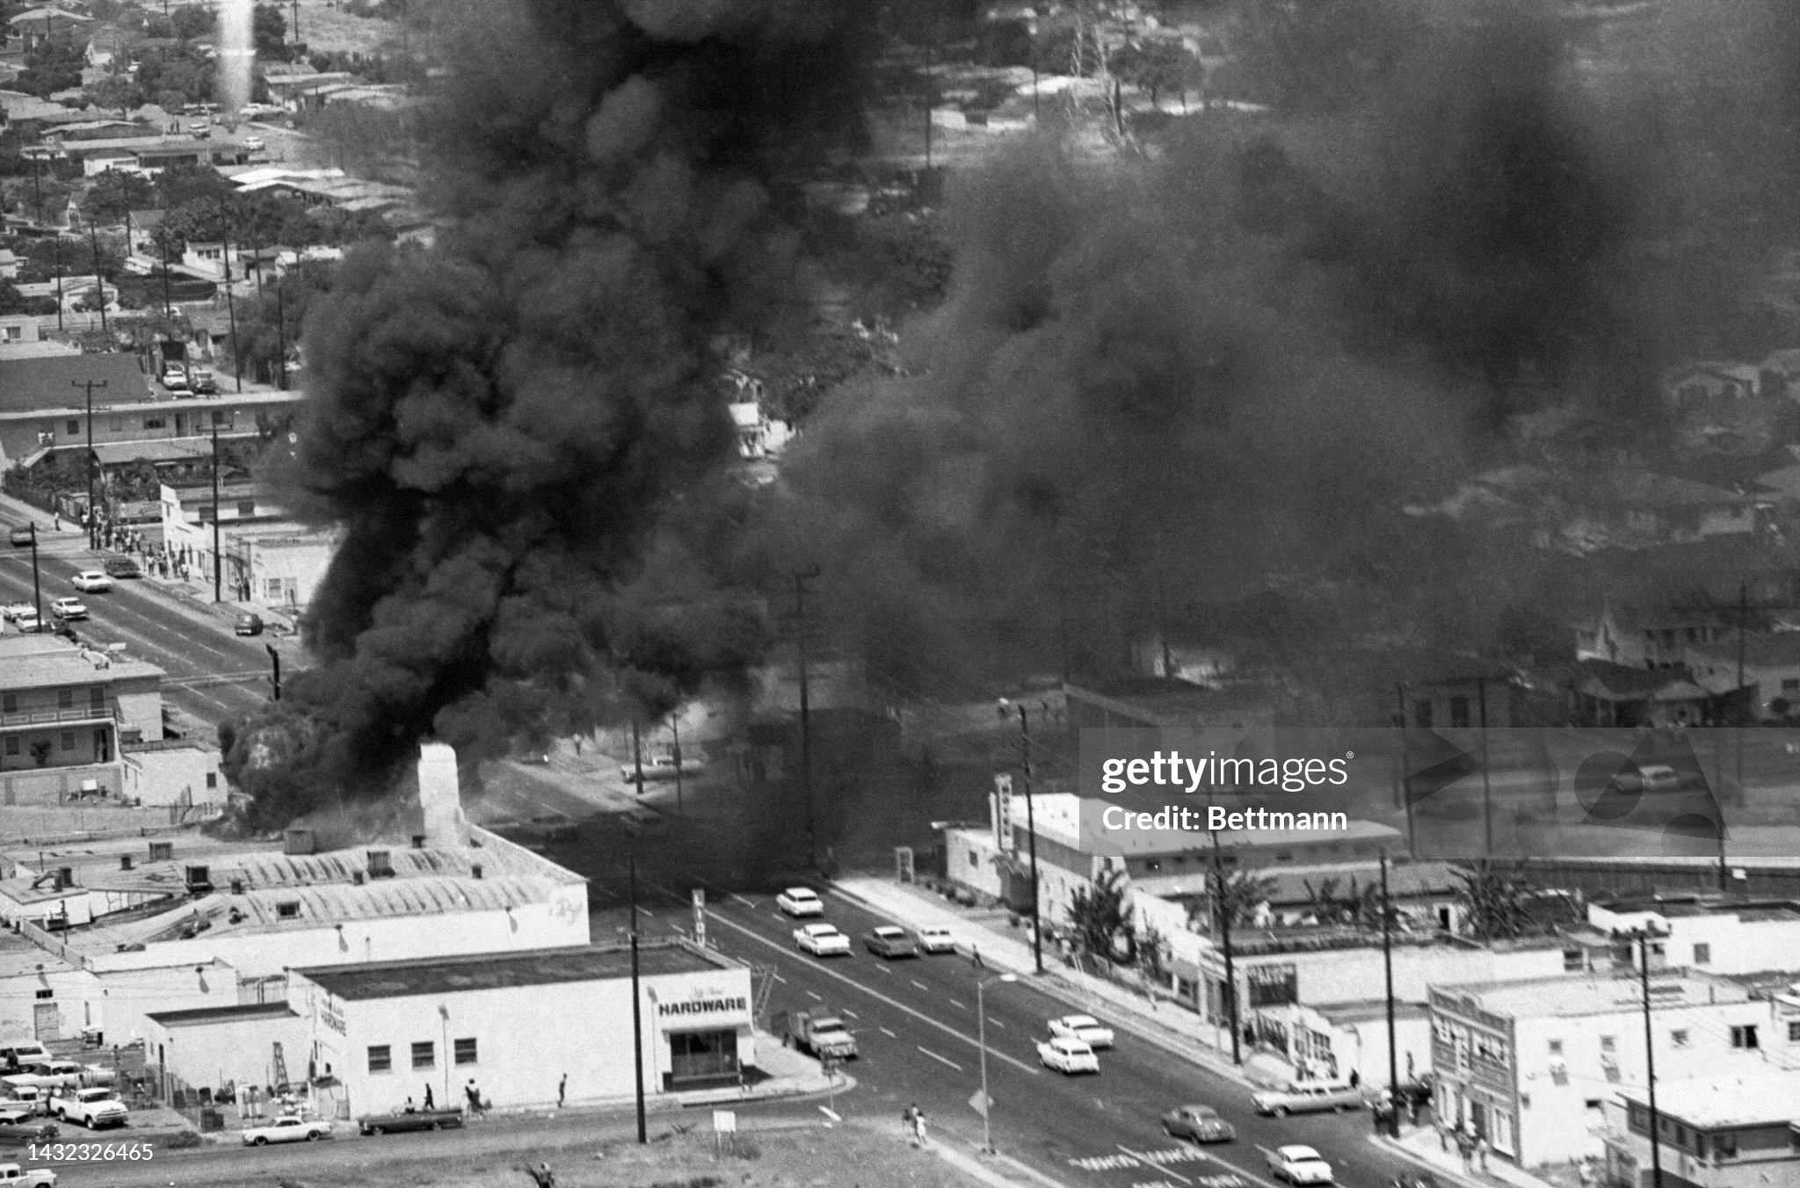
“City of Angeles August 1965” 34 dead (23 shot by police) 800 buildings, $400m ($2024) damaged

Slide 9
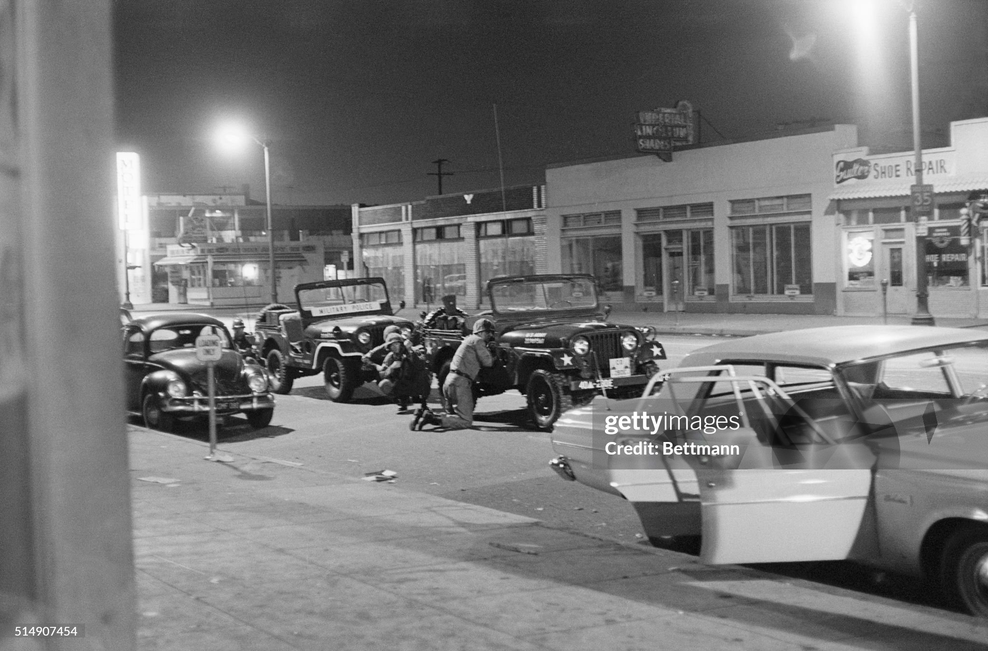
National Guard occupies city

Slide 10
Watts Aftermath
Official Response
Supreme Court rules Proposition 14 unconstitutional….ends housing restrictions
State Government report blames police…80% white public reject findings
Public Response.
White public rejects State Report…80% blame radicals/ communists
Black militant groups blame police (23 of 24 deaths….shot by police)
Rising power of Conservatives
Ronald Reagan elected Governor of California 1967: Government the problem
LBJ view……problem “systemic”, reforms must be in place
before 1968 elections. And before public support lost

Slide 11
Poverty USA mid 1960’s
“Poverty”
living below poverty line, unable to meet basic conditions
No health care, food 33% income, no phone, television, indoor plumbing
Existence “national disgrace”…contrary to US image “leader free world”
Steady decline during 1950’s
17% population, concentrated in pockets (30% 1940, 1950)
Not a “race” problem, concentrated in “pockets”
Appalachia (98% white)/ Urban centres (60% black)
LBJ declares “War on Poverty
…needs an organisation: Office of Economic Opportunity
……and someone to lead it

Slide 12
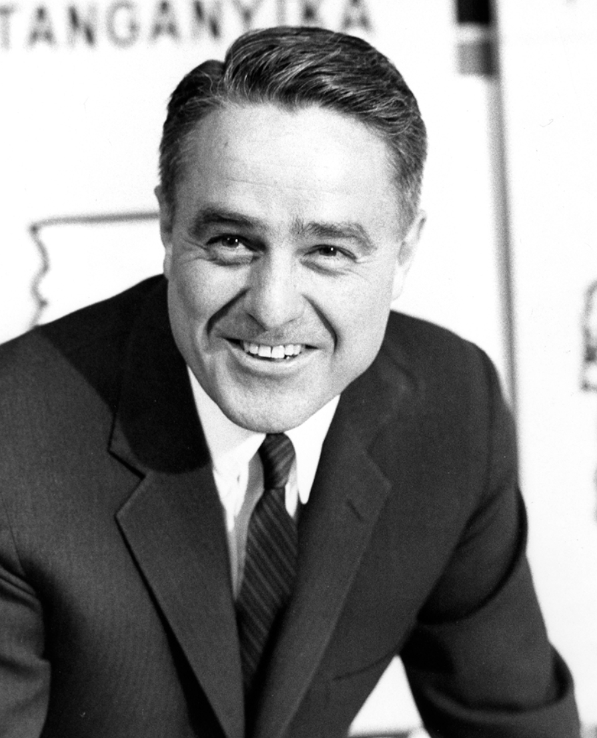
Sargent Shriver (1915-2011): Director of OEO
Devout Catholic
…wealthy family.
.signers of Independence
Lawyer, US navy WW2
..wounded Guadalcanal
Friend of Kennedy’s
..marries Eunice JFK sister
Director OEO 1964-1968
…supporter of MLK
Future ambassador
….dedicate to good
…anti war activist
…pro life campaigner

Slide 13
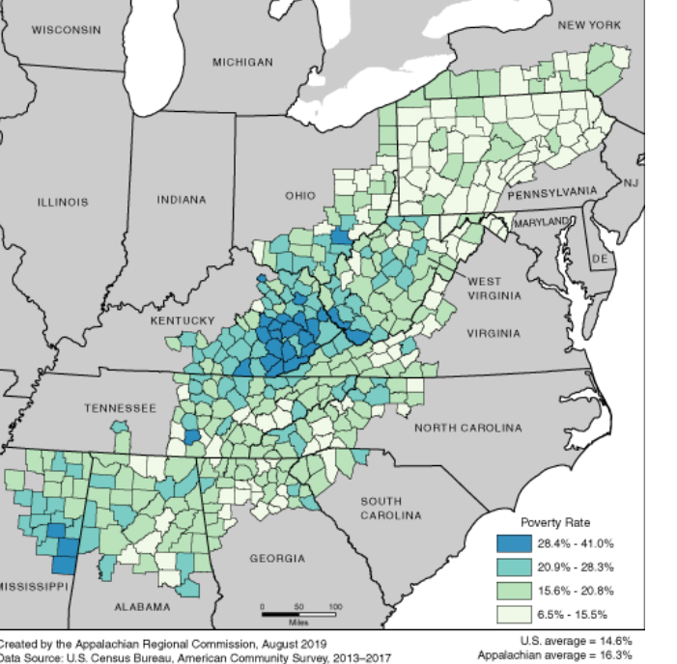
War on Poverty: Appalachia
Appalachia
Rapid growth 19th century
….coal mining/ …small farming
…..settler from “Borders”
…..culture of distrust/ violence
….anti education/…large families
20th century industrialisation
…..geographic isolation
…..reliance on coal
…. Automation eliminating jobs
Coal miner “aristocracy”
…Corrupt politics/election rigging
…company stores (50% + prices)
…salary liens

Slide 14
War on Poverty Appalachia
Community Action Programmes
1000’s of experts despatched to establish
Creates “alternate governments” and sources of employment
CAPs created in every county Georgia to Ohio
Programmes
New Schools/ Training Centres
Health Clinics/ family planning
Job Corps training centres
Voter registration

Slide 15
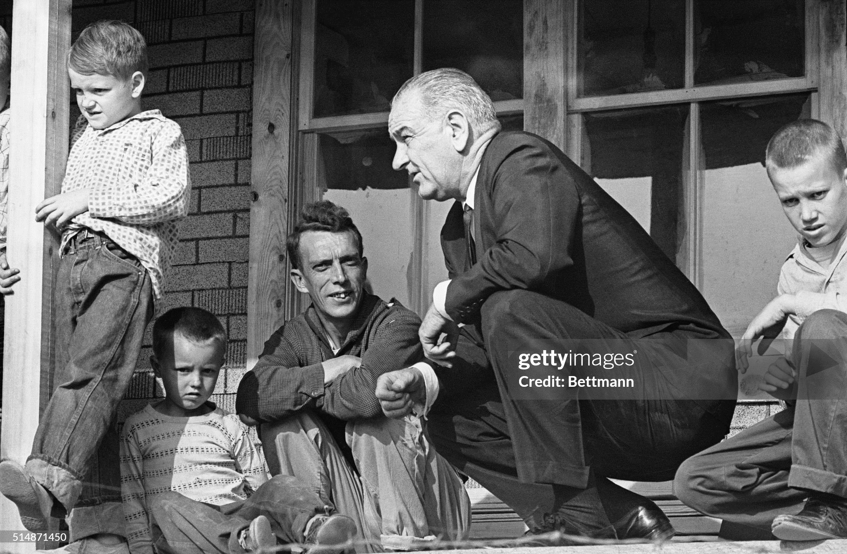
LBJ Tour of Appalachia 1964

Slide 16
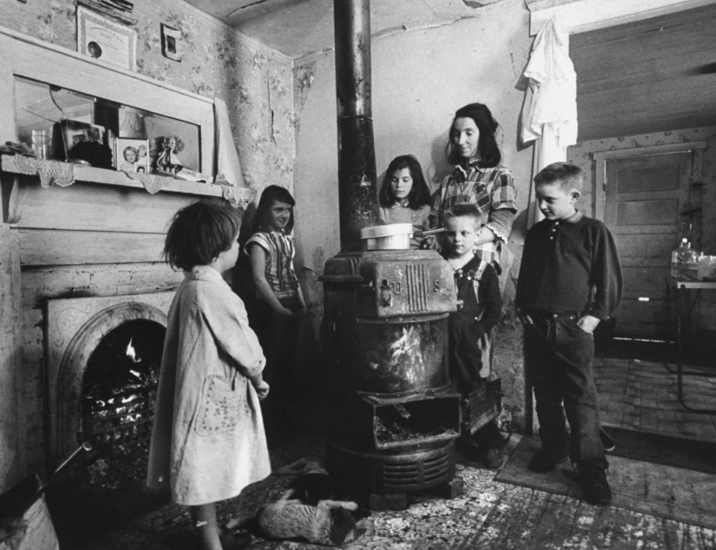
Appalachia home 1964

Slide 17
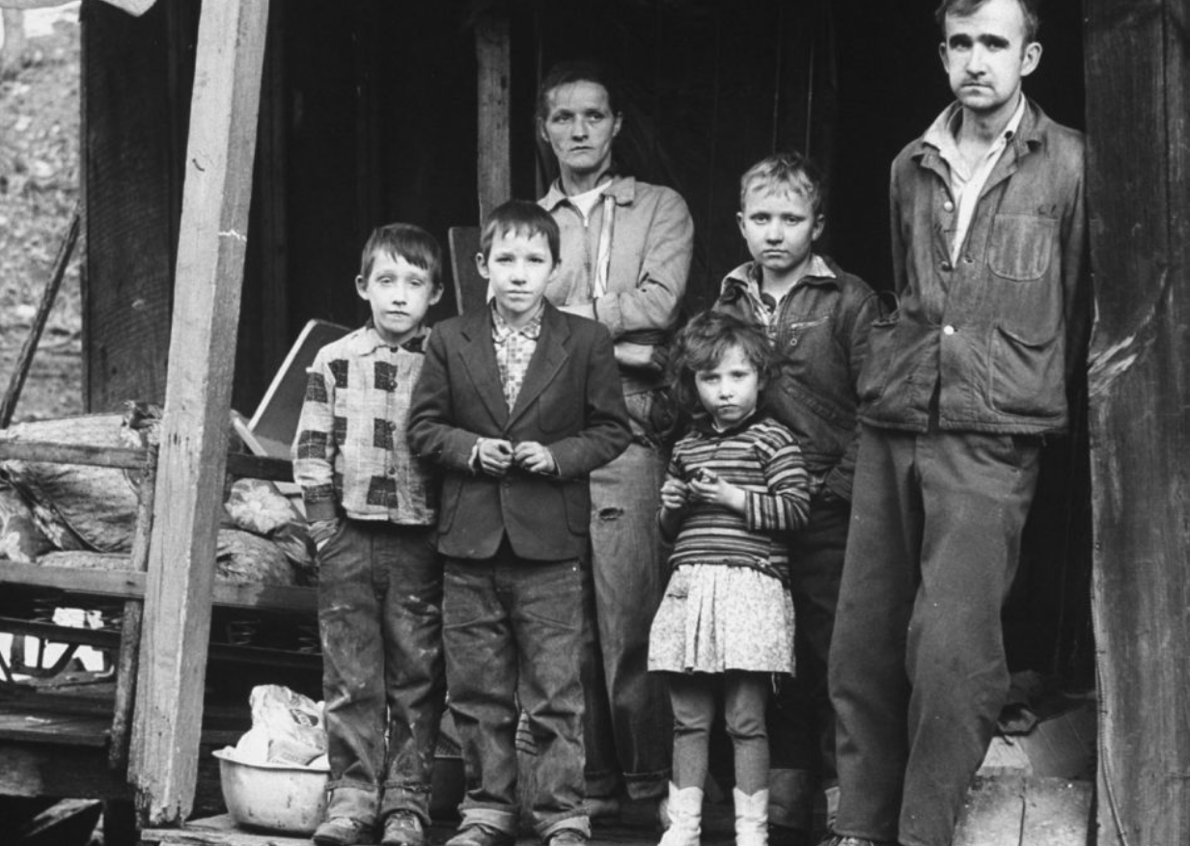
Appalachia Family 1964

Slide 18
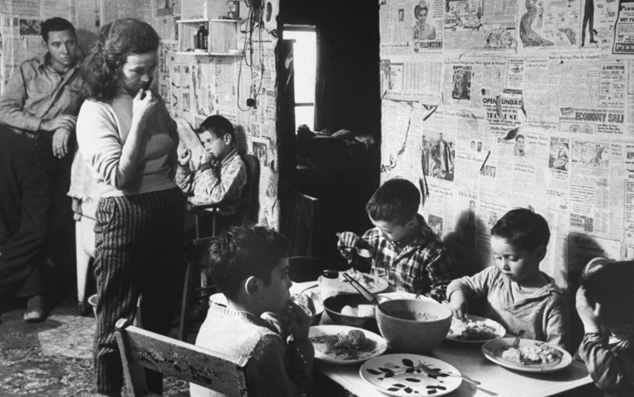
Appalachia family dinner 1964

Slide 19
War on Poverty Appalachia: impact & backlash
Impact
70% reduction infant mortality/ 50% increase high school education by 1980
Wage gap reduction from 40% to 60% national average
Population decline from 5 to 3 million as young/educated leave
Backlash
Mining companies/ local government threatened ..experts labelled “communists”
Automation continued, new jobs not created
Culture war Resentment vs “outsiders”…loss of young
Legacy:
Progress real but slow and marginal as coal and population declines
National indifference…geographical isolation---”invisible". Trouble in the cities

Slide 20
War on Poverty: the US inner city 1965
Rapidly changing populations: Black migration from South to North
Black Population
 | 1960 | 1970
New York | 6% | 14%
Chicago | 8% | 33%
Detroit | 9% | 44%
City Government structures non representative of changing community
…… “White flight”…whites move to suburbs, administration remains “white”
…….Focus on control of costs/minimising welfare (Social Security Act 1935)
…….Police Forces 95%+ white …enforcing segregation rising unemployment

Slide 21
War on Poverty: fixing the cities
Fix the housing problem
Create “affordable housing” for increasing population (Great Migration from South)
Develop “model cities” to increase liveability of cities (parks, recreation)
Provide local empowerment & Community Action Programmes
CAPS lawyers expand role …securing of welfare rights for clients
Overcome State/ City Governments (50% Social Security funded locally)

Slide 22
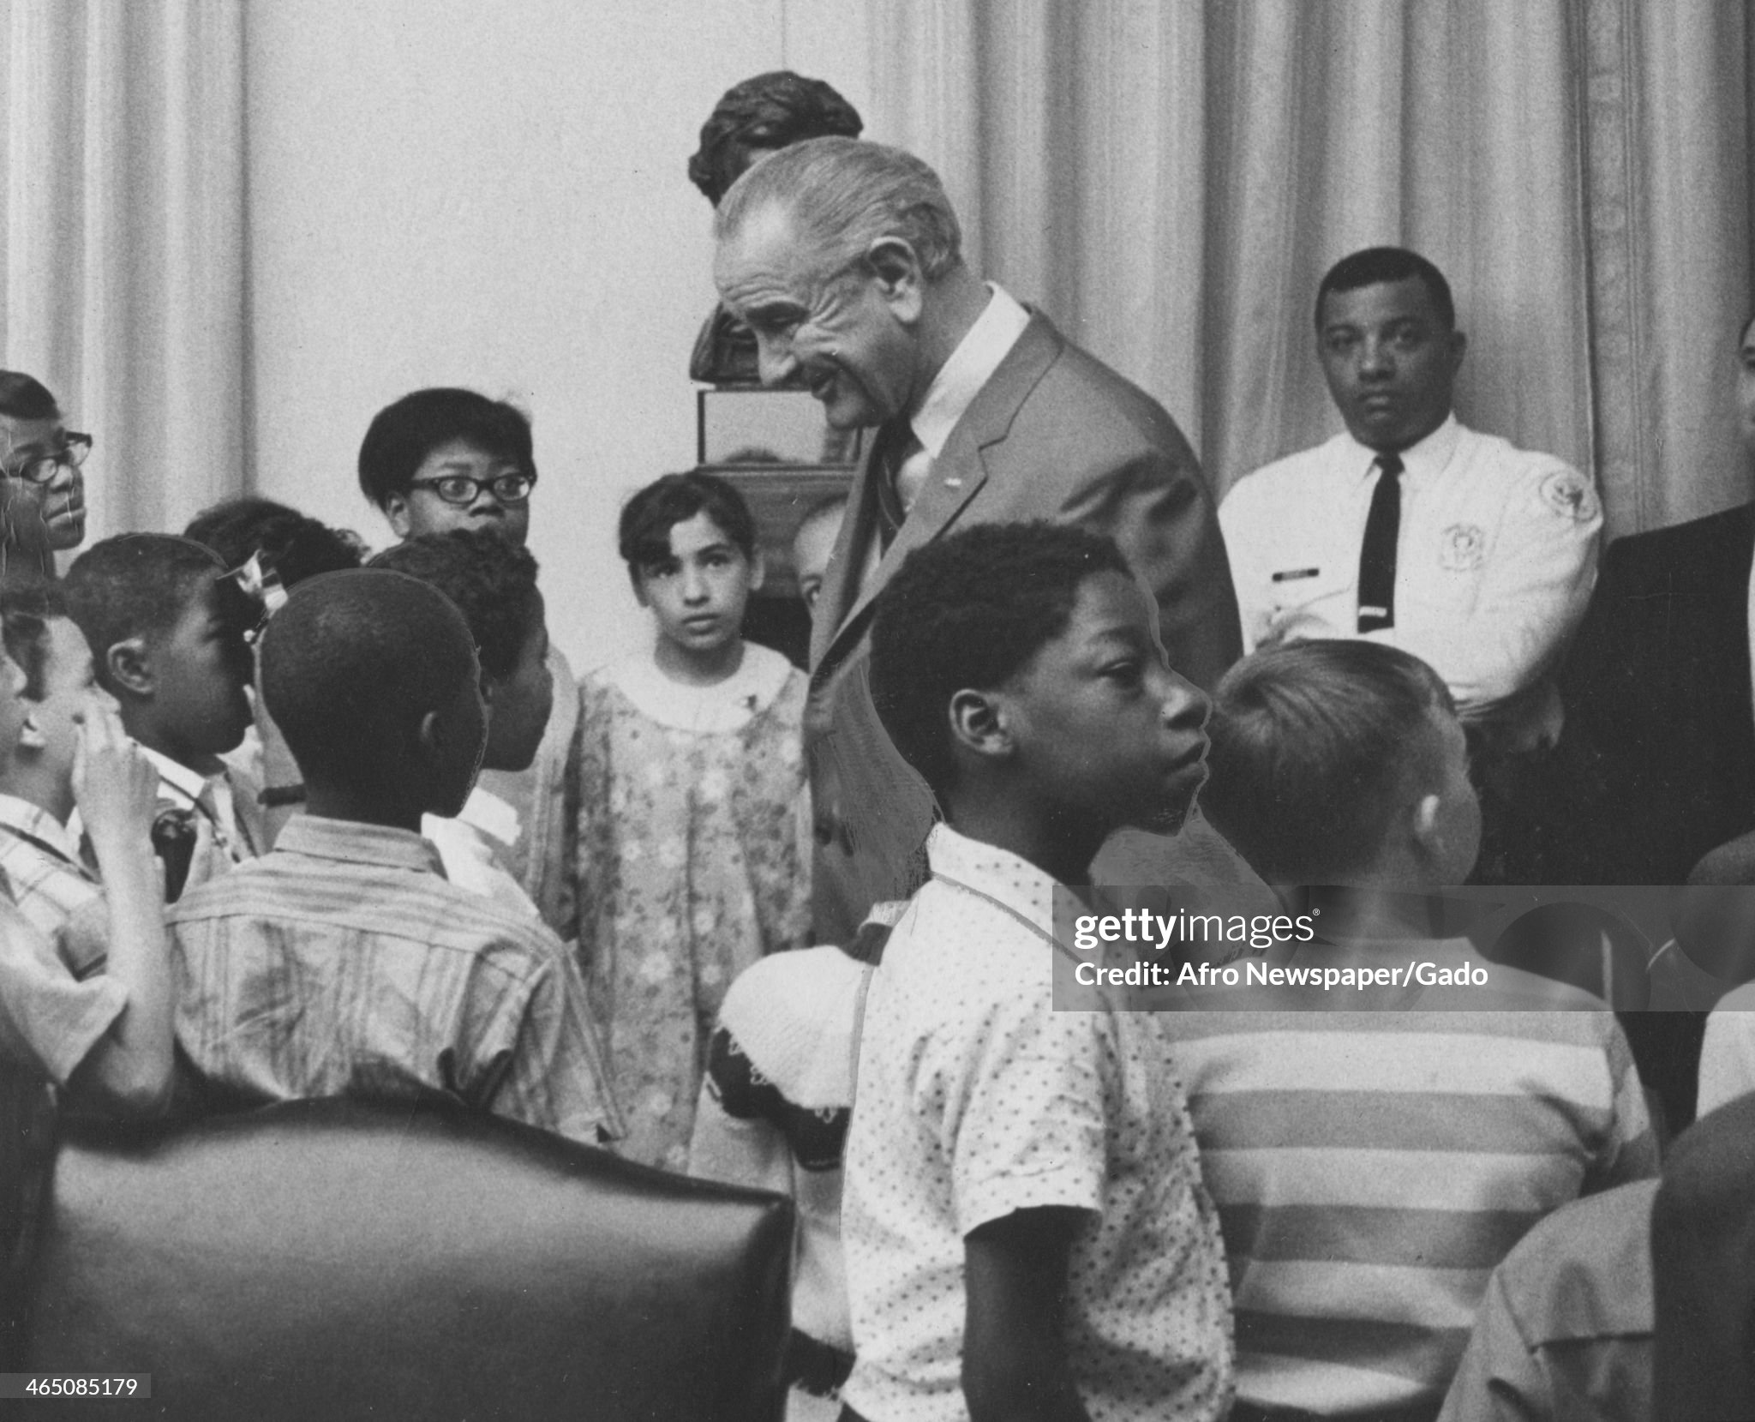
Head Start School

Slide 23
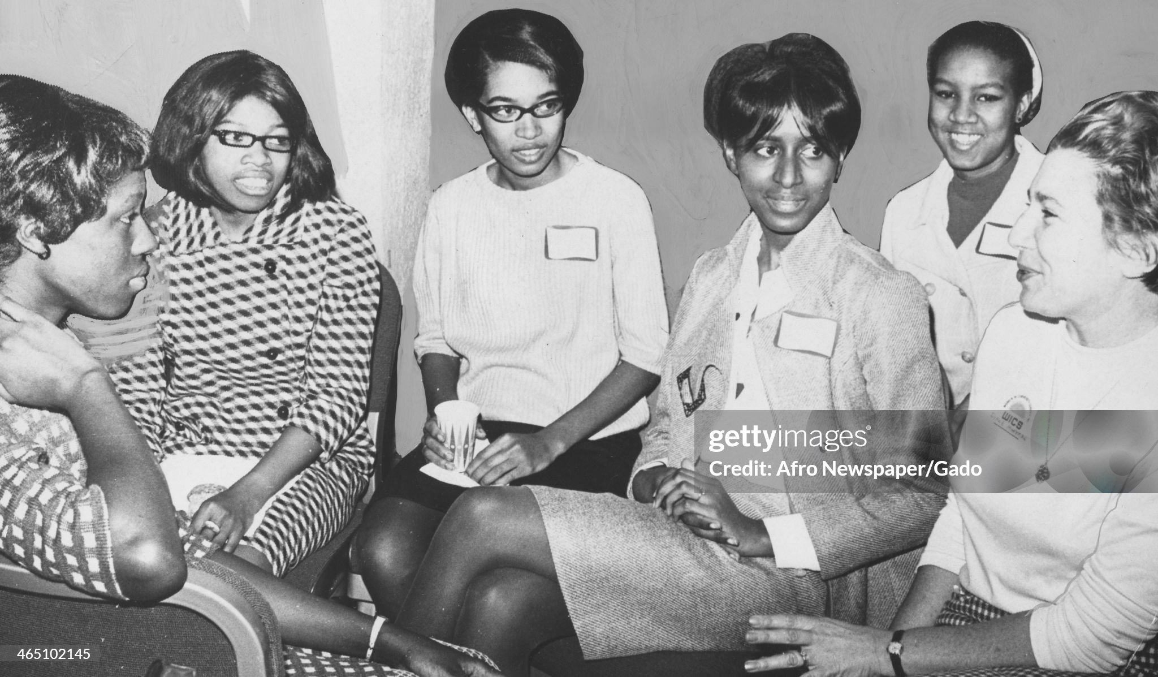
Job Corps at work

Slide 24
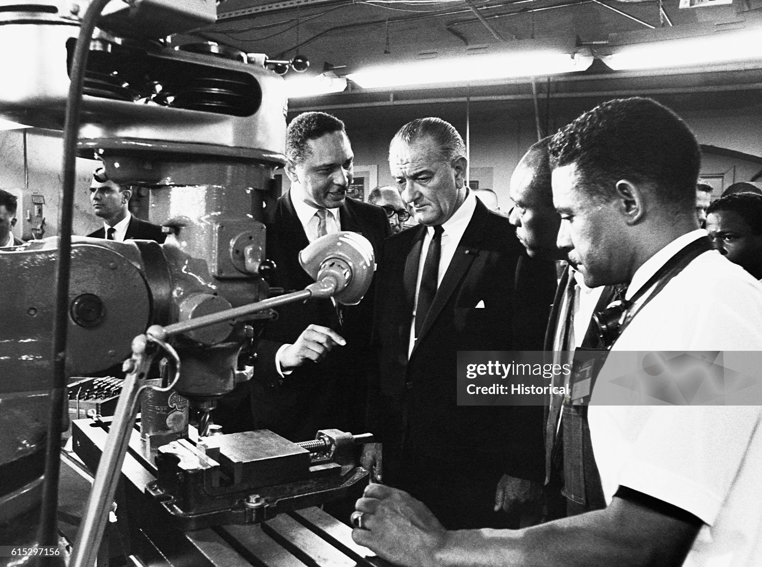
Job Training School …focus on work and creating ability to work

Slide 25
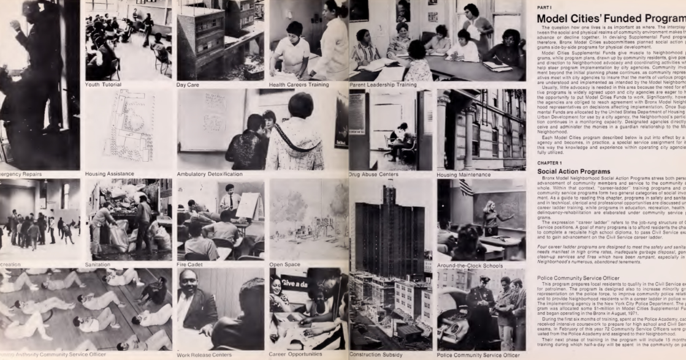
Model Cities Programme …redesigning the city

Slide 26
War on poverty cities: impact and backlash
Progress
Local empowerment…..enforcement of Civil Rights act
Rise of black middle class/ reduced poverty, child deaths
Constraints placed on developers, urban improvements
Successful expansion of support to the most need
Backlash
Power struggle city (local tax funded) government vs CAPs
Rise in black expectations vs reducing budgets due to Vietnam war
Reduced support from white voters: “War on Poverty”= Welfare & Entitlement
“Welfare Queen” myth ….as job availability in cities decline

Slide 27
The problem …Lowering unemployment/Rising welfare payments …..Reduced budgets due to Vietnam War
US employment and welfare
 | 1960 | 1968 | % Increase
US population | 179 million | 199 million | +11%
Unemployed | 3.6m | 2.3m | -36%
Welfare Recipients | 3.0m | 5.7m | +90%
Poverty and welfare relationship complex with solutions elusive, long term
US politics and society….not good at “long term”

Slide 28
The “long hot summer” of 1967
Expectations rising/ response declining
MLK non violent demonstrations losing credibility
Increasing toxic environment
Urban police forces as Los Angeles
95% White (Detroit 95 out of 4,000 police black.)
Single point of contact urban government and community
Riots break out 150 cities: 85 deaths, 2,500 buildings $1Bn property damage
….No central plan….every city a different “trigger”
…usually police incident followed by rumour

Slide 29
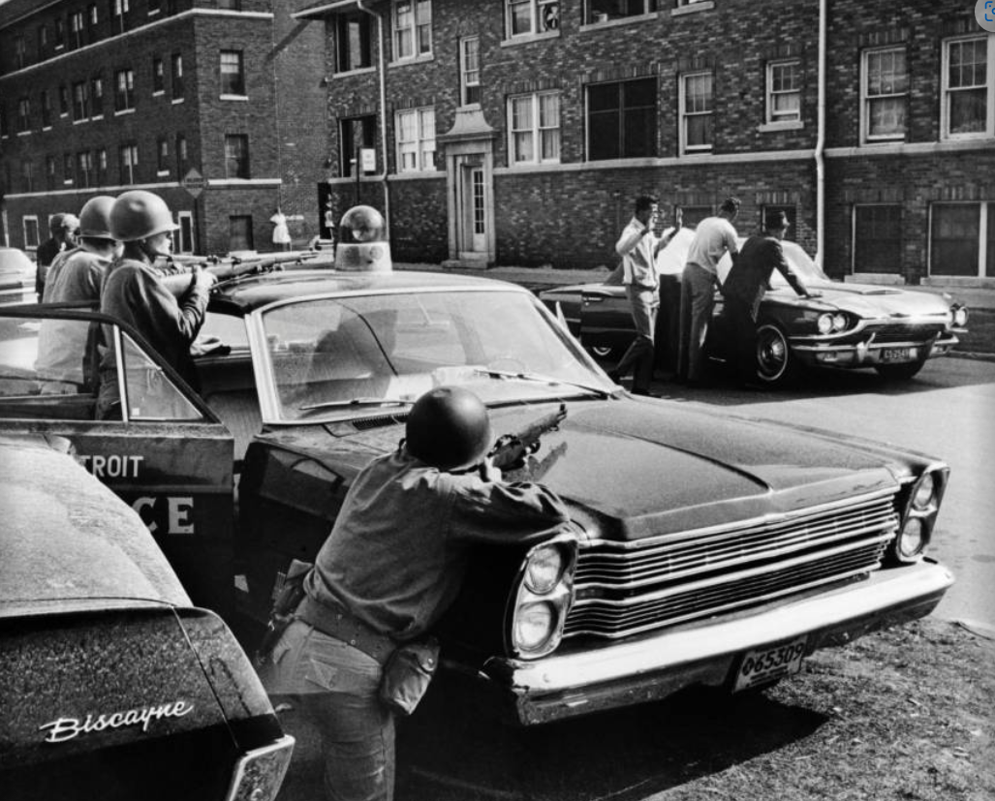
Detroit….44 deaths (30 killed by police)

Slide 30
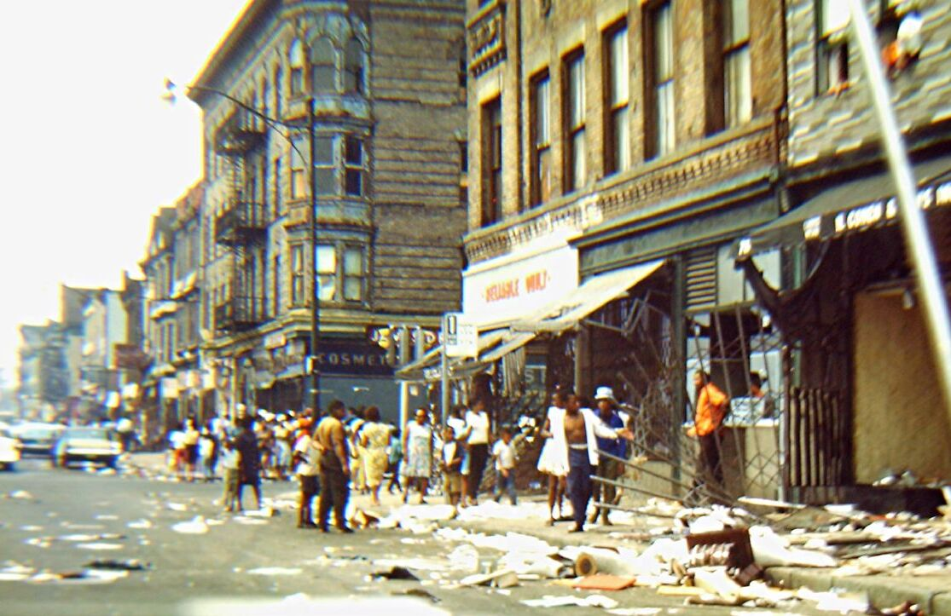
Newark New Jersey ( 40 deaths)

Slide 31
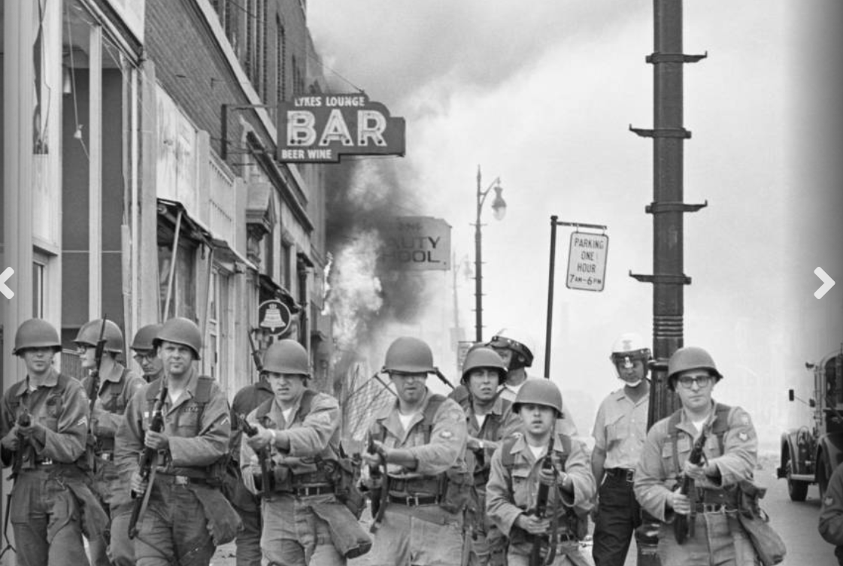
National Guard attacking looters. .Detroit 1967

Slide 32
“Long Hot Summer” aftermath
Public reaction
Riots airwaves….US cities “on fire” message..
Conflate urban riots with Vietnam
Press (almost) universally blame riots on “agitators”, radicals”
LBJ emergency meetings …..losing popularity 60% 1965 to 40% end 1967
LBJ commissions Bi Partisan Kerner Commission: issues best seller 1969 Report
Systemic Racism” as cause….police brutality, profiling: “ “Our society is moving toward two societies one black, one white, separate and unequal”
MLK “voice of the unheard”…relocates to ghetto Chicago, joins anti war protests

Slide 33
End of “Big Society” Vision
January 1968…Tet Offensive Vietnam
Message to date war about to end, troops about to return collapses
Anti war demonstrations escalate “Hey Hey LBJ, how many kids you kill today”
“Great Society” vision in collapse…approval ratings sink to 35%
March 1968 LBJ agrees to resign and not run for re-election March 1968
April 4, 1968…2 sanitation workers crushed to death in Memphis
…….cause lack of safety equipment & indifference
…….riots break out in Memphis….city neglect
…….MKJ leaves Chicago to give speech in Memphis

Slide 34
MLK Memphis Speech
“Like anybody, I would like to live a long life; longevity has its place.
But I'm not concerned about that now.
I just want to do God's will. And He's allowed me to go up to the mountain.
And I've looked over. And I've seen the Promised Land!
I may not get there with you, but I want you
to know tonight, that we, as a people, will get to the Promised Land!

Slide 35
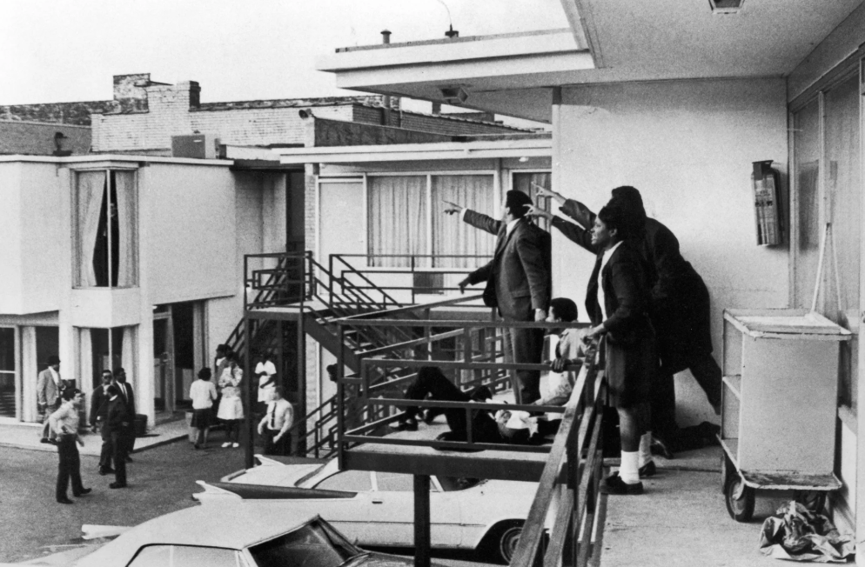
….and is killed that afternoon

Slide 36
Aftermath of MLK assassination
Riots break out in 100 US cities….45 deaths
US appears to be falling apart law and order collapsing
Vision of “Great Society” forgotten
US losing its first war

Slide 37
Next Talk: The Vietnam War Monday June 2nd 10:00 am

