Slide 1
Welcome to US History Talks

Slide 2
Preview : Module 6: A Nation Adrift
Talk | Title | Time Period | Date of Talk
37 | The Great Society | 1964-1968 | May 19th
38 | Vietnam | 1961-1975 | June 2nd
39 | US society and culture 1960’s | 1960-1970 | June 16th
40 | Return of the Republicans | 1968-1976 | September 1st
41 | The “Me Decade” | 1970-1980 | September 15th
42 | The “Humility Experiment” | 1976-1980 | September 29th

Slide 3
Talk 37: Great Society
Aftermath of an assassination
LBJ
Civil Rights Act of 1964
Great Society Programme
War on Poverty and the backlash
Recommended Reading: Robert Dallek: LBJ

Slide 4
Aftermath of an assassination

Slide 5
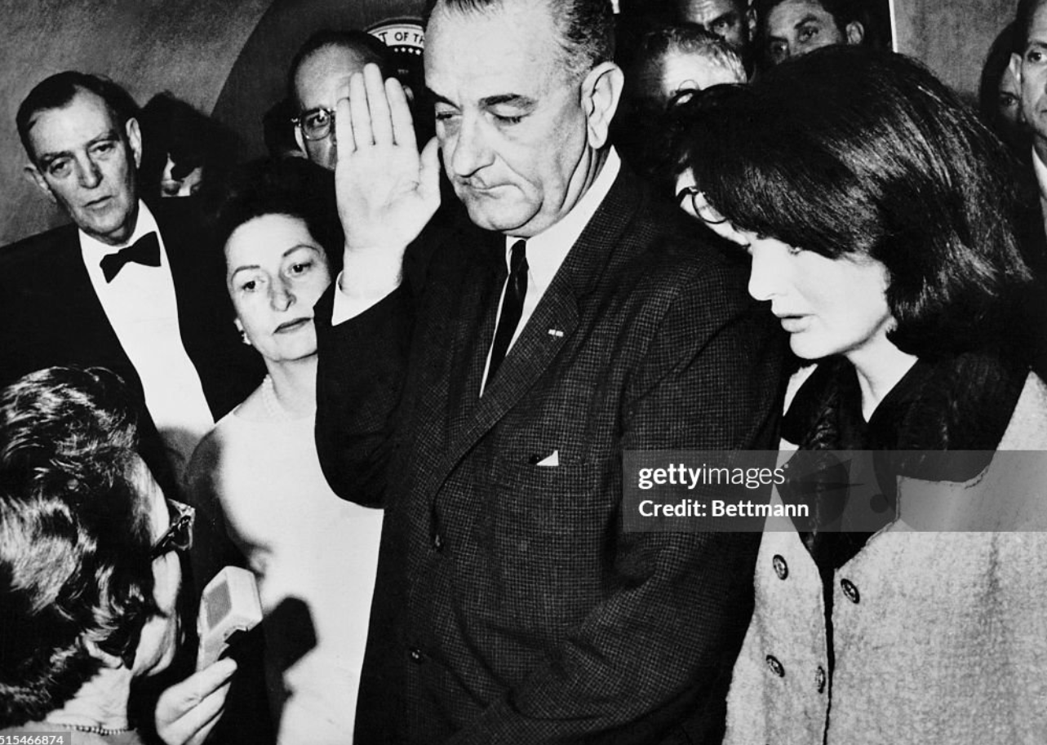
Lyndon Baines Johnson taking the oath …2 hours after the assassination of JFK

Slide 6
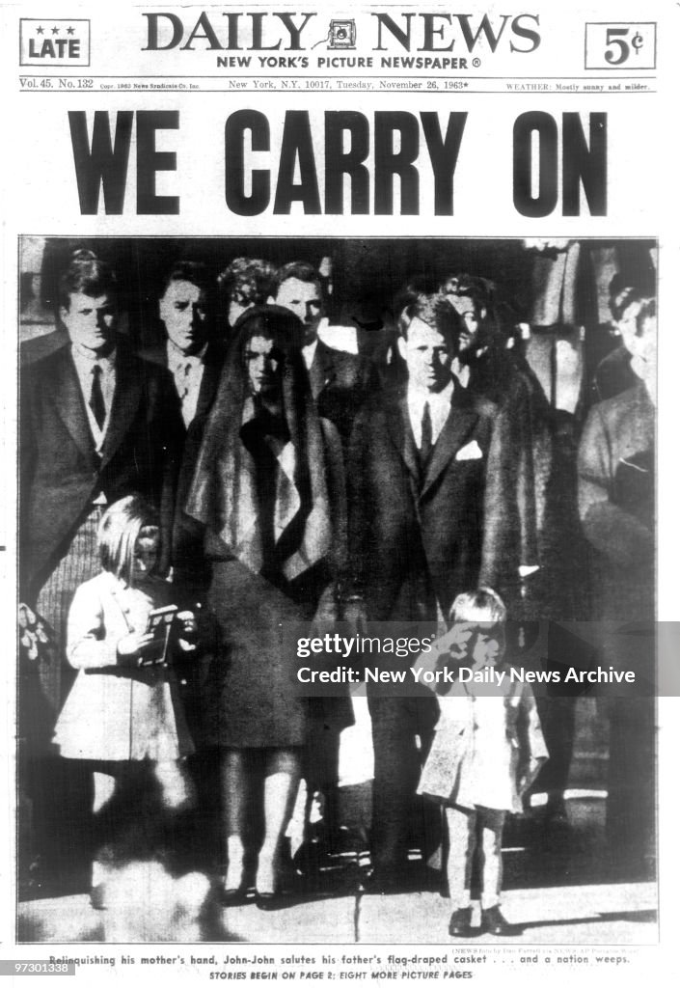

Slide 7
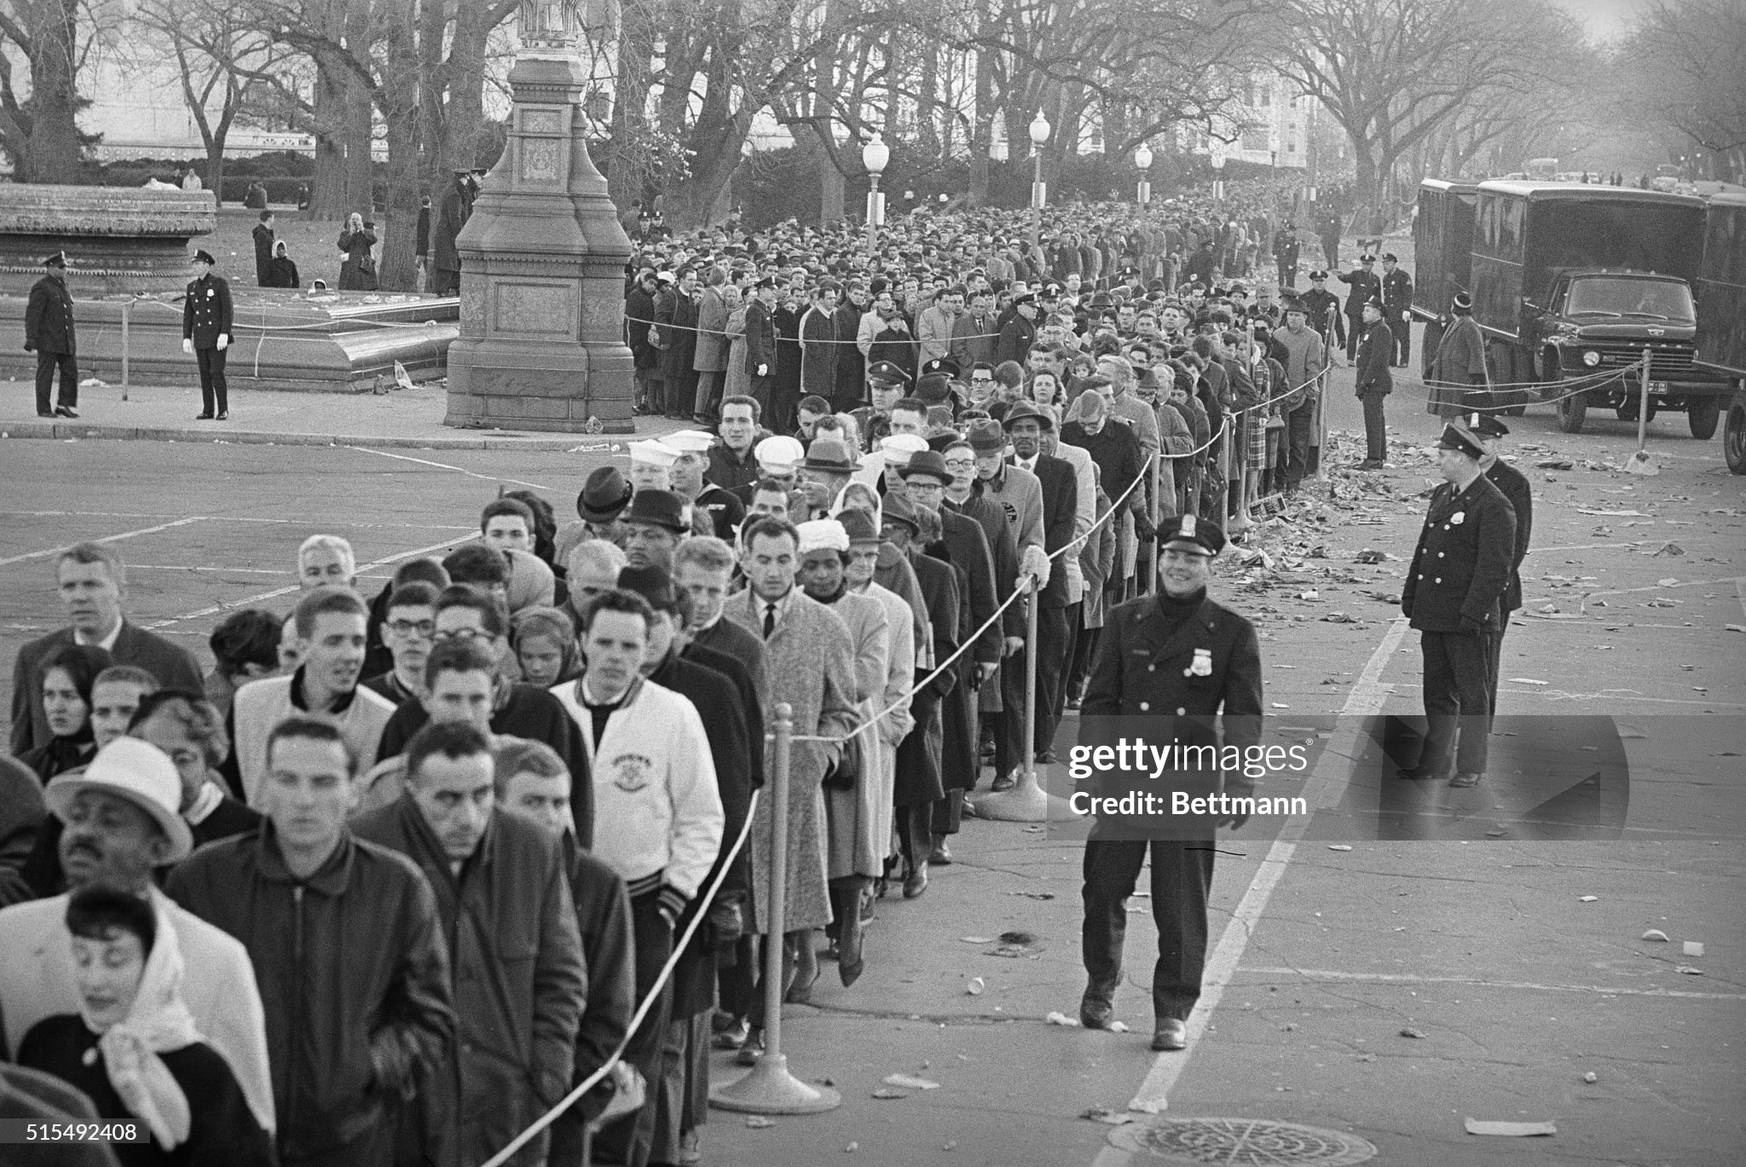

Slide 8
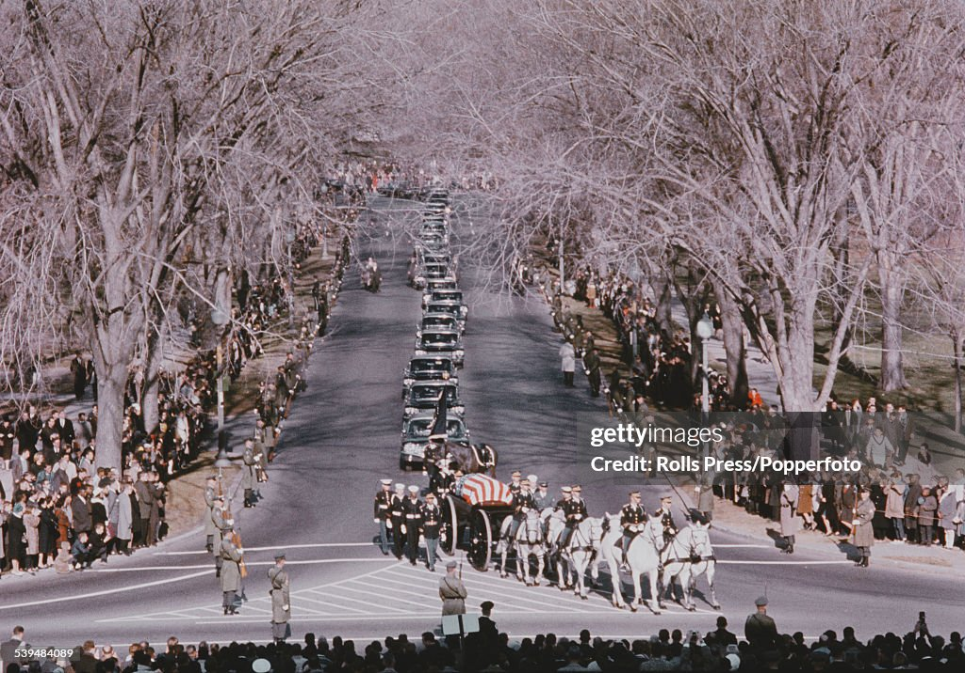

Slide 9
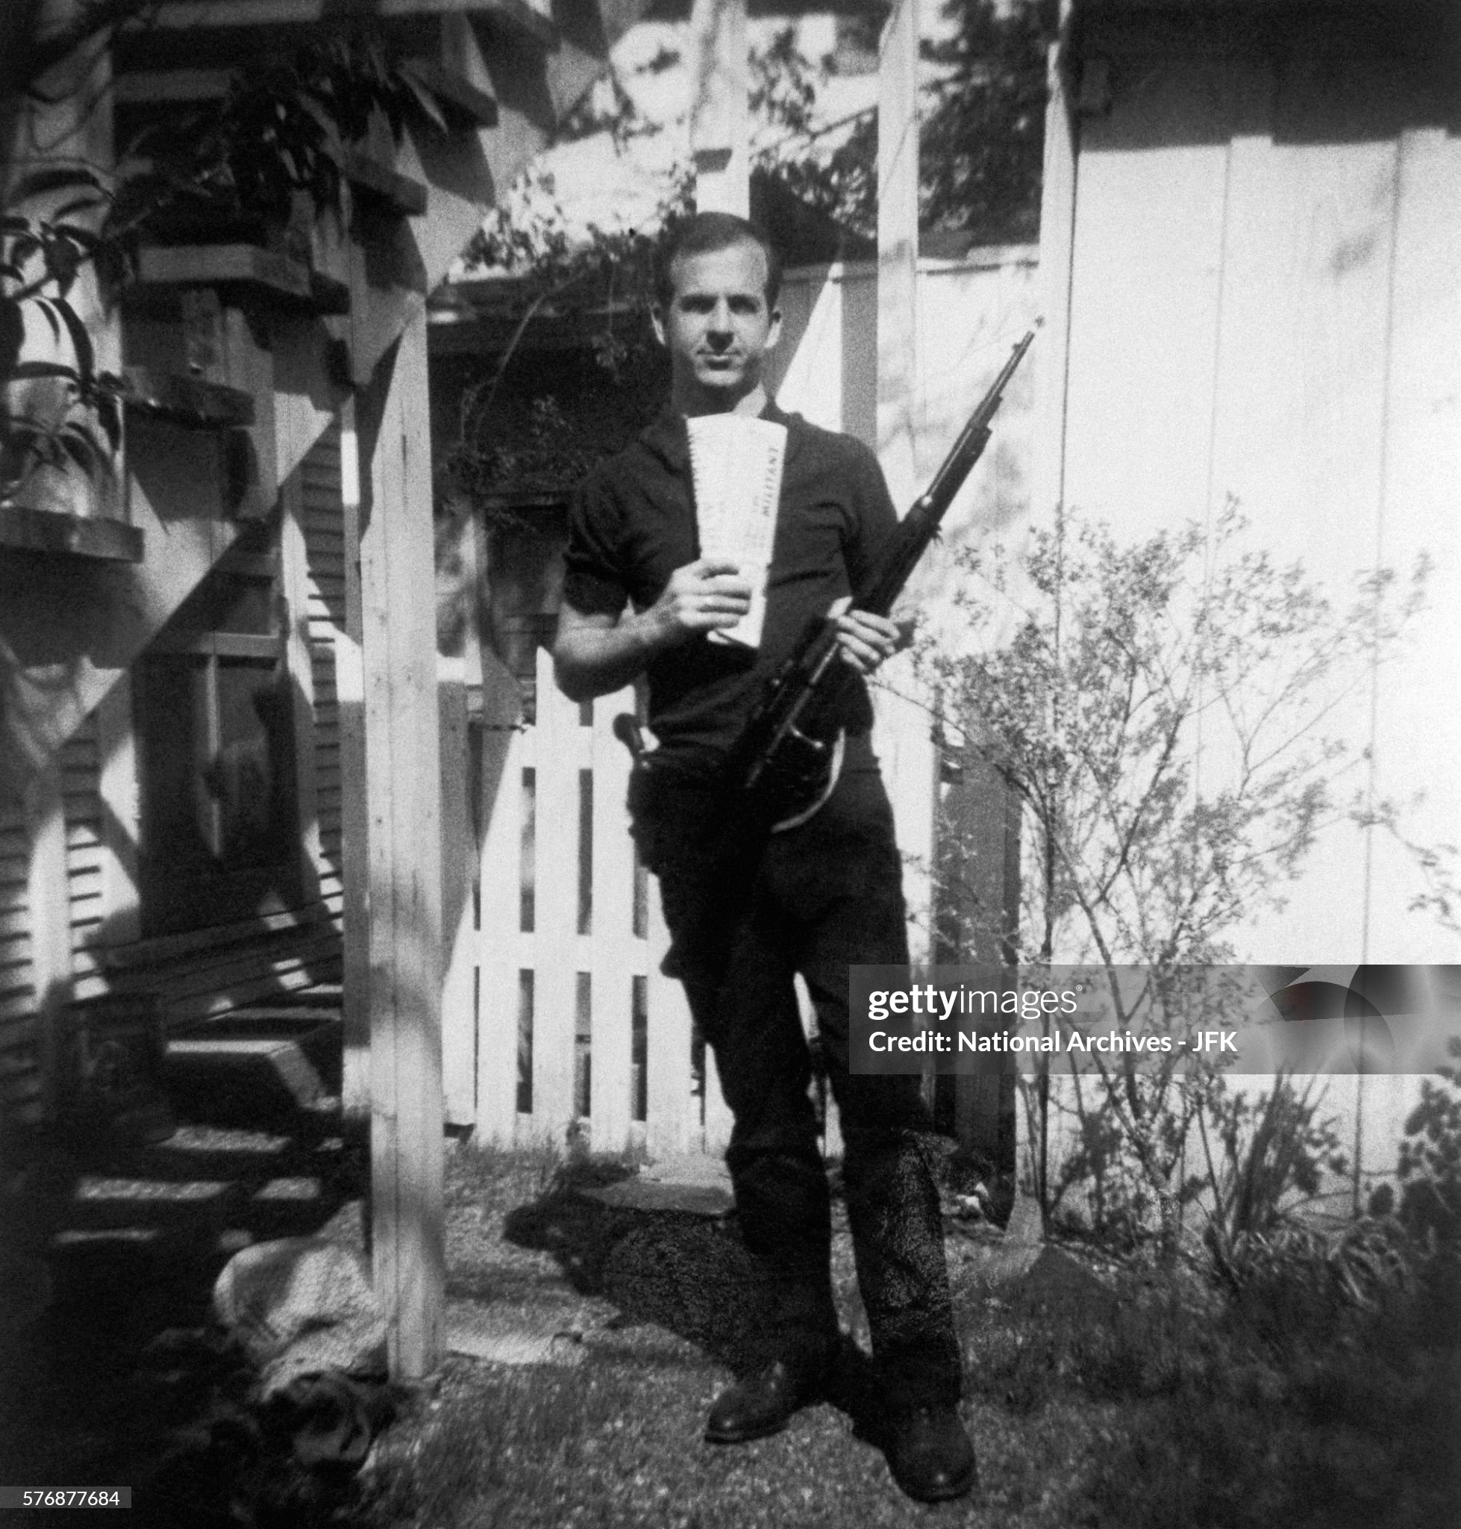
Lee Harvey Oswald
…juvenile delinquent
….US marine…marksman
Defected to USSR 1959
…assigned to factory
..marries East German
..returns to US disillusioned
Fantasist…..pro Castro
…visits Mexico city 1962
…Cubans reject/returns to US
Life in Dallas
…marital disputes
..pro Castro demos
…attempted killing of politician
Buys snipers rifle by mail order
…part time job “Book Depository
…smuggles in gun (curtain rods)

Slide 10
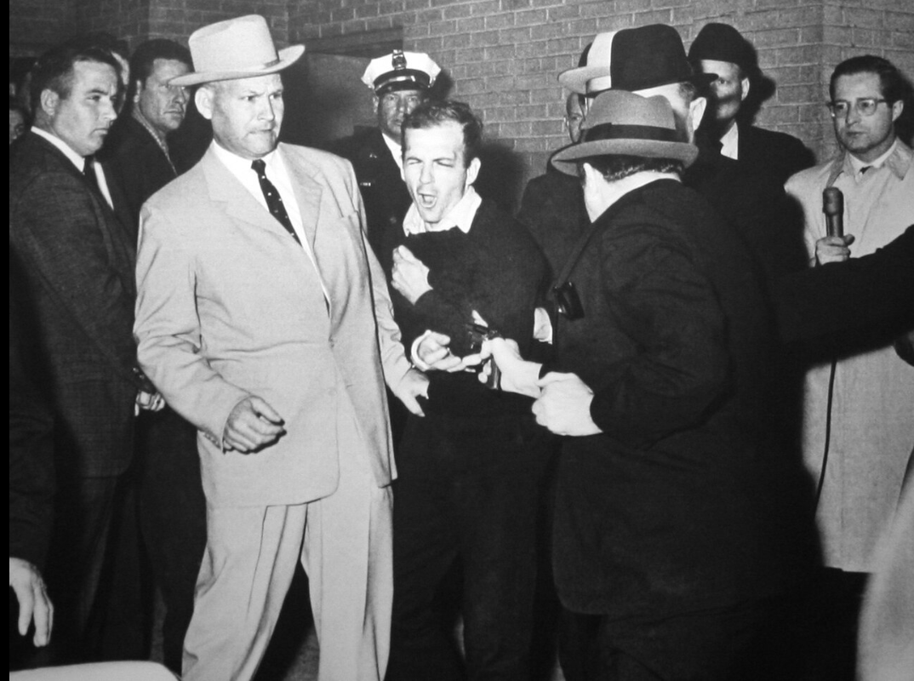
Oswald murder…Sunday
Seen leaving Book Depository/ leaves rifle
Takes bus home
Kills police officer
(Tibbit) on returning
Home…goes to movies
Arrested in movie theatre
News conference
….claims innocence
On way to arraignment
…then this happens

Slide 11
Kennedy Assassination
Rumours and conspiracy theories spread…..and continue
Vice President Lyndon Johnson….despised by JFK…feeling mutual
CIA..JFK pushing back on Vietnam
USSR…revenge vs Cuban missile crisis/Castro…..protection from CIA
Mafia…Kennedy brothers’ pursuit
Warren Commission ....Bi Partisan: No conspiracy, one man, one bullet
The evidence as of today:
no evidence of conspiracy despite 60 years of investigations
Newly released documents….CIA investigating/paying Oswald …possible informant….not assassin. Oswald linked to gun. Motive
Impossible to believe one man could end the life of such a notable figure
….regardless of any proof that is exactly what happened

Slide 12
The days after
Johnson shaken…returns from Dallas to Washington with Jackie, family
Nation in shock….global outpouring of grief (Moscow churches)
Lyndon Johnson
Side-lined by JFK Presidency Opposite Kennedy….and ignored
Opposite in character: uneducated ,crude, ideology free
…..labelled immoral in politics, business, and personal life

Slide 13
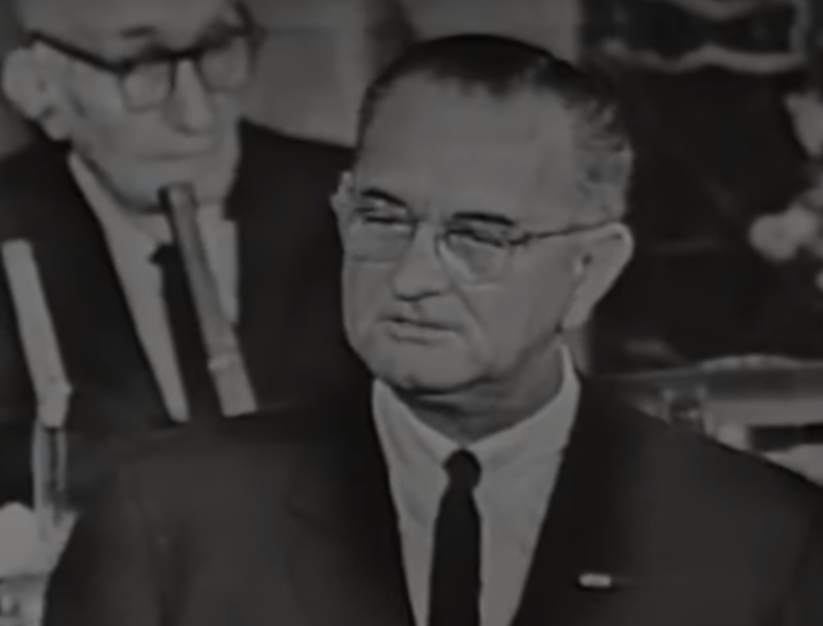
Johnson “Let us Continue”
Retains Kennedy cabinet
LBJ televised address November 27, 1963
Reaches out to
…Congress..
…Civil Rights Leaders
…Unions
Kennedy “the greatest President
Of all time”….I would give up all I
Have not be here today….
"An assassin's bullet has thrust
upon me the awesome burden
of the Presidency. I am here
today to say I need your help;
I cannot bear this burden alone.
…. Today, in this moment of new
resolve, I would say to all my fellow
Americans, let us continue”

Slide 14
LBJ

Slide 15
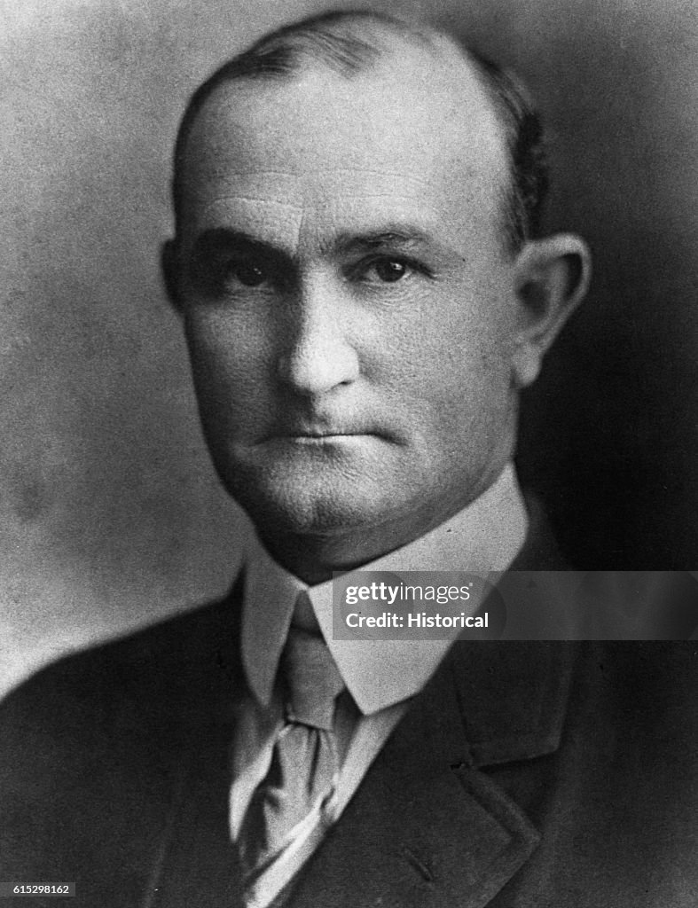
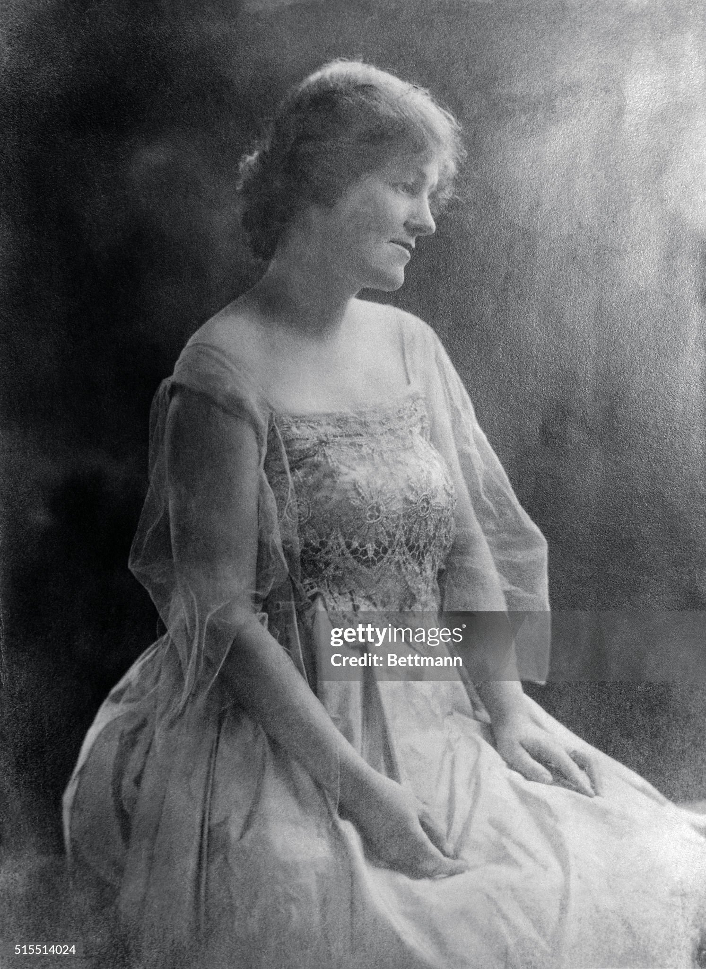
Lyndon Johnson parent
Sam
….failed cotton farmer
…occasional state representative
…hard drinker, violent, reckless
…in sight of…but not part of wealth
…formerly prosperous family
Samuel
(1877-1937)
Rebecca
(1881-1958)
Rebecca
…college educated
…ancestors Confederate officers
…”married down”
…adjust to poverty. No books
…5 children…Lyndon oldest
…determined Lyndon success
Family
…settle Central Texas 1900’s
…log cabin…
…100% white community
…dirt poor…most of time

Slide 16
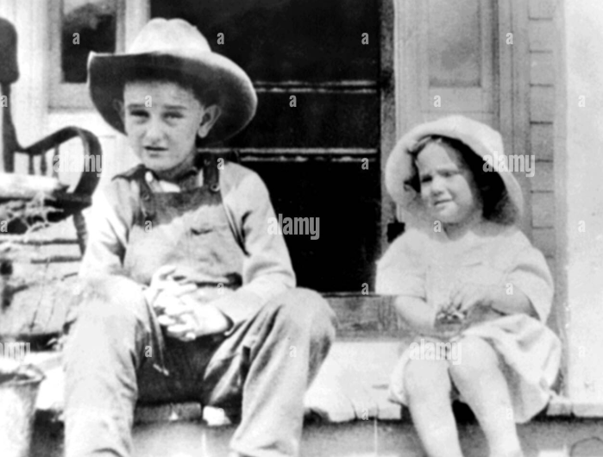
Lyndon Johnson (aged 5) …Rebecca…demands LBJ succeed …and ignores him if he doesn’t

Slide 17
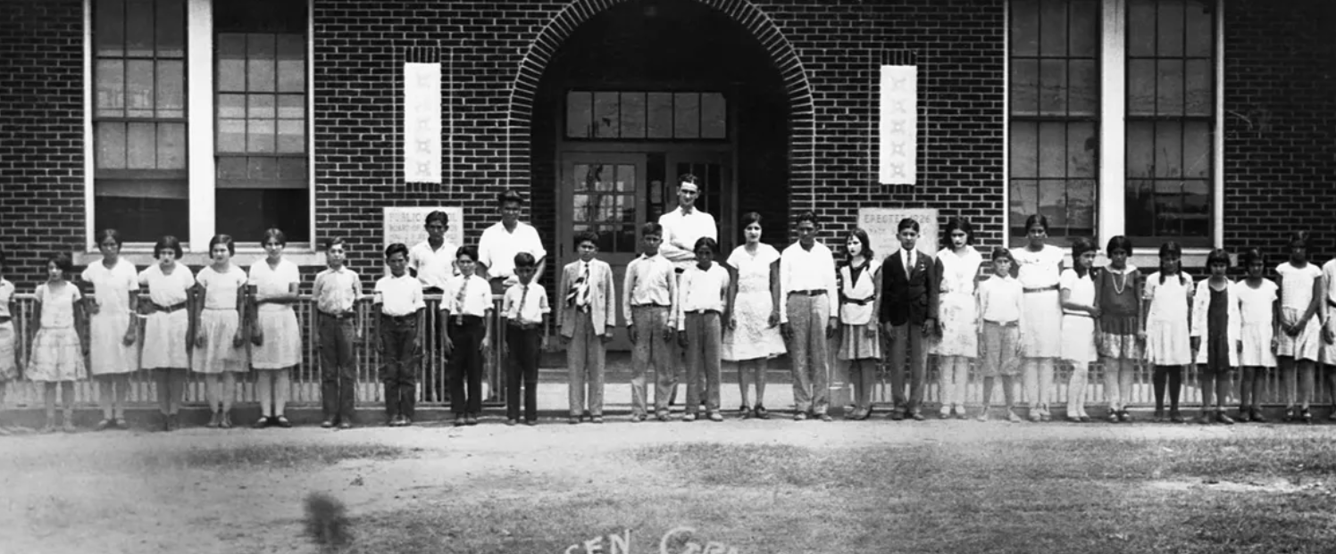
Lyndon Johnson….from chaos to
“Wild youth
…booze, girls, fails at school
…runs away to California
…fails…returns
Lyndon teacher….Hispanic segregated school 1928/1929
Community college
…cheap…disciplined
..LBJ…networker
Teacher…all Hispanic school
….driver
…dedicated
Support father campaign
….aide to Senator
…workaholic
…ambitious
…introduced to State Rep
Kullberg…hired as aide
…moves to Washington

Slide 18
LBJ…the good side …memory of teaching @ Cotulla Texas High School (interviewed 1965)
“I shall never forget the faces of the boys and the girls in that little Welhausen Mexican School, and I remember even yet the pain of realizing and knowing then that college was closed to practically every one of those children because they were too poor. And I think it was then that I made up my mind that this nation could never rest while the door to knowledge remained closed to any American.”

Slide 19
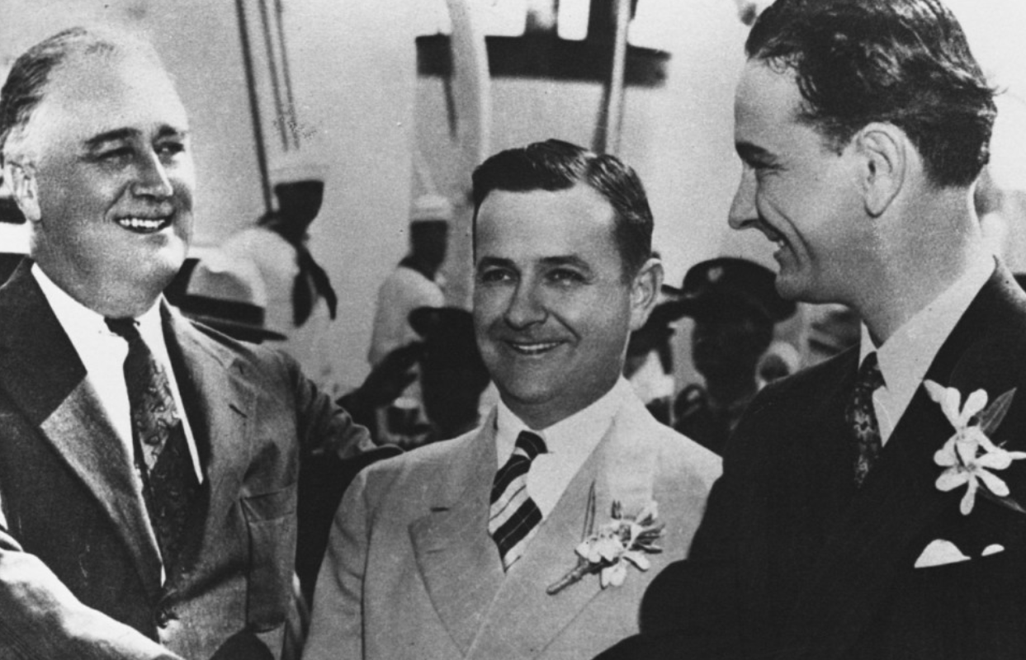
LBJ and FDR….1930’s
LBJ Texas National Youth Administrator 1936
18 hour day worker
..Kleberg..booze, golf
& women
LBJ
FDR
Kleberg arranges
LBJ Texas National
Youth Administrator
Highly successful
….introduced to FDR
…New Deal believer
…govt exists to help
The unfortunate….
…and make LBJ rich
..goal…become
Representative in Congress
Needs wife….and
money

Slide 20
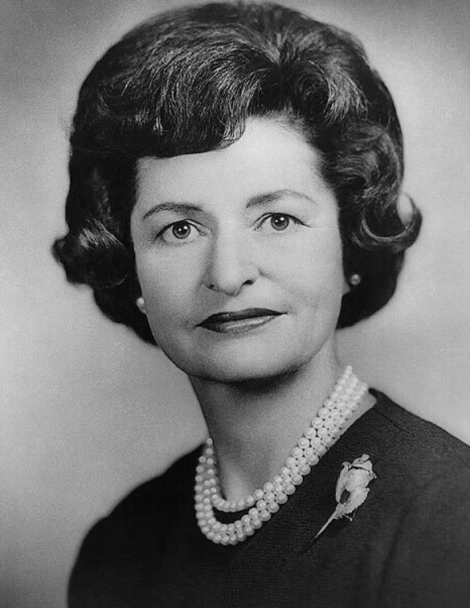
Claudia Alta (“Ladybird) Johnson ( Taylor)1912-2007)
Ladybird 1940’s
Born to extremely wealthy family East Texas
Father owner of 15,000 cotton plantation…classic
Racist..mother socialite…opera lover, who
“scandalized people for miles around by
Entertaining negroes in the home”
Educated University of Texas…two degrees
History& Journalism.
Introduced to LBJ …proposes on first date
….marries after 10 weeks
…2 daughters, 3 miscarriages
…LBJ serially unfaithful… ongoing affairs, boasts
…tolerates but humiliated
Invests in $10,000 (1941) ($250K). In LBJ first campaign
Purchases Texas Radio station for $25,000 1943
….investor in real estate , television, banks
..worth $150m before LBJ President (LBJ holdings)

Slide 21
Democracy “Texas style”
One Party State ( Democrat …till 1960’s Civil Rights)
White control (Jim Crow) disenfranchise Blacks & Mexicans (25% population)
Weak Central Government…Governor limited power…till 1960’s
Part time politicians: low salary, attend 4 months every two years
Politics of money, power, gaming….rampant in 1940’s---now?
….“Correctable votes”….votes adjusted to fit result by election managers
Success requires money, networks, ruthlessness…..violence minimal

Slide 22
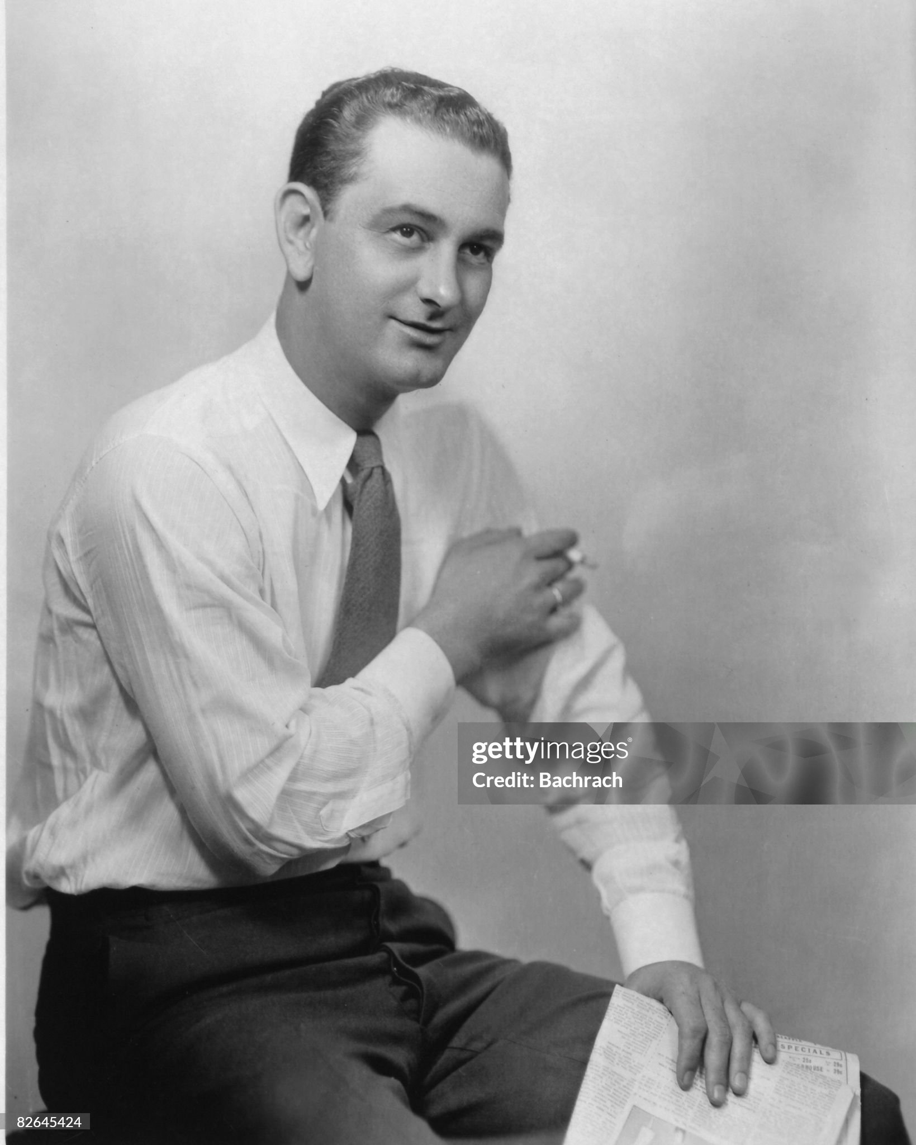
Johnson….the candidate

Slide 23
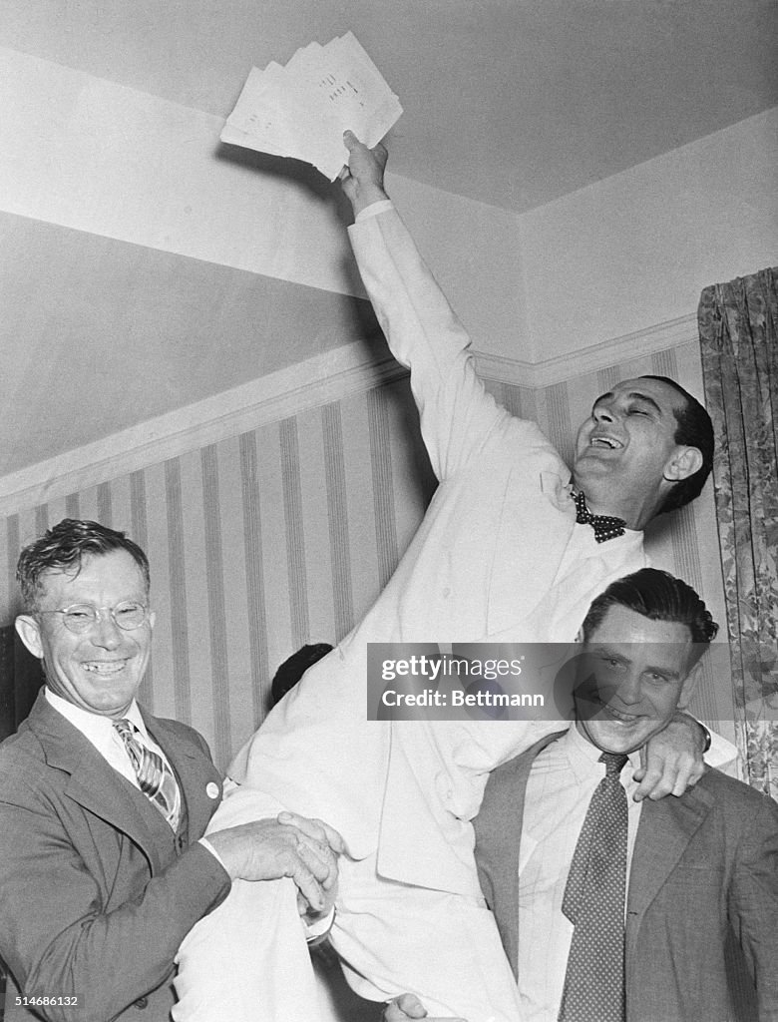
Johnson…rise to power
LBJ Victory Night 1937
(“Corrected votes in hand!)
"Johnson's ambition was uncommon – in the degree to which it was unencumbered by even the slightest excess weight of ideology, of philosophy, of principles, of beliefs.“ ^{Richard Caro}
Runs for Representative 1937
…delivers highway, road grants to Texas
…superb networker
…known, trusted by FDR
….believes in supports “New Deal”
Runs for Senate 1941
….promised no opposition
…tricked……”corrected votes”
…loses election….humiliated

Slide 24
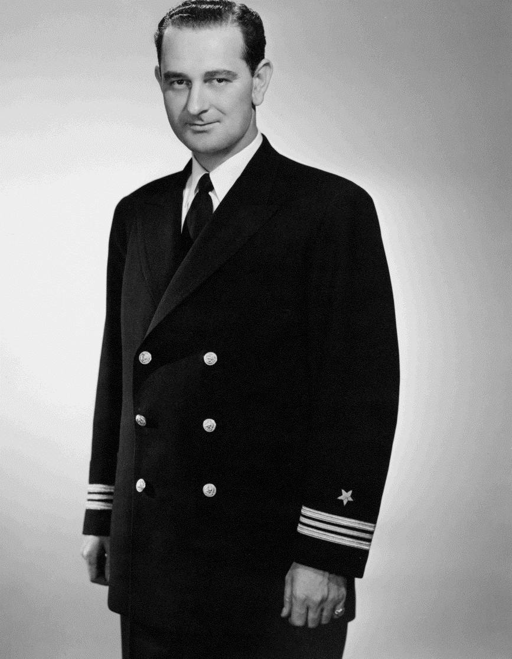
“War Hero” 1941-1942
Needs military experience to
Re-launch political career
Joins Navy…appointed by FDR
….inspect docks
…sent to Pacific to review progress
Needs “Action”
…joins air raid New Guinea
…..plane returns/mechanical issues
….claims attacked by Japanese
Completes report
….identifies issues/ praises McArthur …awarded “Silver Star” (not crew)
…returns to US…discharged
…prepares next step…Senator
…this time…to control vote count

Slide 25
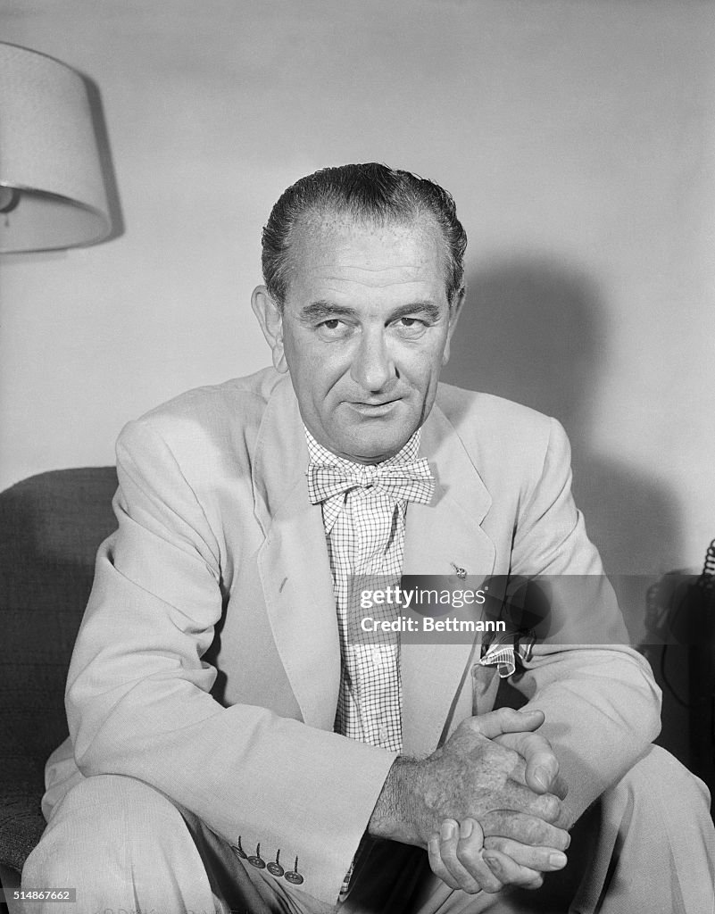
Senator Johnson 1949-1961
Runs for Senate 1948
….pioneers helicopter use
…controls vote counting
…wins by 87 votes (980,000)
…..the mythical 200
Promoted to committee selection
…..inexhaustible, crude, effective
…Heads Federal Trade Commission
…awards Ladybird radio stations licences
Majority Leader 1954
Compels bi-partisan agreements
Civil Rights Bill (and “jury amendment
Supports…then abandons McCarthy
Supports Space programme,
Promotes “missile gap” myth

Slide 26
Johnson as Vice President
Unsuccessful run for President 1960
JFK selects as VP….to win vote for Texas…and South
Relationship with Kennedy
To LBJ, JFK Spoiled rich boy
To JFK: LBJ uncouth country boy… brothers compete to humiliate
LBJ as VP
Sent on overseas trips (out of the way..women)
The “People to People” person…giver of pens

Slide 27
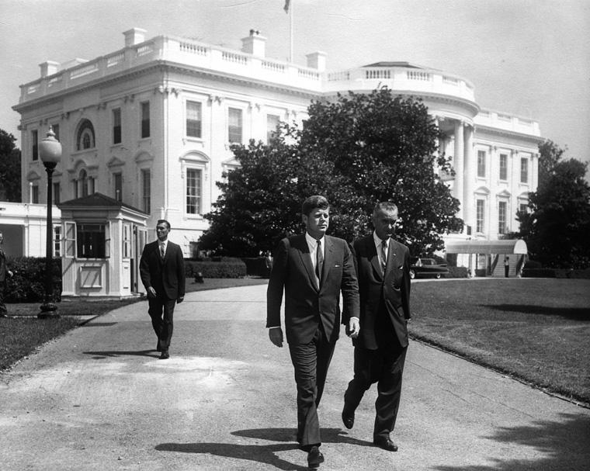

Slide 28
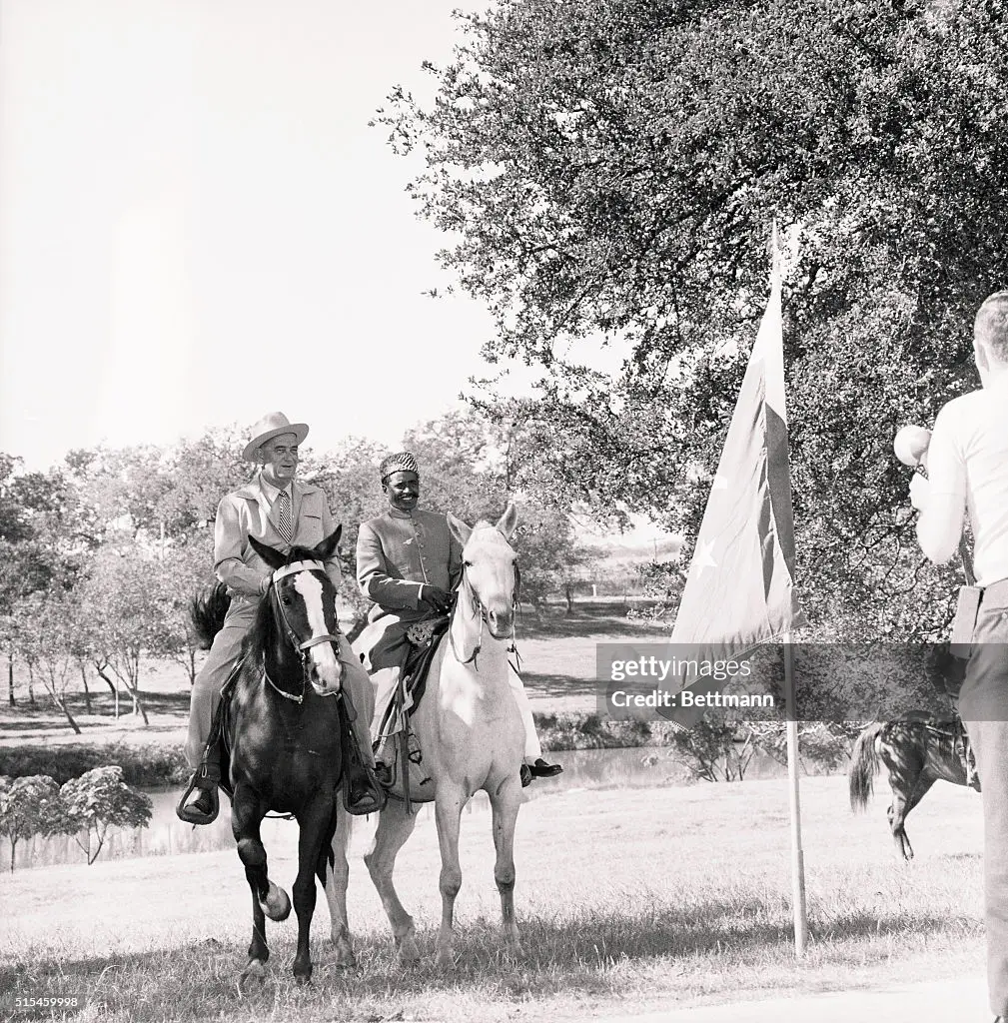
The “People to People Person” ….LBJ as Vice President
LBJ sent to 20 countries
…500,000 air miles
Lyndon and Bashir…..LBJ Ranch
Pakistan
…sees camel driver
….”why don’t y’all come & visit
Bashir trip
..LBJ flies Bashir to Washington
..Grand tour/ gifts/ new truck
….Trip to Mecca
Epilogue
…Bashir goes into business
…target, son kidnapped
…ruined…dies penniless

Slide 29
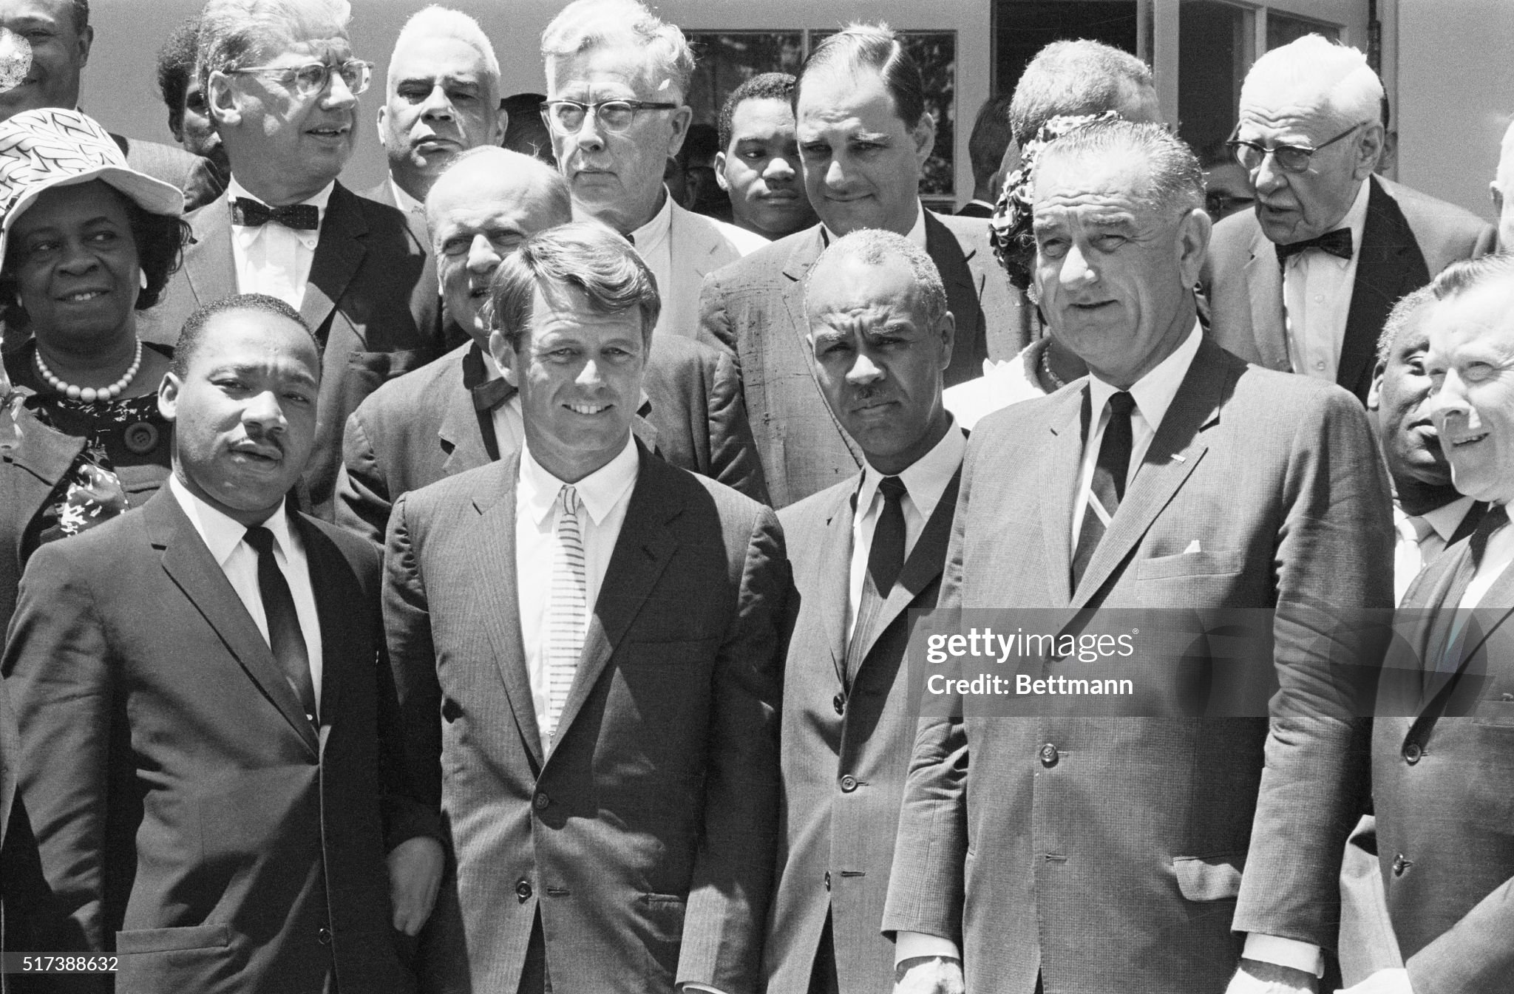
Used as “bridge” to South/ Civil Rights …..balances genuine support/Southern image

Slide 30
Unfinished business: The Kennedy Legacy
Overseas
Vietnam…..situation destabilizing….LBJ increases “advisors” to 23,000
Cold War….maintain “Containment Strategy”….USSR leadership change
US image damaged by Civil Rights issue
Domestic
Tax cuts, welfare increases, expansion of Social Security,
Civil Rights…….promises made, blocked by Senate Democrats
National Mood: 77% “trusted government to do the right thing” (22% in 2024)
Optimistic….success in war, rising affluence, effective Presidents, Bi Partisan
Kennedy a “martyr”…legacy must be honoured….opposition “disloyalty”

