Slide 1
The Turning Point

Slide 2
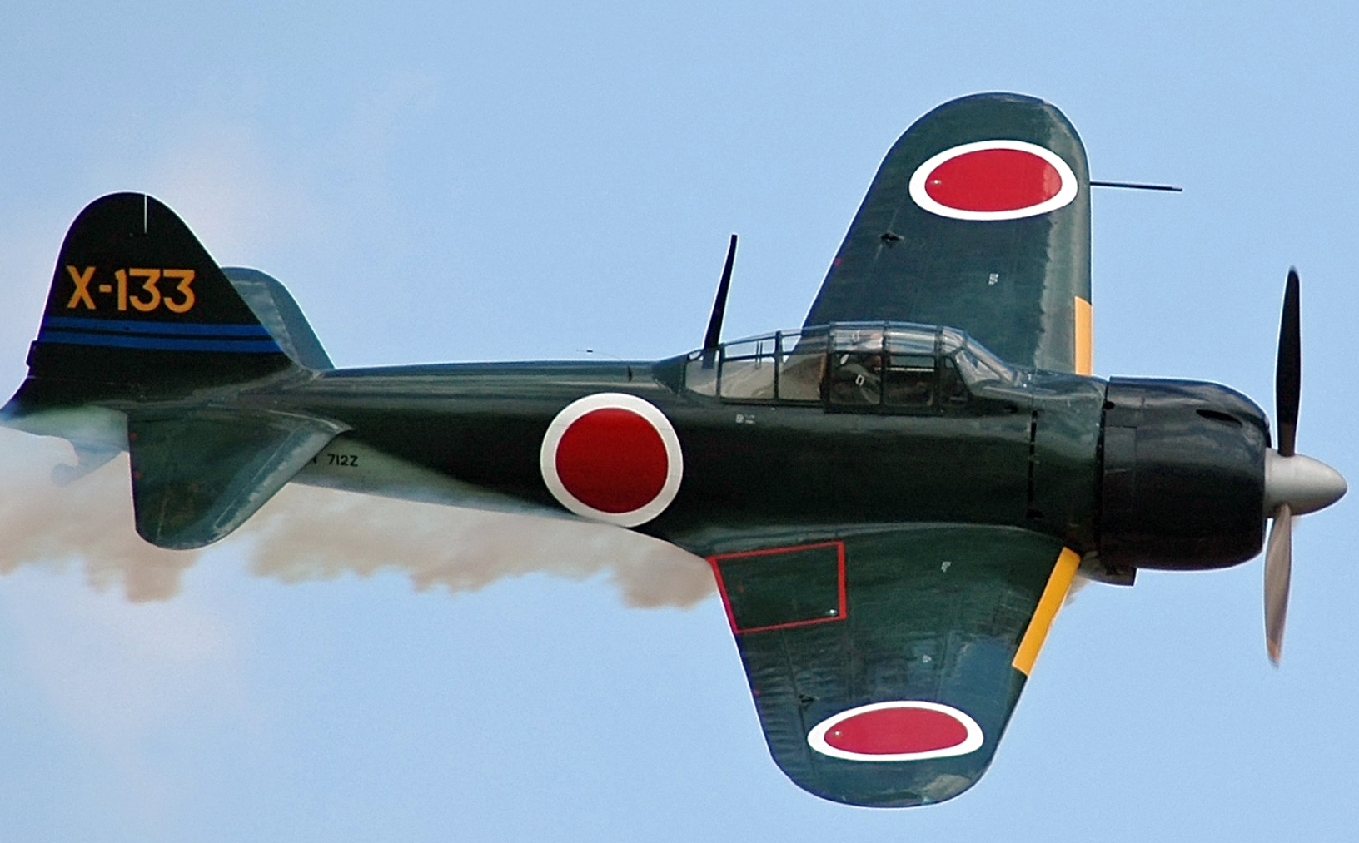
Weapons and Technology: Japanese
Mitsubishi Zero fighter
Deployed 1939
2 machine guns
2 cannons
Speed 310 mph
More advanced
than US/ UK 1940-1942
…highly manoeuvrable
Vulnerable to fire
Highly skilled pilot could
Beat US in dogfight
Upgraded during war
….but at scale and pace
of US

Slide 3
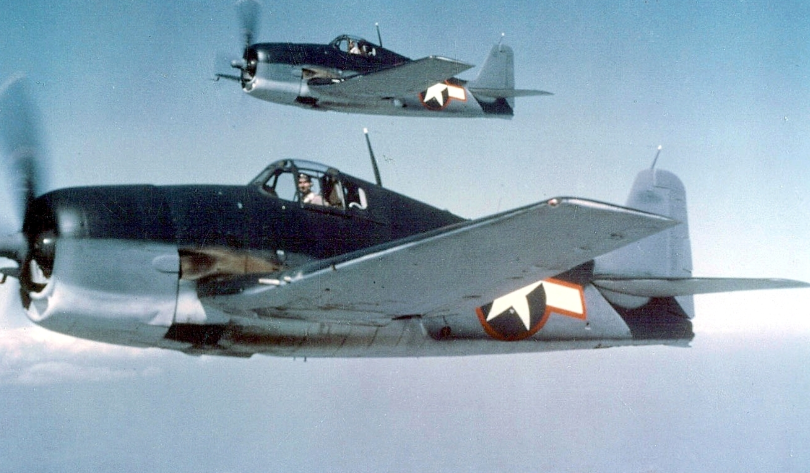
US Carrier Aircraft
Grumman “Hellcat” V 6 ..1943 version
First version “Wildcat” V5 deployed 940….outclassed by Zero. Speed 290 mph
Hellcats mass produced 1943
Speed up to 390 mph
..6 m/c guns/2 cannon
Ability to withstand damage ….wins by diving down on
Zeros
…required less skilled pilot

Slide 4
Other Technology
Radar
US 5 years ahead of Japanese
Use improves as UK and US ally due to “Lend Lease”
1942– US able to detect ships. Planes within 100 miles…range increases
Japanese achieve same goal…1944…but fleet already destroyed
Code Breaking
Japanese do not break US codes….fighting blind
US/ UK break Japanese military code 1940 (not diplomatic code…no Pearl Harbour
US Aware of Japanese fleet movements…Japanese no equivalent

Slide 5
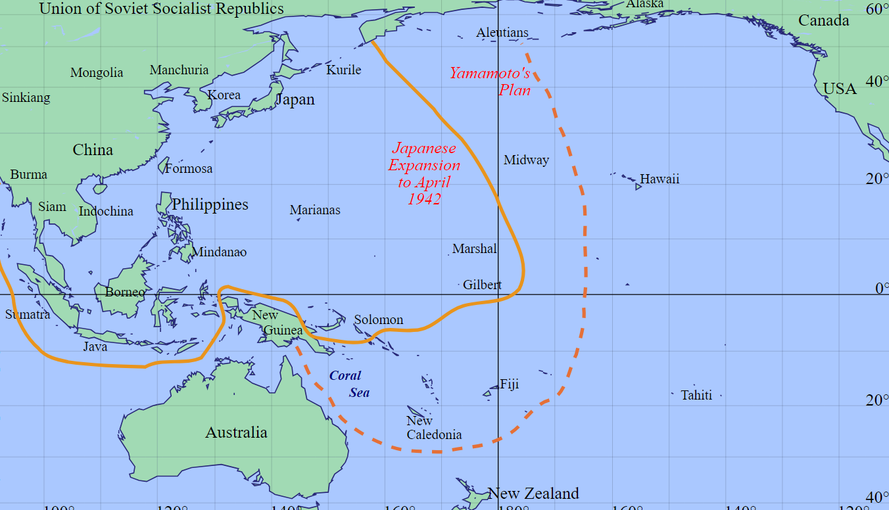
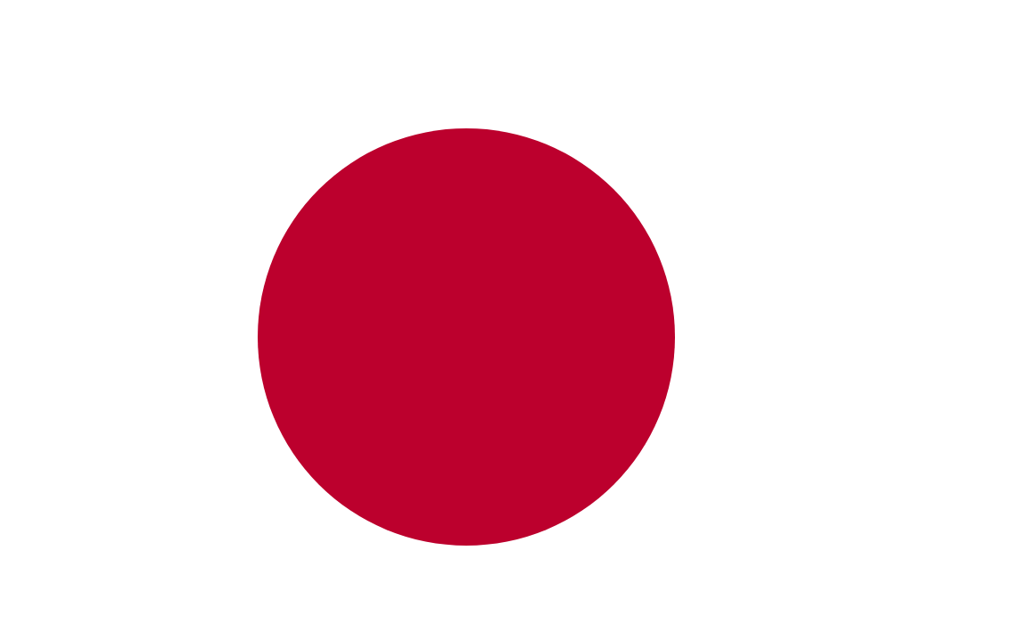
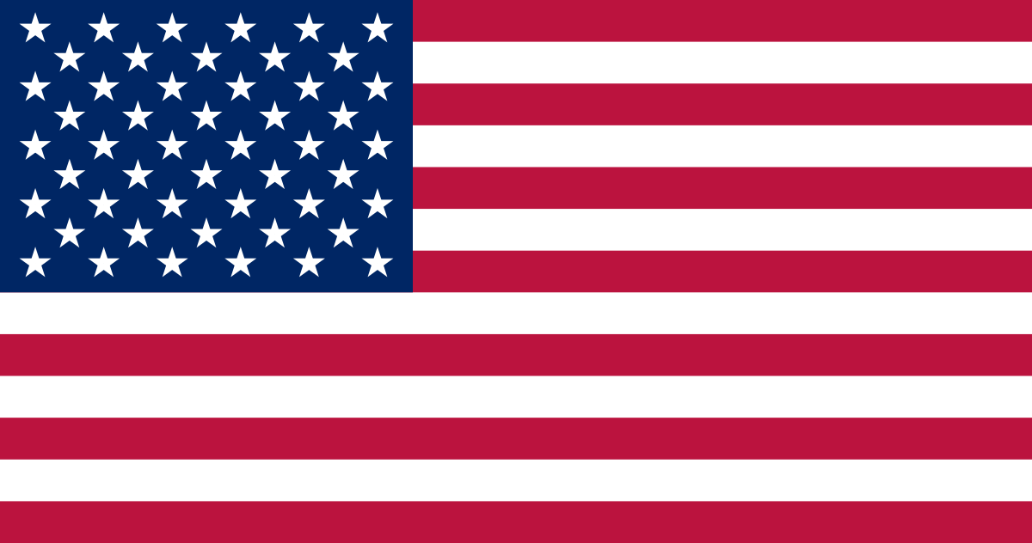
Japanese campaign 1942
1
April Southern fleet
…support occupation
of New Guinea
…prepare invasion
Of Australia
Japanese North Fleet
4 large carriers
Battle fleet & escorts
Pacific fleet
… 2 large carriers
2
2
Japanese South
2 large carriers
1 light carrier
Multiple cruisers
June…revenge for
Doolittle raid
…destroy US Carriers, …capture Midway ….land air base to invade Hawaii
1
South Pacific fleet
….2 large carriers
US/ UK read Japanese
code, send fleets to
intercept

Slide 6
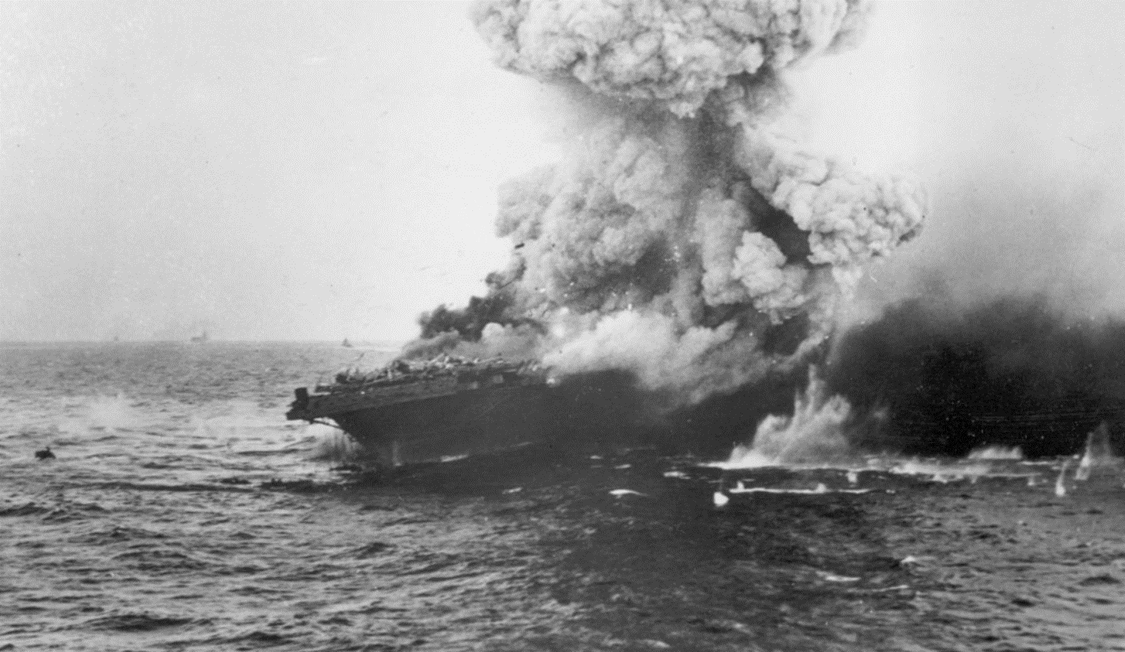
Battle of the Coral Sea May4- 8th 1942
USS Lexington…last moments
First carrier to carrier battle
Japanese 2 large, 1 light carrier..both sides 200 aircraft
US sink 1 light Japanese
Carrier…damage both
Large carriers…lose 70 planes
Japanese sink 1 large
US carrier …lose 70 planes
…and withdraw
US surviving carrier
Yorktown ..to Hawaii for repairs..Joins US North Pacific fleet
Main event in North Pacific imminent

Slide 7
Battle of Midway June 4th -7th 1942
Japanese fleet larger but dispersed, unaware US fleet present
4 large carriers, 2 battleships, 3 cruisers, 12 destroyers
250 aircraft
Escort fleet of 2 light carriers + five battleships can’t keep up…not used
US Fleet smaller, concentrated, supported by land based planes, know Japanese coming
3 large carriers, 10 cruisers, 15 destroyer
230 carrier aircraft + 130 land based ..Midway island
Japanese launch bombing attack on Midway….then detect US fleet
…..recall aircraft to carriers to rearm with anti ship weapons
….US dive bombers detect Japanese fleet …aircraft on deck
Sitting Ducks….10 minutes that changed the war

Slide 8
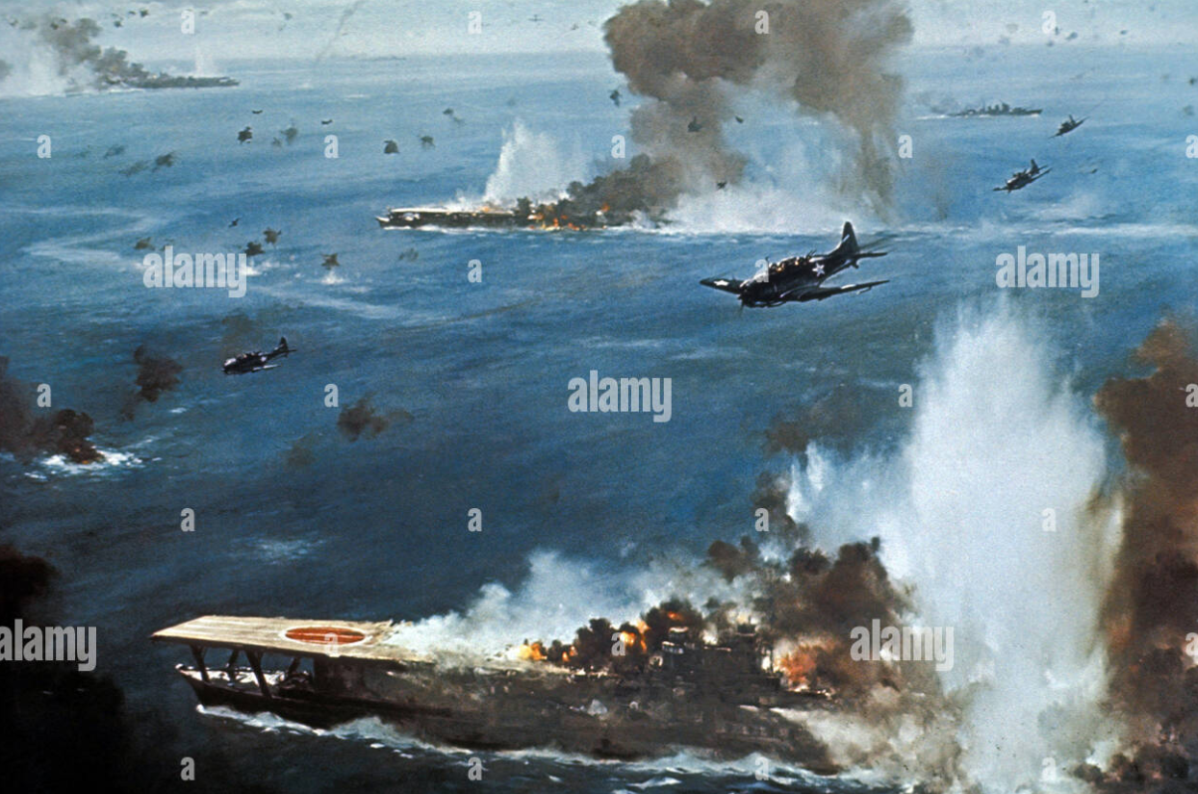
3 large Japanese carriers sunk in 10 minutes

Slide 9
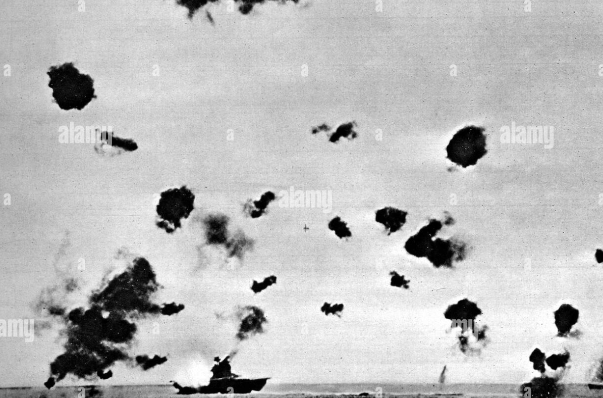
Japanese from last carrier counter-attack…sink US carrier Yorktown

Slide 10
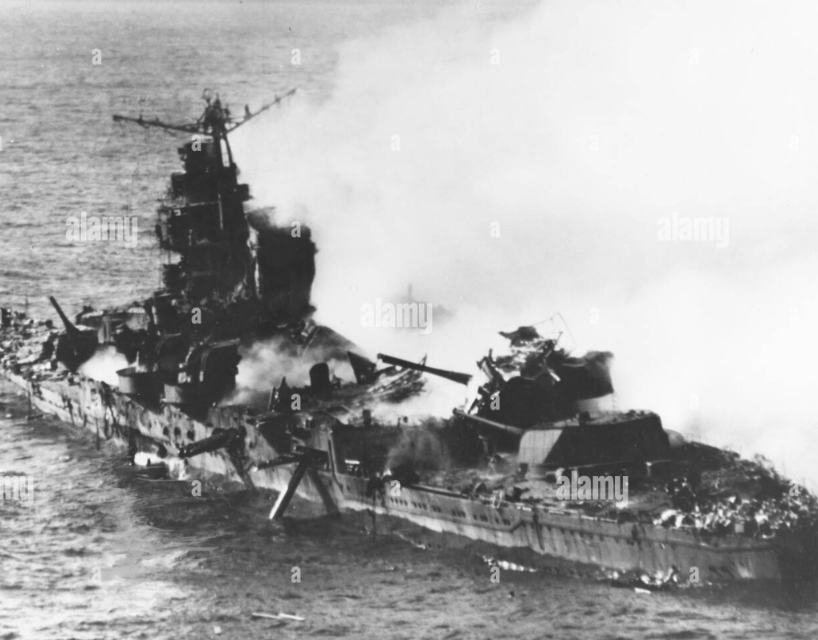
US 2nd attack..sinks last Japanese Carrier …then attack support ships
US lose 1 large carrier
1 destroyer,300 lives
150 aircraft
Japanese Cruiser about to Sink
Japanese lose 4 large
Carriers, 1 cruiser
3,000 lives, 250 aircraft
Japanese losses
Irreplaceable
US 12 large carriers
In preparation plus
10,000 new pilots
…and better aircraft

Slide 11
Japanese dominance ended US on its way, intention total destruction of Japan

Slide 12
Intermission

Slide 13
Japan versus USA August 1942
Japanese: Ring of fortresses (Yamamoto)
Aware US reinforcements coming, US will not accept high losses
Japan to stop all offensive operations
Deploys 400,000 soldiers in ring of island fortresses…and wait
USA approach: Leapfrogging strategy (MacArthur)
Priority Germany and North Africa campaign
Attack strategic islands only/ isolate garrisons
Fight way to Philippines (“I shall return”)..10 new carriers and arrive
Concentrate forces and use overwhelming force

Slide 14
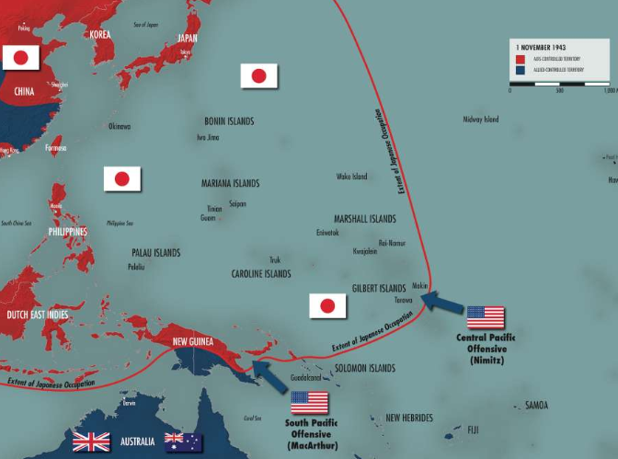
Pacific War Theatre August 1942
Japanese advantage ending 4 carriers, 10 battleships, 40 cruisers, 400 planes
..3 carriers completing readiness
US 4 carriers, 7 battleships, . 20 cruisers, 500 planes
…6 carriers completing
readiness
South Pacific
Guadalcanal first target
…Japanese garrison of 5,000
….supported by battleships
August 7th 1942
1
2
2
Central Pacific
…Japanese garrison
Tarawa second target
..November 1942
1

Slide 15
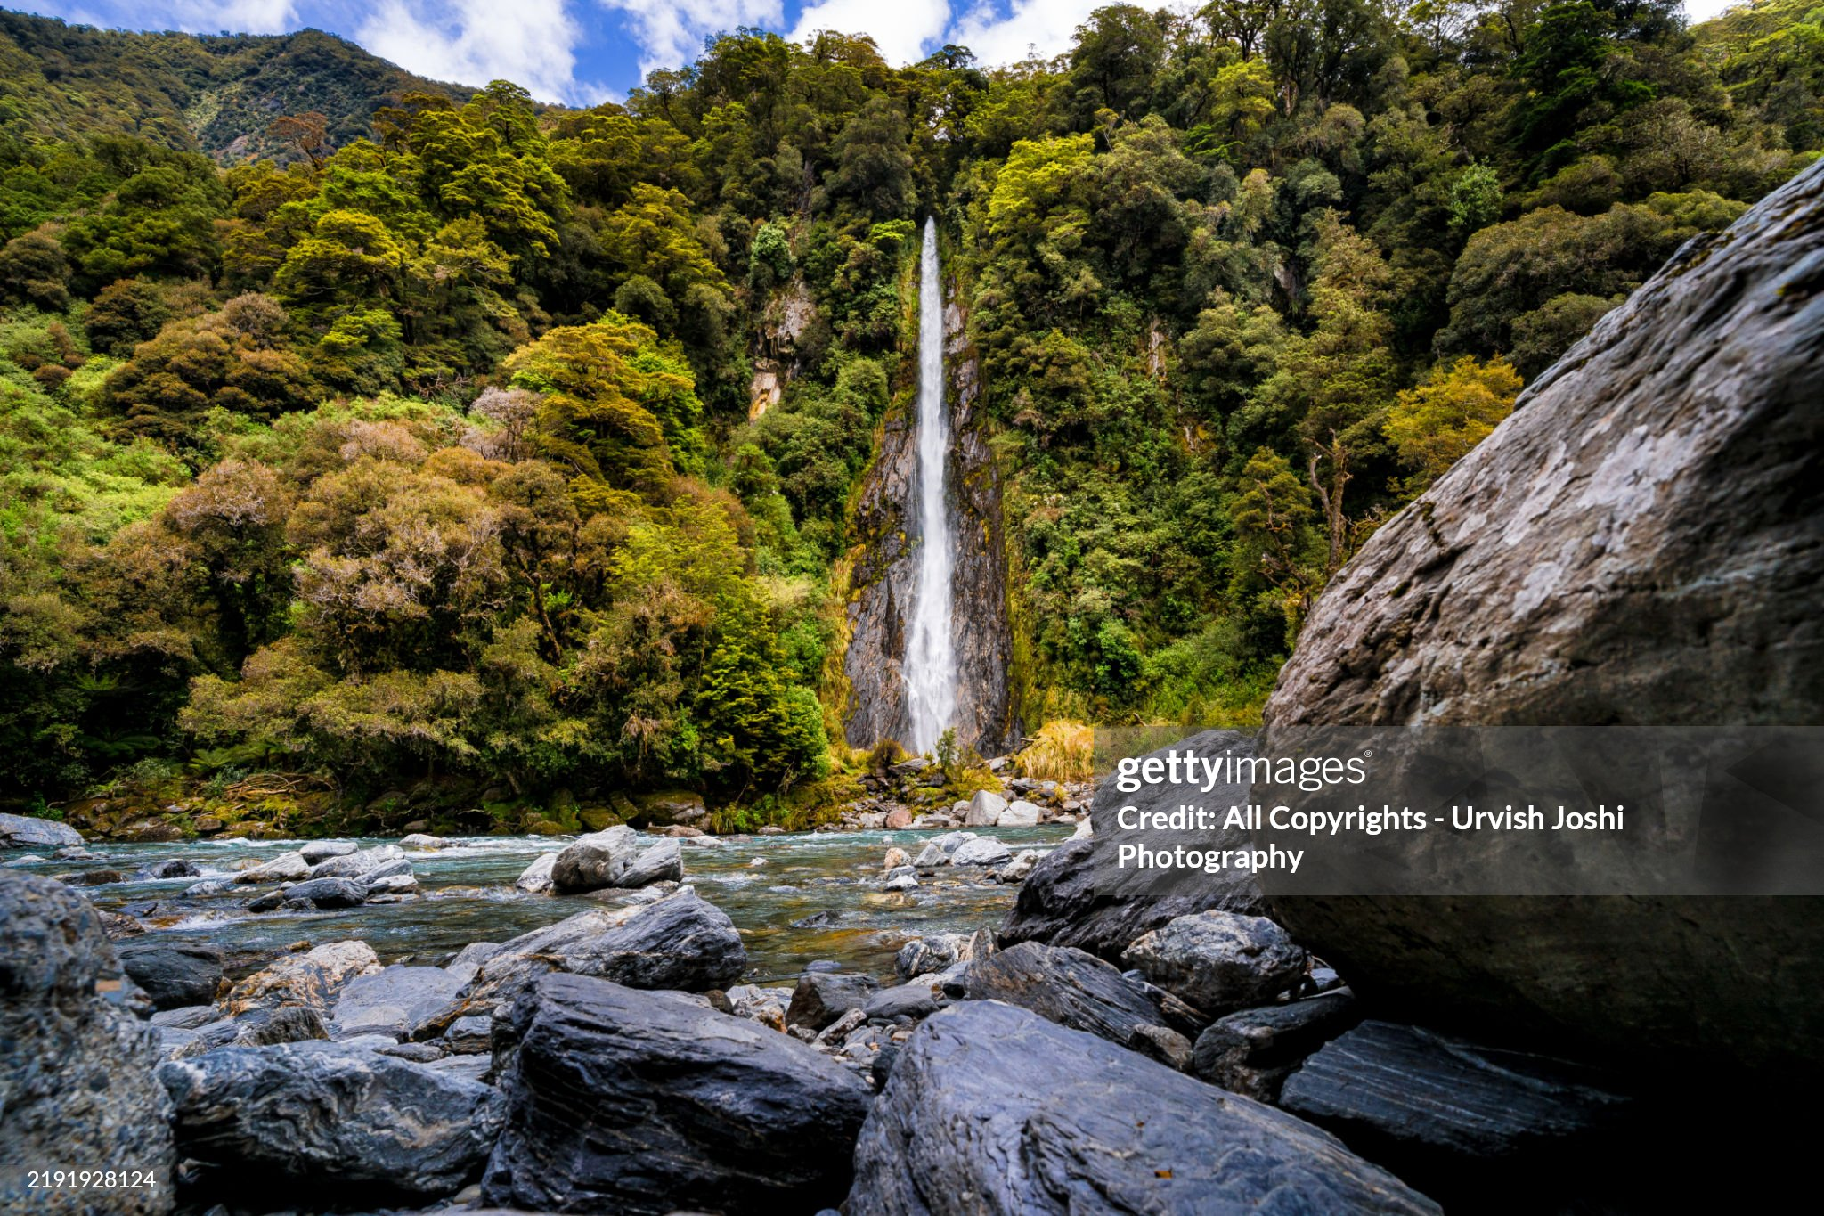
South Pacific Islands (1)

Slide 16
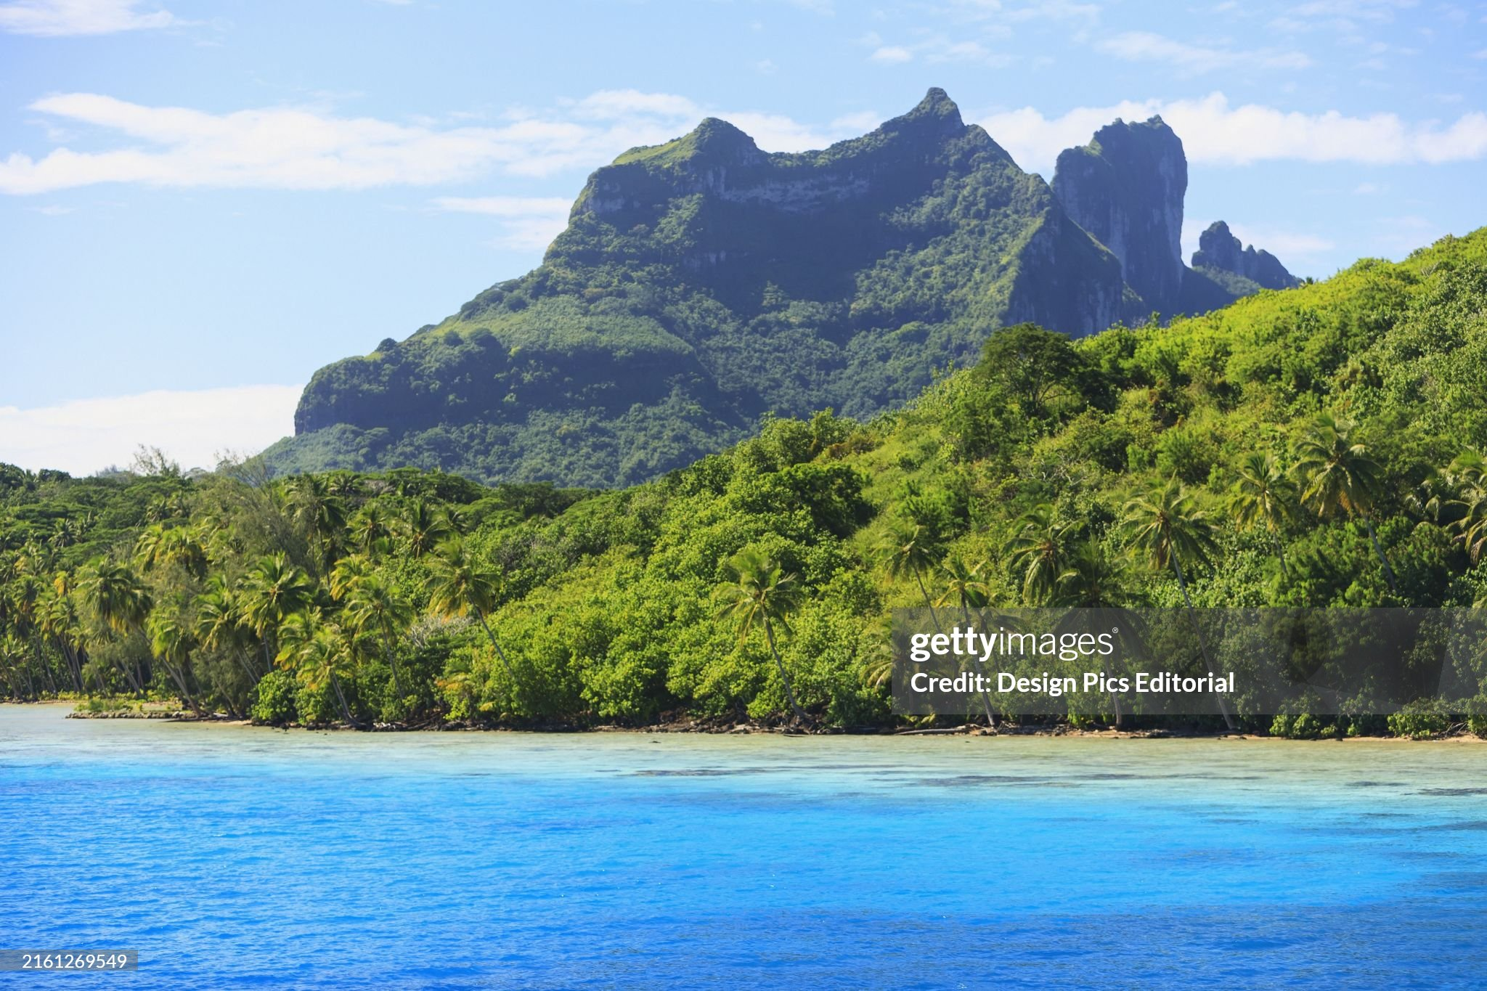
South Pacific Islands (2)

Slide 17
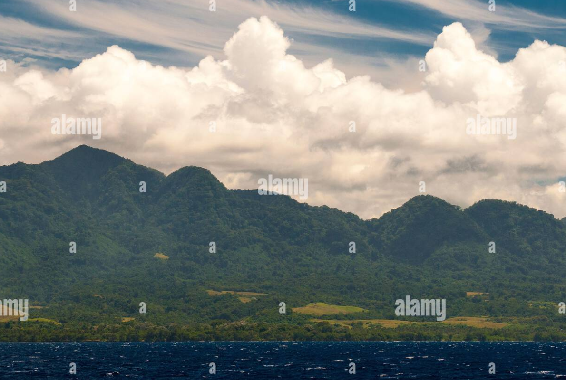
Guadacanal:2,000 square miles, mountains, rivers, swamps, dense jungle….and bugs

Slide 18
Guadalcanal August 1942 – February 1943
10,000 US marines land to take island…..light resistance
Japanese counter attack….amphibious landings, naval assault
Attritional warfare for 7 months
US army of 60,000 lose 7,000 killed, 8,000 wounded, 2 carriers, 8 cruisers,600 aircraft
Japanese army of 30,000. lose 20,000 killed,& 10,000 evacuated, only 1,000 prisoners. Lose 2 battleships,1 carrier, 4 cruisers, 600 aircraft
US can replace losses…..4 new carriers, 5,000+ trained pilots Feb 1943
Japanese cannot….2 new carriers Japanese & 500 ‘untrained’ pilots

Slide 19
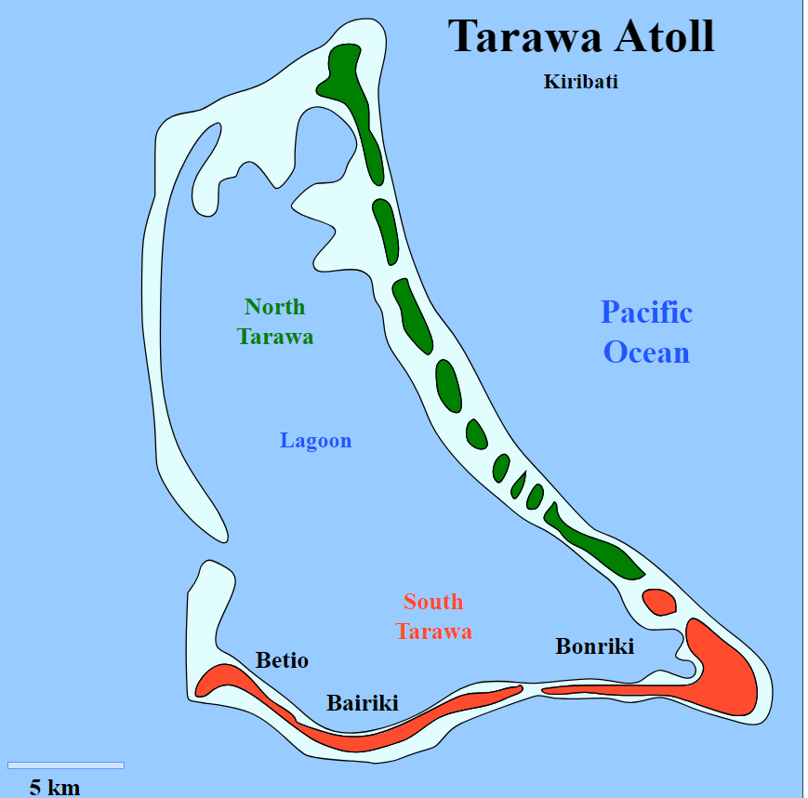
Battle of Tarawa …November 1942
Defended by 2,000 Japanese soldiers + 2,000 construction workers (Korean)
US task force: 30,000 marines
3 battleships, 5 light carriers
4 day battle…US “victory”
US – 2,000 deaths, 2,000 wounded
4,000 Japanese & Koreans killed (Koreans killed by bombardment..and Japanese…only 17 prisoners
12 square mile atoll
US …lessons learned, greater use of technology
…intensify bombardments, air support

Slide 20
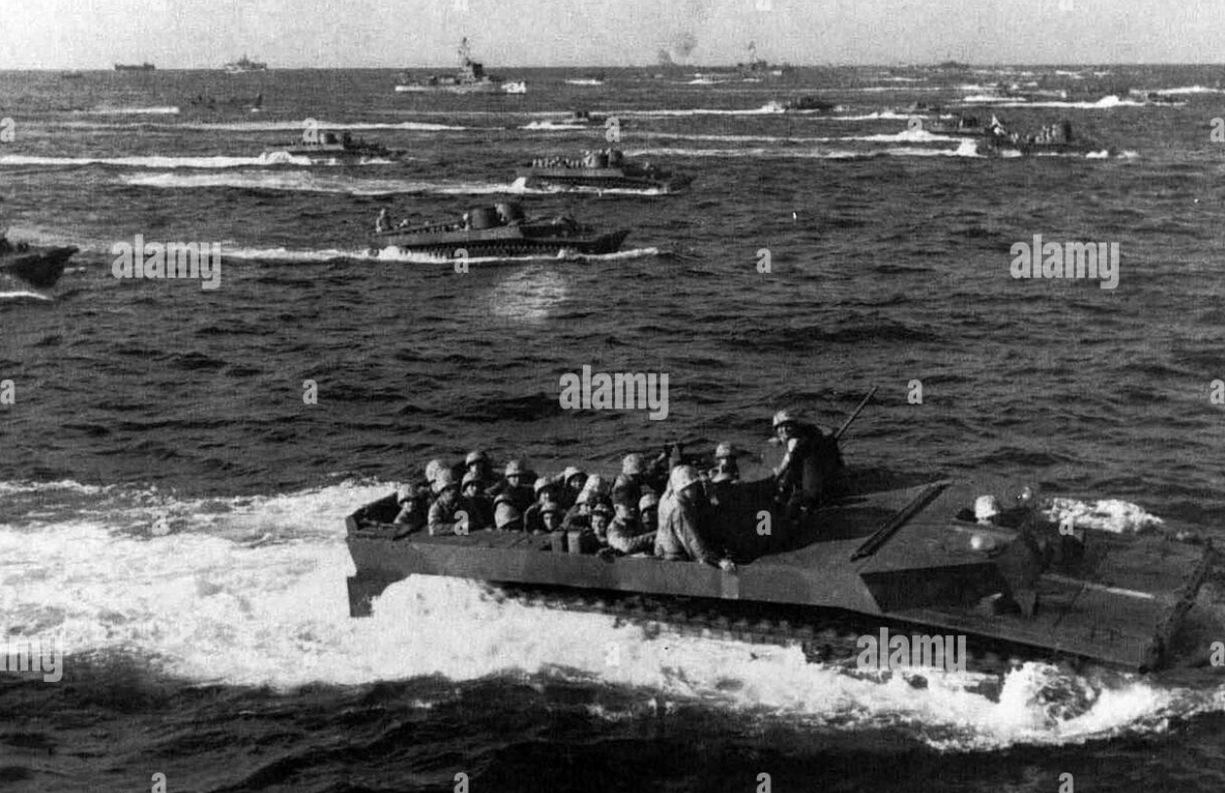
Campaign continues 1943-44

Slide 21
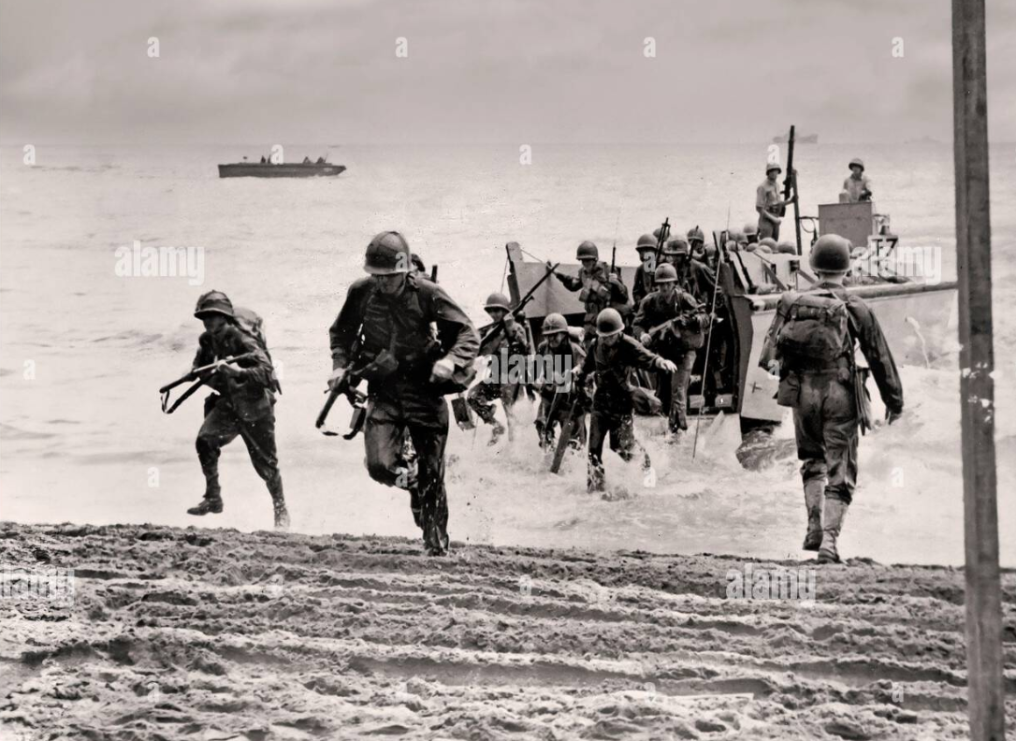
Landings usually unopposed ….due to bombardments
…islands fall to overwhelming US forces

Slide 22
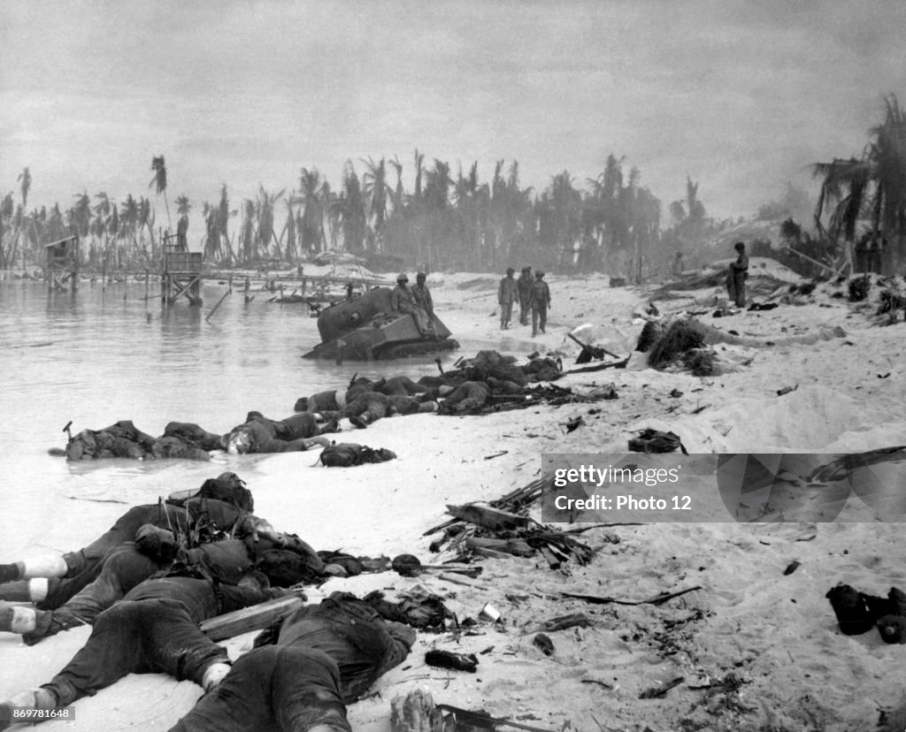
Tarawa beach landings…aftermath

Slide 23
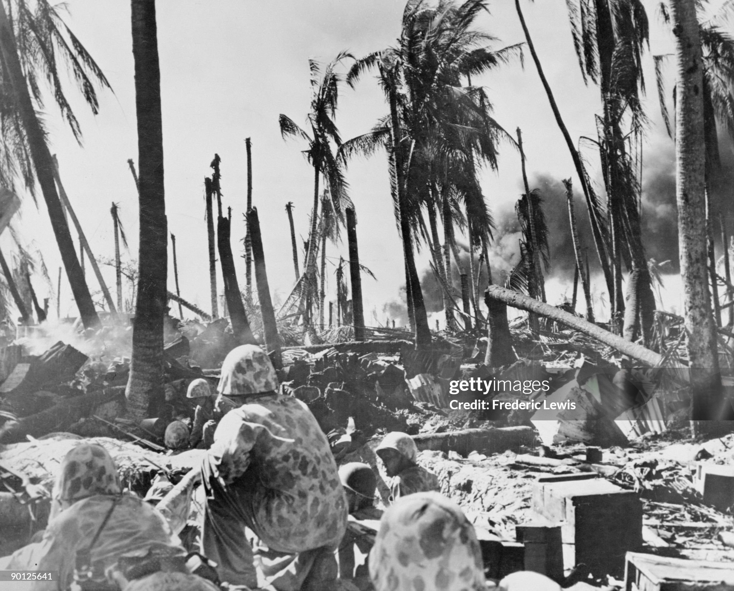

Slide 24
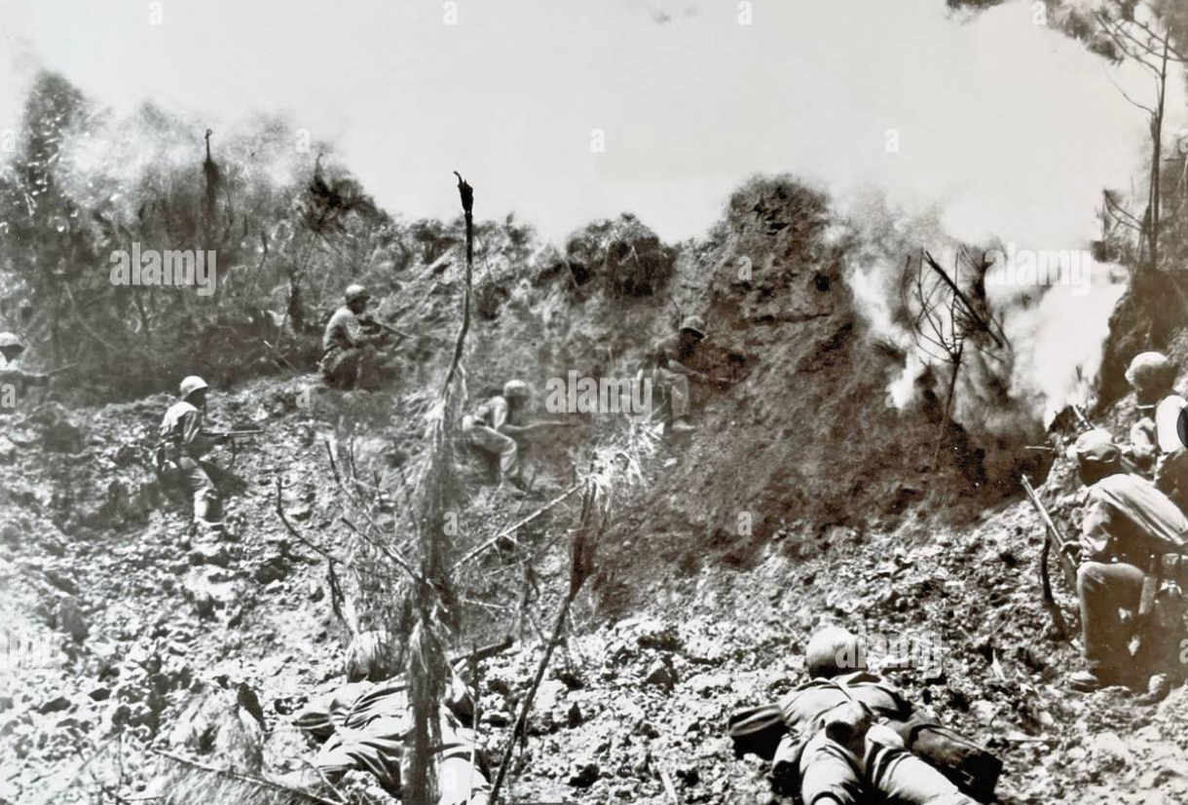
Japanese fight to last man ….intense fighting ending with banzai charges and mass suicide

Slide 25
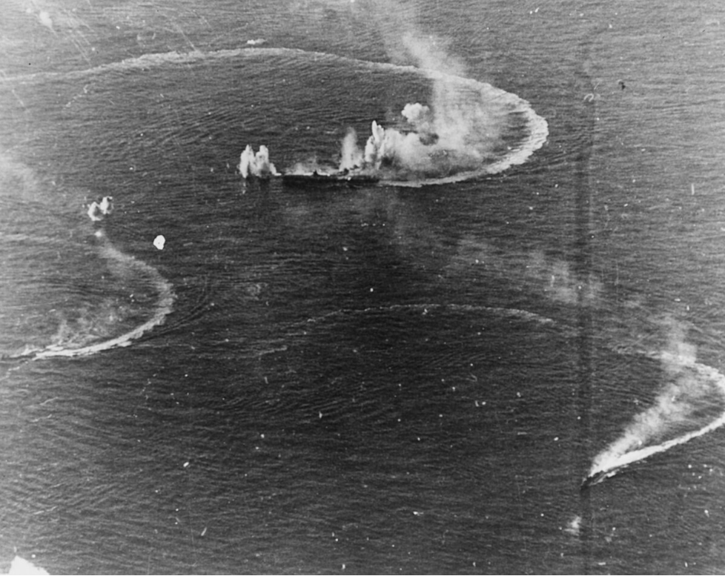
Battle of the Philippine Sea June 19/20 1944 ….US domination of sea and air…technology& training
Island campaign culminates
….Japanese counterattack
US fleet: 7 large 7 small
Carriers, 7 battleships 900
aircraft
Japanese, 3 large, 4 small
Carriers, 5 battleships, 700
Aircraft…untrained pilots
Overwhelming US victory
Lose 120 planes but sink 2
Carriers, destroy 500 planes
`No obstacle to Philippines

