Slide 1
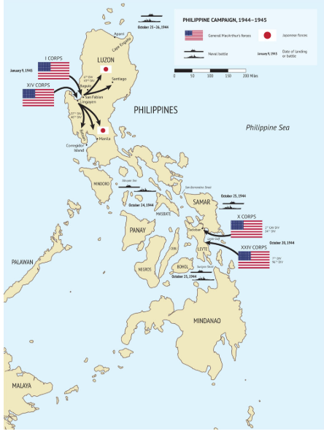
Philippines campaign 1944-1945
US assemble armada
8 large , 27 small carriers
12 battleships, ….300 ships
+ 1,500 planes
Land 1.2 million soldiers
Support from 200,000 Filipinos
Japanese army of 500,000
Unable to prevent invasion

Slide 2
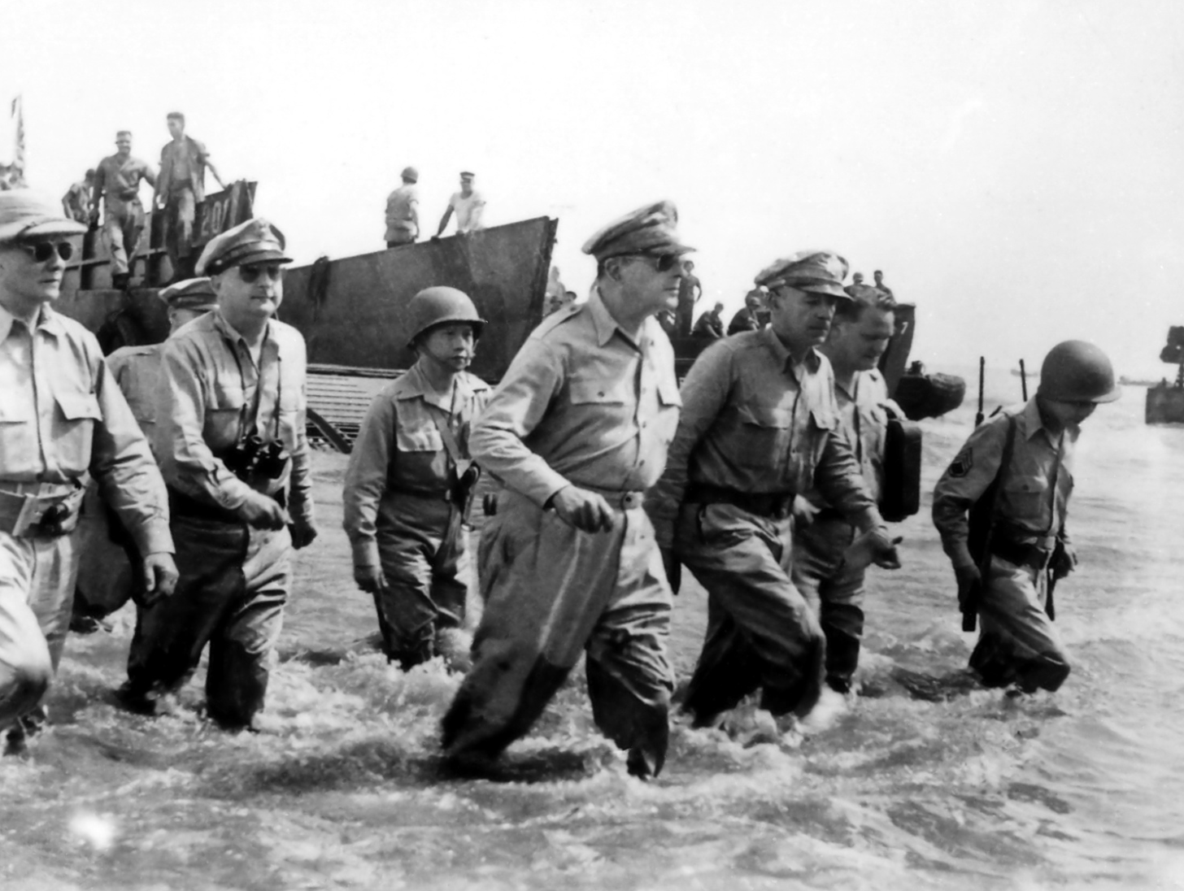
Macarthur returns ( most restaged photo in US history)…this shot too deep…looks ridiculous

Slide 3
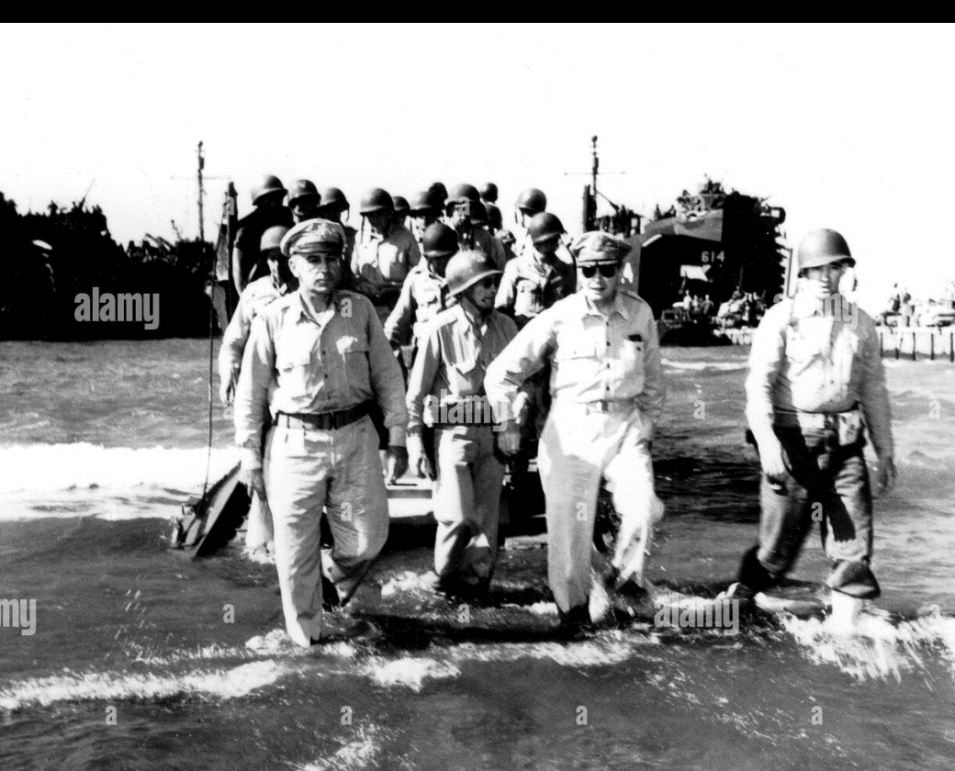
McArthur landing: 2nd shot…just right

Slide 4
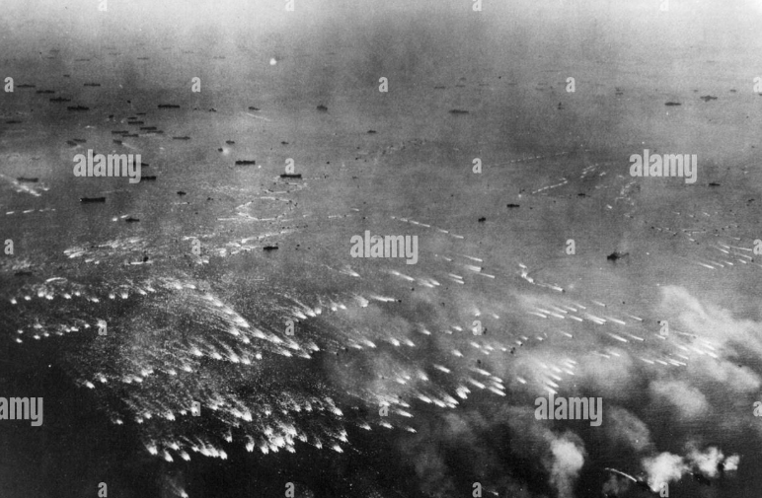
US landing on Philippines (Leyte peninsular)

Slide 5
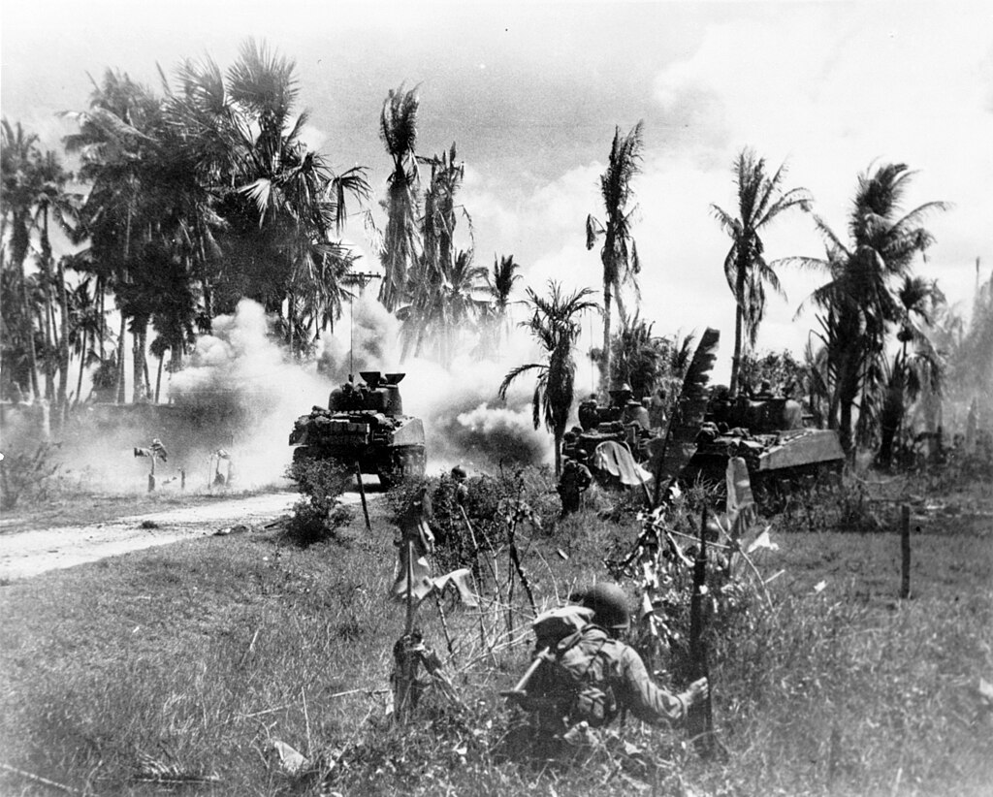
US army mass tank support..”mechanised” attack progress…overwhelming artillery, air support

Slide 6
Japanese response to loss of Philippines
Existential threat to Japan
Order remains of navy on suicide attack
1 large + 5 light carriers + 7 battleships….67 ships (vs 300 US)
The idea
Lure main US fleet to destroy Japanese carrier fleet
Sneak attack by battleships to annihilate US landing craft

Slide 7
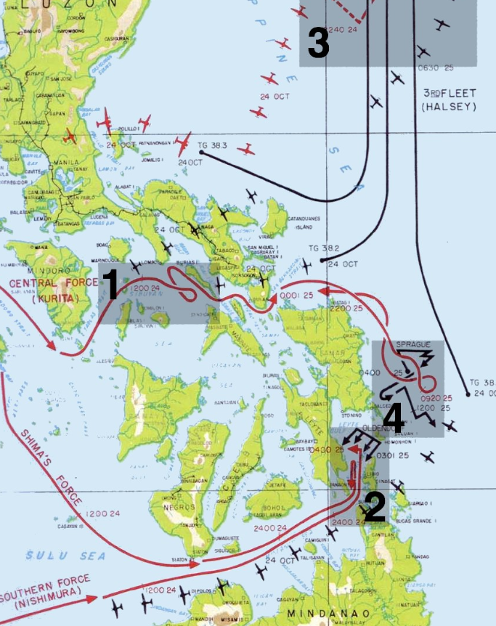
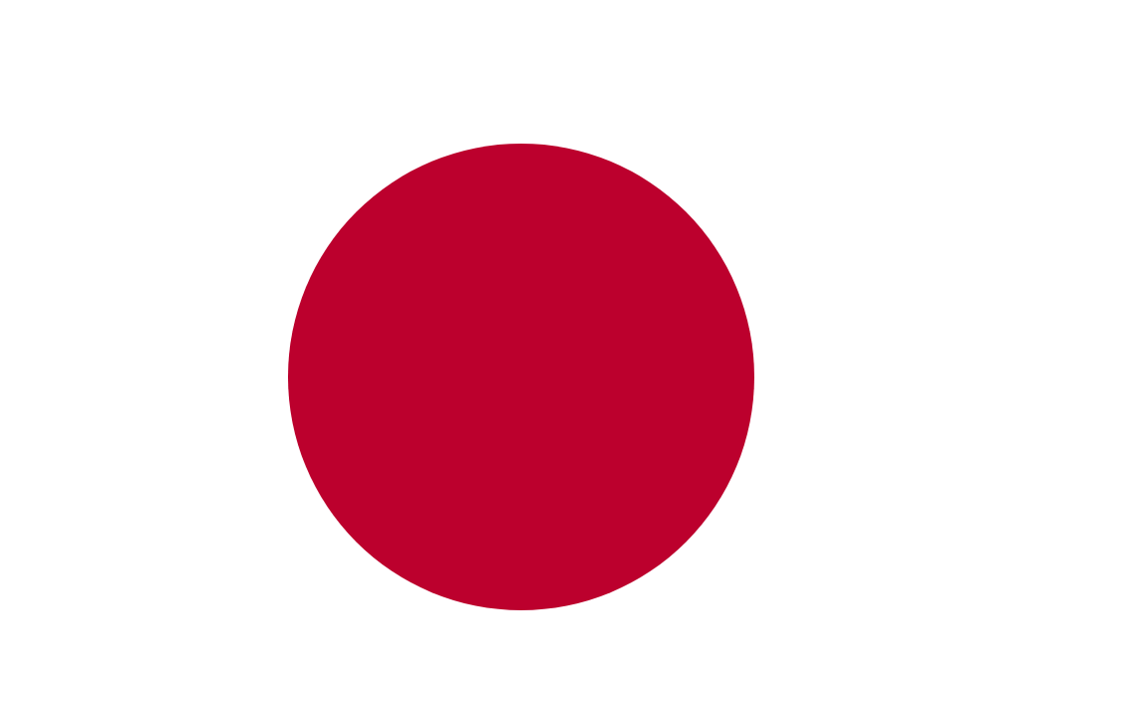
Battle of Leyte Gulf
1
Plan “works”…US detect & attack Japanese decoy fleet
…remove escorts from carrier
And landing fleet
2
1
Japanese battle fleet and
Southern Force approaches
undetected
….It appeared Japan
About to have its own “10 minutes”…only screen of 8 destroyers defend carriers
Vs battleships & cruisers
2

Slide 8
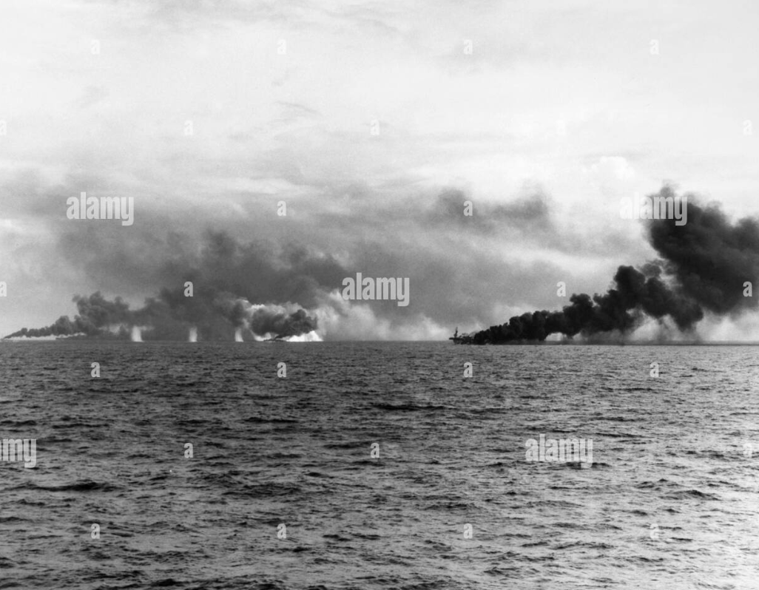
Japanese battleships firing at US carriers …….carriers race to launch planes before getting sunk

Slide 9
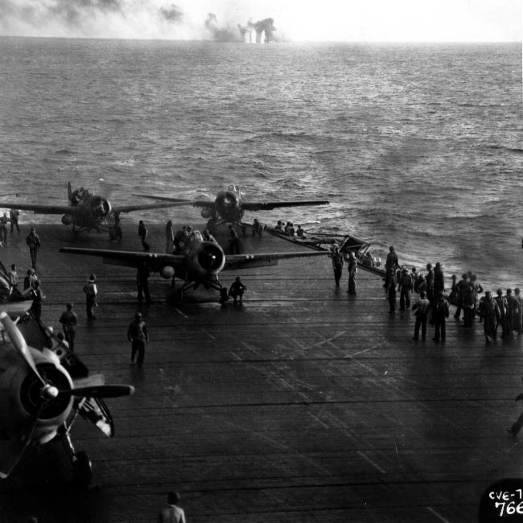
Launching aircraft while under attack

Slide 10
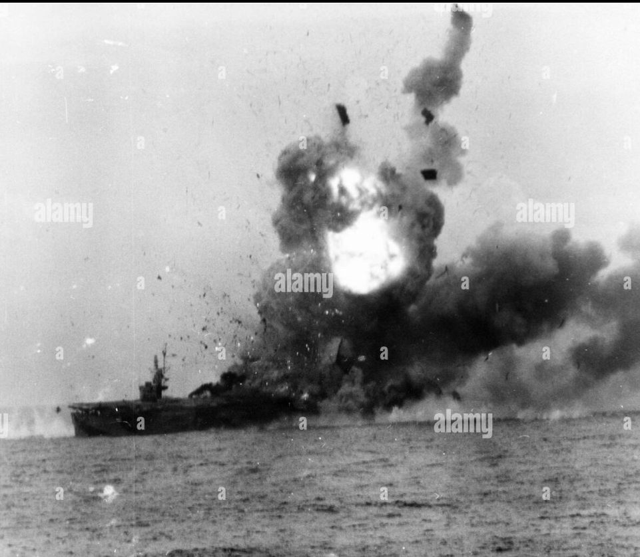
2 US escort carrier sunk by battleships …8 Us destroyers made headlong torpedo attack …create mayhem…sink Japanese cruiser. Japanese panic/ withdraw ….battle fleet virtually wiped out as planes from main US carrier aircraft arrive ..

Slide 11
Battle of Leyte Gulf Aftermath
Japanese Navy destroyed
4 carriers, 3 battleships, 10 cruisers, 9 destroyers sunk..300 planes
US losses 3 carriers, 3 destroyers 250 planes
4 carriers, 3 battleships, 10 cruisers, 9 destroyers sunk..300 planes
US losses: 3 carriers, 3 destroyers and 250 planes
The way to invade Japan is open/ bombing campaign begins
The only solution for Japan
Kamikaze (suicide bombers) and “secret weapons”

Slide 12
Pacific Endgame

Slide 13
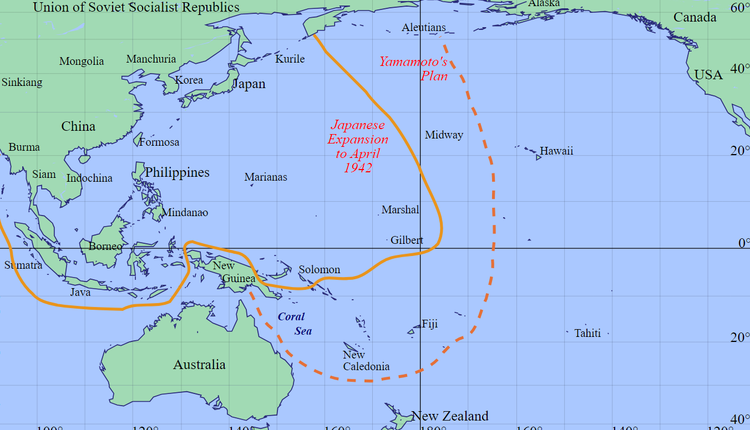
War in the Pacific January 1945
1
Japanese attack
Vs Nationalist& CCP
stalled
1
Iwo Jima
Japanese army
In India destroyed
British/Aust advancing
On Malaya
2
Okinawa
2
3
US Tasks forces s
…capture Pacific islands. Target Iwo Jima
…then Okinawa…
…prepare for land invasion
3

Slide 14
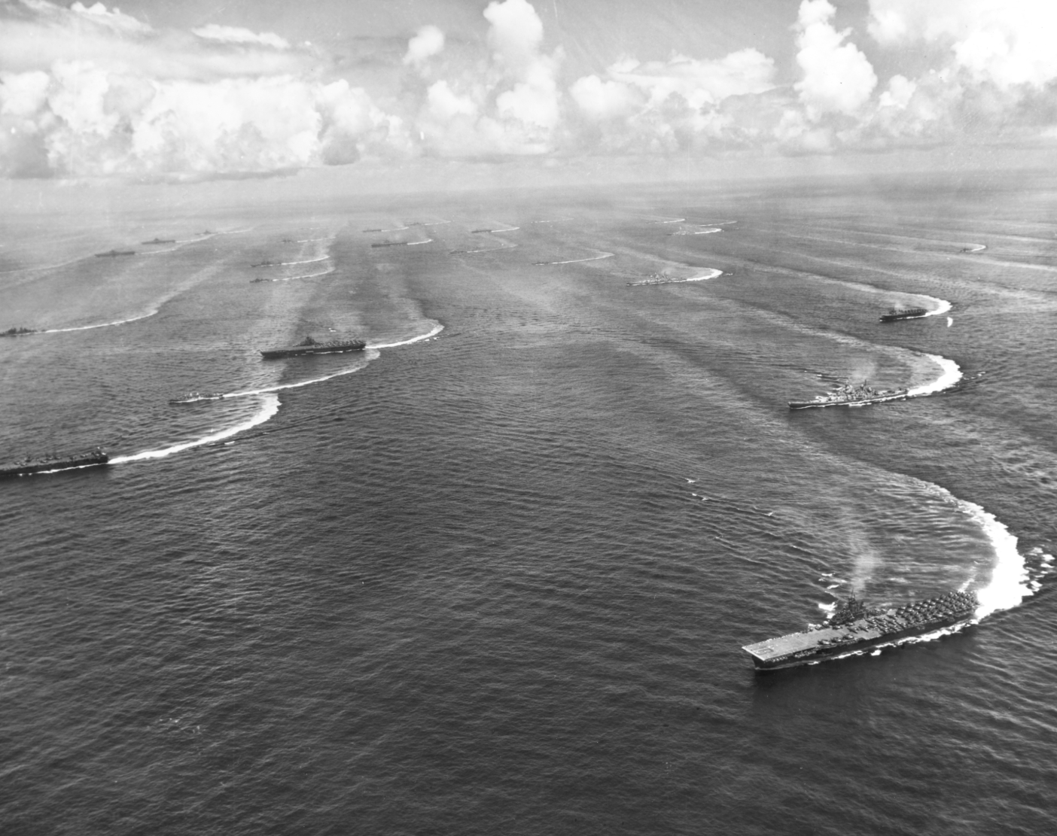
Target Iwo Jima Land base for air raids on Japan mainland 17 carriers, 10 battleships, 100, marines

Slide 15
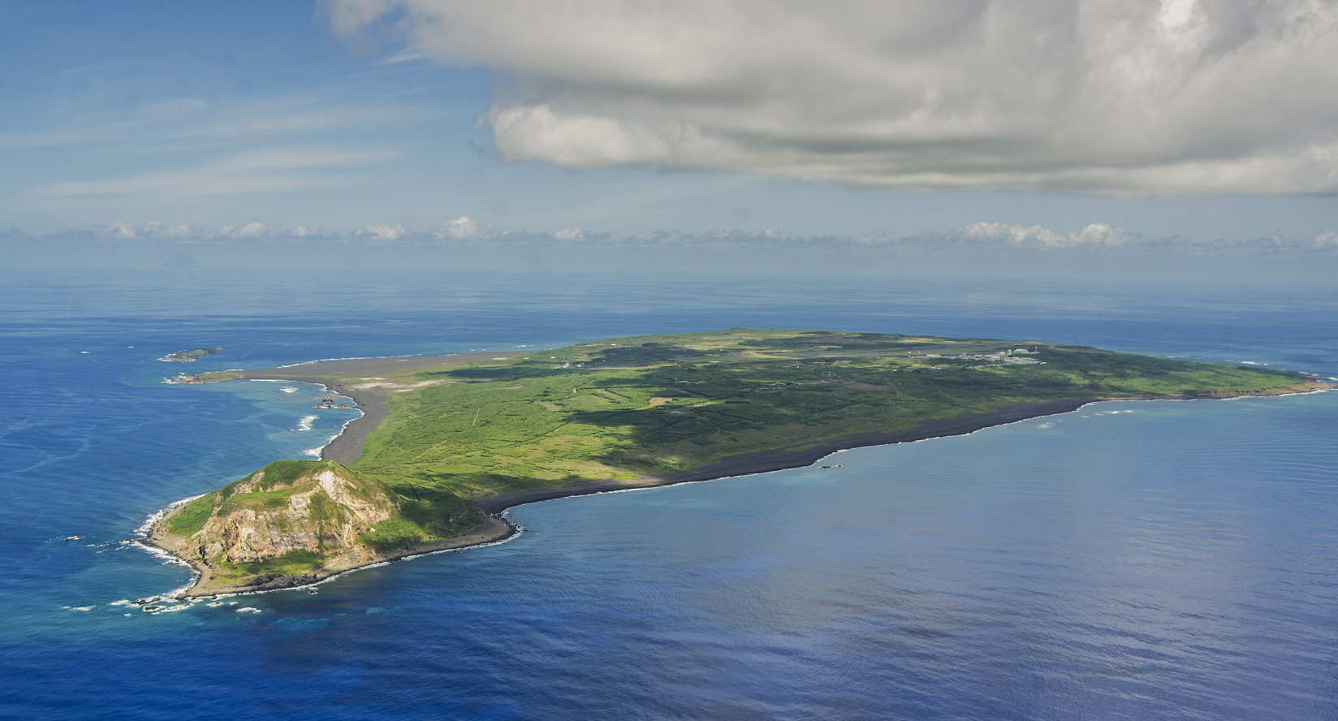
Iwo Jima: 12 sq. mile volcanic island ..20,000 Japanese cave complex …Mount Suribachi

Slide 16
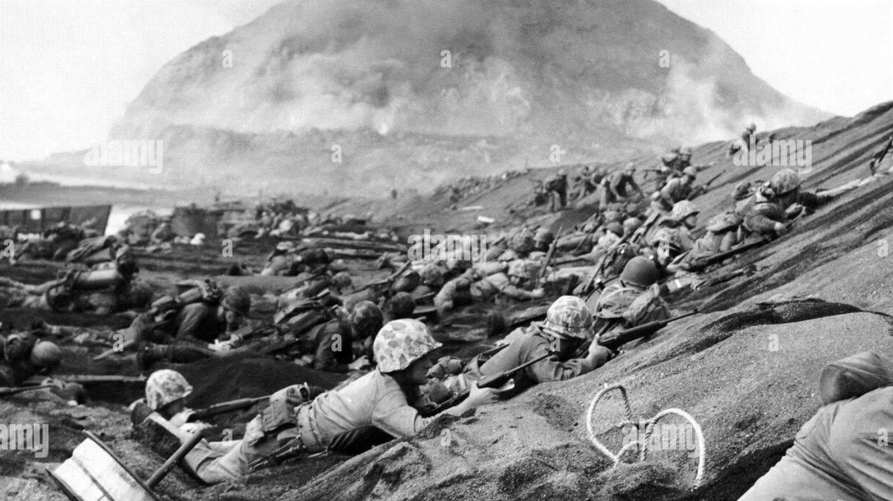
Iwo Jima February – March 1945

Slide 17
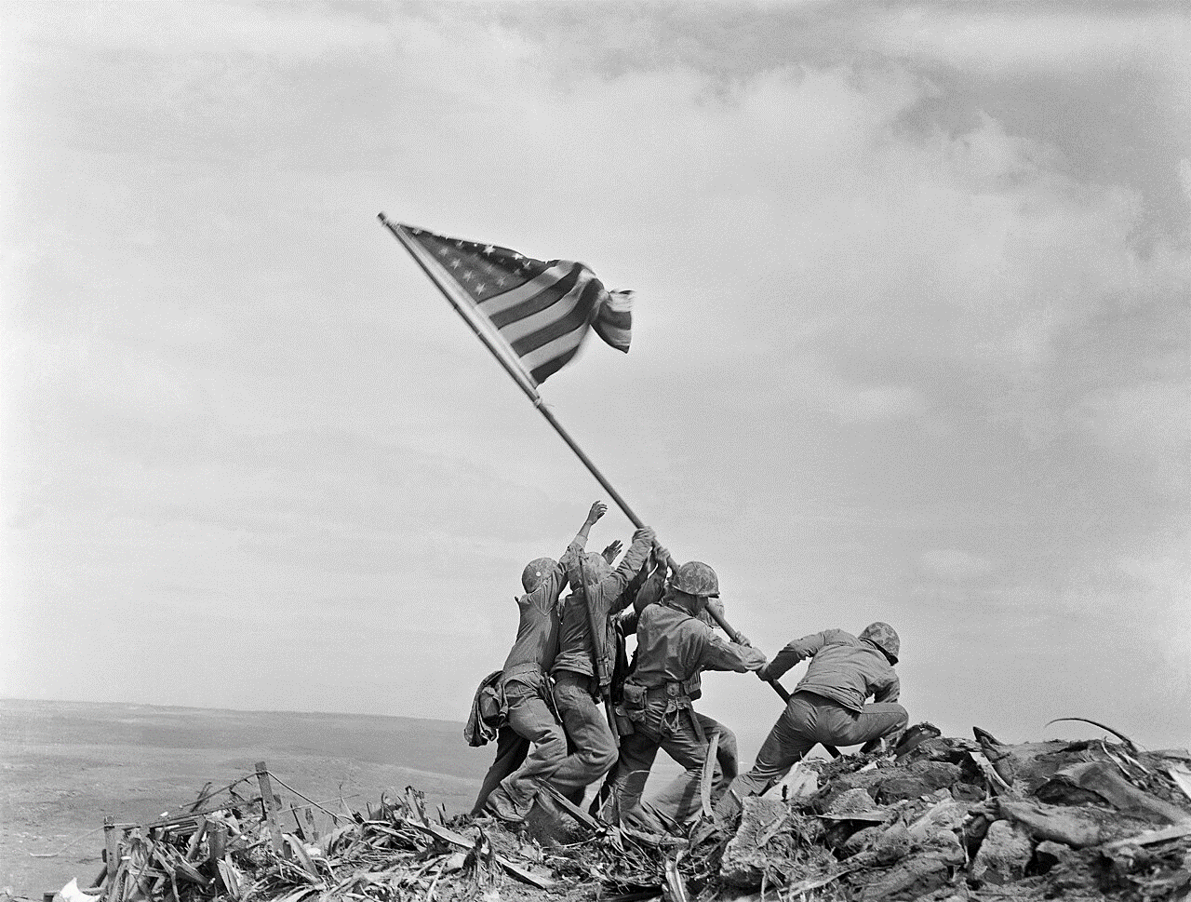
Raising the flag march 1945 US lose 7,000 deaths, 19,000 wounded 800 out of 20,000 Japanese surrender

