Slide 1
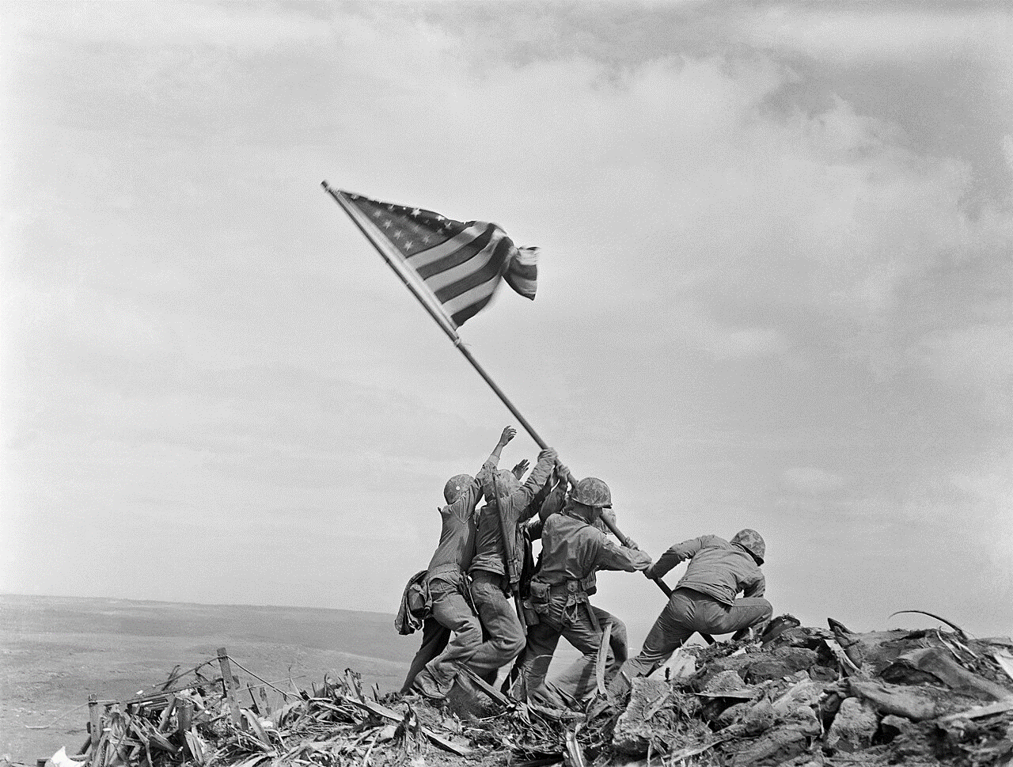
Raising the flag march 1945 US lose 7,000 deaths, 19,000 wounded 800 out of 20,000 Japanese surrender

Slide 2
Japanese “Secret Weapons”
Chemical and Biological weapons
Developed and used during invasion of China
500,000 Chinese killed
Experiments ongoing to spread plague
Balloon campaign v USA …1944…fail
Fire balloon campaign .winds
Incendiary bombs
Ignite Washington State…kill 5 children
US Government aware…supress news to avoid fear/ encourage
The only effective “secret weapon” ….Kamikaze

Slide 3
Okinawa Campaign April – July 1945
About Okinawa
490 square mile
First Japanese territory invaded, 500,000 civilian , 100, 000 soldiers
US Objective
Base for “Super fortress bombers”
Land base for invasion of Japan
US forces overwhelming:
20 carriers (including 8 British)
250,000 landing….rises to 500,000

Slide 4
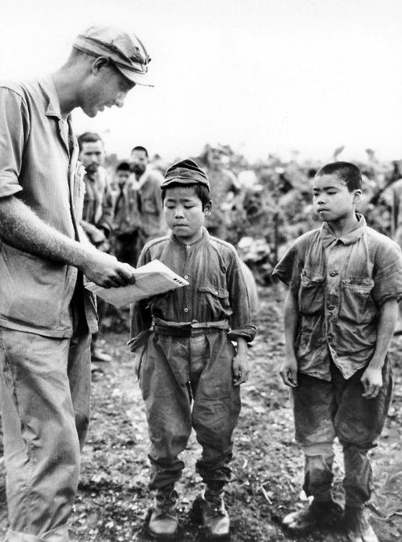
Existential warfare: use of child soldiers

Slide 5
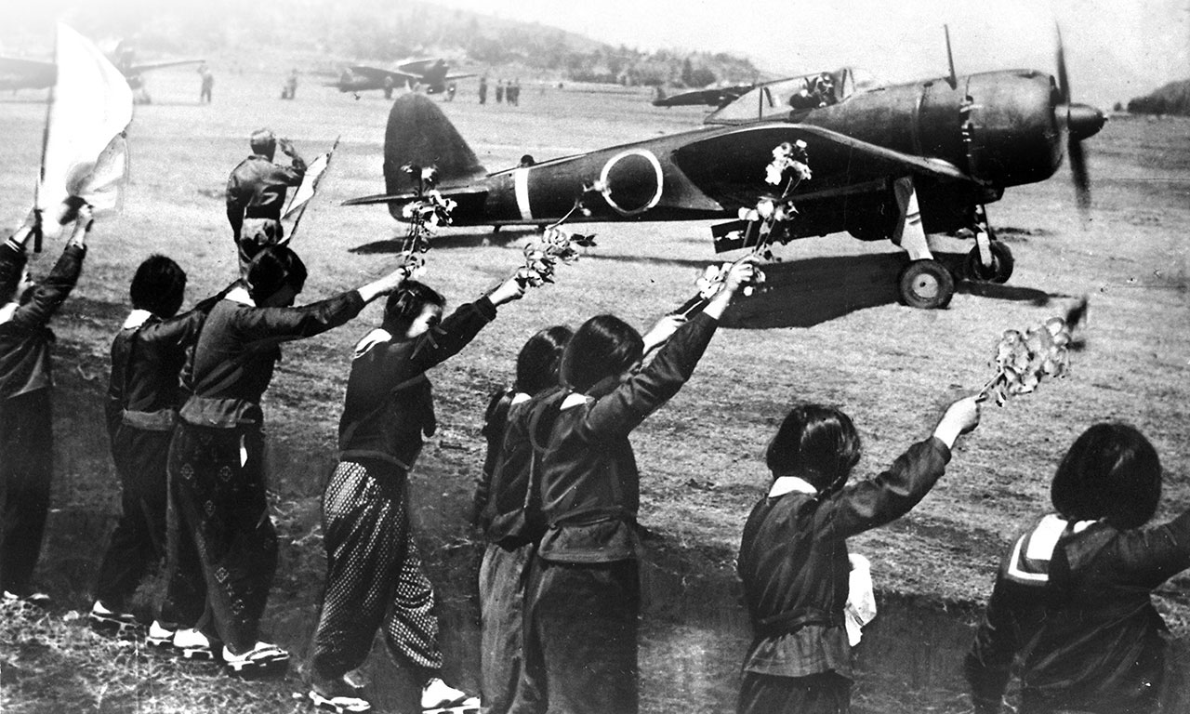
Kamikaze pilots end route to Okinawa

Slide 6
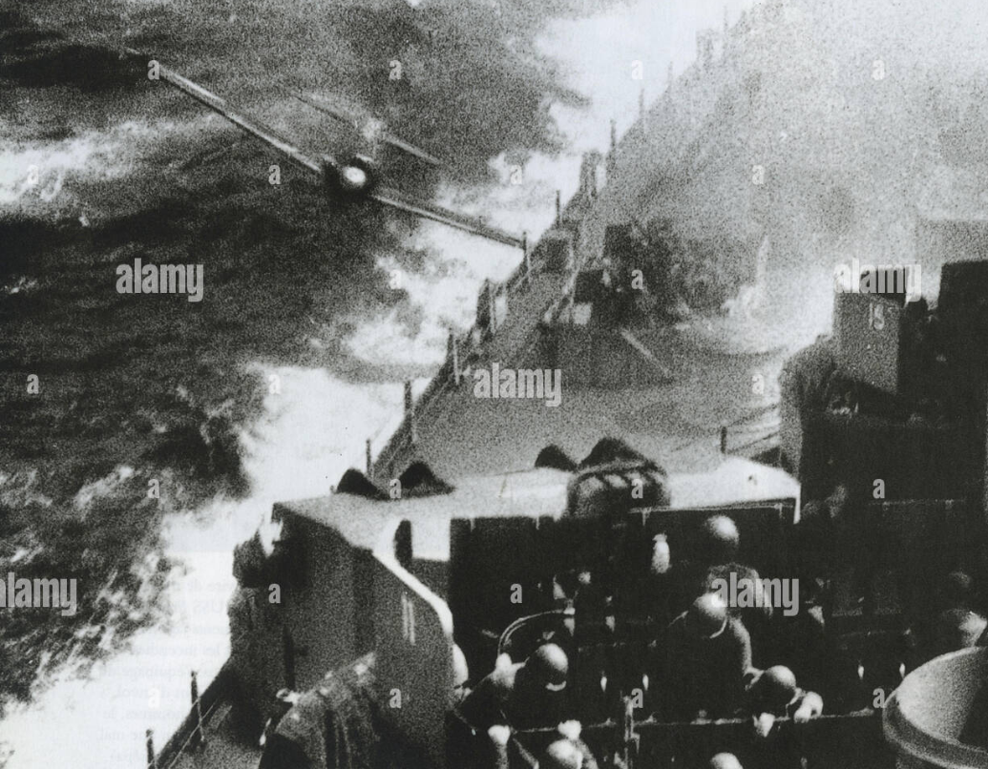
Kamikaze attack

Slide 7
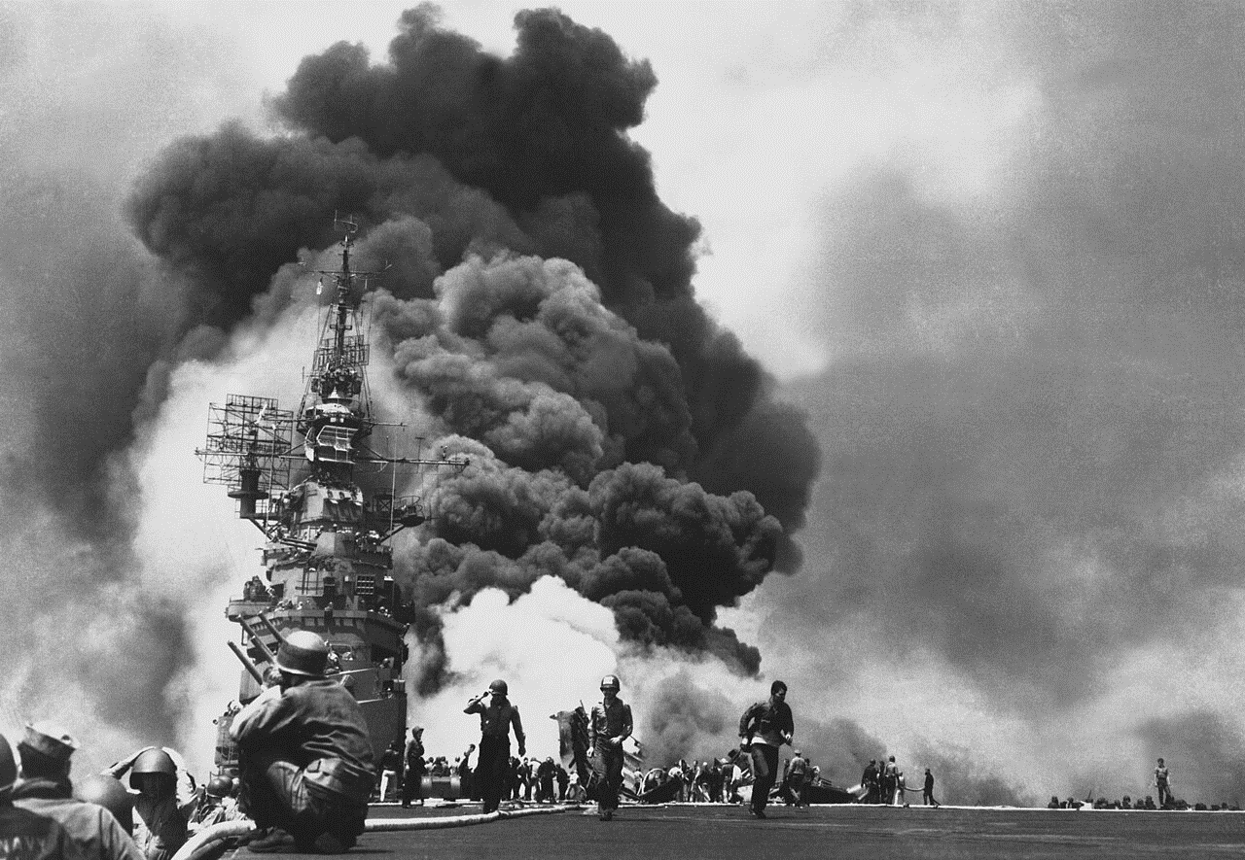
Kamikazes are effective: …8 ships sunk, 400 damaged,

Slide 8
Okinawa aftermath
War becomes a fight to extinction
100,000 Japanese soldiers,(2,000 surrender)
150,000 civilians killed…mass suicides
US lose 13,000 dead, 40,000 wounded ,
Intensification of bombing campaign….objective total destruction
Escalation of brutality

Slide 9
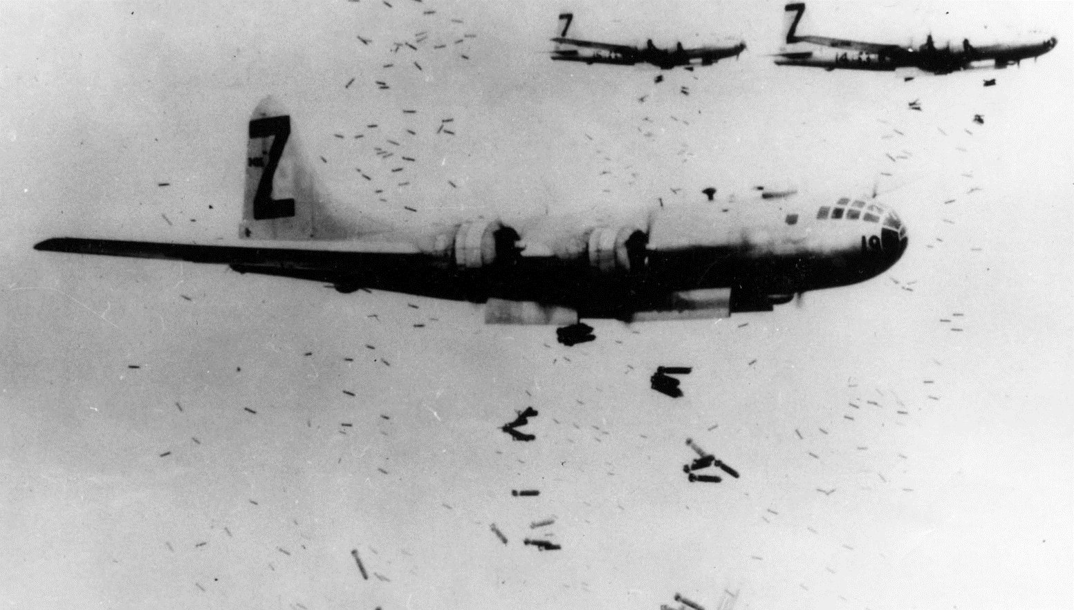
B29 (Super fortress) bombers from China/ Iwo Jima: ………attempts to target factories fail/ city incineration programme …..B29 fly too high for Zeroes to attack

Slide 10
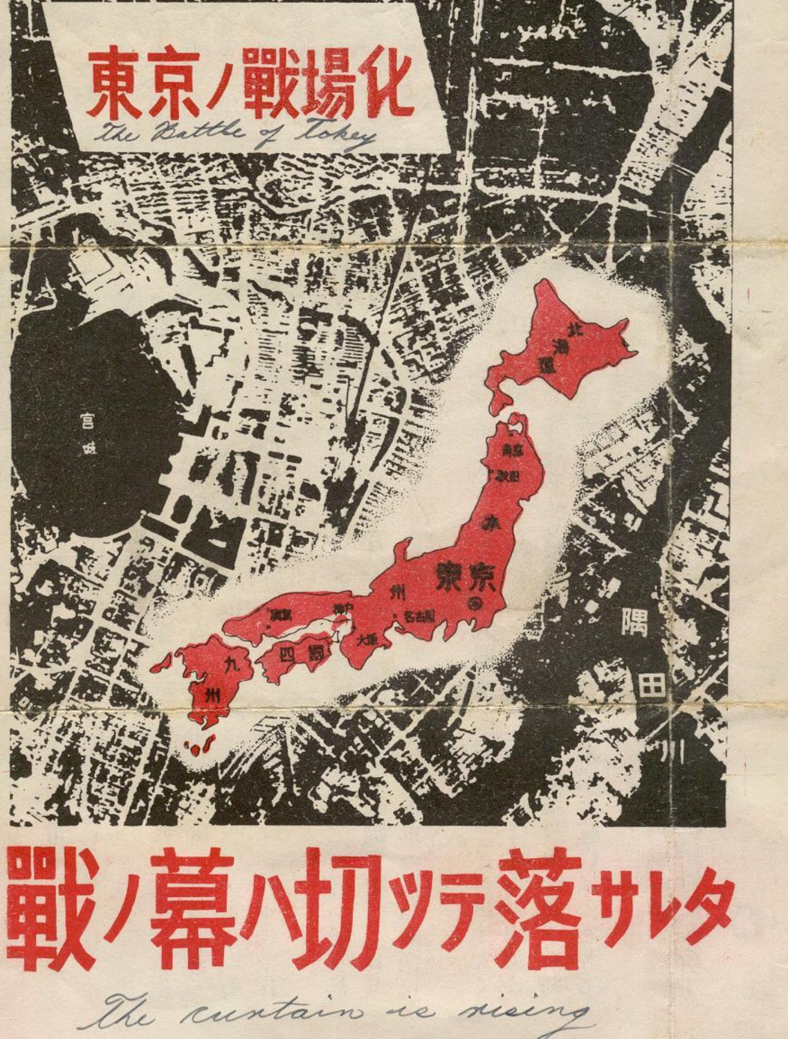
Leaflets distributed….warning ….not believed

Slide 11
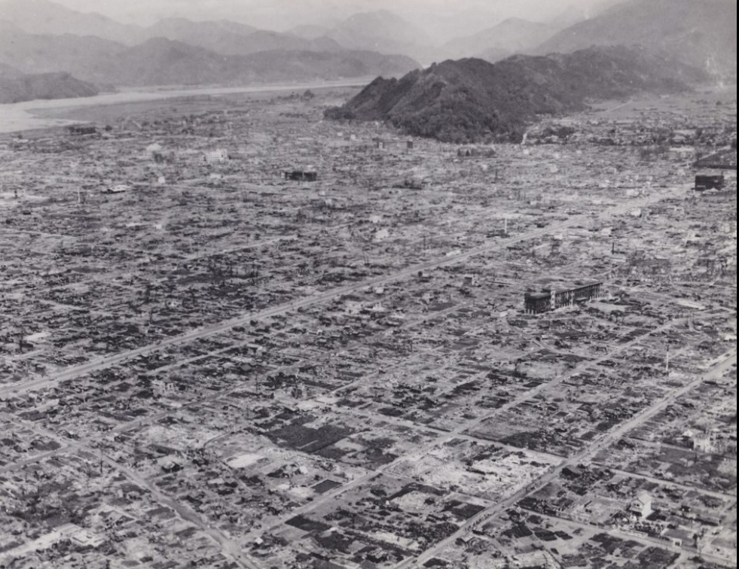
Fire bombing of Tokyo: July 1945 ….all wood city….special designed bombs ….city totally destroyed ,

Slide 12
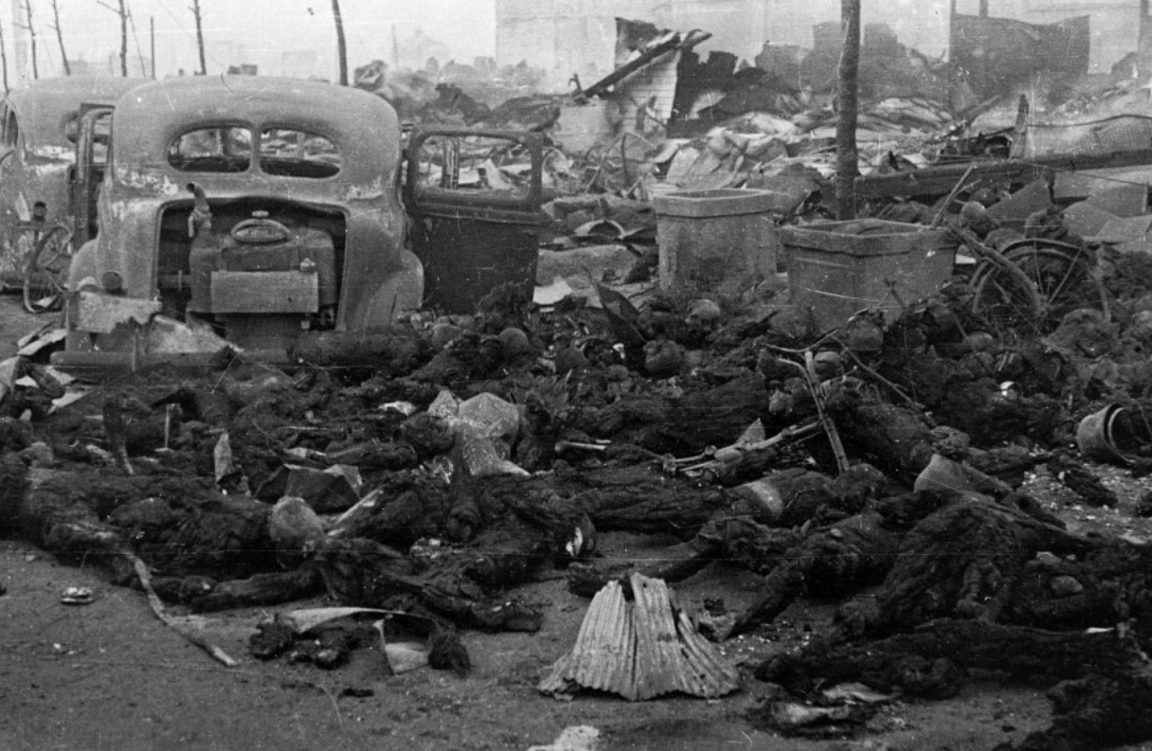
Impact:100,000 killed in one day

Slide 13
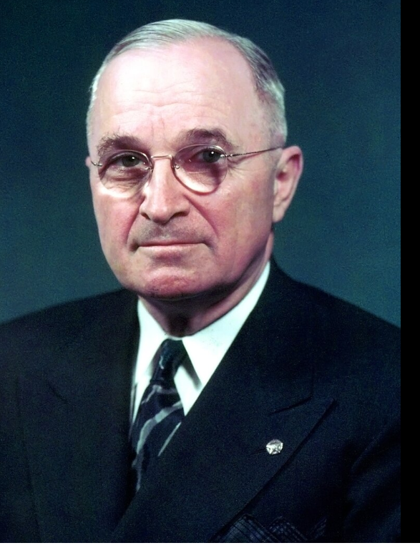
Harry Truman (1884-1972)
FDR dies April 12, 1945
Truman VP for 3 months
…saw FDR twice
Middle class family
Missouri…technical college
….technical college
…small business man
.. Captain artillery ww1
Runs haberdashery post WW!
Local political
Democrat machine
Prendergast “employee”
Senator for Missouri
4th choice for VP
Dept. of Efficiency during WW2
…thought reliable

Slide 14
Manhattan Project 1942-1945
Einstein letter to FDR 1939: warning bomb possible, Germans developing
Research in UK and US begins
1940 University of Birmingham/ Cambridge…prove bomb possible
1941 MAUD committee results shared with US
UK abandons attempt
Shares knowledge….”Lend Lease”
FDR commissions Manhattan project.. US Led
Truman informed about bomb 3 weeks after assuming office
Programme infiltrated by USSR agents….Stalin aware
does not know test due July 1945…Potsdam Conference

Slide 15
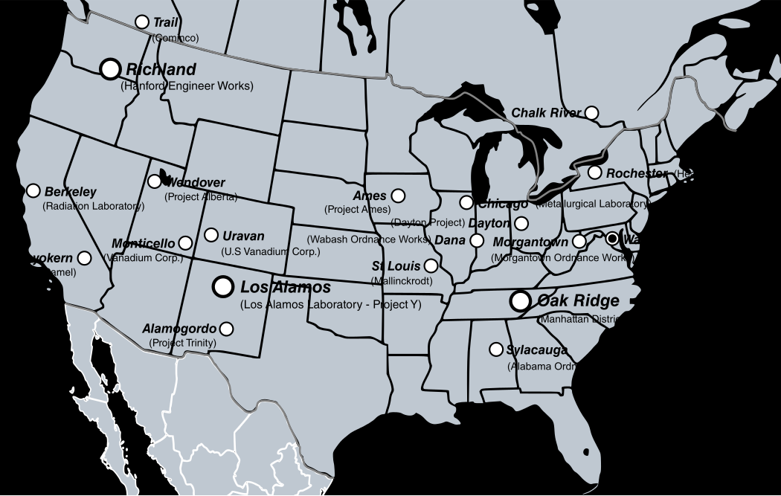
Manhattan project locations …130,000 people, Budget $27Bn (2023)

Slide 16
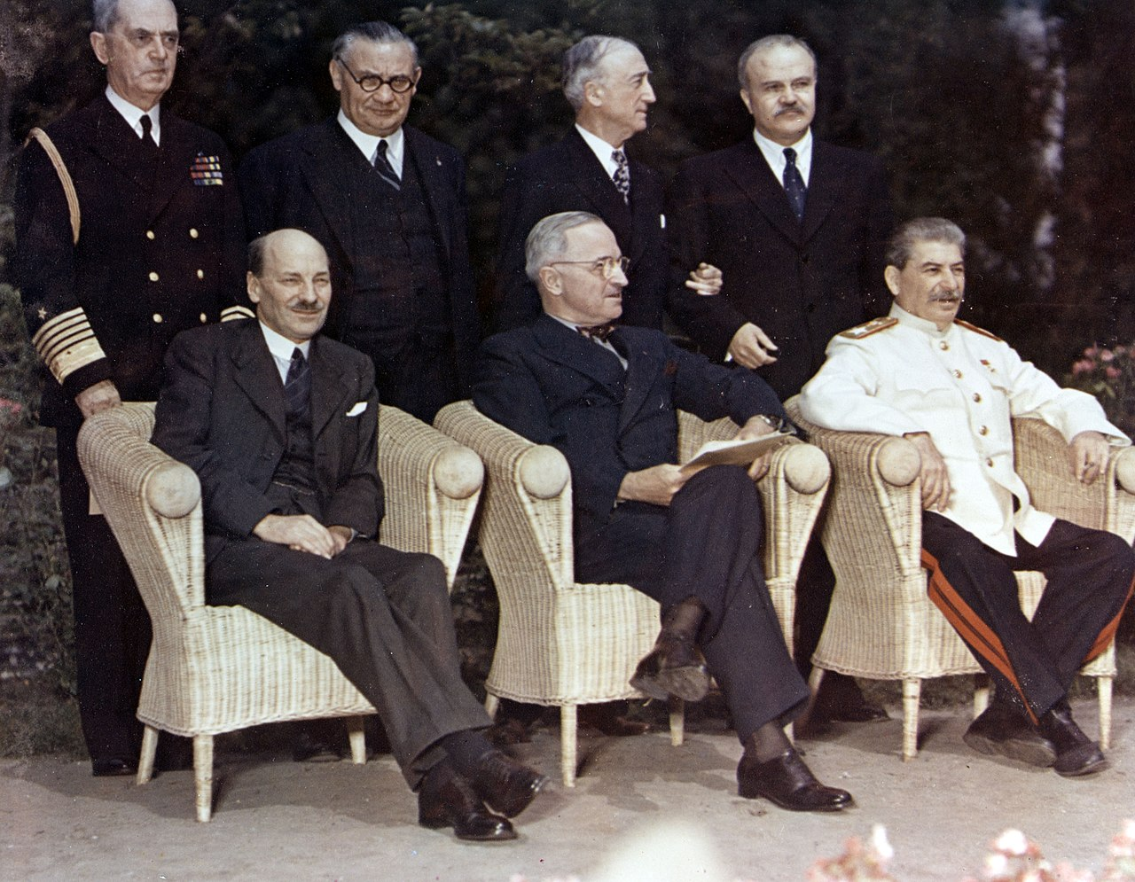
Potsdam Conference July-August 1945 (Churchill, Truman, Stalin) …. Demand unconditional Surrender from Japan…ignored ….USSR to attack Japan …Truman gets results of first atomic test….informs Stalin

Slide 17
Truman decision to use bomb
….Truman diary: “This weapon is to be used against Japan between now and August 10th. I have told the Sec. of War, Mr. Stimson, to use it so that military objectives and soldiers and sailors are the target and not women and children. Even if the Japs are savages, ruthless, merciless and fanatic, we as the leader of the world for the common welfare cannot drop that terrible bomb on the old capital [Kyoto] or the new [Tokyo]. He and I are in accord. The target will be a purely military one.“
Influences on decision:
(1)Invasion of Japan expected 500,000 allied, 1-5 million civilian casualties
(2) 2 bombs available…..fear one would be dud….
(3) Use of demonstration rejected…..only use on city would force surrender

Slide 18
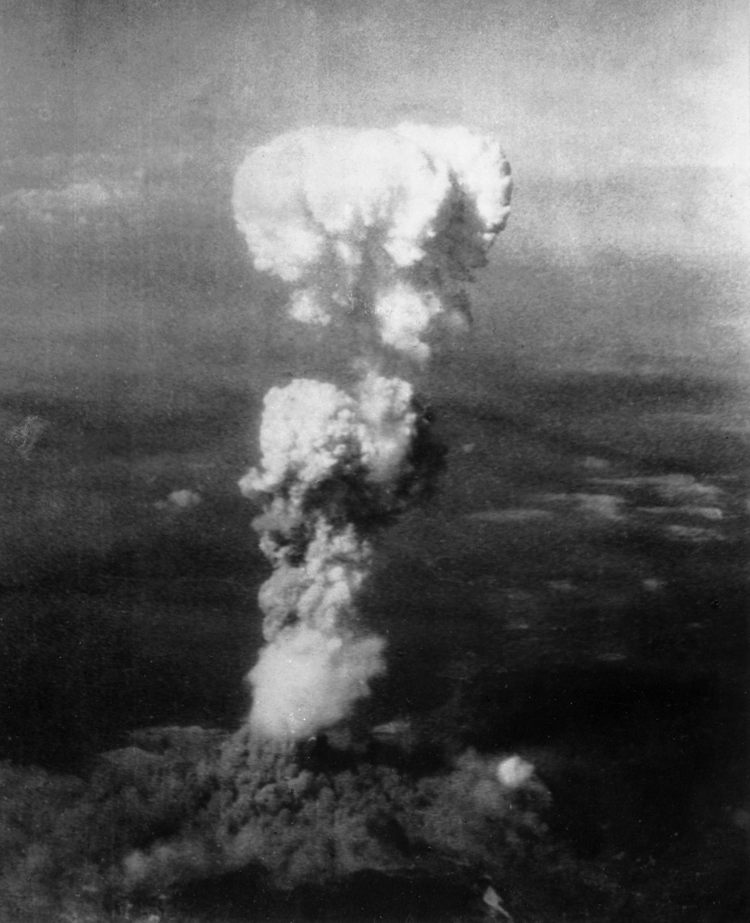
Hiroshima/ Nagasaki
Hiroshima bomb August 6
166,000 die by year end (10,000 soldiers),
Nagasaki bomb August 9th
85,000 civilians
And 800 soldiers

Slide 19
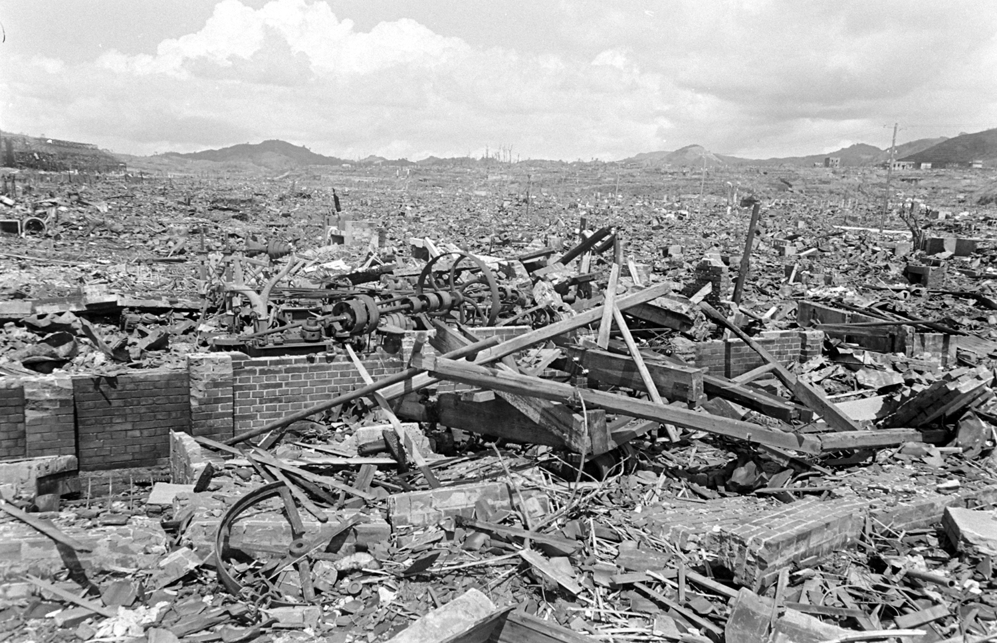
Hiroshima after

Slide 20
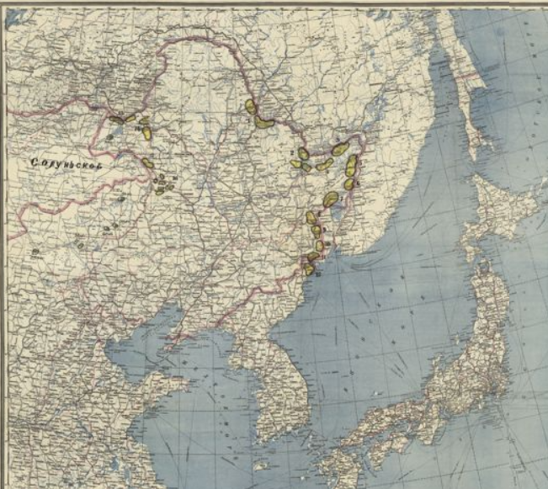
USSR Invasion of Manchuria
Invasion same day as Nagasaki
bomb
USS$ 1.5m overwhelm 1m
Japanese..5x planes & tanks
Advance to 38th parallel Korea
….threaten Japanese mainland

Slide 21
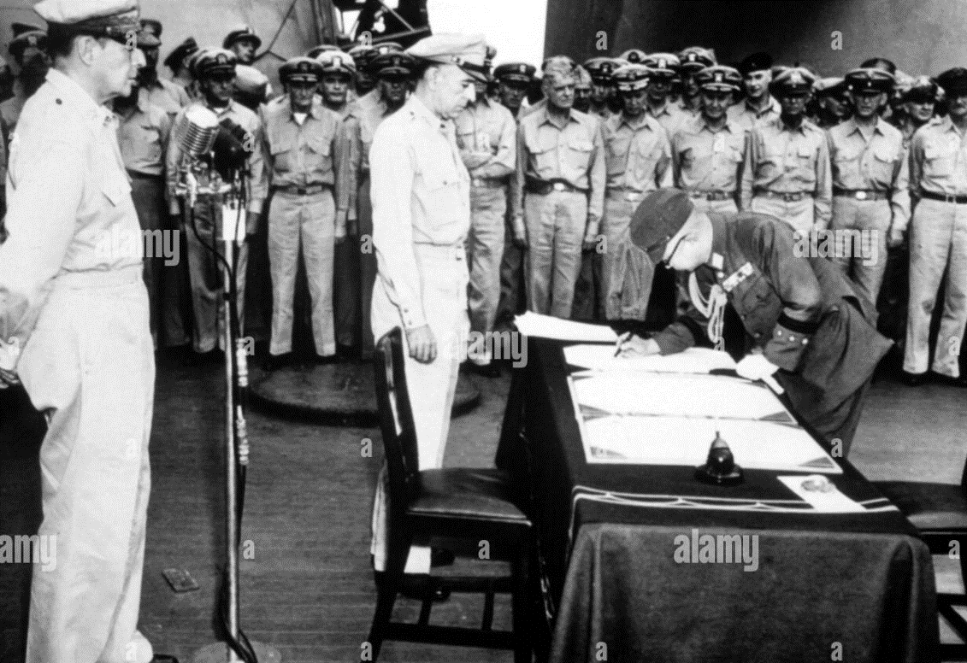
Japanese Surrender on USS Missouri …Macarthur watching

Slide 22
World war is over, much of world in ruins …will Versailles be repeated ….or a new world order created
Next Talk Monday March 3rd …Post War World

