Slide 1
US “invasion” of Britain

Slide 2
The American’s Arrive
 | US Milititary @mid year | Principle Roles
1942 | 150,000 | Naval Support, Airfield development
1943 | 300,000 | Airforce personnel
1944 | 1,500,000 | Invasion of Normandy
1945 | 250,000 | War wind-down/ Post war world

Slide 3
Opportunities/ Challenges
To British Public
Resentment over pay ( US private earned $50 a month…$1,000 per month …..£800 per month (2025..British £145
Upheaval
British army men overseas
Americans different, wealthy, fun, and here ( 60,000 British brides, 10,000 babies
Racial mixing….black soldiers welcomed (mostly) . 2,000 mix race children…marriage forbidden
To Americans
Exposure to different culture..isolated
Welcomed…..creates generation interest in world
Black Americans (200,000) segregated, logistical jobs..exposure to non segregated world.

Slide 4
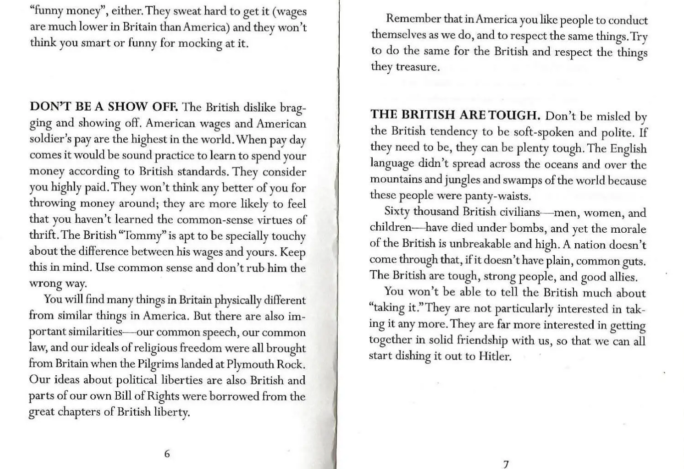
Training manual for US troops to avoid friction …don’t be a show off, or underestimate

Slide 5
The “Jim Crow”
African Americans
150,000 African Americans in UK…support roles, construction, logistics
US army imposes segregation on and off basis
British attitude
Total non white population UK 1940’s ….10,000….along coastal towns
Racial attitudes adopted in colonies not present in UK
African Americans more polite, different fun
Consequences and impacts
2,000 mixed race children… fathers not allowed to marry (mix race marriage illegal most US states)….1,000 fostered after war
British generally adjust to US imposed Jim Crow laws
African Americans profoundly influenced by kindness and acceptance…future civil rights leaders

Slide 6
“Battle of Bamber Bridge” 24th/25th June1943
Pub used by black Logistical company…mix with locals
Ye Olde World Pub”
US white officers attempt to
Impose segregation
…public posts “Black only served”
US MP’s (all white) attempt arrest black soldiers
,,,gunfight. 1 killed, 7 wounded
…threaten mutiny
US military arrest mutineers
…light sentences
…white mp’s discharged
Integrated police force introduced
Bamber Ridge…exception.. Most
Often US rules prevailed.

Slide 7
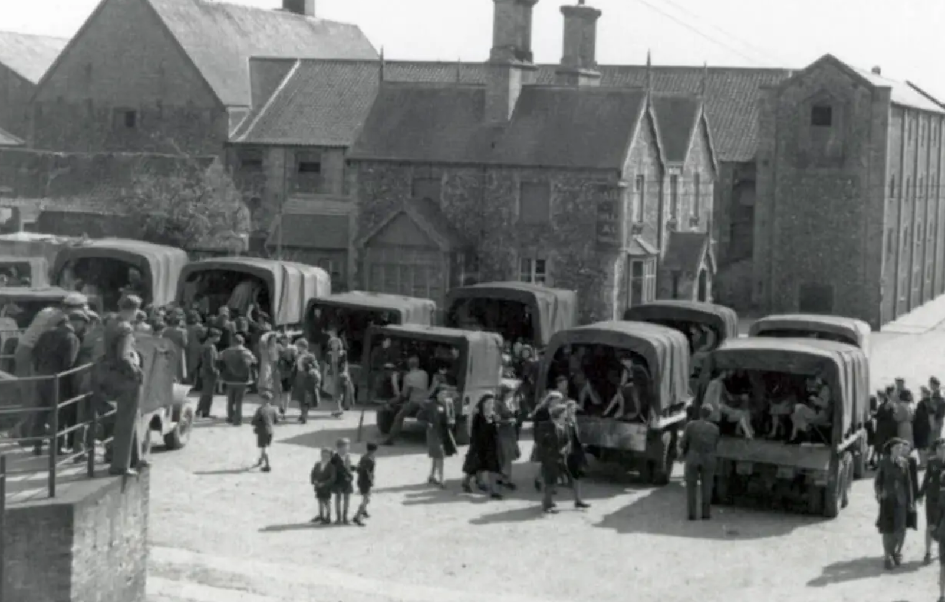
The Saturday night dance…Norfolk 1944

Slide 8
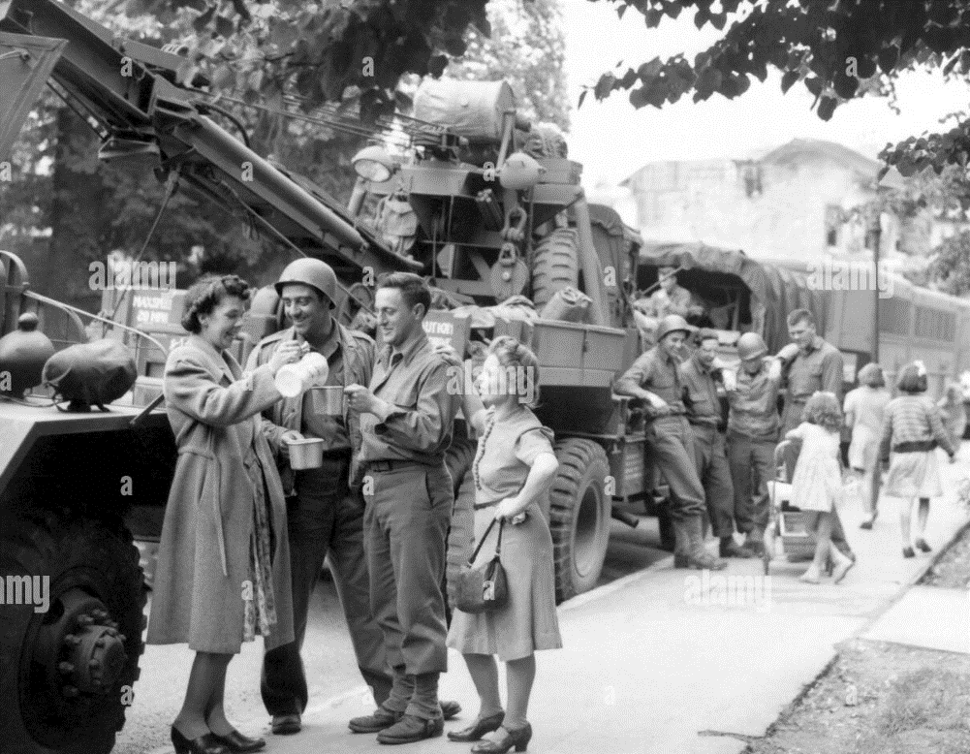
Greeting the troops

Slide 9
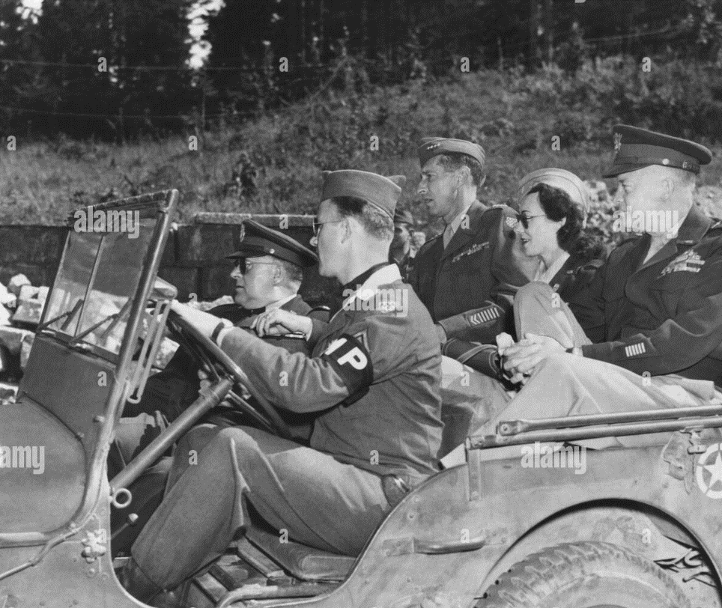
Kate Summersby and Eisenhower
Irish born..moved to England
Ambulance driver during blitz
Love affair British major
Chauffer Secretary Eisenhower1942-1945
…blames Ike when major killed in Tunisia
.. ike takes her to Palestine
.. rumour asks commander to marry..denied
Rumours of affair…but not ubstantiated
….intimate “friends”
…Ike infatuated…
Kate seeks US citizenship post
War..married, divorced, writes
Memoirs…coy

Slide 10
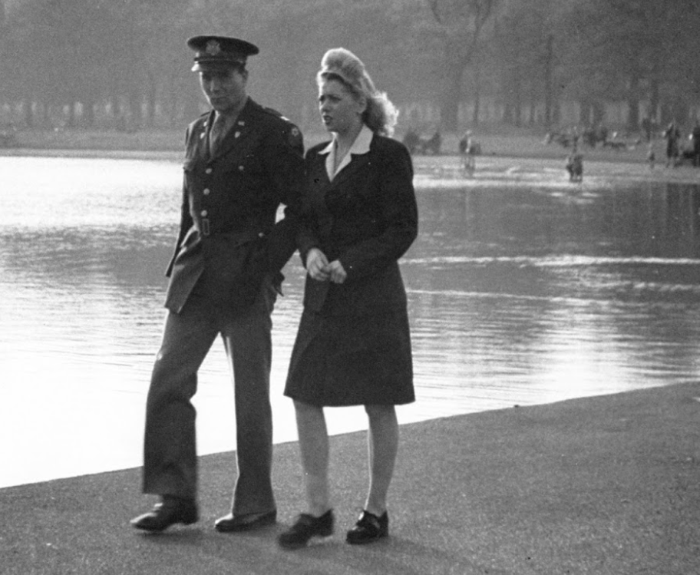
Romance at a difficult time …many will not survive and return in months to come

Slide 11
White cliffs of Dover (Vera Lynn)
There'll be bluebirds over The white cliffs of Dover Tomorrow, just you wait and see
There’ll be love and laughter And peace ever after Tomorrow, when the world is free The shepherd will tend his sheep The valley will bloom again And Jimmy will go to sleep In his own little room again
There'll be bluebirds over The white cliffs of Dover When the world is free

Slide 12
Intermission

Slide 13
Strategic Bombing Campaign 1942-1944

Slide 14
Birth of Strategic bombing 1939-1940
“Strategic versus “Tactical” bombing
Tactical ---bombing of military forces only “Just War Theory”.
Strategic --- 1930 “industrial web” war shorten by destroying industry
First wave
Germans bomb civilian targets Poland
Rotterdam May 14th 1940 ..1,000 killed…propaganda claimed 100,000
British attack on Ruhr industrial ….inaccurate
From Tactical to Strategic bombing
German attack airfields June- July …attempt to limit casualties….inaccurate
British bomb Berlin August 1940---40 killed
Hitler authorises Blitz on Britiain September 1940 – May 1941
British retaliate……develop first heavy bomber Avro Lancaster

Slide 15
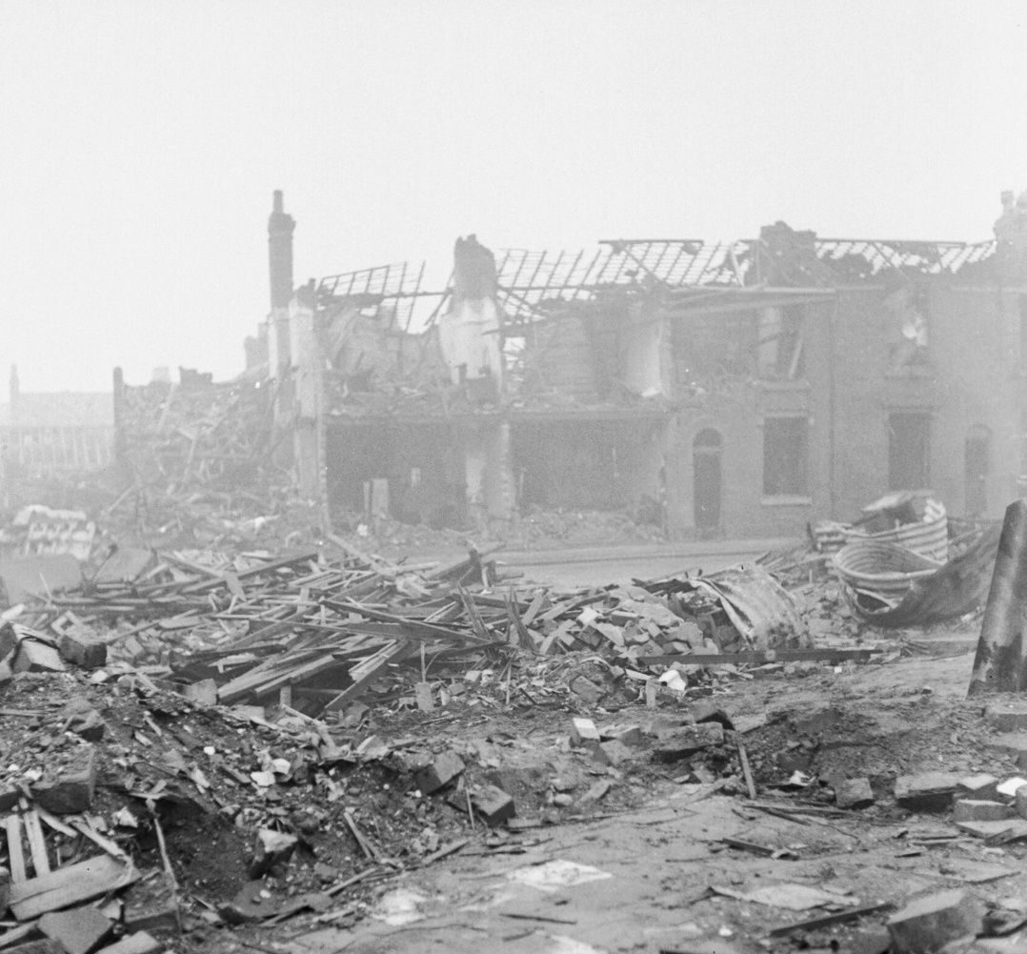
Blitz July 1940 –May 1941
Germans target “industrial”Areas….break military capacity & will to resist
…50,000 killed by 194
Birmingham May 1941
Impact “improve morale”
Limited military impact
…...inaccurate
….lack of heavy bombers
British adopt “de-housing”
industrial workers strategy September 1941-1943
…

Slide 16
Adoption of “strategic bombing”
Study commissioned to assess bombing effectiveness
1 in 3 bombs land within 5 miles of target
Loss of 10% bombers each raid due to German fighters…day raids abandoned
Heavy bombing capability introduced ( Avro Lancaster 1942)
Heavy bomber, up to 10,000KG, crew 7, 4 machine guns
revert to night time raids..loss rate reduced to 5%by 1944
Night raids only strategy by end 1942
Improved accuracy Gee Navigiaon and radar…40% bombs ½ mile radius
Focus on large industrial areas and cities
2,000 bombers operational 1944

Slide 17
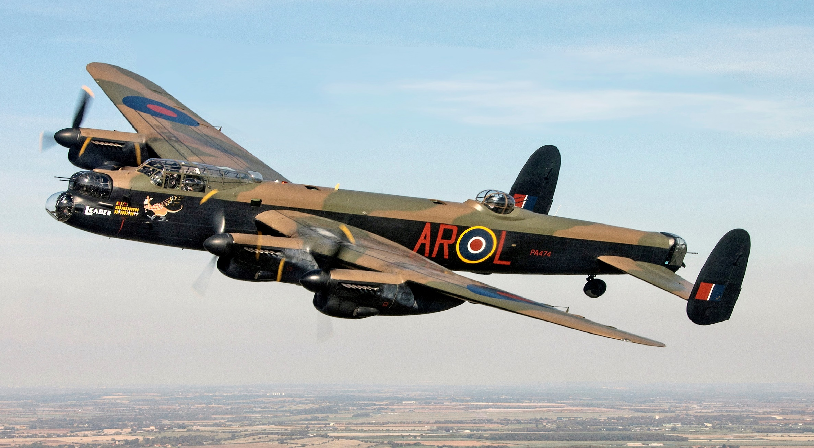
Avro Lancaster: British heavy bomber..1942 …up to 10000 kg, crew 4, 4 machine guns

Slide 18
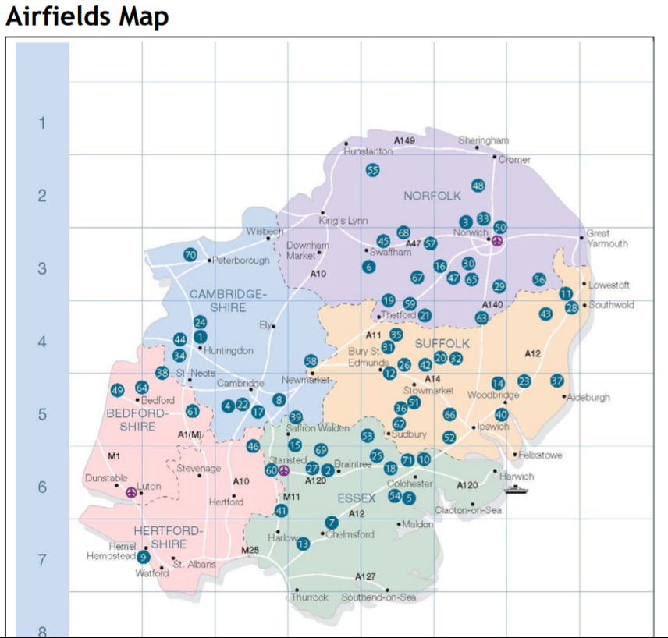
US Airforce arrives 1942…. ..Airfields built 1942…300 bombers by end year ….350,000 air staff by 1945
Bomber a “fortress”
B17…12 m/c guns,12 crew
9Kg payload..vs 10Kg Lancaster
Mass formations
Day raids
..confidence in defence

Slide 19
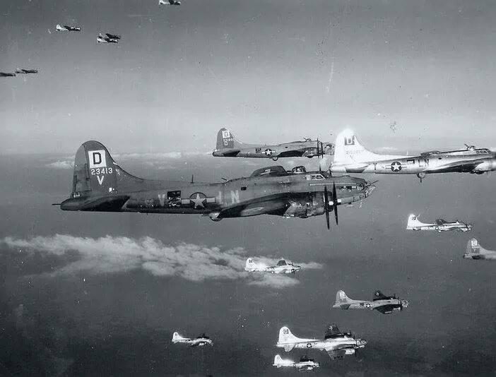
B17 Heavy bomber…in formation

Slide 20
USAAF 1942-1943
Norden sight finder
$1Bn investment (2023$) ..extensive training..30% cost plane
Claimed Accuracy ..artificial “test conditions”
…20% bombs within 1,000 feet of target: 3 x accuracy of British (40% bombs
within ¼ mile target …close enough for “strategic” bombing
German fighters break “mass formations)…US 6
Fighters from UK cannot reach target with bombers
Second Schwienfurt raid October 1943---350 bombers…77 lost + 3 fighters (Germans lose 35 fighter)
Day raids abandoned….
All changes with introduction of long range Mustang..early 1944

Slide 21
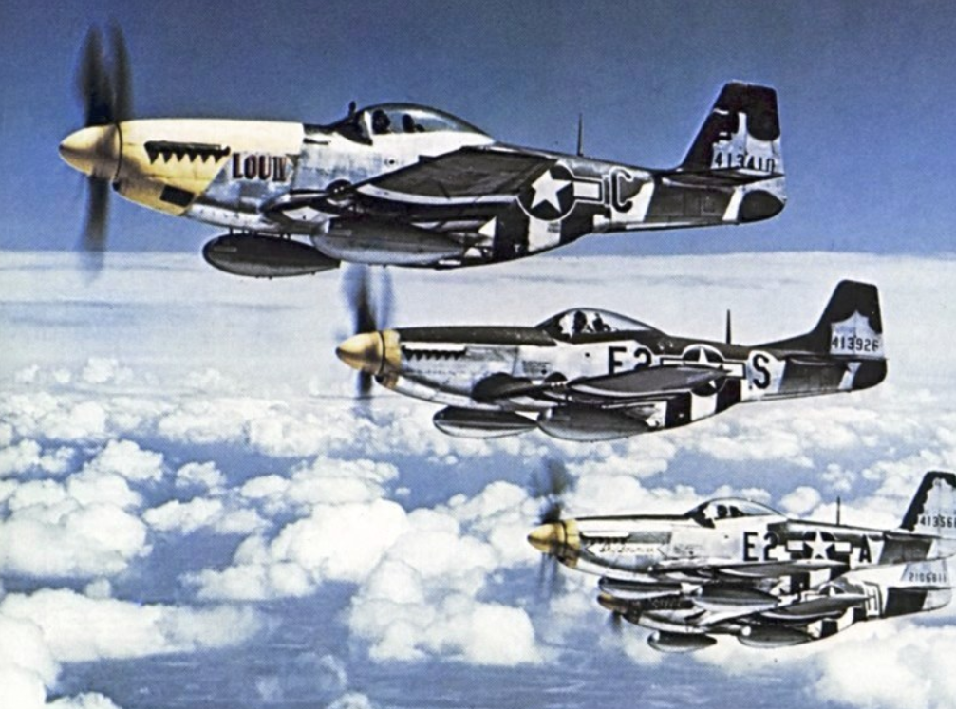
Mustangs1944 …..loss rates decline to less than 2% ..air war won

Slide 22
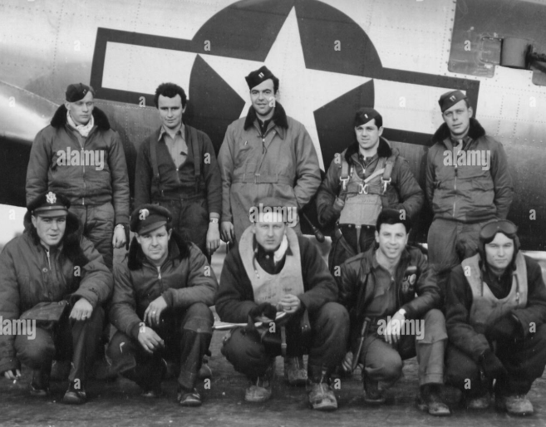
US bomber crew

Slide 23
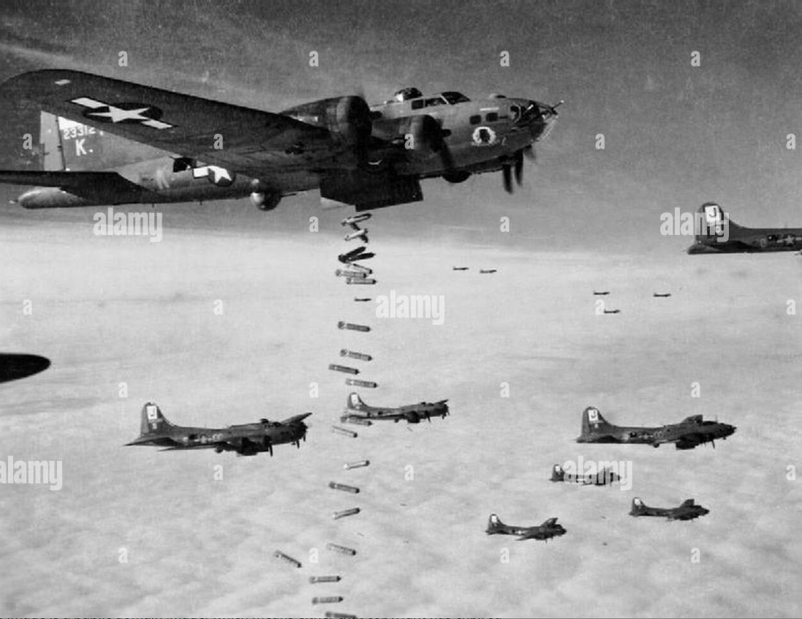

Slide 24
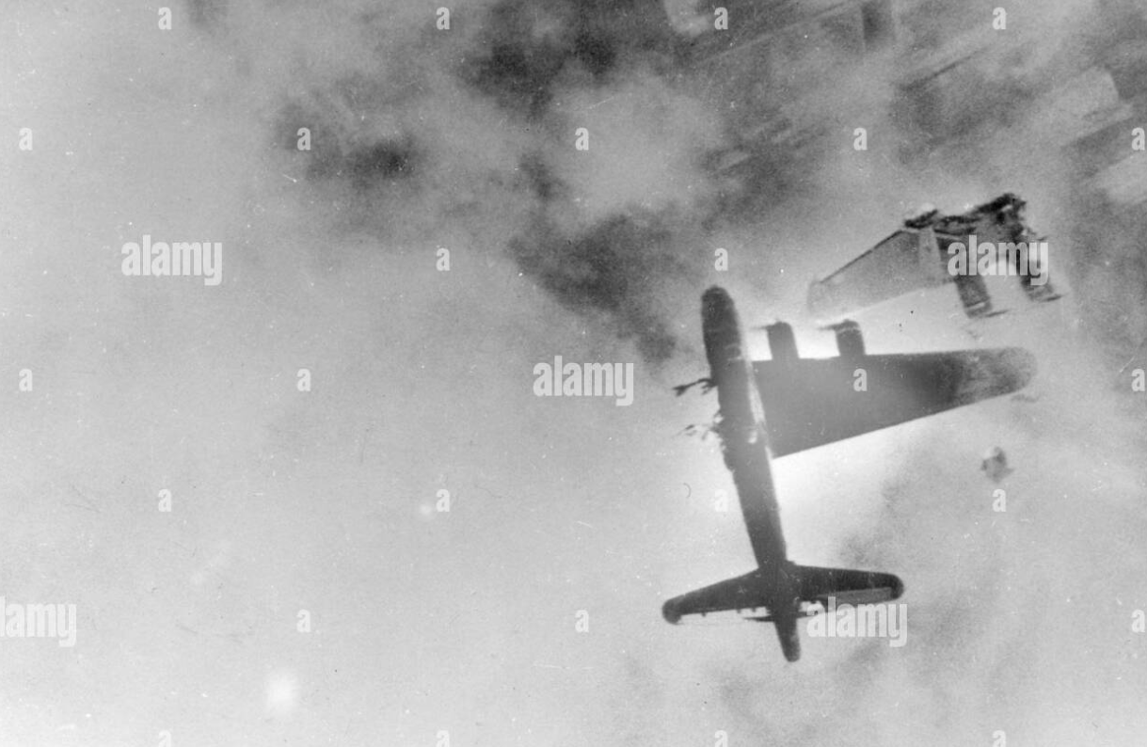

Slide 25
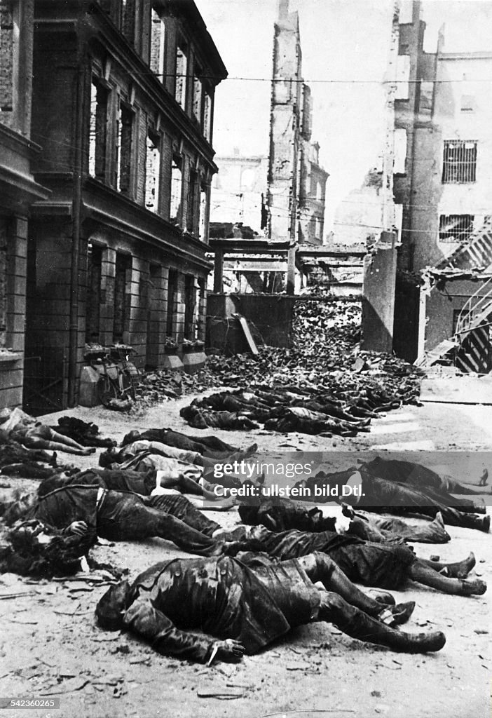
Hamburg 1943 Military and shipping target 75% city destroyed, 60,000 killed

Slide 26
Strategic bombing cost and impact
German Industrial Capacity diminished…but not by much till 1944
Production prevented> destruction
Deprived army of fighter support
Population morale sustained till end of war
German population
600,000 civilians killed, 7,500,000 made homeless
Major Cities reduced to rubble: Cologne 60%, Hamburg 75%, Dresden 6% Berli n 33%
High casualties
26,000 US Airmen,55,000 British (more raids, accidents, less protection)
15% US, 50% UK bomber crews lose lives

Slide 27
Invasion of France

Slide 28
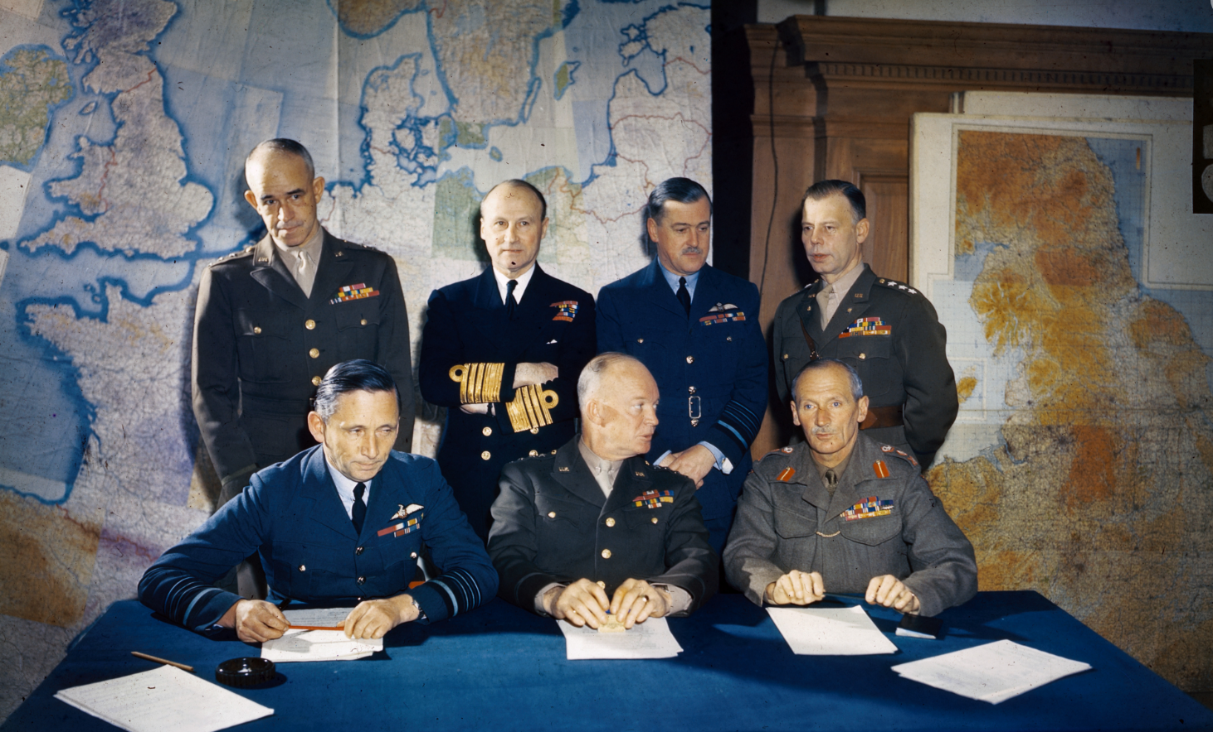
February 1944… Planning begins in earnest …Eisenhower overall commander, Montgomery landing operations

Slide 29
Preparations
Decision to invade made after Tehran Conference…Italy campaign “stuck”
Normandy chosen location: beaches, lack of canals, rivers, space
Decoy army (1st Army Group”) established under Patton….
South Devon evacuated
Training intensified
6 week arial bombardment along total coast…26,000 French civilians killed

Slide 30
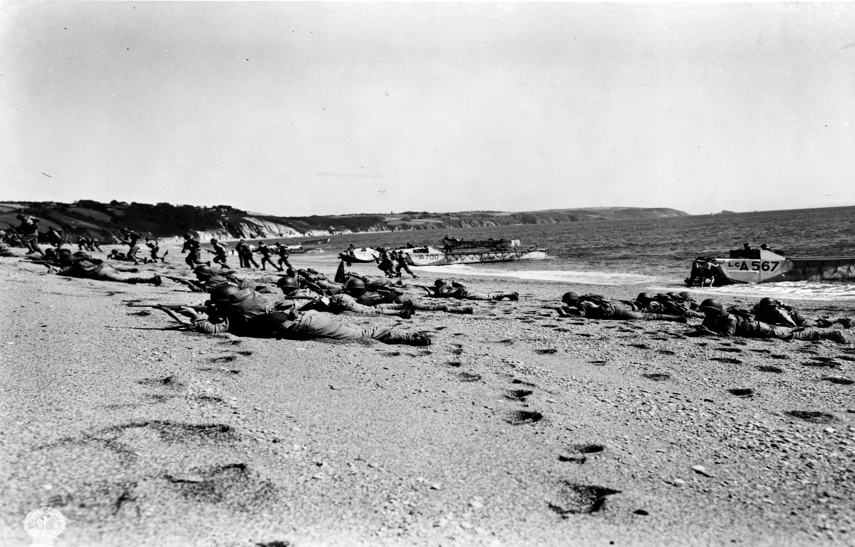
Operation “Thunderbolt Slapton Sands Disaster April 27th, 28th 1944
D day “dry run”
Test landing…live fire ahead of soldiers
April 17th test landing
Timing changed.
Bombardment not
…450 soldiers killed
German e boats alerted…intercept landing craft..750 killed
10 missing officers,
,,,D Day On hold
…till bodies found

Slide 31
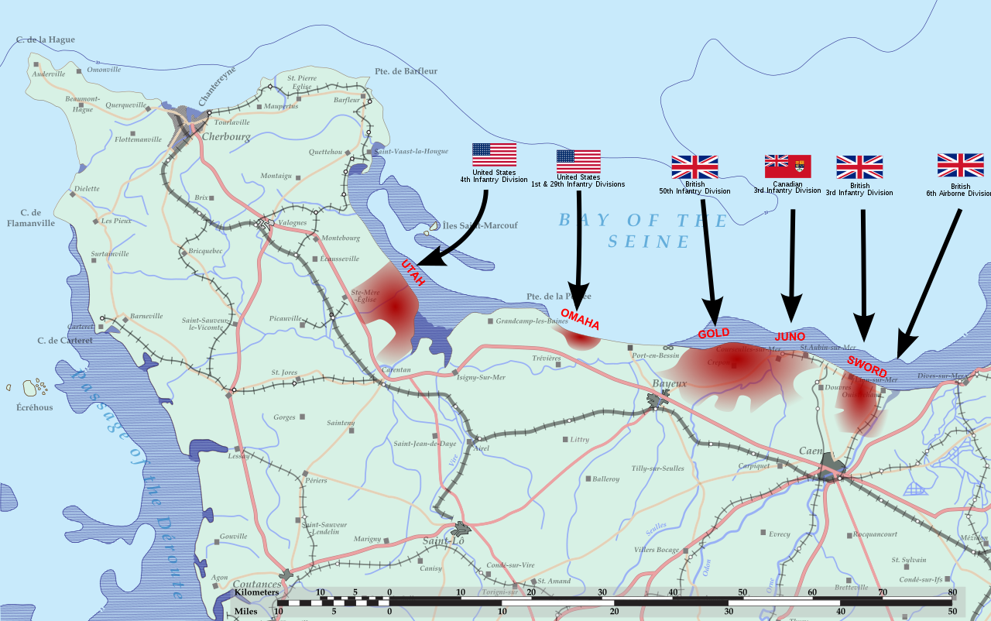
D Day: June 6, 1944 160,000 soldiers, 5 battleships, 10 cruisers, 65 destroyers …4,000 landing craft. 1,500 support vessels+ 2,200 aircraft

Slide 32
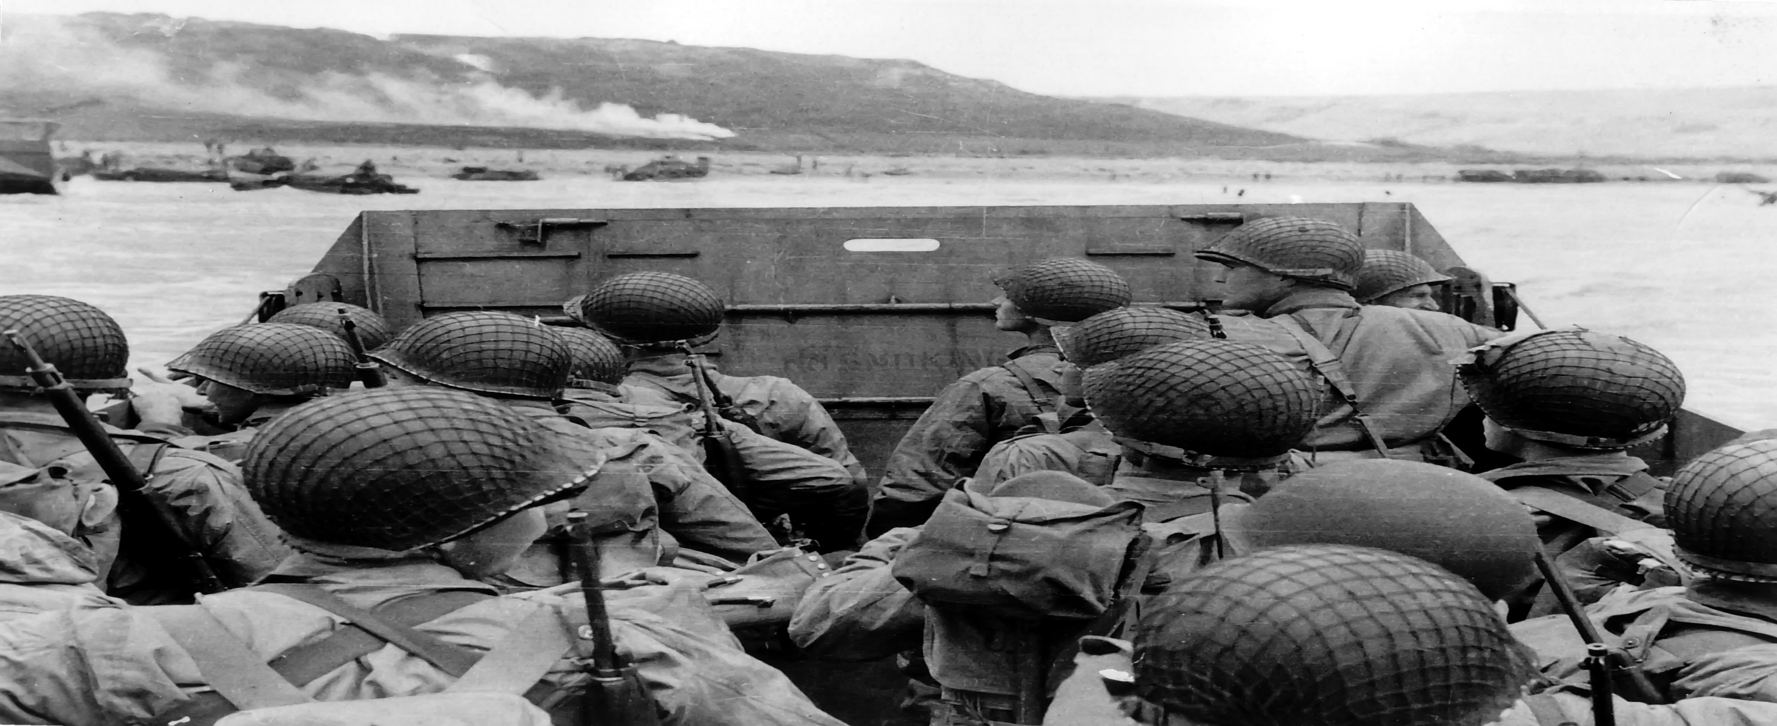
Omaha Beech….6,000 killed, wounded or missing, 65,000 soldiers landed (4,000 on other landings)

Slide 33
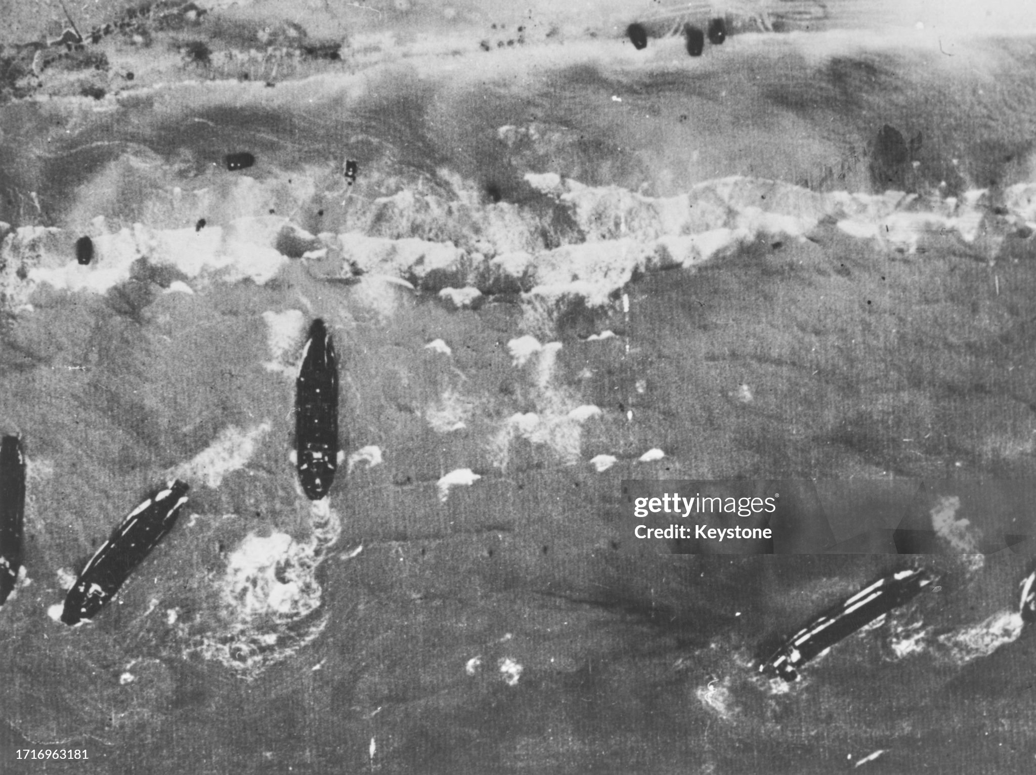
Arial View

Slide 34
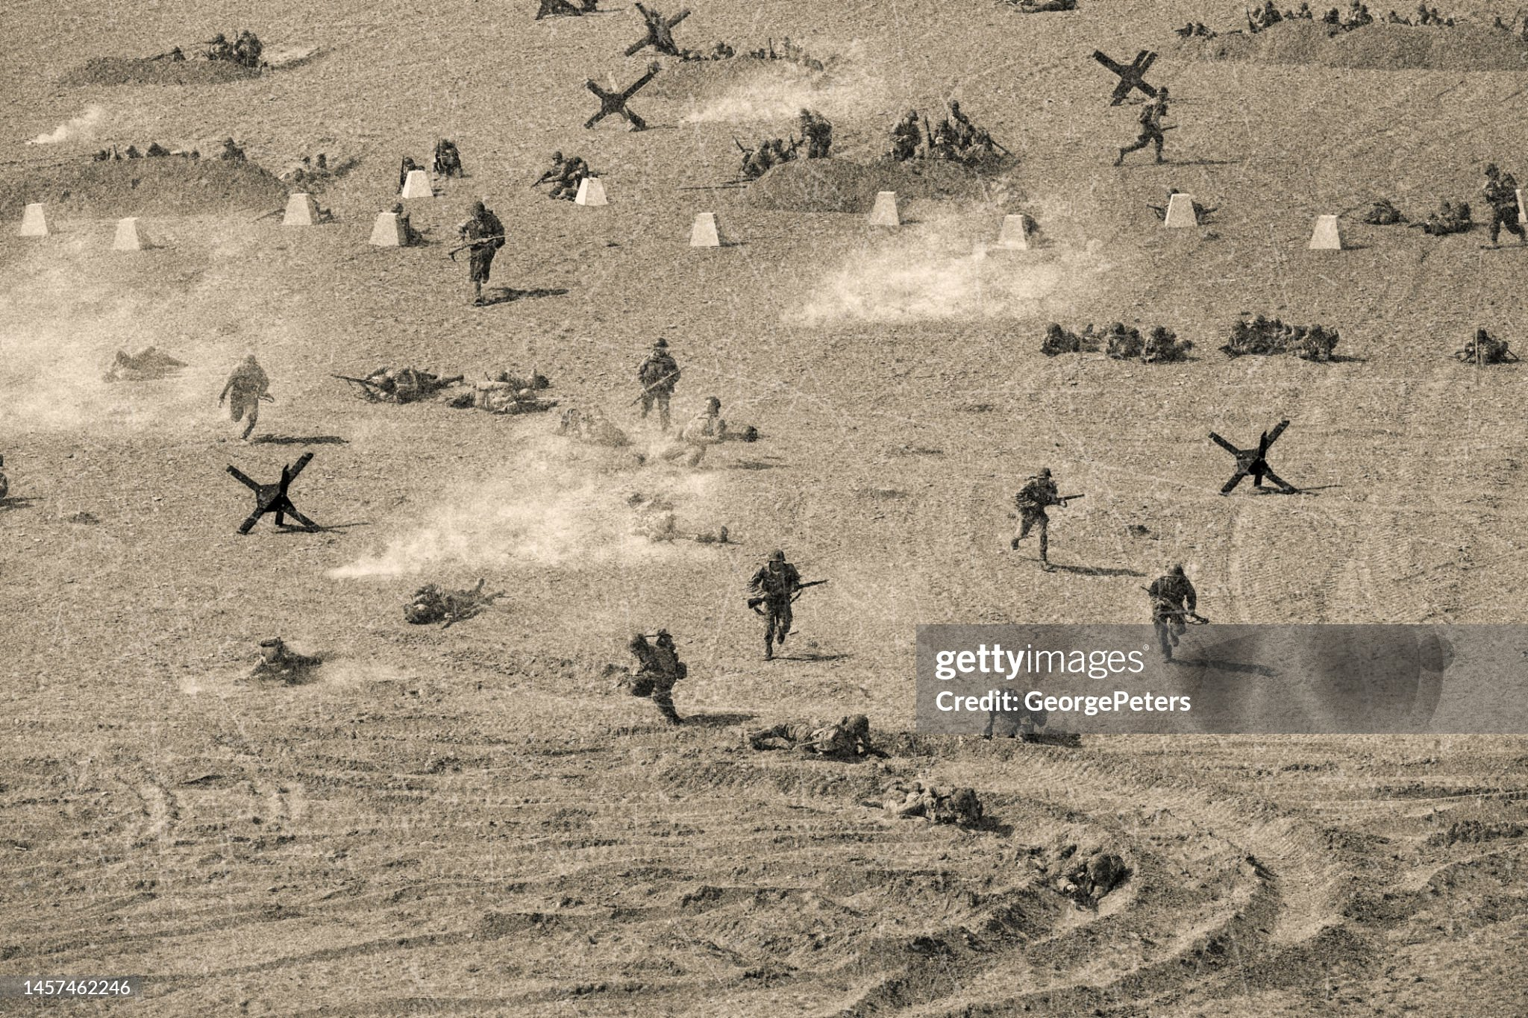
On the Beach

Slide 35
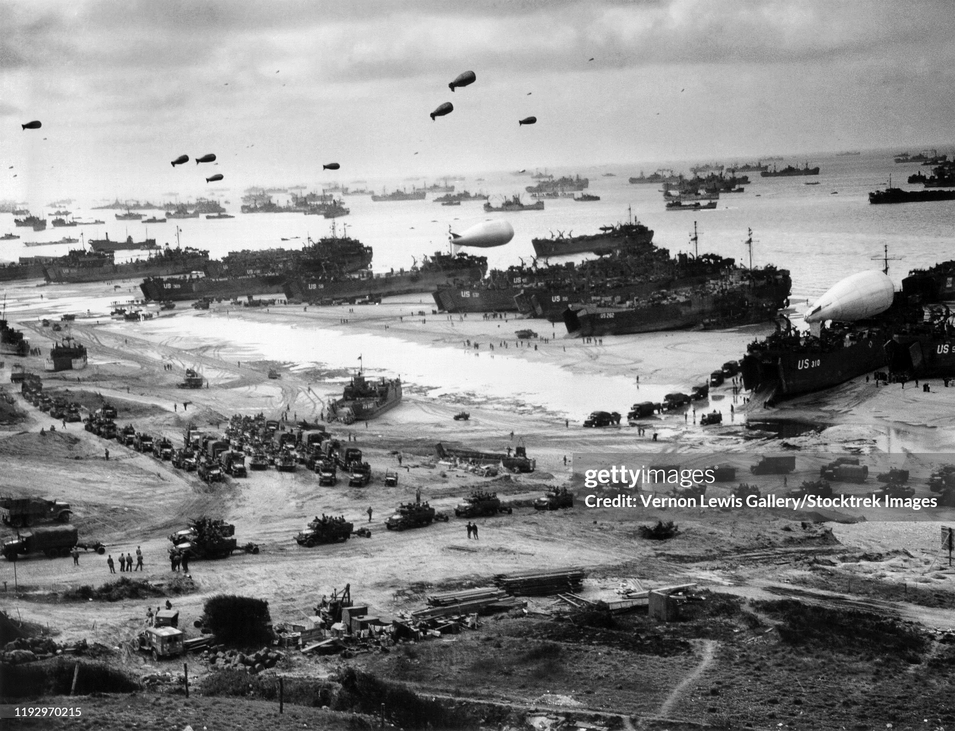
D Day plus one: beaches transform to logistic hubs

Slide 36
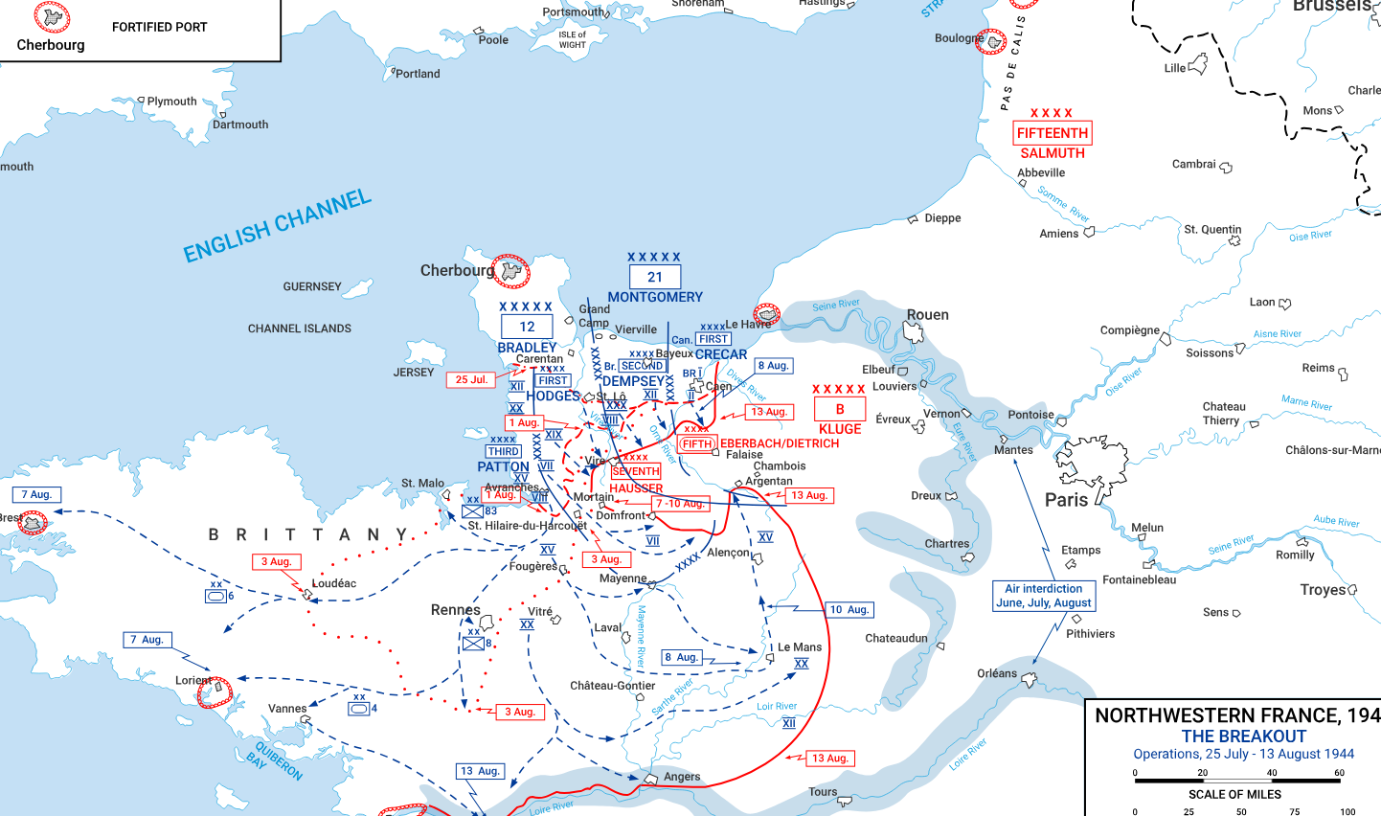
Normandy Campaign June -July 30th Allied army rises to 1.5 million (Germans 400,00)
June- July
British/ Canadians
…blocked
…capture Caen July 9th
1
3
1
US Break out to South and
North…capture Cherboug
2
2
German panzer attack on
British, Canadian
…repulsed
3

Slide 37
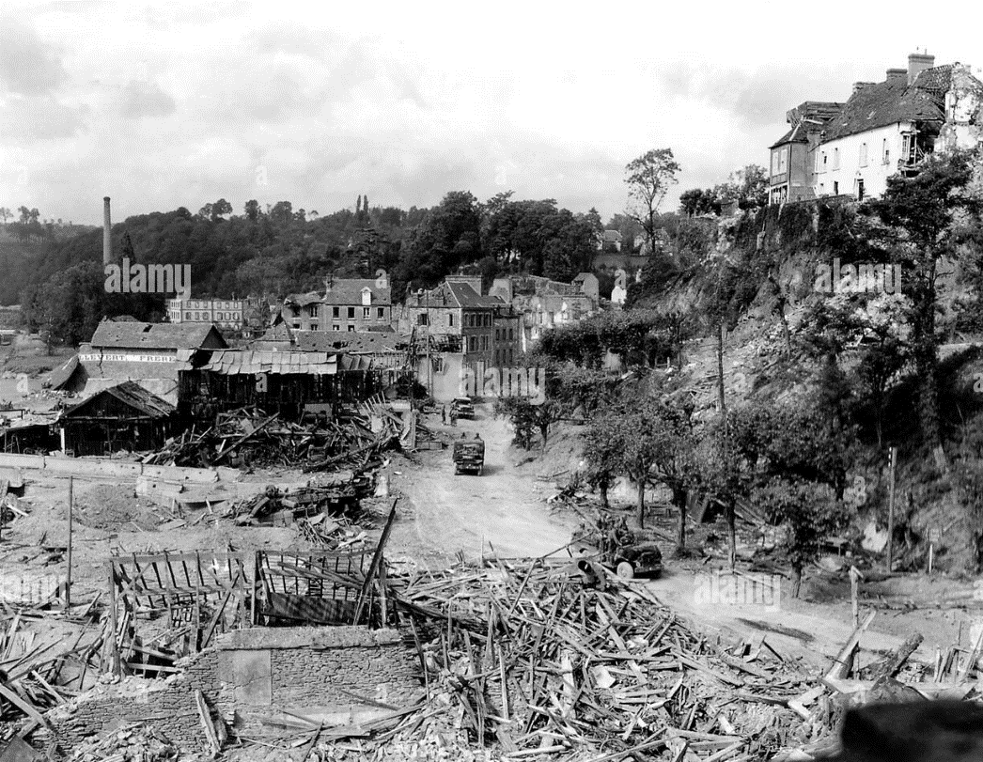
Route to Caen

Slide 38
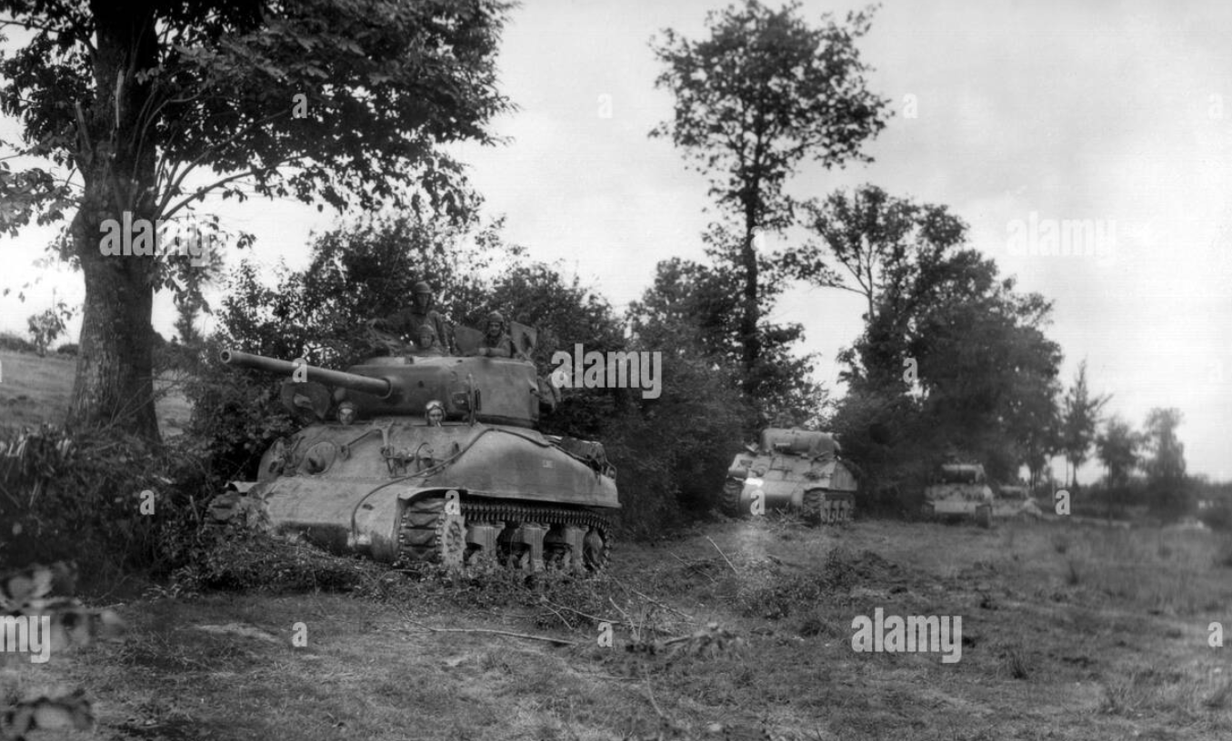
Tanks along the hedgerows

Slide 39
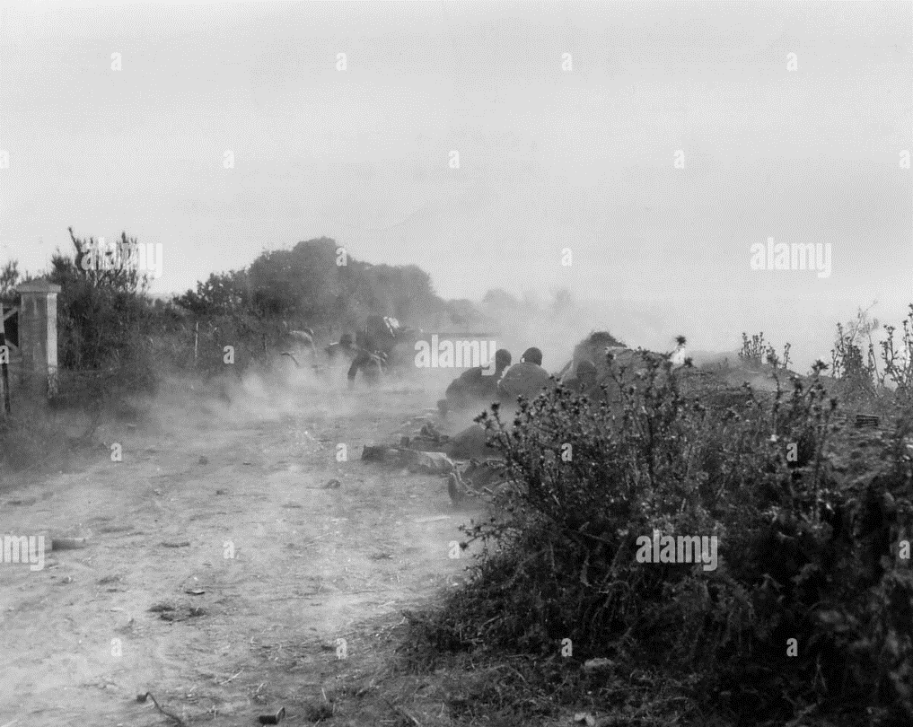
Hedgerow fighting

Slide 40
Normandy campaign August 1944 allies 2.4 million (1.4m US) vs 600,000 Germans
General assault
…British to Caein
…US East from St Lo
1
3rd US army formed
..Patton command
…attack Brittany
…turn east to trap Germans
1
2
2
Germans either trapped or
retreat
3
3
…Germans retreat to border Paris liberated August 25th

Slide 41
Normandy Campaign
Second Front started and secure
Bloody campaign, not one day event
Allied Casualties 226,000 (10,000 first day)
British 65,000,Canadian 24,000,American 125,000 (11,000 killed)
19,000 airmen lose lives…..as do 26,000 French civilian
Germans 200,000 captured, 80,000 killed

Slide 42
Events August – December 1944
Russian “Bagration Offensive” rolling across Eastern Europe/ East Germany
3m Russians vs 1 million Germans, 700,000 Russian, 400,000 German
US has become dominant ally and advancing rapidly to German border
German army in France disintegrates 100,000 captured
Advance 50 miles per day, incur 55,000 casualties (7,500 deaths)
US troops land South of France advancing north…resistance light
British/ Canadians advance through Belgium, South Netherlands
Advance stalled at Arnhem….65,000 engaged, 15,000 casualties
Germany’s hope centres on “Secret Weapons”

Slide 43
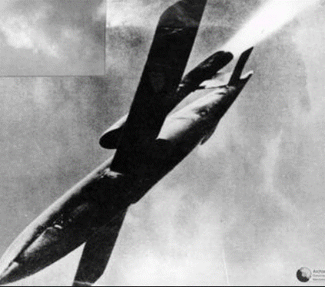
V1 Rocket….introduced August 1944
10,000 launched
400 mph, range 120 miles
20% hit target
Inaccurate…terror only
7,000 killed in London
Increasing ineffective
..80% intercepted by 1945
,,allies advance to launch sites
..allies detect and bomb sites

Slide 44
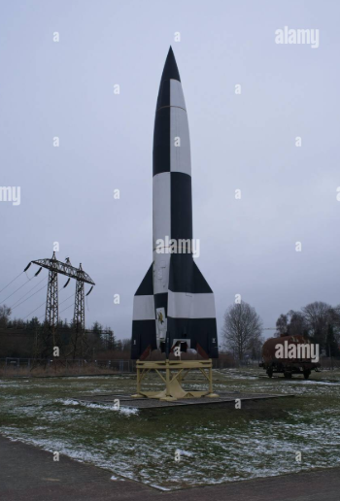
V2 supersonic missile….October 1944
Unstoppable…3,800 mph
Range 300 miles
Accurate to 10 square mile
Target London, Antwerp
Expensive…33% German fuel,
Terror weapon only
1,200 launched
Kills 3,000 …2,000 in London,1,700 Antwerp (cinema 560 killed) ….does cause terror/but not defeatism
…allies occupy launch-sites

Slide 45
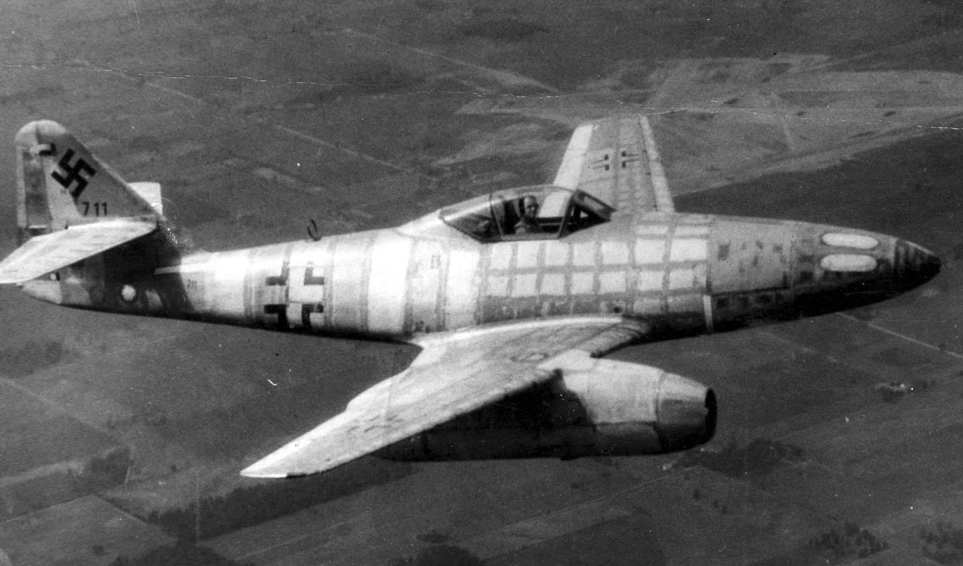
Jet aircraft… ME 220
First operational Jet fighter 530 mph
..double other fighters
..appears 1944 vs US bombers
1,400 delivered
..expensive, fuel usage
…maintenance issues
Operationally lethal
…900 bombers/100 fighter
…300 shot down
Too few to impact war

Slide 46
Germany and atomic bomb
Never close despite fusion pioneered Germany1933
Attempt sidelined 1943
Loss of expertise…Jewish scientists 33% staff…defect to USA/ UK
100 scientists dedicated vs 100,000 USA
Readines projected 1948.too late for Hitler
Development delayed
Estimate completion 1948
Allies bomb research centre…kill 50% scientist
“Secret weapons no real threat to allies….too few, too late
sets the technological foundation for future Cold War

