Slide 1
Welcome to Module 5

Slide 2
American History Overview
1. From Colony to Nation
(1600-1789)
5. Leader of the Free World
(1939-1963)
2. From Nation to Continental Power
(1789-1849)
6. Master of the world
(1963-2001)
3. From Continental to World Power
(1850-1898)
7. America and the multi polar world
(2001-2025)
4. The Vacillating Giant
(1898-1939)

Slide 3
Module 5: Leader of the Free World
Talk | Title | Time Period | Date of Talk
30 | Isolationism interrupted | 1939-1941 | January 20th
31 | The European War | 1941-1945 | February 3rd
32 | The Pacific War | 1941-1945 | February 17th
33 | America and the Post War World | 1945-1948 | March 3rd
34 | The Age of Consensus | 1948-1960 | March 17th
35 | The Cold War | 1948-1960 | March 31st
36 | Camelot | 1961-1963 | April 7th

Slide 4
Isolationism Interrupted
US and world war 1939-1941
Pearl Harbour
Intermission
Pearl Harbour aftermath
The US Home Front
WW2 at the end of 1941

Slide 5
USA 1939

Slide 6
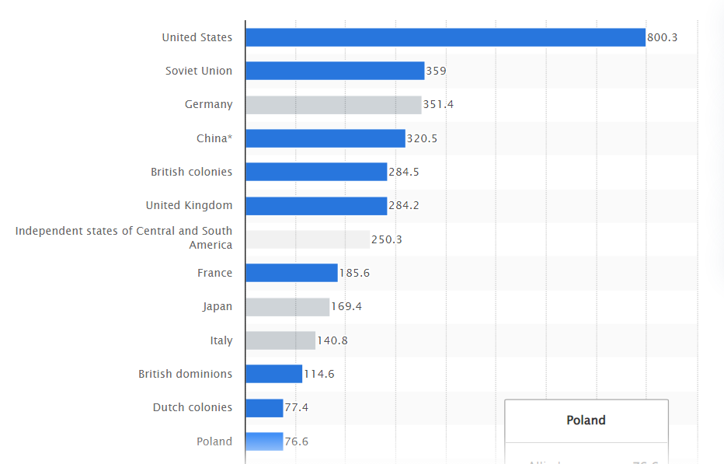
US already the largest economy ….twice size of USSR and Germany (1990$)

Slide 7
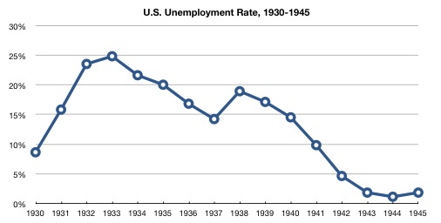
‘New Deal’ not delivering prosperity …economy still smaller than before 1920 ….unemployment “stuck” at 17%
Economy boosted by
…..financial stability
….3m employed by WPA
…oil and gas exports to Japan
US GDP
GDO
1929 | £103Bn
1931 | £77Bn
1933 | £68Bn
1935 | £74Bn
1937 | £93Bn
1939 | £93Bn
Depressed by
….Price and Wage regulations
…budget cuts to reduce debt
…high tariffs preventing trade
Growing opposition to Big
Government offset by hatred
of “Big Business”

Slide 8
Isolationism dominant 1920-1937
1920’s Anti war mood
“All Quiet on Western Front”, 1934 best seller “Merchants of Death”
German propaganda ..Versailles unjust, 70% believed US tricked into WW1
“Nye Committee” 1935: Senator Nye… Anglophobe Anti Semitic
“Right : Jewish conspiracy tricked US into WW1
“Left”: industrialists seeking profit
Creates “America First Movement” …US to remain neutral, arms sales banned
1936 Neutrality Act
Embargoed sales of arms to belligerents/ US citizens travel “at own risk”
FDR “Interventionist” but signs Act….reluctantly

Slide 9
Road to war 1936-1939
Rules based order of 1919 collapses: League impotent
Italy invades Libya 1932, Ethiopia 1938
Japanese invades Manchuria 1932, China 1938
Failure of Appeasement
Germany occupies northern Czechoslovakia 1938
Alliance of “Totalitarians” 1939 Molotov/Ribbentrop Pact 1939
German/ USSR invasion of Poland September 1939
France and Britain declare war on Germany
80% US Public “support” allies, but do not want US directly involved.

Slide 10
FDR Response
Favours allies, but cannot put re-election in 1940 at risk
Isolationism still strong…Germany no threat to USA
Needs German/ Italian/ Irish vote
Commits US to neutrality November 1939
Secures “Cash and Carry” Amendment to Neutrality Act
Arms can be sold to anyone , but must be collected
Biased toward Britain ….huge navy

Slide 11
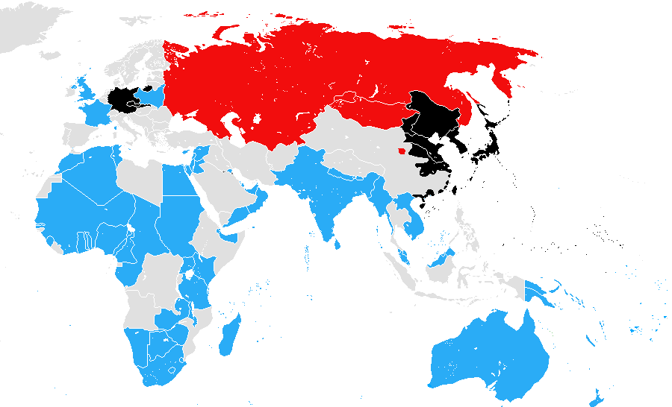
World War 1939
1
Chinese KMT counter attack
Japanese…block advance
4
2
Japanese push “North”
….USSR defeats army
…Japanese adopt “Southern
Strategy
2
3
5
1
August: Molotov –Ribbentrop Pact
…USSR & Nazi Germany “allies”
USSR & Germany invade Poland ..UK/ France declare war
3
4
USSR invades Finland ”Winter War”
End year:3m Germans face 2.5m French
+ 500K British in West Europe
…..”Phoney War”
5
USSR invades Sinkiang
..install puppet/warlord

Slide 12
US and World War 1939-1941

Slide 13
USA and war 1940
Democrat/ Republican Agreement: make America too strong to threaten
Conscription introduced
All males over 21 must register…many exemptions
National lottery by date of birth call to select drafted
Army increased from 180,000 (1939) to 1,400,000 by December 1941)
Rearmament agreed by all parties…..debt constraint removed
Defence budget increased from $2Bn to $10Bn
“Two Ocean Navy” Act: Pacific fleet moved from California to Hawaii
Mass uplift in arm sales to Britain/ China…”Cash and Carry” basis
Keep America safe….too strong to threaten

Slide 14
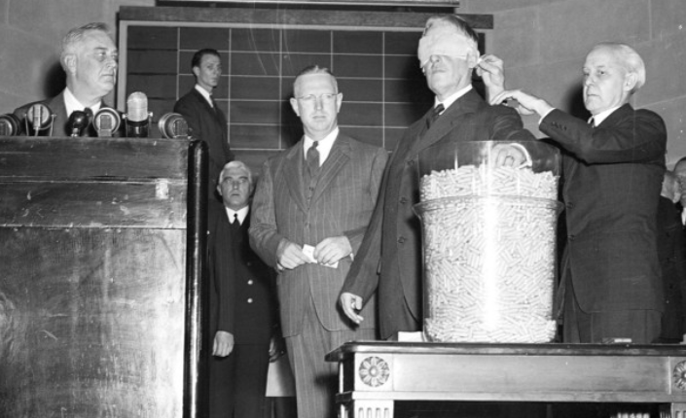
Conscription introduced …all males over 21 to register …..picking the dates for those to serve

Slide 15
Destroyer for Bases Agreement
Battle of the Atlantic intensifies
Germans update torpedoes, British adapting new radar
1,059 merchant ships sunk 1940, 100 U boats deployed, 200 more due
Britain 2 months supply of food….and dwindling
Churchill (PM in May 1940) proposes deal September 1940
Britain transfer naval bases in West Indies, Bahamas, Newfoundland to US
US to supply Britain with 50 WW1 Destroyers
Isolationists attack FDR….in breach of Neutrality Act
Real estate deal
Vital to US security

Slide 16
Presidential Election 1940
Democrats: Interventionist…support allies, but no direct involvement
Roosevelt decides to run for 3rd Term…..”Make America Safe” agenda
Radical left discredited by Ribbentrop Pact
No challenge to “Jim Crow” White Southern Segregationists (despite Eleanor)
Republicans: divided “isolationists vs interventionists
Isolationist convinced FDR pulling US to war….88% Americas
Hard “Right” discredited by German conquest of France, admiration of British
resistance
Select Wendell Willkie, 38 year old pro British industrialist, no political experience

Slide 17
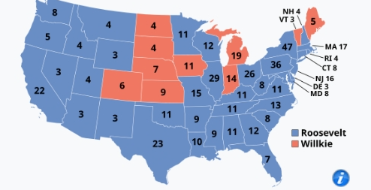
1940 Election Results
Willkie attacks FDR for 3rd Term ,,,”if one man is indispensable, none of us are free
FDR Response Willkie “industrialist”…I
Am friend of common man
Landslide for FDR
..wins 27m, 55% of vote
…449 electoral vote vs 82
FDR controls Senate and House
…Most Republican support Intervention
…Republican isolationists marginalised
….strong enough to block legislation

Slide 18
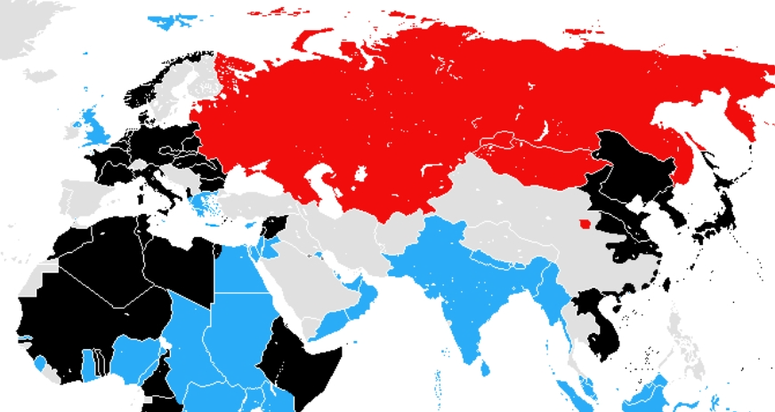
World War end 1940….war everywhere
April – June
Germany conquers Norway , DK and France
May-Sept…Battle of Britain..
1
June…Italy joins Germany
…Japan USSR “peace”
6
Italy invades Albania, Greece
…rescued by Germans
1
2
2
3
Italy invades Egypt & British Somalia ,
4
4
Stalemate in China
5
3
5
Japan occupies French
(Vichy) Indochina
100 German u boats active
Atlantic..150 in construction
…1,300 ships sunk/ 24 U-boats
Britain “losing” battle
3
6

Slide 19
FDR “The New Order” Speech January 1941
“Nazi forces are not seeking mere modifications in colonial maps or in minor European boundaries. They openly seek the destruction of all elective systems of government on every continent, including our own. They seek to establish systems of government based on the regimentation of all human beings by a handful of individual rulers who seize power by force. Yes, these men and their hypnotized followers call this a "New Order." It is not new, and it is not order.”
FDR aware Germans could be developing Atomic bomb…Einstein letter….commission of inquiry set up ….support for Britain based on conviction Germany threat to USA

Slide 20
“Lend Lease”
British running out of gold to pay cash for munitions and food
US Public opinion shifting:70% with conditions “as long as it doesn’t get
into the war”
“Promote the Defence of the USA Act” ( Lend Lease ) signed March 1941
69% Democrats, 40% Republicans support in Congress
“Buy now” return later….or not at all if destroyed, useless. eaten
UK receives £38Bn ($400Bn in $2024) in weapons and food by war end
US gets radar/ jet engines/ nuclear research in return
…nothing loaned, nothing leased…this is AID

Slide 21
Opposition to Lend Lease
Isolationist claim “Lend Lease” = aid, pulling US into war without authority
FDR “Garden Hose" argument:
"I don't say ... 'Neighbour, my garden hose cost me $15; you have to pay me
$15 for it' ... I don't want $15—I want my garden hose back after the fire is over."^{[48]}
Senator Robert Taft (R-Ohio and leader of isolationists
"Lending war equipment is a good deal like lending chewing gum
—you certainly don't want the same gum back."

Slide 22
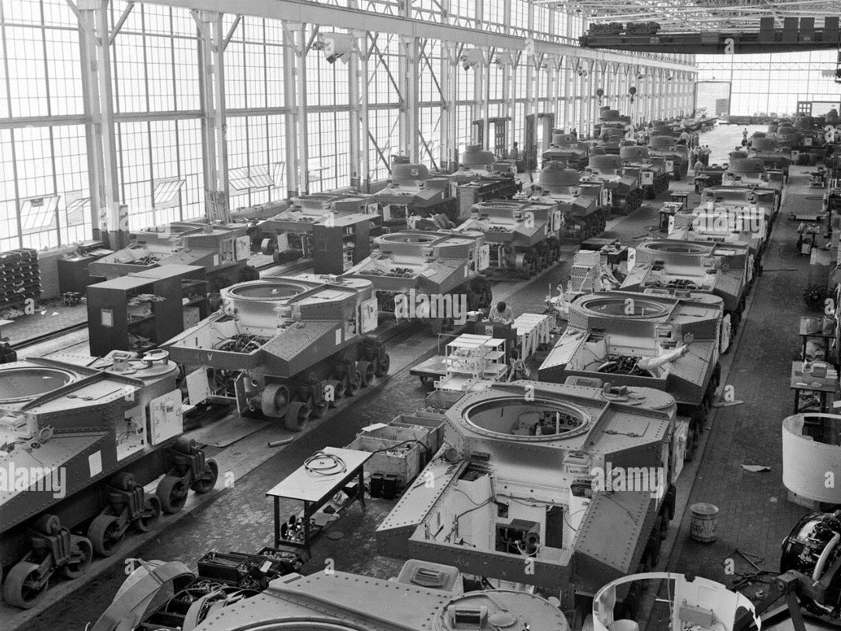
Lend Lease …..munitions
Chrysler tank factory 1943

Slide 23
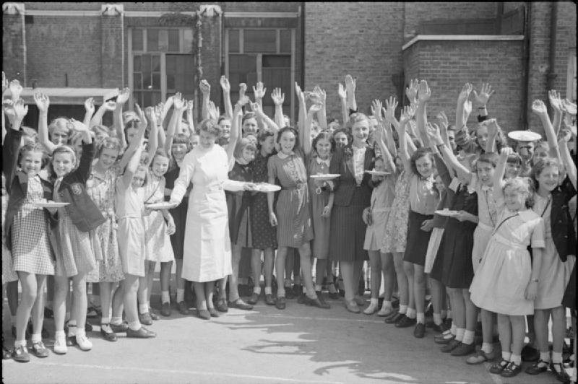
Lend Lease…and food (leased?) ham and eggs for British school children 1941

Slide 24
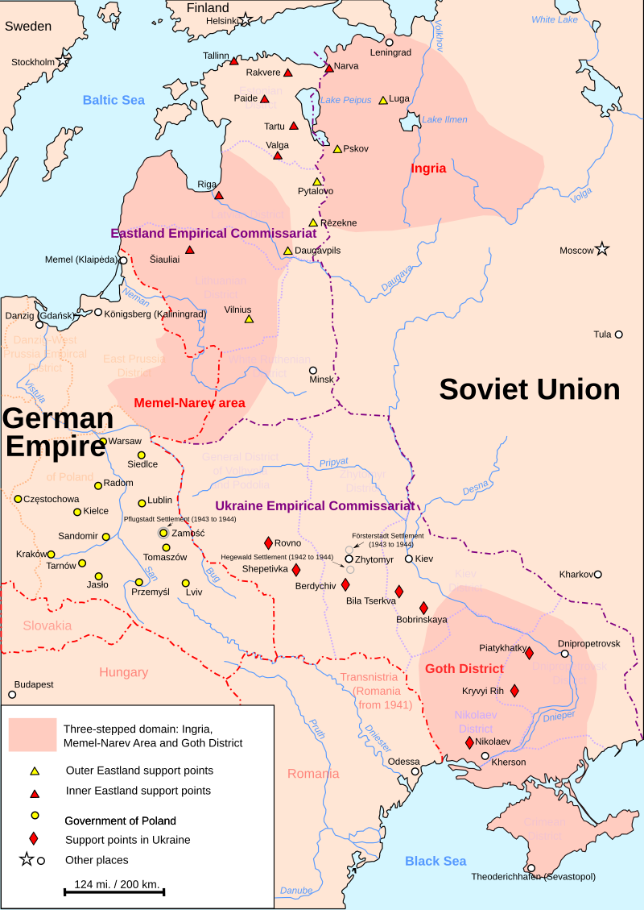
German Invasion of USSR –June 1941
Planned German resettlement areas
,,,rest to be “slave camps”
Non aggression Pact
Agreed Aug 1939 USSR recover Empire
(Poland, Baltics, Bessarabia)
USSR Negotiating energy treaty June 41
British warn Stalin Hitler planning attack
…ignored
4m German 3,400 tanks vs 5m Russians Russians + 25,000 tanks
Germans take 2,000,000 prisoners
Kill wound 1,000,000…reach Moscow by December Lose 1,000,000
Russians replace losses Germans can’t
FDR extends Lend Lease to USSR
….Stalin rejects…at first
…Artic Convoys begin

Slide 25
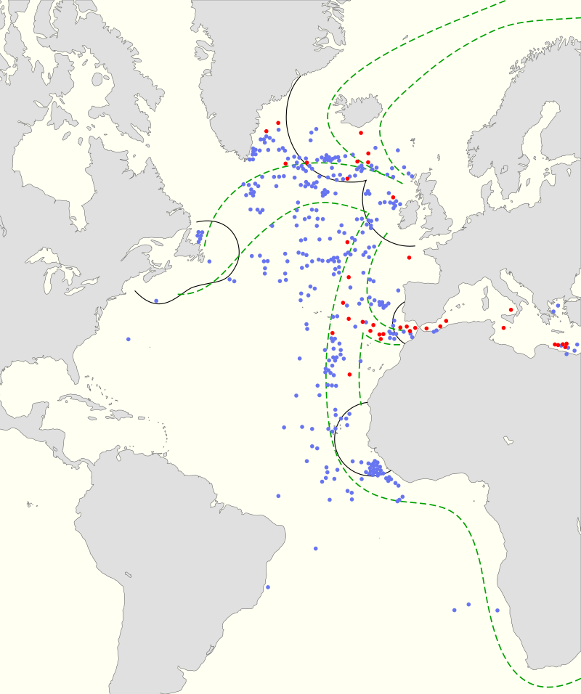
Battle of the Atlantic 1941
Britain losing Battle of Atlantic
…improved torpedoes/ engines
Vs improved radar/ convoys
Britain “survives”….just
1,300 Merchant ship
35 U boats
U boat fleet increased to 300
...longer range, submersed attacks
Britain running out food
And materials, seek US support
FDR agrees US navy provides
Convoy escorts from Mid Atlantic
…..April 1941

Slide 26
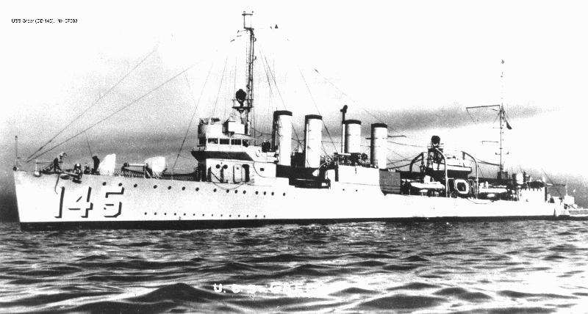
Greer Incident September 1941
FDR escalates early 1941 . US to escort convoys Out to Atlantic. Meet British
USS Greer
Greer escort attacked
By U Boat torpedoes
….they miss
Greer attempts to sink
Submarine….fails
“He said”/ “she said”
…who attacked first

Slide 27
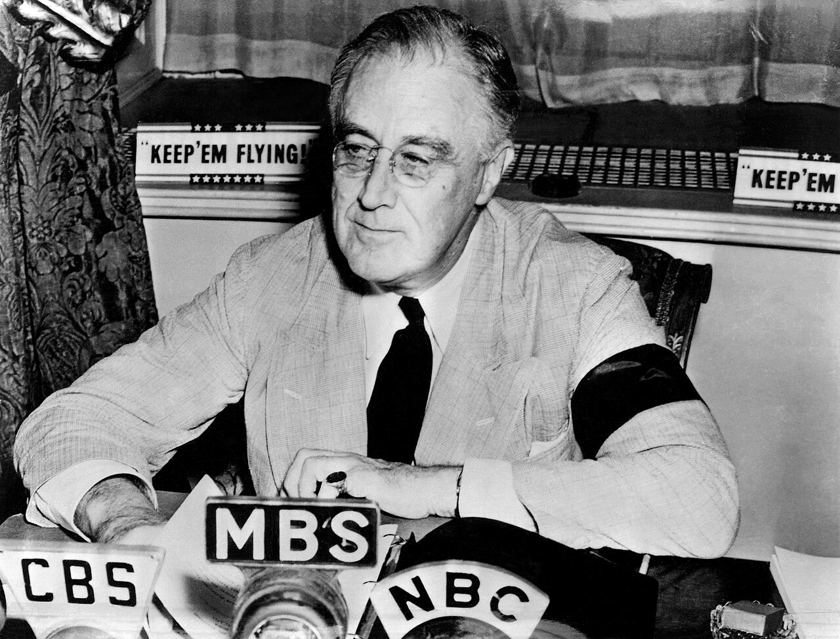
Fire side chats
“The Greer was flying the
American flag. Her identity as
an American ship was
unmistakable. She was then
and there attacked by a
submarine. Germany admits
that it was a German submarine
Claims “act of piracy”
FDR “Shoot on site policy”
..No u boats sunk
.. USS Reuben James sunk by u boat
October 1941..115 sailors drown

Slide 28
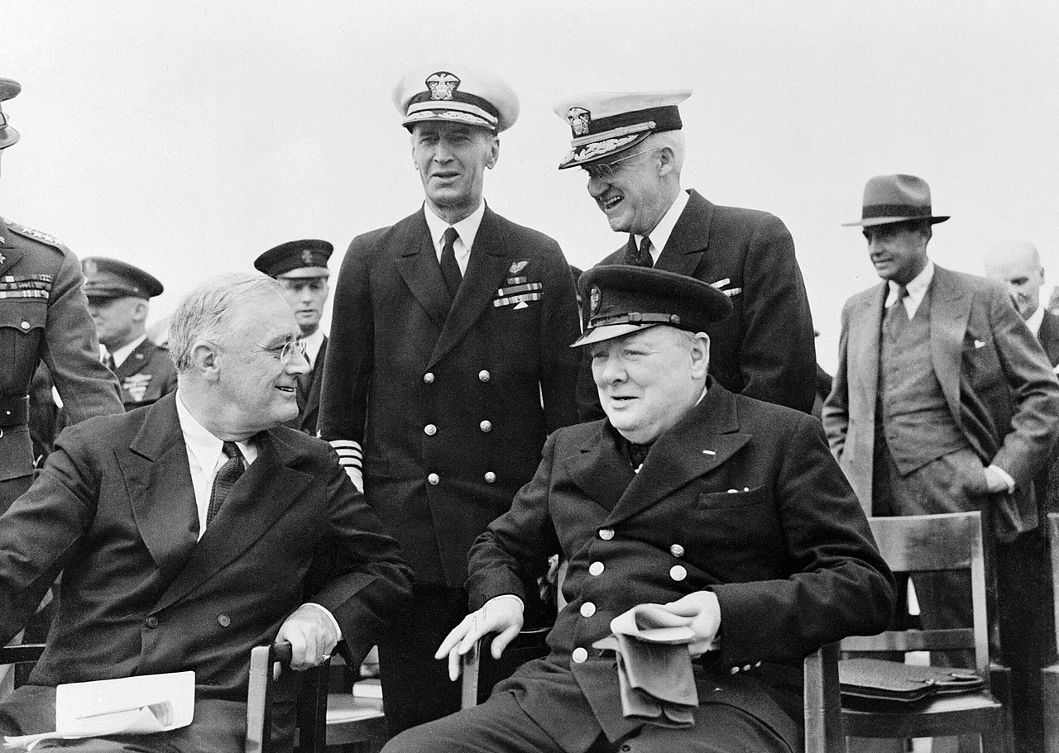
Atlantic Charter August 1941
Secret meeting Mid Atlantic HMR Prince of Wales…suggested by Churchill
First of 10 F2F FDR/ Churchill Meetings …alliance/ trust
Statement of principles
….no territorial gains
….self determination (FDR
…free trade
…no punitive sanctions on
defeated
US support dependent on UK agreeing to end Empire at war’s end

Slide 29
Pearl Harbour

Slide 30
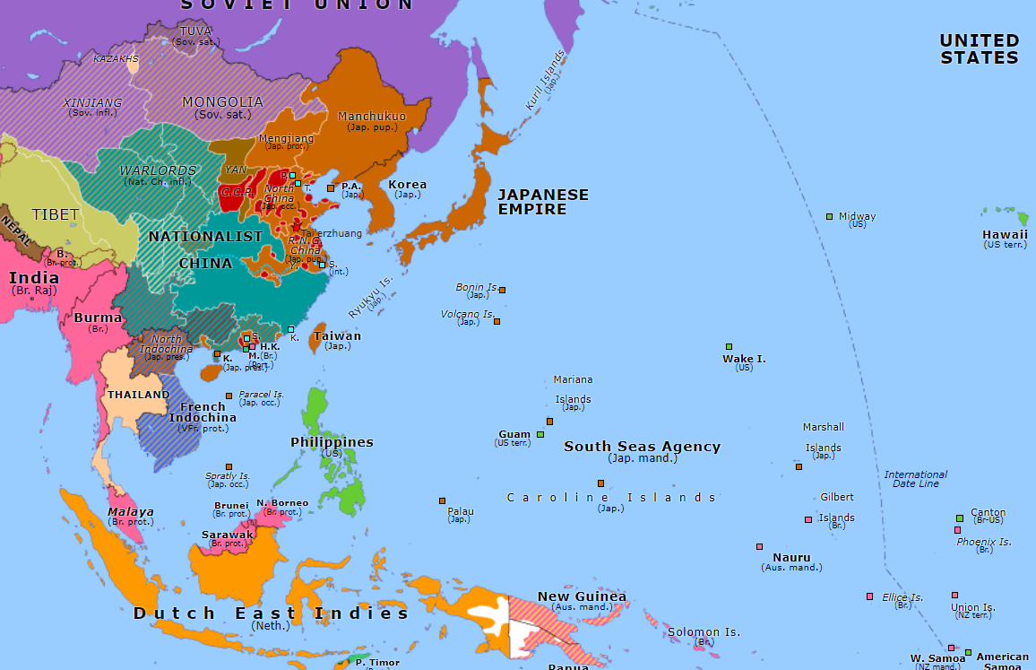
Japanese and East Asia 1940
Democracy overrun by 1936
..politics of assassination
...army independent
..New Emperor Hirohito
Iron
Coal
Far East “Co-prosperity Sphere”
…..East Asia colonies
…Japanese “master race”
… restriction…raw materials
Food,
Slaves
land
Rubber
Expansion
..Korea 1923, ..Manchuria 1931
...China 1938
…Indo China 1940
US impose total oil embargo
October 41…Japan to leave
Indo China, and China
Oil

Slide 31
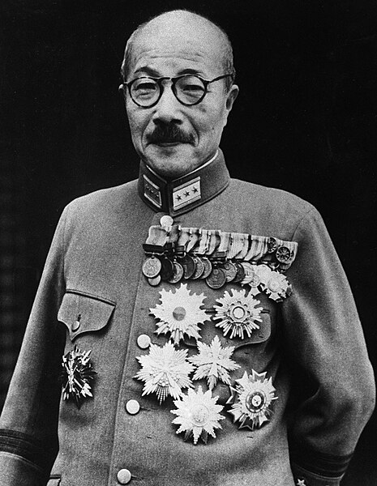
Hideki Tojo (1884-1948)
Tojo 1945
Japanese “casts” prior to 1868– Merchants, artisans peasants, …samurai persist/ control military
…independent of parliament
Tojo from Samurai family
…successful military career
…anger at Treaty of Portsmouth
Contain Japanese expansion
visits US …disgusted by materialism
Committed to Empire…no retreat
"I am just an ordinary man possessing no
shining talents. Anything I have achieved
I owe to my capacity for hard work and
never giving up.”

Slide 32
Japanese Options
(1) Abandon Imperial project:
(2) Withdraw Indochina, China inland, pacify USA
(3) Seize Japanese destiny
Wipe out US Pacific fleet, take British, Dutch colonies, Philippines
Construct ring of island fortresses. Make American response too costly
Complete conquest of China
Tojo: December 41 “Golden moment”….Russia “busy,
British, French Dutch defeated, US rearmament incomplete”

Slide 33
The Pear Harbour Gambit:Destroy Pacific Fleet
Japan1941
US Navy 1941
Battleships | 10
Aircraft Carriers | 6 large 4 escort
Cruisers | 38
Submarines | 65
Pacific | Atlantic
9 | 4
3 | 0
20 | 10
40 | 25

Slide 34
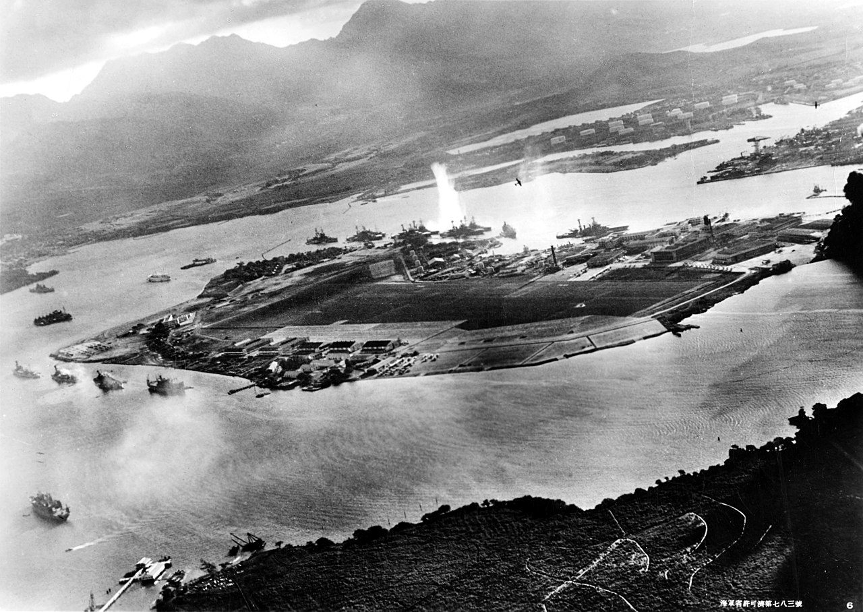
Pear Harbour Attack

Slide 35
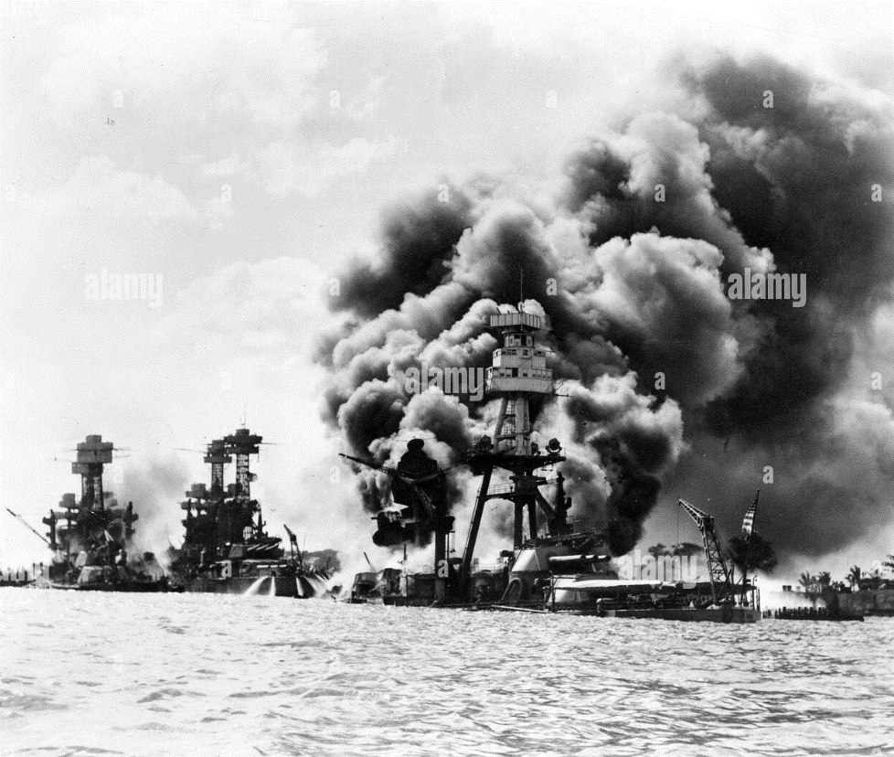
US Battleships “sitting ducks”

Slide 36
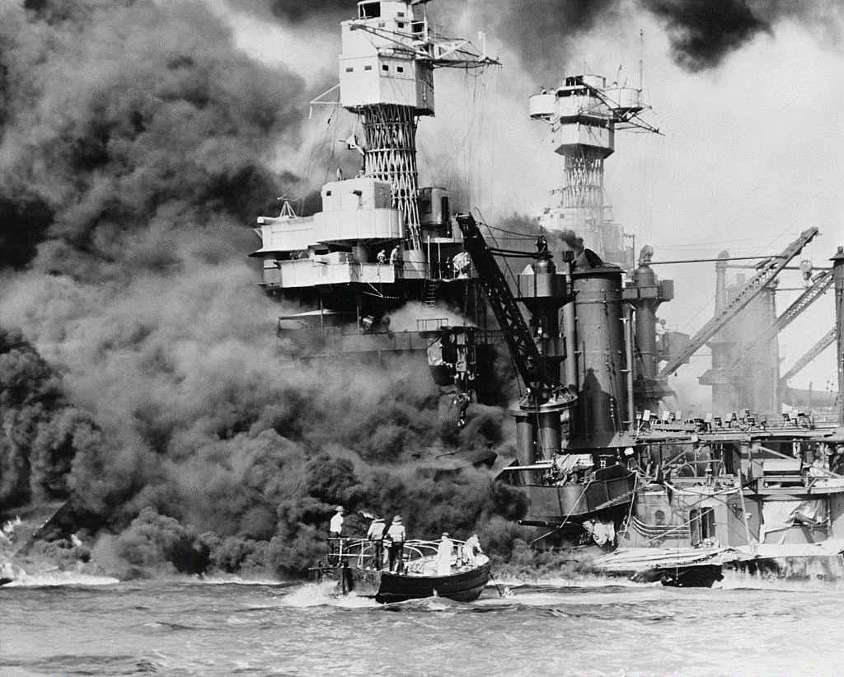
US West Virginia

Slide 37
Everything is changed!

Slide 38
Intermission

Slide 39
WE'LL MEET AGAIN 201
(Vera Lynn)
We'll meet again Don't know where Don't know when But I know we'll meet again some sunny day
Keep smiling through Just like you always do Till the blue skies drive the dark clouds far away So will you please say "Hello" To the folks that I know Tell them I won't be long They'll be happy to know That as you saw me go I was singing this song We'll meet again Don't know where Don't know when But I know we'll meet again some sunny day

Slide 40
Next Talk: The War in Europe

