Slide 1
American History
Talk 2: Exploration and first settlements(1493-1600)

Slide 2
This talk
State of the world in 1500
Spanish explorers and their fates
Enter the French
Enter the English
The Columbian Exchange

Slide 3
State of the World 1500
1
Ming Dynasty of China world super power, population 200 million people, strong government, but ocean travelling technology abandoned, focus on consolidation
Delhi Sultanate, population100 million, no naval resources, under threat from north
Ottoman Empire population 50 million, galley based navy, Mediterranean and Europe
France population 25 million population but weak monarchy and disunited
Spain, population12 million, strong monarchy, unified-Reconquista complete, warrior culture, Bullion shortage, Spice Trade blocked by Ottomans, naval technology
England population 3 million, emerging from civil wars and poor,

Slide 4
Chinese Treasure ships vs Spanish
2

Slide 5
The voyage of Christopher Columbus
3
Spain commissions Genoese adventurer to find new route to Indies 1492
Columbus discovers Bahamas, Hispaniola, & Cuba,
Returns with plants, slaves and rumours of gold:
“I discovered many islands inhabited by numerous people. I took possession of all of them for our most fortunate King by making public proclamation and unfurling his standard, no one making any resistance,… “they are destitute of arms, which are entirely unknown to them, and for which they are not adapted; not on account of any bodily deformity, for they are well made, but because they are timid and full of terror …(the natives are) “fearful and timid . . . guileless and honest, and might become Christians and inclined to love our King and Queen and Princes and all the people of Spain.”
King Ferdinand instructs Columbus to return: "Get gold.
Humanely if you can, but at all hazards, get gold.”
News spreads across Europe rapidly due to printing presses

Slide 6
Spain and New World
4
1492 Columbus returns from first voyage,
returns to Caribbean…tales of gold mostly made up
three more journeys
1495-1505 Spain colonises Puerto Rico , Cuba, Hispaniola (Dominica)…some gold found, legend of ‘Fountain of Youth’
1509 Cortes conquers Aztec Kingdom in (now) Mexico gold and silver discovered and assumed to exist north and south
1513 Expeditions to North America begin led by a generation of warriors ruthless and fearless….“Gold, Glory, and God”
Notes:
Christopher Columbus claimed to have found the Garden of Eden on his Third Voyage. Other men spent years in the Amazon jungle searching for the lost city of El Dorado, "the Golden Man." Still others searched for giants, the land of the Amazons and the fabled Kingdom of Prester John.

Slide 7
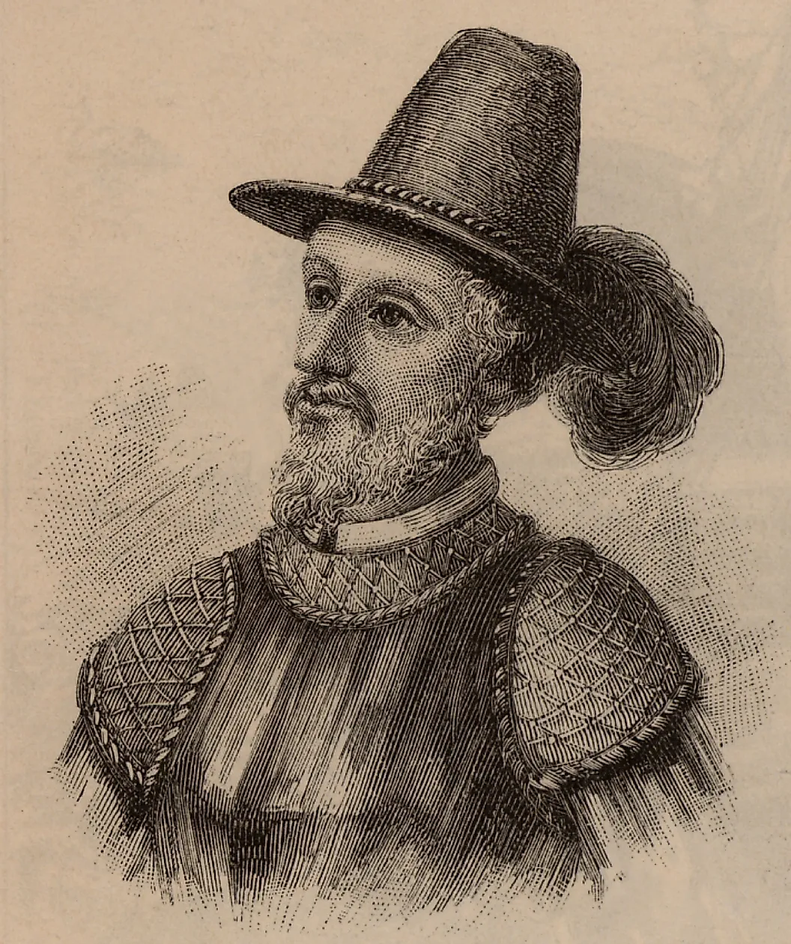
Florida: Ponce De Leon expedition 1513
5

Slide 8
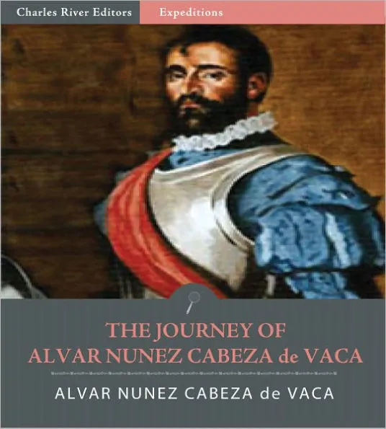
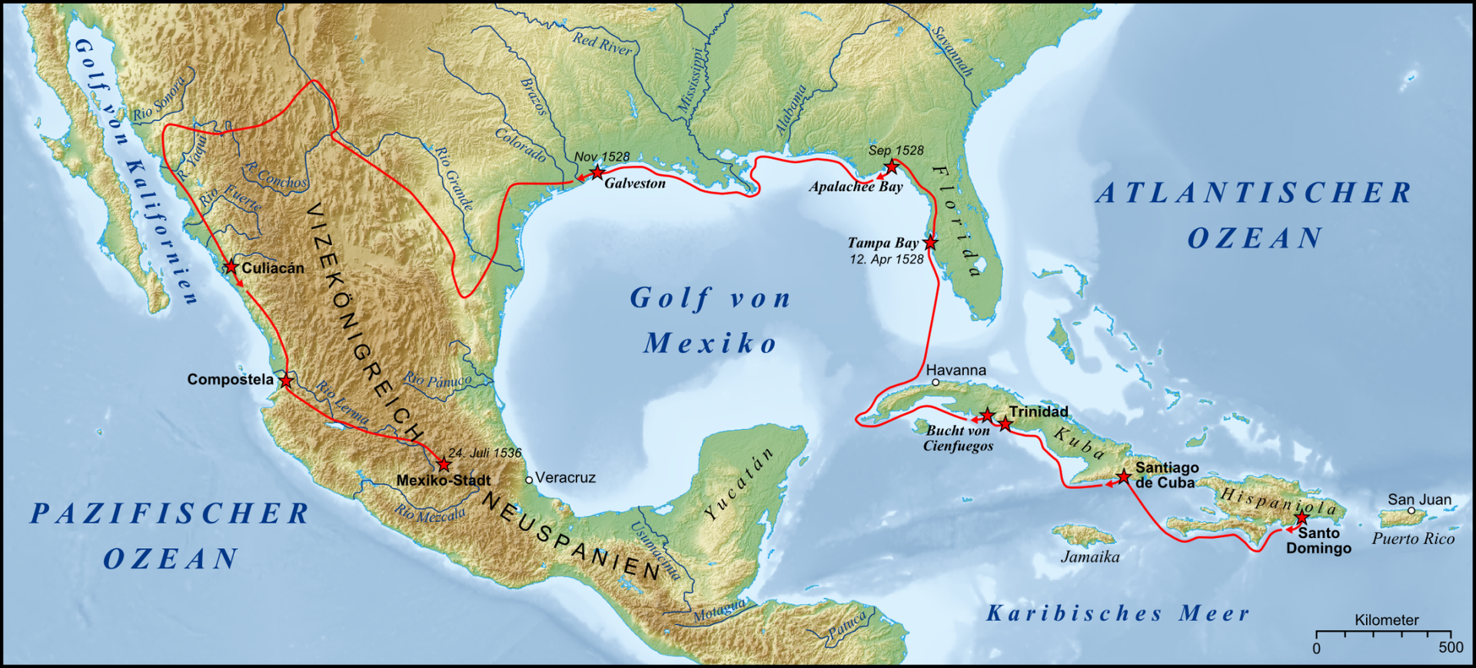
Cabeza de Vaca: first overland explorer (1528-37)
6

Slide 9
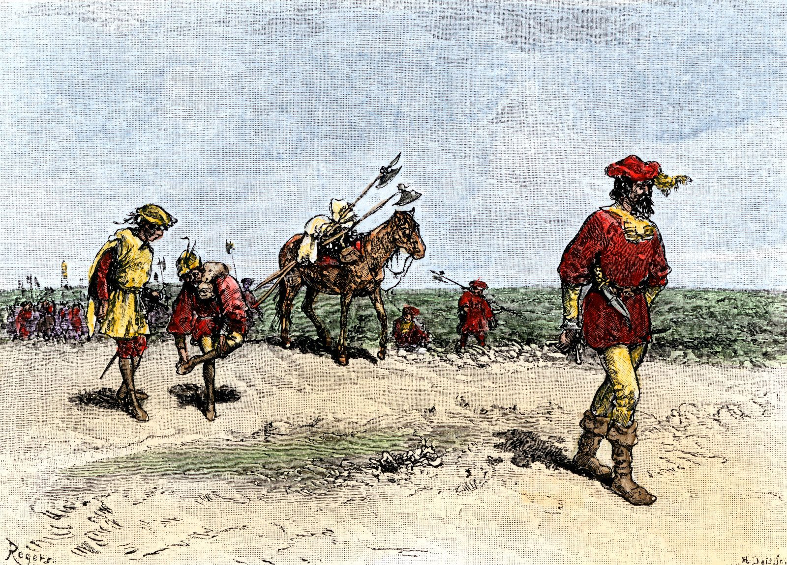
Cabeza de Vaca …American Southwest 1530
7

Slide 10
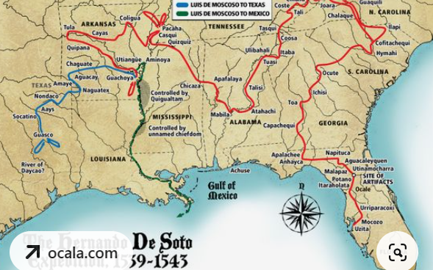
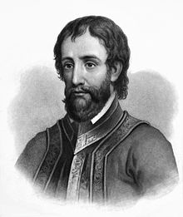
De Soto expedition
8

Slide 11
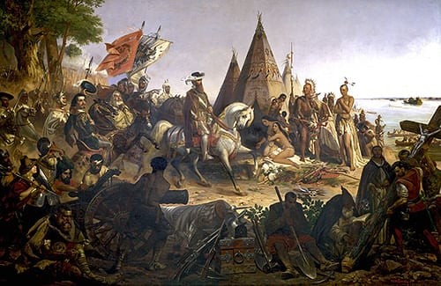
Discovery of Mississippi 1541
7

Slide 12
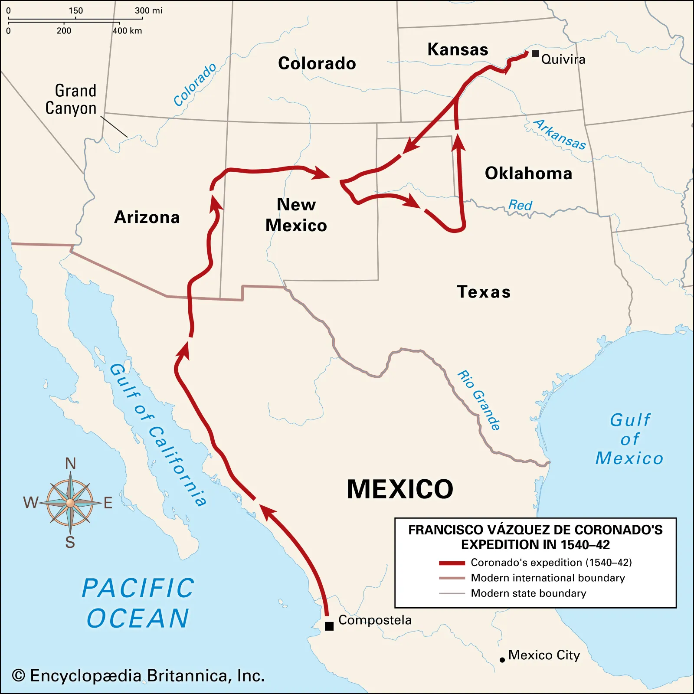
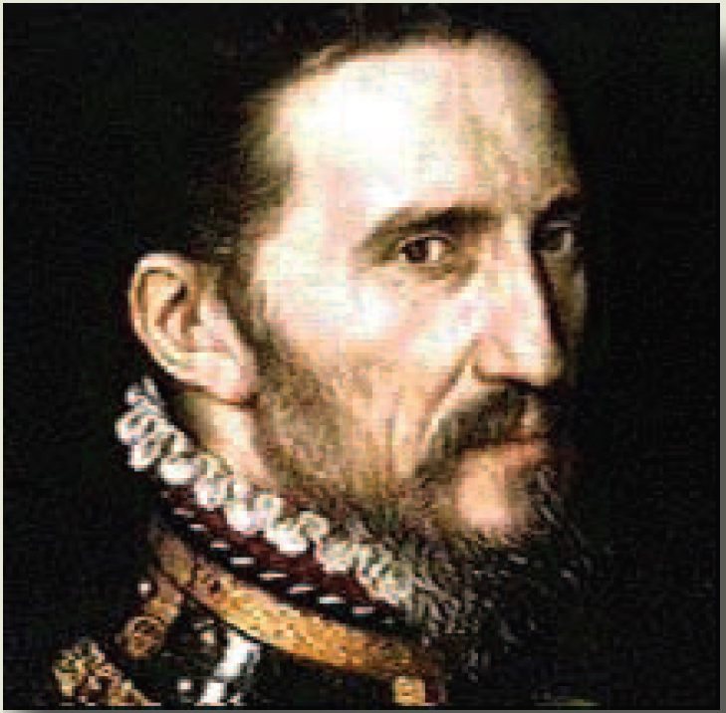
Francisco de Coronado
8
Notes:
Persistent rumors of rich silver lodes north of Mexico set in motion the Spanish exploration of the American West. In 1539 Fray Marcos de Niza set out to search the region, and he heard stories of seven cities of gold and silver, named Cíbola. Between 1540 and 1542 Francisco Vásquez de Coronado followed up Niza’s effort, and his men traveled throughout the West in search of the elusive cities and the treasure they were reputed to contain. In the meantime Coronado also heard of another magical city, Quivira, that lay to the east, so he roamed into present-day Kansas and Arkansas, where he found several villages of semisedentary Indians but no gold and silver. The Coronado expedition was based among the Pueblo Indians, and relations between the two groups were initially peaceful, but the Spaniards’ exorbitant demands for food and land turned the local population against them. The Pueblos’ lack of gold and silver,
A dead end, Coronado survives but bankrupt
Other expeditions
De Vaca 1528 400 men to texas, lost, starve and adopted by Indians, have
No further explorations for 50 years

Slide 13
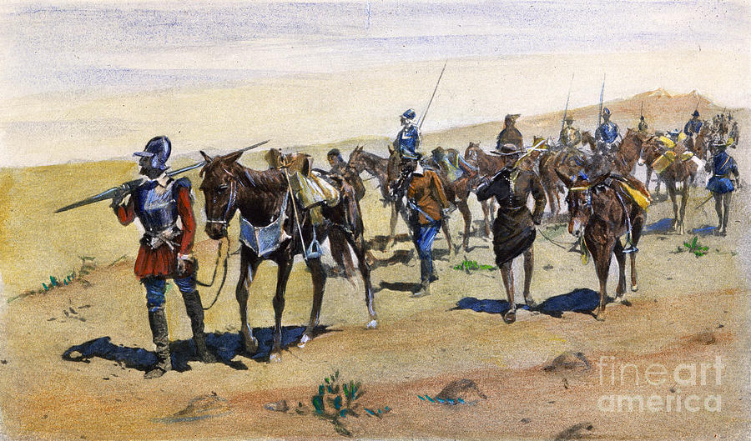
9

Slide 14
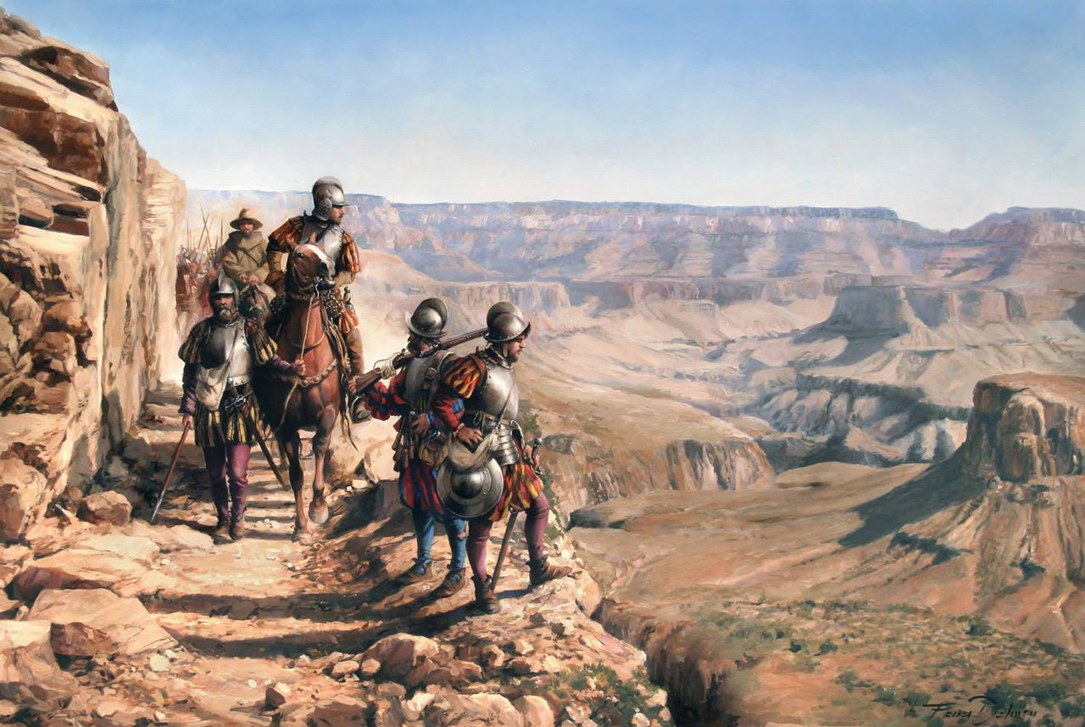
10

Slide 15
Outcomes of Spanish explorers
11
Focused on Central and South, minimal colonisation of North America
One permanent settlement of St Augustine Florida
Horses escaped from De Soto expedition and breed rapidly….Indians on plains transformed
Smallpox spreads across Central North America

Slide 16
Enter the French
12
Rivals to Spain
13 Religious Wars Catholics vs Huguenots…good time for Protestant to leave France
Francis 1st to challenge Spain/ Portugal division of world
Commissions expeditions to Indies avoiding Spanish colonies

Slide 17
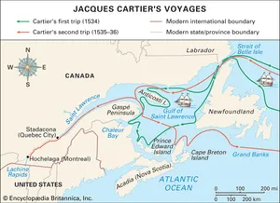
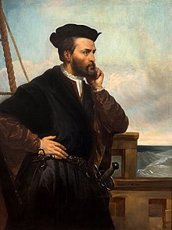
Enter the French
13
Notes:
Constant with Spain…and themselves ( wars of Religion and vs Spain)
So French King Francis1 …find NW passage
Commissions Giovanni Verranza (veteran of Magellan circumnavigation) in1523 to explore coast New York, Newfoundland…reports to king, returns, lands in Antilles and eaten
Jean Cartier commissioned by king to “"discover certain islands and lands where it is said that a great quantity of gold and other precious things are to be found".
Finds gem and thinks they are valuable
Kidnaps Iroquoais visitors
Delegates colonisation of Quebec to subordinate then back to France
Gems prove worthless, Quebec abandoned, soldiers freeze to death or leave

Slide 18
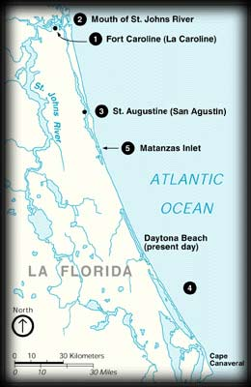
The tale of Jean Ribault expedition 1562-65)
14

Slide 19
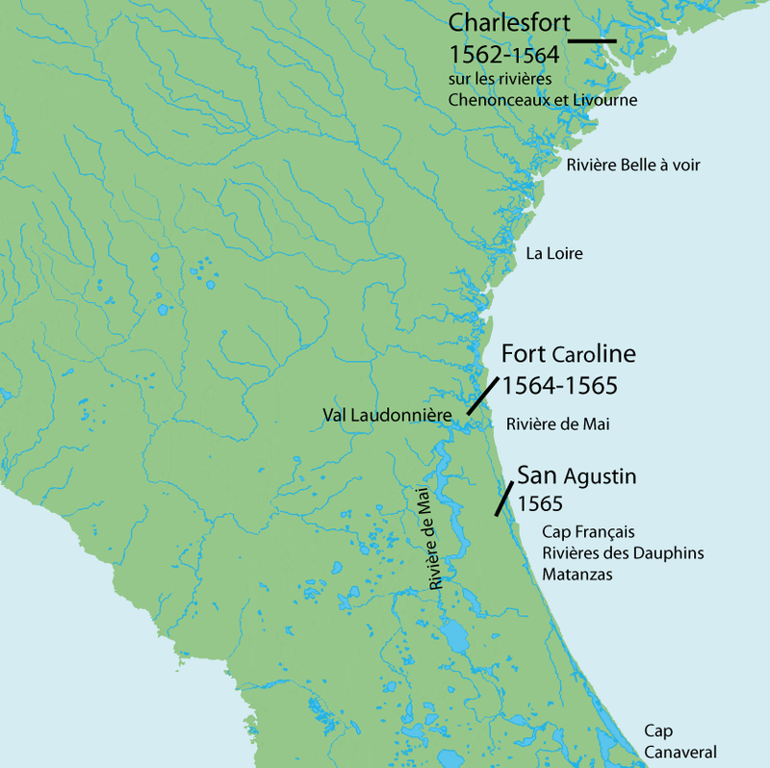
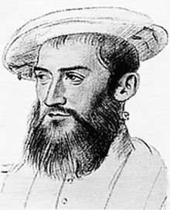
Florida: the first settlement & the sad story of Jean Ribault
15
Notes:
In the 1560s the French Protestants, also known as Huguenots, were seeking out a location in the New World to establish a protestant state. From this protestant state, they would be free to practice their religion without persecution from any outside partiesSpanish monarch was outraged by the news, especially as the settlers were French Huguenots and not devout Catholics like the Spanish King and his subjects.
Preparing For Battle
King Philip II immediately dispatched a fleet of eleven ships, carrying 1,000 soldiers and settlers. General Pedro Menendez de Aviles was one of the Spanish crowns most brutal commanders and was charged with removing the French Huguenots and setting up a Spanish colony in their place.
At the same time, Jean Ribault sailed from France on September 10th, 1565 with a further 600 troops and settlers, to resupply Fort Caroline and drive the Spanish in Florida out. Despite the King’s protests with Jean Ribault’s decision to set sail, he took it upon himself to cross the Atlantic to assist his fellow French Huguenots people who had started their new life in Fort Caroline.
Mendez Captures Fort Carolina
Unfortunately, for Jean Ribault and his crew, a hurricane pushed his ships too far south, leaving them shipwrecked on the Florida Coast, between, what is now, Cape Canaveral and Daytona Beach.
With only five ships left from their fleet of eleven, the Spanish fleet made landfall on September 8th, 1565. They named their new village St. Augustine as the land had been sighted on August 28th, the Feast Day of St Augustine.
Menendez and his men led an attack on Fort Caroline, where they were able to capture the French Huguenot settlement with relative ease. The Spanish soldiers killed most of the men during the battle, sparing the women and children who were sent to Havana by ship. Some of the French inhabitants, including colony founder Rene de Laudonniere and artist, Jacques LeMoyne, managed to escape to ships and return to France. However, Mendez quickly received news of a group of 127 more Frenchmen who were on the other side of an inlet, just south of Fort Caroline.
The Massacre Of The Huguenot By The Spanish In Florida
With the help of a captured Frenchman, who played the role of translator, Menendez informed the surviving Huguenot inhabitants that Fort Caroline had been captured and they needed to surrender. With all of their weapons, food, and supplies onboard the ships they were trying to prepare to sail back to France, the French had no choice but to surrender.
Chaplain Francisco Mendoza asked Menendez to spare any Catholic French. In the end, the majority refused, resulting in the brutal killing of 111 Frenchmen. Just sixteen men were spared including four artisans whose skills were required, some who professed to being Catholic, and a handful of impressed Breton sailors.
Just two weeks later, the same thing happened again as more Fench survivors appeared at the inlet, including Jean Ribault and his men. On October 12th Ribault and his crew surrendered but refused to give up their Protestant faith and convert to Catholics. On this occasion, 134 were savagely killed by the Spanish.

Slide 20
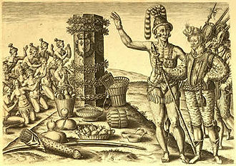

Slide 21
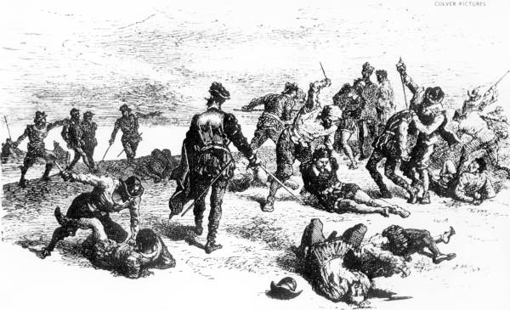
Massacre of Manzanitas 1565
16

Slide 22
Enter the English: The Virginia Colonies
England a Protestant state, but precarious and poor….Elizabeth 1st and existential war with Spain and
Catholic rebellions in Ireland (Hugh O’Neill, earl of Ulster revolt) she fears indirect invasion, commissions
‘Adventurers’ to create plantations
Elizabeth wants to weaken Spain and enrich England by outsourcing war to licensed pirates (Drake, Raleigh, Hawkins)…English magnates want land and new ‘plantations’ to exploit
1578 Awards two ‘patents’ Sir Humphrey Gilbert and Sir Walter Raleigh
Sir Humphrey Gilbert expedition heads north and lost at sea
Sir Walter Raleigh to lose patent unless colony established by 1592
delegates expedition to Sir Richard Grenville

Slide 23
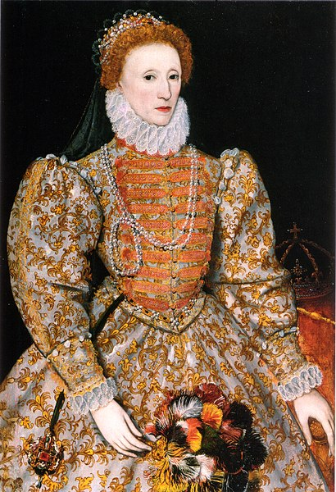

Slide 24
Sir Walter Raleigh

Slide 25
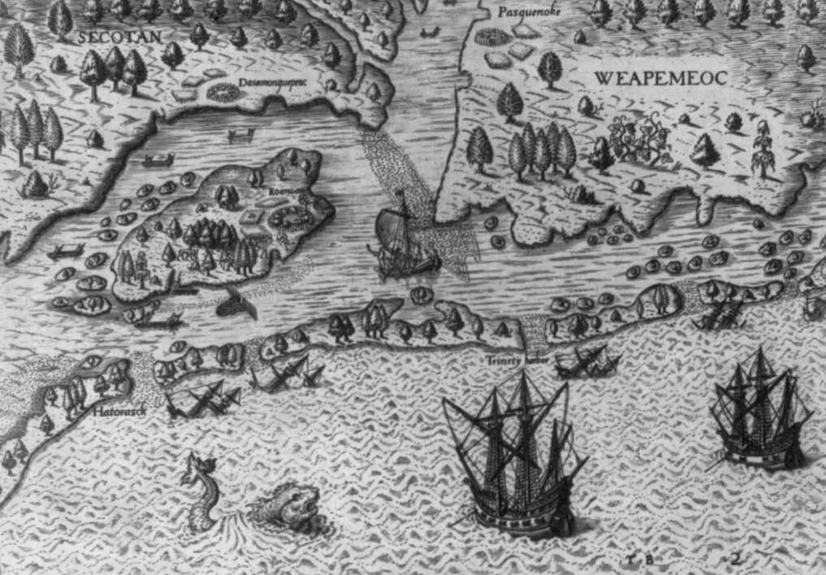
Arrival at Roanoke

Slide 26
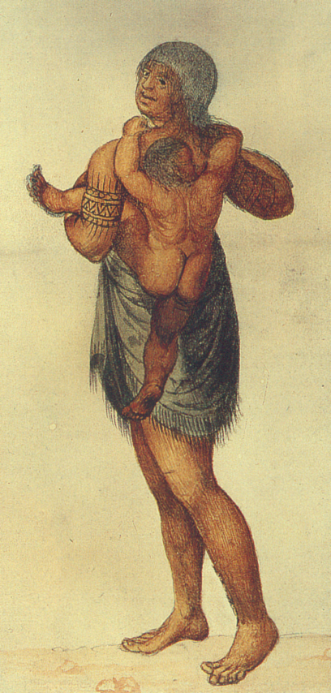
John White Paintings 1

Slide 27
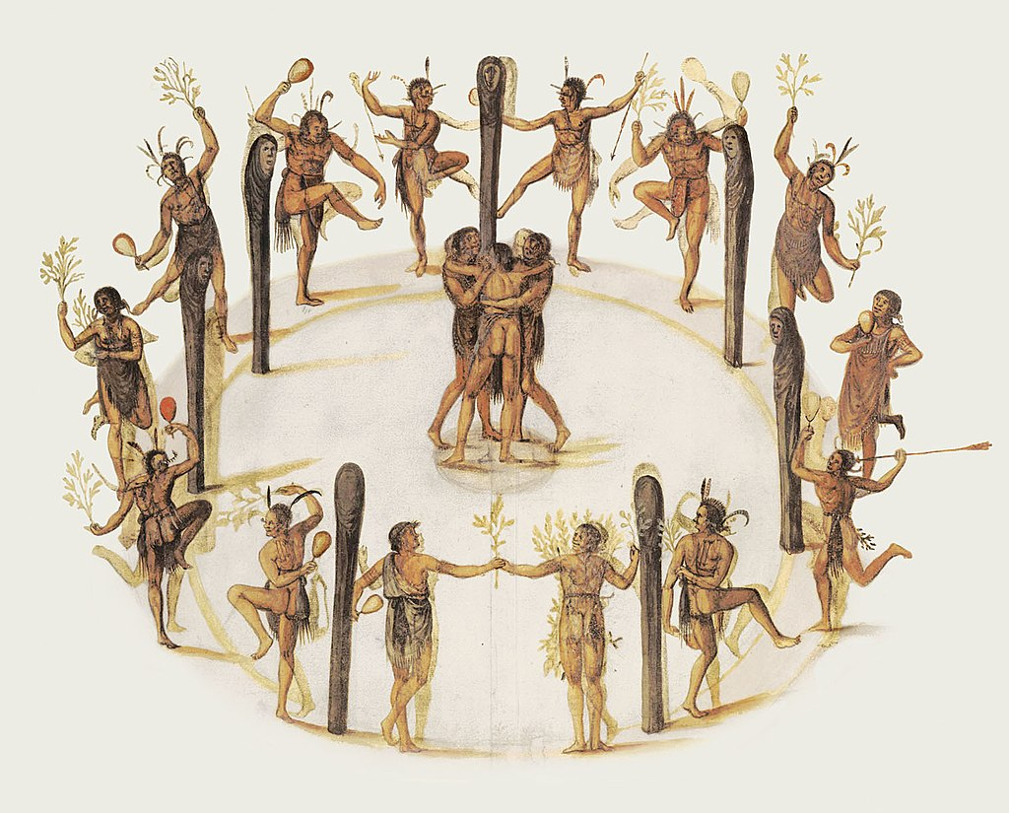
John White Paintings 2

Slide 28
John White Paintings 3

Slide 29
John White Paintings 3

Slide 30
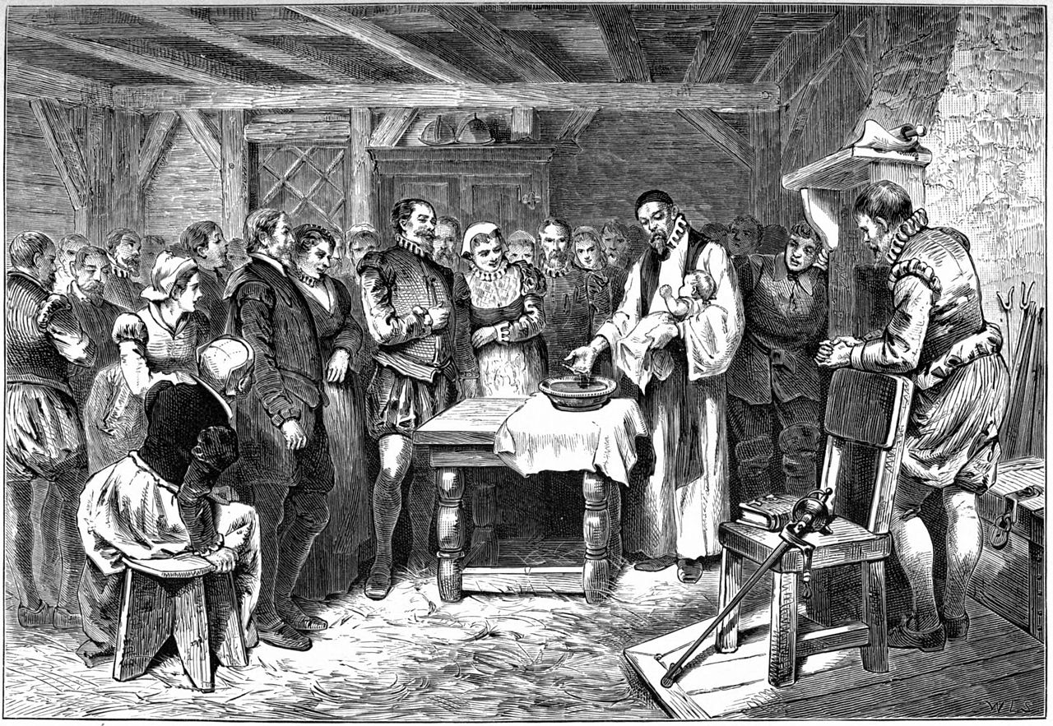
The first new European American Virginia Dare…

Slide 31
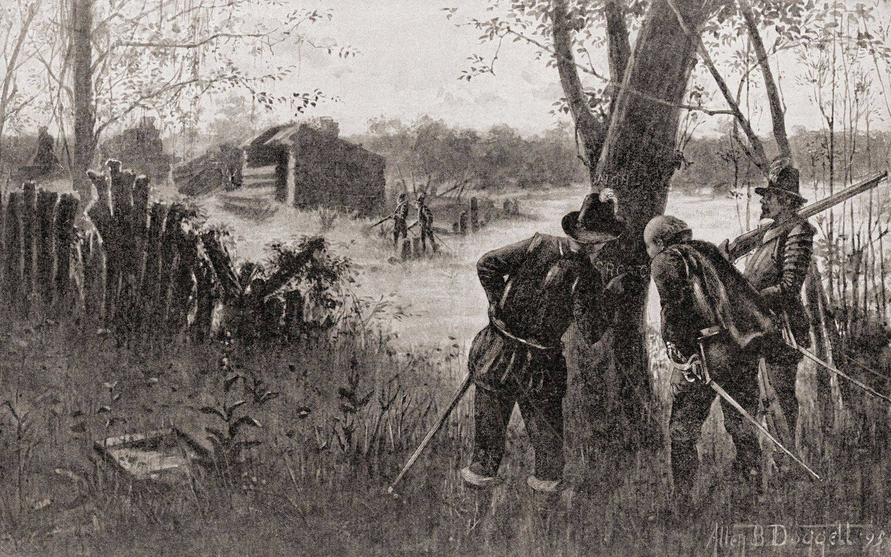
Remains of Roanoke

Slide 32
North America 1600
Only one permanent colony in North America: St Augustine Florida..20-50 settlers.
Spain not interested in North, focuses on Central/South
France & England go north
France – weak state, wars focuses on Canada’ ‘fur fever’
England: United, Irish ‘safe’ policy of ‘Garden colonies’…occupation= (as in Ireland)
Columbian Exchange taking place

Slide 33
Columbian Exchange
From North America to Europe
Gold and Silver to Spain, used fund wars & counter reformation,
Corn and squash (North East) & potatoes (from Peru): new crops reduce famine and enable population growth across Europe
Tobacco
Syphilis
Europe to North America
Small pox, influenza, mumps, measles, yellow fever, malaria (from W Africa)
Guns
Horses, oxen goats, sheep, cows, pigs… change landscape & culture

