Slide 1
American History Talk 25 US and WW1 Part Two

Slide 2
The War 1917
Russian collapse
March Revolution establish …”Provisional Govt” attempts to continue war
Allies send 100,000 troops to provide support vs Germany
October…Bolsheviks seize power “bread and peace”
French March offensive fails catastrophically……army mutinies
British autumn offensive in Flanders fails…due to mud/not stupidity
Peak U Boat success:
3,000 merchant ships sunk, 200 U boats operating
Britain 6 weeks from starvation
Germans transfer 800,000 soldiers from East to crush allies
….. Race is on….German spring offensive vs American arrival

Slide 3
Challenge of US mobilisation
Regular US army in 1917 only 180,000,
Scattered across USA and Philippines, No experience modern war
No artillery, trucks, logistics systems
Largest military unit regiment…need brigades, divisions, corps
4,000,000 men needed
2 million volunteers
2.8 million drafted
400,000 blacks (40,000 in combat roles)

Slide 4
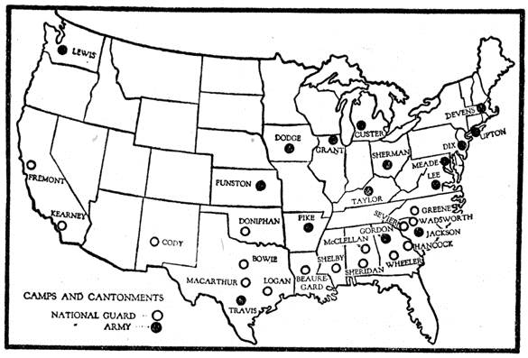
US mobilises at pace: … 32 army camps created in 6 months …..most in the South (martial spirit) …..enforced segregation white/ black regiments

Slide 5
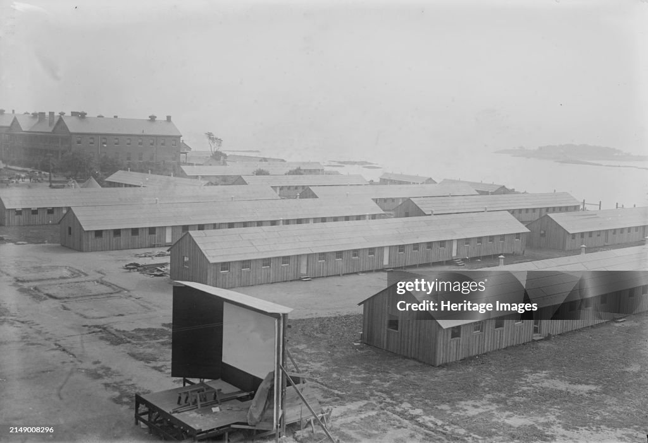
Each camp 30,000 men …constructed in days …unsanitary, crowded, shock to soldiers, communities

Slide 6
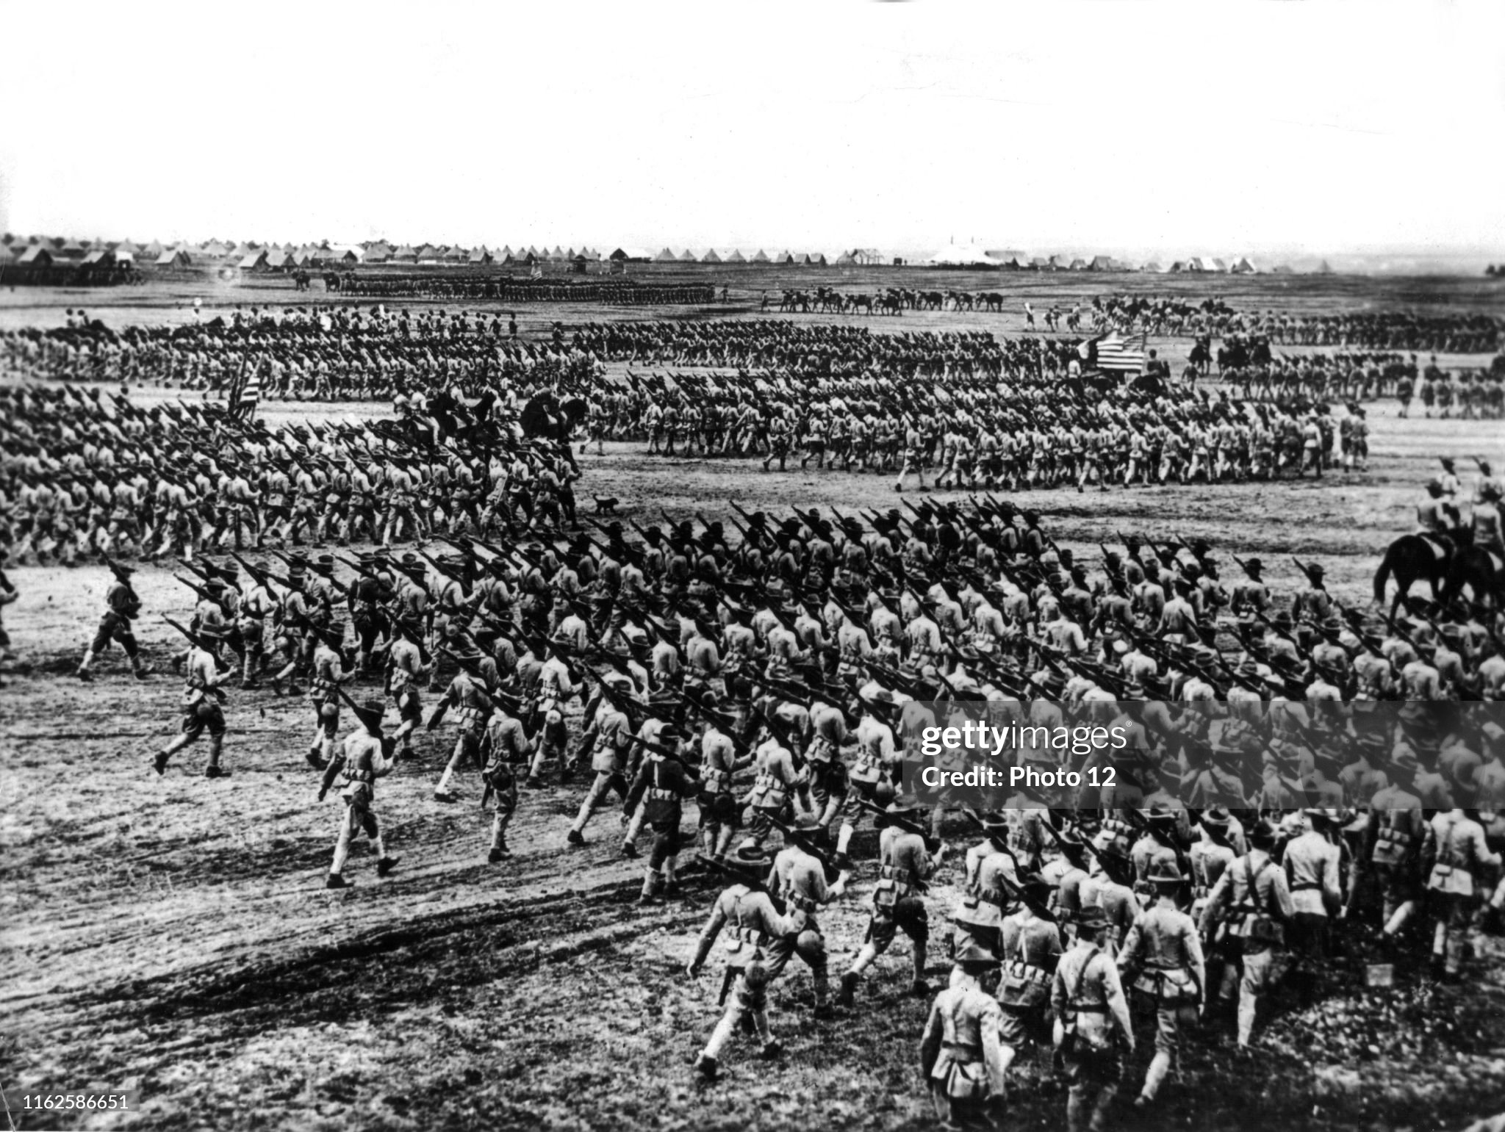
Training at home 1917

Slide 7
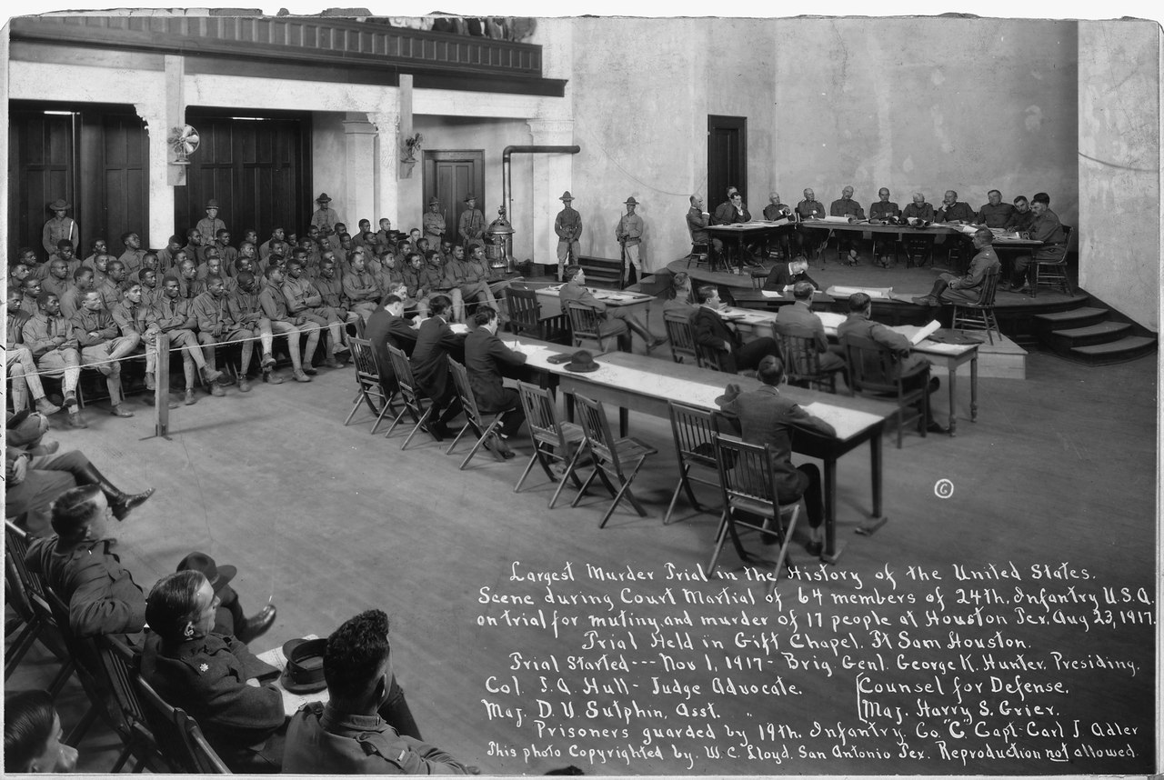
The problem of raceHouston Race Riot August 1917
Black regiments
Created/white officers
Segregated from
Whites…humiliated
By locals…violence
Local police all white
Raid camp, blacks
Retaliate: 20 killed
Largest murder trial US
History…115 soldiers
Court martialled
19 hanged. Wilson
Commutes balance
…portent for future

Slide 8
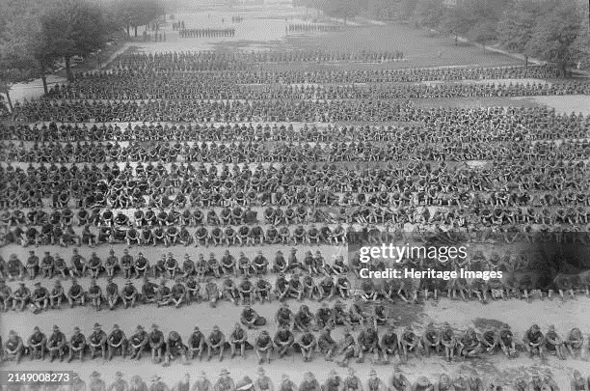
At training….at rest

Slide 9
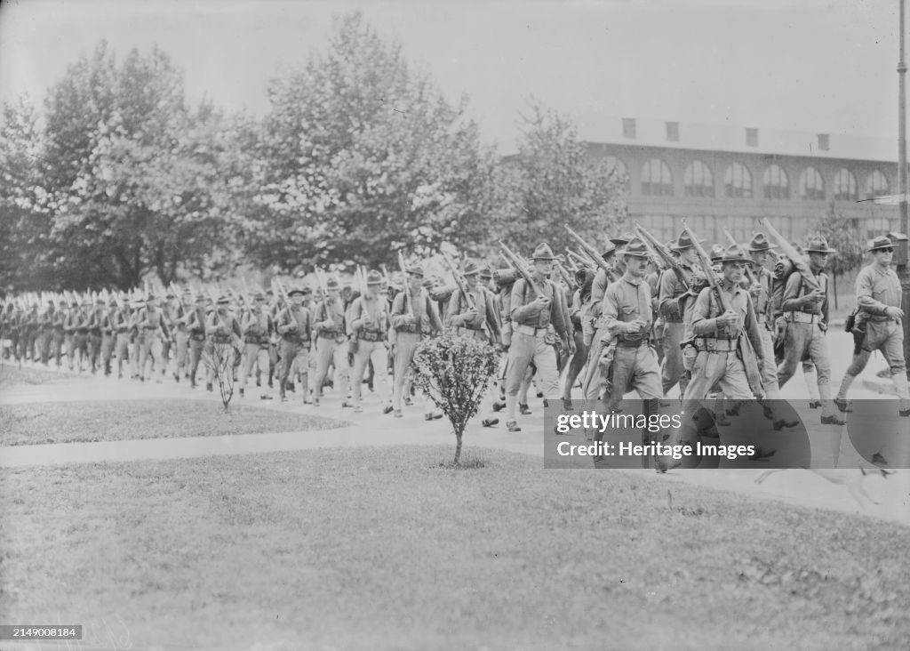
Marching to docks

Slide 10
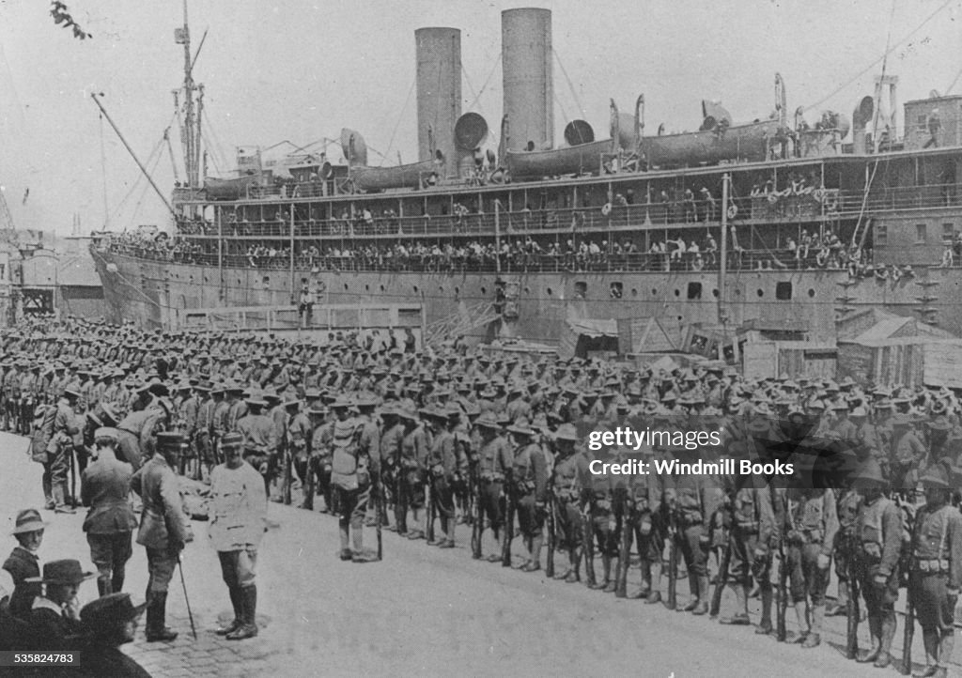
US soldiers arriving in France

Slide 11
Wilson sets out purpose of war: 14 Points
“Peace without Victory”: no mention of reparations
League of Nations to be established to solve disputes
Freedom of the seas
Empires of Austria, Russia devolved into nations based on ethnicity
Treaties to be open and transparent
Germany to abandon Belgium, occupied France, Alsace Lorraine
German & Ottoman Colonies to become “Mandates” …readied for freedom
Reaction of public: ….mass adulation across Europe
Reaction of governments: British/ French/ Germans…contempt
….Germans expect total victory in Spring

Slide 12
War situation Spring 1918
Germans transfer 800,000 troops to Western Front
Convoy system in place and increasingly effective..10,000 US troops arriving per day
US army disengaged April 1917- May 1918
140,000 troops in France December 1917, 500,000 May 1918
Pershing refuses to engage till training complete and Independent command secured
Black soldiers transferred to French army to avoid “contamination”
Chaos in Russia
Peace treaty signed between Germany and Bolsheviks (Reds)
Civil war “Reds” vs “Whites”
Allied army of 100,000 (including 13,000 US) sent to North Russia and Siberia
Support “Whites” to rejoin war vs Germany & protect allied munitions

Slide 13
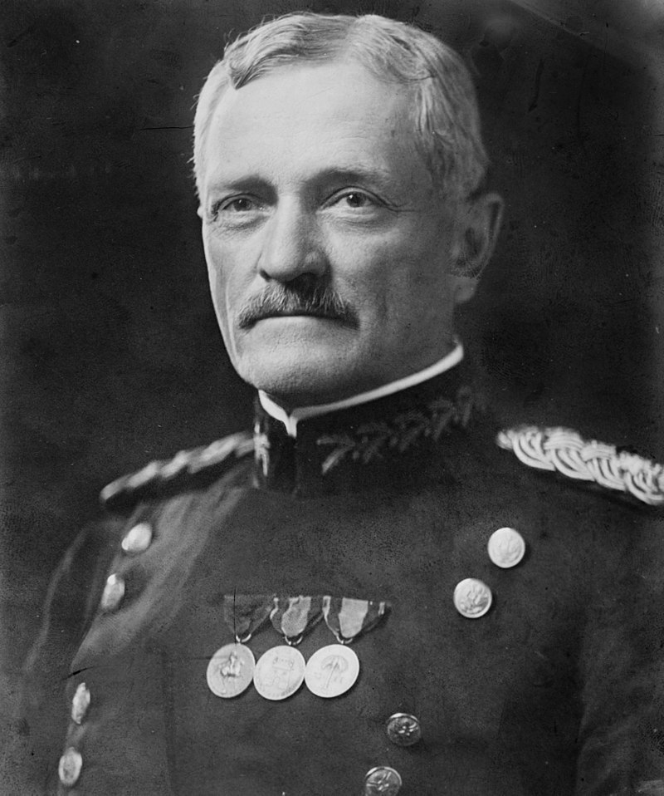
“Black Jack” Pershing (1860-1948)
General during Philippine War
…led black regiments vs Moros
..10,000 men Punitive Expedition vs Pancho Villa
Wife & 3 daughters killed in
Fire 1915…nervous breakdown
No experience commanding large army
Under orders to maintain independent
Command and enforce segregation
….hates British/ dislikes French
Committed to offensive warfare
Focus on training and logistics till convinced army ready to fight

Slide 14
Germans do not wait…..

Slide 15
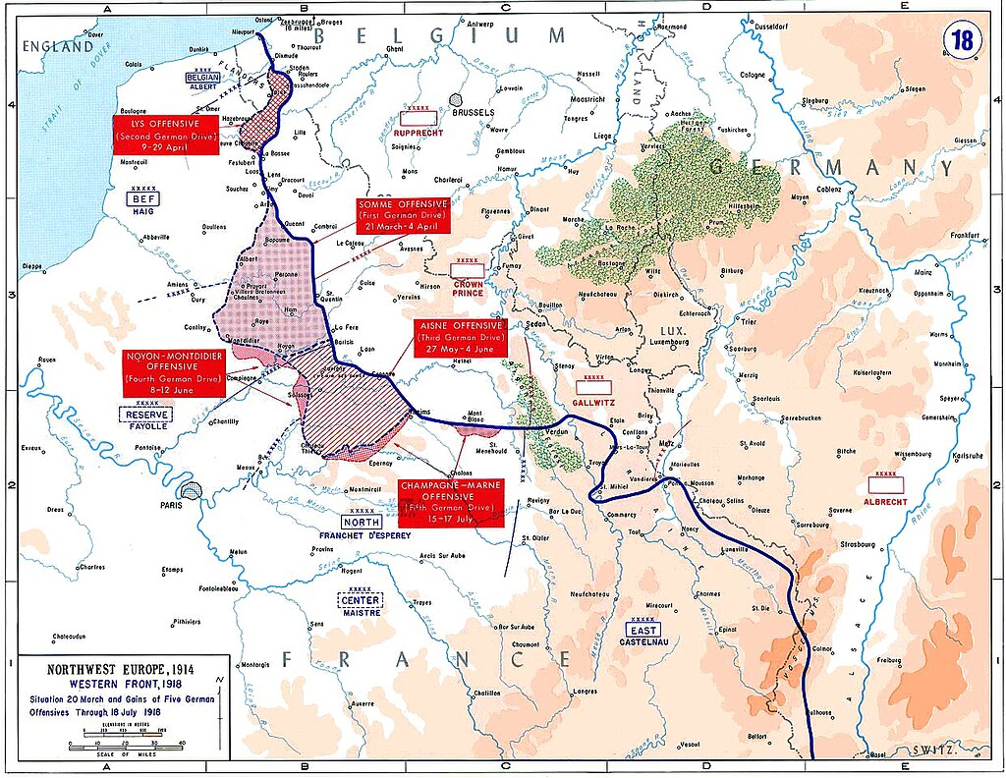
German Spring Offensive March-July 1918
3 Offensives, 4m men
…destroy British army
…French to surrender
3
1. March/April: Crush British
at Somme
…gains 20 miles
…British 5th army smashed
…Stopped by logistics
..high losses
1
2
2. May/June: Crush French
….minimal gains
…US troops agree to support
…effective counter attacks
St Michel/ Bellau Woods
3. June/July crush British at
Chanel ports
…fails…British prepared
…Germans out of men

Slide 16
German Offensive outcome
Pyrrhic “ victory” for Germans…gain 20 miles
400,000 British, 400,000 French killed/ wounded/captured
Germans lose 700,000 irreplaceable soldiers
US troops engaged….at last
10,000 casualties (Belleau Wood, Soissons, Chantilly)
Prove effectiveness and aggression
10,000 American reinforcements arrive per day
Allies adopt unified command: General Foch
All armies face new threat: Influenza epidemic

Slide 17
Influenza Epidemic
Origins:
most likely pig farms by US military basis
possibly China: bird flu)
Waves
First: Spring 1918 ..1% lethal
Second wave Autumn 1918 Lethality increases to 10% infects 33%
Spreads across armies
Third wave early 1919….lethality approx. 2%
Military response (domestic/world impact next talk)
“State Secret” till wave 2…priority “winning the war no matter cost
Disproportionate effect Germany…..poor diet due to blockade

Slide 18
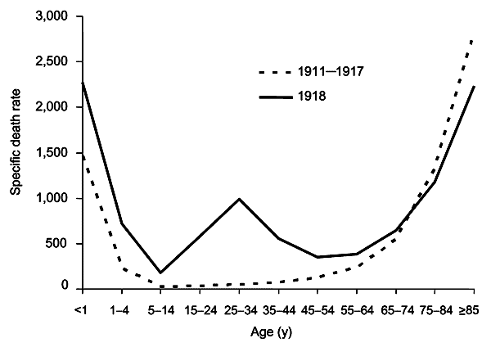
Impact concentrated on 20-35 year olds

Slide 19
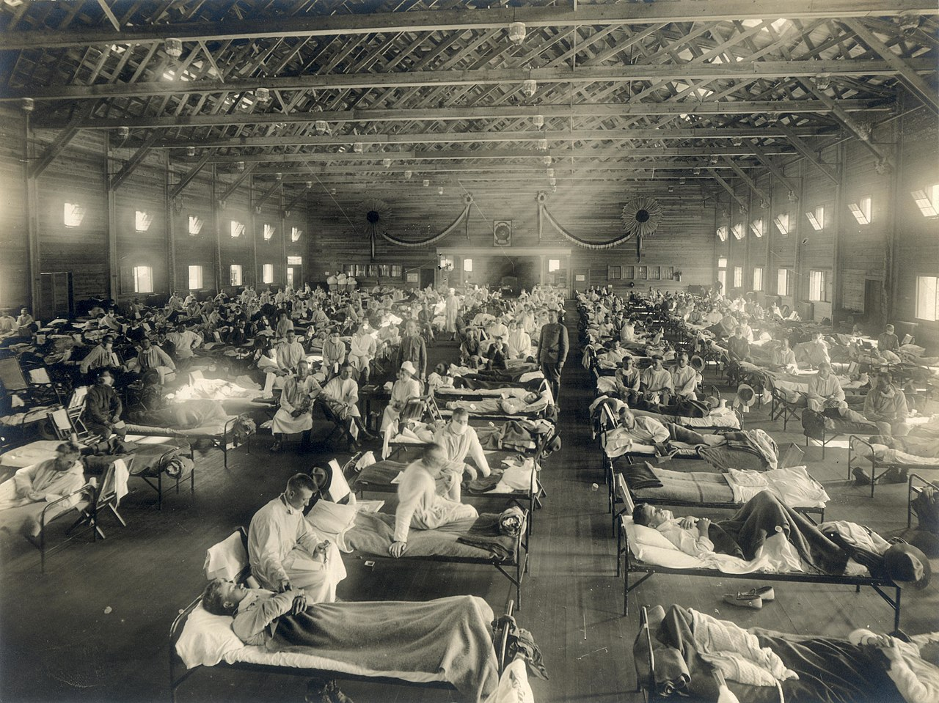
Warehouses converted to hospitals July 1918

Slide 20
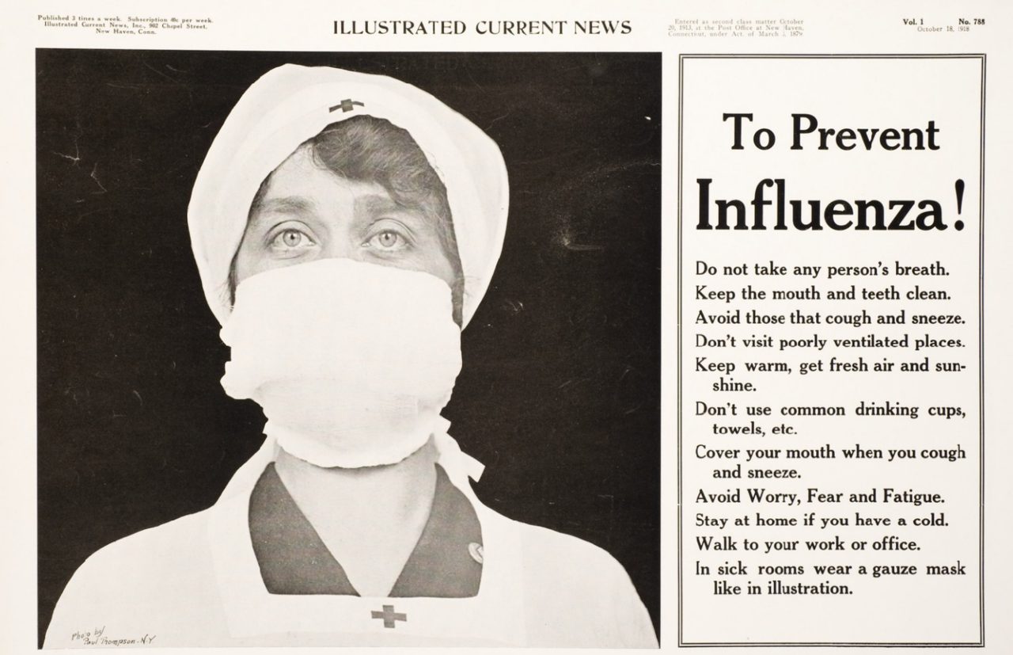
Public response (1)

Slide 21
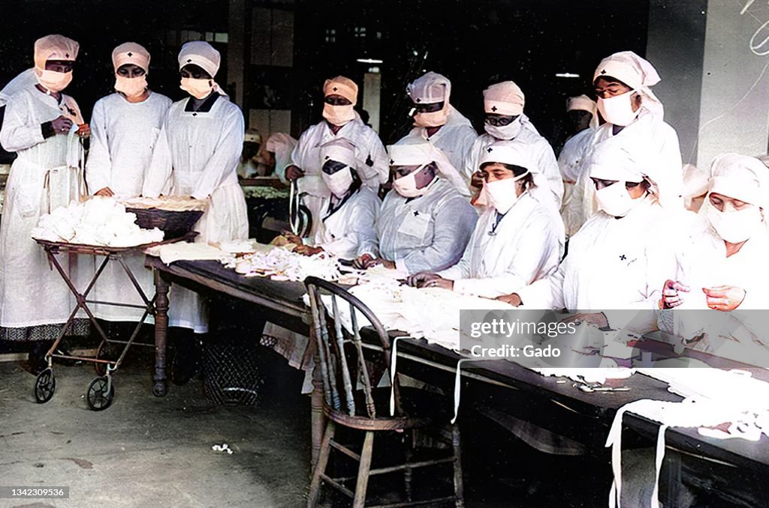
Making masks 1918

Slide 22
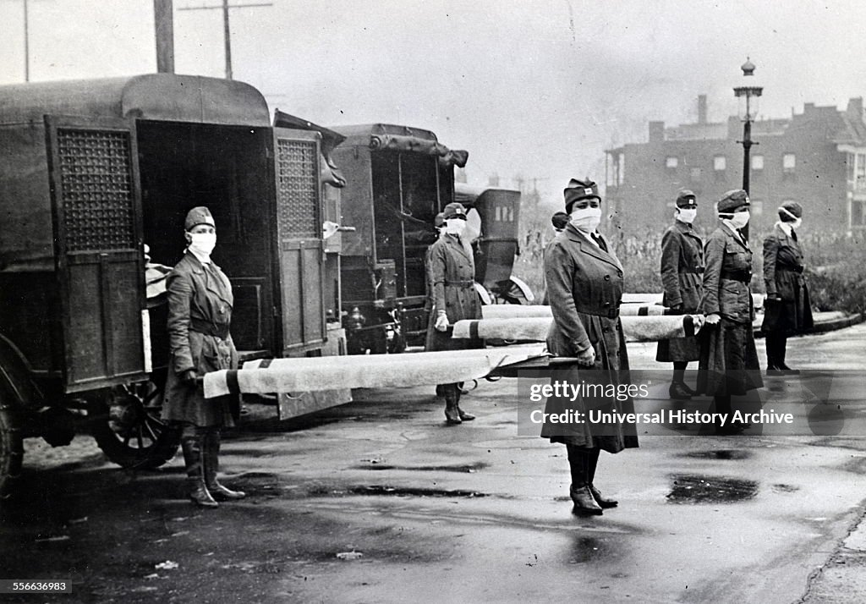
Masks…the only available response

Slide 23
Impact of Influenza on war
Winning war priority
News of deaths suppressed…USA, Britain,France & Germany
US Army will lose 60,000 to disease vs 50,000 to combat
German army weakened more than allies….effect of blockade
Allied Command…Great Offensive to continue regardless

Slide 24
100 days offensive August-November 1918
Allied army 6.5 million strong
French 2.5 million
British 2 million
US 1.9 million (increasing 10k per day!)
German army 3.5 million
Starvation breaking out in Germany…threat of revolution
Army fatalistic but intact
Uboat campaign failing
1917 40 Uboats sunk, 3,000 merchant ships,
1918 80 Uboats sunk, 1,000 merchant ships
10,000 US soldiers arriving every day (zero troop ships sunk)
Starvation breaking out….civil unrest….Bolshevik revolts

Slide 25
Technology shifts advantage to offense
Mass tank attacks
Allies deploy 6 000 tanks…shield for infantry
Barbed wire made useless
Mass use of aircraft
Allies deploy 6,000 (Germans less than 300)
Capable of bombing behind lines, staffing
Artillery technology: rolling barrage, improved Quality control (30% 1917 shells ‘duds;
Allies have combined command and learned how to coordinated tanks, planes, guns

Slide 26
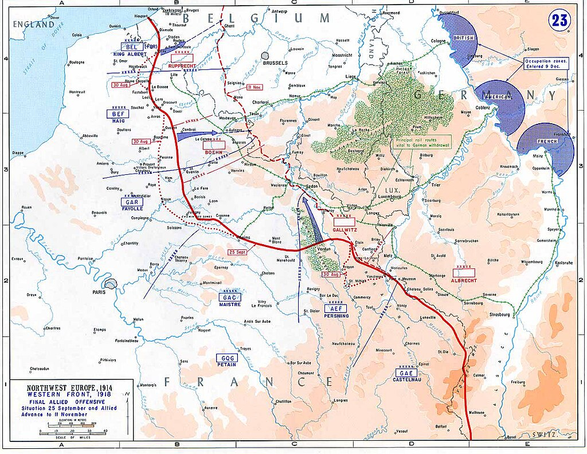
The 100 Days (August – November 1918)
Three coordinated
Offensives
1
August-Sept
British/Australians
break thru @
Amiens..”black day for
German army”
3
(2) September November
US and French attack
Meuse Argonne
2
(3) October - Nov
Canadians and British
Break Hindenburg Line

Slide 27
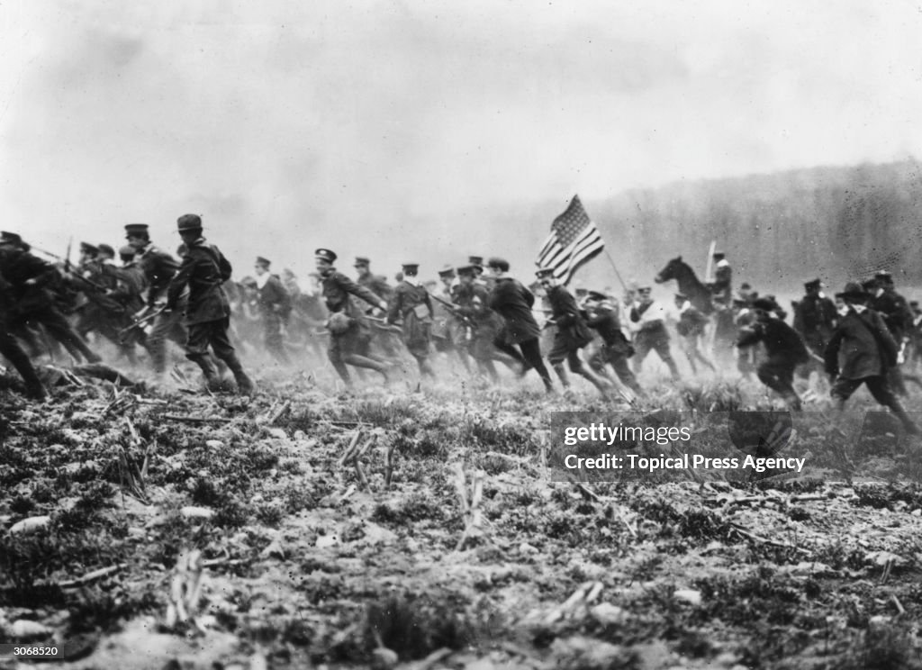
Inappropriate US training= replicate Civil War …….recipe for high causalities

Slide 28
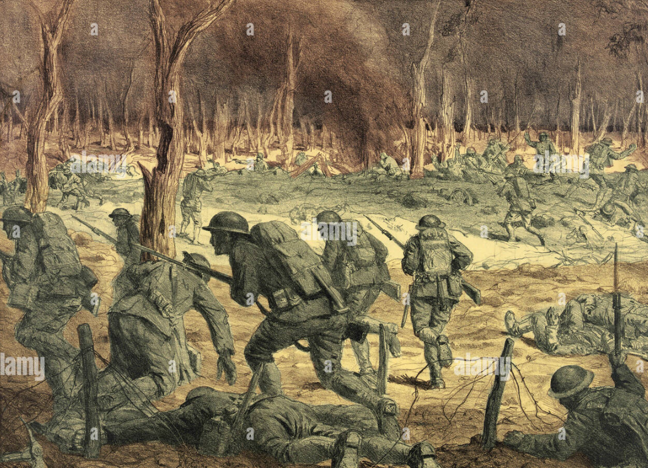
The reality….after first assaults

Slide 29
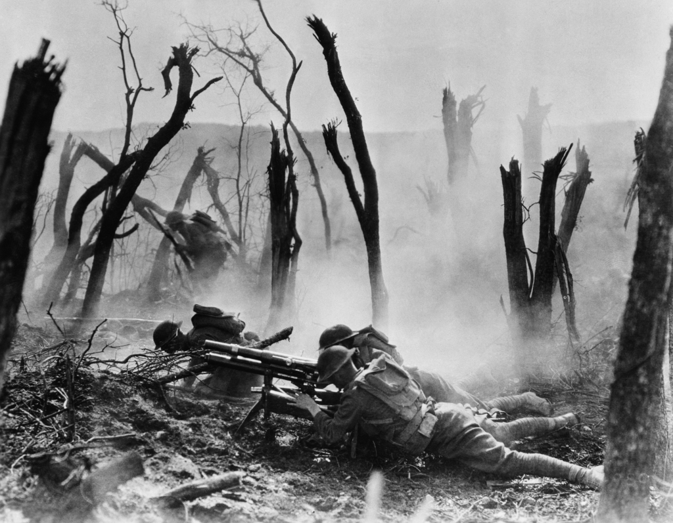
Meuse Argonne : “the wood”

Slide 30
Meuse Argonne Sept-Nov 1918
Led by Pershing as independent command
Largest battle ever fought by USA
700,000 American plus 500,000 French
450,000 Germans
Objective gained…eventually ( Americans gain 15 miles, French 30)
US lose 150,000 including 25,000 killed, French 70,000
….25% of US army killed or wounded, Germans lose 150,000 including 50,000 captured, withdraw to higher ground behind rivers…..no decisive victory
US army proven capable with experience> enthusiasm
Germans lose hope…by November US army 2,000,000 strong and rising

Slide 31
Armistice
German Military recognise position hopeless October 1918
Army disintegrating , Bolshevik revolution, Ottomans, Austria collapse
“Outsource” negotiations to politicians ….attempt deal direct with Wilson
Want ‘cease fire” based on 14 Points” ..Wilson rejects….defers to General Foch
German Socialists cross border to “negotiate”
‘Armistice’…becomes capituluation
Foch imposes surrender: orders Germans to disarm, withdraw, return prisoners
Allies occupy Rhineland
German politicians accept “Armistice”… war ends 11 am November 11, 1918
Blockade continues, German starvation, German prisoners retained till peace treaty

Slide 32
US last attack on Meuse last morning…500 killed by 11am
War Ends 11 am November 11th 1918
German army withdraws, Allied prisoners return, Allies occupy Ruhr Valley
Peace Treaty scheduled January 1919 at Versailles
Wilson leaves US December 1918 to lead negotiations
Believes chosen by God to create A New World Order based on League
… War ended, democracy saved, negotiation to resolve all disputes
….self evident to the American people and the world

Slide 33
He is wrong
….Talk 26: “Transition to “Normalcy”

