Slide 1
American History

Slide 2
Module 4: The vacillating Giant
Talk | Title | Time Period | Date of Talk
23 | USA and the 20th Century | 1898-1900 | September 2nd
24 | The Progressive era | 1900-1916 | September 16th
25 | USA and world War One | 1914-1918 | October 21st
26 | The retreat to “normalcy’ | 1919-1920 | November 4th
26 | The Roaring Twenties | 1921-1929 | November 18th
27 | Great Depression and New Deal | 1929-1941 | December 2nd
29 | Isolationism interrupted | 1932-1941 | December 16th

Slide 3
American History
1
Talk 25: The US and World War One (1914-1920)

Slide 4
Talk 25: US and World War One
Pre war world
Maintaining neutrality 1914-1917
US goes to war
Musical interlude
Western Front 1918
Rendezvous at Versailles 1919

Slide 5
USA and Pre World War One

Slide 6
World 1914: Age competing Empires

Slide 7
State of world 19148
Empires in Conflict: war considered inevitable
Declining : China, Ottomans, Austria Hungary
Rising: Germany and Japan
Threatened by rise of Germany: Great Britain, France, Russia
Alliances in place, details secret
USA isolated
Focus on internal prosperity
Immune from events overseas/ too powerful to threaten
Mexican Revolution will bring war to America

Slide 8
The state of Mexico 1910
Spanish colony 1519 -1820 : population of 6 million equal to USA
1820-1876 years of invasion civil war and chaos
Loss of 50% territory to USA & Texas, invasion by France
Civil wars between “conservatives vs reformists
“Porfiriato” 1876-1911: Stable ‘benevolent’ dictatorship Porfirio Diaz
Alliance army, church, land owners, foreign investors (primarily USA)
Modernisation and reform
Population rises to only15 million (vs 100 million in USA) by 1910

Slide 9
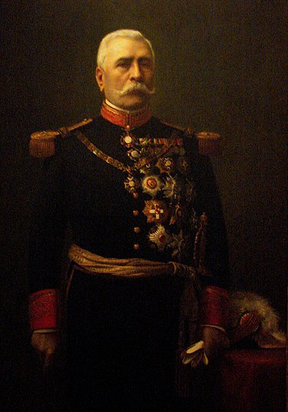
Mexico: collapse of the Porfiriato
Porfirio Diaz (1830-1915)
Rising discontent 1900….
…inequality 1% own 98%
…food shortages due to cash crops
…foreign ownership of land and industry
…strikes broken by use US mercenaries
Rising middle class demand reforms
…fraudulent elections
…US support for “democrats”
Porforio 80 years old
….no succession plan
….ousted by military coup
… exiled

Slide 10
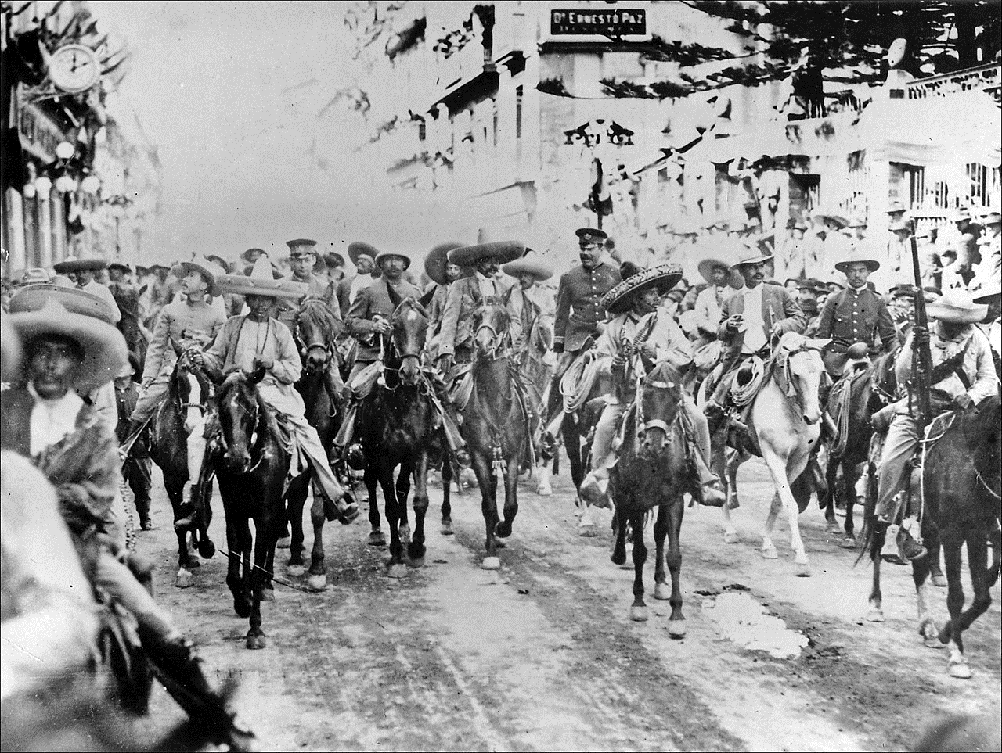
Revolution
Liberal revolt by wealthy
Landowner Madero
…promising land reform
…alliance peasants, workers, army
Revolutionaries seize Mexico City 1911……moment of unity
Madero loses control
….reforms too slow
….Federal army seizes power ….Madero shot
Regions revolt:3 way war
…army…General Huerta
… (Pancho Villa- North, workers
…(Emilio Zapata-South..peasants

Slide 11
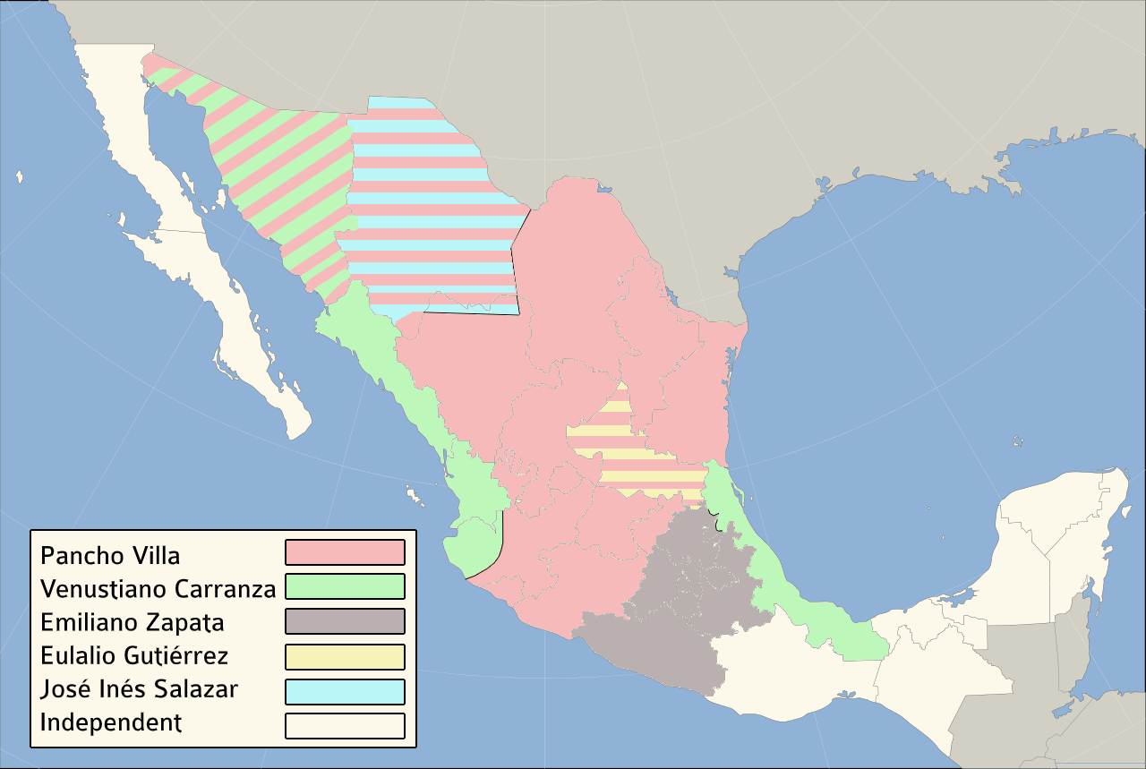
Mexican Revolution 1915: land of warlords
Mexico City
Vera Cruz

Slide 12
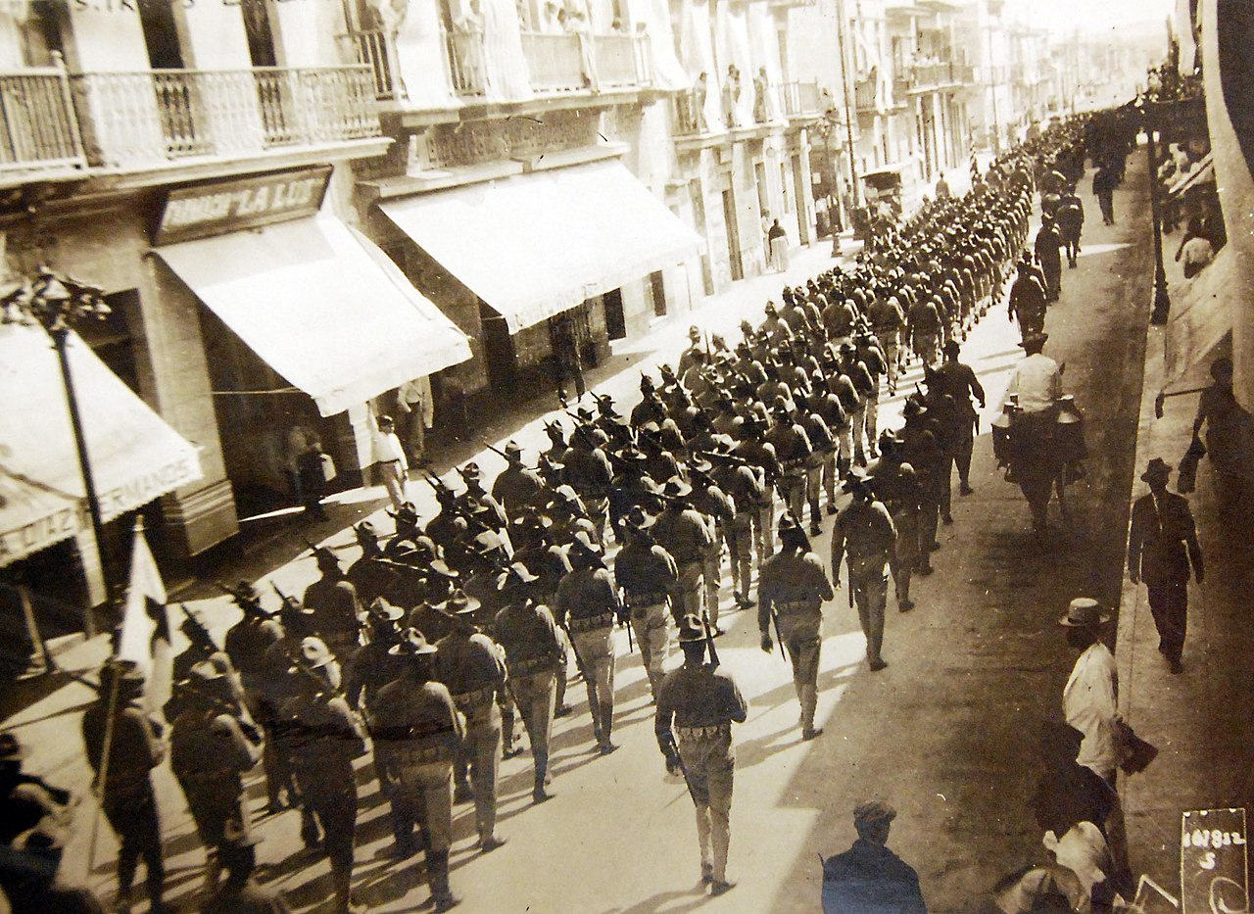
US Intervention
USA won’t recognize Huerta
….arms embargo
….supports rebels
US marines occupy Vera Cruz 1914
Huerta orders arms shipment
….. Wilson thinks German plan
……British propaganda?
US invokes “Roosevelt Corollary “
…occupies Vera Cruz
…attempts to seize arms
…200 Mexican, 20 US soldiers
Huerta exiled,
New general Carrazon takes power
….Constitution written
….US evacuates Vera Cruz and
abandons Villa& Zapata

Slide 13
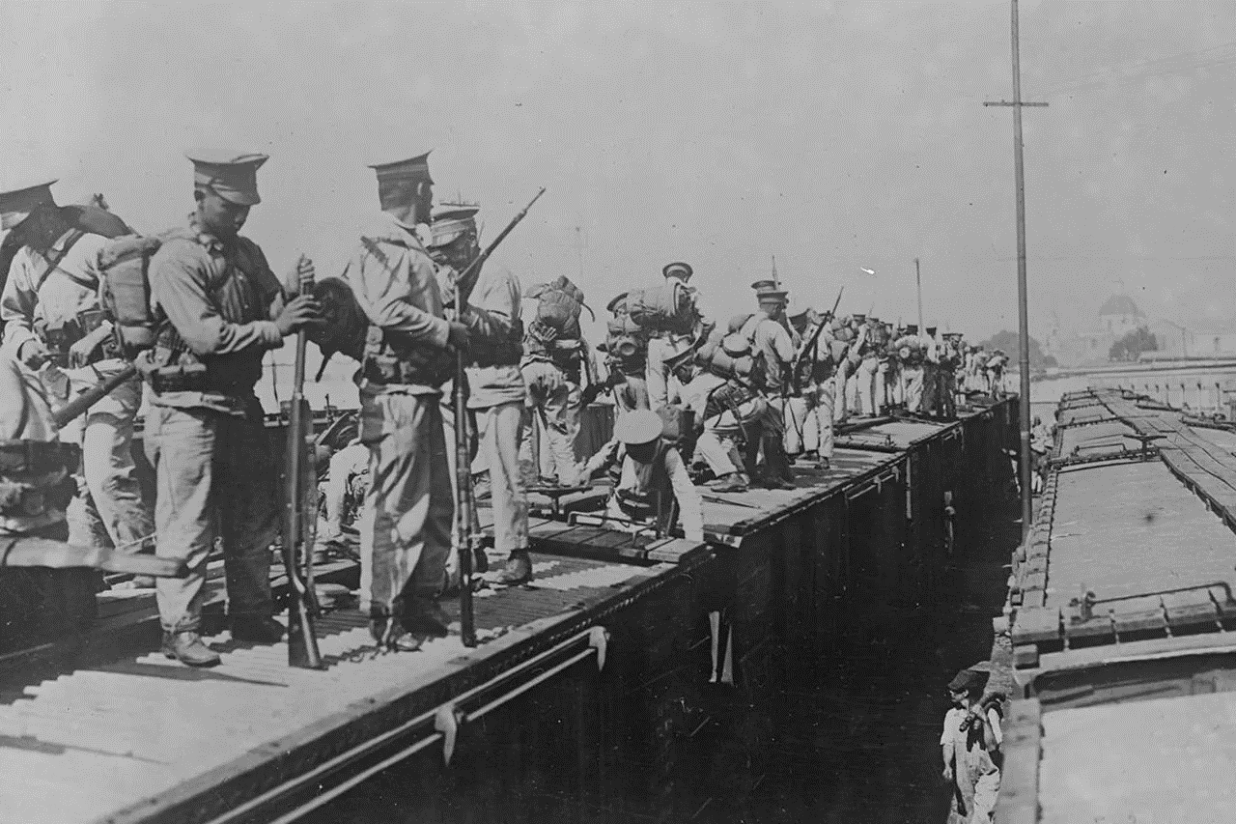
Carrazon seeks to crush rebels

Slide 14
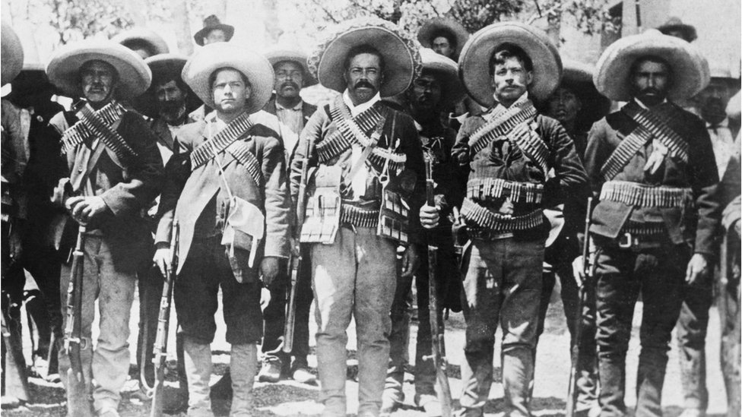
Rebel army of Pancho Villa:

Slide 15
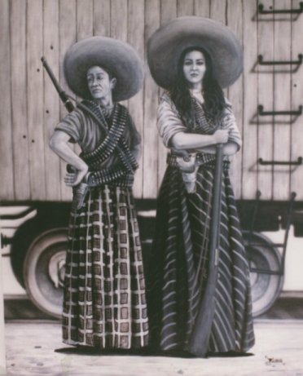
Soldaderos: fight on both sides

Slide 16
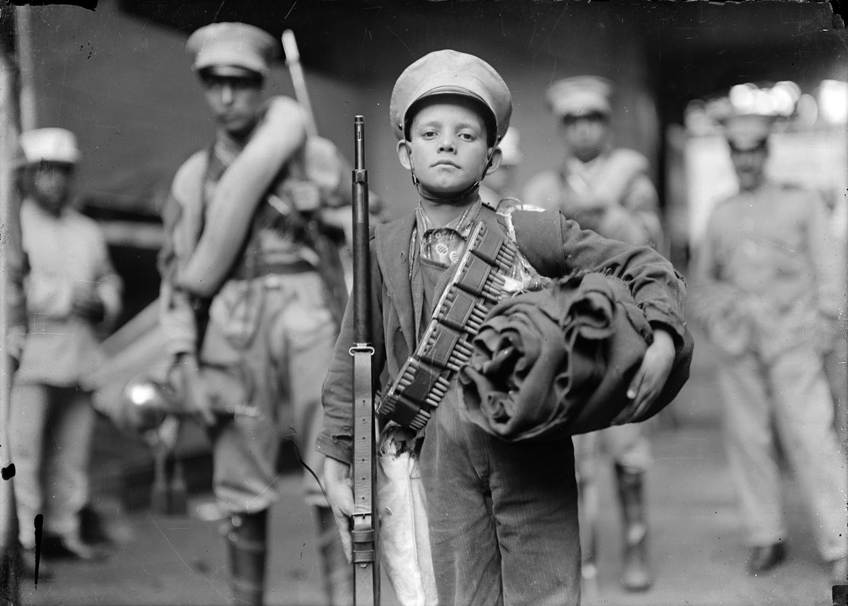
Children at war

Slide 17
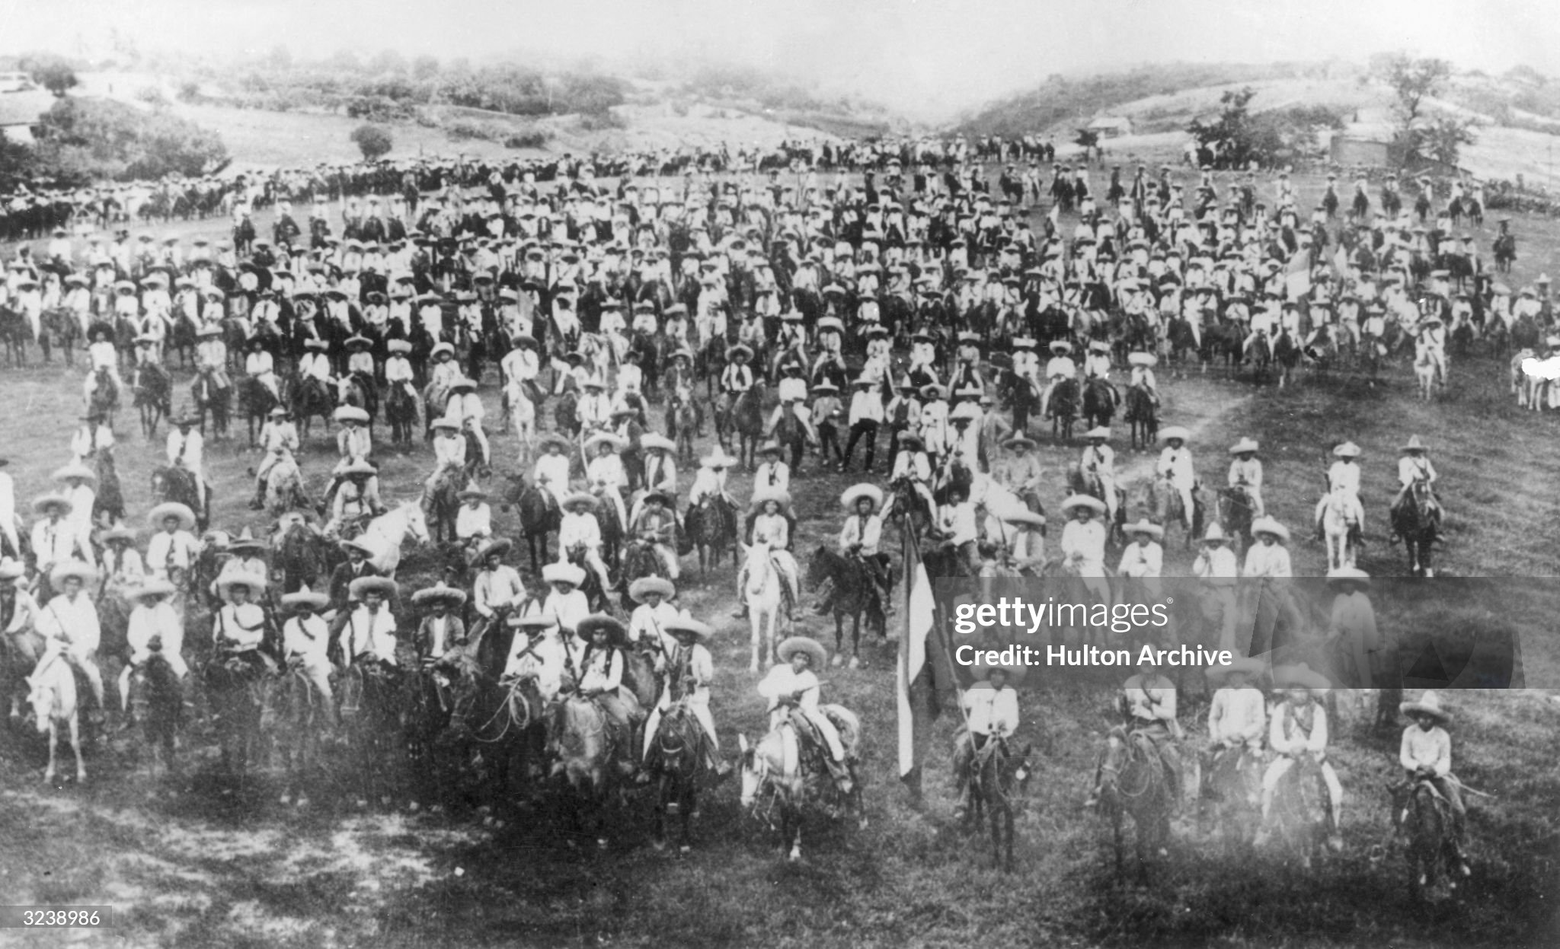
Pancho Villa’s grab for power
Annihilated by machine guns of “Fedarales” at battle of Celaya….loses 50,000 men

Slide 18
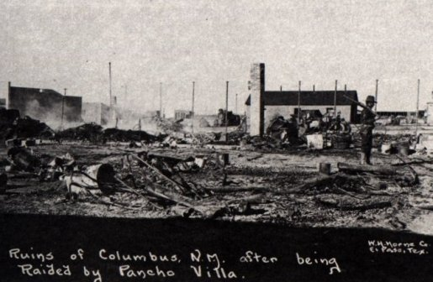
War reaches USA
Villa retreats to US Border
Seeks to recover prestige
seize weapons from arsenal
Raids USA
500 men attacks town of Columbus Murder 20 civilians, burn town to ground
Columbus New Mexico March 1916
US army barracks mobilised
cavalry charge
100 Villa soldiers killed, 10 US
US outraged…Germans suspected

Slide 19
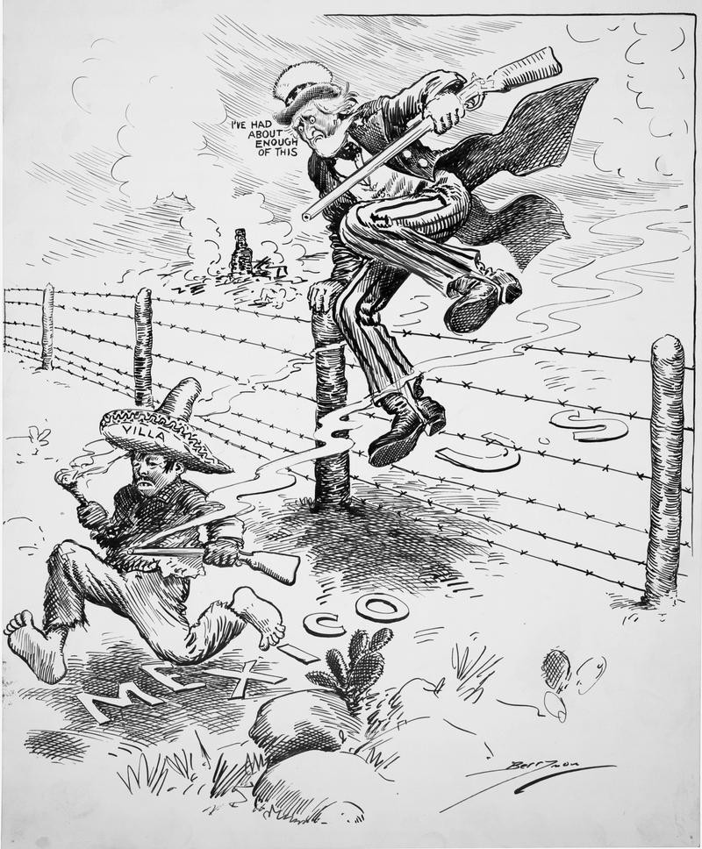
US “invades” Mexico: Punitive expedition 1916/1917
Wilson sends 8,000 marines
to catch/kill Villa
Army invades 100 miles south
of border. Welcomed…at first
Minor skirmishes
Villa escapes
….national hero
….militarily weakened
US abandons efforts
…now at war with Germany

Slide 20
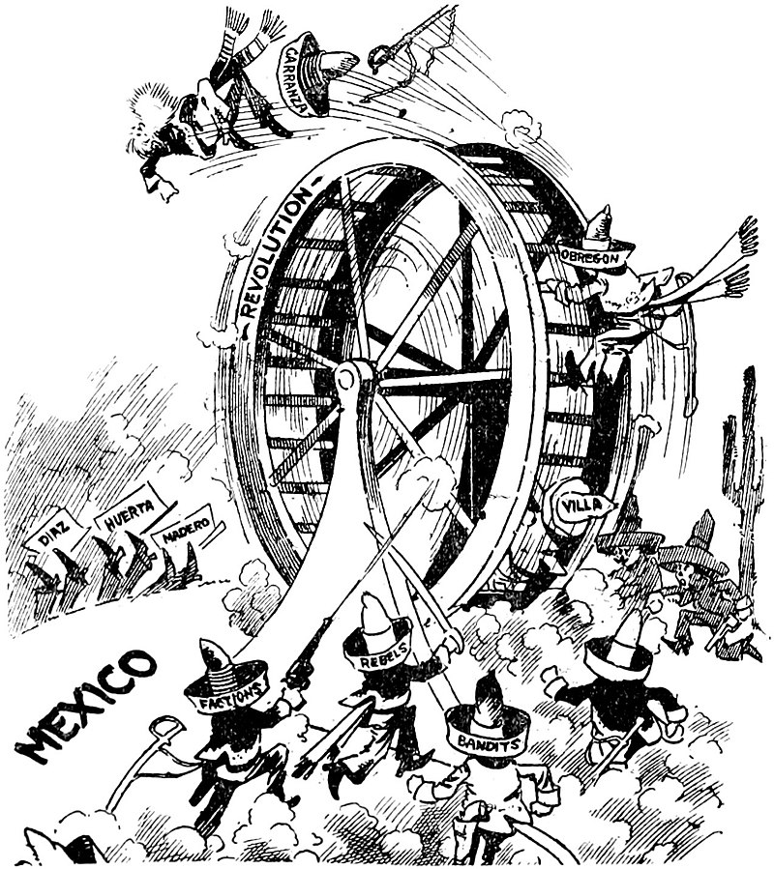
End of the Revolution …
Carrazon persuades
Villa to “retire”
Sets up Peace Treaty with Zapata…has him shot
General Obregon seizes power…Carrazon shot
Obregon becomes first
President 1920-1924
….has Villa shot
….assassinated 1928

Slide 21
Maintaining Neutrality 1914-1917

Slide 22
World War One
War breaks out August 1914
Heir to Austrian throne assassinated by Serbian nationalists
Alliances triggered: Germany/ Austria/ Ottomans vs France, Russia, Britain
President Wilson: US neutrality with no preference
British announce blockade all trade to Germany November 1914
Wilson protests…demands “freedom of the seas”
Britain rejects demand
Agrees to purchase goods on any American ship seized
Wilson agrees to British terms and offers loans

Slide 23
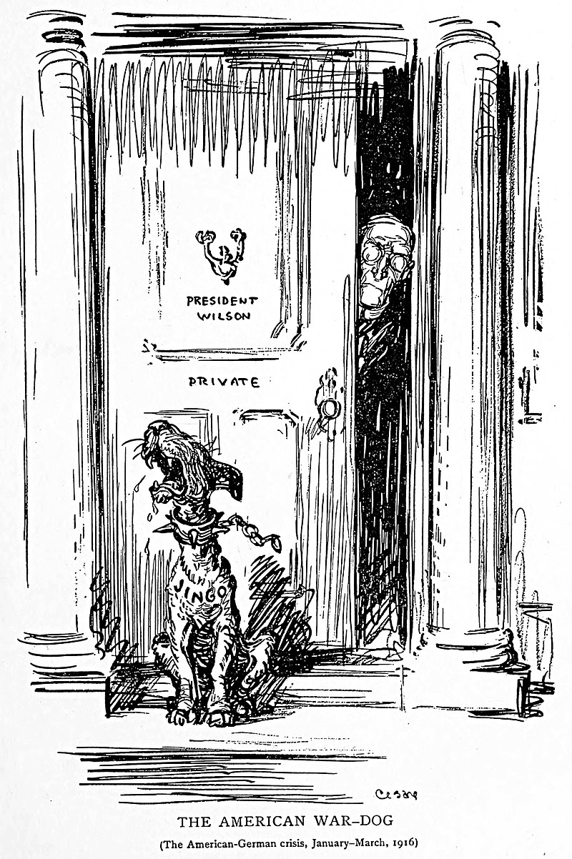
Americans vs War
Wilson anglophile….frequent visitor, admirer Oxford
Large German & Irish population 1910
50% British
15% German
10% Irish
Republicans pro war
Theodore Roosevelt “dog of war”
Declare Wilson is weak
Wilson committed to peace
US 1914 cartoon: “Dogs of war kept out!”

Slide 24
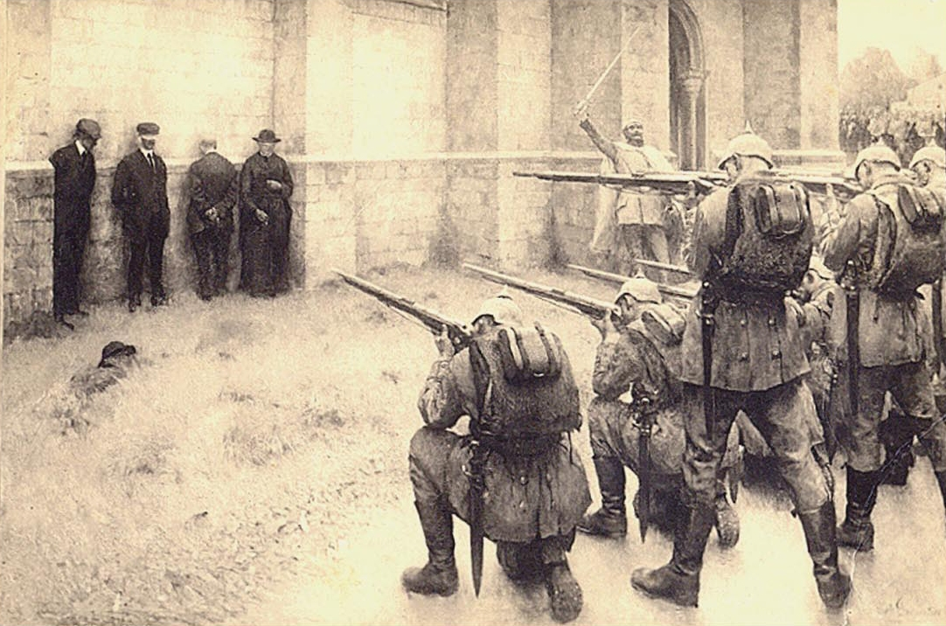
Belgian atrocities
“Execution of the notables” Blegny 1914
Germany invades Belgium
…army mostly conscripts untrained
…told Belgium would surrender
Belgian civilians resist
German army goes bezerk
…5,000 civilians executed
…burn cathedral city of Louvain
…atrocities published (as in Cuba)
British commission Bryce Report 1915
….published in USA
….feeds anti German feelings
Propaganda…..but also true

Slide 25
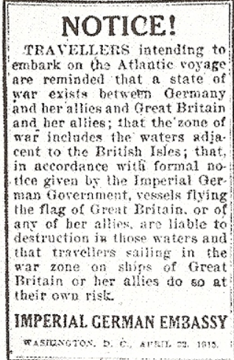
Submarine warfare 1914/15
Stalemate on Western front
British blockade effective
…food shortages in Germany
…US accept British interference
Germany announce counter blockade
…30 operational submarines 1914
…sunk 21 merchant ships 1914
…doubles fleet to 60 1915..overconfident
Issue warning: sink “any” British ship
…50 US newspapers
…day before Lusitania leaves New York
with 1,900 passengers and crew
……and 173 tons armaments (guns& ammo)

Slide 26
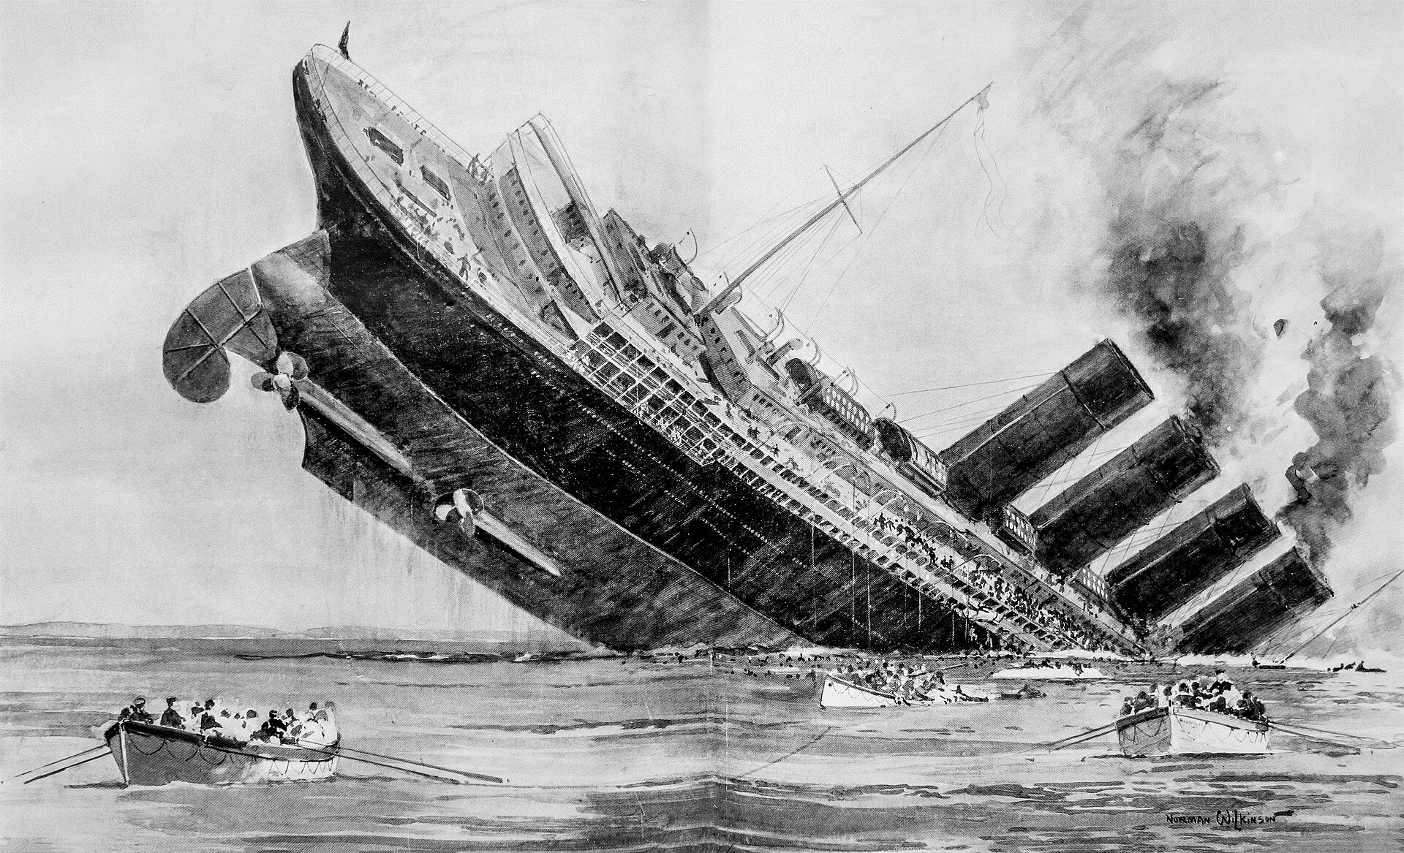
Sinking of Lusitania
British passenger ship
… largest in service
….thought “too fast” for sub
…escorts sent but can’t find
Sinking of Lusitania May 7, 1915
Torpedoed off Irish coast
…..1,200 out 1,900 die
….126 Americans
No warning, sub submerged
….flying British flag
…secondary explosion
Outrage in USA
…”barbaric Huns”
…demand apology
Germans applaud
…legitimate target
…munitions intercepted

Slide 27
Impact of Lusitania sinking
Diplomatic crisis US and Germany
Germany refuses apology
Blames munitions/Gave warning
Britain…no regrets…munitions small arms only and within law
Wilson imposes restraint : “There is such a thing as a man being too proud to fight. There is such a thing as a nation being so right that it does not need to convince others by force that it is right.” ….(US “too proud to fight)
Germany changes tactics
Expresses “regret” over incident
Abandons “unrestricted warfare
Restricts sinking to merchant ships only

Slide 28
Events 1915…1916
In the US:
Wilson and Democrats win election of 1916 “He kept us out of the war”
Public opinion increasingly pro Allies (Belgium, Lusitania)
US providing loans to allies but not Germans
…$10Bn by 1918 ($100m Germany)…Morgan’s 1% commission
War continues
Allied and German offensives fails, naval stalemate at Jutland
Russian army and state falling apart
German Submarines effective (100 deployed, 1,000 ships sunk)
German harvest fails….malnutrition expanding
Germany must change strategy…or lose

Slide 29
German Decisions
Russia can be removed from war
...`.regime unstable…Revolution of February 1917
….support Bolsheviks “bread and peace”
Americans will inevitability join the war to recover loans made to allies.
Britain and France can be defeated before Americans arrive
“Unrestricted warfare” to starve Britain
…submarines increasingly effective ..1,000 ships sunk 1916, 3,000
Concentrate army on Western front to crush French and British
Americans will take 2 years to mobilise
…can be delayed by “distractions”

Slide 30
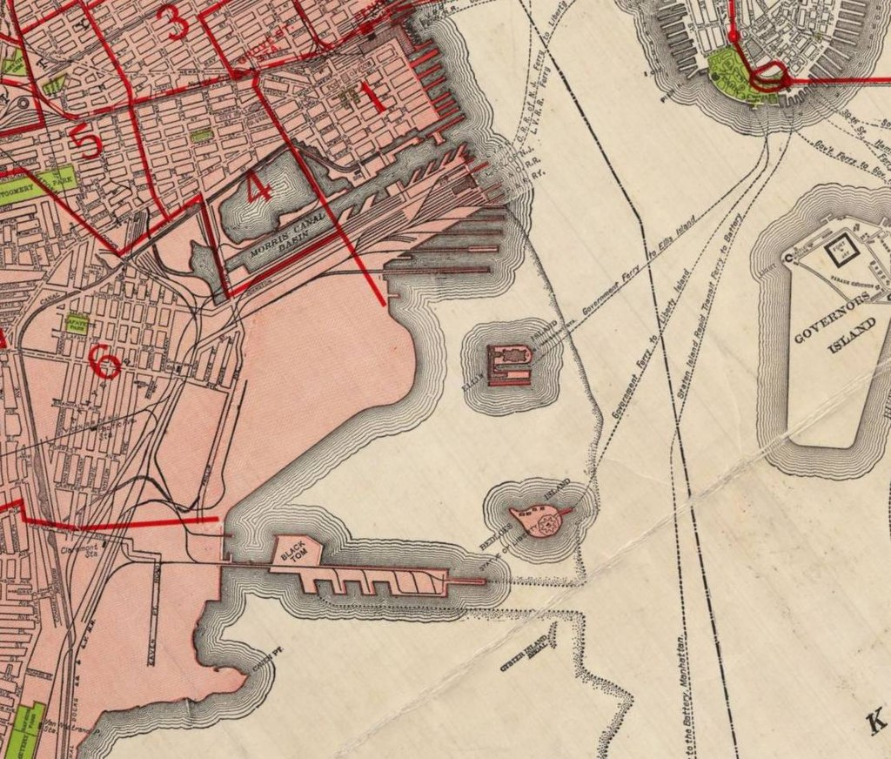
Big Tom: Jersey Harbour
US selling munitions to anyone
…British blockade
…munitions to Allies only
Munitions stored in NY
Before shipment at
“Black Tom”
Statue of Liberty
German agents target
….guards
….security
Black Tom
Set off bombs July 31, 1916

Slide 31
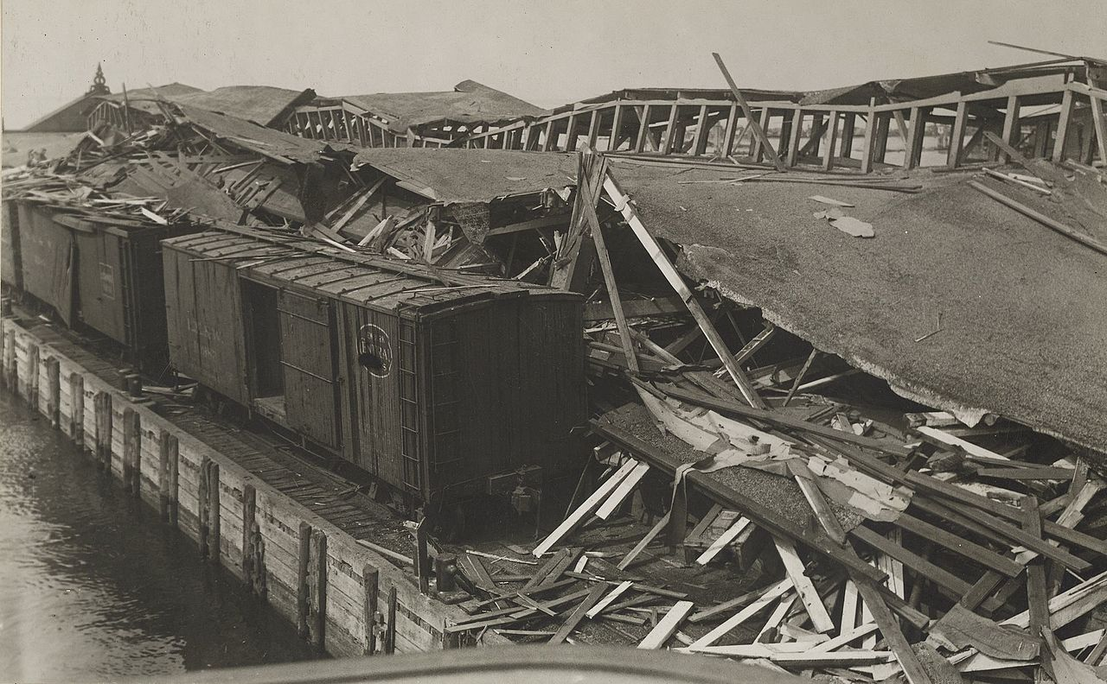
Biggest explosion recorded to date ….45K explosions for Russia: earthquake 5.5
Largest explosion recorded to date
windows shattered 25 miles away
5.5 scale local earthquake
4 killed, $20m in
Damage, 2,000 tons of TNT for Russia, 4 killed, 100 rail cars
…Statue of Liberty damaged
…agents captured
Wilson does not retaliate
….Jan 1917 “Peace without victory”
…offers to act as “peace broker
Germans assess Wilson as weak

Slide 32
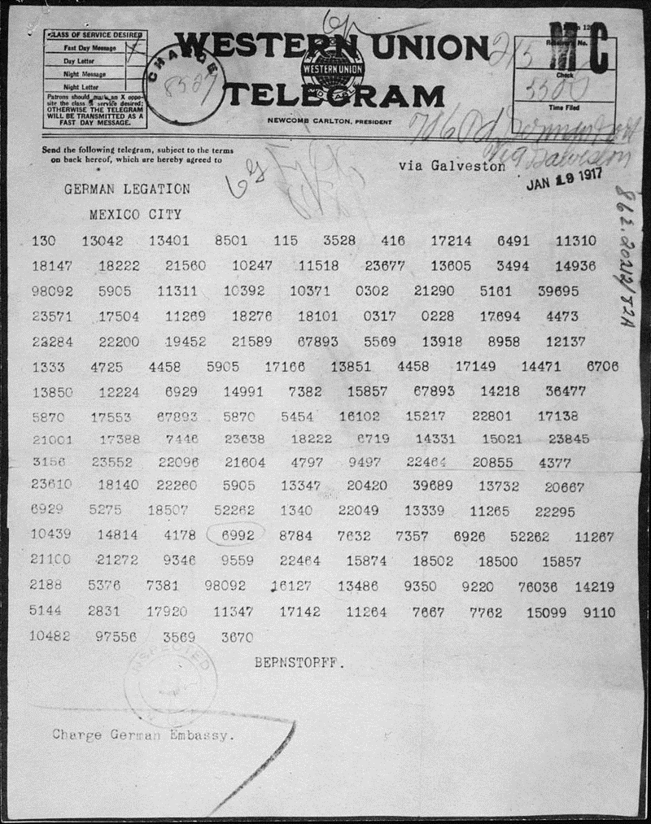
Zimmerman telegram
Germans to launch “unrestricted submarine war February 1917
….all ships a target
…attack “without warning”
Ambassador Zimmerman's telegram
....announce “unrestricted war
…. incites Mexico to recover land lost to USA
… suggest united attack with Japan
British intercept…decode..release to US
Viewed as “act of war” by Wilson

Slide 33
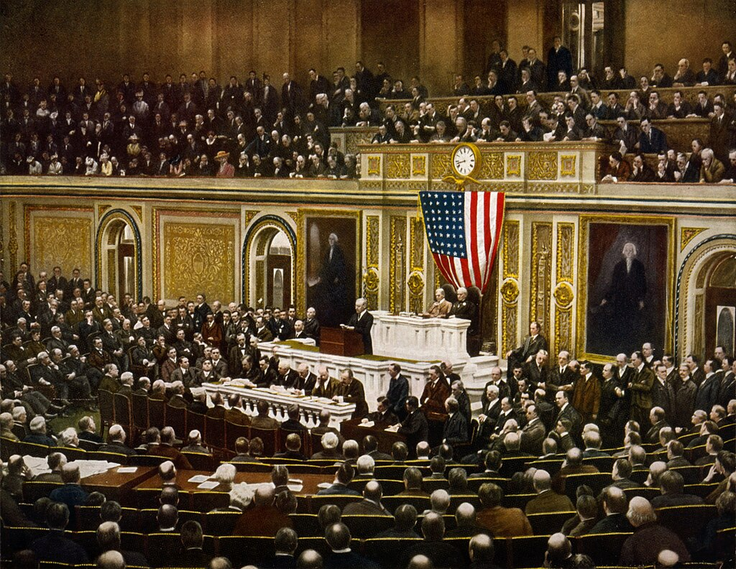
US goes to war April 6, 1917
Wilson addressing Congress
German announce “Unrestricted war” effective April 1st
Wilson: “attack on US sovereignty” ….Germany telling US where to trade
….Speech to Congress: “World must be made safe for democracy”
Congress votes for war
..Senate 82-6, House 373-50
Anti war (Democrats) argue
British equally guilty
..prevent trade with Germans
..purpose of war financial!

Slide 34
US goes to war

Slide 35
State of US April 1917
Financial infrastructure to finance war not in place
Large anti British immigration population
15% population German, 10% Irish background
US Regular army too small to make an impact
180,000 strong vs 5 million German army)
No modern war experience, artillery, logistics
Wilson must create financial structure and crush dissent

Slide 36
Crushing domestic opposition
Espionage and Trading with enemy act April 1917
Crime to broadcast enemy success/ convey information to enemy
Post office intercepts suspect mail
Punishable by 30 years….or death
Alien and Sedition Act May 1918
Crime to “"any disloyal, profane, scurrilous, or abusive language about the form of government of the United States ... or the flag of the United States, or the uniform of the Army or Navy".
Enforced fast and with rigour
All films, books considered anti British banned
10,000 arrested and imprisoned till war’s end
Eugene Debs Socialist jailed
Movie producer “Spirit of 76” Robert Goldstein…considered anti British

Slide 37
Creating financial infrastructure
Income Tax
Introduced during civil war, removed 1872
16th Amendment passed 1913 to reduce reliance on tariffs
Reintroduced 1917…top rates raised to 77%
Liberty Bonds
First issue for $2Bn April 1917 @ 3 1/2 % interest
$20Bn raised by Septembr 1918
Interest tax exempt
Committee of Public Information established to Sell the war
…….frenzy of propaganda launched

Slide 38
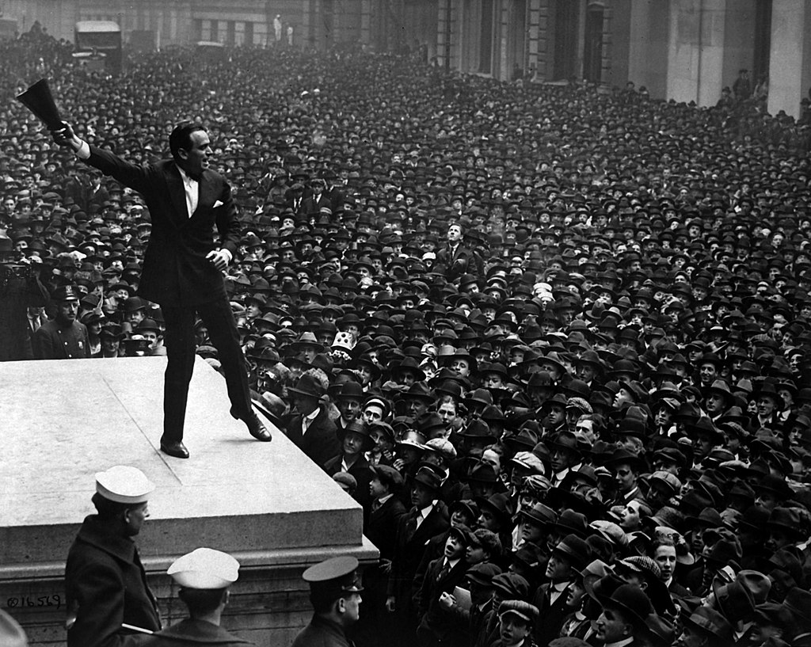
Selling Liberty bonds (Douglas Fairbanks Jnr 1917)

Slide 39
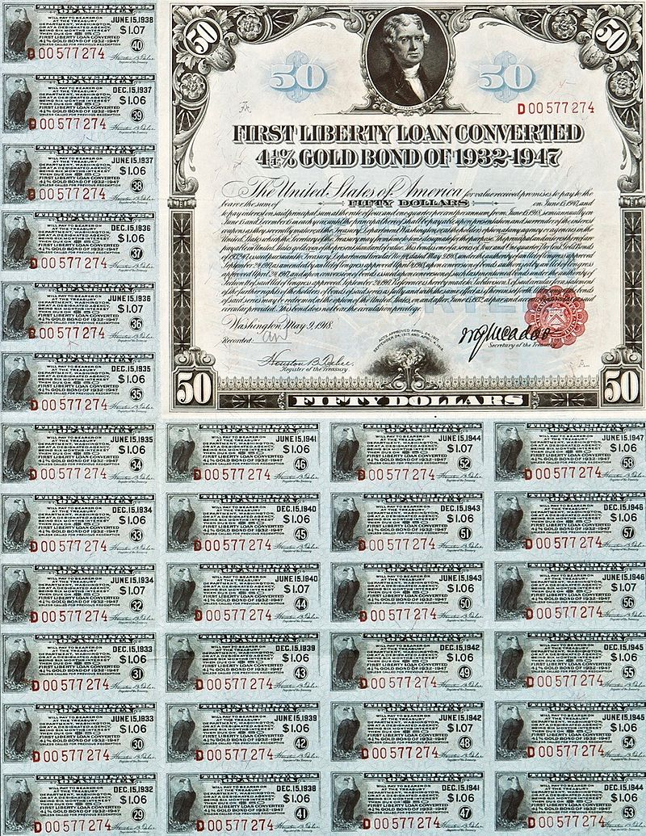
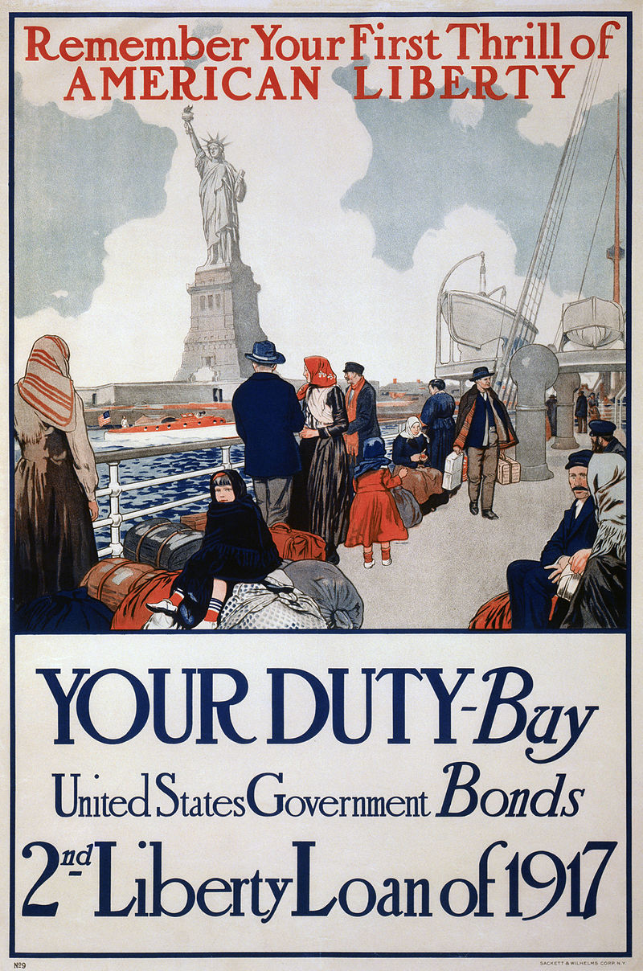
Liberty Bonds
The Bonds
Selling to immigrants

Slide 40
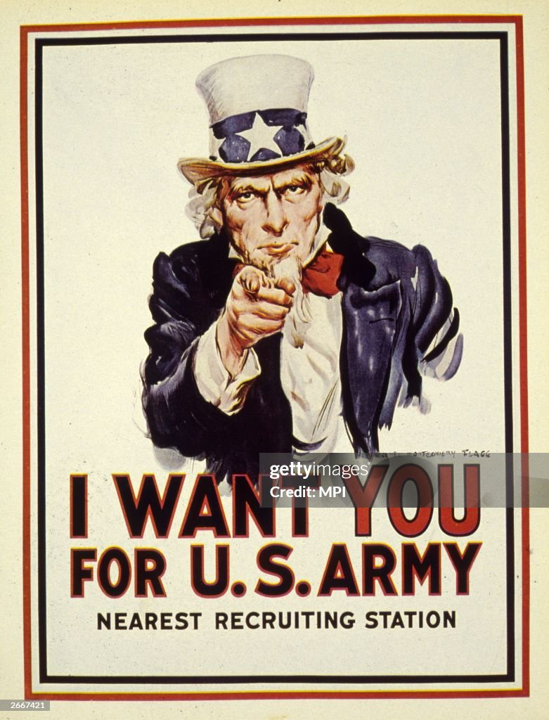
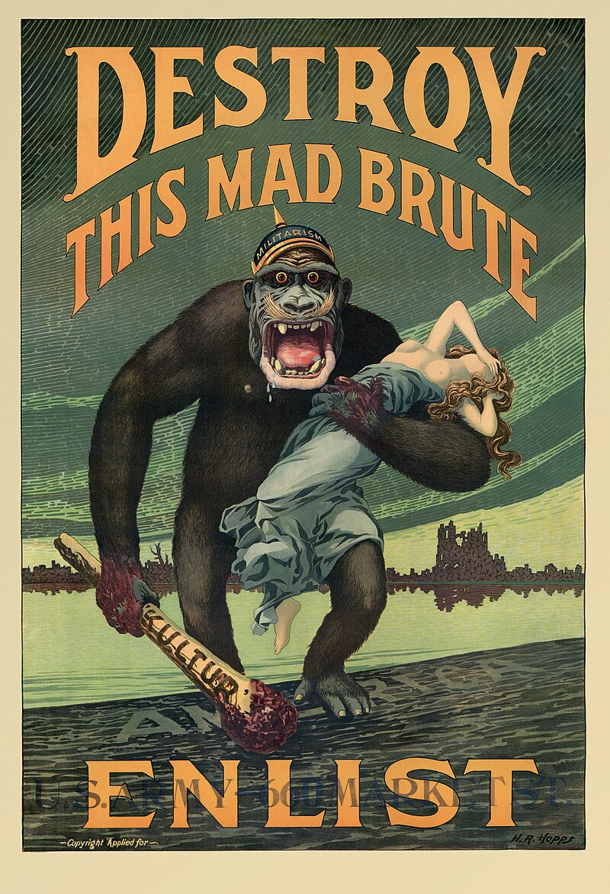
Committee of Public Information

Slide 41
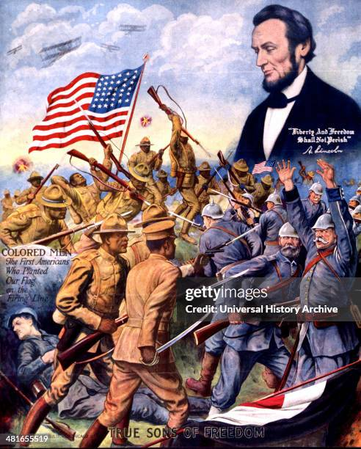
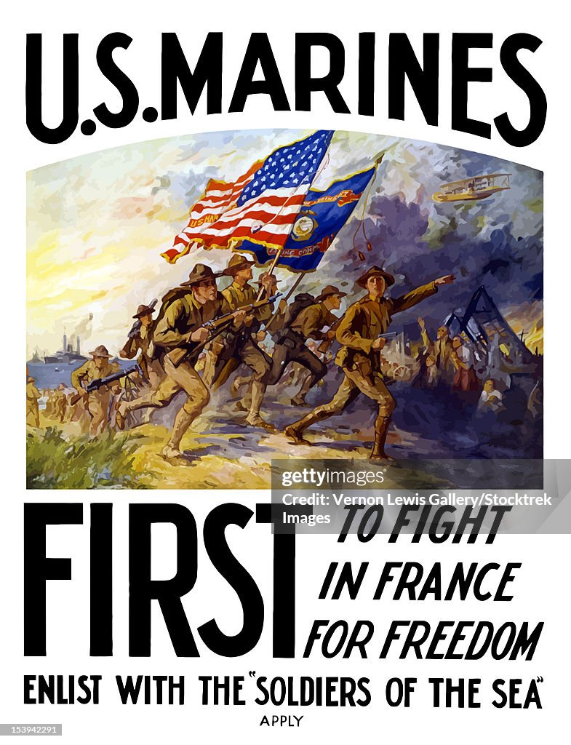
Recruiting posters
Flag waving…young men
…even to African Americans

Slide 42
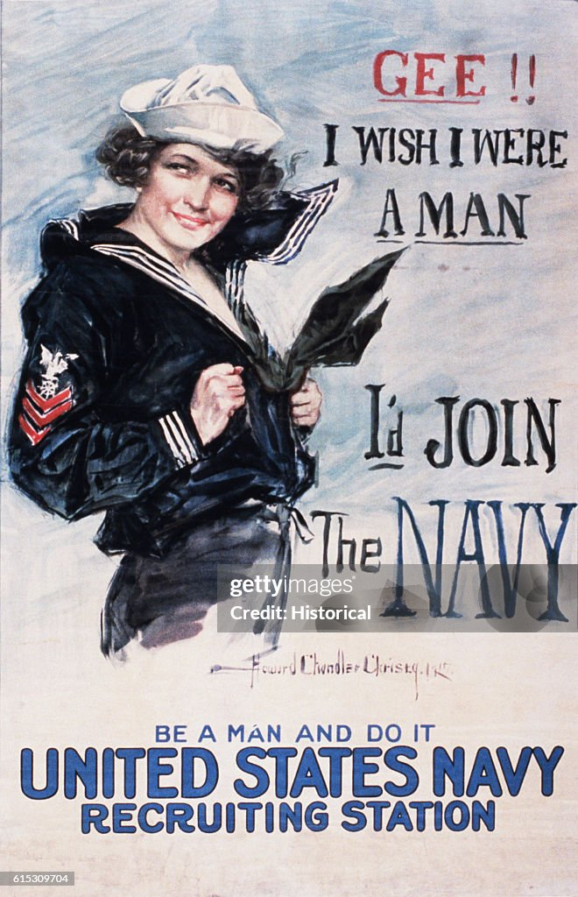
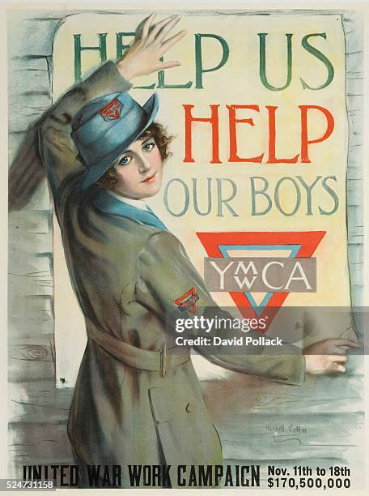
Appeals to women
Making war “sexy”
….and maternal

Slide 43
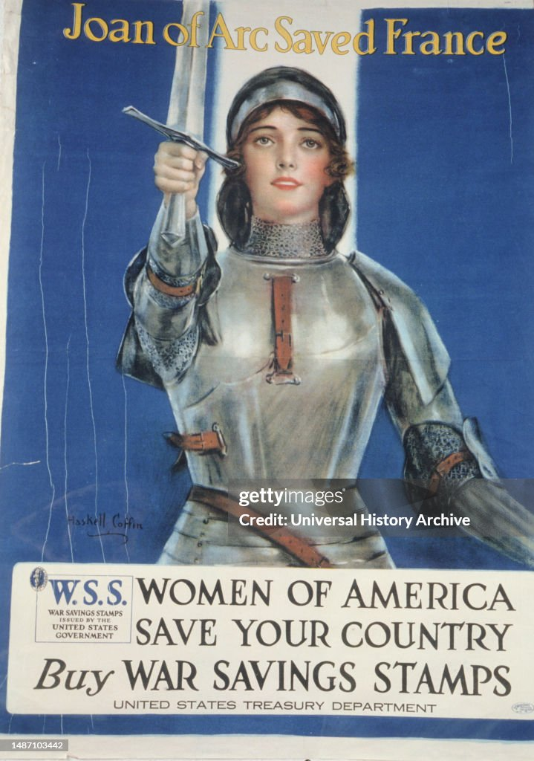
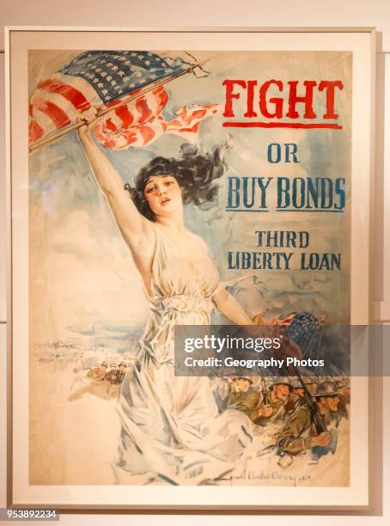
Appeals to women

Slide 44
“Over There” (George Cohen 1917)
Johnnie get your gun, get your gun, get your gun, Take it on the run, on the run, on the run; Hear them calling you and me; Every son of liberty.
Hurry right away, no delay, go today, Make your daddy glad, to have had such a lad,
Tell your sweetheart not to pine, To be proud her boy's in line.

Slide 45
Over there, over there, Send the word, send the word over there, That the Yanks are coming, the Yanks are coming, The drums rum-tumming everywhere.
So prepare, say a prayer, Send the word, send the word to beware, We'll be over, we're coming over, And we won't come back till it's over over there.

Slide 46
Johnnie get your gun, get your gun, get your gun, Johnnie show the Hun, you're a son-of-a-gun, Hoist the flag and let her fly, Like true heroes do or die.
Pack your little kit, show your grit, do your bit, Soldiers to the ranks from the towns and the tanks, Make your mother proud of you, And to liberty be true.

Slide 47
Over there, over there, Send the word, send the word over there, That the Yanks are coming, the Yanks are coming, The drums rum-tumming everywhere.
So prepare, say a prayer, Send the word, send the word to beware, We'll be over, we're coming over, And we won't come back till it's over over there.

