Slide 1
American History Talk 24 “The Progressives Part Two”

Slide 2
Panic of 1907

Slide 3
Panic of 1907: State of US Banking
National Bank abolished by Andrew Jackson 1836
“Independent Treasury System” established 1840;s
Adjust reserves of 1000’s independent banks by regulating stocks of gold
Control bank behaviour by controlling supply of gold
No mechanism to adjust money supply rapidly: Panics 1857, 1873,1893
US financial system increasingly unstable
Trusts broken up, reduced profits…but many remain and interlinked
Exports rising, imports protected…too much Gold to US
British raise interest rates to retain gold
Vulnerable to shocks: (1) Earthquake and (2) Stock manipulation

Slide 4
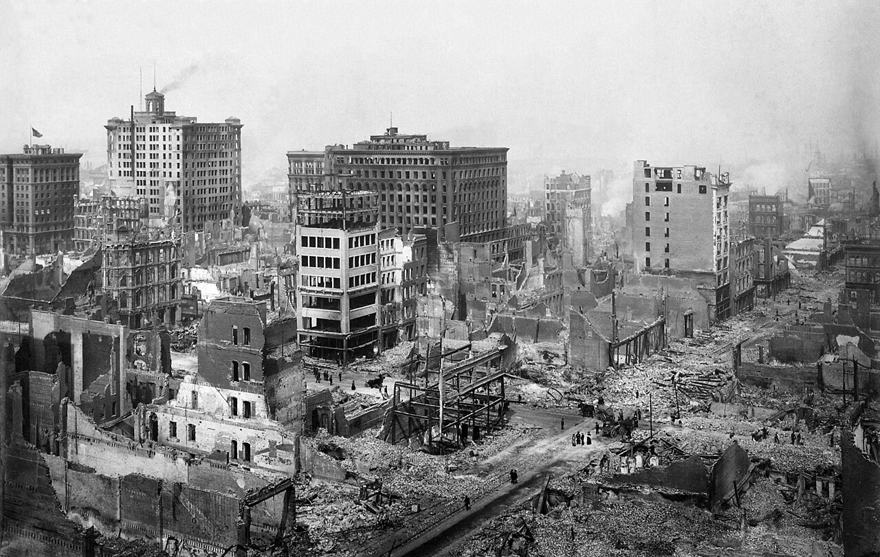
San Francisco Earthquake 1906

Slide 5
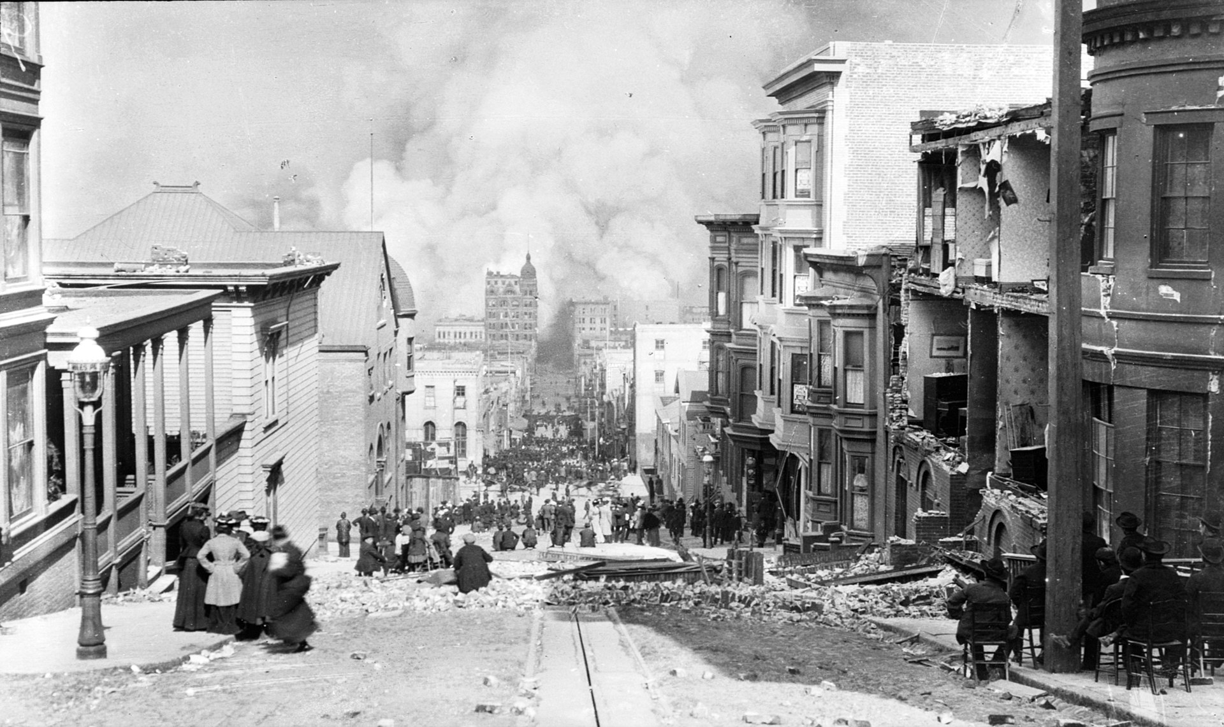
3,000 killed, 300,000 out 400,000 homeless…$29Billion (2024) damage…surge in demand for gold creates liquidity crisis …British interest rate rises

Slide 6
The first “Big Short“ Corner” Copper Market in 1907
Short selling
Borrow stock for X limited at £100 a share from Broker
Sell X limited shares at £100 and buy option to buy same shares in 3 months for £10
Price of X shares falls to £10
Buy shares at X limited at £10 and returns shares to Broker
Takes profit of £90
Dangers of Short Selling if price of X limited stock rises
Stock of x company rises to £200
Short seller must buy stock at new price
Potential unlimited loss……Broker can demand loan repayment

Slide 7
Stock Price Manipulation…and its effects
The attempted “Corner”
Copper Magnate August Heinz moves into banking business
Brother Otto wants to take over firm….believes other stock holders shorting stock
Uses dodgy bankers to mass purchase stocks to raise price and “Squeeze” short sellers and force stock transfer…borrows millions
Price rises from $39 to $62 per share in one day
The disaster
The “Squeeze” fails …short sellers few and secure financing, stock repurchased
Market realize stock price increase due to Otto’s purchase
Price of United copper collapses to $10…Otto ruined
Panic spreads across banking system……suspicion stock values.. N
NY City set to default

Slide 8
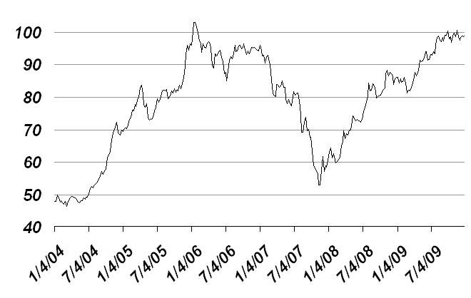
Panic of 1907…impact
Manipulation
exposed
Enter PK Morgan Bank
..support from Rothschild in UK
...gold transfer from UK to US
Morgan
intervenes
Real market effects:
….Multiple bank failures
….Production falls 11%..3 yrs to recover
….Unemployment rises from 3% to 8%
Political effects:
….Morgan demands freedom buy
Carnegie Steel & create US Steel
…new “Trust”
…Teddy Roosevelt blackmailed
but has to relent to protect economy
US destiny …to be defined by Morgan?

Slide 9
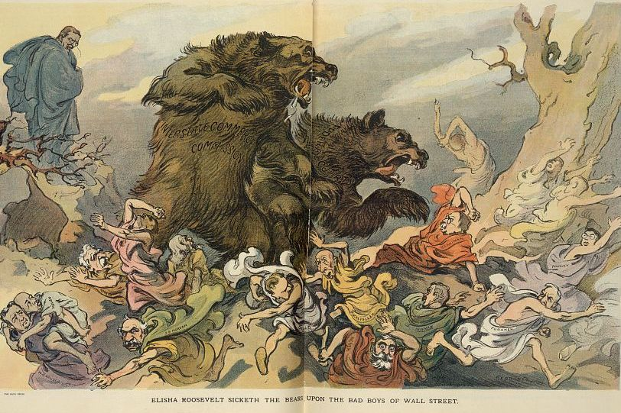
T
Teddy Roosevelt turns on the banks
….dependency cannot recur
….establishes commission to investigate and reform banking system

Slide 10
Transition to Taft

Slide 11
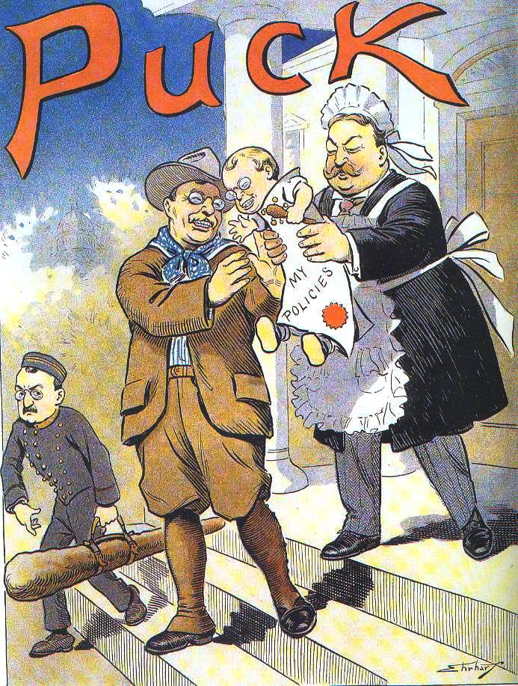
Transition to Taft & Bull Moose election 1912
Teddy promised to avoid 3rd term
….considers it undemocratic
…major reforms and policies in place
…wants adventure
Convinces Republicans to choose
Reluctant friend Howard Taft to run
….and do what he says
Republicans win 1908 election
51% of vote…
Roosevelt to Africa for 2 years
… big game hunting…nature
…supports British efforts to create
protected game reserves

Slide 12
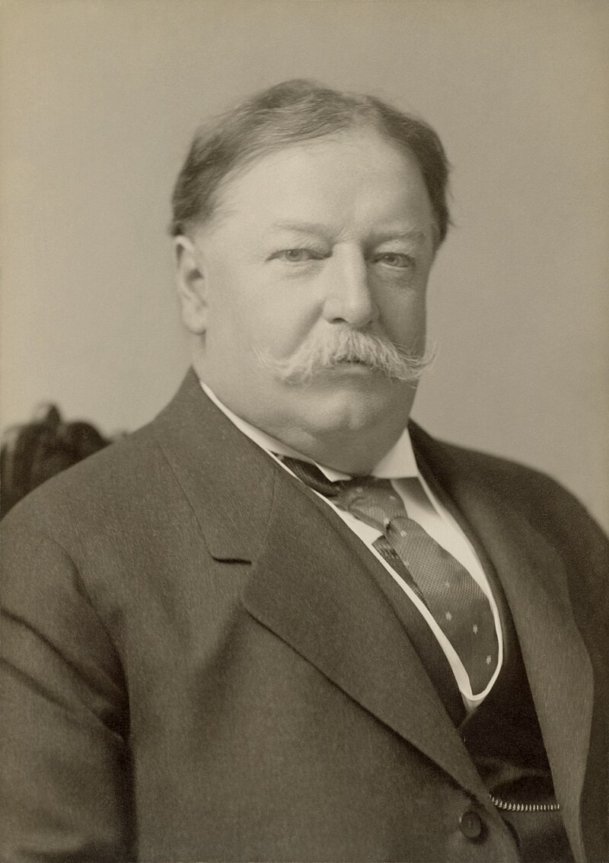
Howard Taft Presidency 1908-1912
Wealthy family. Friend of Theodore Roosevelt, wants to Be judge…legal scholar ..never elected to office
…dominated by ambitious wife
.. Governor of Philippines & Cuba
….peace and calm
Howard Taft 1858-1930
Nicest man to be President
……Rooms full of enemies made friends
Huge. Subject to ridicule...
…gave seat on tram, 3 ladies accepted
..out riding “how is your horse?” asks aide
…Taft…no response…just smile
Objective in office: tranquillity
…wife has stroke…dedicates himself to her

Slide 13
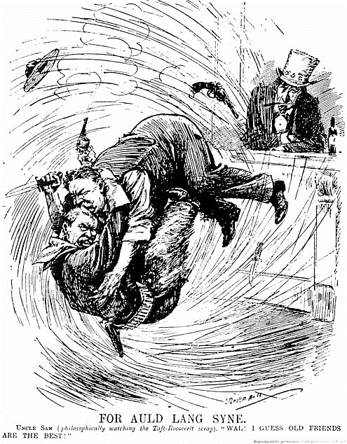
1912 Election
Theodore Roosevelt & Taft fall out
…Taft seeks to break up US Steel …believes TR blackmailed in 1907
…slows down creation of National Parks
…abandons labour reform, child labour
Friendship Broken
TR claims real Republicans betrayed
…”New Nationalism”…social reform
Republican Party Splits
….Roosevelt supports walk out of Convention
… TR Creates Progressive or “Bull Moose Party”
Democrat Convention selects “Progressive”
Governor of New Jersey & Professor of History
Woodrow Wilson

Slide 14
Fight of the “Progressives”
Progressives (Bull Moose):Big Government, social reform, high tariffs
Tours country, Shot while speaking…continues talking.. recovers,
Republicans: Howard Taft: Gradual reform, continue break up of monopolies, does not campaign…not interested in winning
Democrats: Wilson: “New Freedom” platform
Small Government, Break up monopolies, reform banks, reduce tariff, White Supremacy
Socialist: Eugene Debs: All above servants of Business,
Workers rights, unions, end child labour, equal rights for blacks & women

Slide 15
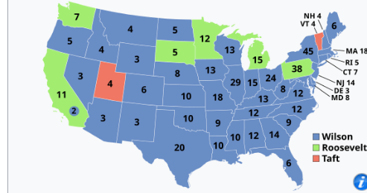
1912 Election Results
First election all 48 states
Women voting in most western states
1912 Election
Democratic electoral landslide
435 electoral votes…40% vote
…Progressives 88 electoral, 27%vote
…Taft 8 electoral, 23% vote
…Debs 0 electoral but 6% popular vote
…highest for Socialist Party
Wilson first Southerner to White House
since Civil War
Democrats control Senate and House
Last election “appointed” Senators
…17 Amendment passed 1913
… elected directly by people from 1914

Slide 16
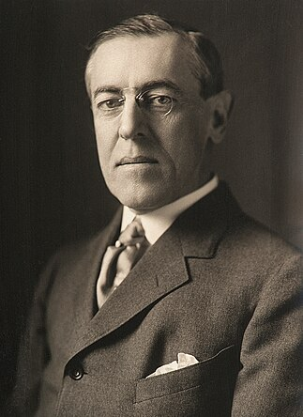
Woodrow Wilson
Born Virginia…father Minister founded Southern Presbyterian Church
..intellectual without friends but admired
..not as admired as he was by himself
Woodrow Wilson 1856-1924
Only US President with PhD (History)
....author US history text books
President of Princeton…Anglophile
….replicates Oxford. Introduces “rigour”
…. exclude blacks from education
Elected Governor of New Jersey
… Progressive & not controversial
Convinced chosen by Divine intervention Determined to apply “Science” to business of government…and only he understood how

Slide 17
‘Scientific’ Government at work
Federal Reserve Act 1913 : Creates National Bank
Lender of Last resort, issue national currency, set interest rates
Board appointed by President, 12
Revenue Act 1913: US government funded more by taxes than excise duty
Income tax on highest earners 1% on top 3% of population
Reduced tariffs from 50% to 20%
Trade & Industry Reforms 1914
Creates Federal Trade Commission to outlaw “anti competitive practices”
Child Labour Act 1916 : approved law but rejected by Supreme Court
Philippines to be given independence after “trial period”…no more empires

Slide 18
Dark side of “Progressivism”

Slide 19
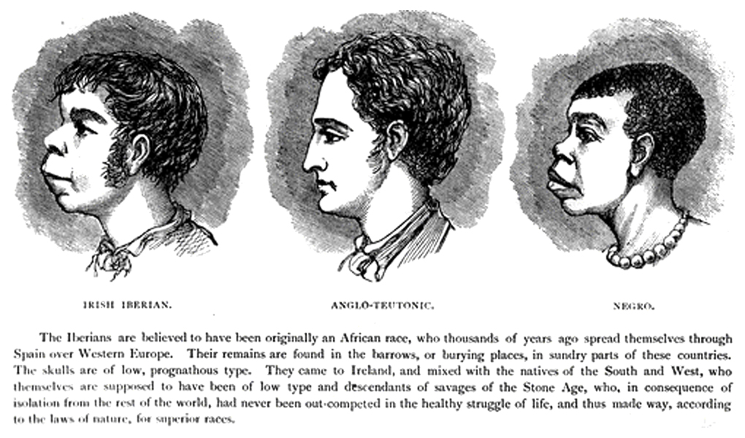
“Scientific Racism”
Humans divided into “taxa”
Pre Darwin….racism justified by “biblical teaching” ….and economics
Darwin: Origin of Species posed question
…but “no racial distinctions that would indicate
that human races are discrete species”
19th/ Century “pseudo scientists”
British professor Dalton: race hierarchy
….Blacks….lowest form
…Europeans “Aryan” non Aryan…non …Aryan/“Nordic”..Iberian, Italians …Slavs…Jewish “race”
Wilson combined “biblical teaching” with
“Scientific proof” of White superiority

Slide 20
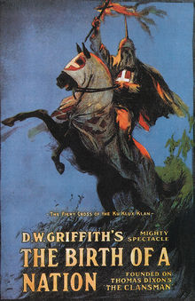
Scientific Racism impact
Wilson orders Federal Government
To segregate blacks in government
First Hollywood 1916 “Blockbuster “
Fires 15 out 17 black managers
Enforces segregation throughout US
Government & US army: black officers fired…including black solders in Spanish war
Promotes first Hollywood blockbuster
… “Birth of a Nation”
…revives “Old South” myth & “Lost Cause”
Shapes legislation and immigration policy
Post 1910…re-emergence of KKK

Slide 21
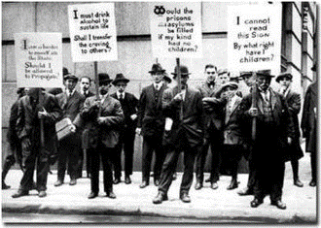
“Eugenics Movement”
Improve the “race” by
‘selective breeding”
Positive “eugenics”…promote
…American Breeders Association
…Better Baby contests…white only
Negative “eugenics”
….sterilisation programmes
of disabled, convicts
… (Buck vs Bell) court support
…60,000 sterilisations 1910-1960
…principally black women in
Shapes immigration and social
Policies through 1960’s

Slide 22
Social Change: Women’s right to vote

Slide 23
US Suffragette Movement 1900-1913
1900-1913
Reject “Woman’s Bible
Discard “Abolitionists” roots practice segregation & encourage support in white South
Leadership white upper and middle class women….link with “Temperance”
Comparisons to British
American reject militant tactics of British
Message “good behaviour & Temperance: “White women model”
Less violent response by US legislators
Evidence of progress….state by state

Slide 24
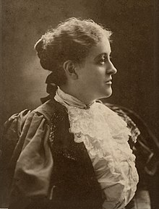
Carrie Chapman Catt (1859-1947)
Modest Iowa family…works way through college
…Agriculture College…demands right to speak
…Superintendent of Schools
…marries wealthy industrialists
Carrie 1901
Attends International Conference 1902
..co writes resolution:
“That men and women are born equally free and independent members of the human race; equally endowed with talents and intelligence, and equally entitled to the free exercise of their individual rights and liberty.”
Leads US Woman’s suffrage movement 1895-1900 &
1915-1920…focus on organisation & discipline,
…..avoids public confrontation
…..accommodates White Supremacy
….segregates blacks…to win South

Slide 25
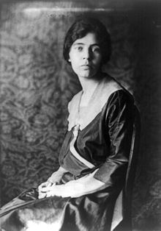
Alice Paul (1885-1972)
Alice in 1918
Born New Jersey...Quaker family
….descendent of William Penn
…joins mother at suffragette meetings
…goes to college, degree in Biology
...then to England
Studies at Birmingham University & Quaker
College, Selly Oak. 1907-1910
….meets Emily Pankhurst/ Webbs/ Socialist
…joins militant protest..arrested …hunger strike
Returns to ….Joins NWSA
….Catt & committee disagree
….rejects conservative state by state approach
…organises “Suffrage Procession of 1913

Slide 26
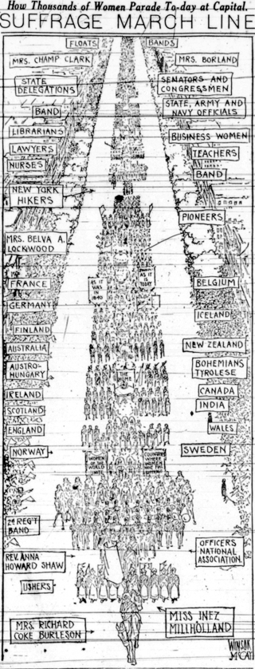
1913 Women’s Suffrage Procession
First ever march by women
To fight for rights
Alice organises to take place
Alongside Wilson’s inauguration
Plan: maximise publicity and
present orderliness
...8,000 women, all nations
… 500,000 spectators ….led by Inez Mulholland
, lawyer…on white horse

Slide 27
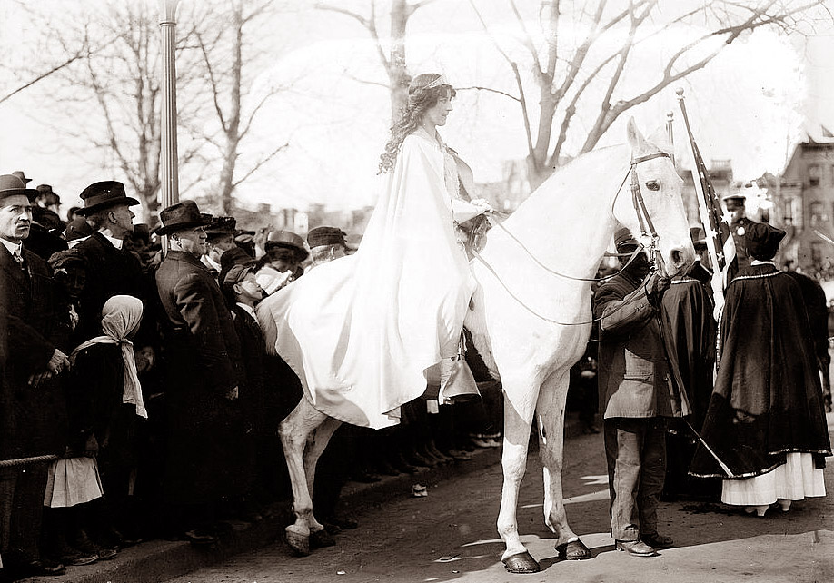
Women’s Suffrage Procession 1913

Slide 28
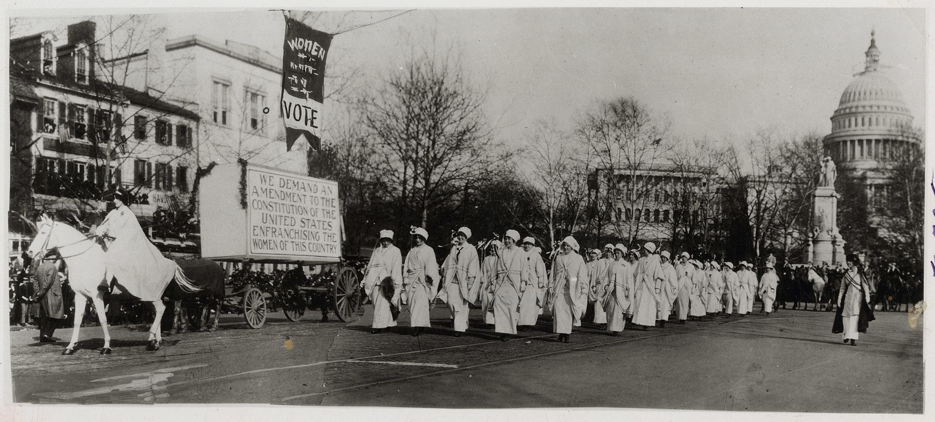
The head of the Procession

Slide 29
Suffragettes 1913-1919
Procession blocked by violent male demonstrations
100 women injured
Widespread publicity…
Post Procession strategy: a two pronged attack
NWSA (Catt) lobby congress…publications
NA (Alice Paul) demonstrations, publicity
Vigils outside White House…arrested, return, arrested, return
19th Amendment issued to Congress
Rejected by Wilson….State responsibility
Efforts to secure vote intensify

Slide 30
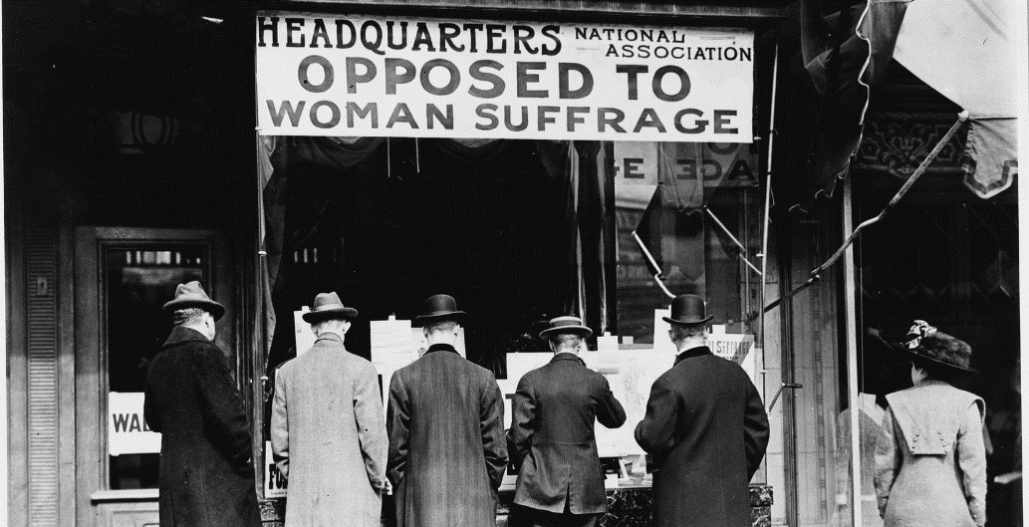
Opposition: Religious Fundamentalists, Conservatives,, New Immigrant patriarchal families

Slide 31
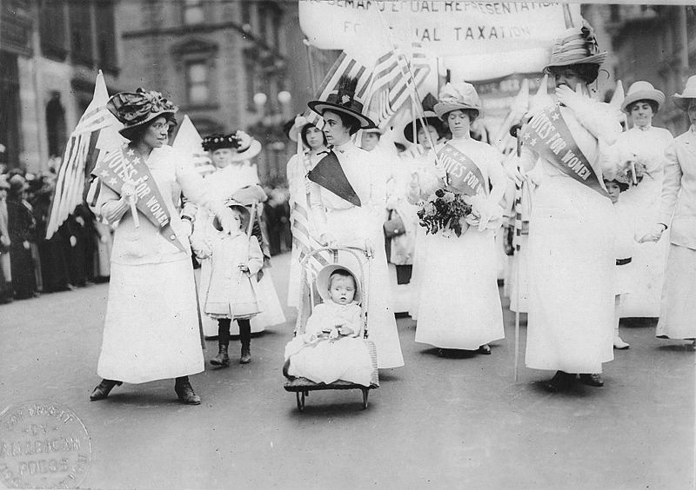
Suffragettes march 1916

Slide 32
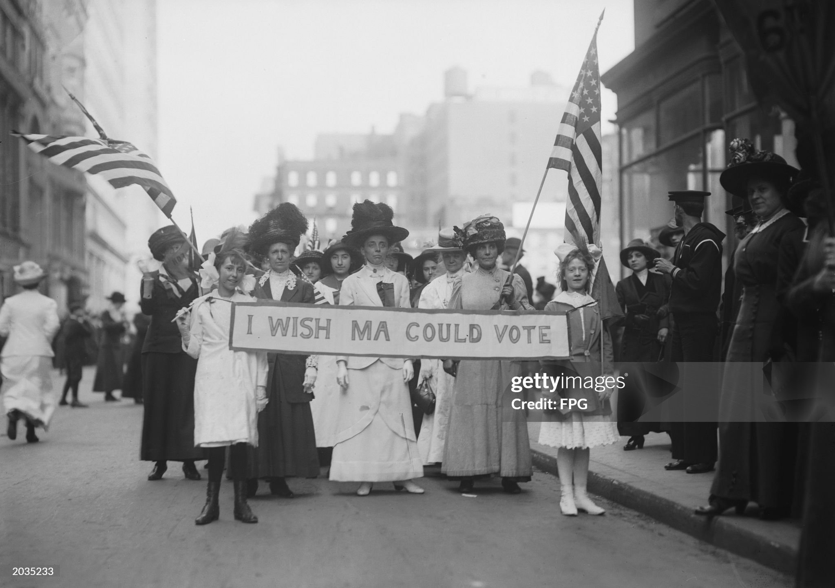
Marches continue: New York 1916

Slide 33
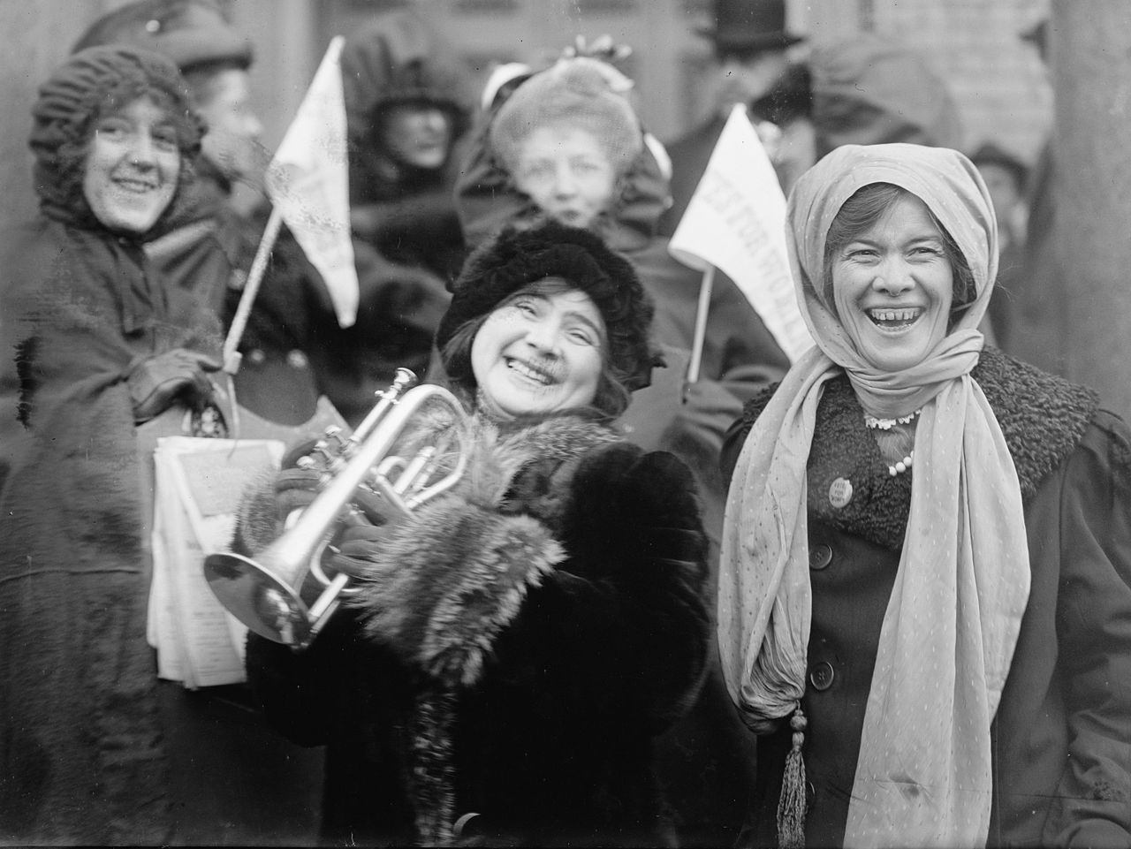
Happy Marchers 1916 ….males cease obstructing marches ….more states give women vote

Slide 34
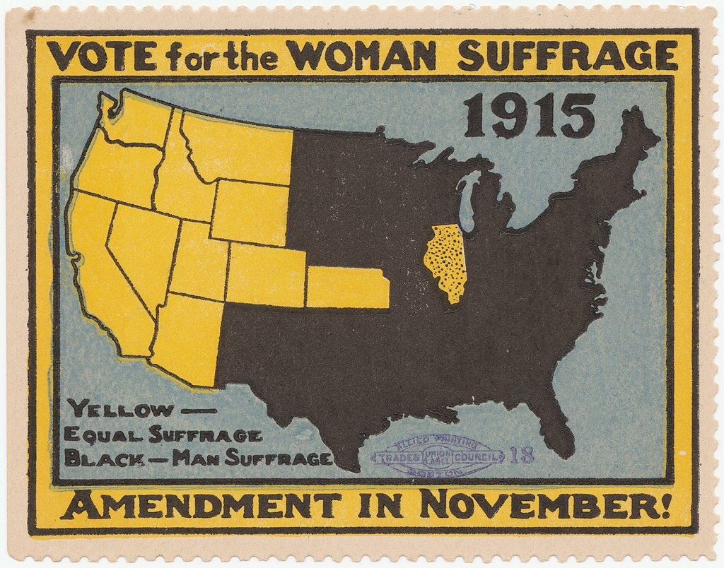
Women’s Suffrage 1915 ….votes in West…shortage/power of women

Slide 35
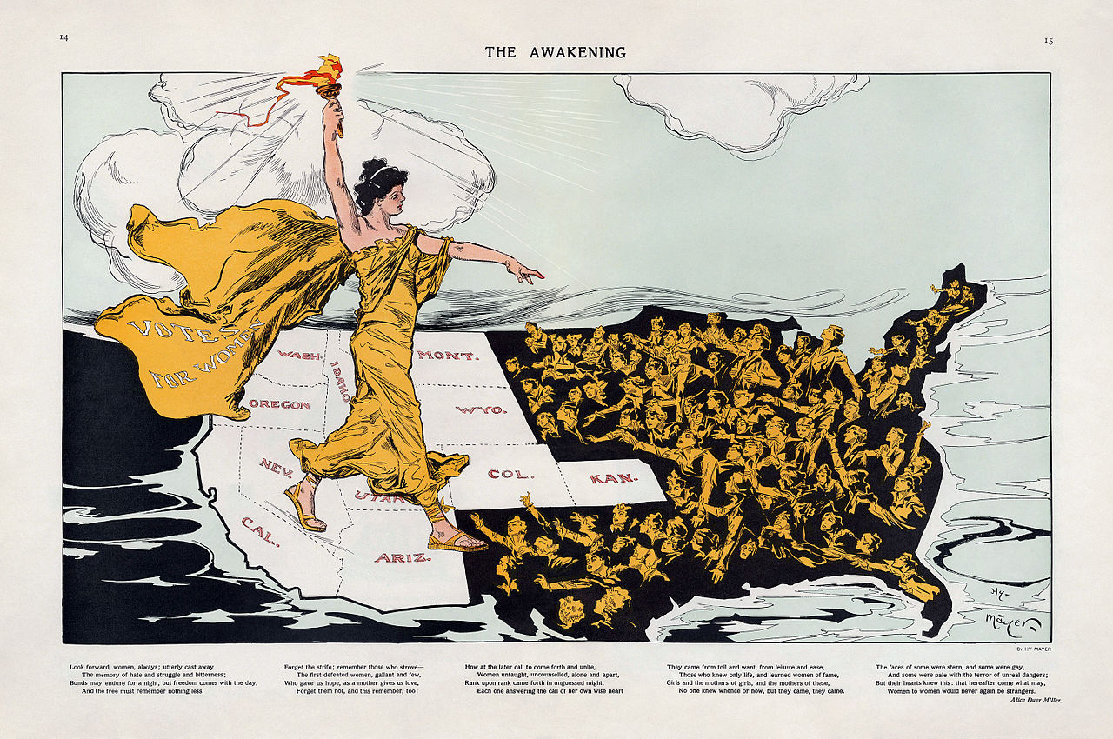
Alice Paul strategy: shame East & South & North to pass Amendment

Slide 36
USA 1914: a hyper confident nation immersed into itself, the outside world a distraction, at most a source for profit
All that is about to change as Mexico dissolves into chaos and the
Great Empires of the world self destruct…..and go mad
Talk 15: The USA and a world at war

