Slide 1
American History

Slide 2
Module 4: The vacillating Giant
Talk | Title | Time Period | Date of Talk
23 | USA and the 20th Century | 1898-1900 | September 2nd
24 | The Progressive era | 1900-1916 | September 16th
25 | USA and world War One | 1914-1920 | October 21st
26 | The retreat to “normalcy’ | 1919-1921 | November 4th
26 | The Roaring Twenties | 1921-1929 | November 18th
27 | Great Depression and New Deal | 1929-1941 | December 2nd
29 | Isolationism interrupted | 1932-1941 | December 16th

Slide 3
American History
1
Talk 24: The Progressive Era

Slide 4
Talk 24: The Progressives
Presidential Election of 1900
The Republican Progressives (1901-1912)
Panic of 1907
Taft Transition & election of 1912
Woodrow Wilson and “Scientific Government (1912-1916)
Suffragettes: rise of the women

Slide 5
US election of 1900

Slide 6
US Political situation 1900
Economy recovering…Silver issue irrelevant, farms prosperous
Surge in patriotism: triumphant in war with Spain
Reconstruction dead. White Supremacy and Democrats rule South
Public anger at monopolies, power of trusts, inequality…yellow press
Rising levels of revulsion about war in Philippines

Slide 7
Democrats
Origins
Founded 1830’s by Andrew Jackson as “Party of Common (White) Man
Splits 1850’s
Southern Democrats: White supremacy, end reconstruction, lower tariff
Northern Democrats: Big Cities, Irish & German immigrants
By 1900
Small government…unions threat to American values
Sustain White Supremacy/ restrict immigration to Whites only
Anti imperialism, pro isolationism
Georgism economics

Slide 8
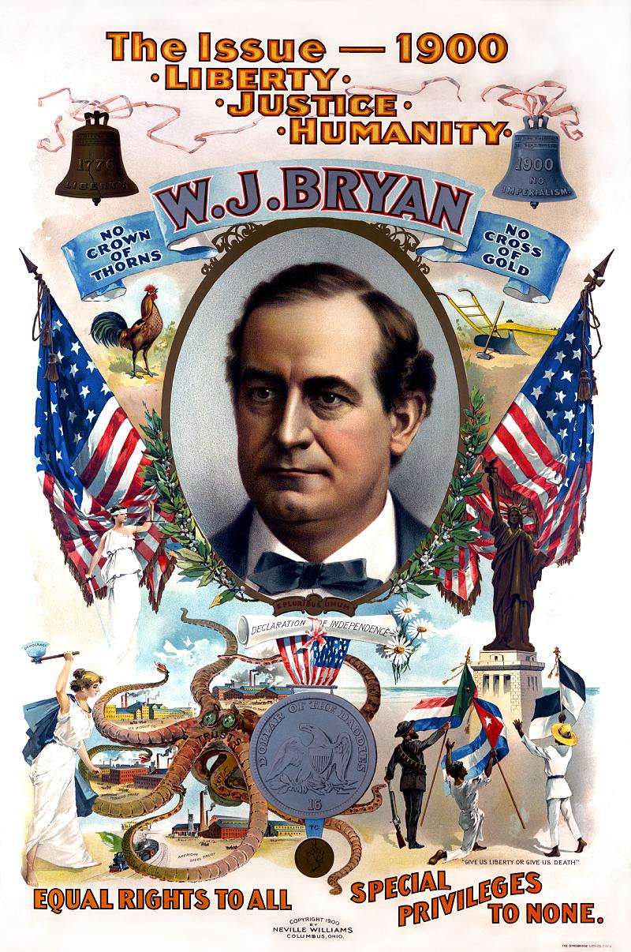
The Democrat Challenge
William Jennings Bryan Democrat Nominee
…….(Cross of Gold”
…….brilliant orator
Absorbs Populists
Platform…and “Georgism”
anti monopoly “Rights for all” (White only)..tours country,
Appalled by Philippine War
US Empire….markets for
Trust only…

Slide 9
The Republicans
Origins
Founded as “radical” anti slavery party 1856..part of Lincoln
‘Radicals and Conservative wings
Radicals …Reconstruct South, reform government
Conservatives….Ignore South, Big Business, High tariffs
By 1898
Reconstruction abandoned
Pro Mass immigration …reduce labour costs
Party of Trusts/ Monopolies
Pro Imperialism. New Markets in Latin America & Far East

Slide 10
The Republican Dilemma
President Mckinley
McKinley the businessman’s friend
…”Manifest Destiny”
…pro Empire, US expansion
...pro high tariffs to protect US industrialists
Sees “Progressives” as anti American
….solid, earnest man
….considers Bryan a fanatic
Preferred VP dies before nomination
Republican leadership concerned:
…need a “hero” to balance ticket
…Teddy nominated for Vice President
…VP …no power, invisible, harmless

Slide 11
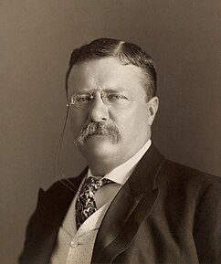
Teddy Roosevelt
Wealthy family….protected child (asthma)
…notoriously active, overcomes asthma
…keen hunter, naturalist, historian
.…believes “born to rule”
State Assemblyman: a “Bully of bullies”
…2 years Cattle Rancher Dakotas 1882-1884
…Returns to NY after “white out”
… Police Commissioner New York
… campaigns for McKinley
….Undersecretary Navy
Self publiciser, fearless
….forms regiment of cowboys, Indians
for war in Cuba…made “Colonel” ……wants glory, risks life
…as long as photographed doing so

Slide 12
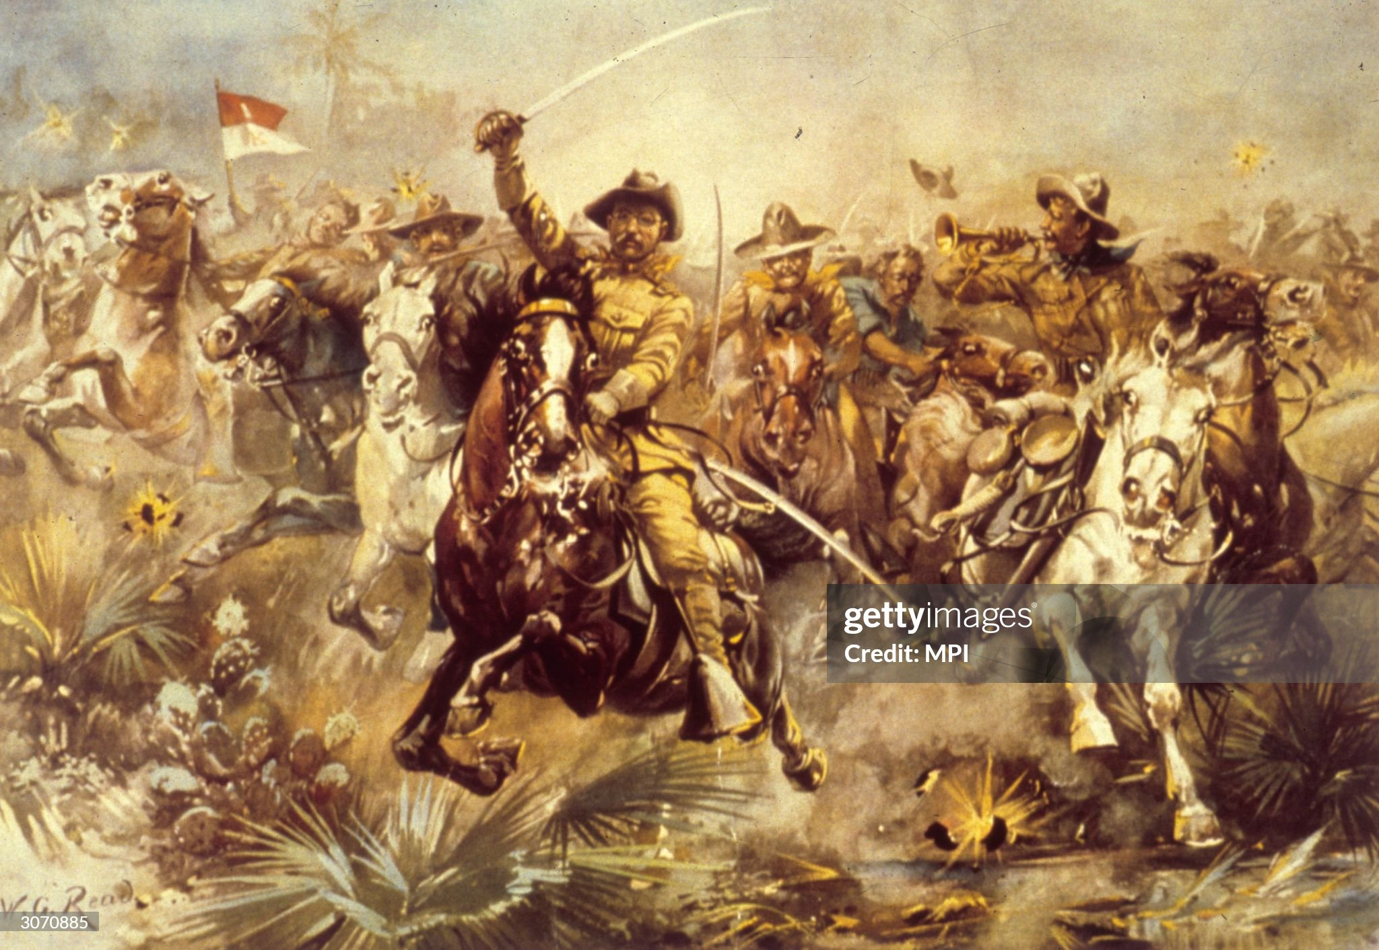
The official (Roosevelt) image: Teddy …
The reality…”battle of San Juan Hill” : 8,000 US troops vs 500 Cubans
Teddy’s horse snagged on barbed wire…Teddy climbed up hill following soldiers.
….leads charge up second hill….but reprimanded and told to wait for regular army

Slide 13
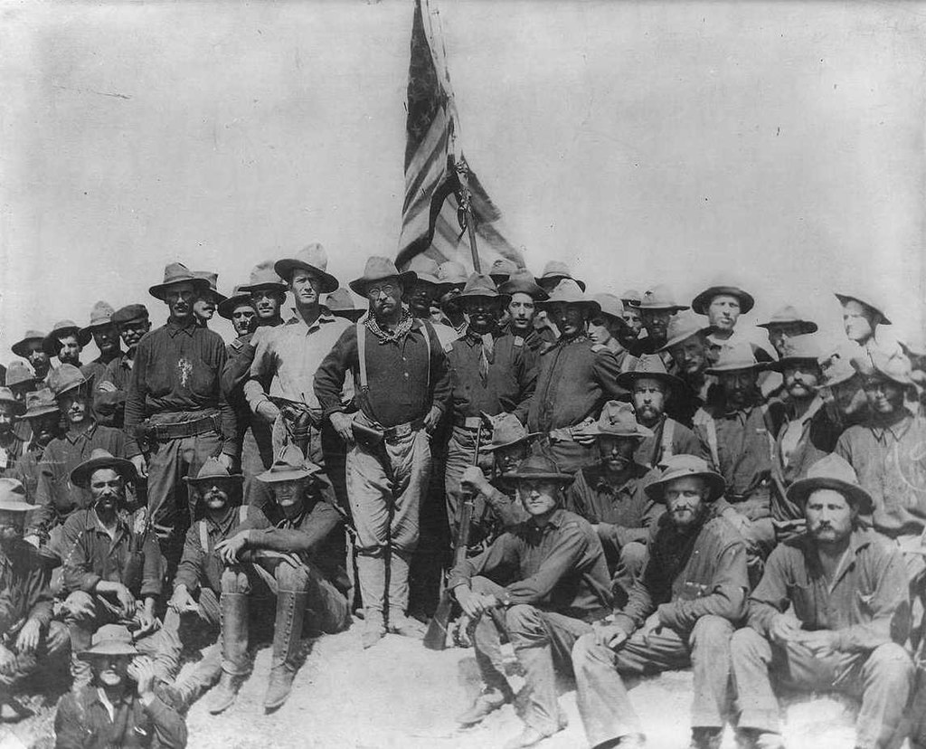
Teddy and the “Rough Riders”
After battle of San Juan Hill
(staged days after battle)
Leaves army runs …writes story to
…national hero
Runs for and wins Governor of NY
Attacks corruption in NY,
Plans to clear slums, sewage
Sees Trusts as “bullies”….and
Targets them for regulation
Gives two press conferences each day
….never done before
….national “celebrity”
Mc Kinley offers VP role to shut him up
….TR thinks role will diminish him
…duty to accept

Slide 14
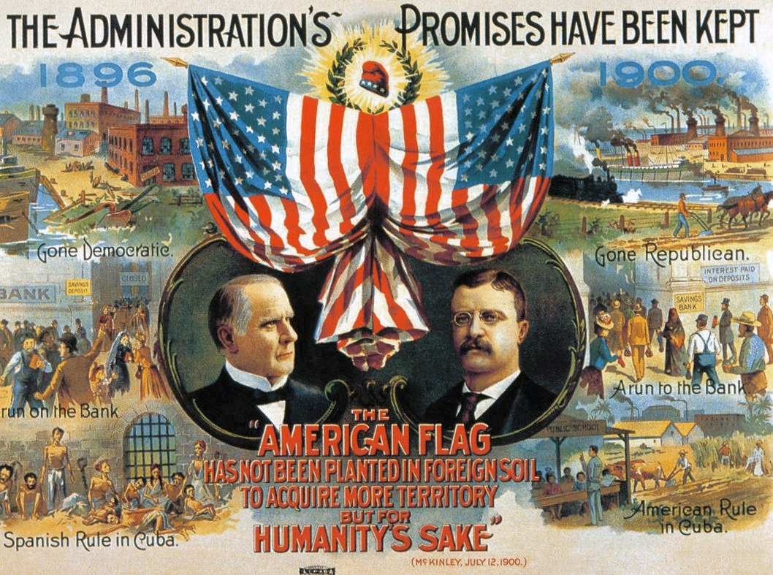
The Republican Campaign

Slide 15
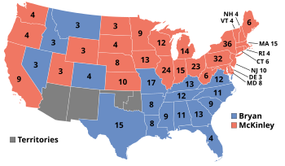
The Result: Republican Triumph
Republicans 50% of vote
292 electoral college…control both Senate & House
Democrats 46% vote ..155 electoral
…Roosevelt brings in the West
Socialists impact minimal
(Social Democratic…0.5%vote !)
Forces of Business & Empire
Appear set for control

Slide 16
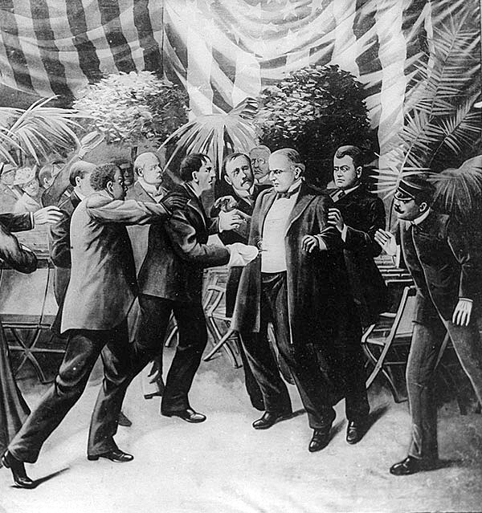
Assassination of President McKinley (Sept 1901)
McKinley set for four years in office
..represents Business elite
..dominates party
McKinley increases tariff, attends
Trade Exhibitions….disdains protection
Stalked and killed by Leon Czolgosz..Polish immigrant Anarchist
Theodore Roosevelt….on holiday camping,
and sworn in as President
Conservatives appalled

Slide 17
Presidency of Theodore Roosevelt

Slide 18
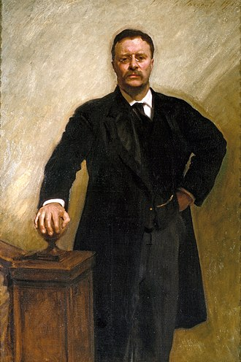
Theodore Roosevelt (1858-1919)
A new type of President, youngest eve (44),
Vigorous, Ambitious...confidence born to rule
….beholden to no-one…voracious reader
Deeply respected Henry George….single tax
Too radical…but determined to use government
to improve life of working people
“Behind the ostensible government sits enthroned
an invisible government owing no allegiance and acknowledging no responsibility to the people. To destroy this invisible government, to befoul the unholy alliance between corrupt business and corrupt politics is the first task of the statesmanship of today.”
“The Square Deal”: equal playing field
…..except blacks, Indians, women

Slide 19
Domestic Reforms

Slide 20
US politics 1898: The power of the Trusts

Slide 21
“Roosevelt attacks Monopolies”
About Trusts & Teddy
‘Good Trusts: Monopolies that work in public interest….lower prices, better service, “fair profit”
‘Bad Trusts’: Monopolies that work in business interest only..higher prices
Drives to approval through Congress and courts 44 law suites to break up Trusts:
Meat packing
Railroads…Interstate Commerce Commission to regulate prices & competition
Standard Oil
Sugar Refining
Coal
Shapes himself as neutral: “Square Deal” good for everyone
….reminds Business alternative Socialism

Slide 22
Other Reforms
Pure food and Drug Act…mislabelled drugs
Meat Inspection Act 1906 …(Upton Sinclair “the Jungle”…contaminated foods
Anti corruption drives….Post Office, Indian lands,
Simplified spelling initiative, standardise rules of football,
“That fellow at the other end of the avenue wants everything from the birth of Christ to the death of the devil.”
"Even his friends occasionally wondered whether there wasn't any custom or practice too minor for him to try to regulate, update or otherwise improve.”

Slide 23
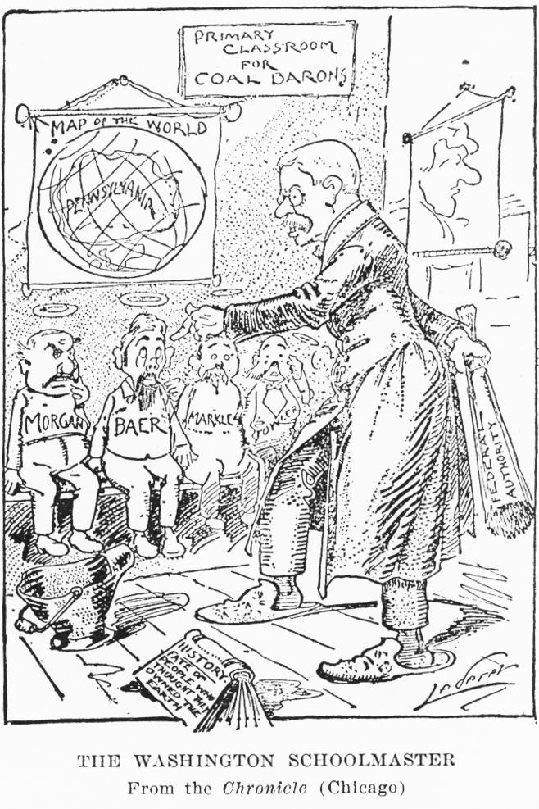
Labour Reforms: Anthracite Coal Strike 1902
Strikes late 90’s….mining concessions
Surplus coal….miners demand 8 hour day
Day off, right to union
… Operators close mines
…threat of winter
Teddy threatens troops to force mines to
reopened &owners to negotiate
…sets up commission to investigate
“Settlement a “Square Deal”
…..no union
….9 hour day, wage increase
…1/2 day off Saturday
First intervention made by President in public interest not owners

Slide 24
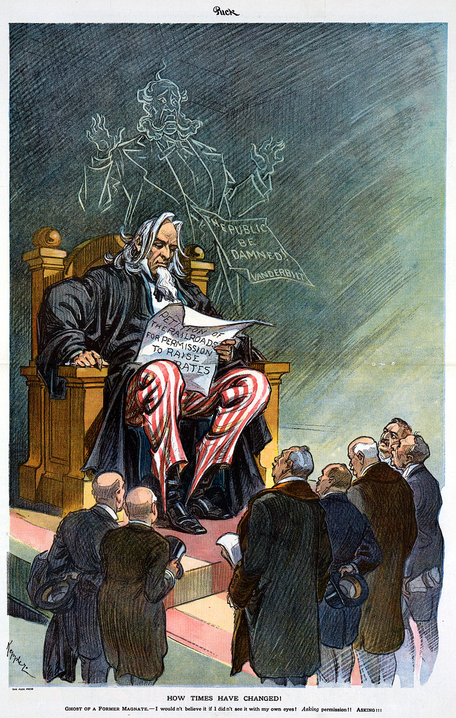
Anti Roosevelt cartoon: Government the overseer of business

Slide 25
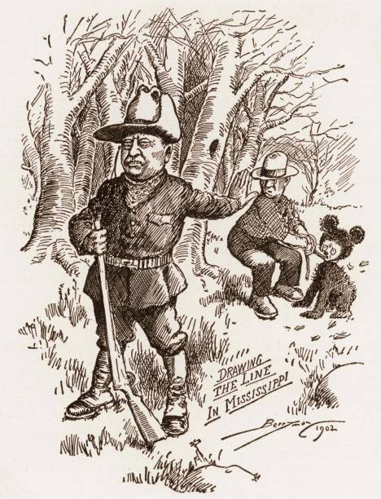
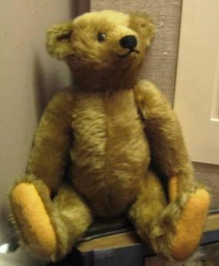
Teddy Bear
Theodore & bear
The first “Teddy Bear”
Voracious hunter, bears,
Deer, buffalo, Rhino, elephant
….anything
Also insist on sustainable hunter and
Passionate naturalist
Hunting trip story
…bear tied to tree for TR to shoot
…refuses
..unsportsmanlike

Slide 26
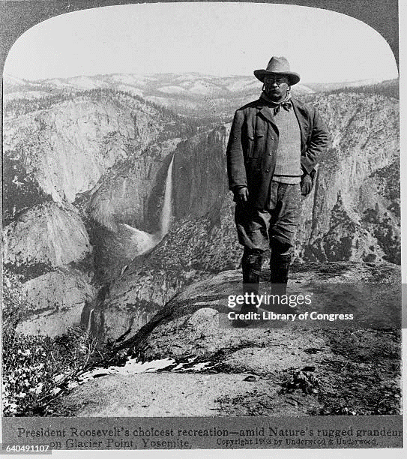
“Conservationism” & “Reclamation”
TR at Yosemite, California
Appalled by uncontrolled development
Of West…years as cowboy in Dakotas
..lifetime camping,
Speech 1908 “the time has come to inquire seriously what
will happen when our forests are gone, when the coal,
the iron, the oil, and the gas are exhausted, when the
soils shall have been still further impoverished and
washed into the streams, polluting the rivers, denuding the
fields, and obstructing navigation.”
Uses “Executive Orders” to protect wilderness
230 million acres protected, national monuments
5 national parks...creates US National Forest Service
Divides “West” in two categories
… Conservation ….protect
…”Reclamation” …put to use of nation
and in the west ………….WATER

Slide 27
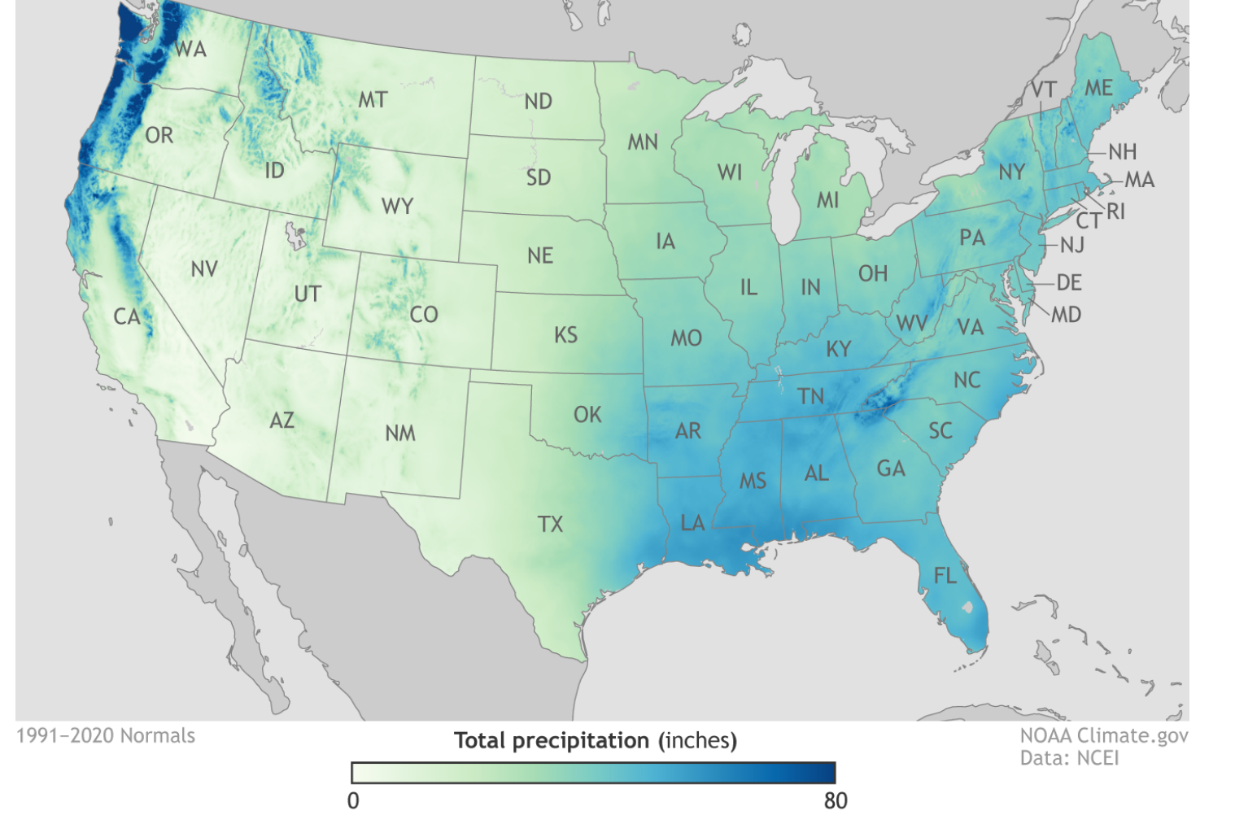
“Reclamation” of the West ….low rainfall…..most West arid and in need of ”Reclamation” to be made productive
US Rainfall

Slide 28
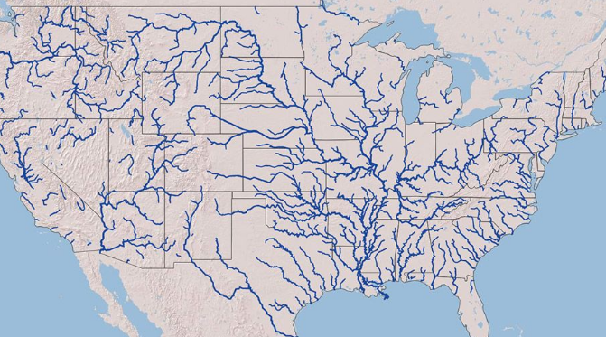
The solution: abundant rivers ….use dams and canals to move water from where it flows to where it will be most useful by dams and canals:
Major River Systems

Slide 29
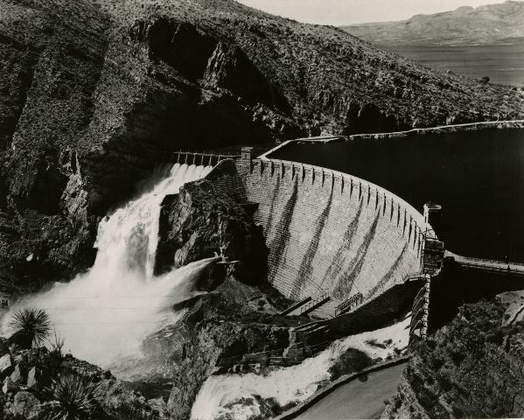
Land “Reclamation” Act 1902
Theodore Roosevelt Dam 1911…largest dam built at the time
TR Authorises construction
of dams & Irrigation system
To “transform” West
Indians removed to “reduced” reservations
“Frontier” to be either
Preserved or made “useful”
… farms
….recreation
…great cities (Phoenix,
, Los Angeles emerge)

Slide 30
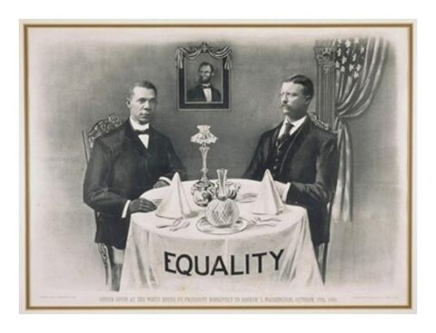
Roosevelt and Race
Booker T Washington & TR (1901)
Roosevelt: s “White Race” superiority
& destiny of Anglo Saxons to run world
..supports “eugenics…breeding of the best”
Believes blacks can “rise”
…seeks black votes in North
…Invites Booker T to dinner with family
S Carolina Senator Tillman: “Now that Roosevelt has eaten with that nigger Washington, we shall have to kill
a thousand niggers to get them back at their places.”
TR: does not repeat dinner invitation
…breakfast meetings instead
….does approve promotion of blacks

Slide 31
“Reforming the world”

Slide 32
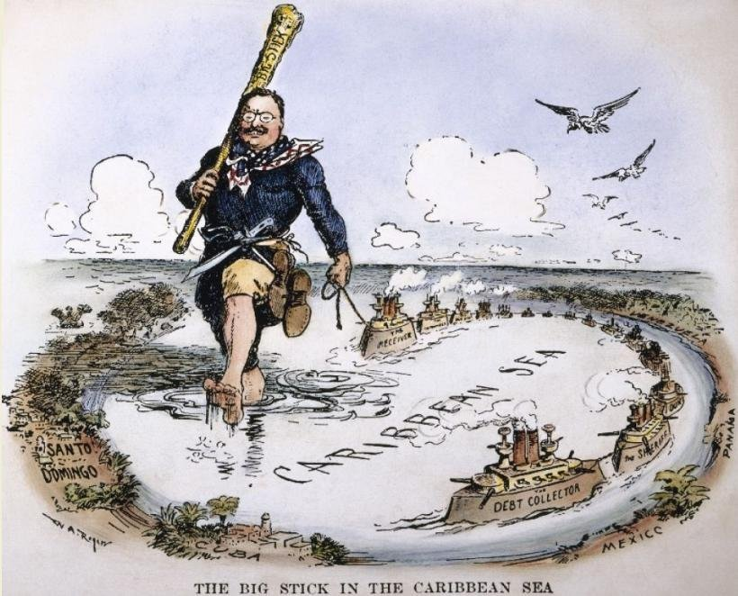
Big Stick Diplomacy: Carribean/Central America …”belongs to USA
“Roosevelt corollary” 1904
..US has right/duty to intervene
…“civilisation” threatened
…Europeans to stay out
US control varied by country
…40% land of Honduras
…75% Cuban sugar plantation
...80% Dominican Sugar
Single cash crop economies linking local elites to US business
TR expands navy to 3rd largest
(after Britain and Germany
…uses marines and bombardment
to enforce will……no occuppy

Slide 33
US & Cuba
Occupation 1898-1903 (“Teller Amendment” guarantees Cuba independence
“Platt Amendment 1901
Free trade Sugar imports (US own Sugar companies
US “right to intervene” if elections rigged, foreign interest emerge, US investment threatened
Guantanamo Bay “perpetual lease” to US as naval base
Reoccupation 1906-1909
Widespread fraud 1905 election
Unrest…threats to US sugar plantations
US marines land and seize government
Enforce “fair elections” 1908 and withdraw
Civil wars and Dictatorship follow

Slide 34
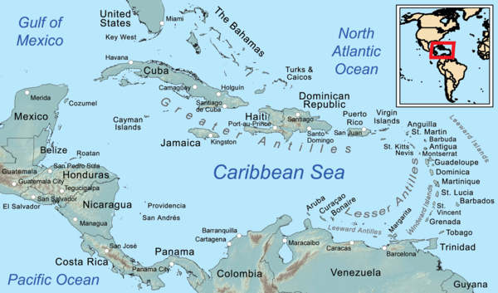
US “Big Stick” Diplomacy: US occupations
Cuba 1898-1902, 2905-1909
Dominican Republic
Protect sugar interests : 1916-1924
Haiti collect debts, prevent
Foreign influence occupied 1915-1934
Honduras 1903-1907 …Banana
Industry protection
Nicaragua 1909-1933…protect
US mining & agriculture ..prevent
New canal
Mexico dominated by pro US Dictator Porfirio and calm..for now
Costa Rico…stable, low US presence
…never occupied
Panama….different….not so much
Occupied as created by USA

Slide 35
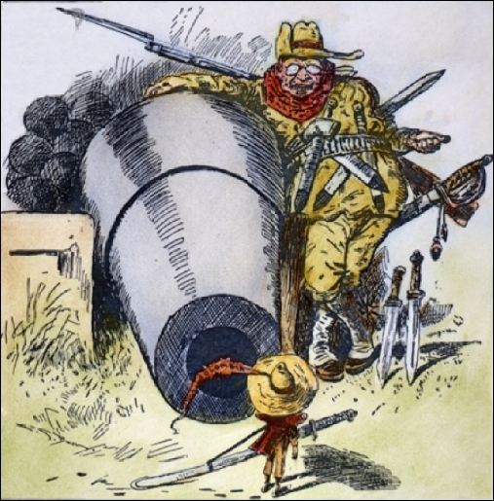
Big Stick and Central America …a history forgotten in US, not in Central America

Slide 36
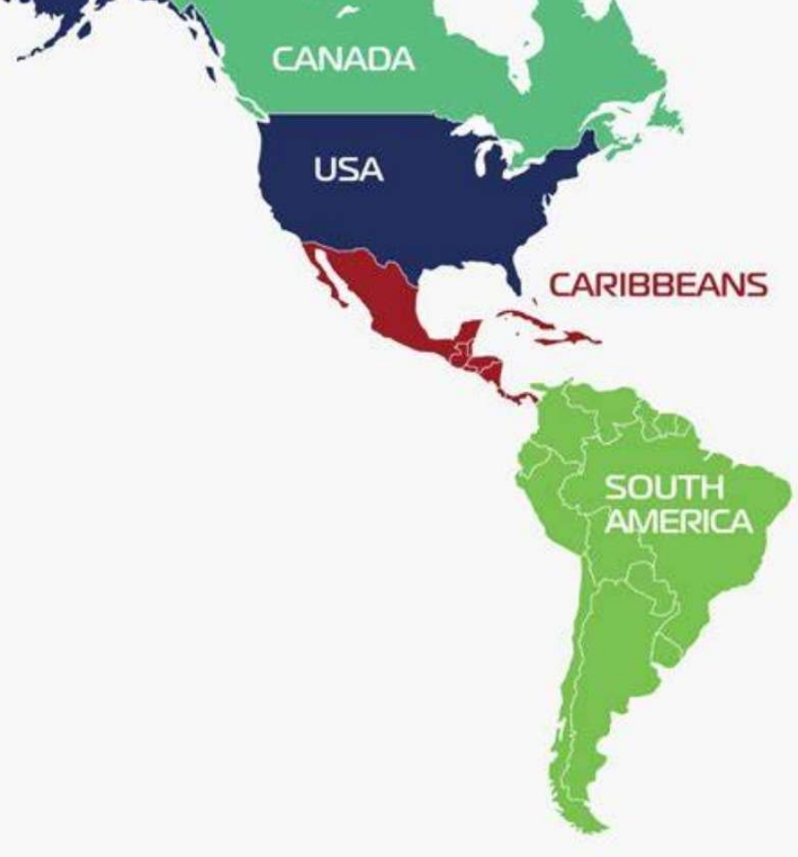
Panama Canal
Reduces mileage from New York to San Francisco from 13,000 to 5,000 miles..
Canal area within border of Columbia
French complete Suez Canal 1881 …..contract with Columbians
…..spend £200m, 20,000 lives lost
…. Abandon work 1889
Teddy Roosevelt wants 2 ocean navy
…threat from Japan,,,,victory over Chinese
Negotiates rental agreement with Columbia
…rejected by Columbian Senate
.. Rebels in “Panama” offer zone to USA
Columbia sends army and navy to crush

Slide 37
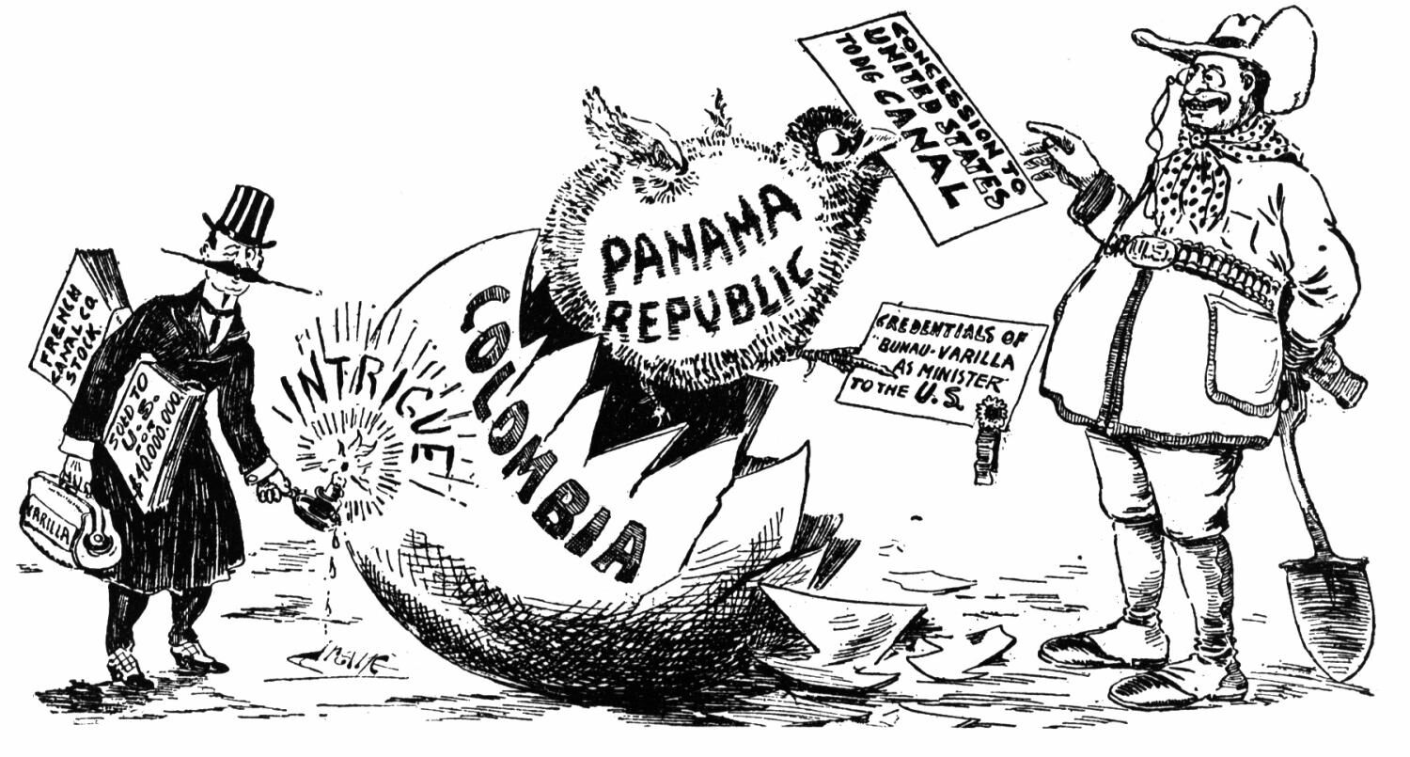
Panama Canal
US sends and marines
…Columbia backs down
….accepts Panama independence
US secures: “indefinite lease” with Panama ….rights to operate Canal +occupy and control bordering district
….Restarts construction 1903
“I took the Isthmus, started the canal and then left Congress not to debate the canal, but to debate me."

Slide 38
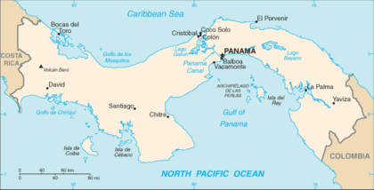
Canal opens 1914 …50 locks, one new lake, 5,000 lives lost by US (10,000 by French cost $500 million, (£12Bn today)

Slide 39
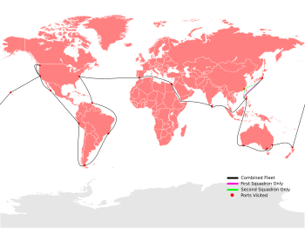
Great White Fleet 1907/1909
Great White Fleet round the world tour
1905 Japan victory over Russia
…US intermediary for peace
…First US world intervention ….TR Nobel Prize
Japan the rising power…challenge
TR wants show off US to world
….and intimidate Japanese
Fleet of 16 battleships, 10 cruisers world tour
Friendly visits : message delivered
……US has arrived
……“Stick” is very powerful

Slide 40
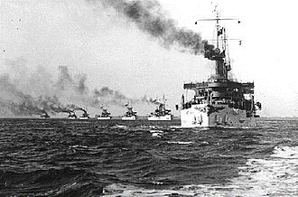
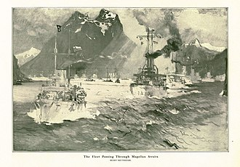
The Great White Fleet: US world naval power, 3rd strongest: ultimate “big stick” …...

Slide 41
US Destiny about to be challenged …from an unexpected place ….fragility of financial system

