Slide 1
American History
Talk 1: Before the Europeans (20,000 BC – 1493 CE)

Slide 2
About this talk
First Arrivals to the Americas
Native Americans (Indigenous Peoples before the European arrival)
The world 1600
First contact

Slide 3
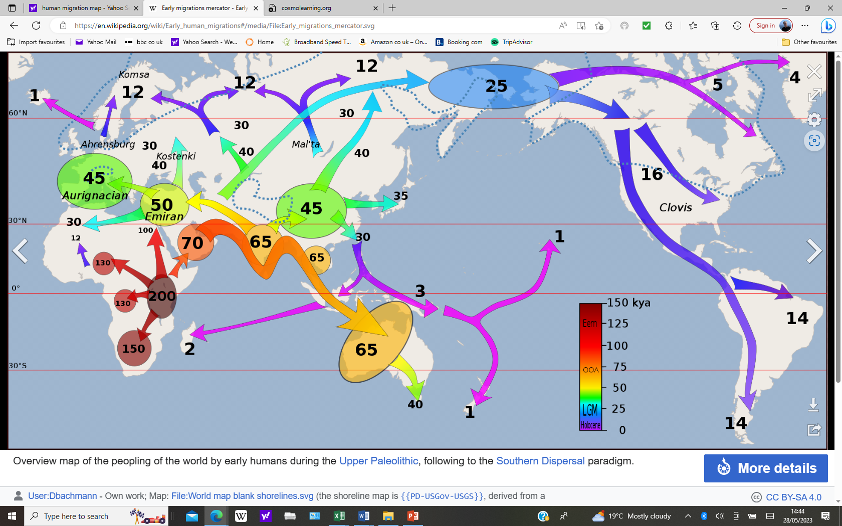
The migration of people
(1)
Notes:
First migrations from Africa 70,000 years ago
Europe 45, 000
North America 25,000
Some discoveries in Mexico indicate much earlier but did not persists

Slide 4
Indigenous People: Common Assumptions
(2)
Primitive hunter gatherers, living off game, fish, and berries
Peaceful, living in a state of nature
Housing all wood, tepees, temporary
Egalitarian societies
New world sparsely populated, waiting to be occupied

Slide 5
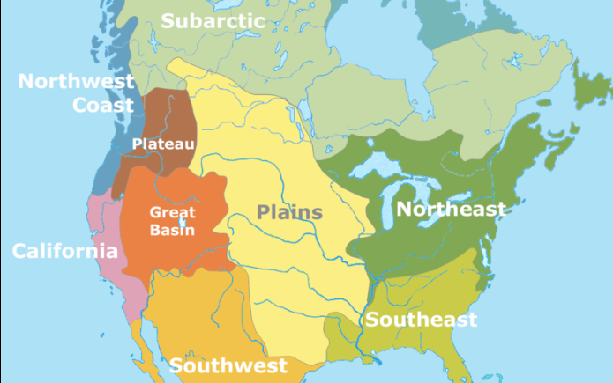
North America, climates & hundreds of cultures 5-10 million inhabitants
(3)
Mississippi
Culture
Irroquois
Pueblo
peoples

Slide 6
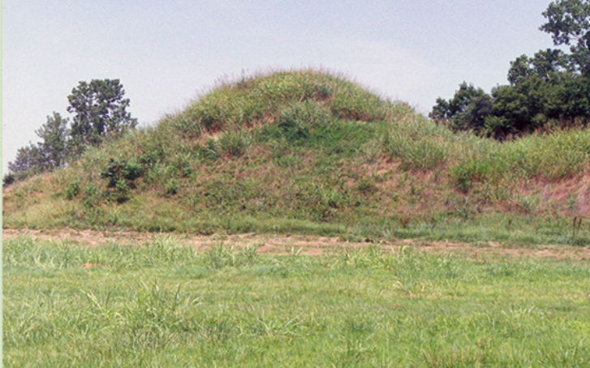
Mississippi Culture all that remains
(4)
Notes:
Mounds such as this found between Mississippi and Oklahoma
Ignored, considered simple burial mounds
Tutankamen tomb famous 1920’s depression mining company decides to excavate in 1933
Picola Mining Company Failed Gold Miners desperate to find something of value. he compatriots pushed their way through the debris into a Native American mound.
Inside unimaginable treasure. Hundreds of engraved conch shells, thousands of pearl and shell beads, copper breast plates, large human effigy pipes and piles of brightly coloured blankets and robes. Newspapers would later call the find an American "King Tut's tomb".
"Nothing like this had ever been discovered anywhere else in North America," said Eric Singleton, curator of ethnology at the National Cowboy & Western Heritage Museum in Oklahoma City. But the treasure soon disappeared.
Artefacts they discovered were immediately sold around the globe. US Govt steps in
1935 artefact gradually recovered and controlled excavations across

Slide 7
Mississippi Culture artifacts 1
(5)

Slide 8
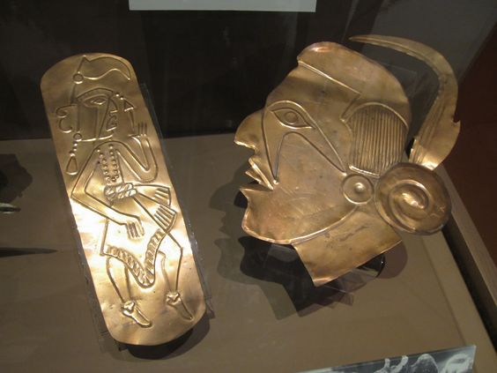
Mississippi Artefacts 2
(6)

Slide 9
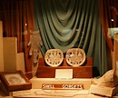
Mississippi artefacts 3
(7)

Slide 10
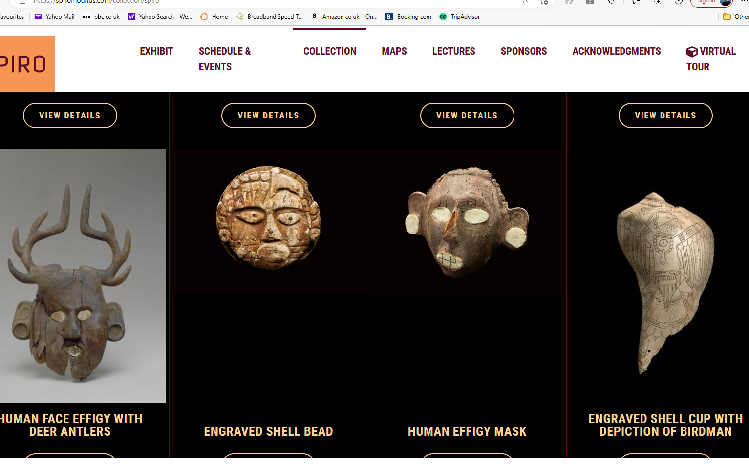
Mississippi artifacts 4
(8)

Slide 11
Cahokia City. Iowa
(9)

Slide 12
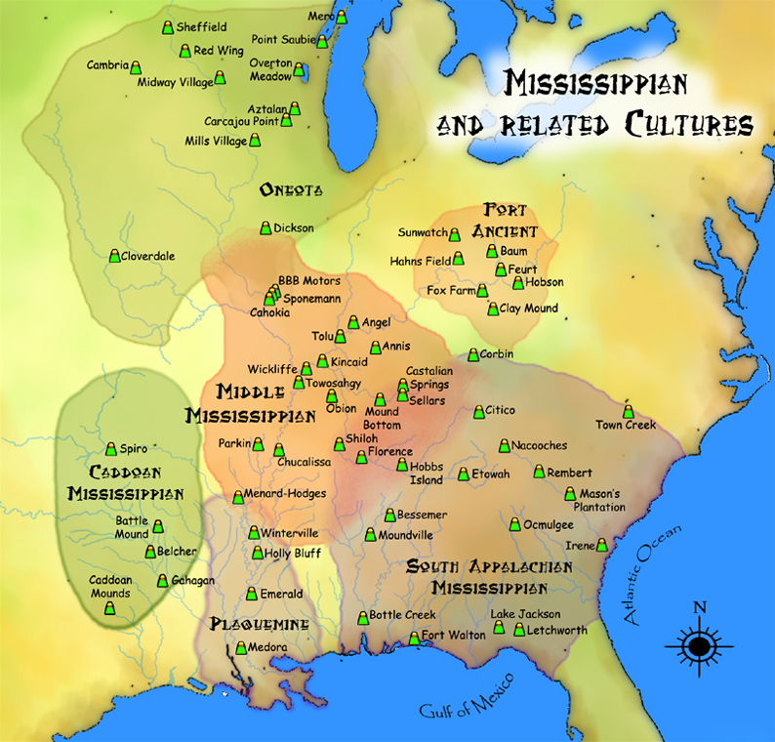
Mississippi Cultures 1200 AD
(10)

Slide 13
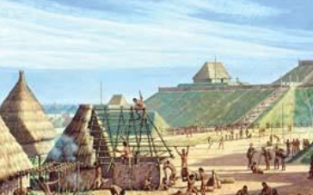
Cahokia (700 AD – 1400+ AD?)
(11)
Notes:
15,000 – 20,000 inhabitants, with up to 100,000 in wider area. as large as European towns at same time
Central plaza, parks, meeting houses,
Irrigation system
Trade across south east across to Ok
A centre of culture more than an empire, no central bureaucracy or written language,
Evidence of high status individuals and ritual

Slide 14
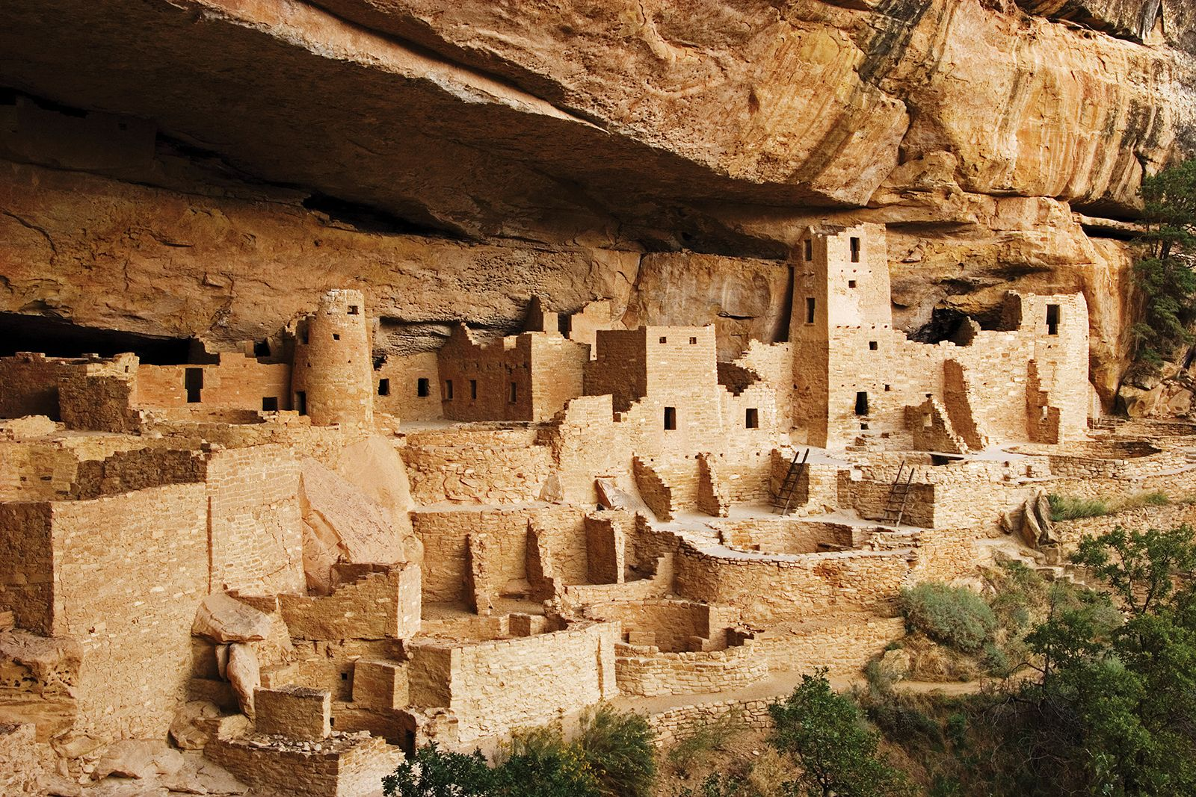
Pueblo culture New Mexico, Arizona 100-1500 AD
(12)

Slide 15
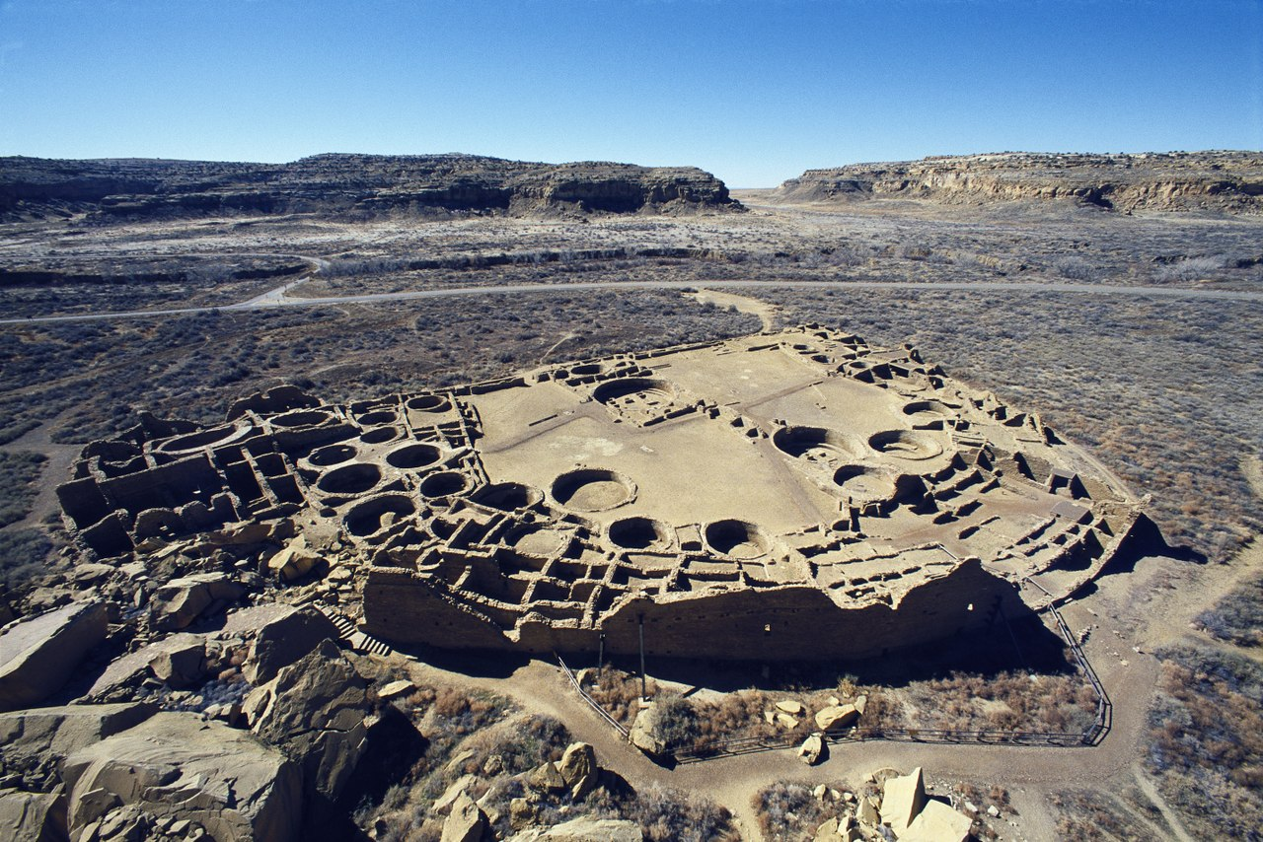
Pueblo settlement 1000 -1500 CE
(13)

Slide 16
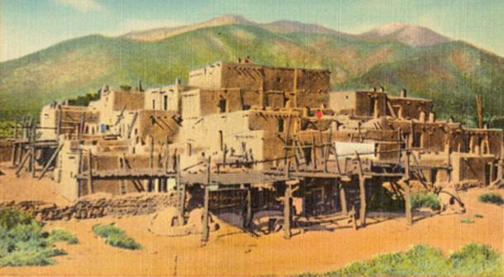
Pueblo Indians South west
(14)
Notes:
Pueblo (Spanish for house) several tribes common culture ( Zuni, Apache, Hope Navajho) descended from Asanazi .. In place and thriving when Spanish arried
Up to 70 autonomous permanent communities identified
Primarily farming with communal hunting
Religion based on spiritual intermediates to God
Mulit storey apartment complexes adobe brick designed to cool summers and retain heat in winter
Underground chambers as relaxtion rooms

Slide 17
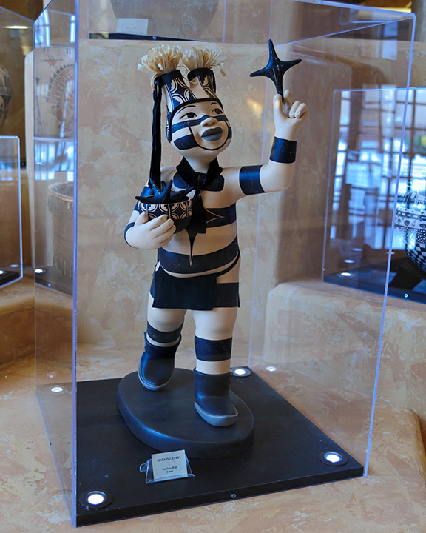
The Jester Clown
(15)

Slide 18
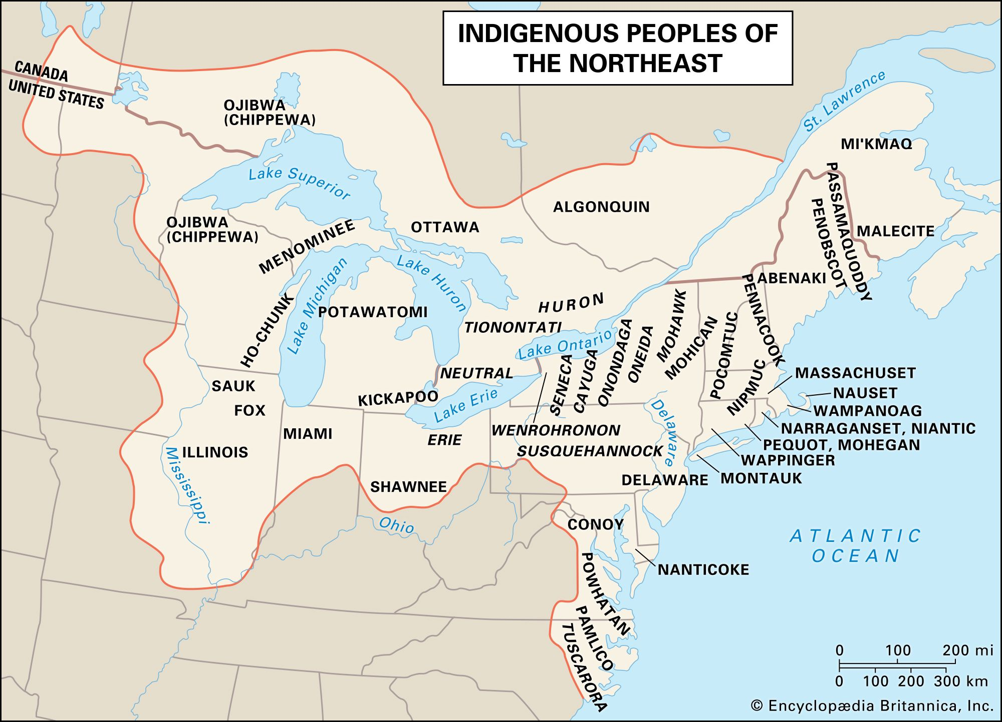
North East Indigenous Peoples 1450…1700
(15)
Iroquois
Notes:
Highly fragmented –except for Iroquois Confederacy
Many tribes each a few thousand strong
Complex relationships, constant warfare, palisade surrounded villages,

Slide 19
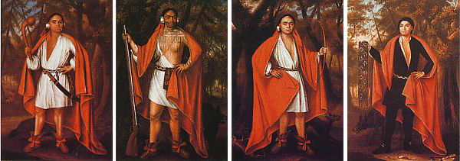
Iroquois ambassadors to London 1700

Slide 20
Iroquois Long House
(16)

Slide 21
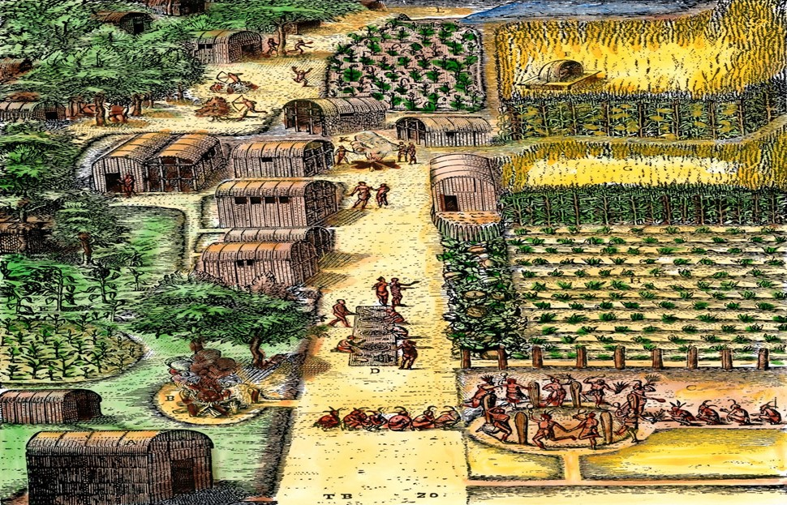
Iroquois settlement
(17)
Notes:
5 united tribes south of Great Lakes
Hiawatha legend uniting the tribes
Central Government meetings in Long houses preventing war between tribes (and slaughter of anyone else)
Matrilienial societies with war leaders supervised by women. Women hunted less farmed more but all descendency through them
Complex agriculture ‘ 3 sisters- corn beans and squash)
Hundreds of villages each with hundreds of houses total population around 200,000 at time of Europeans
‘Constituion regulating the ‘Great Peace’
Ritual torture of prisoners..
Cherokee offshoot Rotating Chiefs (White Peace Red War regulated by women

Slide 22
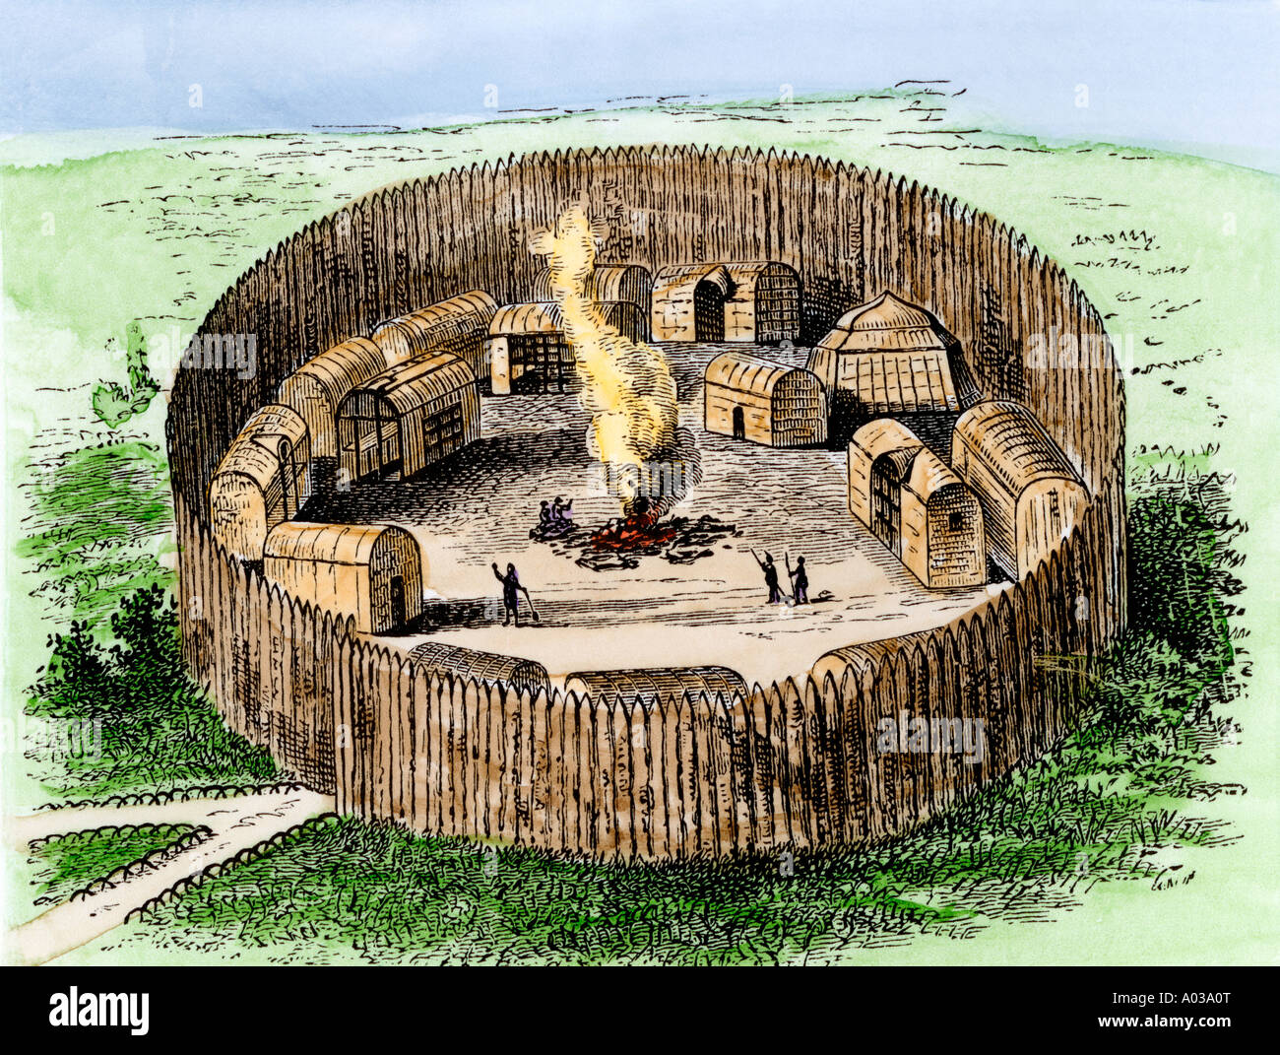
Iroquois fort
(18)

Slide 23
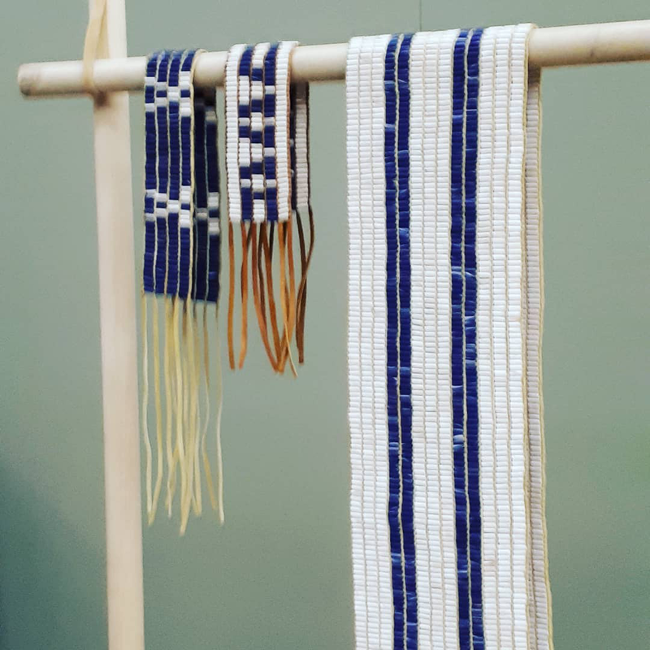
Great Law of Peace…Wampum belts….symbolic writing
(19)

Slide 24
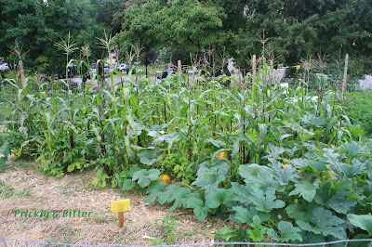
3 sisters: corn, squash, and beans

Slide 25
North American Indigenous Peoples
Complex cultures, hunter gatherer and agricultural societies
Structured, mostly matrilineal based, mostly consensus leadership
Oral Tradition, no written languages
Land ‘owned’ by tribe, allocated to individual
Intensive warfare, slave raiding
Common beliefs in ‘Great Father’, ancestors, spirits, life in all things
No use of advanced metals or wheels
No large draft animals, oxen, horses or immunities from related diseases

Slide 26
Why no ‘advanced culture in North America? (Thomas Sowell: ‘Conquest & Cultures’)
Europe and Asia’s 20,000 year head start
East West trade (Asia > Europe) easier than North>South America (Arabs>Europe, not Aztec>Iroquois)
No ‘pack animals’ (horses, oxen, cows, sheep)
Impossible to trade in volume, everything delivered by hand
Expansion slow and difficult. Long distance conquest impossible
No incentive to develop wheels and means of transportation

Slide 27
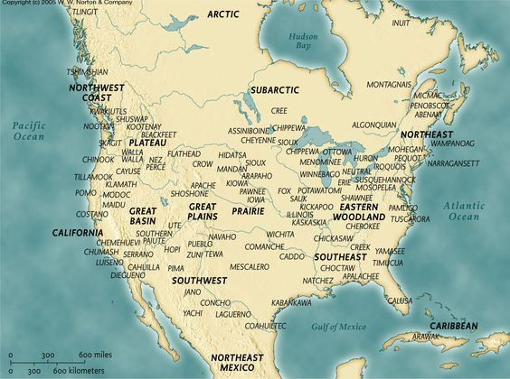
North America Tribes

Slide 28
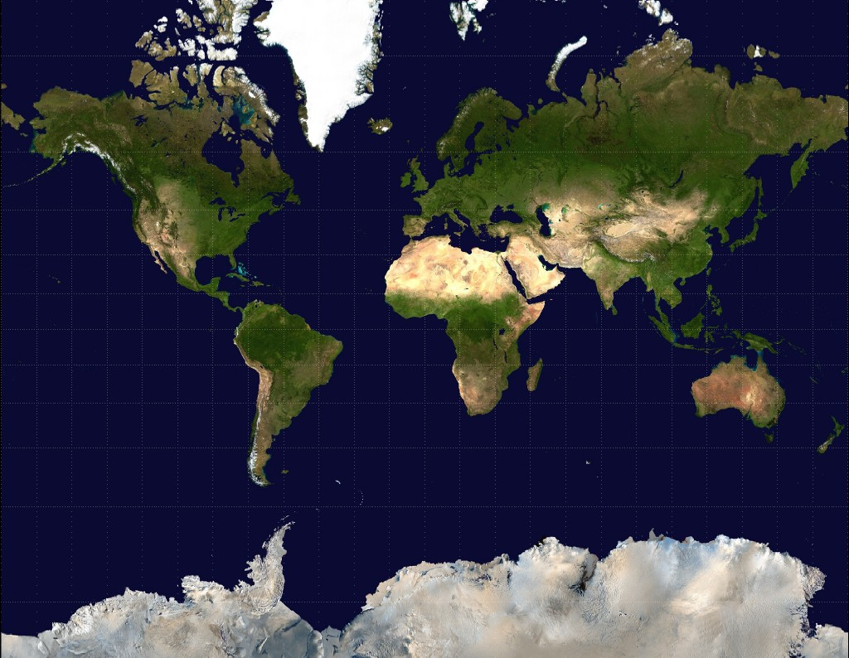
Cultural Transfers Middle East> Europe vs North South America
Low cost, fast by horse
Desert
Sahara
Impossible
…by foot
Amazon

Slide 29
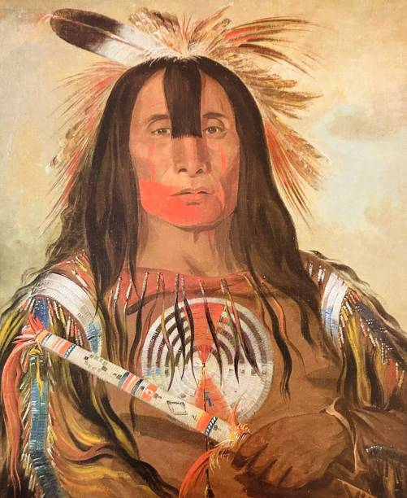
Great Plains… 1700’s

Slide 30
South East Creek

Slide 31
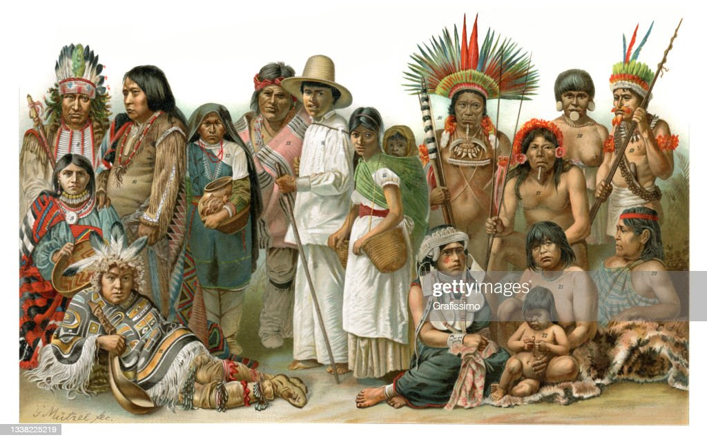
Pueblo Family

Slide 32
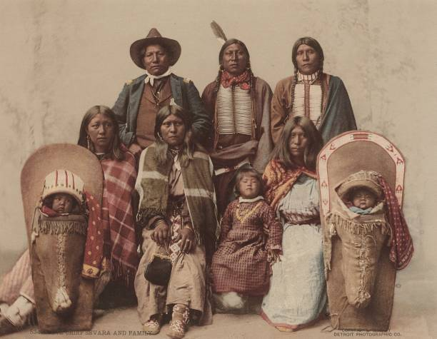
South West Family (2)

Slide 33
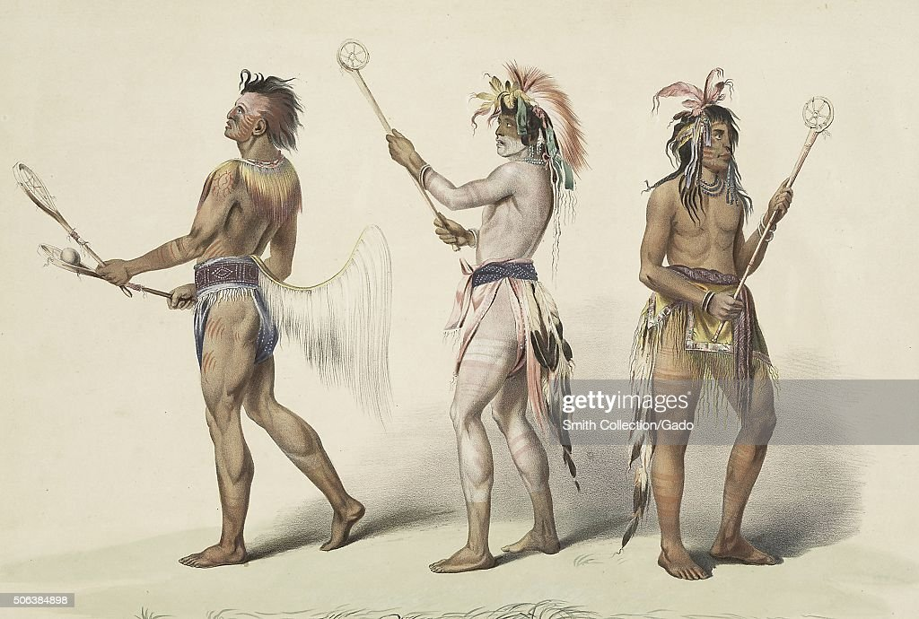
Iroqouis lacross players

Slide 34
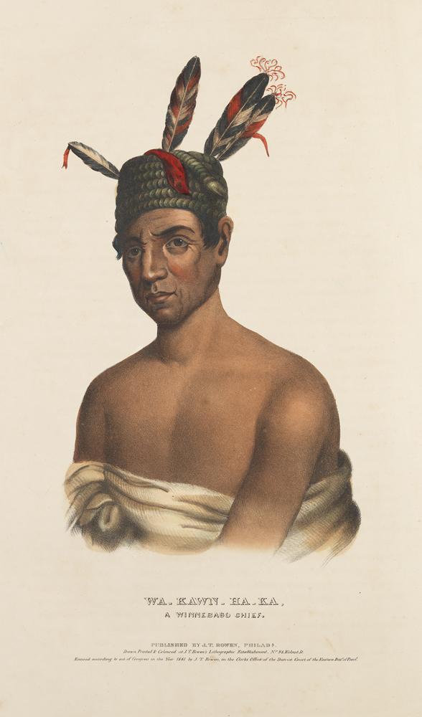
Calfornian Indian 1700’s

Slide 35
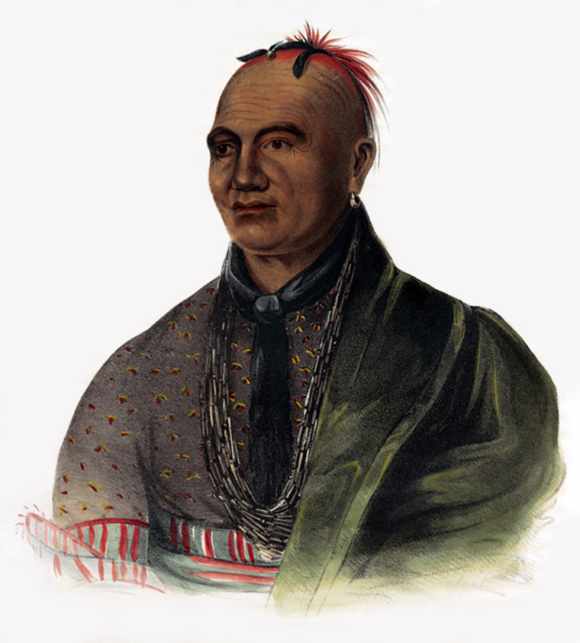
Iroquois Chief Joseph Bryant 1750

Slide 36
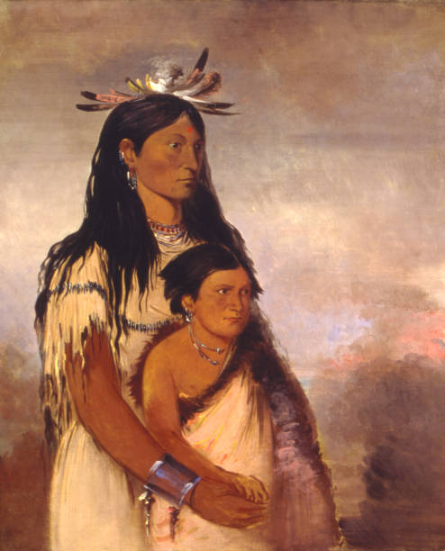
Great Plains India circa 1800

Slide 37
Summary
perfectly adapted to land and climate
Complex cultures, not ‘stone age’ cultures
Freed from the diseases associated with large animals…and associated immunities
Fragmented, disunited…and vulnerable

